Slide 1
Asymmetric Encryption
CT1405 Lecture 5

Slide 2
Asymmetric Cryptographic Algorithms
Weakness of symmetric algorithms
Distributing and maintaining a secure single key among multiple users distributed geographically
Asymmetric cryptographic algorithms
Also known as public key cryptography
Uses two mathematically related keys
Public key available to everyone and freely distributed
Private key known only to individual to whom it belongs

Slide 3
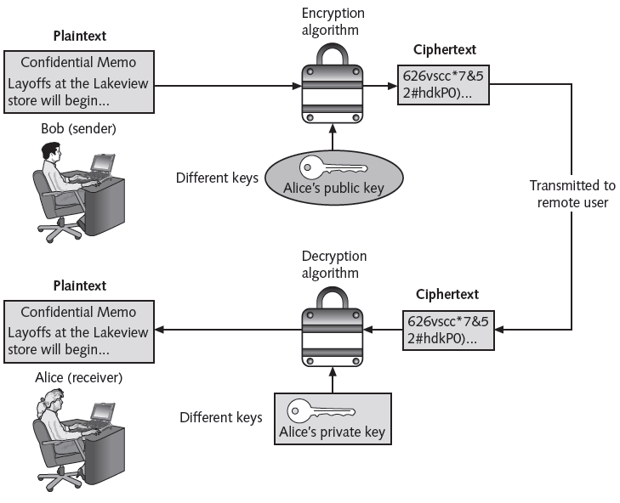
Asymmetric Cryptographic Algorithms (cont’d.)
Figure 11-12 Asymmetric (public key) cryptography
© Cengage Learning 2012

Slide 4
Asymmetric Cryptographic Algorithms (cont’d.)
Important principles
Key pairs
Public key
Private key
Both directions
Digital signature
Verifies the sender
Prevents sender from disowning the message
Proves message integrity

Slide 5
Digital Signature
Used to provide: Data integrity, Message authentication, Non-repudiation
Signer’s private key
Signing
algorithm
Signer’s public key
message
Signature
verification
algorithm
Unsecured channel
Ok / not Ok
message
signature
Signer
Verifier

Slide 6
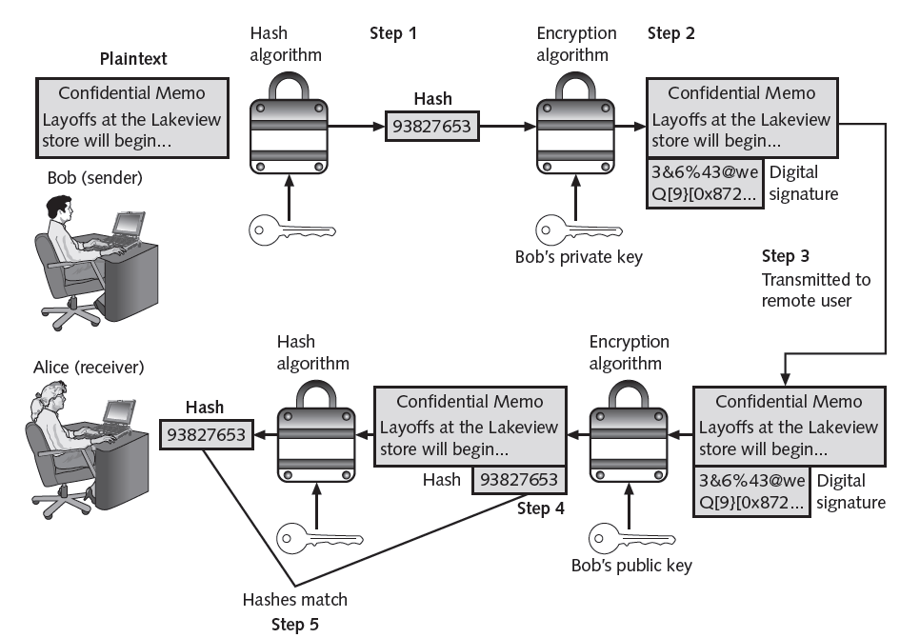
Digital Signature
Figure 11-13 Digital signature
© Cengage Learning 2012

Slide 7
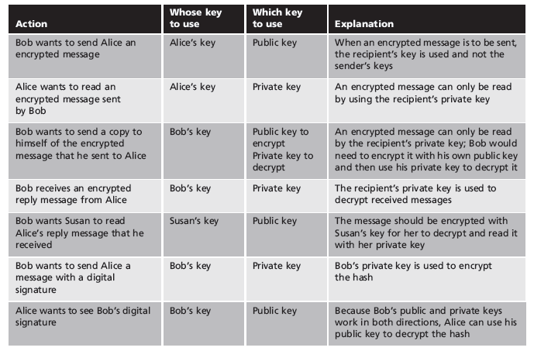
Asymmetric Cryptographic Algorithms (cont’d.)
Table 11-4 Asymmetric cryptography practices

Slide 8
Asymmetric Cryptographic Algorithms (cont’d.)
Table 11-5 Information protections by asymmetric cryptography

Slide 9
Asymmetric Cryptographic Algorithms (cont’d.)
RSA
Published in 1977 and patented by MIT in 1983
Most common asymmetric cryptography algorithm
Uses two large prime numbers
Elliptic curve cryptography (ECC)
Users share one elliptic curve and one point on the curve
Uses less computing power than prime number-based asymmetric cryptography
Key sizes are smaller

Slide 10
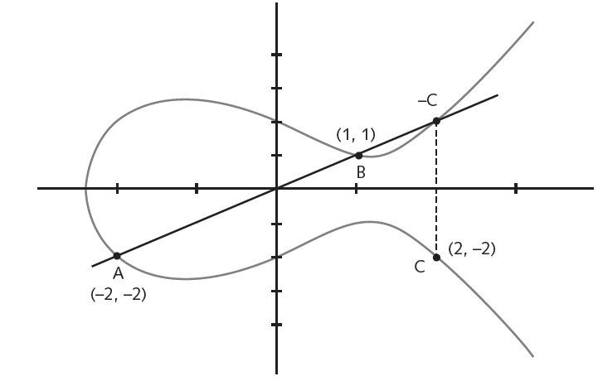
Asymmetric Cryptographic Algorithms (cont’d.)
Figure 11-14 Elliptic curve cryptography (ECC)
© Cengage Learning 2012

Slide 11
Asymmetric Cryptographic Algorithms (cont’d.)
Quantum cryptography
Exploits the properties of microscopic objects such as photons
Does not depend on difficult mathematical problems
NTRUEncypt
Uses lattice-based cryptography
Relies on a set of points in space
Faster than RSA and ECC
More resistant to quantum computing attacks

Slide 12
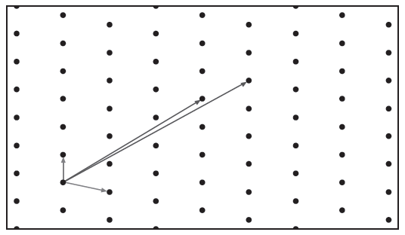
Asymmetric Cryptographic Algorithms (cont’d.)
Figure 11-15 Lattice-based cryptography
© Cengage Learning 2012

Slide 13
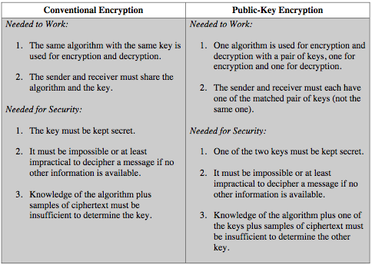
Symmetric vs. Asymmetric

