Slide 1
Lecture 4
LAN Hardware

Slide 2
1. Network Interface Cards (NIC)
For any computer, a network interface card (NIC) performs two crucial tasks
Establishes and manages the computer’s network connection
Translates digital computer data into signals (appropriate for the networking medium) for outgoing messages, and translates signals into digital computer data for incoming messages
NIC establishes a link between a computer and a network, and then manages that link

Slide 3
From Parallel to Serial and Vice Versa
NICs also manage transformations in network data’s form
The computer bus has series of parallel data lines
Parallel transmission
For nearly all forms of networking media, signals traversing the media consist of a linear sequence of information that corresponds to a linear sequence of bits of data (serial transmission)
To redistribute serial data to parallel lines (and vice versa), one of the most important components on a NIC is memory, which acts as a buffer

Slide 4
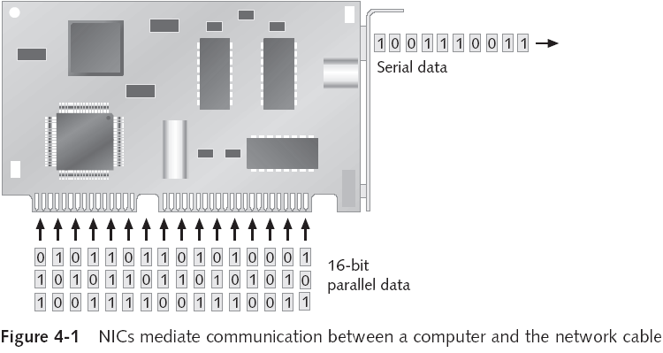
Bus width

Slide 5
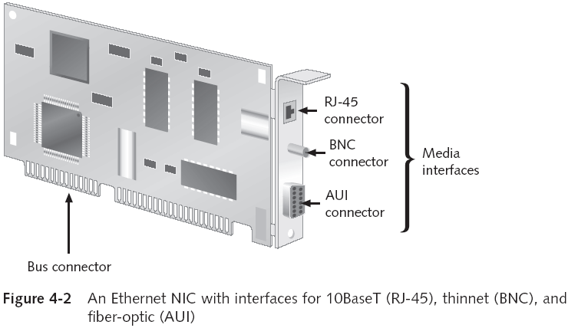

Slide 6
Additional Functions of a NIC
Creates, sends, and receives frames
Frame: fundamental unit of data for network transmission and reception
Deals with frame-level errors and incomplete or unintelligible frame structures
Manages access to medium
Acts as gatekeeper (permits inbound communications aimed only at its computer (or broadcast) to pass through NIC and on to CPU)
Each card has a unique MAC address in ROM

Slide 7
PC Buses
When PCs were introduced, only a single bus design existed: a limited 8-bit bus
As technology evolved, other buses came along
Peripheral Component Interconnect (PCI)
PCI-X
PCI Express
PCMCIA cards
Industry Standard Architecture (ISA)

Slide 8
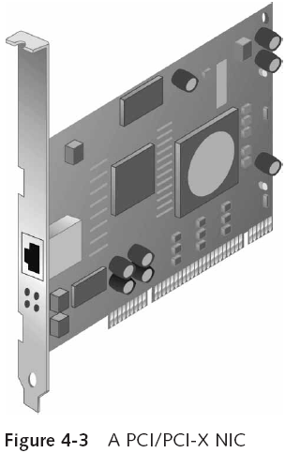
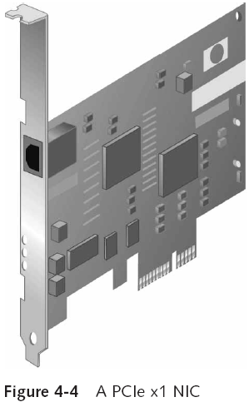

Slide 9
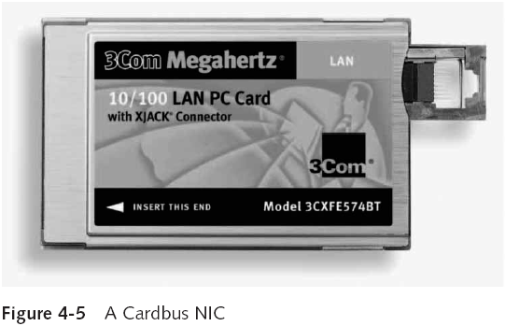

Slide 10
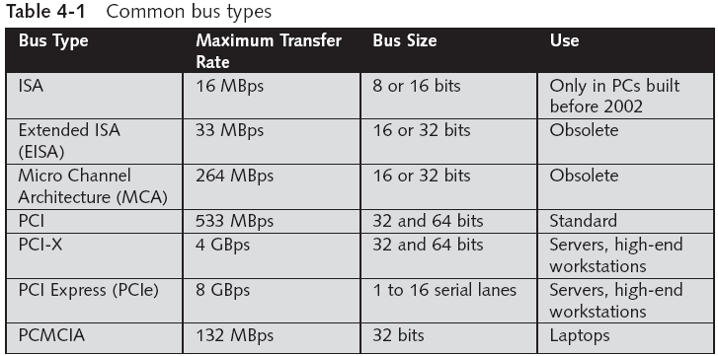

Slide 11
Other PC Interfaces Used for Networking
Although the following interface technologies don’t replace the buses in most typical PCs, they do offer other ways to attach computers to networks:
Universal Serial Bus (USB)
USB 1.0 can operate at up to 12 Mbps
USB 2.0 can operate at up to 480 Mbps
FireWire (also known as IEEE 1394)
Can operate up to 400 Mbps
IEEE 1394b supports transfer rates up to 3200 Mbps

Slide 12
Integrated NICs
On-board NICs: Most PC motherboard and laptop computer manufacturers integrate the network interface directly on to the motherboard
Might not meet a user’s needs
Wrong media
Wrong speed
Wrong architecture
Most on-board NICs are suitable for most users’ requirements

Slide 13
Making the Network Attachment
NICs perform several vital roles to coordinate communications between computer and network
Establishing a physical link to networking medium
Generating signals that traverse networking medium
Receiving incoming signals
Implementing controls for when to transmit signals to or receive signals from the network medium
It is essential that you match the adapter you choose with the medium it must attach to
Some NICs support multiple media types, and configuration is usually automatic or uses SW

Slide 14
Choosing Network Adapters for Best Performance
Increased performance features have payoffs for servers that might not apply to workstations
The following is a checklist for purchasing NICs:
Bus width—Higher is better
Bus type—Use 64-bit PCI-X or PCIe for servers
Memory transfer—Shared memory outpaces I/O or DMA
Special features—Choose security, management, protocol-handling, and hot-plug capabilities
Bus mastering—Important for servers
Vendor factors—Look for quality, reliability, staying power, and reputation

Slide 15
Special-Purpose NICs
Wireless Adapters
Remote Boot Adapters
In addition to straightforward network adapters, several types of cards deliver specialized capabilities
They include interfaces for wireless networks, as well as a feature for so-called diskless workstations (“thin clients”), which must access the network to load an OS when they boot
These cards are said to support remote booting or remote initial program load

Slide 16
1. Wireless Adapters
Wireless interfaces usually incorporate some or all of the following components:
Indoor antenna and antenna cable
Software to enable the adapter to work with a particular network environment
Diagnostic software
Installation software
Wireless NICs are commonly used with an access point to add wireless elements to an existing LAN
Select: speed, wireless standard, other (e.g., security)

Slide 17
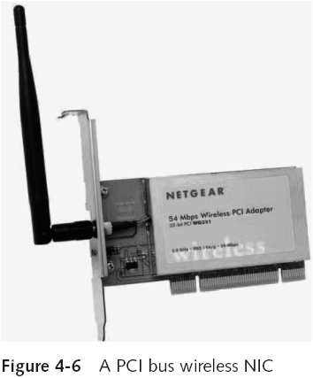

Slide 18
2. Remote Boot Adapters
The network must be the source of access to the programs needed to start a diskless workstation
Some NICs include a chip socket for a special bit of circuitry called a Boot PROM.
Remote boot adapters offer several advantages
Cost savings because no hard drive is required
Improved reliability (hard drives are a common source of problems)
Security is increased (no sensitive data can be stored on the computer)
Virus attacks are useless

Slide 19
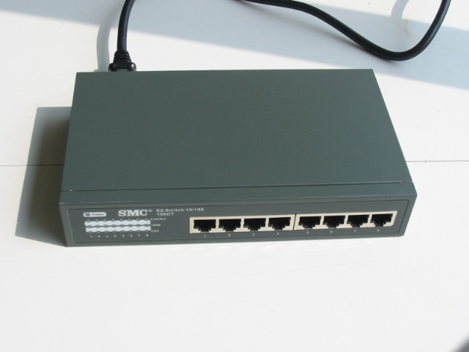
2 Hub
An unintelligent network device that sends one signal to all of the stations connected to it.
All computers/devices are competing for attention because it takes the data that comes into a port and sends it out all the other ports in the hub.
Traditionally, hubs are used for star topology networks, but they are often used with other configurations to make it easy to add and remove computers without bringing down the network.
Resides on Layer 1 of the OSI model
OSI Model Layers
7 Application 6 Presentation 5 Session 4 Transport 3 Network 2 Data Link 1 Physical

Slide 20
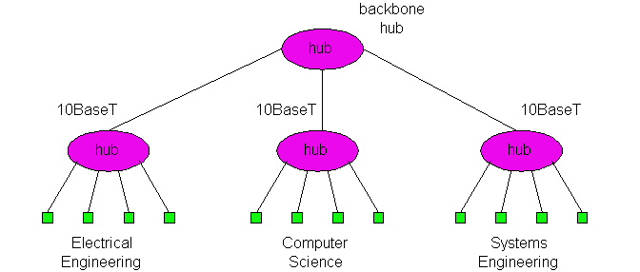
Hub
Operating at bit levels: repeat received bits on one interface to all other interfaces
Called: Multiport or Multi Access Unit.
Hubs can be arranged in a hierarchy (or multi-tier design), with backbone hub at its top

Slide 21
Hubs
Each connected LAN referred to as LAN segment
Hubs do not isolate collision domains: node may collide with any node residing at any segment in LAN

Slide 22
Hubs
Active Hub:
Regenerating and amplifying the signal before resending it to all the ports.
Passive Hub:
Only resending the signal to the ports.
Stand-alone Hub:
single products with a number of ports, used to connect number of devices.
least expensive type of hub.
best suited for small, independent workgroups, departments, or offices.
fewer than 12 users per LAN.

Slide 23
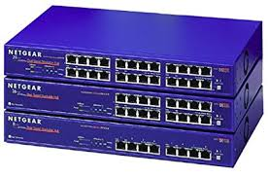
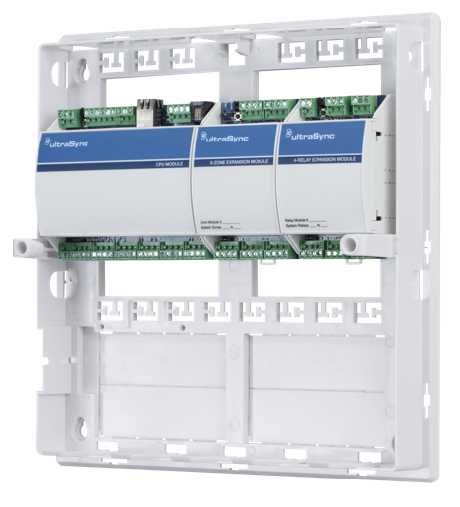
Hubs
Stacked Hub:
Several of hubs are "stacked" or connected together with short lengths of special cable.
Ideal for who want to start with a minimal investment, but realize that the LAN will grow.
Modular Hub:
Like card cage with multiple card slots, each of which accepts a communications card, or module. Each module acts like a standalone hub
Expandable by adding more cards.
A network hub that is configured by adding different modules, each supporting a topology, such as Ethernet, Token Ring, FDDI, Modules supporting different types of network cabling, like coaxial
For a medium to large sized company.

Slide 24
Hubs
Hub Advantages:
simple, inexpensive device
Multi-tier provides graceful degradation: portions of the LAN continue to operate if one hub malfunctions
extends maximum distance between node pairs (100m per Hub)
Hub Disadvantages:
If hub disabled or crashed, all the network will be stopped.
Long cables needed to link devices to hubs.

Slide 25
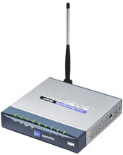
3 Bridge
Connects two LANs and forwards or filters data packets between them.
Creates an extended network in which any two workstations on the linked LANs can share data.
Transparent to protocols
A bridge can be used to connect two similar LANs, such as two CSMA/CD LANs.
A bridge can also be used to connect two closely similar LANs, such as a CSMA/CD LAN and a token ring LAN.
Resides on Layer 2 of the OSI model.
OSI Model Layers
7 Application 6 Presentation 5 Session 4 Transport 3 Network 2 Data Link 1 Physical

Slide 26
Bridges
Forward data depending on the Hardware (MAC) address, not the Network address (IP).
The bridge examines the destination address in a frame and either forwards this frame onto the next LAN or does not.
The bridge examines the source address in a frame and places this address in a routing table, to be used for future routing decisions.

Slide 27
Bridge
Bridges are used to logically separate network segments within the same network.
The function of the bridge is to make intelligent decisions about whether or not to pass signals on to the next segment of a network.
When a bridge receives a frame on the network, the destination MAC address is looked up in the bridge table to determine whether to filter, flood, or copy the frame onto another segment
Broadcast Packets are forwarded
Bridge isolates collision domains since it buffers frames

Slide 28
Bridges
Bridge advantages:
Isolates collision domains resulting in higher total max throughput, and does not limit the number of nodes nor geographical coverage
Can connect different type Ethernet since it is a store and forward device
Transparent: no need for any change to hosts LAN adapters

Slide 29
Backbone Bridge

Slide 30
Interconnection Without Backbone
Not recommended for two reasons:
- single point of failure at Computer Science hub
- all traffic between EE and SE must path over CS segment

Slide 31
Bridges: frame filtering, forwarding
bridges filter packets
same-LAN -segment frames not forwarded onto other LAN segments
forwarding:
how to know on which LAN segment to forward frame?

Slide 32
Bridge Filtering
bridges learn which hosts can be reached through which interfaces: maintain filtering tables
when frame received, bridge “learns” location of sender: incoming LAN segment
records sender location in filtering table
filtering table entry:
(Node LAN Address, Bridge Interface, Time Stamp)
stale entries in Filtering Table dropped (TTL can be 60 minutes)

Slide 33
1.Transparent Bridge
A transparent bridge does not need programming but observes all traffic and builds routing tables from this observation.
This observation is called backward learning.
Each bridge has two connections (ports) and there is a routing table associated with each port.
A bridge observes each frame that arrives at a port, extracts the source address from the frame, and places that address in the port’s routing table.
A transparent bridge is found with CSMA/CD LANs.

Slide 34
1.Transparent Bridge
A transparent bridge can also convert one frame format to another.
Note that some people / manufacturers call a bridge such as this a gateway or sometimes a router.
The bridge removes the headers and trailers from one frame format and inserts (encapsulates) the headers and trailers for the second frame format.

Slide 35
2. Source-routing Bridge
A source-routing bridge is found with token ring networks.
Source-routing bridges do not learn from watching tables.
When a workstation wants to send a frame, it must know the exact path of network / bridge / network / bridge / network …
If a workstation does not know the exact path, it sends out a discovery frame.
The discovery frame makes its way to the final destination, then as it returns, it records the path.

Slide 36
3. Remote Bridge
A remote bridge is capable of passing a data frame from one local area network to another when the two LANs are separated by a long distance and there is a wide area network connecting the two LANs.
A remote bridge takes the frame before it leaves the first LAN and encapsulates the WAN headers and trailers.
When the packet arrives at the destination remote bridge, that bridge removes the WAN headers and trailers leaving the original frame.

Slide 37
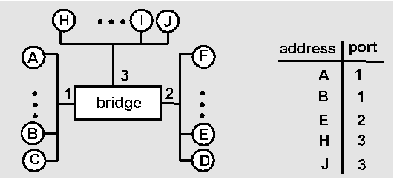
Bridge Learning: example
Suppose C sends frame to D and D replies back with frame to C
C sends frame, bridge has no info about D, so floods to both LANs
bridge notes that C is on port 1
frame ignored on upper LAN
frame received by D

Slide 38
Bridge Learning: example
C 1
D generates reply to C, sends
bridge sees frame from D
bridge notes that D is on interface 2
bridge knows C on interface 1, so selectively forwards frame out via interface 1

Slide 39
Can this method of learning addresses be extended to a network of bridges?
On this example, yes.
Q. How does B2 see the network? solution
port 1
port 2
port 1
port 2
B1
B2
A
X
B
Y
C
Z

Slide 40
Can this method of learning addresses be extended to a network of bridges?
On this example, yes.
Q. How does B2 see the network? A. B2 sees that A, X, B and Y are on port 1 (B1 is transparent !) Its forwarding table is A 1 B 1 C 2 X 1 Y 1 Z 2 back
port 1
port 2
B2
A
X
B
Y
C
Z
B2

Slide 41
The method of learning does not work if there are loops in the topology
Q. What happens when A send a frame to B?
assume empty forwarding tables at the beginning
A. frame is sent by B1 to ports 2 and 3. B1 learns that A is on port 1. B3 sends it to port 2. B2 sends it to ports 1 and 2. B1 now learns that A is on port 2. B1 sends frame to ports 1 and 3 etc… the frame is multiplied a number of times. B receives several copies back
port 1
port 2
B3
port 3
port 1
B1
port 2
port 1
B2
port 2
A
X
B
Y
C
Z

Slide 42
What Can We Do?
Decide that using bridges is a bad idea ?
But clearly it has many advantages.
When using bridges, the network topology must be a tree.
However, when the network becomes large and complicated, it is hard to know if adding a link will cause a loop.
Design bridges so that they can detect the existence of loops and issue people a warning.
Design bridges so that they can prune the topology into a tree.

Slide 43
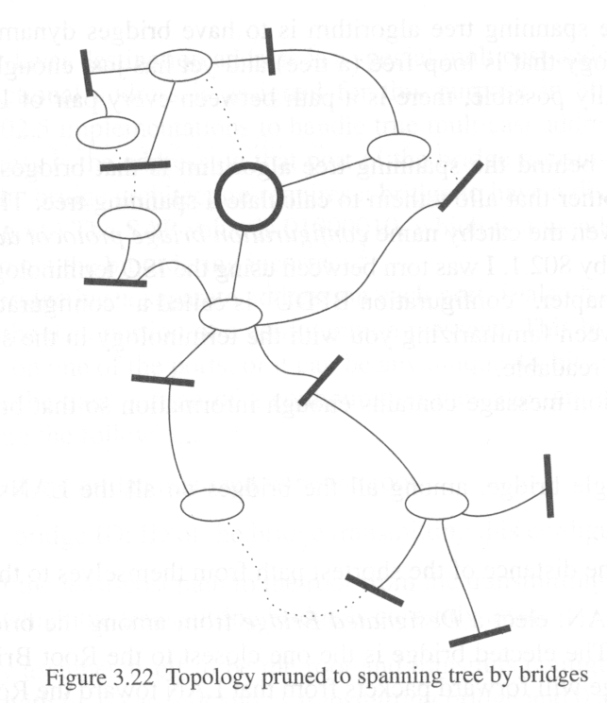
A Spanning Tree Algorithm Is Needed
Bridges will need to use a distributed spanning tree algorithm to shut off some ports so that the resulting topology is a loop-free tree.

Slide 44
The Way Spanning Tree Works
Bridges transmit special messages (called configuration message) to each other.
A bridge will be elected as the root bridge.
Every bridge calculates the distance of the shortest path from itself to the root bridge.
For each LAN, select a designated bridge among the bridges residing on the LAN.
For each bridge, choose a port (root port) that lead to the root bridge.
Ports to be included in a spanning tree are the root ports and the ports on which self has been elected as designated bridge.

Slide 45
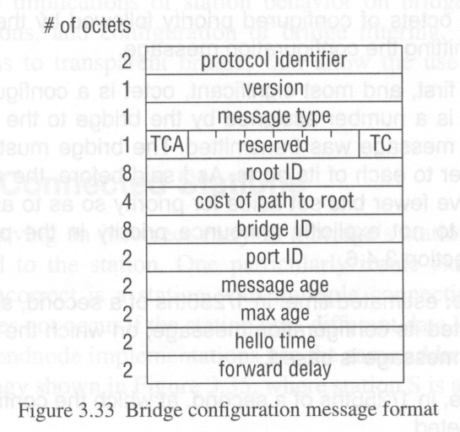
Configuration Message

Slide 46
Configuration Message
A configuration message is transmitted by a bridge onto a port. It is received by all the other bridges on the LAN attached to the port. It is not forwarded outside the LAN.
Root ID: ID of the bridge assumed to be the root.
Bridge ID: ID of the bridge transmitting this configuration message.
Cost: Cost of the shortest path from the transmitting bridge to the root bridge.
Port ID: ID of the port from which the configuration message is transmitted.

Slide 47
Configuration Message
A bridge initially assume itself to be to root and transmits configuration messages on each of its ports with its ID as root and as transmitting bridge and 0 as cost.
A bridge continuously receives configuration messages on each of its ports and save the best configuration messages from each port.
The bridge determines the “best” configuration message by comparing not only the configuration messages received from a particular port but also the configuration message that the bridge would transmit on that port.

Slide 48
Compare Two Configuration Messages C1 and C2
C1 is better than C2 if the root ID in C1 is lower than that in C2.
If the root IDs are equal, then C1 is better than C2 if the cost in C1 is lower than that in C2.
If the root ID and cost are equal, then C1 is better than C2 if its transmitting ID is lower than that in C2.
If the root ID, cost, and transmitting IDs are equal, then then C1 is better than C2 if its port ID is lower than that in C2.

Slide 49
Compare Two Configuration Messages C1 and C2
In the above three cases, C1 is better than C2.
If a bridge receives a better configuration message on a LAN than it would transmit, it no longer transmits configuration messages on that LAN.

Slide 50
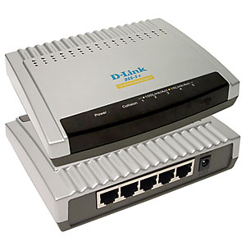
4 Switch
Split large networks into small segments, decreasing the number of users sharing the same network resources and bandwidth.
Understands when two devices want to talk to each other, and gives them a switched connection
Helps prevent data collisions and reduces network congestion, increasing network performance.
Most home users get very little, if any, advantage from switches, even when sharing a broadband connection.
Resides on Layer 2 of the OSI model.
OSI Model Layers
7 Application 6 Presentation 5 Session 4 Transport 3 Network 2 Data Link 1 Physical

Slide 51
Switch
Switches are Multiport Bridges.
Switches provide a unique network segment on each port, thereby separating collision domains.
Today, network designers are replacing hubs in their wiring closets with switches to increase their network performance and bandwidth while protecting their existing wiring investments.
Like bridges, switches learn certain information about the data packets that are received from various computers on the network.
Switches use this information to build forwarding tables to determine the destination of data being sent by one computer to another computer on the network.

Slide 52
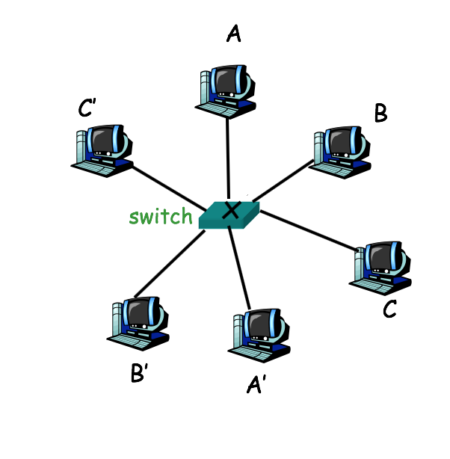
Switches: Dedicated Access
Hosts have direct connection to switch
Full Duplex: No collisions
Switching: A-to-A’ and B-to-B’ simultaneously, no collisions
Switches can be cascaded to expand the network

Slide 53
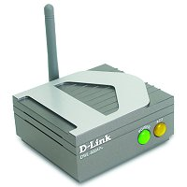
5 Repeater
Used to boost the signal between two cable segments or wireless access points.
Can not connect different network architecture.
Does not simply amplify the signal, it regenerates the packets and retimes them.
Resides on Layer 1 of the OSI model.
OSI Model Layers
7 Application 6 Presentation 5 Session 4 Transport 3 Network 2 Data Link 1 Physical

Slide 54
Repeater
The Four Repeater Rule for 10-Mbps Ethernet should be used as a standard when extending LAN segments.
This rule states that no more than four repeaters can be used between hosts on a LAN.
This rule is used to limit latency added to frame travel by each repeater.

Slide 55
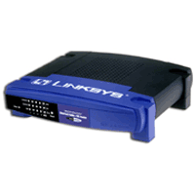
6 Router
A device that connects any number of LANs.
Uses standardized protocols to move packets efficiently to their destination.
More sophisticated than bridges, connecting networks of different types (for example, star and token ring)
Forwards data depending on the Network address (IP), not the Hardware (MAC) address.
Routers are the only one of these four devices that will allow you to share a single IP address among multiple network clients.
Resides on Layer 3 of the OSI model.
OSI Model Layers
7 Application 6 Presentation 5 Session 4 Transport 3 Network 2 Data Link 1 Physical

Slide 56
Routers
Multiport connectivity device
Can integrate LANs and WANs running at different transmission speeds and using a variety of protocols
Routers operate at the Network layer (Layer 3) of the OSI Model

Slide 57
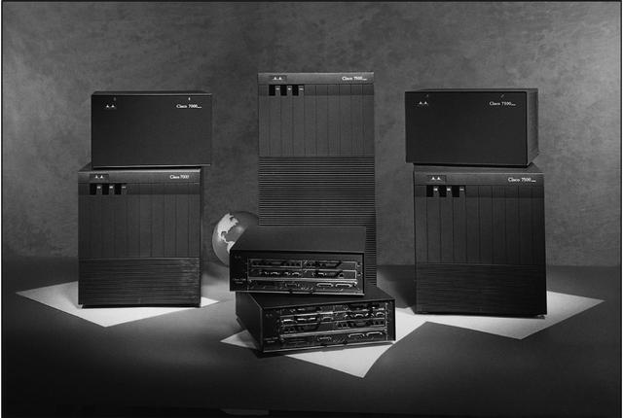
Router Features and Functions
Modular router
Router with multiple slots that can hold different interface cards or other devices

Slide 58
Router Features and Functions
Filter out broadcast transmission to reduce network congestion
Prevent certain types of traffic from getting to a network
Support simultaneous local and remote activity
Provide high network fault tolerance through redundant components
Monitor network traffic and report statistics
A router accepts an outgoing packet, removes any LAN headers and trailers, and encapsulates the necessary WAN headers and trailers
Because a router has to make wide area network routing decisions, the router has to dig down into the network layer of the packet to retrieve the network destination address

Slide 59
Router Features and Functions
Static routing
Technique in which a network administrator programs a router to use a specified paths between nodes
Dynamic routing
Automatically calculates best path between nodes and accumulates this information in a routing table

Slide 60
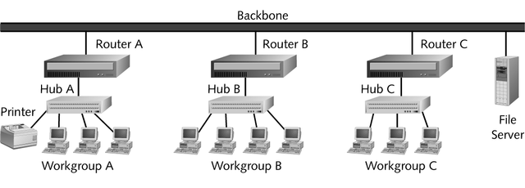
Router Features and Functions

Slide 61
Routing Protocols
To determine the best path, routers communicate with each other through routing protocols
In addition to its ability to find the best path, a routing protocol can be characterized according to its convergence time and bandwidth overhead
Convergence time
The time it takes for a router to recognize a best path in the event of a change or outage
Bandwidth overhead
Burden placed on an underlying network to support the routing protocol

Slide 62
Routing Protocols
The four most common routing protocols:
RIP (Routing Information Protocol) for IP and IPX
OSPF (Open Shortest Path First) for IP
EIGRP (Enhanced Interior Gateway Routing Protocol) for IP, IPX, and AppleTalk
BGP (Border Gateway Protocol) for IP

Slide 63
Brouters and Routing Switches
Bridge router
Also called a brouter
Industry term used to describe routers that take on some characteristics of bridges
Routing switch
Router hybrid that combines a router and a switch

Slide 64
7 Gateways
Combination of networking hardware and software that connects two dissimilar kinds of networks
Popular types of gateways include:
E-mail gateways
IBM host gateways
Internet gateways
LAN gateways

