Slide 1
Java Fundamentals 4

Slide 2
Parsing Numeric Strings
Integer, Float, and Double are classes designed to convert a numeric string into a number.
These classes are called wrapper classes.
parseInt is a method of the class Integer, which converts a numeric integer string into a value of the type int.
parseFloat is a method of the class Float and is used to convert a numeric decimal string into an equivalent value of the type float.
parseDouble is a method of the class Double, which is used to convert a numeric decimal string into an equivalent value of the type double.
Java Programming: From Problem Analysis to Program Design, Second Edition
2
Notes:
2

Slide 3
Parsing Numeric Strings
A string consisting of only integers or decimal numbers is called a numeric string.
To convert a string consisting of an integer to a value of the type int, we use the following expression:
Integer.parseInt(strExpression)
Example:
Integer.parseInt("6723") = 6723
Integer.parseInt("-823") = -823
Java Programming: From Problem Analysis to Program Design, Second Edition
3
Notes:
3

Slide 4
Parsing Numeric Strings
To convert a string consisting of a decimal number to a value of the type float, we use the following expression:
  Float.parseFloat(strExpression)
Example:
  Float.parseFloat("34.56") = 34.56
  Float.parseFloat("-542.97") = -542.97
To convert a string consisting of a decimal number to a value of the type double, we use the following expression:
  Double.parseDouble(strExpression)
Example:
  Double.parseDouble("345.78") = 345.78
  Double.parseDouble("-782.873") = -782.873
Java Programming: From Problem Analysis to Program Design, Second Edition
4
Notes:
4

Slide 5
Formatting Output with printf
READ
The syntax to use the method printf to produce output on the standard output device is:
System.out.printf(formatString);
or
System.out.printf(formatString,argumentList);
formatString is a string specifying the format of the output.
argumentList is a list of arguments that consists of constant values, variables, or expressions.
If there is more than one argument in argumentList, the arguments are separated with commas.
Java Programming: From Problem Analysis to Program Design, Second Edition
5
Notes:
5

Slide 6
Formatting Output with printf
READ
System.out.printf("Hello there!");
Consists of only the format string and the statement:
System.out.printf("There are %.2f inches in %d centimeters.%n",
centimeters / 2.54, centimeters);
Consists of both the format string and argumentList.
%.2f and %d are called format specifiers.
By default, there is a one-to-one correspondence between format specifiers and the arguments in argumentList.
The first format specifier, %.2f, is matched with the first argument, which is the expression centimeters / 2.54.
Java Programming: From Problem Analysis to Program Design, Second Edition
6
Notes:
6

Slide 7
Formatting Output with printf
READ
The second format specifier, %d, is matched with the second argument, which is centimeters.
The format specifier %n positions the insertion point at the beginning of the next line.
If centimeters = 150 ➔ 150/2.54 =59.05511811023
The o/p would be :
There are 59.06 inches in 150 centimeters
The output of a printf statement is right-justified by default. To force the output to be left-justified, negative column widths may be used.
Java Programming: From Problem Analysis to Program Design, Second Edition
7
Notes:
7

Slide 8
Example1
READ
public class Example3_6
{
public static void main (String[] args)
{
int num = 763;
double x = 658.75;
String str = "Java Program.";
System.out.println("123456789012345678901234567890"); System.out.printf ( "%5d%7.2f%15s%n", num, x, str);
System.out.printf ("%15s%6d%9.2f %n", str, num, x);
}
}
Java Programming: From Problem Analysis to Program Design, Second Edition
8
Notes:
8

Slide 9
Example1
READ
Sample run :
123456789012345678901234567890
763 658.75 Java Program.
Java Program. 763 658.75
Java Programming: From Problem Analysis to Program Design, Second Edition
9
Notes:
9

Slide 10
Example2
READ
public class Example3_7
{
public static void main (String[] args)
{
int num = 763;
double x = 658.75;
String str = "Java Program.";
System.out.println("123456789012345678901234567890");
System.out.printf("%-5d%-7.2f%-15s ***%n", num, x, str);
System.out.printf("%-15s%-6d%- 9.2f ***%n", str, num, x);
}
}
Java Programming: From Problem Analysis to Program Design, Second Edition
10
Notes:
10

Slide 11
Example2
READ
Sample Run :
123456789012345678901234567890
763 658.75 Java Program. ***
Java Program. 763 658.75 ***
Java Programming: From Problem Analysis to Program Design, Second Edition
11
Notes:
11

Slide 12
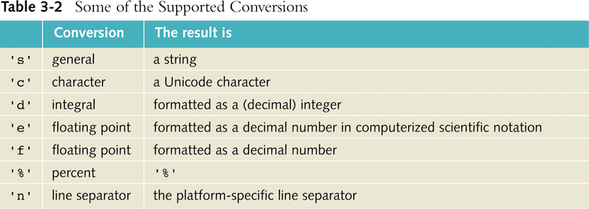
Formatting Output with printf
READ
Java Programming: From Problem Analysis to Program Design, Second Edition
12
Notes:
12

Slide 13
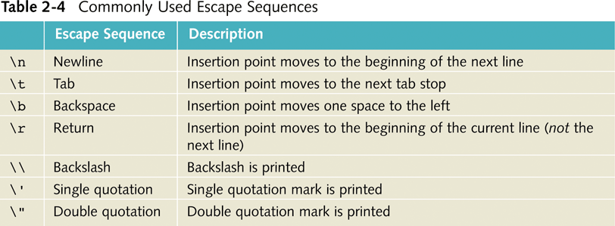
Commonly Used
Escape Sequences
READ
Java Programming: From Problem Analysis to Program Design, Second Edition
13
Notes:
13

Slide 14
Control Structures 1

Slide 15
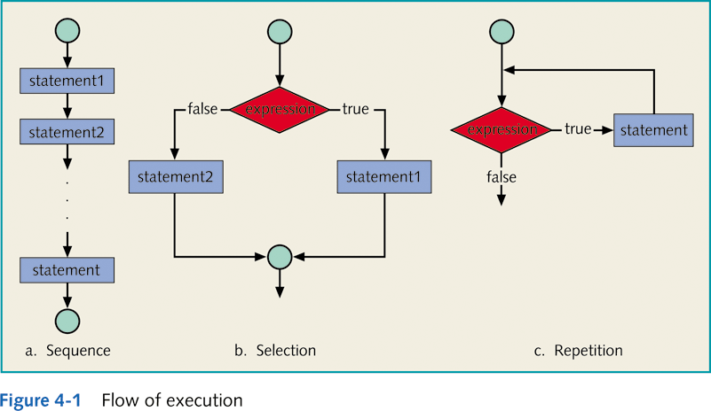
Control Structures

Slide 16
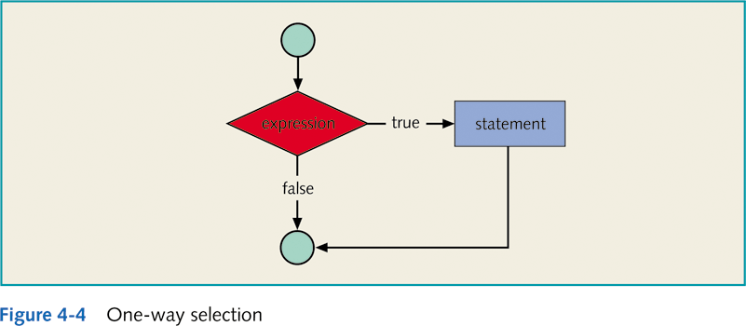
One-Way Selection
Syntax:
if (expression)
statement
Expression referred to as decision maker.
Statement referred to as action statement.

Slide 17
Short-Circuit Evaluation
A process in which the computer evaluates a logical expression from left to right and stops as soon as the value of the expression is known.
Example:
(x>y) || (x==5) // if (x>y) is true, (x==5) is not evaluated
(a==b) && (x>=7) // if (a==b) is false, (x>=7) is not evaluated
(x>0) && ( (y = z*2) > 5) // if (x>0) is false, ((y = z*2) > 5) is not evaluated and the value of y will not change

Slide 18
Two-Way Selection
Syntax:
if (expression)
statement1
else
statement2
else statement must be paired with an if.

Slide 19
Two-Way Selection
Example 4-13
if (hours > 40.0)
wages = 40.0 + rate * hours;
else
wages = hours * rate;

Slide 20
Compound (Block of) Statements
Syntax:
{
statement1
statement2
.
.
.
statementn
}

Slide 21
Compound (Block of) Statements
if (age > 18)
{
System.out.println("Eligible to vote.");
System.out.println("No longer a minor.");
}
else
{
System.out.println("Not eligible to vote.");
System.out.println("Still a minor.");
}
Java Programming: From Problem Analysis to Program Design, D.S. Malik

Slide 22
Multiple Selection: Nested if
Syntax:
if (expression1)
statement1
else
if (expression2)
statement2
else
statement3
Multiple if statements can be used if there is more than two alternatives
else is associated with the most recent if that does not have an else.
Java Programming: From Problem Analysis to Program Design, D.S. Malik

Slide 23
Multiple Selection: Nested if
Example 4-19
// Assume that score is of type int. Based on the value of score, the following code determines the grade
if (score >= 90)
System.out.println (“Grade is A”);
else
if (score >=80 )
System.out.println (“Grade is B”);
else
if (score >=70 )
System.out.println (“Grade is C”);
else
if (score >=60 )
System.out.println (“Grade is D”);
else
System.out.println (“Grade is F”);

Slide 24
Multiple Selection: Nested if
Example 4-20
if( tempreture >= 50 )
if (tempreture >= 80)
System.out.println (“Good swimming day”);
else
System.out.println (“Good golfing day”);
else
System.out.println (“Good tennis day”);

Slide 25
Switch Structures
switch (expression)
{
case value1: statements1
break;
case value2: statements2
break;
...
case value n: statements n
break;
default: statements
}
Expression is also known as selector.
Expression can be an identifier.
Value can only be integral.

Slide 26
Switch With break Statements
true
N == 1 ?
x = 10;
switch (N) {
case 1: x = 10;
break;
case 2: x = 20;
break;
case 3: x = 30;
break;
}
false
break;
true
N == 2 ?
x = 20;
false
break;
true
N == 3 ?
x = 30;
false
break;

Slide 27
Switch With No break Statements
true
N == 1 ?
x = 10;
switch (N) {
case 1: x = 10;
case 2: x = 20;
case 3: x = 30;
}
false
true
N == 2 ?
x = 20;
false
true
N == 3 ?
x = 30;
false

Slide 28
Switch With Break And Default Statements
Example 4-23
switch (grade)
{
case 'A': System.out.println("The grade is A.");
break;
case 'B': System.out.println("The grade is B.");
break;
case 'C': System.out.println("The grade is C.");
break;
case 'D': System.out.println("The grade is D.");
break;
case 'F': System.out.println("The grade is F.");
break;
default: System.out.println("The grade is invalid.");
}

Slide 29
Example 4-23 With Nested If
if (grade == 'A')
System.out.println("The grade is A.");
else
if (grade == 'B')
System.out.println("The grade is B.");
else
if (grade == 'C')
System.out.println("The grade is C.");
else
if (grade == 'D')
System.out.println("The grade is D.");
else
if (grade == 'F')
System.out.println("The grade is F.");
else
System.out.println("The grade is invalid.");

Slide 30
Why is Repetition Needed?
There are many situations in which the same statements need to be executed several times.
Example:
  Formulas used to find average grades for students in a class.

Slide 31
Repetition
Java has three repetition, or looping, structures that let you repeat statements over and over again until certain conditions are met:
  while
  for
  do…while

Slide 32
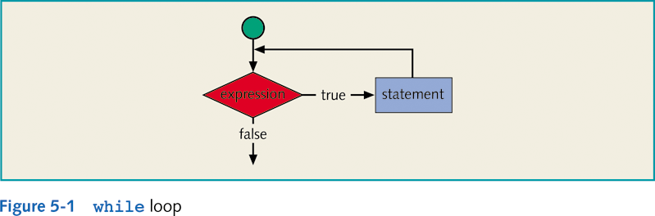
The while Looping (Repetition) Structure
Syntax:
while (expression)
statement
Statements must change value of expression to false.
A loop that continues to execute endlessly is called an infinite loop (expression is always true).

Slide 33
The while Looping (Repetition) Structure
Example 5-1
i = 0;
while (i <= 20)
{
System.out.print(i + " ");
i = i + 5;
}
System.out.println();
Output
0 5 10 15 20

Slide 34
Sentinel-Controlled while Loop
Used when exact number of entry pieces is unknown, but last entry (special/sentinel value) is known.
General form:
  Input the first data item into variable;
  while (variable != sentinel)
  {
  .
  .
  .
  input a data item into variable;
  .
  .
  .
  }

Slide 35
Sentinel-Controlled while Loop
Example 5-4
//Sentinel-controlled while loop
import java.util.*;
public class SentinelControlledWhileLoop
{
static Scanner console = new Scanner(System.in);
static final int SENTINEL = -999;
public static void main (String[] args)
{
int number; //variable to store the number
int sum = 0; //variable to store the sum
int count = 0; //variable to store the total
//numbers read
System.out.println("Enter positive integers "
+ "ending with " + SENTINEL);

Slide 36
Sentinel-Controlled while Loop
Example 5-4 (continued)
number = console.nextInt();
while (number != SENTINEL)
{
sum = sum + number;
count++;
number = console.nextInt();
}
System.out.println("The sum of the “+ count +”numbers = “ +sum);
if (count != 0) System.out.println("The average = “+(sum / count));
else
System.out.println("No input");
}
}

Slide 37
Flag-Controlled while Loop
Boolean value used to control loop.
General form:
  boolean found = false;
  while (!found)
  {
  .
  .
  .
  if (expression)
  found = true;
  .
  .
  .
  }

Slide 38
The for Looping (Repetition) Structure
Specialized form of while loop.
Its primary purpose is to simplify the writing of counter-controlled loops. For this reason, the for loop is typically called a counted or indexed for loop. .
Syntax:
for (initial statement; loop condition; update statement)
  statement

Slide 39
The for Looping (Repetition) Structure
Example 5-10
The following for loop outputs the word Hello and a star (on separate lines) five times:
for (i = 1; i <= 5; i++)
{
System.out.println("Hello");
System.out.println("*");
}
2. The following for loop outputs the word Hello five times and the star only once:
for (i = 1; i <= 5; i++)
System.out.println("Hello");
System.out.println("*");

Slide 40
The for Looping (Repetition) Structure
Does not execute if loop condition is initially false.
Update expression changes value of loop control variable, eventually making it false.
If loop condition is always true, result is an infinite loop.
Infinite loop can be specified by omitting all three control statements.

Slide 41
For Loop Programming Example: Classify Numbers
Input: N integers (positive, negative, and zeros).
  int N = 20; //N easily modified
Output: Number of 0s, number of even integers, number of odd integers.

Slide 42
For Loop Programming Example: Classify Numbers (solution)
for (counter = 1; counter <= N; counter++)
{
number = console.nextInt();
System.out.print(number + " ");
switch (number % 2)
{
case 0: evens++;
if (number == 0)
zeros++;
break;
case 1:
case -1: odds++;
} //end switch
} //end for loop

Slide 43
The do…while Loop (Repetition) Structure
Syntax:
  do
  statement
  while (expression);
Statements are executed first and then expression is evaluated.
Statements are executed at least once and then continued if expression is true.

Slide 44
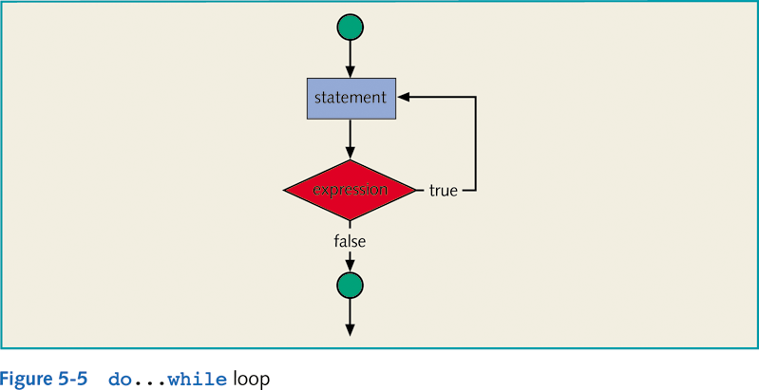
do…while Loop (Post-Test Loop)

Slide 45
do…while Loop (Post-Test Loop)
Example :
i = 0 ;
do {
System.out.print(i + “ “ ) ;
i = i + 5 ;
} while ( i <= 30 ) ;
output : 0 5 10 15 20 25 30

Slide 46
break Statements
Used to
  exit early from a loop. (while, for, and do...while)
  skip remainder of switch structure.
Can be placed within if statement of a loop.
  If condition is met, loop is exited immediately.
After the break statement executes, the program continues to execute with the first statement after the structure

Slide 47
break Statements
Example :
int count ;
for ( count = 1 ; count <= 10 ; count ++ )
{ if ( count == 5)
break ;
System.out.print(count + “ ” );
}
Output
1 2 3 4

Slide 48
continue Statements
Used in while, for, and do...while structures.
When executed in a loop, the remaining statements in the loop are skipped; proceeds with the next iteration of the loop.
When executed in a while/do…while structure, expression is evaluated immediately after continue statement.
In a for structure, the update statement is executed after the continue statement; the loop condition then executes.

Slide 49
continue Statements
Example :
int count ;
for ( count = 1; count <= 10 ; count ++ )
{ if ( count == 5)
continue;
System.out.print(count + “ ” );
}
Output
1 2 3 4 6 7 8 9 10

Slide 50
Nested Control Structures
Provides new power, subtlety, and complexity.
if, if…else, and switch structures can be placed within while loops.
for loops can be found within other for loops.

Slide 51
Nested Control Structures
(Example 5-18)
for (int i = 1; i <= 5; i++)
{
for (int j = 1; j <= i; j++)
System.out.print(" *");
System.out.println();
}
Output:
*
**
***
****
*****

