Slide 1
NET 301
LECTURE3

Slide 2
LAN data transmission
Layer1 Physical Layer:
Electronic, Electrical, mechanical and procedural aspects of electrical signal of the data transmission.
Data VS. Information
Data: is raw, plain and unorganized facts that need to be processed. Data can be something simple and seemingly random and useless until it is organized.
Information: When data is processed, organized, structured or presented in a given context so as to make it useful, it is called Information.

Slide 3
signals
Signals:
is a function that conveys information about the behaviour or attributes of some phenomenon.
a detectable physical quantity or impulse (as a voltage, current, or magnetic field strength) by which messages or information can be transmitted .
Electrical, electromagnetic or optical wave that represent an information

Slide 4
data
Analogue data:
Any continuous data for which the time varying feature (variable) of the signal is a representation of some other time varying quantity.
Sound waves
Temperature
Pressure

Slide 6
data
Digital data:
can only take one finite number or value in one time.
Students number
Word “ book”

Slide 8
signals
Signals also can be divided into :
Analogue signals:
Continuous, changing with time. Can take a continuous electronic signal.

Slide 9
Analogue signal
Microphone signal illustration:

Slide 10
Analogue signal
The primary disadvantage of analog signal is that any system has noise
even if the resolution of an analog signal is higher than a comparable digital signal, after enough processing the analog signal to noise ratio will be lower.
Electrically, analog signal noise can be diminished by shielding, good connections, and several cable types such as coaxial or twisted pair.

Slide 11
signal
Digital signal:
Take discrete value in a time, discontinuing values over continuing time.

Slide 12
signal
In computer architecture and other digital systems, a waveform that switches between two voltage levels representing the two states of a Boolean value (0 and 1).
The clock signal is a special digital signal that is used to synchronize digital circuits. Logic changes are triggered either by the rising edge or the falling edge.

Slide 13
signal
The given diagram is an example of the practical pulse and therefore we have introduced two new terms that are:
Rising edge: the transition from a low voltage (level 1 in the diagram) to a high voltage (level 2).
Falling edge: the transition from a high voltage to a low one

Slide 14
How to study signals?
Analogue and digital signals can be studied by studying:
Frequency and Time.
Frequency:
Number of occurrences of a repeating event per unit time.
Signal Frequency:
Number of signal cycles per second.

Slide 15
signal
Signal1: needs 8\200=( 0.04) second for one cycle, 25 cycle per 1 second.
Signal1 frequency: 25 (cycle\second) Hertz
Signal2 Frequency: 100 cycle\second

Slide 16
Frequency bandwidth
Electrical waves could be a set of frequencies, more than one single frequency.
Signal Bandwidth:
The difference between the highest frequency and the lowest frequency.
It is typically measured in hertz, and may sometimes refer to passband bandwidth, sometimes to baseband bandwidth

Slide 17
Frequency bandwidth

Slide 18
Signals
signals can be represented:
X(t) = A. sin (2 π.f. t + θ )
Where:
A: signal amplitude value in volts
Sin: sin function.
π : (Pi)3.14
F: frequency ( cycles per second, Hz)
T: time or period (seconds)
Θ: (theta) Phase (radian)

Slide 19
Signals
Amplitude (A)اتساع الاشارة :
A measurement of the signal change over a single period.
Can be positive or negative value.
Measured in Volts.
Frequency (F) التردد :
Number of cycle per one second
Measured in Hertz Hz
Period (T):
Time signal needs to perform one single cycle
Measured in second

Slide 20
Signals
Period and frequency are in a inverse relation.
Frequency is inverse of period.
period is inverse of Frequency.
F= 1\T and T=1\F
Phase θ:
The initial angle of a sinusoidal function (sin) at its origin.
Another usage is the fraction of the wave cycle which has elapsed relative to the origin
Measured in degree °
Could be positive if signal leading ,or negative if signal lagging.

Slide 21
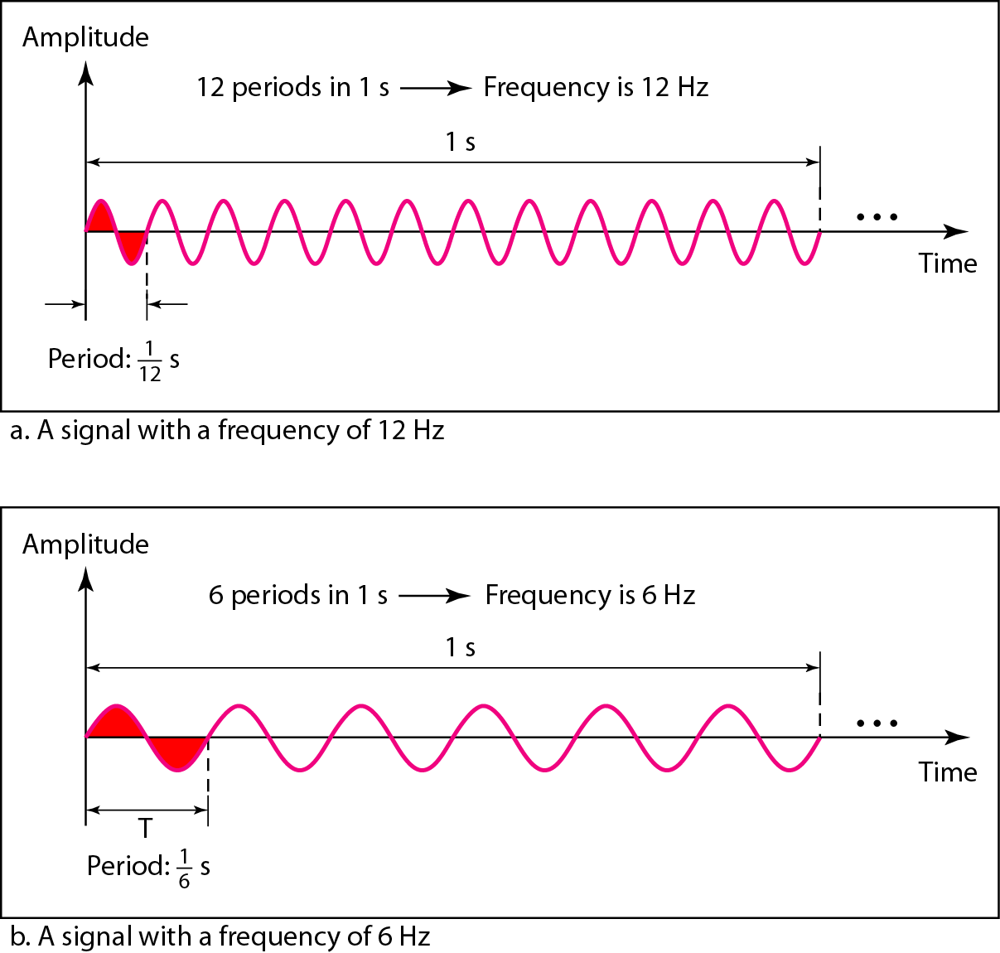
Two signals with the same amplitude and phase, but different frequencies

Slide 22
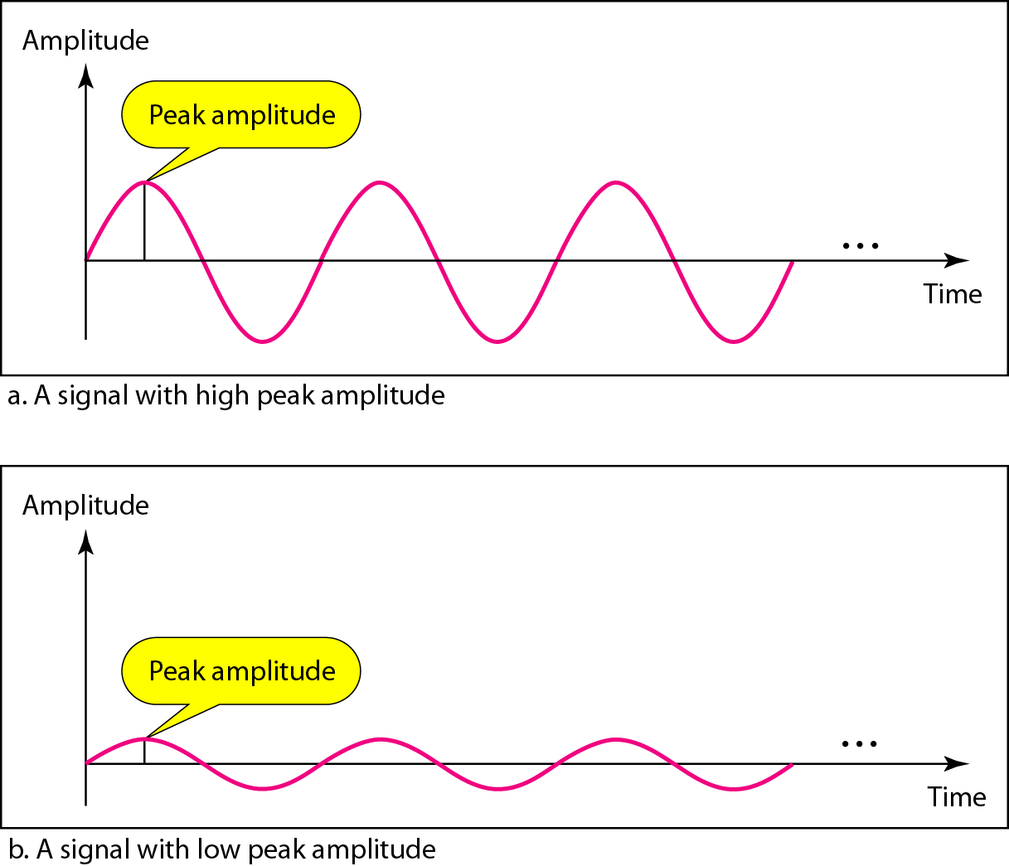
Two signals with the same phase and frequency, but different amplitudes

Slide 23
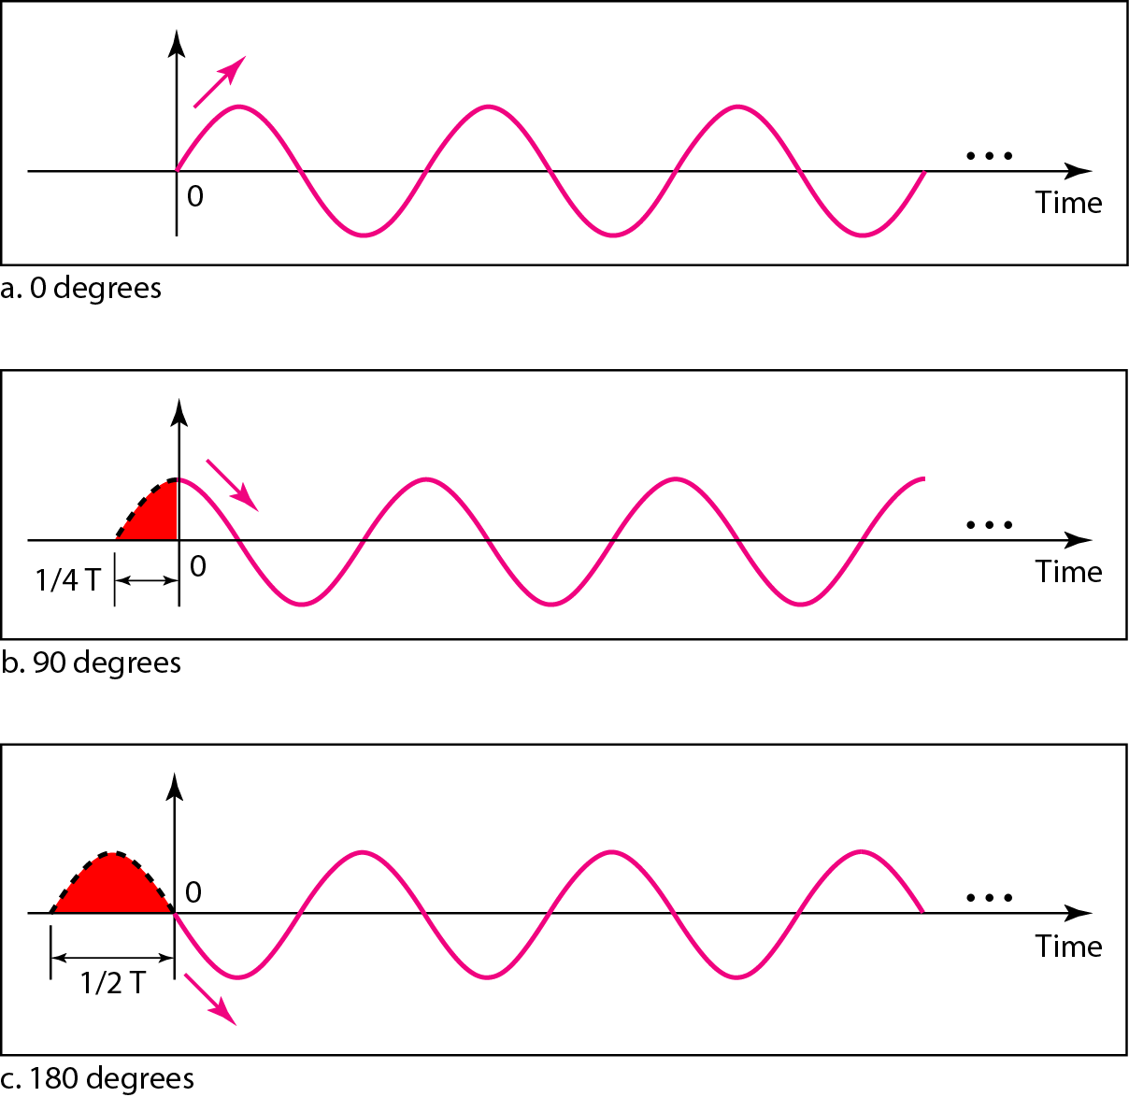
Three sine waves with the same amplitude and frequency, but different phases

Slide 24
Signals
Signal1 phase= 0 °
Phase could be measured in (radians).
One cycle= 2 π radian = 360 °

Slide 25
Signals
Wave length:
The distance between peaks (high points) is called wavelength
Length of one complete cycle.

Slide 26
Signals
V= f . λ
V: wave propagation speed (meter/second)
F: frequency (hertz)
λ: (lambda)wavelength ( meter)
Wave speed differ from wave to wave, differ based on the Propagation medium.
In space: electronic and electromagnetic wave propagation speed equals to light speed 300,000,000 m\s (3*10 ⁸ m\s)
Sound wave propagation speed 332m\s in zero degree temperature 0°

Slide 27
signals
As F=1\T ,, then:
λ = V.T
So λ unit is a distance based unit:

