Slide 1
Cryptography and Network Security
Chapter 2
Fifth Edition
by William Stallings
Lecture slides by Lawrie Brown
Notes:
Lecture slides by Lawrie Brown for “Cryptography and Network Security”, 5/e, by William Stallings, Chapter 2 – “Classical Encryption Techniques”.

Slide 2
Contents
Symmetric Cipher Model
Substitution Techniques
Transposition Techniques
Rotor Machines
Steganography

Slide 3
Ciphers
Symmetric cipher: same key used for encryption and decryption
  Block cipher: encrypts a block of plaintext at a time (typically 64 or 128 bits)
  Stream cipher: encrypts data one bit or one byte at a time
Asymmetric cipher: different keys used for encryption and decryption

Slide 4
Symmetric Encryption
or conventional / private-key / single-key
sender and recipient share a common key
all classical encryption algorithms are private-key
was only type prior to invention of public-key in 1970’s
and by far most widely used
Notes:
Symmetric encryption, also referred to as conventional encryption or single-key encryption, was the only type of encryption in use prior to the development of public-key encryption in the 1970s. It remains by far the most widely used of the two types of encryption. All traditional schemes are symmetric / single key / private-key encryption algorithms, with a single key, used for both encryption and decryption. Since both sender and receiver are equivalent, either can encrypt or decrypt messages using that common key.

Slide 5
Some Basic Terminology
plaintext - original message
ciphertext - coded message
cipher - algorithm for transforming plaintext to ciphertext
key - info used in cipher known only to sender/receiver
encipher (encrypt) - converting plaintext to ciphertext
decipher (decrypt) - recovering ciphertext from plaintext
cryptography - study of encryption principles/methods
cryptanalysis (codebreaking) - study of principles/ methods of deciphering ciphertext without knowing key
cryptology - field of both cryptography and cryptanalysis
Notes:
Briefly review some terminology used throughout the course.

Slide 6
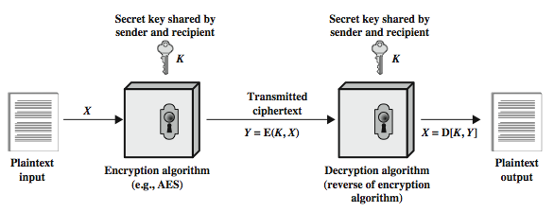
Symmetric Cipher Model
Notes:
Detail the five ingredients of the symmetric cipher model, shown in Stallings Figure 2.1:
plaintext - original message
encryption algorithm – performs substitutions/transformations on plaintext
secret key – control exact substitutions/transformations used in encryption algorithm
ciphertext - scrambled message
decryption algorithm – inverse of encryption algorithm

Slide 7
Requirements and Assumptions
Requirements for secure use of symmetric encryption:
  Strong encryption algorithm: Given the algorithm and ciphertext, an attacker cannot obtain key or plaintext
  Sender/receiver know secret key (and keep it secret)
Assumptions:
  Cipher is known
  Secure channel to distribute keys
Notes:
There are two requirements for secure use of conventional encryption that mean we assume that it is impractical to decrypt a message on the basis of the cipher- text plus knowledge of the encryption/decryption algorithm, and hence do not need to keep the algorithm secret; rather we only need to keep the key secret. This feature of symmetric encryption is what makes it feasible for widespread use. It allows easy distribution of s/w and h/w implementations.
Can take a closer look at the essential elements of a symmetric encryption scheme: mathematically it can be considered a pair of functions with: plaintext X, ciphertext Y, key K, encryption algorithm E, decryption algorithm D. The intended receiver, in possession of the key, is able to invert the transformation. An opponent, observing Y but not having access to K or X, may attempt to recover X or K.

Slide 8
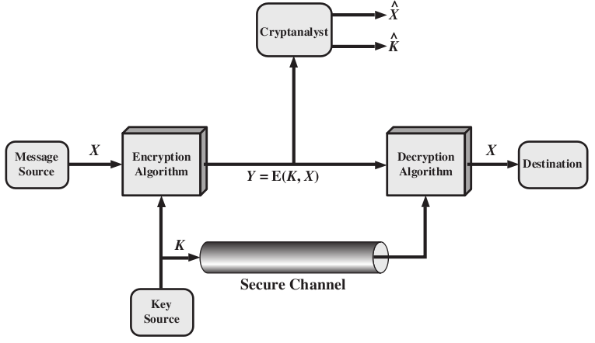
Model of Symmetric Cryptosystem
Intended receiver can calculate: X = D(K;Y )
Attacker knows E, D and Y . Aim:
  Determine plaintext:
  Determine key:

Slide 9
Characterising Cryptographic Systems
Operations used for encryption:
  Substitution replace one element in plaintext with another
  Transposition re-arrange elements
  Product systems multiple stages of substitutions and transpositions
Number of keys used:
  Symmetric sender/receiver use same key (single-key,secret-key, shared-key, conventional)
  Public-key sender/receiver use different keys (asymmetric)
Processing of plaintext:
  Block cipher process one block of elements at a time
  Stream cipher process input elements continuously
Notes:
Cryptographic systems can be characterized along these three independent dimensions.
The type of operations used for transforming plaintext to ciphertext. All encryption algorithms are based on two general principles: substitution, in which each element in the plaintext (bit, letter, group of bits or letters) is mapped into another element, and transposition, in which elements in the plaintext are rearranged. The fundamental requirement is that no information be lost (that is, that all operations are reversible). Most systems, referred to as product systems, involve multiple stages of substitutions and transpositions.
The number of keys used. If both sender and receiver use the same key, the system is referred to as symmetric, single-key, secret-key, or conventional encryption. If the sender and receiver use different keys, the system is referred to as asymmetric, two-key, or public-key encryption.
The way in which the plaintext is processed. A block cipher processes the input one block of elements at a time, producing an output block for each input block. A stream cipher processes the input elements continuously, producing output one element at a time, as it goes along.

Slide 10
Cryptanalysis
Objective of attacker: recover key (not just message)
Approaches of attacker:
  Cryptanalysis Exploit characteristics of algorithm to deduce plaintext or key
  Brute-force attack Try every possible key on ciphertext until intelligible translation into plaintext obtained
If either attack finds key, all future/past messages are compromised
Notes:
Typically objective is to recover the key in use rather then simply to recover the plaintext of a single ciphertext. There are two general approaches:
Cryptanalysis: relies on the nature of the algorithm plus perhaps some knowledge of the general characteristics of the plaintext or even some sample plaintext- ciphertext pairs. This type of attack exploits the characteristics of the algorithm to attempt to deduce a specific plaintext or to deduce the key being used.
Brute-force attacks try every possible key on a piece of ciphertext until an intelligible translation into plaintext is obtained. On average,half of all possible keys must be tried to achieve success.
If either type of attack succeeds in deducing the key, the effect is catastrophic: All future and past messages encrypted with that key are compromised.

Slide 11
Cryptanalytic Attacks
ciphertext only
  only know algorithm & ciphertext, is statistical, know or can identify plaintext
known plaintext
  know/suspect plaintext & ciphertext
chosen plaintext
  select plaintext and obtain ciphertext
chosen ciphertext
  select ciphertext and obtain plaintext
chosen text
  select plaintext or ciphertext to en/decrypt
Notes:
Stallings Table 2.1 summarizes the various types of cryptanalytic attacks, based on the amount of information known to the cryptanalyst, from least to most. The most difficult problem is presented when all that is available is the ciphertext only. In some cases, not even the encryption algorithm is known, but in general we can assume that the opponent does know the algorithm used for encryption. Then with increasing information have the other attacks. Generally, an encryption algorithm is designed to withstand a known-plaintext attack.

Slide 12
Measures of Security
Unconditionally Secure
  Ciphertext does not contained enough information to derive plaintext or key
  One-time pad is only unconditionally secure cipher (but not very practical)
Computationally Secure
  If either:
    Cost of breaking cipher exceeds value of encrypted information
    Time required to break cipher exceeds useful lifetime of encrypted information
  Hard to estimate value/lifetime of some information
  Hard to estimate how much effort needed to break cipher
Notes:
Two more definitions are worthy of note. An encryption scheme is unconditionally secure if the ciphertext generated by the scheme does not contain enough information to determine uniquely the corresponding plaintext, no matter how much ciphertext is available. An encryption scheme is said to be computationally secure if either the cost of breaking the cipher exceeds the value of the encrypted information, or the time required to break the cipher exceeds the useful lifetime of the information. Unconditional security would be nice, but the only known such cipher is the one-time pad (later).
For all reasonable encryption algorithms, we have to assume computational security where it either takes too long, or is too expensive, to bother breaking the cipher.

Slide 13
Brute Force Search
always possible to simply try every key
most basic attack, proportional to key size
assume either know / recognise plaintext
Key Size (bits) | Number of Alternative Keys | Time required at 1 decryption/µs | Time required at 10⁶ decryptions/µs
32 | 2³² = 4.3 × 10⁹ | 2³¹ µs = 35.8 minutes | 2.15 milliseconds
56 | 2⁵⁶ = 7.2 × 10¹⁶ | 2⁵⁵ µs = 1142 years | 10.01 hours
128 | 2¹²⁸ = 3.4 × 10³⁸ | 2¹²⁷ µs = 5.4 × 10²⁴ years | 5.4 × 10¹⁸ years
168 | 2¹⁶⁸ = 3.7 × 10⁵⁰ | 2¹⁶⁷ µs = 5.9 × 10³⁶ years | 5.9 × 10³⁰ years
26 characters (permutation) | 26! = 4 × 10²⁶ | 2 × 10²⁶ µs = 6.4 × 10¹² years | 6.4 × 10⁶ years
On average, number of guesses is half the key space
Notes:
A brute-force attack involves trying every possible key until an intelligible translation of the ciphertext into plaintext is obtained. On average, half of all possible keys must be tried to achieve success. Stallings Table 2.2 shows how much time is required to conduct a brute-force attack, for various common key sizes (DES is 56, AES is 128, Triple-DES is 168, plus general mono-alphabetic cipher), where either a single system or a million parallel systems, are used.

Slide 14
Substitution Ciphers - Caesar Cipher
earliest known substitution cipher
replaces each letter by 3rd letter on
example:
  meet me after the toga party
  PHHW PH DIWHU WKH WRJD SDUWB
A | B | C | D | E | F | G | H | I | J | K | L | M | N | O | P | Q | R | S | T | U | V | W | X | Y | Z
D | E | F | G | H | I | J | K | L | M | N | O | P | Q | R | S | T | U | V | W | X | Y | Z | A | B | C
Notes:
Substitution ciphers form the first of the fundamental building blocks. The core idea is to replace one basic unit (letter/byte) with another. Whilst the early Greeks described several substitution ciphers, the first attested use in military affairs of one was by Julius Caesar, described by him in Gallic Wars (cf. Kahn pp83-84). Still call any cipher using a simple letter shift a caesar cipher, not just those with shift 3.

Slide 15
Caesar Cipher
Generalised Caesar Cipher
  Allow shift by k positions
  Assume each letter assigned number (a = 0, b = 1, . . . )
  then have Caesar cipher as:
    c = E(k, p) = (p + k) mod (26)
    (plain letter index + key) mod (total number of letters)
    p = D(k, c) = (c – k) mod (26)
    (ciper letter index - key) mod (total number of letters)
A | B | C | D | E | F | G | H | I | J | K | L | M | N | O | P | Q | R | S | T | U | V | W | X | Y | Z
0 | 1 | 2 | 3 | 4 | 5 | 6 | 7 | 8 | 9 | 10 | 11 | 12 | 13 | 14 | 15 | 16 | 17 | 18 | 19 | 20 | 21 | 22 | 23 | 24 | 25
Notes:
This mathematical description uses modulo (clock) arithmetic. Here, when you reach Z you go back to A and start again. Mod 26 implies that when you reach 26, you use 0 instead (ie the letter after Z, or 25 + 1 goes to A or 0).
Example: howdy (7,14,22,3,24) encrypted using key f (ie a shift of 5) is MTBID

Slide 16
Security of Caesar Cipher
Key space: {0, 1, ..., 25}
Brute force attack
  Try all 26 keys, e.g. k = 1, k = 2, . . .
  Plaintext should be recognised
How to improve against brute force?
  Hide the encryption/decryption algorithm: Not practical
  Compress, use different language: Limited options
  Increase the number of keys
Notes:
With a caesar cipher, there are only 26 possible keys, of which only 25 are of any use, since mapping A to A etc doesn't really obscure the message! Note this basic rule of cryptanalysis "check to ensure the cipher operator hasn't goofed and sent a plaintext message by mistake"!
Can try each of the keys (shifts) in turn, until can recognise the original message. See Stallings Fig 2.3 for example of search.
Note: as mentioned before, do need to be able to recognise when have an original message (ie is it English or whatever). Usually easy for humans, hard for computers. Though if using say compressed data could be much harder.
Example "GCUA VQ DTGCM" when broken gives "easy to break", with a shift of 2 (key C).

Slide 17
Monoalphabetic Cipher
use a single alphabet for both plaintext and ciphertext
Arbitrary substitution: one element maps to any other element
n element alphabet allows n! permutations or keys
Example:
  Plain : a b c d e ... w x y z
  Cipher: D Z G L S ... B T F Q
Try brute force . . .
  Caesar cipher: 26 keys
  Monoalphabetic (English alphabet): 26! = 4 x 10²⁶ keys
Notes:
With only 25 possible keys, the Caesar cipher is far from secure. A dramatic increase in the key space can be achieved by allowing an arbitrary substitution, where the translation alphabet can be any permutation of the 26 alphabetic characters. A permutation of a finite set of elements S is an ordered sequence of all the elements of S, with each element appearing exactly once. In general, there are n! permutations of a set of n elements.
See text example of a translation alphabet, and an encrypted message using it.

Slide 18
Monoalphabetic Cipher example
We can use the key in the below Figure to encrypt the message
The ciphertext is

Slide 19
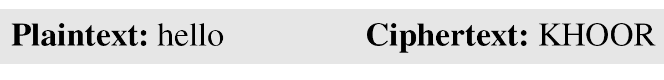
Examples of Monoalphabetic Ciphers
Example
The following shows a plaintext and its corresponding ciphertext. The cipher is probably monoalphabetic
because both l’s are encrypted as O’s.
Example
The following shows a plaintext and its corresponding ciphertext. The cipher is not monoalphabetic
because each l (el) is encrypted by a different character.

Slide 20
Monoalphabetic Cipher Security
now have a total of 26! = 4 x 10²⁶ keys
With so many keys, it is secure against brute-force attacks.
But not secure against some cryptanalytic attacks.
Problem is language characteristics.
Notes:
Note that even given the very large number of keys, being 10 orders of magnitude greater than the key space for DES, the monoalphabetic substitution cipher is not secure, because it does not sufficiently obscure the underlying language characteristics.
The size of the key space
for monoalphabetic substitution cipher
is 26! (almost 4x10²⁶).
This makes a brute-force attack extremely difficult
even with a powerful computer.
However, the ciphers do not change
the frequency of characters in the ciphertext,
which makes the ciphers vulnerable to statistical attack.

Slide 21
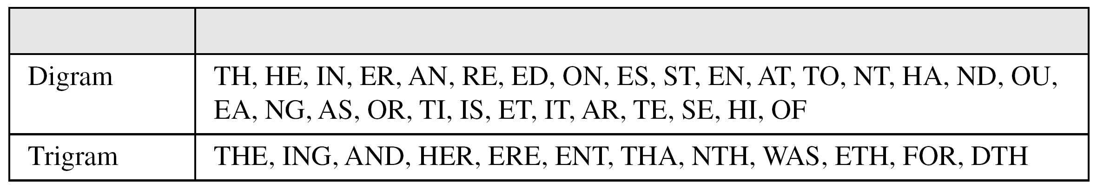
Attacks on Monoalphabetic Ciphers
Exploit the regularities of the language
  Frequency of letters, digrams, trigrams
  Expected words
Fundamental problem with monoalphabetic ciphers
  Ciphertext reflects the frequency data of original plaintext
  Solution 1: encrypt multiple letters of plaintext
  Solution 2: use multiple cipher alphabets
Notes:
As the example shows, we don't actually need all the letters in order to understand written English text. Here vowels were removed, but they're not the only redundancy. cf written Hebrew has no vowels for same reason. Are usually familiar with "party conversations", can hear one person speaking out of hubbub of many, again because of redundancy in aural language also. This redundancy is also the reason we can compress text files, the computer can derive a more compact encoding without losing any information. Basic idea is to count the relative frequencies of letters, and note the resulting pattern.

Slide 22
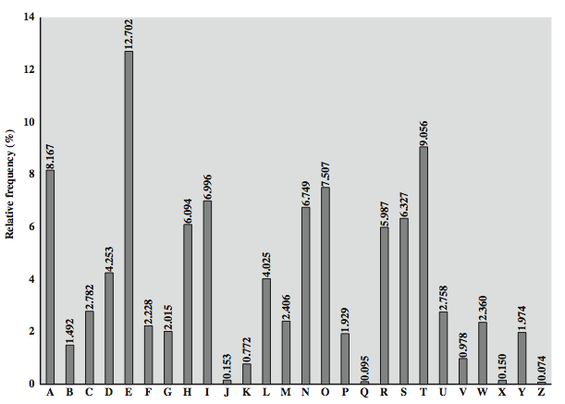
English Letter Frequencies
eg "th lrd s m shphrd shll nt wnt"
letters are not equally commonly used
in English E is by far the most common letter
  followed by T,R,N,I,O,A,S
other letters like Z,J,K,Q,X are fairly rare
Notes:
Note that all human languages have varying letter frequencies, though the number of letters and their frequencies varies. Stallings Figure 2.5 shows English letter frequencies. Seberry & Pieprzyk, "Cryptography - An Introduction to Computer Security", Prentice-Hall 1989, Appendix A has letter frequency graphs for 20 languages (most European & Japanese & Malay). Also useful are tables of common two-letter combinations, known as digrams, and three-letter combinations, known as trigrams.

Slide 23
Example Cryptanalysis
given ciphertext:
  UZQSOVUOHXMOPVGPOZPEVSGZWSZOPFPESXUDBMETSXAIZ
  VUEPHZHMDZSHZOWSFPAPPDTSVPQUZWYMXUZUHSX
  EPYEPOPDZSZUFPOMBZWPFUPZHMDJUDTMOHMQ
count relative letter frequencies (see text)
guess P & Z are e and t
guess ZW is th and hence ZWP is the
proceeding with trial and error finally get:
  it was disclosed yesterday that several informal but
  direct contacts have been made with political
  representatives of the viet cong in moscow
Notes:
Illustrate the process with this example from the text in Stallings section 2.2. Comparing letter frequency breakdown with Figure 2.5, it seems likely that cipher letters P and Z are the equivalents of plain letters e and t, but it is not certain which is which. The letters S, U, O, M, and H are all of relatively high frequency and probably correspond to plain letters from the set {a, h, i, n, o, r, s}. The letters with the lowest frequencies (namely, A, B, G, Y, I, J) are likely included in the set {b, j, k, q, v, x, z}. A powerful tool is to look at the frequency of two-letter combinations, known as digrams. A table similar to Figure 2.5 could be drawn up showing the relative frequency of digrams. The most common such digram is th. In our ciphertext, the most common digram is ZW, which appears three times. So we make the correspondence of Z with t and W with h. Then, by our earlier hypothesis, we can equate P with e. Now notice that the sequence ZWP appears in the ciphertext, and we can translate that sequence as "the." This is the most frequent trigram (three- letter combination) in English, which seems to indicate that we are on the right track. Next, notice the sequence ZWSZ in the first line. We do not know that these four letters form a complete word, but if they do, it is of the form th_t. If so, S equates with a. Only four letters have been identified, but already we have quite a bit of the message. Continued analysis of frequencies plus trial and error should easily yield a solution from this point. The complete plaintext, with spaces added between words, is shown on slide.

Slide 24
Playfair Cipher
Initialisation
  Create 5x5 matrix and write keyword (row by row)
    eg. using the keyword MONARCHY
  Fill out remainder with alphabet, not repeating any
  letters
  Special: Treat I and J as same lettera
Encryption
  Operate on pair of letters (digram) at a time
  Special: if digram with same letters, separate by special letter (e.g. x)
  Plaintext in same row: replace with letters to right
  Plaintext in same column: replace with letters below
  Else, replace by letter in same row as it and same column as other plaintext letter
M | O | N | A | R
C | H | Y | B | D
E | F | G | I/J | K
L | P | Q | S | T
U | V | W | X | Z
Notes:
not even the large number of keys in a monoalphabetic cipher provides security
one approach to improving security was to encrypt multiple letters
Consider ways to reduce the "spikyness" of natural language text, since if just map one letter always to another, the frequency distribution is just shuffled. One approach is to encrypt more than one letter at once. The Playfair cipher is an example of doing this, treats digrams in the plaintext as single units and translates these units into ciphertext digrams.
The best-known multiple-letter encryption cipher is the Playfair, which treats digrams in the plaintext as single units and translates these units into ciphertext digrams. The Playfair algorithm is based on the use of a 5x5 matrix of letters constructed using a keyword. The rules for filling in this 5x5 matrix are: L to R, top to bottom, first with keyword after duplicate letters have been removed, and then with the remain letters, with I/J used as a single letter. This example comes from Dorothy Sayer's book "Have His Carcase", in which Lord Peter Wimsey solves it, and describes the use of a probably word attack.
Plaintext is encrypted two letters at a time,according to the rules as shown. Note how you wrap from right side back to left, or from bottom back to top.
if a pair is a repeated letter, insert a filler like 'X', eg. "balloon" encrypts as "ba lx lo on"
if both letters fall in the same row, replace each with letter to right (wrapping back to start from end), eg. “ar" encrypts as "RM"
if both letters fall in the same column, replace each with the letter below it (again wrapping to top from bottom), eg. “mu" encrypts to "CM"
otherwise each letter is replaced by the one in its row in the column of the other letter of the pair, eg. “hs" encrypts to "BP", and “ea" to "IM" or "JM" (as desired)
Decrypting of course works exactly in reverse. Can see this by working the example pairs shown, backwards.

Slide 25
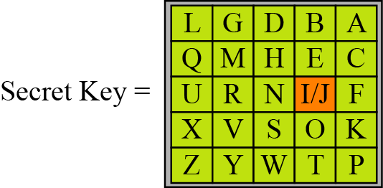
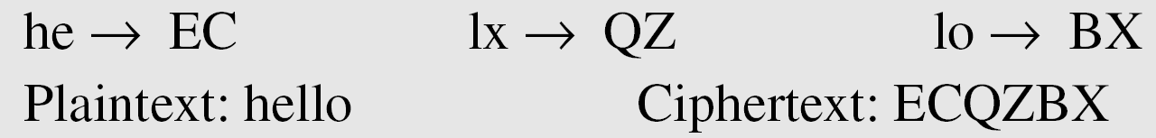
Playfair Cipher example
An example of a secret key in the Playfair cipher
Example
Let us encrypt the plaintext “hello”
using the key in Figure 3.13.

Slide 26
Security of Playfair Cipher
Is it Breakable?
Better than monoalphabetic:
  relative frequency of digrams
  much less than of individual letters
But relatively easy (digrams, trigrams, expected words)
Notes:
security much improved over monoalphabetic
since have 26 x 26 = 676 digrams
would need a 676 entry frequency table to analyse (verses 26 for a monoalphabetic)
and correspondingly more ciphertext
was widely used for many years
eg. by US & British military in WW1
it can be broken, given a few hundred letters
since still has much of plaintext structure
The Playfair cipher is a great advance over simple monoalphabetic ciphers, since there are 26*26=676 digrams (vs 26 letters), so that identification of individual digrams is more difficult. Also,the relative frequencies of individual letters exhibit a much greater range than that of digrams, making frequency analysis much more difficult. The Playfair cipher was for a long time considered unbreakable. It was used as the standard field system by the British Army in World War I and still enjoyed considerable use by the U.S.Army and other Allied forces during World War II. Despite this level of confidence in its security, the Playfair cipher is relatively easy to break because it still leaves much of the structure of the plaintext language intact. A few hundred letters of ciphertext are generally sufficient.

Slide 27
Polyalphabetic Ciphers
polyalphabetic substitution ciphers
  A sequence of monoalphabetic ciphers (M₁, M₂, M₃, ..., M_{k}) is used in turn to encrypt letters.
  A key determines which sequence of ciphers to use.
  Each plaintext letter has multiple corresponding ciphertext letters.
  This makes cryptanalysis harder since the letter frequency distribution will be flatter.
Examples:
  Vigenere cipher
  Vernam cipher ( see the text book)
  One time pad
Notes:
One approach to reducing the "spikyness" of natural language text is used the Playfair cipher which encrypts more than one letter at once. We now consider the other alternative, using multiple cipher alphabets in turn. This gives the attacker more work, since many alphabets need to be guessed and because the frequency distribution is more complex, since the same plaintext letter could be replaced by several ciphertext letters, depending on which alphabet is used. The general name for this approach is a polyalphabetic substitution cipher. All these techniques have the following features in common:
A set of related monoalphabetic substitution rules is used.
A key determines which particular rule is chosen for a given transformation.

Slide 28
Vigenère Cipher
Simplest polyalphabetic substitution cipher
Consider the set of all Caesar ciphers:
{ C_{a}, C_{b}, C_{c}, ..., C_{z} }
Key: e.g. security
Encrypt each letter using C_{s}, C_{e}, C_{c}, C_{u}, C_{r}, C_{i}, C_{t}, C_{y} in turn.
Repeat from start after C_{y}.
Decryption simply works in reverse.

Slide 29
  Vigenere cipher example
Note that the Vigenere key stream does not depend
on the plaintext characters;
it depends only on the position of the character in the plaintext.

Slide 30
Vigenere cipher example
Encrypt the message “She is listening” , using the 6-character keyword “PASCAL”.

Slide 31
Security of Vigenère Ciphers
Is it Breakable?
Yes , Vigenere ciphers, like all polyalphabetic ciphers, do not preserve the frequency of the characters.
Weakness is repeating, structured keyword
Notes:
The Vigenère & related polyalphabetic ciphers still do not completely obscure the underlying language characteristics. The strength of this cipher is that there are multiple ciphertext letters for each plaintext letter, one for each unique letter of the keyword. Thus, the letter frequency information is obscured. However, not all knowledge of the plaintext structure is lost. The key to breaking them is to identify the number of translation alphabets, and then attack each separately. If a monoalphabetic substitution is used, then the statistical properties of the ciphertext should be the same as that of the language of the plaintext. If, on the other hand, a Vigenère cipher is suspected, then progress depends on determining the length of the keyword.
For some centuries the Vigenère cipher was le chiffre indéchiffrable (the unbreakable cipher). As a result of a challenge, it was broken by Charles Babbage (the inventor of the computer) in 1854 but kept secret (possibly because of the Crimean War - not the first time governments have kept advances to themselves!). The method was independently reinvented by a Prussian, Friedrich Kasiski, who published the attack now named after him in 1863. However lack of major advances meant that various polyalphabetic substitution ciphers were used into the 20C. One very famous incident was the breaking of the Zimmermann telegram in WW1 which resulted in the USA entering the war. The important is that if two identical sequences of plaintext letters occur at a distance that is an integer multiple of the keyword length, they will generate identical ciphertext sequences.
In general the approach is to find a number of duplicated sequences, collect all their distances apart, look for common factors, remembering that some will be random flukes and need to be discarded. Now have a series of monoalphabetic ciphers, each with original language letter frequency characteristics. Can attack these in turn to break the cipher.

Slide 32
The cryptanalysis of Vigenère Ciphers
The cryptanalysis here consists of two parts :
  finding the length of the key and finding the key itself.
  Kaiski test
    the cryptanalyst searches for repeated text segments, of at least three characters,
    finds their distance, d₁, d₂, …, d_{n}, in the ciphertext.
    Then gcd(d₁, d₂, …, d_{n})/m where m is the key length.
  For keyword length m, Vigenere is m monoalphabetic substitutions
  Break the monoalphabetic ciphers separately

Slide 33
cryptanalysis of Vigenère Ciphers example
Example
Let us assume we have intercepted the following ciphertext:
The Kasiski test for repetition of three-character segments
yields the results shown in Table 3.4.

Slide 34
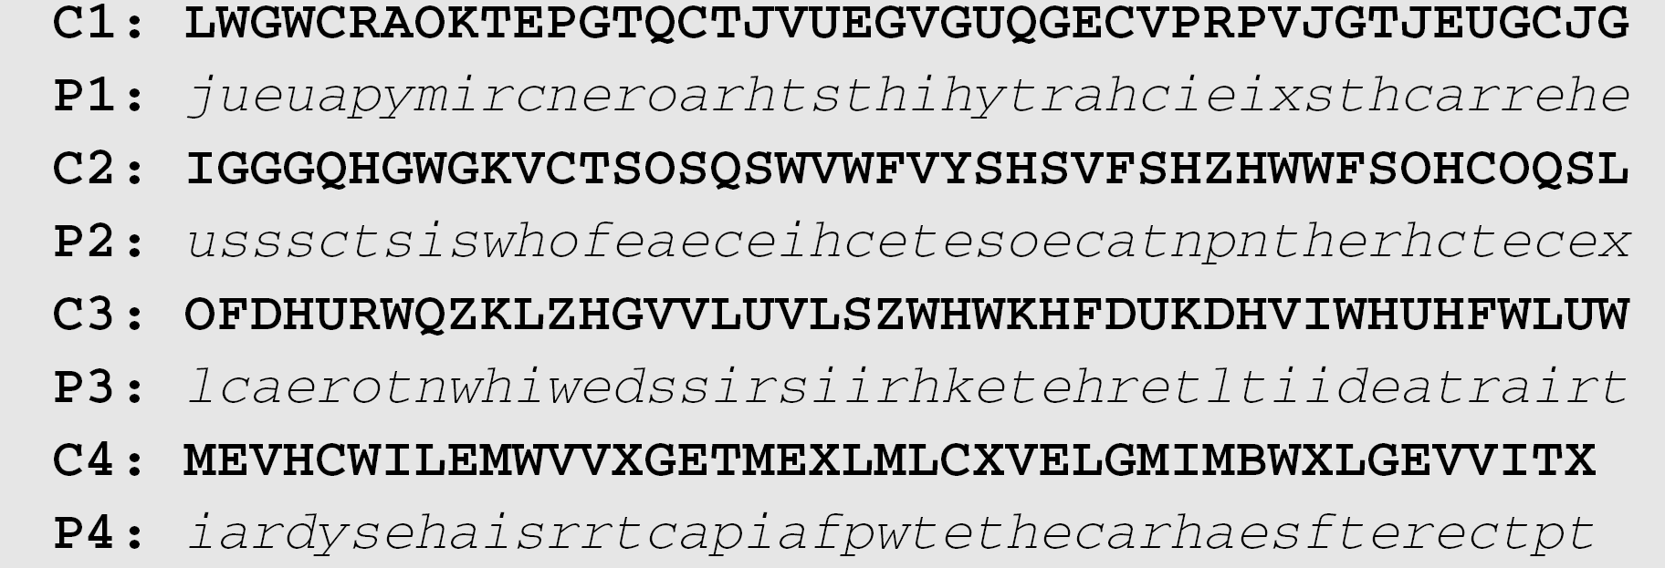
cryptanalysis of Vigenère Ciphers example (cont.)
The greatest common divisor of differences is 4, which means that the key length is multiple of 4. First try m = 4.
In this case, the plaintext makes sense.

Slide 35
An unconditionally Secure Cipher

Slide 36
One-Time Pad
if a truly random key as long as the message is used, the cipher will be secure
called a One-Time pad
is unbreakable since ciphertext bears no statistical relationship to the plaintext
since for any plaintext & any ciphertext there exists a key mapping one to other
can only use the key once though
problems in generation & safe distribution of key
Notes:
The One-Time Pad is an evolution of the Vernham cipher. An Army Signal Corp officer, Joseph Mauborgne, proposed an improvement using a random key that was truly as long as the message, with no repetitions, which thus totally obscures the original message. It produces random output that bears no statistical relationship to the plaintext. Because the ciphertext contains no information whatsoever about the plaintext, there is simply no way to break the code, since any plaintext can be mapped to any ciphertext given some key.
The one-time pad offers complete security but, in practice, has two fundamental difficulties:
There is the practical problem of making large quantities of random keys.
And the problem of key distribution and protection, where for every message to be sent, a key of equal length is needed by both sender and receiver.
Because of these difficulties, the one-time pad is of limited utility, and is useful primarily for low-bandwidth channels requiring very high security. The one-time pad is the only cryptosystem that exhibits what is referred to as perfect secrecy.

Slide 37
Transposition Ciphers
now consider classical transposition or permutation ciphers
these hide the message by rearranging the letter order
without altering the actual letters used
can recognise these since have the same frequency distribution as the original text
Notes:
All the techniques examined so far involve the substitution of a ciphertext symbol for a plaintext symbol. A very different kind of mapping is achieved by performing some sort of permutation on the plaintext letters. This technique is referred to as a transposition cipher, and form the second basic building block of ciphers. The core idea is to rearrange the order of basic units (letters/bytes/bits) without altering their actual values.

Slide 38
Keyless Transposition Ciphers –Rail fence Ciphers
A good example of a keyless cipher using the first method ,is the rail fence cipher.
write message letters out diagonally over a number of rows
then read off cipher row by row
She then creates the ciphertext “MEMATEAKETETHPR”.

Slide 39
Keyless Transposition Ciphers – Row transposition
Example 3.23
Alice and Bob can agree on the number of columns.
Alice writes the same plaintext, row by row, in a table of four columns.
She then creates the ciphertext “MMTAEEHREAEKTTP”.

Slide 40
Keyed Transposition Ciphers - Row Transposition Ciphers
Is a more complex transposition
write letters of message out in rows over a specified number of columns
then reorder the columns according to some key before reading off the rows
  Plaintext is written row by row in a rectangle.
  Ciphertext: write out the columns in an order specified by a key.
Example:
  Key: 3 4 2 1 5 6 7
  Ciphertext:
  TTNAAPTMTSUOAODWCOIXKNLYPETZ
a | t | t | a | c | k | p
o | s | t | p | o | n | e
d | u | n | t | i | l | t
w | o | a | m | x | y | z
Notes:
A more complex transposition cipher is to write the message in a rectangle, row by row, and read the message off shuffling the order of the columns in each row. The order of the columns then becomes the key to the algorithm. In the example shown, the key is 4312567, that is use column 4 first, then column3, then 1 etc (as shown in the Column Out row).
A pure transposition cipher is easily recognized because it has the same letter frequencies as the original plaintext. For the type of columnar transposition just shown, cryptanalysis is fairly straightforward and involves laying out the ciphertext in a matrix and playing around with column positions. Digram and trigram frequency tables can be useful.

Slide 41
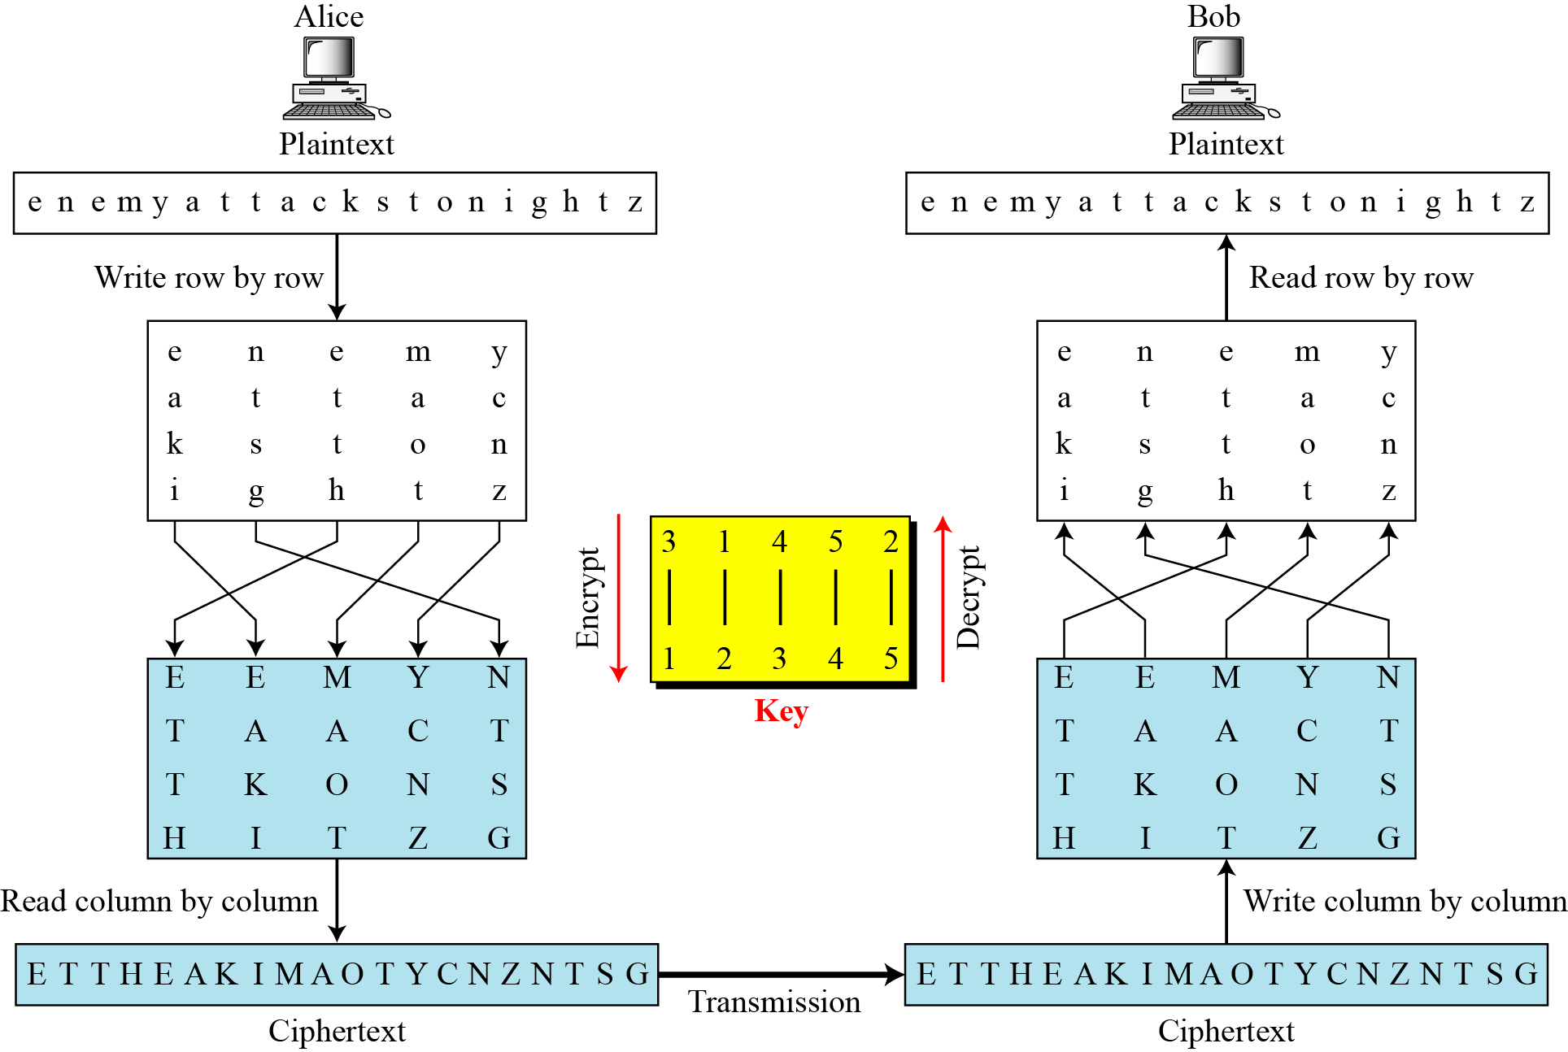
Row Transposition Ciphers – encryption /de
Figure 3.21

Slide 42
Double Transposition
Transposition ciphers can be made stronger by using multiple stages of transposition
  plaintext: attackpostponeduntiltwoamxyz
  key: 4312567
  ciphertext: TTNAAPTMTSUOAODWCOIXKNLYPETZ
Transpose again using same key:
  output: NSCYAUOPTTWLTMDNAOIEPAXTTOKZ
Original plaintext letters, by position:
  01 02 03 04 05 06 07 08 09 10 11 12 13 14
  15 16 17 18 19 20 21 22 23 24 25 26 27 28
After 1st transposition:
  03 10 17 24 04 11 18 25 02 09 16 23 01 08
  15 22 05 12 19 26 06 13 20 27 07 14 21 28
After second transposition:
  17 09 05 27 24 16 12 07 10 02 22 20 03 25
  15 13 04 23 19 14 11 01 26 21 18 08 06 28

Slide 43
Cryptanalysis of Transposition Ciphers
The ciphers are vulnerable to several kinds of ciphertext-only attacks.
Statistical Attack:
  A transposition cipher does not change the frequency of letters in ciphertext, but dose not preserve the frequency of digrams and trigrams.
Brute-Force Attack:
  The number of keys can be huge (1! + 2! + … + L!), where L is the length of the ciphertext.
A better approach is to guess the number of columns.

Slide 44
Product Ciphers
ciphers using substitutions or transpositions are not secure because of language characteristics
hence consider using several ciphers in succession to make harder, but:
  two substitutions make a more complex substitution
  two transpositions make more complex transposition
  but a substitution followed by a transposition makes a new much harder cipher
this is bridge from classical to modern ciphers
Notes:
Have seen that ciphers based on just substitutions or transpositions are not secure, and can be attacked because they do not sufficient obscure the underlying language structure
So consider using several ciphers in succession to make harder.
A substitution followed by a transposition is known as a Product Cipher, and makes a new much more secure cipher, and forms the bridge to modern ciphers.

Slide 45
Rotor Machines
Multiple stages of encryption can be used for substitution and transposition ciphers
Rotor machines were early application of this
  Principle was basis for Enigma cipher used by Germany in WW2
Machine has multiple cylinders
Monoalphabetic substitution cipher for each cylinder
Output of one cylinder is input to next cylinder
Plaintext is input to first cylinder; ciphertext is output of last cylinder
Entering a plaintext letter causes last cylinder to rotate its cipher
Complete rotation of one cylinder causes previous cylinder to rotate its cipher
Principle is used in Data Encryption Standard (DES)
Notes:
The next major advance in ciphers required use of mechanical cipher machines which enabled to use of complex varying substitutions.
A rotor machine consists of a set of independently rotating cylinders through which electrical pulses can flow. Each cylinder has 26 input pins and 26 output pins, with internal wiring that connects each input pin to a unique output pin. If we associate each input and output pin with a letter of the alphabet, then a single cylinder defines a monoalphabetic substitution. After each input key is depressed, the cylinder rotates one position, so that the internal connections are shifted accordingly. The power of the rotor machine is in the use of multiple cylinders, in which the output pins of one cylinder are connected to the input pins of the next, and with the cylinders rotating like an “odometer”, leading to a very large number of substitution alphabets being used, eg with 3 cylinders have 26³=17576 alphabets used.
They were extensively used in world war 2, and the history of their use and analysis is one of the great stories from WW2.

Slide 46
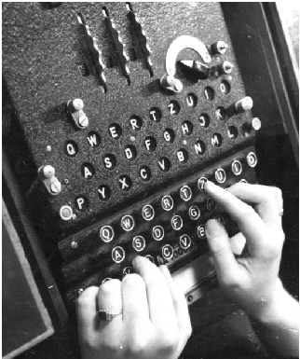
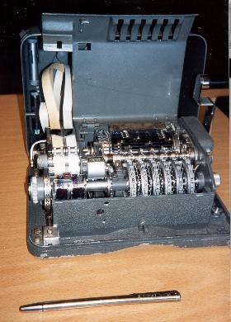
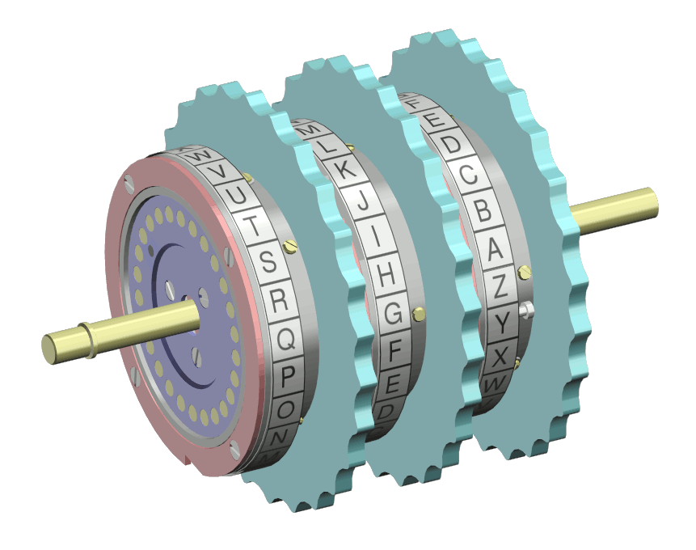
Hagelin Rotor Machine
Notes:
This photo of an Allied Hagelin machine was taken by Lawrie Brown at Eurocrypt'93 in Norway. Note pen for scale, and the rotating cipher wheels near the front.

Slide 47
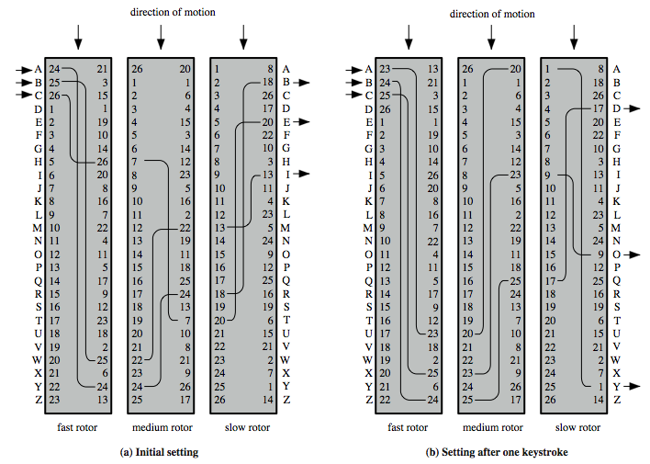
Rotor Machine Principles
Notes:
The basic principle of the rotor machine is illustrated in Figure 2.8. The machine consists of a set of independently rotating cylinders through which electrical pulses can flow. Each cylinder has 26 input pins and 26 output pins, with internal wiring that connects each input pin to a unique output pin. If we associate each input and output pin with a letter of the alphabet, then a single cylinder defines a monoalphabetic substitution. If an operator depresses the key for the letter A, an electric signal is applied to the first pin of the first cylinder and flows through the internal connection to the twenty-fifth output pin. Consider a machine with a single cylinder. After each input key is depressed, the cylinder rotates one position, so that the internal connections are shifted accordingly. Thus, a different monoalphabetic substitution cipher is defined. After 26 letters of plaintext, the cylinder would be back to the initial position. Thus, we have a polyalphabetic substitution algorithm with a period of 26.
A single-cylinder system is trivial and does not present a formidable cryptanalytic task. The power of the rotor machine is in the use of multiple cylinders, in which the output pins of one cylinder are connected to the input pins of the next. Figure 2.8 shows a three-cylinder system. With multiple cylinders, the one closest to the operator input rotates one pin position with each keystroke. The right half of Figure 2.8 shows the system's configuration after a single keystroke. For every complete rotation of the inner cylinder, the middle cylinder rotates one pin position. Finally, for every complete rotation of the middle cylinder, the outer cylinder rotates one pin position. The result is that there are 26 " 26 " 26 = 17,576 different substitution alphabets used before the system repeats.

Slide 48
Steganography
an alternative to encryption
hides existence of message
  using only a subset of letters/words in a longer message marked in some way
  using invisible ink
  hiding in LSB in graphic image or sound file
has drawbacks
  Once attacker knows your method, everything is lost
  Can be inecient (need to send lot of information to
  carry small message)
advantage is can obscure encryption use
Notes:
Steganography is an alternative to encryption which hides the very existence of a message by some means. There are a large range of techniques for doing this.
Steganography has a number of drawbacks when compared to encryption. It requires a lot of overhead to hide a relatively few bits of information.
Also, once the system is discovered, it becomes virtually worthless, although a message can be first encrypted and then hidden using steganography. The advantage of steganography is that it can be employed by parties who have something to lose should the fact of their secret communication (not necessarily the content) be discovered.

Slide 49
Summary
have considered:
  classical cipher techniques and terminology
  monoalphabetic substitution ciphers
  cryptanalysis using letter frequencies
  Playfair cipher
  polyalphabetic ciphers
  transposition ciphers
  product ciphers and rotor machines
  stenography
Notes:
Chapter 2 summary.

