Slide 1
Relational Algebra
Lecture 2

Slide 2
Relational Algebra
Operations to manipulate relations.
Used to specify retrieval requests (queries).
Query results in the form of a relation -> this relation may be used

Slide 3
Theoretical expressions where both operands are relations
The output from one operation can become the input to another operation (nested relational algebra)
Eight fundamental operations in relational algebra:
Unary operations work on one relation
Selection
Projection
Binary operations work on pairs of relations
Cartesian product Join
Union Intersection
Set difference Division

Slide 4
Algebra Operators
Selection
Projection
Cartesian Product
Join
a
b
c
x
y
a
a
b
b
c
c
x
y
x
y
x
y
a1
a2
a3
b1
b2
b3
b1
b2
b3
c1
c2
c3
a1
a2
a3
b1
b2
b3
c1
c2
c3
Union
Intersection
Difference
Divide
a
a
a
b
c
x
y
z
x
y
x
y
a

Slide 5
Selection Operation
Return the tuples of R that satisfy a selection condition
Denoted by σ_{<selection condition>}(R)
Selection condition = can be one condition or more using AND / OR .
Example:
Select all staff with a salary greater than 10,000
σ_{salary > 10000} (STAFF)

Slide 6
Selection Operation
StaffNo
FName
LName
Sex
DOB
Salary
BrnNo
SL21
John
White
M
1-Oct-45
30000
D005
SG37
Ann
Beech
F
10-Nov-60
12000
D003
SG14
David
Ford
M
24-May-58
18000
D003
SG5
Susan
Brand
F
3-Jun-40
24000
D003
σ_{salary > 10000} (STAFF)

Slide 7
Projection Operation
Return the attributes of R
Denoted by π_{<attribute list>}(R)
Example:
Produce a list of salaries for all staff, showing only the staff number, first name, last name, and salary.
π_{sno,fname,lname,salary}(STAFF)

Slide 8
Projection Operation
SNo
FName
LName
Salary
SL21
John
White
30000
SG37
Ann
Beech
12000
SG14
David
Ford
18000
SA9
Mary
Howe
9000
SG5
Susan
Brand
24000
SL41
Julie
Lee
9000
π_{sno,fname,lname,salary}(STAFF)

Slide 9
Question
Retrieve the names and salaries of employees who work in department 4.
π_{FNAME,LNAME,SALARY}( σ_{DNO=4}(EMPLOYEE))
OR
R1= σ_{DNO=4}(EMPLOYEE)
R2= π_{FNAME,LNAME,SALARY}( R1)
You can rename the attributes of the resulted relation
R1= σ_{DNO=4}(EMPLOYEE)
R2 _{(FIRSTNAME, LASTNAME,SALARY)} = π_{FNAME,LNAME,SALARY}( R1)

Slide 10
Set Operations
Binary operations
  Union R ∪ S
  Intersection R ∩ S
  Difference R-S
  Cartesian Product R x S
  Note: (union compatible): Dom ( Ai ε R )= Dom (Bi ε S)
  R,S must have the same number of attributes and same domain.
  The resulting relation has the same names as the first operand (R)

Slide 11
Union Operation
Return a relation that includes all tuples that are either in R or in S, or in both R and S. Eliminate duplicate tuples.
R & S must be union-compatible.
Denoted by R ∪ S
R S R ∪ S
a
b
c
a
d
f
a
b
c
d
f

Slide 12
Union Operation
Example:
List all cities where there is either a branch office or a property for rent.
π_{city}(BRANCH) ∪ π_{city}(PROPERTY)

Slide 13
Union Operation
PROPERTY
PropertyNo
Street
City
PostCode
Type
OwnerNo
BrnNo
PA14
Holheld
Aberdeen
AB7 5SU
House
CO46
B001
PL94
Argyll St
London
NW2
Flat
CO87
B001
PG4
Lawrence
Glasgow
G11 9QX
Flat
CO40
B003
PG36
Monar
Glasgow
G32 4QX
Flat
CO93
B003
PG21
Novar
Bristol
G12
House
CO87
B003
City
London
BRANCH
Aberdeen
BrnNo
Street
City
PostCode
Glasgow
B001
Deer Rd
London
SW1 4EH
Bristol
B002
Argyll St
Aberdeen
AB2 3SU
π_{city}(BRANCH) ∪ π_{city}(PROPERTY)
B003
Main St
Glasgow
G11 9QX

Slide 14
Intersection Operation
Return a relation that includes all tuples that are in both R and S.
R & S must be union-compatible.
Denoted by R ∩ S
R S R ∩ S
a
b
c
a
d
f
a

Slide 15
Intersection Operation
Example:
List all cities where there is a branch office and at least one property for rent.
π_{city}(BRANCH) ∩ π_{city}(PROPERTY)

Slide 16
Intersection Operation
PROPERTY
PropertyNo
Street
City
PostCode
Type
OwnerNo
BrnNo
PA14
Holheld
Aberdeen
AB7 5SU
House
CO46
B001
PL94
Argyll St
London
NW2
Flat
CO87
B001
PG4
Lawrence
Glasgow
G11 9QX
Flat
CO40
B003
PG36
Monar
Glasgow
G32 4QX
Flat
CO93
B003
PG21
Novar
Bristol
G12
House
CO87
B003
City
London
BRANCH
Aberdeen
BrnNo
Street
City
PostCode
Glasgow
B001
Deer Rd
London
SW1 4EH
π_{city}(BRANCH) ∩ π_{city}(PROPERTY)
B002
Argyll St
Aberdeen
AB2 3SU
B003
Main St
Glasgow
G11 9QX

Slide 17
Difference Operation
Return a relation that includes all tuples that are in R but NOT in S.
R & S must be union-compatible.
Denoted by R - S
R S R - S
a
b
c
a
d
f
b
c

Slide 18
Difference Operation
Example:
List all cities where there is a property for rent but no branch office.
π_{city}(PROPERTY) - π_{city}(BRANCH)

Slide 19
Difference Operation
PROPERTY
PropertyNo
Street
City
PostCode
Type
OwnerNo
BrnNo
PA14
Holheld
Aberdeen
AB7 5SU
House
CO46
B001
PL94
Argyll St
London
NW2
Flat
CO87
B001
PG4
Lawrence
Glasgow
G11 9QX
Flat
CO40
B003
PG36
Monar
Glasgow
G32 4QX
Flat
CO93
B003
PG21
Novar
Bristol
G12
House
CO87
B003
City
Bristol
BRANCH
BrnNo
Street
City
PostCode
π_{city}(PROPERTY) - π_{city}(BRANCH)
B001
Deer Rd
London
SW1 4EH
B002
Argyll St
Aberdeen
AB2 3SU
B003
Main St
Glasgow
G11 9QX

Slide 20
Cartesian Product Operation
Return a relation that is the concatenation of tuples from two relations R & S
Denoted by R X S
{a,b} X {1,2,3} = {(a,1), (a,2), (a,3), (b,1), (b,2), (b,3)}
Cartesian Product is meaningless on its own , it can combine related tuples from two relations if followed by the appropriate SELECT operation.

Slide 21
Cartesian Product Operation
Example:
List the names and comments of all clients who viewed a property.
Step 1: Cartesian product
π_{ClientNo, Fname, Lname} (CLIENT) X π_{ClientNo, PrprtyNo, Comment}(VIEW)
πClient.ClientNo, Fname, Lname, View.ClientNo, PrprtyNo, Comment (CLIENT X VIEW)
Step 2: Selection
σ_{Client.ClientNo=View.ClientNo}(π_{ClientNo, Fname, Lname} (CLIENT) X π_{ClientNo, PrprtyNo, Comment}(VIEW) )

Slide 22
Cartesian Product Operation
CLIENT
ClientNo
FName
LName
TelNo
CR76
John
Kay
207-774-5632
Cardinality = 4 Tuples
Degree = 3 Attributes
(projected)
CO56
Aline
Stewart
141-848-1825
CR74
Mike
Ritchie
1475-392178
CR62
Mary
Tregear
1224-196720
VIEW
ClientNo
PrprtyNo
ViewDate
Comment
CR56
PA14
24-May-01
Too small
Cardinality = 5 Tuples
Degree = 3 Attributes
(projected)
CR76
PG4
20-Apr-01
Too remote
CR56
PG4
26-May-01
CR62
PA14
14-May-01
No dining room
CR56
PG36
28-Apr-01

Slide 23
π_{ClientNo, Fname, Lname} (CLIENT) X π_{clientNo, PropertyNo, comment}(VIEW))
Client.
ClientNo
FName
View.
ClientNo
LName
PrprtyNo
Comment
CR76
John
Kay
CR56
PA14
Too small
CR76
John
Kay
CR76
PG4
Too remote
CR76
John
Kay
CR56
PG4
CR76
John
Kay
CR62
PA14
No dining room
Cardinality = 5 * 4
= 20 Tuples
Degree = 3 + 3
= 6 Attributes
CR76
John
Kay
CR56
PG36
CR56
Aline
Stewart
CR56
PA14
Too small
CR56
Aline
Stewart
CR76
PG4
Too remote
CR56
Aline
Stewart
CR56
PG4
CR56
Aline
Stewart
CR62
PA14
No dining room
CR74
Mike
Ritchie
CR56
PG36
CR74
Mike
Ritchie
CR56
PA14
Too small
CR74
Mike
Ritchie
CR76
PG4
Too remote
CR74
Mike
Ritchie
CR56
PG4
CR74
Mike
Ritchie
CR62
PA14
No dining room
CR74
Mike
Ritchie
CR56
PG36
CR62
Mary
Tregear
CR56
PA14
Too small
CR62
Mary
Tregear
CR76
PG4
Too remote
CR62
Mary
Tregear
CR56
PG4
CR62
Mary
Tregear
CR62
PA14
No dining room
CR62
Mary
Tregear
CR56
PG36

Slide 24
Join Operation
Return a relation that is the concatenation of tuples from two relations R & S that satisfy a certain condition
Form of join operation:
- Theta join
- Equijoin
- Natural join
- Outer join

Slide 25
JOIN
THETA JOIN
EQUIJOIN
(INNER JOIN)
NATURAL JOIN
OUTER JOIN
*
Similar to CP followed by Select.
The condition is called join condition (>,<, = ….)
The join condition contains one or more equality conditions.
(Could be redundant)
Contains one or more equality conditions
With no redundancy
If there are no matching tuples in S that matches R then the NULL is shown

Slide 26
OUTER JOIN
R_{1 ,} R₂
LEFT
OUTER JOIN
Shows all
R1 tuples
RIGHT
OUTER JOIN
Shows all
R2 tuples
FULL
OUTER JOIN
Shows all
R1,R2 tuples

Slide 27
Theta join Operation
Return a relation that includes all tuples that satisfy the logical condition F from the Cartesian product of R & S.
Logical operators (<,≤,>,≥,=,≠)
Denoted by R _{F} S = σ_{F} (R X S)

Slide 28
Theta join Operation
CLIENT(ClientNo, FName, Lname, TelNo)
VIEW(ClientNo, PropertyNo, ViewDate, Comment)
Example:
List the names and comments of all renters who have viewed a property.
πClient.ClientNo, Fname, Lname, View.ClientNo, PrprtyNo, Comment (CLIENT _{Client.ClientNo=View.ClientNo} VIEW)
Alternative:
σ_{Client.ClientNo=View.ClientNo}(π_{ClientNo, Fname, Lname} (CLIENT) X
π_{ClientNo, PrprtyNo, Comment}(VIEW))

Slide 29
Equijoin Operation
A Theta join where the logical condition is equality (=).
Example:
List the names and comments of all renters who have viewed a property.
πClient.ClientNo, Fname, Lname, View.ClientNo, PrprtyNo, Comment (CLIENT _{Client.ClientNo=View.ClientNo} VIEW)

Slide 30
π_{ClientNo, Fname, Lname} (CLIENT) X π_{clientNo, PropertyNo, comment}(VIEW))
Client.
ClientNo
FName
View.
ClientNo
LName
PrprtyNo
Comment
CR76
John
Kay
CR56
PA14
Too small
CR76
John
Kay
CR76
PG4
Too remote
CR76
John
Kay
CR56
PG4
CR76
John
Kay
CR62
PA14
No dining room
CR76
John
Kay
CR56
PG36
CR56
Aline
Stewart
CR56
PA14
Too small
CR56
Aline
Stewart
CR76
PG4
Too remote
CR56
Aline
Stewart
CR56
PG4
CR56
Aline
Stewart
CR62
PA14
No dining room
CR74
Mike
Ritchie
CR56
PG36
CR74
Mike
Ritchie
CR56
PA14
Too small
CR74
Mike
Ritchie
CR76
PG4
Too remote
CR74
Mike
Ritchie
CR56
PG4
CR74
Mike
Ritchie
CR62
PA14
No dining room
CR74
Mike
Ritchie
CR56
PG36
CR62
Mary
Tregear
CR56
PA14
Too small
CR62
Mary
Tregear
CR76
PG4
Too remote
CR62
Mary
Tregear
CR56
PG4
CR62
Mary
Tregear
CR62
PA14
No dining room
CR62
Mary
Tregear
CR56
PG36

Slide 31
Equijoin Operation
σ_{Client.ClientNo=View.ClientNo}(π_{ClientNo, Fname, Lname} (CLIENT) X π_{ClientNo, PrprtyNo, Comment}(VIEW))
Client.
ClientNo
FName
View.
ClientNo
LName
PrprtyNo
Comment
CR76
John
Kay
CR76
PG4
Too remote
CR56
Aline
Stewart
CR56
PA14
Too small
CR56
Aline
Stewart
CR56
PG4
CR62
Mary
Tregear
CR62
PA14
No dining room

Slide 32
Natural join Operation
Equijoin of two relation R & S over all common attributes and values. One occurrence of each common attribute is eliminated from the result
Denoted by R * _{(A ε R),(B ε S)} S
Example:
Retrieve each EMPLOYEE’s name and the name of department he/she belongs to:
T EMPLOYEE * _{(DNO),(DUNMBER)} DEPARTMENT
RESULT π _{FNAME, LNAME, DNAME} (T)

Slide 33
Natural join Operation
Invariably the JOIN involves an equality test, and thus is often described as an equi-join. Such joins result in two attributes in the resulting relation having exactly the same value. A `natural join' will remove the duplicate attribute(s).
If you do use natural joins make sure that the relations do not have two attributes with the same name by accident.

Slide 34
Outer join Operation
A natural join in which tuples from R that do not have matching values in the common attributes of S are included in the result relation. Missing values in S are set to null.
Denoted by R S
Example:
Produce a status report on property viewings.
(πPropertyNo, Street, City, CLientNo,ViewDate, Comment (PROPERTY) VIEW)

Slide 35
Outer Join Operation
PROPERTY
PropertyNo
Street
City
PostCode
Type
OwnerNo
PA14
Holheld
Aberdeen
AB7 5SU
House
CO46
PL94
Argyll St
London
NW2
Flat
CO87
PG4
Lawrence
Glasgow
G11 9QX
Flat
CO40
PG36
Monar
Glasgow
G32 4QX
Flat
CO93
PG21
Novar
Bristol
G12
House
CO87
VIEW
ClientNo
PrprtyNo
ViewDate
Comment
CR56
PA14
24-May-01
Too small
CR76
PG4
20-Apr-01
Too remote
CR56
PG4
26-May-01
CR62
PA14
14-May-01
No dining room

Slide 36
Outer Join Operation
πPropertyNo, Street, City, CLientNo,ViewDate, Comment (PROPERTY) VIEW
PropertyNo
Street
City
ClientNo
ViewDate
Comment
PA14
Holheld
Aberdeen
CR56
24-May-01
Too small
PA14
Holheld
Aberdeen
CR62
14-May-01
No dining room
PL94
Argyll St
London
null
null
null
PG4
Lawrence
Glasgow
CR76
20-Apr-01
Too remote
PG4
Lawrence
Glasgow
CR56
26-May-01
null
PG36
Monar
Glasgow
null
null
null
PG21
Novar
Bristol
null
null
null

Slide 37
More examples

Slide 38
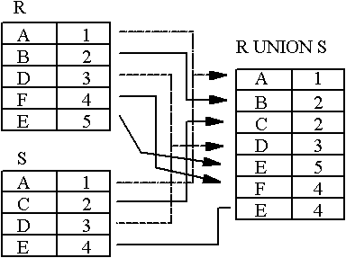
UNION Example

Slide 39
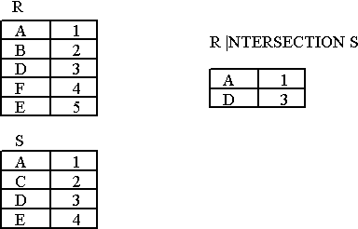
INTERSECTION Example

Slide 40
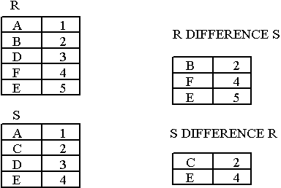
DIFFERENCE Example

Slide 41
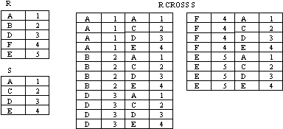
CARTESIAN PRODUCT example

Slide 42
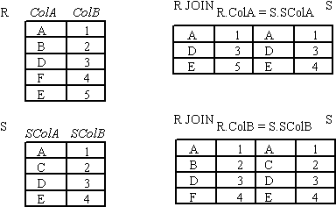
JOIN Example

Slide 43
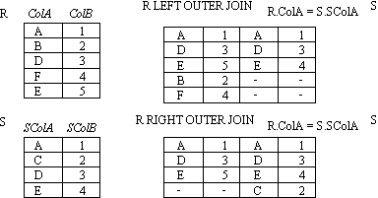
OUTER JOIN example 1

Slide 44
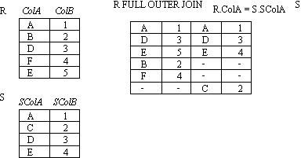
OUTER JOIN example 2

Slide 45
Additional Relational Functions

Slide 46
Aggregate Functions
SUM : returns the sum of the values in a specified attribute.
COUNT: returns the number of tuples in a specified attribute.
AVERAGE: returns the average of the values in a specified attribute.
MIN: returns the smallest value in a specified attribute.
MAX: returns the largest value in a specified attribute.

Slide 47
Examples
EMPLOYEE
NR | Name | Salary | Department
1 | John | 100 | A
5 | Sara | 300 | C
7 | Tom | 100 | A
12 | Annie | null | C

Slide 48
1- SUM
Find the total of the employees salary
R  _{SUM(SALARY)} (EMPLOYEE)
The result is sum= 500
select sum(salary) from EMPLOYEE
Note:
Duplicates are not eliminated.
Null values are ignored.

Slide 49
2- COUNT
Count all the empolyees who get a salary
R  _{count(salary)} (EMPLOYEE)
The result is count=3
select count(salary) from EMPLOYEE

Slide 50
3- AVERAGE
Retrieve the average of the employees’ salaries.
R  _{AVG( SALARY)} (EMPLOYEE)
Select avg(salary) from EMPLOYEE

Slide 51
4- MIN
Retrieve the minimum salary among all employees.
R  _{MIN (SALARY)} (EMPLOYEE)
The result is min= 100

Slide 52
5- MAX
Retrieve the maximum salary among all employees.
R  _{MAX( SALARY)} (EMPLOYEE)
The result is max= 300

Slide 53
Rename Operation
Allows us to name, and therefore to refer to, the results of relational-algebra expressions.
Allows us to refer to a relation by more than one name.
Example:
ρ _{X} (E)
returns the expression E under the name X
If a relational-algebra expression E has arity n, then
ρ _{(A1, A2, …, An)} (E)
returns the result of expression E under the name X, and with the attributes renamed to A1, A2, …., An.

Slide 54
Rename Operation
ρ _{(DNO,NOEMPS,AVGSAL)}  DNO _{COUNT (SSN),AVG( SALARY)} (EMPLOYEE)
DNO is the grouping attribute

Slide 55

Summary of Relational Algebra Operations
Operation Notation
Selection
Projection
Union
Difference
Intersection
Cartesian Product
Theta join
Equijoin
Natural join
Outer join
Rename
Aggregate Function
σ_{<selection condition>}(R)
π_{<attribute list>}(R)
R ∪ S
R - S
R ∩ S
R X S
R _{F} S
R _{F} S
R * S
R S

