Slide 1
NET 301 LAN Technology
LECTURE1

Slide 2
REVISION
Computer networks
Networks advantages.(Recourse sharing, programs updating ,e- commerce ..)
Networks classification (size, topology)

Slide 3
REVISION
LAN networks
Client/server (terminal pc / speed , storage, process )
Peer to peer network ( client pcs or workstations )
Home network.

Slide 4
Network architecture
Defines:
Layers.
Interface: interconnection and service transmit between layers within one device
Protocols: procedures and rules that define and governed service of one layer to the one. between layers in different devices.

Slide 5
Layers, Protocols & Interfaces
Layer n/n+1
interface
Layer n/n+1
interface
Layer n protocol
Layer n
Layer n
Layer n-1/n
interface
Layer n-1/n
interface
Layer 2/3
interface
Layer 2/3
interface
Layer 2 protocol
Layer 2
Layer 2
Layer 1/2
interface
Layer 1/2
interface
Layer 1 protocol
Layer 1
Layer 1
Physical communications medium

Slide 6
Lan model & architecture
Network architecture includes
Access methodology
Physical and logical topology
Media choice

Slide 7
Access Method
Since many users have to send requests onto the shared LAN media at the same time, there must be some way to control access by multiple users to that media. These media-sharing methods are named “Access methodologies”.
There are two access controlling methods:
1- CSMA/CD 2-Token Passing

Slide 8
CSMA/CD
Carrier Sense Multiple Access with Collision Detection
It is based on the philosophy: “Let’s just let everyone onto the media whenever they want & if two users access the media at the same time, we’ll work it out somehow.”

Slide 9
topology
Logical
Sequential
Broadcast
Physical
Bus.
Token Ring.
Star.

Slide 10
Logical Topology
This passing technology is known as “Logical Topology”.
A logical topology is how devices appear connected to the user. A physical topology is how they are actually interconnected with wires and cables.
Logical topologies are bound to network protocols and describe how data are moved across the network.
There are two known logical topologies:
1- Sequential 2- Broadcast

Slide 11
Sequential Topology
Also known as “ring logical topology”.
The data is passed from one PC (or node) to another.
Each node examines the destination address of the data packet to determine if this packet is meant for it.
If the data was not meant to be delivered at this node, the data packet is passed along to another node in the logical ring.

Slide 12
Broadcast Topology
Also known as “bus logical topology”.
A data message is sent simultaneously to all nodes on the network.
Each node decides individually if the data message was directed toward it. If not, the message is ignored.
No need to pass the message to a neighboring node.

Slide 13
Physical Topology
The clients & servers must be physically connected to each other according to some configuration & be linked by the shared media of choice.
The physical layout configuration can have a significant impact on LAN performance & reliability.
There are three main physical topologies:
1- Bus 2- Ring 3-Star

Slide 14
The OSI Reference Model
OSI Reference Model – an internationally standardised network architecture.
An abstract representation of an ideal network protocol stack; not used in real networks.
OSI = Open Systems Interconnection.
Model has 7 layers.

Slide 15
The OSI Model
Layer 7
Application Layer
Layer 6
Presentation Layer
Layer 5
Session Layer
Layer 4
Transport Layer
Layer 3
Network Layer
Layer 2
Data Link Layer
Layer 1
Physical Layer

Slide 16
Lower/Upper Layers
Layers 1-4 often referred to as lower layers.
Layers 5-7 are the upper layers.
Lower layers relate more closely to the communications technology.
Layers 1 – 3 manage the communications subnet.
the entire set of communications nodes required to manage massages between a pair of machines.
Layers 4 – 7 are true ‘end-to-end’ protocols.
Upper layers relate to application.

Slide 19
Layer 7: Application Layer
Home to wide variety of protocols for specific user needs, e.g.:
virtual terminal service,
file transfer,
electronic mail,
directory services.

Slide 20
Layer 6: Presentation Layer
Concerned with representation of transmitted data.
Deals with different data representations.
ASCII or EBCDIC,
byte ordering conventions,
Also deals with data compression.

Slide 21
Layer 5: Session Layer
Allows establishment of sessions between machines, e.g. to
allow remote logins
provide file transfer service.

Slide 22
Layer 4: Transport Layer
Basic function is to take data from Session Layer, split it up into smaller units, and ensure that the units arrive correctly.
Concerned with efficient provision of service.

Slide 23
Layer 3: Network Layer
Key responsibility is control of routing in the subnet.

Slide 24
Layer 2: Data Link Layer
Provides reliable, error-free service on top of raw Layer 1 service.
Breaks data into frames

Slide 25
Layer 1: Physical Layer
Concerned with bit transmission over physical channel.
Issues include:
definition of 0/1,

Slide 26
Ethernet
Functionality
Access method: CSMA/CD
Logical topology: broadcast
Physical topology: bus or star
Ethernet II
Header (preamble) for synchronizing
Destination & source address (MAC layer address)
Type field for network protocol
Data field
Frame check sequence (FCS): CRC-32
IEEE 802.3 replace type field with length field

Slide 27
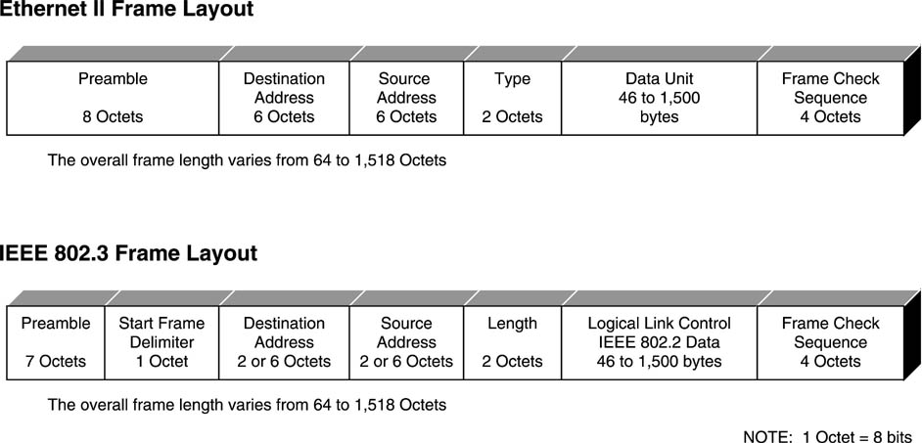
Ethernet II and IEEE 802.3 Standards
Purpose of preamble is to alert and synchronize the Ethernet NIC to the incoming data.
MAC layer addresses. First 3 octets identify the manufacturer (assigned by IEEE). Next 3 are unique address for each NIC.
Which network protocols are used, e.g., for IPX/ SPX protocol it will be 8137H, for TCP/IP protocols 0800H.
Contains all of the encapsulated upper layer (Network through Application) protocols. Vary from 46 to 1500.
Error detection mechanism generated by the transmitting Ethernet NIC. 32-bit CRC over the address, type, and data fields.
Indicates the length of the variable-length LLC data field.
It contains all upper layer embedded protocols with the data.

Slide 28
standards organization
is any organization whose primary activities are developing, coordinating, revising, amending, reissuing, interpreting, or otherwise producing technical standards that are intended to address the needs of some relatively wide base of affected adopters.

Slide 29
standards organization
Most standards are voluntary in the sense that they are offered for adoption by people or industry without being mandated in law. Some standards become mandatory when they are adopted by regulators as legal requirements in particular domains.

Slide 30
The term de jure standard refers to a standard mandated by legal requirements or refers generally to any formal standard. In contrast, the term de facto standard refers to a specification (or protocol or technology) that has achieved widespread use and acceptance – often without being approved by any standards organization (or receiving such approval only after it already has achieved widespread use)

Slide 31
International organization for standardization - ISO
is the world’s largest developer of voluntary International Standards. International Standards give state of the art specifications for products, services and good practice, helping to make industry more efficient and effective. Developed through global consensus, they help to break down barriers to international trade.

Slide 32
ITU- Telecommunication Standardization Sector (ITU-T
it coordinates standards for telecommunications.
The ITU organization established as a permanent agency of the United Nations, in which governments are the primary members although other organizations (such as non-governmental organizations and individual companies) can also hold a form of direct membership status in the ITU as well.
Standards and recommendations for networks and communications * ITU-T Recommendation

Slide 33
Data transmission
is the physical transfer of data (a digital bit stream) over a point-to-point or point-to-multipoint communication channel. Examples of such channels are copper wires, optical fibres and wireless communication channels
data are represented as an electromagnetic signal such as an electrical voltage, radio wave, microwave, or infrared signal
Telecommunication services
telecommunications service is a service provided by a telecommunications provider, or a specified set of user-information transfer capabilities provided to a group of users by a telecommunications system.
Integrated Service Digital Network
is a set of communication standards for simultaneous digital transmission of voice, video, data, and other network services over the traditional circuits of the public switched telephone network

Slide 34
American national standards institute - ANSI
the Institute is private, non-profitable membership organization supported by a diverse constituency of private and public sector organizations.
ANSI has maintained as its primary goal the enhancement of global competitiveness of U.S. business and the American quality of life by promoting and facilitating voluntary consensus standards and conformity assessment systems and promoting their integrity.

Slide 35
These standards ensure that the characteristics and performance of products are consistent, that people use the same definitions and terms, and that products are tested the same way. ANSI also accredits organizations that carry out product or personnel certification in accordance with requirements defined in international standards
ASCII code for encoding English alphabets

Slide 36
Institute of Electrical and Electronics Engineers - IEEE
Pronounced as: I-Triple-E.
that is dedicated to advancing technological innovation and excellence. It has about 425,000 members in about 160 countries, slightly less than half of whom reside in the United States.
IEEE 802 standards for networks

Slide 37
Electronic Industrial Association - EIA
comprises individual organizations that together have agreed on certain data transmission standards
EIA/TIA-232

Slide 38
the European telecommunications standards institute
Independent, Non-profitable institution.
Consists of telecommunication , producing companies, users , organizations, equipment makers and network operators to develop and produce systems and telecommunication standards in Europe .

Slide 39
Other organizations
Asynchronous Transfer Mode : ATM Forum
International, non-profitable companies concerned in ATM switches used in WAN and fast LAN.
Specifications and standards for those switches.

Slide 40
Ethernet Forum
Ethernet standards.
Giga Ethernet.
gigabit Ethernet (GbE or 1 GigE) is a term describing various technologies for transmitting Ethernet frames at a rate of a gigabit per second as defined by the IEEE 802.3-2008 standard. It came into use beginning in 1999, gradually supplanting Fast Ethernet in wired local networks, where it performed considerably faster.
Ethernet Allianc.

