Slide 1
GE209 Introduction to Computer Programming Using Matlab

Slide 2
Instructor
Name: Mohammed Almannaa
Website: https://fac.ksu.edu.sa/malmannaa
Office: 2A 70
Email: malmannaa@ksu.edu.sa
Course Notes: LMS.ksu.edu.sa

Slide 3
Syllabus
:
• Credit hours: 3
• Goals : To introduce computer programming with the use of MATLAB computing environment.
• Main learning outcomes
Provide students with a basic knowledge of programming skills in the context of MATLAB language.
Apply MATLAB plotting capabilities
Enable students to understand programming process from algorithm steps design to solve computational problems.
• Reference materials
Required Textbook: MATLAB for Engineers by Holly Moore, Pearson; 5th edition (2018).
Tutorial notes are available in the copy center.
LMS (the Learning Management System): www.lms.ksu.edu.sa Plus personal website
• Tools: The required software and hardware will be available in the college
of engineering computer labs+ can be downloaded through
https://www.mathworks.com/academia/tah-portal/king-saud-university-31434547.html

Slide 4
Syllabus : Outline
No. of Lectures | Topics | Section from textbook
2 | Introduction to programming Chap 1 : Introduction to the MATLAB | (1-1),(1-2), (1-3-1 to 1-3-3) and (1-4)
2 | Chap 2 : The MATLAB environment | (2-1), (2-2-1 to 2-2-8), (2-3-1) and (2-4-1 to 2-4-3)
3 | Chap 3 : Built-In Functions | (3-1),(3-2),(3-3-1,3-3-2),(3-4), (3-5-1 to 3-5-5),(3-6-1),(3-7),(3-8),(3-9)
3 | Chap4: Manipulating matrices in MATLAB | (4-1-1, 4-1-2),(4-2),(4-3-1 to 4-3-3)
4 | Chap 5 : Plotting in Matlab | (5-1-1 to 5-1-3), (5-2), (5-3-2 to 5-3-6), (5-4-1),(5-5),(5-6),(5-7)

Slide 5
Syllabus : Outline
Week | Topics
3 | Chap 6 : User defined functions | (6-1-1 to 6-1-8), (6-2)
2 | Chap 7 : User controlled input/output | (7-1),(7-2-1 to 7-2-3), (7-5-1,7-5-2),(7-6-1,7-6-2
4 | Chap 8 : Logical functions and selection structures | (8-1), (8-2), (8-3), (8-4-1 to 8-4-4), (8-5)
4 | Chap 9 : Repetition structures | (9-1),(9-2), (9-4),(9-5)
2 | Chap 12 : Symbolic mathematics | (12-1-1 to 12-1-2), (12-2-1 to 12-2-2), (12-3-1 to 12-3-2), (12-4-1 to 12-4-2)

Slide 6
Syllabus : Grading
– Computer labs (15 %)
– Mid-term exams (45 %) = (20% in-class + 25% in-lab)
– Final exam (40 %)
Total (100 %)
Important note :
The Mid-Term Exam-I : Oct.21 at 6:30 PM
The Mid-Term Exam-II : Week 13

Slide 7
Lecture 1 Outline
General Introduction
Computer Hardware
Computer software
Application programs
Data & information handling
Computer Programming languages
The problem Solving Process

Slide 8
Introduction Lecture 1 Computer literacy requirements
Awareness
Importance of computer systems
Versatility across all domains
Widespread presence in our society
Knowledge
What is a computer
How do computers work
Terminology (common terms)
Interaction or effective use
Computer application software
Computer programming software

Slide 9
Lecture 1 Introduction
What Is A Computer?
A computer is an electronic device, operating under the control of instructions (software) stored in its own memory unit, that can accept data (input), manipulate data (processing), and produce information (output) from the processing. Generally, the term is used to describe a collection of devices that function together as one system.

Slide 10
Devices that comprise a computer system
Monitor (output)
Speaker (output)
System unit
(processor, memory…)
Printer (output)
Keyboard (input)
Storage devices
(CD-RW, Floppy, Hard disk, zip,…)
Mouse (input)
Scanner (input)
Other devices
(input/output)
Modem,
data exchange and sharing (input/output)

Slide 11
What Does A Computer Do?
Computers can perform four general operations, which comprise the information processing cycle.
Input
Processing
Output
Storage

Slide 12
Data and Information
All computer processing requires data, which is a collection of raw facts, figures and symbols, such as numbers, words, images, video and sound, given to the computer during the input phase.
Computers manipulate data to create information. Information is data that is organized, meaningful, and useful.
During the output Phase, the information that has been created is put into some form, such as a printed report.
The information can also be put in computer storage for future use.

Slide 13
Why Is A Computer So Powerful?
The ability to perform the information processing cycle with amazing speed.
Reliability (low failure rate).
Accuracy.
Ability to store huge amounts of data and information.
Ability to communicate with other computers.

Slide 14
How Does a Computer Know what to do?
It must be given a detailed list of instructions, called a compute program or software, that tells it exactly what to do.
Before processing a specific job, the computer program corresponding to that job must be stored in memory.
Once the program is stored in memory the compute can start the operation by executing the program instructions one after the other.

Slide 15
What Are The Primary Components/Functions Of A Computer ?
Input devices.
Central Processing Unit (containing the control unit and the arithmetic/logic unit).
Memory.
Output devices.
Storage devices.

Slide 16
Computer Software
Computer software is the key to productive use of computers. Software can be categorized into two types:
Operating system software
Application software.

Slide 17
Operating System Software
Operating system software tells the computer how to perform the functions of loading, storing and executing an application and how to transfer data.
Today, many computers use an operating system that has a graphical user interface (GUI) that provides visual clues such as icon symbols to help the user. Microsoft Windows 98 is a widely used graphical operating system. DOS (Disk Operating System) is an older but still widely used operating system that is text-based.

Slide 18
Application Software
Application Software consists of programs that tell a computer how to produce information. Some of the more commonly used packages are:
Word processing
Electronic spreadsheet
Database
Presentation graphics
Programming languages
Programming environments

Slide 19
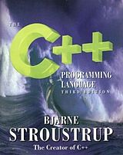
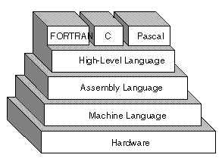
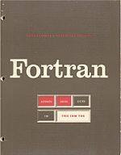
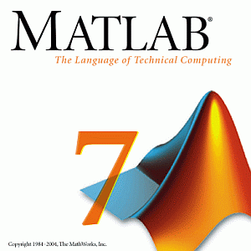
Programming Languages
Consist in a vocabulary and set of grammatical rules instructing a computer to execute specific tasks.
The term programming language normally refers to high-level languages, such as FORTRAN, BASIC, C, C++, COBOL, Ada, and Pascal. Each language has a unique set of keywords (words that it understands) and a special syntax for organizing program instructions leading to the expected result.

Slide 20
Programming Languages
Regardless of what language you use, you eventually need to convert your program into machine language so that the computer can understand it. There are two ways to do this:
compile : translate high-level instructions directly into machine language.
Interpret : translate high-level instructions into an intermediate form, which it is then executed.
Compiled programs generally run faster than interpreted programs. The advantage of an interpreter, however, is that it does not need to go through the time consuming compilation stage during which machine instructions are generated.

Slide 21
What Programming Languages ?
Every language has its strengths and weaknesses. For example, FORTRAN is a particularly good language for processing numerical data, but it does not lend itself very well to organizing large programs. Pascal is very good for writing well-structured and readable programs, but it is not as flexible as the C programming language. C++ embodies powerful object-oriented features, but it is complex and difficult to learn. MATLAB (MatrixLabrotory) is a complete set of programming environment (all-in-one)
The choice of which language to use depends on the type of computer the program is to run on, what sort of program it is, and the expertise of the programmer.
We will be using Matlab (version 7 and newer)

Slide 22
Programs, Algorithms, Data, commands
A Program is set of instructions written with a syntax proper to a given programming language; this program is based on a structured pre-specified steps leading to a particular objective for which the program is written.
An Algorithm is a structured pre-specified steps that should be laid out prior to writing the actual program. It is a road map to follow when transforming a problem solving process into a program.
A computer program always deals with Data to perform the instructions. From the point of view of a programmer, these data are either numeric or characters.
A command or a set of commands is (are) instruction(s) to perform certain actions and are interpreted one by one.

Slide 23
Problem Solving Process
Problem definition
$$given data$$
$$additional$$
$$data$$
$$$$
$$$$
Mathematical
modeling
$$Theory$$
$$Solving steps:$$
Hand calculations
Applied numerical methods
Computer programming
$$$$
Numeric and graphic results
$$implement$$
$$computer$$
$$programming$$
Report
delivering

Slide 24
Lecture 2 : MatLab Basics What’s next ? Introduction to the Matlab programming environment

Slide 25
Describing MATLAB
MatLab : Matrix Laboratory
Numerical Computations with matrices
Every number can be represented as matrix
Why Matlab?
User Friendly (GUI)
Easy to work with
Powerful tools for complex mathematics
→ A programming Environment :
→ Computation and visualization
→ Communication of ideas
→ Programming:
Built-in editor, debugger, and help
Many predefined functions (grouped in toolboxes)
Interpreted or compiled programs

Slide 26
What is Matlab?
Matlab is basically a high level language which has many specialized toolboxes and built-in programs for making things easier for us
How high?
Matlab
General Public
programmers
Ease of use
High Level
Languages such as
Fortran, Pascal, C etc.
Assembly
to
Machine Language
Specialized
programmers

Slide 27
Scope of the course?
Matlab is much broader than the scope of this course.
You will learn MATLAB within the following framework :
Series of Matlab commands
Matlab
m-files
Command
Line
mat-files
functions
Command execution like DOS command window
Data storage/ loading
Input
Output
capability

Slide 28
Why MATLAB ?
Computers dominate the industrial workplace.
The fundamental programming concepts learned using MATLAB will enable you to adapt to other programming environments.
You will be required to use MATLAB in this course and future courses.
MATLAB is widely used in industry.
Notes:
28

Slide 29
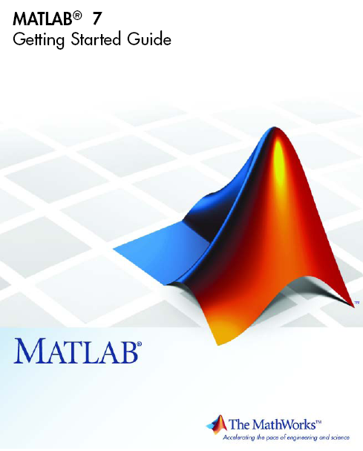
MATLAB Resources
Getting Started – html document on
Mathworks web site
–http:/www.mathworks.com/access
/helpdesk/help/helpdesk.shtml
–Click on “Getting Started”
–Click on “This manual in PDF”
Open or save to disk
Print
Help from MATLAB program
Course Webpage
Practice and learn from each other
Notes:
29

Slide 30
1. Getting started
Launching MATLAB : Possible scenarios
→ Case 1 : look on the desktop screen for the Matlab
Icon and clik on it
→ Case 2 : search in the start menu for Matlab
shortcut and launch
→ Case 3 : search for a Matlab folder and look for the
executable application “Matlab.exe”
→ Case 4 : install Matlab all over !

Slide 31
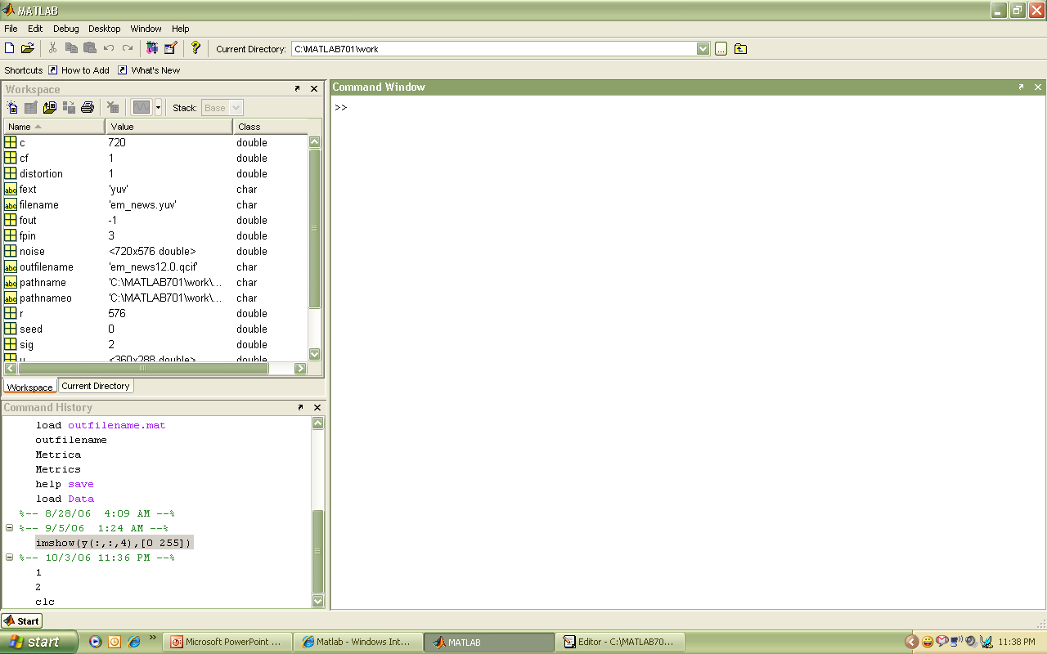
A snap shot of the MATLAB working environment
Command Window
type commands
Current Directory
View folders and m-files
Workspace
View program variables
Double click on a variable
to see it in the Array Editor
Command History
view past commands
save a whole session
using diary
Workspace
Command Window
Command History
Notes:
31

Slide 32
MATLAB Basics
MATLAB can be thought of as a super-powerful graphing calculator
Remember the TI-83 from calculus?
With many more buttons (built-in functions)
In addition it is a programming language
MATLAB is an interpreted language, like Scheme
Commands executed line by line

Slide 33
The Commands Window
Recognizable by the Command prompt >>
Basic arithmetic operations are available:
addition +
subtraction –
division /
multiplication *
exponentiation ^
More complex operations and programming instructions
Pressing “enter” key
→ “executes” or “runs”
or “invokes” the operation
Command Window

Slide 34
Arithmetic Operations
Addition + >> 1+2
Subtraction - >> 3-4
Multiplication * >> 5*6
Division / >> 7/8
Back Slash \ >> 9\10 or 10/9
Exponentiation ^ >> 2^3
Priority rule :
PEMDAS (Parentheses, Exponentiation, Multiplication,
Division, Addition, Subtraction)
>> ((2+5)^2+2*2-10/5) → = ?

Slide 35
Priority rules
Precedence is the order operations are preformed, remember PEMDAS
>> ((2+5)^2+2*2-10/5) innermost parentheses is done first
7^2 exponentiation is next
2*2 or 10/5 multiplication or division next
(49 + 4 – 2) addition or subtraction next
Operations are done from left to right
→ final result gives 51

Slide 36
Illustrative example (ex.1.1 from text book pg 6)

Slide 37
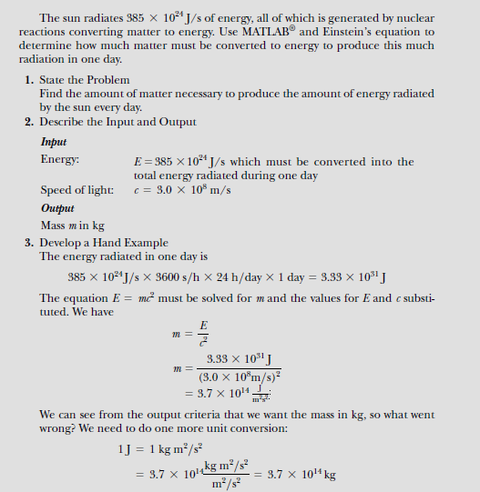
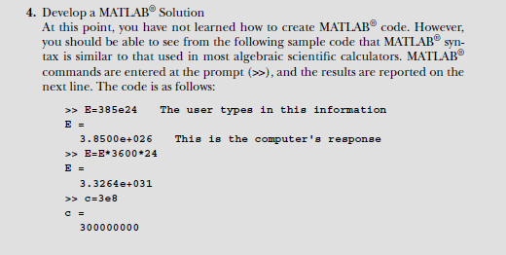
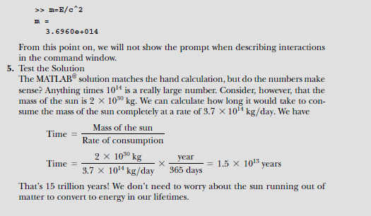
Example 1.1 (from text book pg 6)

