Slide 1
Disk storage Index structures for files
Lecture 12

Slide 2
Disk Storage Devices
Basic unit of data stored in disks is a single bit to represent data in 0/1 form.
Bits are grouped into Byte.
The capacity of disk: the amount of bytes it can store.
FloppyDiskd: 400KBytes- 1.5MBytes
Hard disks: several hundred Mbytes – tera Bytes.

Slide 3
Disk Storage Devices (cont.)
Preferred secondary storage device for high storage capacity and low cost.
Data stored as magnetized areas on magnetic disk surfaces.
A disk pack contains several magnetic disks connected to a rotating spindle.
Disks are divided into concentric circular tracks on each disk surface. Track capacities vary typically from 4 to 50 Kbytes.

Slide 4
Disk Storage Devices (cont.)
Because a track usually contains a large amount of information, it is divided into smaller blocks or sectors.
The division of a track into sectors is hard-coded on the disk surface and cannot be changed. One type of sector organization calls a portion of a track that subtends a fixed angle at the center as a sector.
A track is divided into blocks. The block size B is fixed for each system. Typical block sizes range from B=512 bytes to B=4096 bytes. Whole blocks are transferred between disk and main memory for processing.

Slide 5
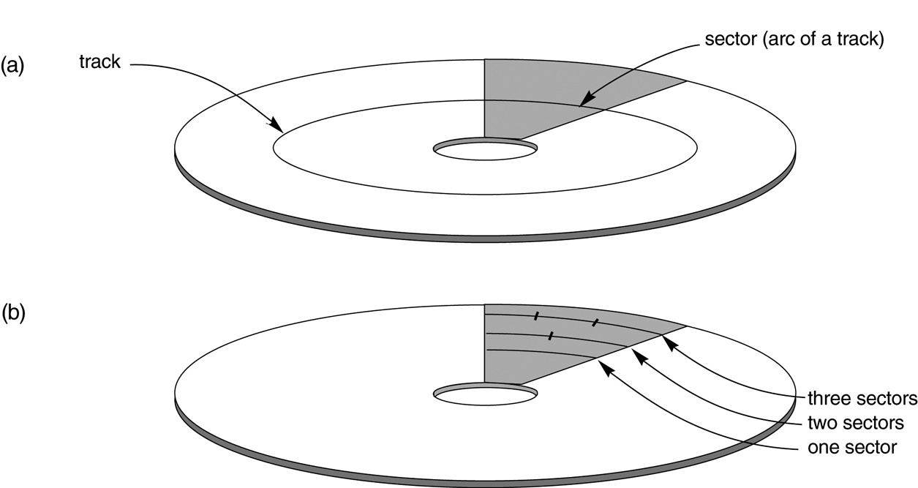
Disk Storage Devices (cont.)

Slide 6
Disk Storage Devices (cont.)
A read-write head moves to the track that contains the block to be transferred. Disk rotation moves the block under the read-write head for reading or writing.
A physical disk block (hardware) address consists of a cylinder number (imaginery collection of tracks of same radius from all recoreded surfaces), the track number or surface number (within the cylinder), and block number (within track).
physical disk block address = cylinder number + track number + block number

Slide 7
Disk Storage Devices (cont.)
Reading or writing a disk block is time consuming because of the seek time s and rotational delay (latency) rd.
Double buffering can be used to speed up the transfer of contiguous disk blocks.

Slide 8
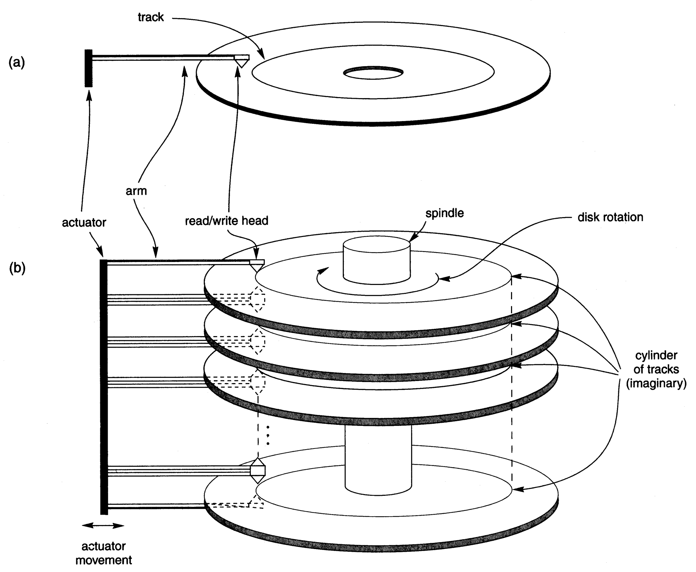
Disk Storage Devices (cont.)

Slide 9
Records
Data is usually stored in the form of records.
A File is a sequence of records.
Fixed and variable length records
Records contain fields which have values of a particular type (e.g., amount, date, time, age)
Fields themselves may be fixed length or variable length

Slide 10
Blocking
Blocking: refers to storing a number of records in one block on the disk.
Blocking factor (bfr) refers to the number of records per block.
There may be empty space in a block if an integral number of records do not fit in one block.
Spanned Records: refer to records that exceed the size of one or more blocks and hence span a number of blocks.

Slide 11
Files of Records
A file is a sequence of records, where each record is a collection of data values (or data items).
A file descriptor (or file header ) includes information that describes the file, such as the field names and their data types, and the addresses of the file blocks on disk.
Records are stored on disk blocks. The blocking factor bfr for a file is the (average) number of file records stored in a disk block.
A file can have fixed-length records or variable-length records.

Slide 12
Spanned and Unspanned records

Slide 13
Files of Records (cont.)
File records can be unspanned (no record can span two blocks) or spanned (a record can be stored in more than one block).
The physical disk blocks that are allocated to hold the records of a file can be contiguous, linked, or indexed.
In a file of fixed-length records, all records have the same format. Usually, unspanned blocking is used with such files.
Files of variable-length records require additional information to be stored in each record, such as separator characters and field types. Usually spanned blocking is used with such files.

Slide 14
Operation on Files
Typical file operations include:
OPEN: Reads the file for access, and associates a pointer that will refer to a current file record at each point in time.
FIND: Searches for the first file record that satisfies a certain condition, and makes it the current file record.
FINDNEXT: Searches for the next file record (from the current record) that satisfies a certain condition, and makes it the current file record.
READ: Reads the current file record into a program variable.
INSERT: Inserts a new record into the file, and makes it the current file record.

Slide 15
Operation on Files (cont.)
DELETE: Removes the current file record from the file, usually by marking the record to indicate that it is no longer valid.
MODIFY: Changes the values of some fields of the current file record.
CLOSE: Terminates access to the file.
REORGANIZE: Reorganizes the file records. For example, the records marked deleted are physically removed from the file or a new organization of the file records is created.
READ_ORDERED: Read the file blocks in order of a specific field of the file.

Slide 16
Unordered Files
Also called a heap or a pile file.
New records are inserted at the end of the file.
To search for a record, a linear search through the file records is necessary. This requires reading and searching half the file blocks on the average, and is hence quite expensive.
Record insertion is quite efficient.
Reading the records in order of a particular field requires sorting the file records.

Slide 17
Ordered Files
Also called a sequential file.
File records are kept sorted by the values of an ordering field.
Insertion is expensive: records must be inserted in the correct order.
A binary search can be used to search for a record on its ordering field value. This requires reading and searching log₂ of the file blocks on the average, an improvement over linear search.
Reading the records in order of the ordering field is quite efficient.

Slide 18
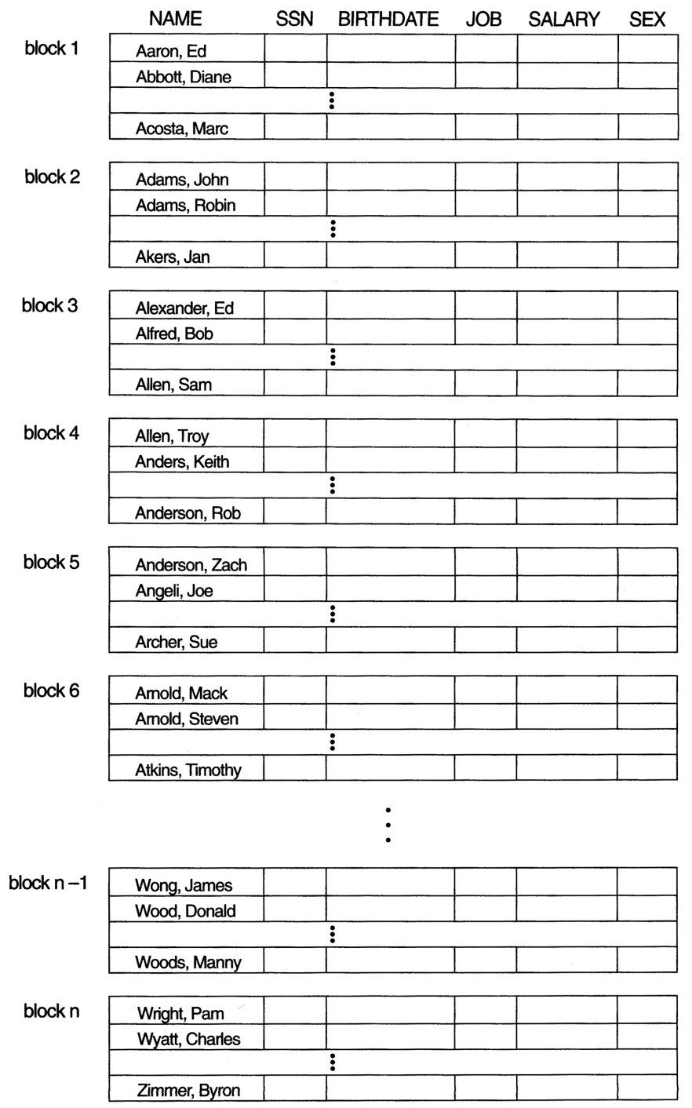
Ordered Files (cont.)

Slide 19
Average Access Times
The following table shows the average access time to access a specific record for a given type of file

Slide 20
Introduction
Indexes are additional auxiliary access structures with typically provide:
faster access to data
makes it more efficient to search for a record in the data file.
One form of an index is a file of entries:
＜ field value, pointer to record ＞ , which is ordered by field value
The index file usually occupies considerably less disk blocks than the data file because its entries are much smaller

Slide 21
Types of Indexes
Single-Level Indexes
Primary.
Secondary.
Clustering.
Multi-Level Indexes
ISAM
B Trees
B+ Trees

Slide 22
Single-Level Indexes
A Primary Index:
is specified on the ordering key field where each tuple has a unique value.
A Clustering Index:
is specified on the ordering key field where each tuple DOES NOT have a unique value in that field.
A Secondary Index :
is specified on a NON-ORDERING Field of the file.

Slide 23
Primary Index
A Primary Index is an ordered file whose records of fixed length of two parts:
The first field is the same data type of the primary key of a file block of the data file and the second field is file block pointer (block address)
The Anchor Record or Block anchor is the first record in a file block. This is where the value for the first field of the primary index come from along with the respective address of that block.

Slide 24
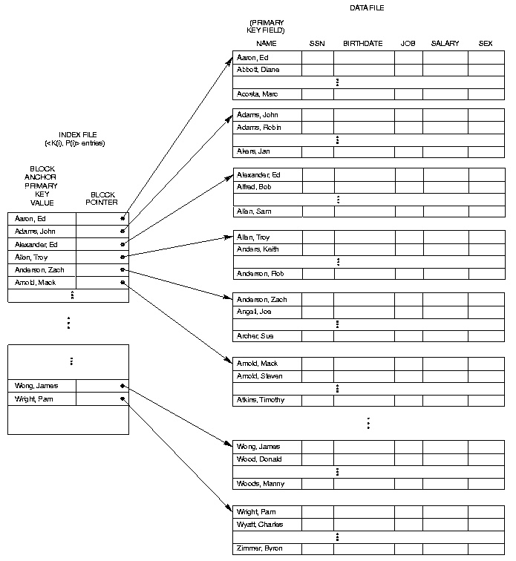

Slide 25
Clustering Index
Clustering Indexes are used when the ordering index is a field where each value is not unique.
An entry in the clustering index is composed of a SINGLE entry for each distinct value in the clustering field and its respective file block pointer.

Slide 26
Clustering Field
Data file
INDEX File
( <ki,Pi,> entries
Dnumber NAME SSN Birthdate JOB SALARY
CLUSTERING Field Value
Block pointer

Slide 27
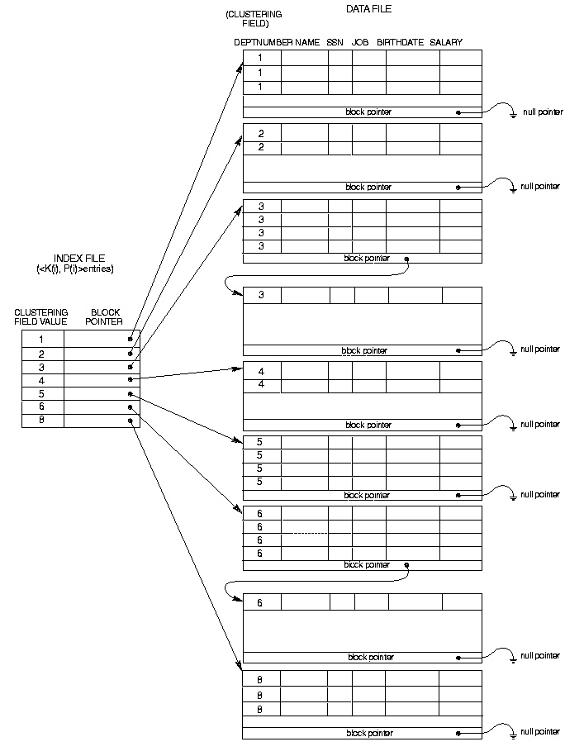

Slide 28
Secondary Index
A Secondary Index is an ordered file with two fields.
The first is of the same data type as some nonordering field and the second is either a block or a record pointer.
The secondary index may be on a field which is a candidate key and has a unique value in every record, or a nonkey with duplicate values

Slide 29
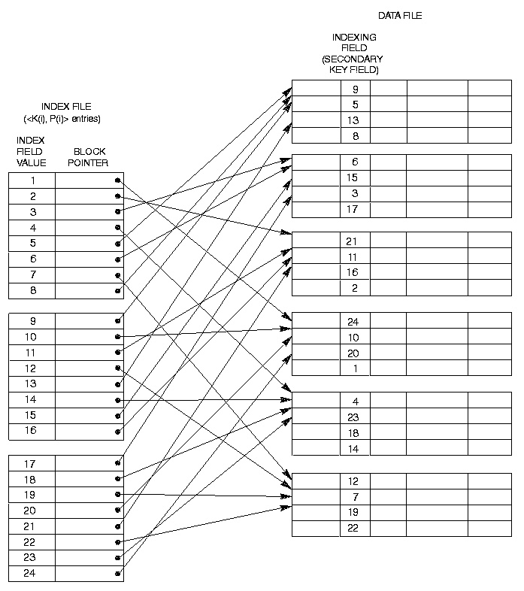

Slide 30
Secondary Index
Since there is no guarantee that the value will be unique the previous index method will not work.
Option 1: Include index entries for each record. This results in multiple entries of the same value.
Option 2: Use variable length records with a pointer to each block/record with that value.
Option 3: Have the pointer; point to a block or chain of blocks that contain pointers to all the blocks/records that contain the field value.

Slide 31
