Slide 1

Introduction to GUI in
Graphical User Interface
3

Slide 2
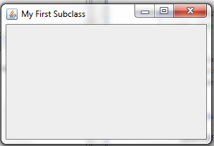
This gray area is the content pane of this frame.
The content pane is where we put GUI objects such as buttons, labels, scroll bars, and others.
We access the content pane by calling the frame’s getContentPane method in class Container.
Container contentPane = getContentPane();
contentPane methods:
setBackground(Color.BLUE);
add(Object_name);
setLayout( layout_type);

Slide 3
Placing GUI Objects on a Frame
There are two ways to put GUI objects on the content pane of a frame:
  Use a layout manager (using setLayout()method)
  Use absolute positioning
    null layout manager

Slide 4
Layout Managers
The layout manager determines how the GUI components are added to the container
the common ones are
  FlowLayout ()
  GridLayout (rows, columns)
  BorderLayout

Slide 5
FlowLayout
In using this layout, GUI components are placed in the top-to-bottom, left-to right order
As a default, components on each line are centered, but you can change it to left or right alignment.
When the frame containing the component is resized, the placement of components is adjusted accordingly.

Slide 6
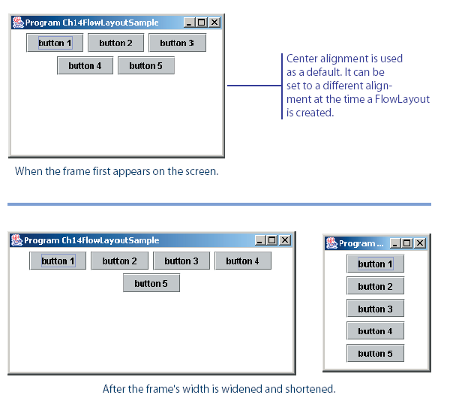
FlowLayout Sample
This shows the placement of five buttons by using FlowLayout.

Slide 7
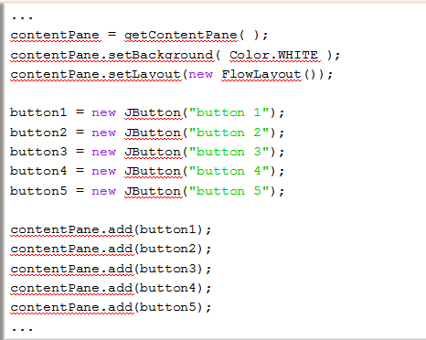

Slide 8
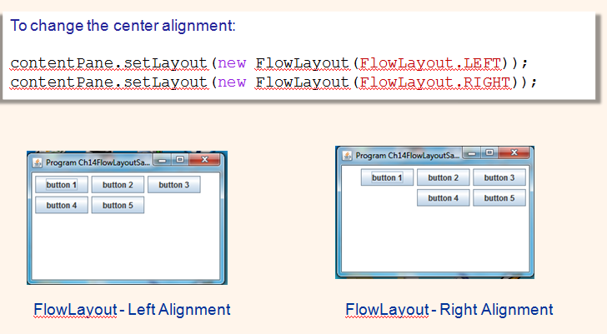

Slide 9
GridLayout
This layout manager placesGUI components on equal-size N by M grids.
Components are placed in top-to-bottom, left-to-right order.
The number of rows and columns remains the same after the frame is resized, but the width and height of each region will change.

Slide 10
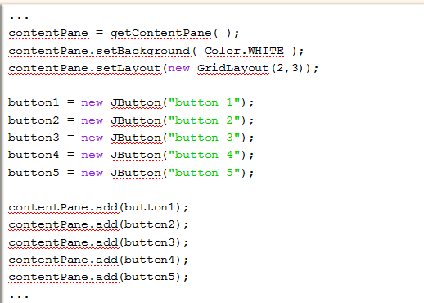

Slide 11
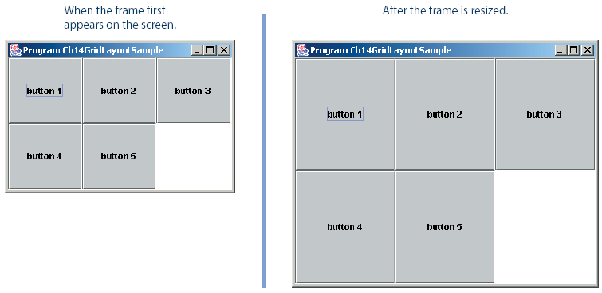

Slide 12
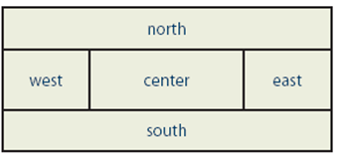
BorderLayout
This layout manager divides the container into five regions: center, north, south, east, and west.
If the window is enlarged, the center area gets as much of the available space as possible.
The other areas expand only as much as necessary to fill all available space.
Not all regions have to be occupied.

Slide 13
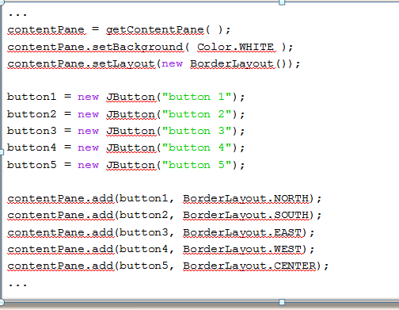

Slide 14
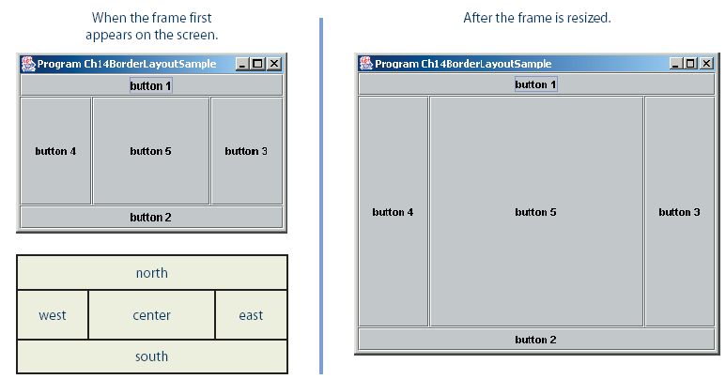

Slide 15
Absolute Positioning
Here we do not use any layout manager.
We place the GUI objects on the frame’s content pane by explicitly specifying their position and size.
This is called absolute positioning

Slide 16
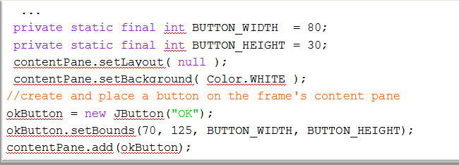
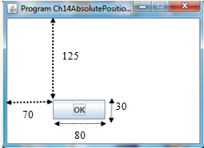

Slide 17
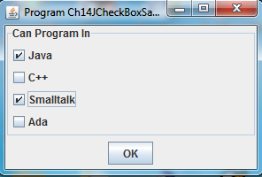
Other Common GUI Components
JCheckBox
Useful in representing a collection of binary (yes/no, true/false) options.
A JCheckBox object generates action events (like a JButton), but also generates item events, when the state of a check-box button changes (selected or deselected).

Slide 18
JCheckBox
JCheckBox box1= new JCheckBox(“BOX1");
box1.setSelected(true); //for defualt selection
Handling the CheckBox events:
implements ActionListener , ItemListener
Redefine the function itemStateChanged
public void itemStateChanged(ItemEvent e) {
Object source = e.getSource();
if (source == box1) {//do something }
else if (source == ......) {}

Slide 19
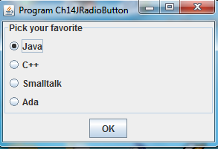
JRadioButton
The radio button is similar to the check-box, but only one button can be selected from the group.
When you select a new item, the currently selected radio button will get deselected.
Thus, the JRadioButton must be added to a group.
A JRadioButton generates both action events and item events.
JRadioButton radio1= new JRadioButton(“r1");

Slide 20
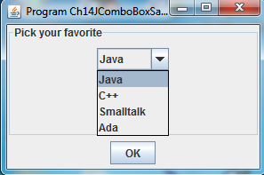
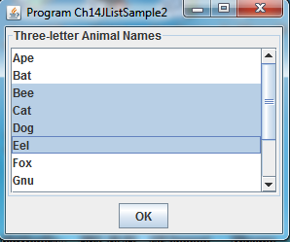
Other Common GUI Components
JComboBox (drop-down list)
Similar to JRadioButton,
but the choices are presented to the user
in a form of a drop-down list
Jlist
Used to display a list of items
You can highlight one or more selection

Slide 21
Menus
The javax.swing package contains three menu-related classes: JMenuBar, JMenu, and JMenuItem.
JMenuBar is a bar where the menus are placed. There is one menu bar per frame.
JMenu (such as File or Edit) is a group of menu choices. JMenuBar may include many JMenu objects.
JMenuItem (such as Copy, Cut, or Paste) is an individual menu choice in a JMenu object.
Only the JMenuItem objects generate events.

Slide 22
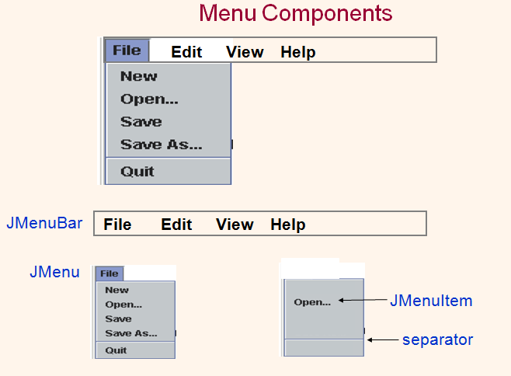

Slide 23
Sequence for Creating Menus
Create a JMenuBar object and attach it to a frame.
Create a JMenu object.
Create JMenuItem objects and add them to the JMenu object.
Attach the JMenu object to the JMenuBar object.

