Slide 1
Lecture#9:VTP Create once and send to the other switches.
.
Asma ALosaimi

Slide 2
LAN Design
Basic Switch Concepts
Wireless
STP
VLANs
VTP
Inter-VLAN routing

Slide 3
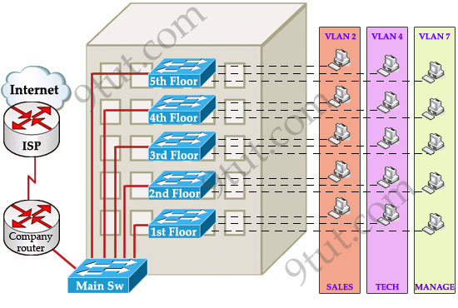
Why?
One day, your boss decides to add a new department to your office, the Support Department, and you are tasked to add a new SUPPORT VLAN for this department. How will you do that? Well, without VTP you have to go to each switch to enable this new VLAN. Fortunately your office only has 5 floors so you can finish this task in some hours!!!

Slide 4
VTP MODE
To maintain domain consistency, only one switch should be allowed to create (or delete, modify) new VLANs. This switch is like the “master” of the whole VTP domain and it is operated in Server mode. This is also the default mode.
Other switches are only allowed to receive and forward updates from the “server” switch. They are operated in Client mode. Switches in this mode cannot create, delete or modify VLANs.
In some cases, the network manager doesn’t want a switch to learn VTP information from other switches. He can set it to Transparent mode.
In this mode, a switch maintains its own VLAN database and never learn any VTP information from other switches (even from the switch in VTP server mode).
However, it still forwards VTP advertisements from the server to other switches (but doesn’t read that advertisement).
A transparent switch can add, delete and modify VLAN database locally.

Slide 5
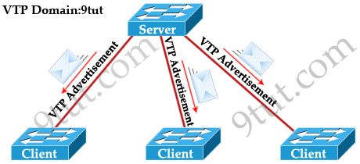
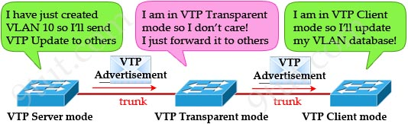
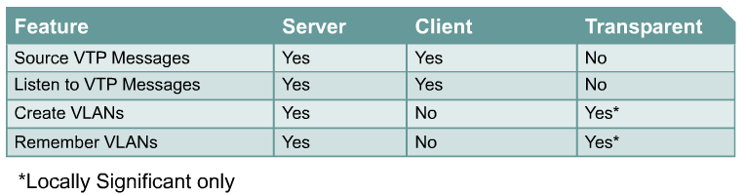

Slide 6
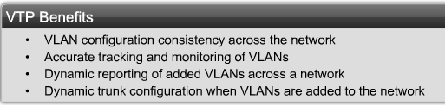
Benefits of VTP (VLAN Trunking Protocol)
.
Before discussing VTP, it is important to understand that VTP is not necessary in order to configure VLANs or Trunking on Cisco Switches.
VTP is a Cisco proprietary protocol that allows VLAN configuration to be consistently maintained across a common administrative domain.
VTP minimizes the possible configuration inconsistencies that arise when changes are made.
Additionally, VTP reduces the complexity of managing and monitoring VLAN networks, allowing changes on one switch to be propagated to other switches via VTP.
On most Cisco switches, VTP is running and has certain defaults already configured.

Slide 7
VTP Operation – Revision Number
.
A critical parameter governing VTP function is the VTP configuration revision number.
This 32-bit number indicates the particular revision of a VTP configuration.
A configuration revision number starts at 0 and increments by 1 with each modification until it reaches 4294927295, at which point it recycles back to 0 and starts incrementing again.
Each VTP device tracks its own VTP configuration revision number
VTP packets contain the sender’s VTP configuration number.
This information determines whether the received information is more recent than the current version.
If the switch receives a VTP advertisement over a trunk link, it inherits the VTP domain name and configuration revision number.
The switch ignores advertisements that have a different VTP domain name or an earlier configuration revision number.

Slide 8
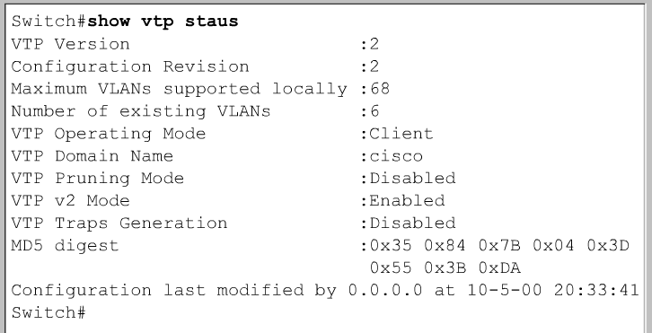
Verifying VTP
.
This command is used to verify VTP configuration settings on a Cisco IOS command-based switch.

Slide 9
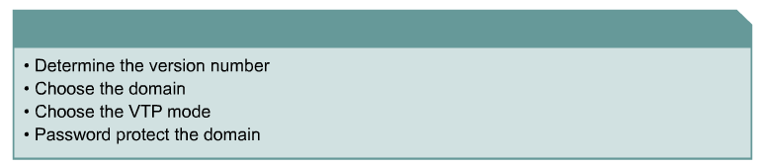
VTP configuration
.
VTP can be configured by using these configuration modes.
VTP Configuration in global configuration mode
VTP Configuration in VLAN configuration mode
VLAN configuration mode is accessed by entering the vlan database privileged EXEC command.

Slide 10
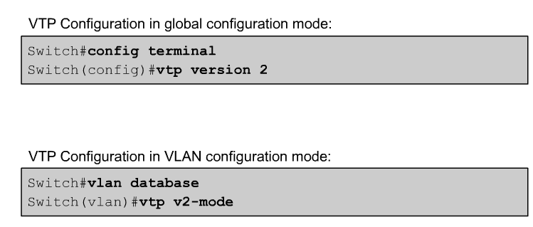
VTP configuration - Version
.
Two different versions of VTP can run in the management domain, VTP Version 1 and VTP Version 2.
The two versions are not interoperable in the same VTP domain.
The major difference between the two versions is version 2 introduces support for Token Ring VLANs.
If all switches in a VTP domain can run VTP Version 2, version 2 only needs to be enabled on one VTP server switch, which propagates it to other VTP switches in the VTP domain.
Version 2 should not be enabled unless every switch in the VTP domain supports version 2.

Slide 11
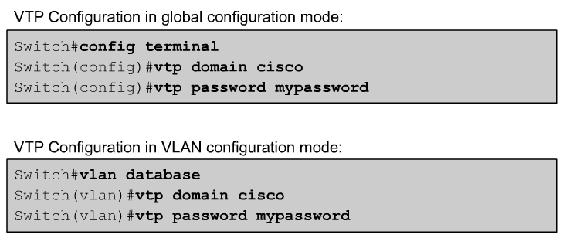
VTP configuration – Domain and Password
.
The domain name can be between 1 and 32 characters.
The optional password must be between 8 and 64 characters long.
If the switch being installed is the first switch in the network, the management domain will need to be created.
However, if the network has other switches running VTP, then the new switch will join an existing management domain.
Caution: The domain name and password are case sensitive.
To avoid incorrectly configuring a VTP domain name, only set the VTP domain name on one VTP server switch. All other switches in the same VTP domain will accept and automatically configure their VTP domain name when they receive the first VTP summary advertisement.

Slide 12
VTP configuration – Domain and Password (Secure Mode)
.
By default, management domains are set to a nonsecure mode, meaning that the switches interact without using a password.
Adding a password automatically sets the management domain to secure mode.
The same password must be configured on every switch in the management domain to use secure mode.

Slide 13
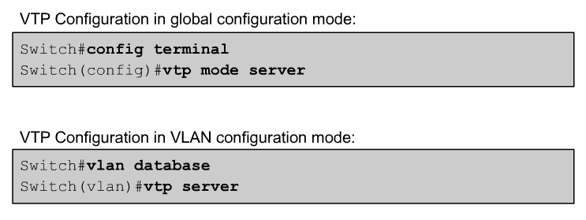
VTP configuration – VTP mode
.
Switch#config terminal
Switch(config)#vtp mode [client|server|transparent]
Switch#vlan database
Switch(vlan)#vtp [client|server|transparent]

Slide 14
VTP Configuration - Overview
.
VTP Configuration in global configuration mode:
Switch#config terminal
Switch(config)#vtp version 2
Switch(config)#vtp mode server
Switch(config)#vtp domain cisco
Switch(config)#vtp password mypassword
VTP Configuration in VLAN configuration mode:
Switch#vlan database
Switch(vlan)#vtp v2-mode
Switch(vlan)#vtp server
Switch(vlan)#vtp domain cisco
Switch(vlan)#vtp password mypassword

Slide 15
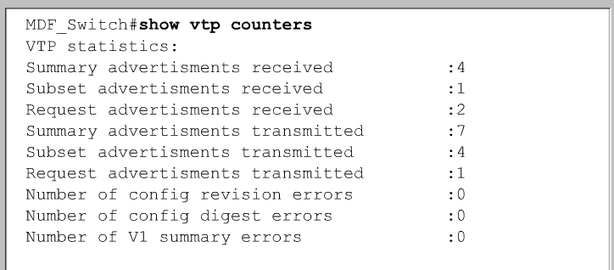
Verifying VTP
.
This command is used to display statistics about advertisements sent and received on the switch.

Slide 16
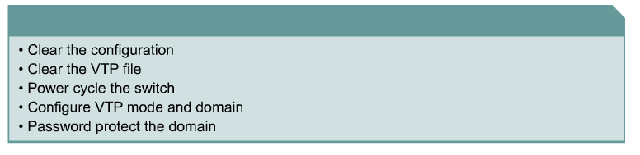
Adding a switch to an existing VTP domain
Use caution when inserting a new switch into an existing domain.
In order to prepare a switch to enter an existing VTP domain, perform the following steps.
Delete the VLAN database, erase the startup configuration, and power cycle the switch.
This will avoid potential problems resulting from residual VLAN configurations or adding a switch with a higher VTP configuration revision number that could result in the propagation of incorrect VLAN information.
From the privileged mode, issue the delete vlan.dat and erase startup-config commands, then power cycle the switch.

Slide 17
Things to check
VTP Version. It needs to be the same on all switches in the domain.
Domain name. Is it exactly the same on all switches?
VTP Password if any. Is it exactly the same on all switches?
Check that there is at least one server. Better to have at least two.
If you recently added a new switch, had its revision number been set to 0?

Slide 18
http://www.9tut.com/vlan-trunk-protocol-vtp-tutorial

