Slide 1
Lecture#6:Connectivity Verification
Asma Alosaimi
Notes:
8.3 Connectivity Verification

Slide 2
ICMP
ICMP = Internet Control Message Protocol
Layer 3
Part of TCP/IP suite of protocols
Network layer protocol
  Reports on data delivery success/failure
Announces transmission failures to sender
  Network congestion
  Data fails to reach destination
  Data discarded: TTL expired
ICMP cannot correct errors
  Provides critical network problem troubleshooting information
ICMPv6 used with IPv6

Slide 3
ICMP

Slide 4
ICMP Echo Request
Called “ping”
Important network testing tool
Tests connectivity at layers 3-1
Most TCP/IP hosts can send pings
  PCs
  routers
All TCP/IP hosts will reply to pings (unless configured to discard them for security reasons.)

Slide 5
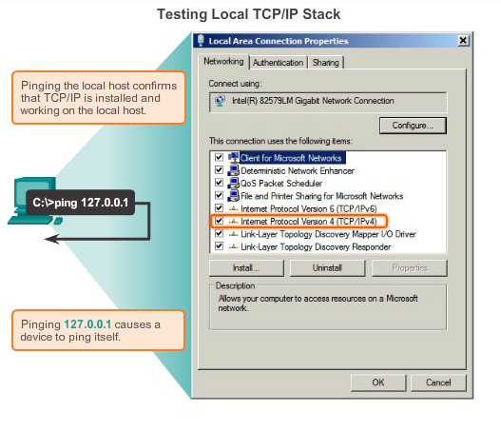
Testing and Verification
Ping – Testing the Local Stack
Notes:
8.3.2.1 Ping – Testing the Local Stack

Slide 6
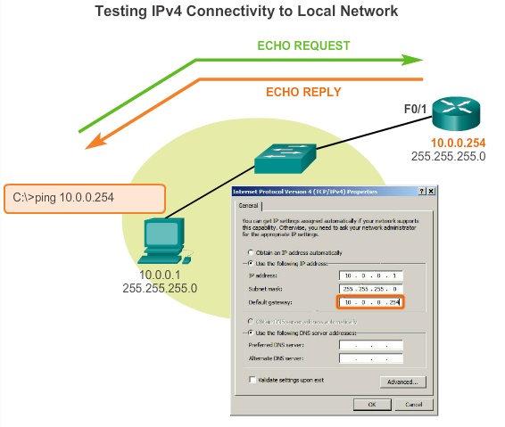
Testing and Verification
Ping – Testing Connectivity to the Local LAN
Notes:
8.3.2.2 Ping – Testing Connectivity to the Local LAN

Slide 7
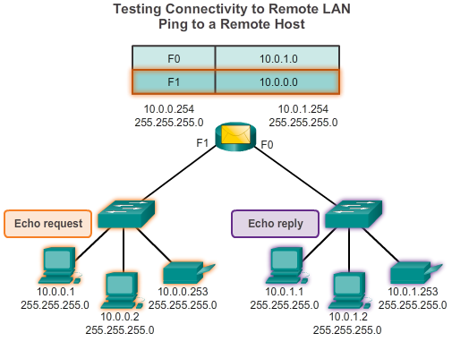
Testing and Verification
Ping – Testing Connectivity to Remote
Notes:
8.3.2.3 Ping – Testing Connectivity to Remote

Slide 8
DOS Ping Display
C:\WINDOWS>ping 172.28.118.1
Pinging 172.28.118.1 with 32 bytes of data:
Reply from 172.28.118.1: bytes=32 time=1ms TTL=255
Reply from 172.28.118.1: bytes=32 time=1ms TTL=255
Reply from 172.28.118.1: bytes=32 time=1ms TTL=255
Reply from 172.28.118.1: bytes=32 time=1ms TTL=255
Ping statistics for 172.28.118.1:
Packets: Sent = 4, Received = 4, Lost = 0 (0% loss),
Approximate round trip times in milli-seconds:
Minimum = 1ms, Maximum = 1ms, Average = 1ms
Successful replies
Key results

Slide 9
Cisco IOS Ping Display
Differs in format from DOS display
Contains same information
You’ll work with IOS ping in an upcoming lab.

Slide 10
ICMP Echo Request
To check the configuration of layer 3-1 on your PC, you can ping a special internal test address - the loopback address.
Try it now -
  Open a DOS window
  >ping 127.0.0.1

Slide 11
ICMP Echo Request
To check the configuration of layer 3-1 between your PC and another host, you can ping that host’s address.
Try it now -
  Open a DOS window
  >ping 172.28.118.10

Slide 12
ICMP Echo Request
You can also use hostnames in the ping command (if DNS is running, or host tables are enabled).
Try it now -
  Open a DOS window
  >ping academy1

Slide 13
Testing and Verification
Traceroute – Testing the Path
  Traceroute
  Generates a list of hops that were successfully reached along the path.
  Provides important verification and troubleshooting information.
  If the data reaches the destination, then the trace lists the interface of every router in the path between the hosts.
  If the data fails at some hop along the way, the address of the last router that responded to the trace can provide an indication of where the problem or security restrictions are found.
  Provides round-trip time for each hop along the path and indicates if a hop fails to respond.
Notes:
8.3.2.4 Traceroute – Testing the Path

Slide 14
Traceroute Packets
Most traceroute programs, including the Cisco IOS traceroute, send UDP packets (User Datagram Protocol).
Micrososft tracert sends ICMP echo request (ping) packets.

Slide 15
Traceroute Command
Unix: traceroute
Cisco IOS: traceroute (trace)
DOS: tracert

Slide 16
Traceroute Operation
Transmits packets with small Time-To-Live (TTL) values.
  First packets have TTL = 1
  Second have TTL = 2
  Third have TTL = 3
  etc.

Slide 17
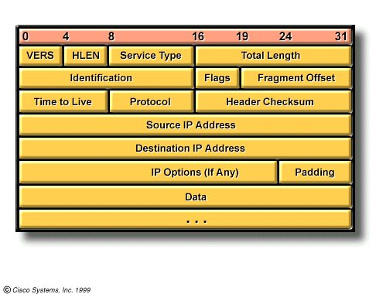
Time to Live Field
TTL

Slide 18
Traceroute Operation

Slide 19
Traceroute is initiated by PC1
ICMP packet is sent with TTL=1, it expires at the first hop (LAN GW), and is sent back to the PC, which shows the first hop in the traceroute
A third packet is sent with TTL=3, which decrements at each hop, and expires after RTR2, so a message is sent to PC1.
The last packet is sent with TTL=4, which expires at DST and PC1 then knows it has reached the target.
PC1
LAN GW
SP
RTR1
SP
RTR2
DST
1 <1 ms <1 ms <1 ms 172.16.96.1
2 15 ms 22 ms 31 ms rtr1 [4.132.159.25]
3 * * * rtr2 [4.144.175.42]
4 * 25 ms 21 ms dst [4.168.18.3]
Note that even though RTR2 did not respond, it DID forward the last packet to DST. The last packet had to traverse RTR2 to get to DST, indicating there is no ‘trouble’ with RTR2 except it did not send a Time Exceeded message back to PC1.

Slide 20
DOS Traceroute Display
C:\WINDOWS>tracert www.husd.k12.ca.us
Tracing route to www.husd.k12.ca.us [206.110.193.5]
over a maximum of 30 hops:
1 1 ms 1 ms 1 ms 192.168.0.1
2 23 ms 32 ms 32 ms adsl-63-198-176-254.dsl.snfc21.pacbell.net [63.198.176.254]
3 20 ms 19 ms 21 ms core4-g3-0.snfc21.pbi.net [216.102.187.130]
4 20 ms 19 ms 19 ms ded2-fa12-0-0.snfc21.pbi.net [209.232.130.5]
5 25 ms 51 ms 21 ms vip-Alameda-Co.cust-rtr.pacbell.net [216.102.184.2]
6 44 ms 37 ms 43 ms 206.110.252.174
7 47 ms 40 ms 40 ms www.husd.k12.ca.us [206.110.193.5]
Trace complete.
Hop
Round trip time
Router

