Slide 1
Lecture#3-IPV4 Addressing
CT1304- Asma AlOsaimi

Slide 2
Topics
IPv4 Address Structure
IPv4 Subnet Mask
IPv4 Unicast, Broadcast, and Multicast
Types of IPv4 Address
Notes:
Chapter 8 Sections

Slide 3
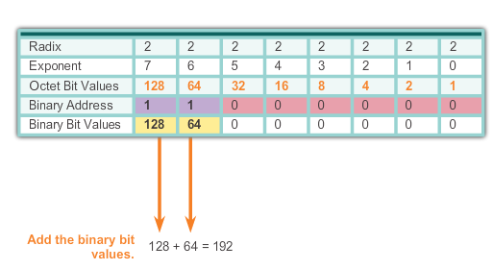
IPv4 Address Structure Binary Number System
Notes:
8.1.1.2 Binary Number System

Slide 4
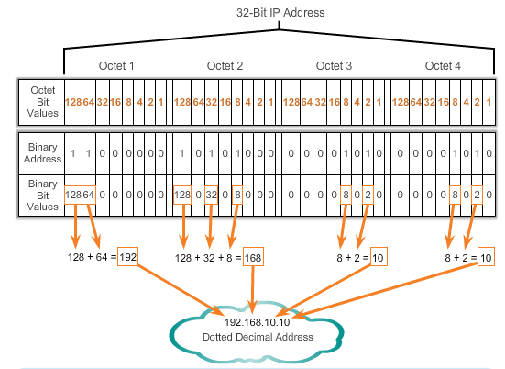
IPv4 Address Structure Converting a Binary Address to Decimal
Notes:
Section 8.1.1.3 & 8.1.1.4 Converting a Binary Address to Decimal

Slide 5
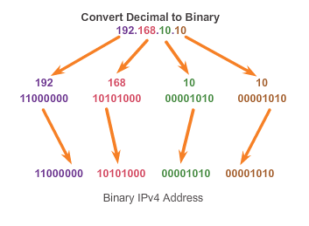
IPv4 Address Structure Converting from Decimal to Binary (Cont.)
Notes:
8.1.1.6 Converting from Decimal to Binary (Cont.)

Slide 6
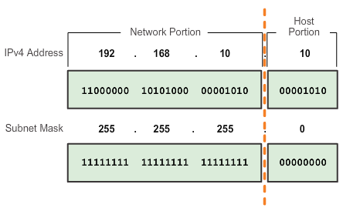
IPv4 Subnet Mask Network Portion and Host Portion of an IPv4 Address
To define the network and host portions of an address, a devices use a separate 32-bit pattern called a subnet mask
The subnet mask does not actually contain the network or host portion of an IPv4 address, it just says where to look for these portions in a given IPv4 address
Notes:
8.1.2.1 Network Portion and Host Portion of an IPv4 Address

Slide 7
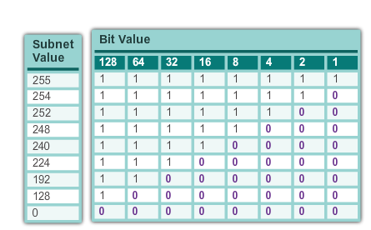
IPv4 Subnet Mask Network Portion and Host Portion of an IPv4 Address (cont.)
Valid Subnet Masks
Notes:
8.1.2.1 Network Portion and Host Portion of an IPv4 Address (cont.)

Slide 8
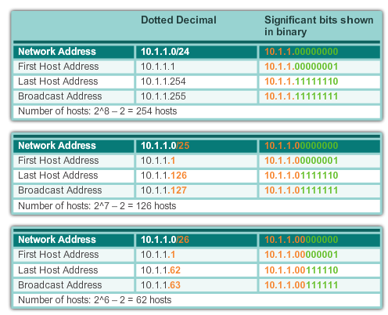
IPv4 Subnet Mask Examining the Prefix Length
Notes:
8.1.2.2 Examining the Prefix Length

Slide 9
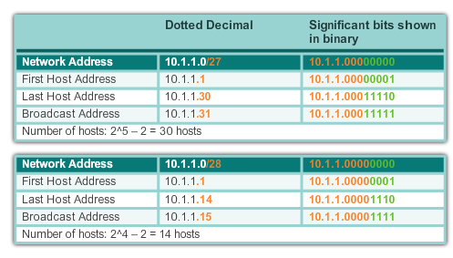
IPv4 Subnet Mask Examining the Prefix Length (cont.)
Notes:
8.1.2.2 Examining the Prefix Length (cont.)

Slide 10
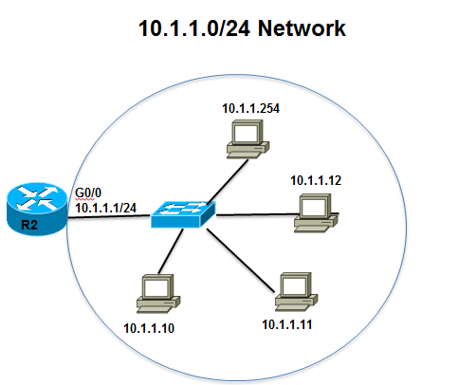
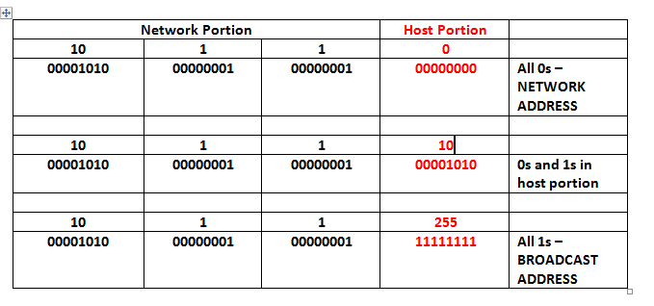
IPv4 Subnet Mask IPv4 Network, Host, and Broadcast Address
10.1.1.0/24
Notes:
8.1.2.3 IPv4 Network, Host and Broadcast Address

Slide 11
IPv4 Subnet Mask First Host and Last Host Addresses
10.1.1.0/24
Notes:
8.1.2.4 First Host and Last Host Addresses

Slide 12
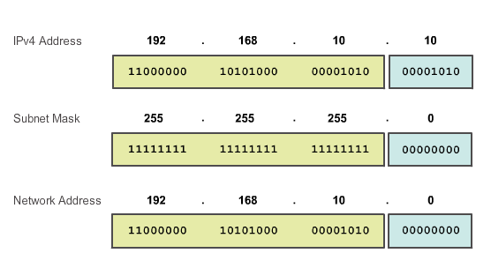
IPv4 Subnet Mask Bitwise AND Operation
1 AND 1 = 1 1 AND 0 = 0 0 AND 1 = 0 0 AND 0 = 0
Notes:
8.1.2.5 and 8.1.2.6 Bitwise AND Operation/Importance of ANDing

Slide 13
IPv4 Subnet Mask Exercise
what is the subnet Id of the IP address 165.212.18.5/20?
The subnet Id of the IP address 165.212.18.5/20 is 165.212.16.0 The available host address range is 165.212.16.1 - 165.212.31.254 Broadcast address: 165.212.31.255

Slide 14
IPv4 Subnet Mask Exercise
You have an IP address of 156.16.3.47 with an 11-bit subnet mask. What are your valid hosts?
156.16.3.47 is a class B IP address and is normally used with a subnet mask of type 255.255.x.x
11 bit subnet mask is equivalent to 255.224.0.0=11111111.11100000.00000000.00000000
Netmask - 255.224.0.0
Network address -156.0.0.0/11
Broadcast: 156.31.255.255
Host Min: 156.0.0.1
Host max: 156.31.255.254
Host/Network-2097150

Slide 15
IPv4 Subnet Mask Exercise
What does the IP address 172.17.4.250/24 represent?
network address
multicast address
host address
broadcast address

Slide 16
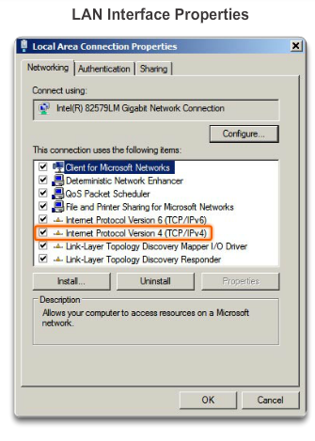
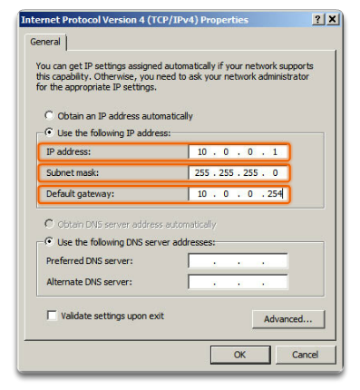
IPv4 Unicast, Broadcast, and Multicast Assigning a Static IPv4 Address to a Host
LAN Interface Properties
Configuring a Static IPv4 Address
Notes:
8.1.3.1 Assigning a Static IPv4 Address to a Host

Slide 17
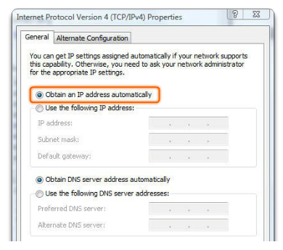
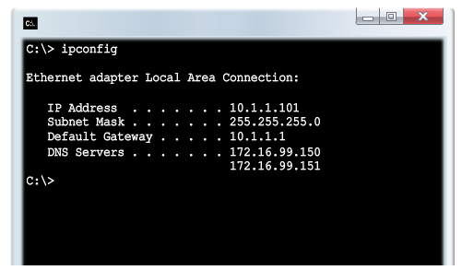
IPv4 Unicast, Broadcast, and Multicast Assigning a Dynamic IPv4 Address to a Host
Verification
DHCP – The preferred method of assigning IPv4 addresses to hosts on large networks because it reduces the burden on network support staff and virtually eliminates entry errors.
Notes:
8.1.3.2 Assigning a Dynamic IPv4 Address to a Host

Slide 18
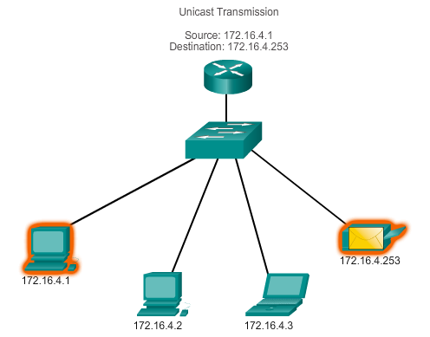
IPv4 Unicast, Broadcast, and Multicast Unicast Transmission
In an IPv4 network, the hosts can communicate one of three different ways:
Unicast, Broadcast, and Multicast
#1 Unicast – the process of sending a packet from one host to an individual host.
Notes:
8.1.3.3 Unicast Transmission

Slide 19
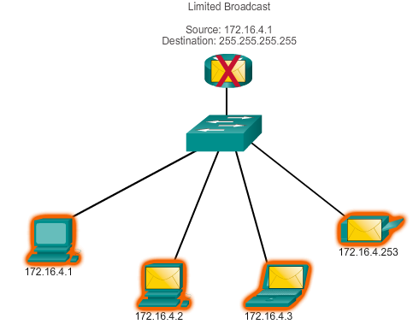
IPv4 Unicast, Broadcast, and Multicast Broadcast Transmission
In an IPv4 network, the hosts can communicate one of three different ways: Unicast, Broadcast, and Multicast.
#2 Broadcast – the process of sending a packet from one host to all hosts in the network.
Directed broadcast
Destination 172.16.4.255
Hosts within the 172.16.4.0/24 network
NOTE: Routers do not forward a limited broadcast!
Directed broadcast
Destination 172.16.4.255
Hosts within the 172.16.4.0/24 network
Notes:
8.1.3.4 Broadcast Transmission

Slide 20
IPv4 Unicast, Broadcast, and Multicast Multicast Transmission
In an IPv4 network, the hosts can communicate one of three different ways: Unicast, Broadcast, and Multicast.
#3 Multicast – The process of sending a packet from one host to a selected group of hosts, possibly in different networks.
Reduces traffic
Reserved for addressing multicast groups – 224.0.0.0 to 239.255.255.255.
Link local – 224.0.0.0 to 224.0.0.255 (Example: routing information exchanged by routing protocols)
Globally scoped addresses – 224.0.1.0 to 238.255.255.255 (Example: 224.0.1.1 has been reserved for Network Time Protocol)
Notes:
8.1.3.5 Multicast Transmission

Slide 21
Types of IPv4 Address Public and Private IPv4 Addresses
Private address blocks are:
Hosts that do not require access to the Internet can use private addresses
10.0.0.0 to 10.255.255.255 (10.0.0.0/8)
172.16.0.0 to 172.31.255.255 (172.16.0.0/12)
192.168.0.0 to 192.168.255.255 (192.168.0.0/16)
Shared address space addresses:
Not globally routable
Intended only for use in service provider networks
Address block is 100.64.0.0/10
Notes:
8.1.4.1 Public and Private IPv4 Addresses

Slide 22
Types of IPv4 Address Special Use IPv4 Addresses
Network and Broadcast addresses – within each network the first and last addresses cannot be assigned to hosts
Loopback address – 127.0.0.1 a special address that hosts use to direct traffic to themselves (addresses 127.0.0.0 to 127.255.255.255 are reserved)
Link-Local address – 169.254.0.0 to 169.254.255.255 (169.254.0.0/16) addresses can be automatically assigned to the local host
TEST-NET addresses – 192.0.2.0 to 192.0.2.255 (192.0.2.0/24) set aside for teaching and learning purposes, used in documentation and network examples
Experimental addresses – 240.0.0.0 to 255.255.255.254 are listed as reserved
Notes:
8.1.4.3 Special Use IPv4 Addresses

Slide 23
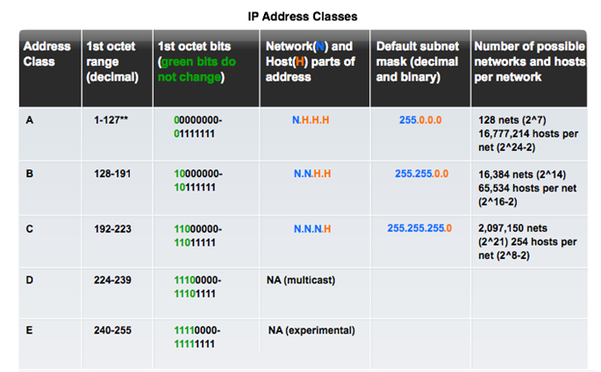
Types of IPv4 Address Legacy Classful Addressing
See if updated graphic with top row in text case for consistency.
Notes:
8.1.4.4 Legacy Classful Addressing

Slide 24
Types of IPv4 Address Legacy Classful Addressing (cont.)
Classless Addressing
Formal name is Classless Inter-Domain Routing (CIDR, pronounced “cider
Created a new set of standards that allowed service providers to allocate IPv4 addresses on any address bit boundary (prefix length) instead of only by a class A, B, or C address
Notes:
8.1.4.4 Legacy Classful Addressing (cont.)

Slide 25
Recourses
Cisco Networking Academy program , Introduction to Networks

