Slide 1
Lecture#3:
Configuring a Network Operating System
Asma AlOSAIMI
Notes:
Cisco Networking Academy program
Introduction to Network
Chapter 2: Configuring a Network Operating System

Slide 2
Objectives
Upon completion of this chapter you will be able to:
Explain the purpose of the Cisco IOS.
Explain how to access and navigate Cisco IOS to configure network devices.
Describe the command structure of the Cisco IOS software.
Configure hostnames on a Cisco IOS device using the CLI.
Use Cisco IOS commands to limit access to device configurations.
Use Cisco IOS commands to save the running configuration.
Explain how devices communicate across network media.
Configure a host device with an IP address.
Configure the port security feature to restrict network access
Verify connectivity between two end devices.
Notes:
Chapter 2 Objectives

Slide 3
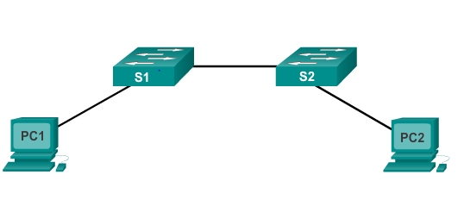
Cisco IOS
Operating Systems
All networking equipment dependent on operating systems
The operating system on home routers is usually called firmware
Cisco IOS – Collection of network operating systems used on Cisco devices
Notes:
2.1.1.1 Operating Systems

Slide 4
Cisco IOS
Purpose of OS
PC operating systems (Windows 8 and OS X) perform technical functions that enable:
  Use of a mouse
  View output
  Enter text
Switch or router IOS provides options to:
  Configure interfaces
  Enable routing and switching functions
All networking devices come with a default IOS
Possible to upgrade the IOS version or feature set
In this course, primary focus is Cisco IOS Release 15.x
Notes:
2.1.1.2 Purpose of OS

Slide 5
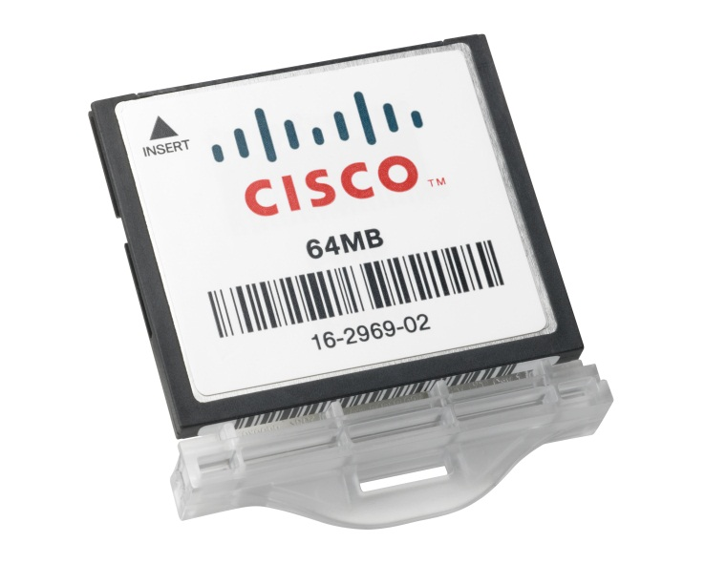
Cisco IOS
Location of the Cisco IOS
Cisco IOS stored in Flash
Non-volatile storage, not lost when power is lost
Can be changed or overwritten as needed
Can be used to store multiple versions of IOS
IOS copied from flash to volatile RAM
Quantity of flash and RAM memory determines IOS that can be used
Notes:
2.1.1.3 Location of the Cisco IOS

Slide 6
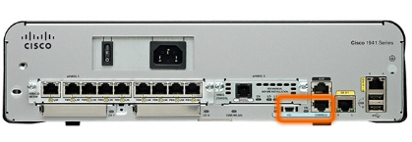
Accessing a Cisco IOS Device
Access the CLI
Most common methods to access the CLI:
Console
Telnet or SSH
AUX port
Notes:
2.1.2.1 Console Access Method

Slide 7
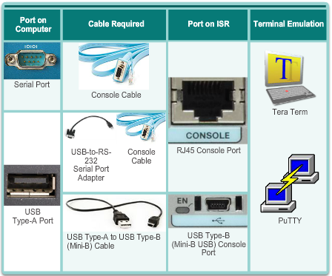
Accessing a Cisco IOS Device
Console Access
Console access requires:
Console cable – RJ-45-to-DB-9 console cable
Terminal emulation software – Tera Term, PuTTY, HyperTerminal
4.1.2.6
Do buttons on 4.1.2.6
Notes:
7
4.1.2 Connect Devices
4.1.2.6 Console Access

Slide 8
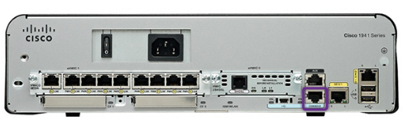
Accessing a Cisco IOS Device
Console Access Method
Console Port
Device is accessible even if no networking services have been configured (out-of-band)
Need a special console cable
Allows configuration commands to be entered
Should be configured with passwords to prevent unauthorized access
Device should be located in a secure room so console port cannot be easily accessed
Notes:
2.1.2.1 Console Access Method
Out-of-band access refers to access via a dedicated management channel that is used for device maintenance purposes only.
In the event that a password is lost, there is a special set of procedures for bypassing the password and accessing the device.

Slide 9
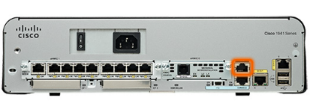

Accessing a Cisco IOS Device
Telnet, SSH, and AUX Access Methods
Telnet
Method for remotely accessing the CLI over a network
Require active networking services and one active interface that is configured
Secure Shell (SSH)
Remote login similar to Telnet, but utilizes more security
Stronger password authentication
Uses encryption when transporting data
Aux Port
Out-of-band connection
Uses telephone line
Can be used like console port
Notes:
2.1.2.2 Telnet, SSH, and AUX Access Methods

Slide 10
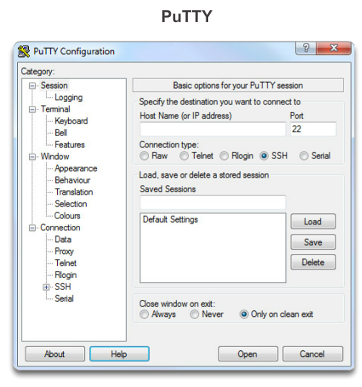
Accessing a Cisco IOS Device
Terminal Emulation Programs
Software available for connecting to a networking device:
PuTTY
Tera Term
SecureCRT
HyperTerminal
OS X Terminal
Notes:
2.1.2.3 Terminal Emulation Programs
There are a number of excellent terminal emulation programs available for connecting to a networking device either by a serial connection over a console port or by an SSH connection. Some of these include:
PuTTY
Tera Term
SecureCRT
HyperTerminal
OS X Terminal
There are a number of excellent terminal emulation programs available for connecting to a networking device either by a serial connection over a console port or by an SSH connection.
Each network technician tends to have a favorite terminal emulation program that they use exclusively. These programs allow you to enhance your productivity by adjusting window sizes, changing font sizes, and changing color schemes

Slide 11
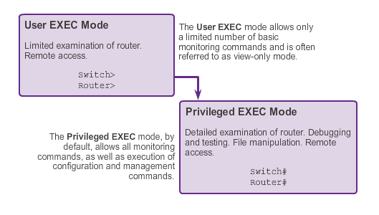
Navigating the IOS
Primary Modes
Notes:
2.1.3.2 Primary Modes
The two primary modes of operation are user EXEC mode and privileged EXEC mode. Tthe privileged EXEC mode has a higher level of authority in what it allows the user to do with the device.
User EXEC Mode
The user EXEC mode has limited capabilities but is useful for some basic operations. This mode is the first mode encountered upon entrance into the CLI of an IOS device.
This is often referred to as view-only mode. The user EXEC level does not allow the execution of any commands that might change the configuration of the device.
By default, there is no authentication required to access the user EXEC mode from the console. However, it is a good practice to ensure that authentication is configured during the initial configuration.
The user EXEC mode is identified by the CLI prompt that ends with the > symbol. This is an example that shows the > symbol in the prompt: Switch>
Privileged EXEC Mode
The execution of configuration and management commands requires that the network administrator use the privileged EXEC mode, or a more specific mode in the hierarchy.
The privileged EXEC mode can be identified by the prompt ending with the #symbol. Switch#
By default, privileged EXEC mode does not require authentication.
Global configuration mode and all other more specific configuration modes can only be reached from the privileged EXEC mode.

Slide 12
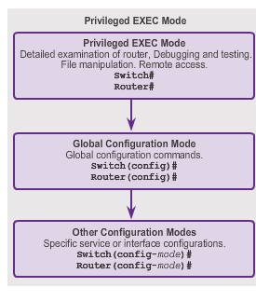
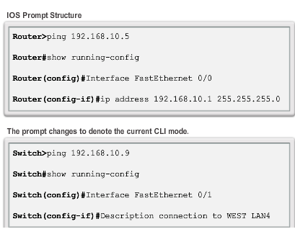
Navigating the IOS
Global Configuration Mode and Submodes
Notes:
2.1.3.3 Global Configuration Mode and Submodes
Global configuration mode and interface configuration modes can only be reached from the privileged EXEC mode.
From global config, CLI configuration changes are made that affect the operation of the device as a whole.
Switch# configure terminal
Switch(config)#
From the global config mode, the user can enter different subconfiguration modes. Each of these modes allows the configuration of a particular part or function of the IOS device.
Interface mode - to configure one of the network interfaces (Fa0/0, S0/0/0)
Line mode - to configure one of the physical or virtual lines (console, AUX, VTY)
To exit a specific configuration mode and return to global configuration mode, enter exit at a prompt. To leave configuration mode completely and return to privileged EXEC mode, enter end or use the key sequence Ctrl-Z.
As commands are used and modes are changed, the prompt changes to reflect the current context.

Slide 13
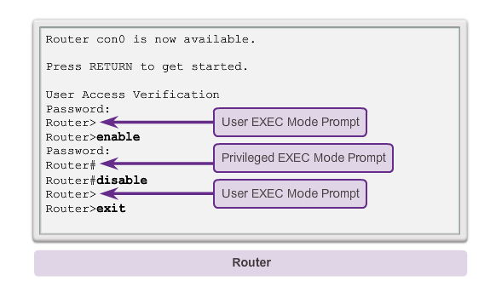
Navigating the IOS
Navigating Between IOS Modes
Notes:
2.1.3.4 Navigating between IOS Modes
The enable and disable commands are used to change the CLI between the user EXEC mode and the privileged EXEC mode, respectively.

Slide 14
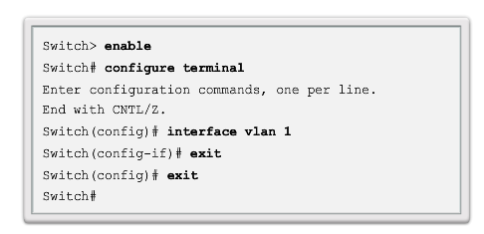
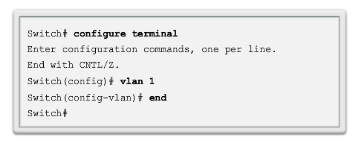
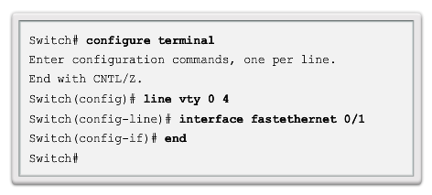
Navigating the IOS
Navigating Between IOS Modes (cont.)
global configuration mode → the privileged EXEC :exit.
any submode of the global configuration mode → the mode one step above it in the hierarchy of modes: exit
To move from any submode of the privileged EXEC mode -→ the privileged EXEC mode,:end or Ctrl+Z.
To move from any submode of the global configuration mode to another “immediate” submode of the global configuration mode, simply enter the corresponding command that is normally entered from global configuration mode
Notes:
2.1.3.5 Navigating between IOS Modes (cont.)
To move from the global configuration mode to the privileged EXEC mode, you enter the command exit.
To move from any submode of the global configuration mode to the mode one step above it in the hierarchy of modes, enter the exit command.
To move from any submode of the privileged EXEC mode to the privileged EXEC mode, enter the end command or enter the key combination Ctrl+Z.
To move from any submode of the global configuration mode to another “immediate” submode of the global configuration mode, simply enter the corresponding command that is normally entered from global configuration mode

Slide 15
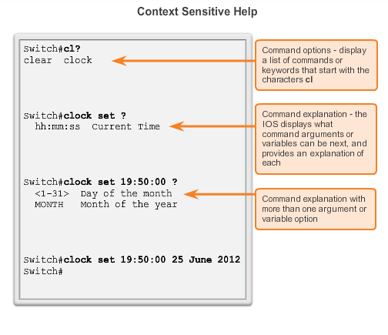
The Command Structure
Context-Sensitive Help
Notes:
2.1.4.3 Context Sensitive Help
The IOS has several forms of help available:
Context-sensitive help
Command Syntax Check
Hot Keys and Shortcuts

Slide 16
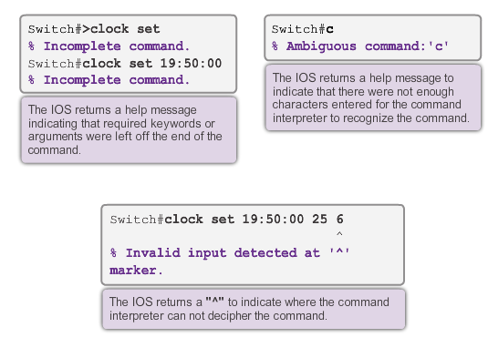
The Command Structure
Command Syntax Check
Notes:
2.1.4.4 Command Syntax Check
There are three different types of error messages:
Ambiguous command
Incomplete command
Incorrect command

Slide 17
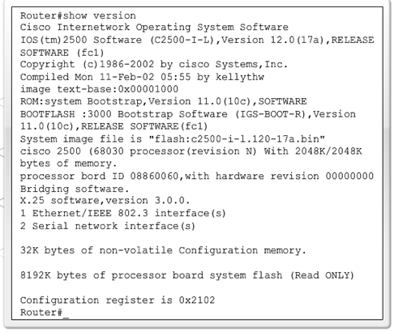
The Command Structure
The show version Command
Cisco IOS Version
System Bootstrap
Cisco IOS Image
CPU and RAM
Number and Type of Physical Interfaces
Amount of NVRAM
Amount of Flash
Configuration Register
Notes:
11.3.3.2 Viewing Router Settings with the Show Version Command

Slide 18
Basic Switch Configuration
Switch Boot Sequence
POST
Run boot loader software
Boot loader does low-level CPU initialization
Boot loader initializes the flash filesystem
Boot loader locates and loads a default IOS operating system software image into memory and hands control of the switch over to the IOS.
2.0.1.1
Notes:
18
2.1 Basic Switch Configuration
2.1.1 Configure a Switch With Initial Settings
2.1.1.1 Switch Boot Sequence

Slide 19
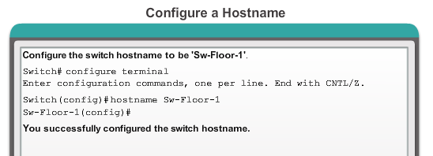
Basic Switch Configuration
Configuring Hostnames
Start with a letter
Contains no spaces
Ends with a letter or digit
Uses only letters, digits, and dashes
Be less than 64 characters in length
Notes:
2.2.1.4 Configuring Hostnames

Slide 20
Basic Switch Configuration
Securing Device Access
These are device access passwords:
enable password – Limits access to the privileged EXEC mode
enable secret – Encrypted, limits access to the privileged EXEC mode
console password – Limits device access using the console connection
VTY password – Limits device access over Telnet
Note: In most of the labs in this course, we will be using simple passwords such as cisco or class.
Notes:
2.2.2.1 Securing Device Access
Consider these key points when choosing passwords:
Use passwords that are more than eight characters in length.
Use a combination of upper and lowercase letters, numbers, special characters, and/or numeric sequences in passwords.
Avoid using the same password for all devices.
Avoid using common words such as password or administrator, because these are easily guessed

Slide 21
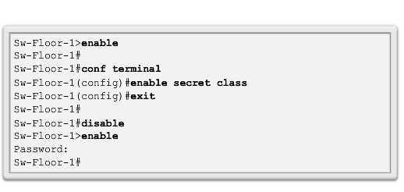
Basic Switch Configuration
Securing Privileged EXEC Access Mode
Use the enable secret command, not the older enable password command.
The enable secret command provides greater security because the password is encrypted.
Notes:
2.2.2.2 Securing Privileged EXEC Access

Slide 22
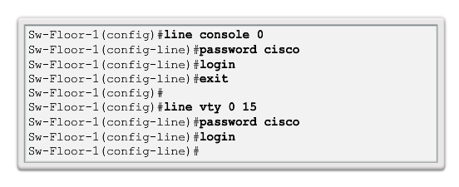
Basic Switch Configuration
Securing User EXEC Access
Console port must be secured; it reduces the chance of unauthorized personnel physically plugging a cable into the device and gaining device access.
VTY lines allow access to a Cisco device via Telnet. The number of VTY lines supported varies with the type of device and the IOS version.
Notes:
2.2.2.3 Securing User EXEC Access

Slide 23
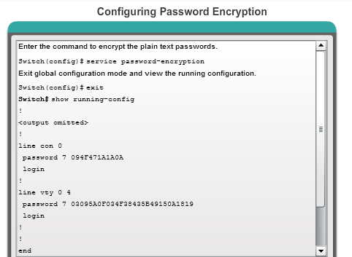
Basic Switch Configuration
Encrypting Password Display
service password-encryption
Prevents passwords from showing up as plain text when viewing the configuration
Keeps unauthorized individuals from viewing passwords in the configuration file
Once applied, removing the encryption service does not reverse the encryption
Notes:
2.2.2.4 Encrypting Password Display

Slide 24
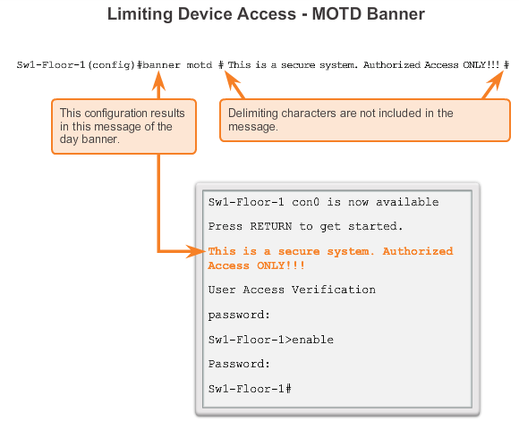
Basic Switch Configuration
Banner Messages
Important part of the legal process in the event that someone is prosecuted for breaking into a device
Wording that implies that a login is "welcome" or "invited" is not appropriate
Often used for legal notification because it is displayed to all connected terminals
Notes:
2.2.2.5 Banner Messages

Slide 25
Basic Switch Configuration
Preparing for Basic Switch Management
In order to remotely manage a Cisco switch, it needs to be configured to access the network
An IP address and a subnet mask must be configured
If managing the switch from a remote network, a default gateway must also be configured
The IP information (address, subnet mask, gateway) is to be assigned to a switch SVI (switch virtual interface)
Although these IP settings allow remote management and remote access to the switch, they do not allow the switch to route Layer 3 packets.
2.1.1.4
Notes:
25
2.1 Basic Switch Configuration
2.1.1 Configure a Switch With Initial Settings
2.1.1.4 Preparing for Basic Switch Management

Slide 26
Addressing Devices
Configuring a Switch Virtual Interface
IP address – Together with subnet mask, uniquely identifies end device on internetwork.
Subnet mask – Determines which part of a larger network is used by an IP address.
interface VLAN 1 – Available in interface configuration mode,
ip address 192.168.10.2 255.255.255.0 – Configures the IP address and subnet mask for the switch.
no shutdown – Administratively enables the interface.
Switch still needs to have physical ports configured and VTY lines to enable remote management.
Notes:
2.3.2.1 Configuring a Switch Virtual Interface

Slide 27
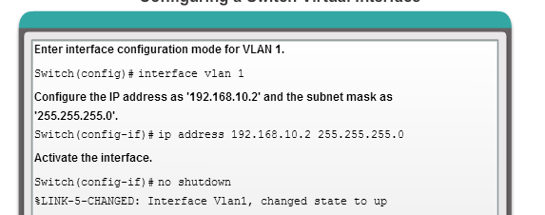
Basic Switch Configuration
Configuring a Switch Virtual Interface
Notes:
2.3.2.1 Configuring a Switch Virtual Interface

Slide 28
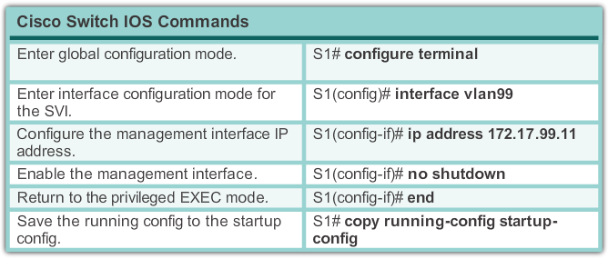
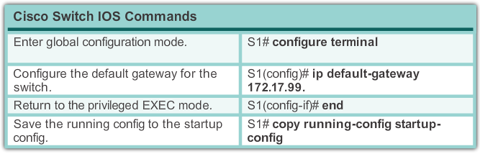
Basic Switch Configuration
Preparing for Basic Switch Management
2.1.1.5
Do the Buttons on 2.1.1.5
Notes:
28
2.1 Basic Switch Configuration
2.1.1 Configure a Switch With Initial Settings
2.1.1.5 Preparing for Basic Switch Management

Slide 29
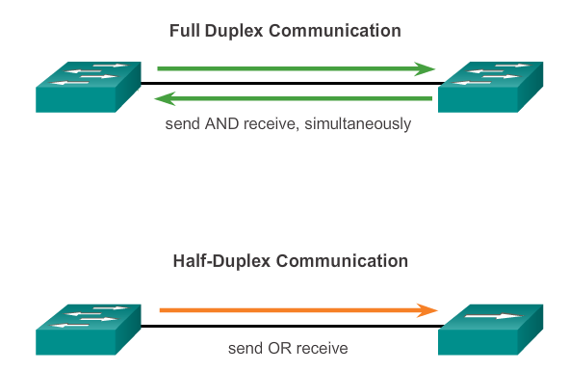
Configure Switch Ports
Duplex Communication
2.1.2.1
Notes:
29
2.1 Basic Switch Configuration
2.1.2 Configure Switch Ports
2.1.2.1 Duplex Communication

Slide 30
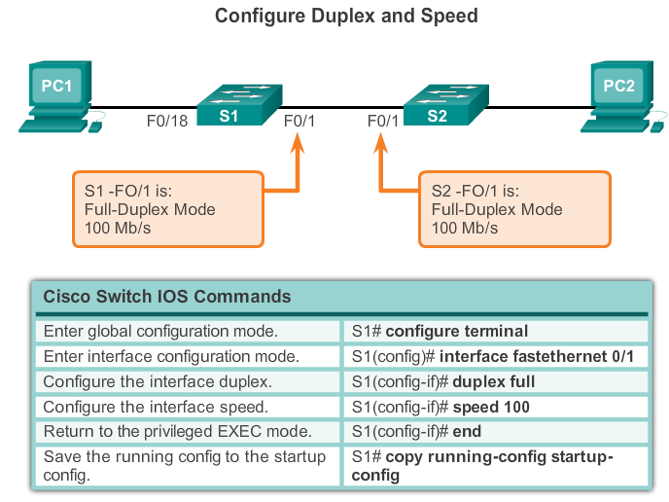
Configure Switch Ports
Configure Switch Ports at the Physical Layer
Do the Buttons on 2.1.2.2
Students do button 2
2.1.2.2
Notes:
30
2.1 Basic Switch Configuration
2.1.2 Configure Switch Ports
2.1.2.2 Configure Switch Ports at the Physical Layer

Slide 31
Configure Switch Ports
MDIX Auto Feature
Certain cable types (straight-through or crossover) were required when connecting devices
The automatic medium-dependent interface crossover (auto-MDIX) feature eliminates this problem
When auto-MDIX is enabled, the interface automatically detects and configures the connection appropriately
When using auto-MDIX on an interface, the interface speed and duplex must be set to auto
2.1.2.3
Notes:
31
2.1 Basic Switch Configuration
2.1.2 Configure Switch Ports
2.1.2.3 MDIX Auto Feature

Slide 32
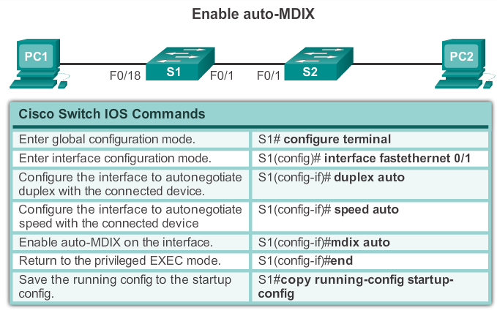
Configure Switch Ports
MDIX Auto Feature
2.1.2.3
Notes:
32
2.1 Basic Switch Configuration
2.1.2 Configure Switch Ports
2.1.2.3 MDIX Auto Feature

Slide 33
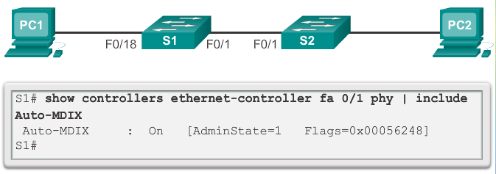
Configure Switch Ports
MDIX Auto Feature
2.1.2.3
Notes:
33
2.1 Basic Switch Configuration
2.1.2 Configure Switch Ports
2.1.2.3 MDIX Auto Feature

Slide 34
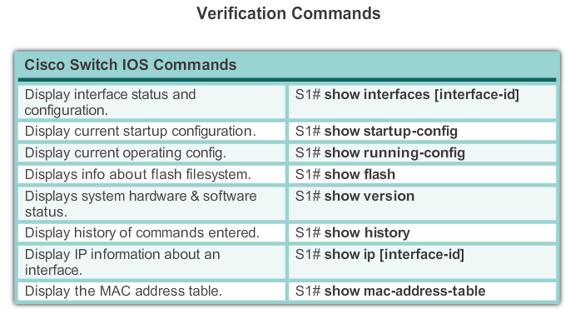
Configure Switch Ports
Verifying Switch Port Configuration
2.1.2.4
Do the Buttons on 2.1.2.4
Notes:
34
2.1 Basic Switch Configuration
2.1.2 Configure Switch Ports
2.1.2.4 Verifying Switch Port Configuration

Slide 35
Secure Remote Access
SSH Operation
Secure Shell (SSH) is a protocol that provides a secure (encrypted) command-line based connection to a remote device
SSH is commonly used in UNIX-based systems
Cisco IOS also supports SSH
A version of the IOS software including cryptographic (encrypted) features and capabilities is required in order to enable SSH on Catalyst 2960 switches
Because its strong encryption features, SSH should replace Telnet for management connections
SSH uses TCP port 22 by default. Telnet uses TCP port 23
2.2.1.1
Do the Buttons on 2.2.1.1
Notes:
35
2.2 Switch Security: Management and Implementation
2.2.1 Secure Remote Access
2.2.1.1 SSH Operation

Slide 36
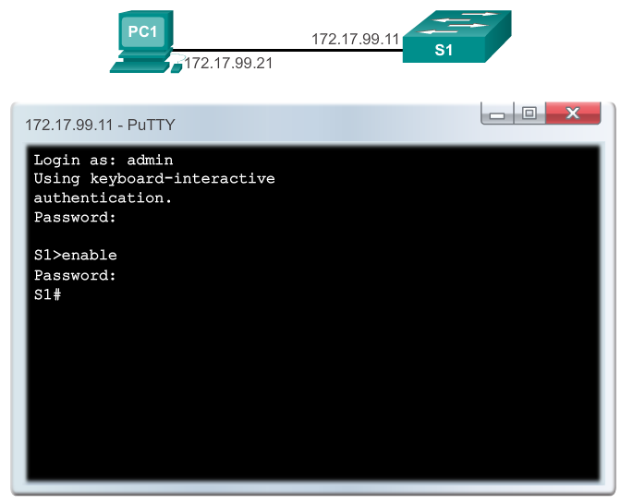
Secure Remote Access
SSH Operation
2.2.1.1
Do the Buttons on 2.2.1.1
Notes:
36
2.2 Switch Security: Management and Implementation
2.2.1 Secure Remote Access
2.2.1.1 SSH Operation

Slide 37
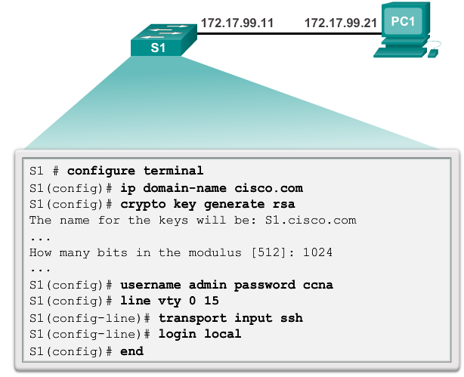
Secure Remote Access
Configuring SSH
2.2.1.2
Do the Buttons on 2.2.1.2
Students do button 2
Notes:
37
2.2 Switch Security: Management and Implementation
2.2.1 Secure Remote Access
2.2.1.2 Configuring SSH

Slide 38
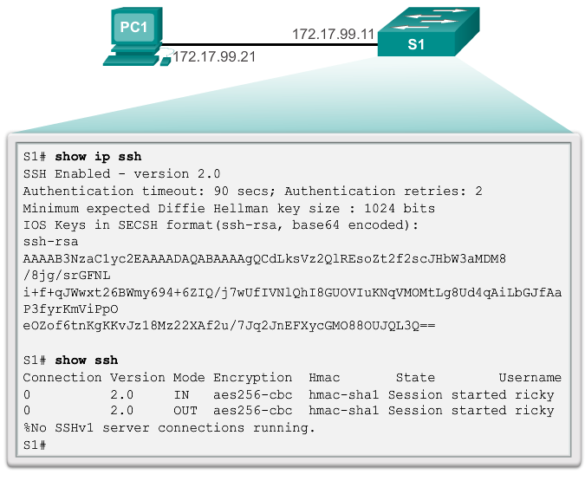
Secure Remote Access
Verifying SSH
2.2.1.3
Do the Buttons on 2.2.1.3
Notes:
38
2.2 Switch Security: Management and Implementation
2.2.1 Secure Remote Access
2.2.1.3 Verifying SSH

Slide 39
Switch Port Security
Port Security: Operation
Port security limits the number of valid MAC addresses
allowed on a port
The MAC addresses of legitimate devices are allowed
access, while other MAC addresses are denied
Any additional attempts to connect by unknown MAC
addresses will generate a security violation
Secure MAC addresses can be configured in a number
of ways:
  Static secure MAC addresses
  Dynamic secure MAC addresses
  Sticky secure MAC addresses
2.2.4.3
Do the Buttons on 2.2.4.3
Notes:
39
2.2 Switch Security: Management and Implementation
2.2.4 Switch Port Security
2.2.4.3 Port Security: Operation

Slide 40
Switch Port Security
Port Security: Violation Modes
IOS considers a security violation when either of these situations occurs:
The maximum number of secure MAC addresses for that interface have been added to the CAM, and a station whose MAC address is not in the address table attempts to access the interface.
An address learned or configured on one secure interface is seen on another secure interface in the same VLAN.
There are three possible action to be taken when a violation is detected:
    Protect
    Restrict
    Shutdown
2.2.4.4
Notes:
40
2.2 Switch Security: Management and Implementation
2.2.4 Switch Port Security
2.2.4.4 Port Security: Violation Modes

Slide 41
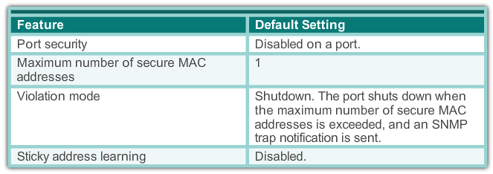
Switch Port Security
Port Security: Configuring
Dynamic Port Security Defaults
2.2.4.5
Do the Buttons on 2.2.4.5
Notes:
41
2.2 Switch Security: Management and Implementation
2.2.4 Switch Port Security
2.2.4.5 Port Security: Configuring

Slide 42
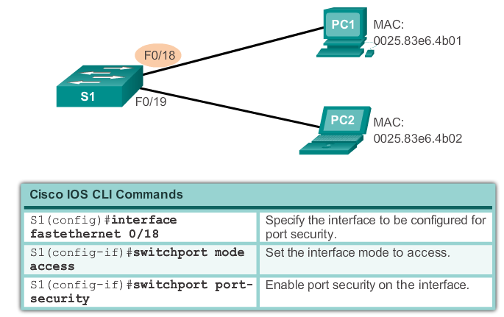
Switch Port Security
Port Security: Configuring
Configuring Dynamic Port Security
2.2.4.5
Notes:
42
2.2 Switch Security: Management and Implementation
2.2.4 Switch Port Security
2.2.4.5 Port Security: Configuring

Slide 43
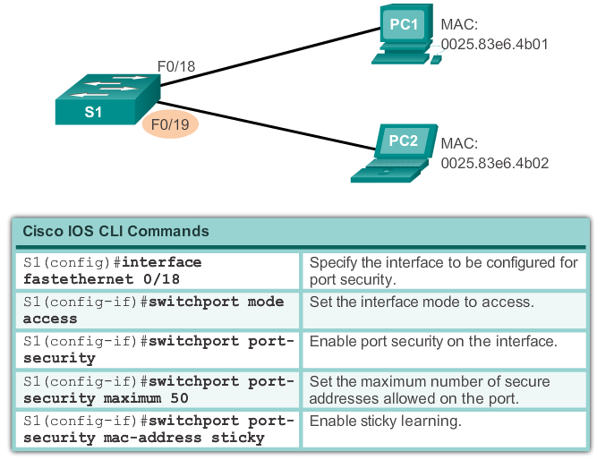
Switch Port Security
Port Security: Configuring
Configuring Port Security Sticky
2.2.4.5
Notes:
43
2.2 Switch Security: Management and Implementation
2.2.4 Switch Port Security
2.2.4.5 Port Security: Configuring

Slide 44
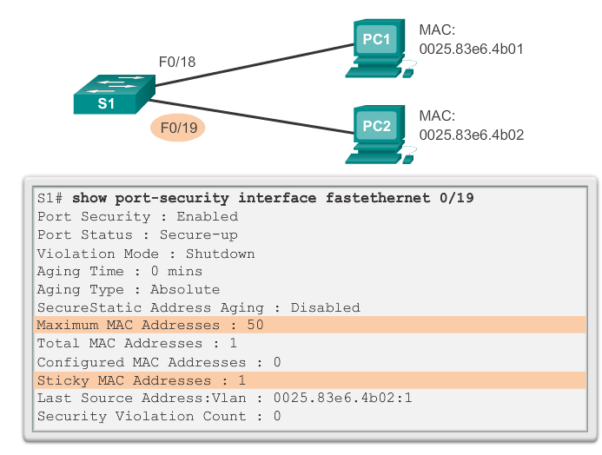
Switch Port Security
Port Security: Verifying
Verifying Port Security Sticky
2.2.4.6
Do the Buttons on 2.2.4.6
Notes:
44
2.2 Switch Security: Management and Implementation
2.2.4 Switch Port Security
2.2.4.6 Port Security: Verifying

Slide 45
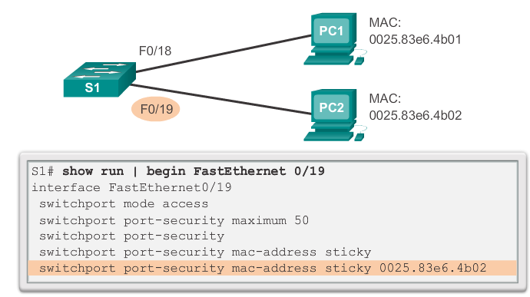
Switch Port Security
Port Security: Verifying
Verifying Port Security Sticky – Running Config
2.2.4.6
Notes:
45
2.2 Switch Security: Management and Implementation
2.2.4 Switch Port Security
2.2.4.6 Port Security: Verifying

Slide 46
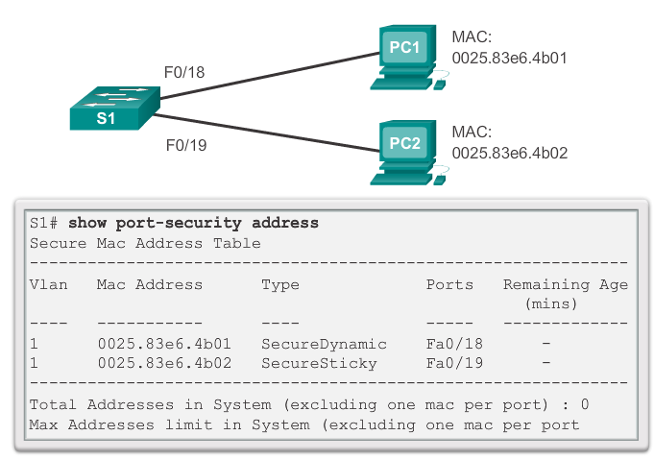
Switch Port Security
Port Security: Verifying
Verifying Port Security Secure MAC Addresses
2.2.4.6
Notes:
46
2.2 Switch Security: Management and Implementation
2.2.4 Switch Port Security
2.2.4.6 Port Security: Verifying

Slide 47
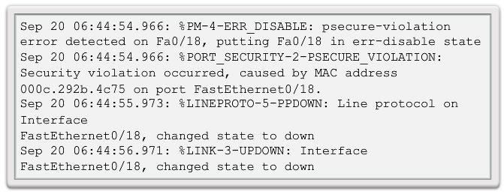
Switch Port Security
Ports In Error Disabled State
A port security violation can put a switch in error disabled state
A port in error disabled is effectively shut down
The switch will communicate these events through console messages
2.2.4.7
Do the Buttons on 2.2.4.7
Notes:
47
2.2 Switch Security: Management and Implementation
2.2.4 Switch Port Security
2.2.4.7 Ports In Error Disabled State

Slide 48
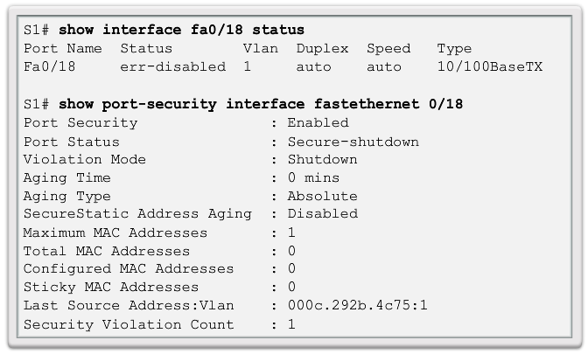
Switch Port Security
Ports In Error Disabled State
The show interface command also reveals a switch port
on error disabled state
2.2.4.7
Notes:
48
2.2 Switch Security: Management and Implementation
2.2.4 Switch Port Security
2.2.4.7 Ports In Error Disabled State

Slide 49
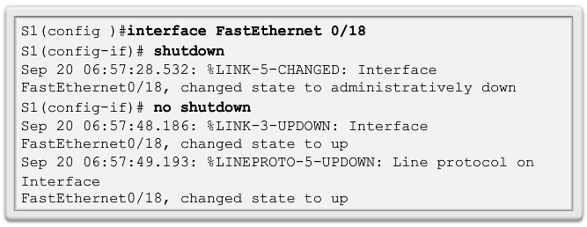
Switch Port Security
Ports In Error Disabled State
A shutdown/no shutdown interface command must be issued to re-enable the port
2.2.4.7
Notes:
49
2.2 Switch Security: Management and Implementation
2.2.4 Switch Port Security
2.2.4.7 Ports In Error Disabled State

Slide 50
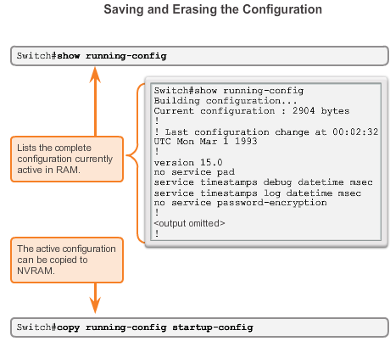
Saving Configurations
Configuration Files
Switch# reload
  System configuration has been modified. Save? [yes/no]: n
  Proceed with reload? [confirm]
Startup configuration is removed by using the erase startup-config
  Switch# erase startup-config
On a switch, you must also issue the delete vlan.dat
  Switch# delete vlan.dat
  Delete filename [vlan.dat]?
  Delete flash:vlan.dat? [confirm]
Notes:
2.2.3.1 Configuration Files
Switch# erase startup-config
After the command is issued, the switch will prompt you for confirmation:
Erasing the nvram filesystem will remove all configuration files! Continue? [confirm]
Confirm is the default response. To confirm and erase the startup configuration file, press . Pressing any other key will abort the process.

Slide 51
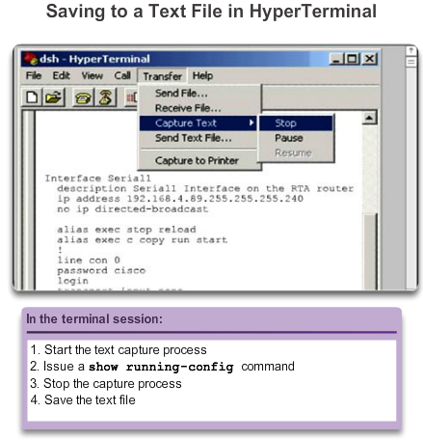
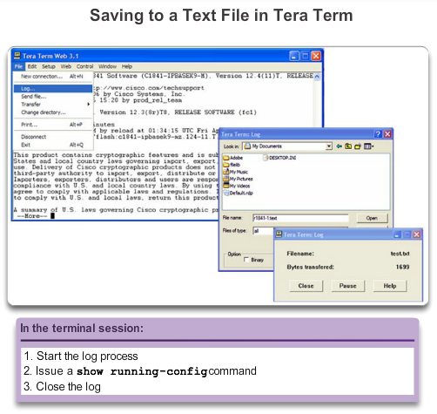
Saving Configurations
Capturing Text
Notes:
2.2.3.2 Capturing Text
Restoring Text Configurations
A configuration file can be copied from storage to a device. When copied into the terminal, the IOS executes each line of the configuration text as a command. This means that the file will require editing to ensure that encrypted passwords are in plain text and that non-command text such as "--More--" and IOS messages are removed. This process is discussed in the lab.
Further, at the CLI, the device must be set at the global configuration mode to receive the commands from the text file being copied.
When using HyperTerminal, the steps are:
Locate the file to be copied into the device and open the text document.
Copy all of the text.
On the Edit menu, click paste to host.
When using TeraTerm, the steps are:
On the File menu, click Send file.
Locate the file to be copied into the device and click Open.
TeraTerm will paste the file into the device.

Slide 52
Addressing Schemes
Notes:
2.3 Addressing Schemes

Slide 53
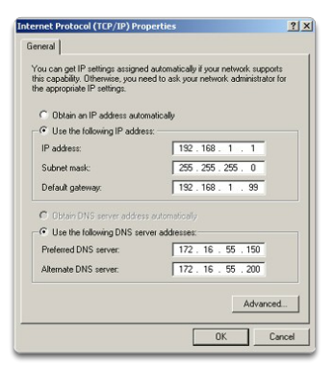
Ports and Addresses
IP Addressing of Devices
Each end device on a network must be configured with an IP address.
Structure of an IPv4 address is called dotted decimal.
IP address displayed in decimal notation, with four decimal numbers between 0 and 255.
With the IP address, a subnet mask is also necessary.
IP addresses can be assigned to both physical ports and virtual interfaces.
Notes:
2.3.1.1 IP Addressing of Devices

Slide 54
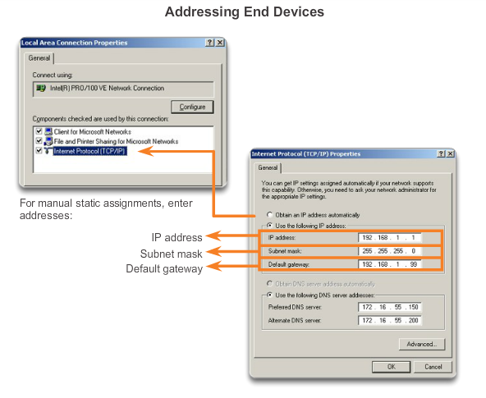
Addressing Devices
Manual IP Address Configuration for End Devices
Notes:
2.3.2.2 Manual IP Address Configuration for End Devices

Slide 55
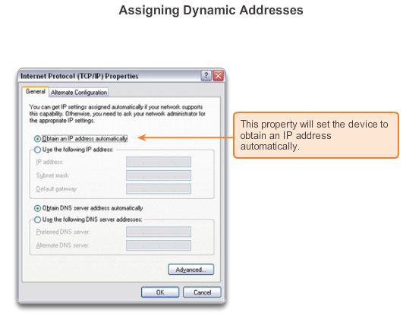
Addressing Devices
Automatic IP Address Configuration for End Devices
Notes:
2.3.2.3 Automatic IP Address Configuration for End Devices

Slide 56
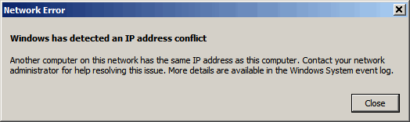
Addressing Devices
IP Address Conflicts
Notes:
2.3.2.4 IP Address Conflicts

Slide 57
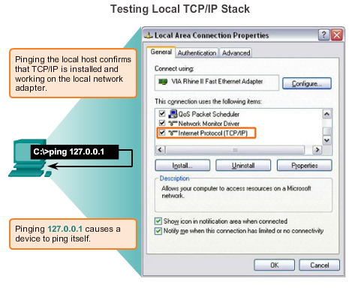
Verifying Connectivity
Test the Loopback Address on an End Device
Notes:
2.3.3.1 Test the Loopback Address on an End Device

Slide 58

Verifying Connectivity
Testing the Interface Assignment
Notes:
2.3.3.2 Testing the Interface Assignment

Slide 59

Verifying Connectivity
Testing End-to-End Connectivity
Notes:
2.3.3.3 Testing End-to-End Connectivity

Slide 60

Managing Devices
Basic Switch CLI Commands
Hostname
Passwords
In-Band access requires the Switch to have an IP address (assigned to VLAN 1).
Save configuration – copy running-config startup-config command.
To clear switch – erase startup-config, and then reload.
To erase VLAN information – delete flash:vlan.dat.
Notes:
1.2.3.5 Basic Switch CLI commands

Slide 61

Basic Router CLI commands
Basic router configuration includes:
Hostname
Passwords (console, Telnet/SSH, and privileged mode)
Interface IP addresses
Enabling a routing protocol
Notes:
1.2.3.3 Basic Router CLI commands

Slide 62
Recourses
Cisco Networking Academy program , Introduction to Networks

