Slide 1
Lecture#2:
Network Devices
ct1304 Asma AlOsaimi

Slide 2
Devices and the layers at which they operate
Layer | Name of Layer | Device
3 | Network | Routers, layer 3 switches
2 | Data Link | Switches, bridges, NIC’s
1 | Physical | Hubs

Slide 3
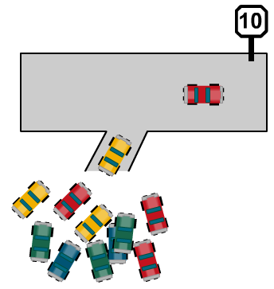
Hubs
Layer 1 devices
Regenerate, retime, amplify signals
1 collision/bandwidth domain
Broadcasts propagated out of every port
Only 1 device can transmit at a time
Only 50-60% bandwidth available

Slide 4
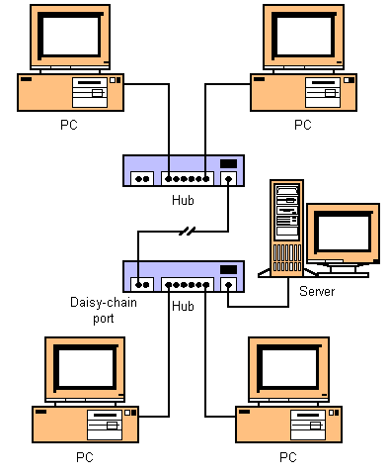
Sending and receiving Ethernet frames via a hub
•
3333
1111
So, what does a hub do when it receives information?
Remember, a hub is nothing more than a multiport repeater.
1111
?
2222
5555
3333
4444

Slide 5
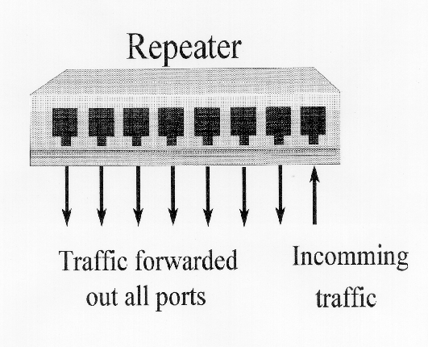
Sending and receiving Ethernet frames via a hub
•
Hub or

Slide 6
Sending and receiving Ethernet frames via a hub
•
3333
1111
The hub will flood it out all ports except for the incoming port.
Hub is a layer 1 device.
A hub does NOT look at layer 2 addresses, so it is fast in transmitting data.
Disadvantage with hubs: A hub or series of hubs is a single collision domain.
A collision will occur if any two or more devices transmit at the same time within the collision domain.
More on this later.
1111
2222
Nope
5555
Nope
3333
For me!
4444
Nope

Slide 7
Sending and receiving Ethernet frames via a hub
•
2222
1111
Another disadvantage with hubs is that is take up unnecessary bandwidth on other links.
1111
2222
For me!
5555
Wasted bandwidth
Nope
3333
Nope
4444
Nope

Slide 8
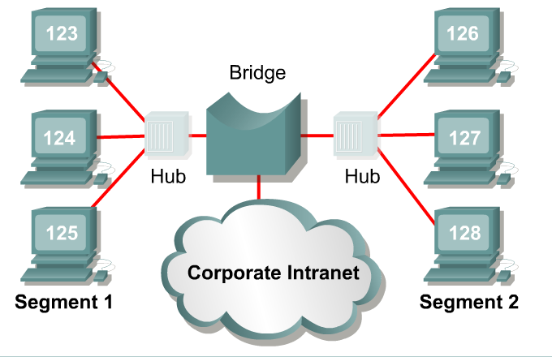
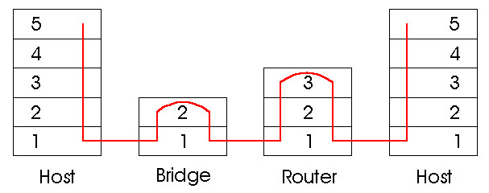
Bridges
Layer 2 device
Splits network into 2 collision/bandwidth domains
Broadcasts are forwarded
Local traffic stays local
Checks Layer 2 MAC addresses in 802.3 frame

Slide 9
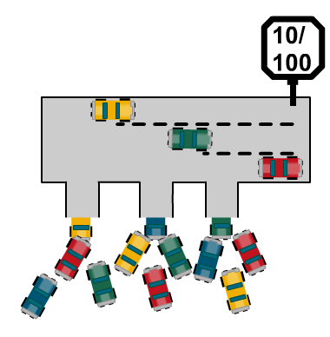
Switches
Layer 2 device
Learns MAC addresses of devices attached to each port
Each switchport is a collision domain
More collision domains BUT smaller collision domains
Broadcasts still sent out of every port
Each switchport has dedicated bandwidth
100% bandwidth available

Slide 10
Switch’s functions
There are two functions :
Address learning
  switches and bridges remember the source hardware address of each frame received on an interface and enter this information into a MAC database.
Forward/filter decisions
  When a frame is received on an interface, the switch looks at the destination hardware address and finds the exit interface in the MAC database.

Slide 11
The Address Learning Function
Initially, the MAC address table of the switch is empty.
When a device transmits and an interface receives a frame, the switch places the source address in the MAC filtering table (it it is not already exist), remembering what interface the device is located on.

Slide 12

Sending and receiving Ethernet frames via a switch
•
Source Address Table
Port Source MAC Add. Port Source MAC Add.
3333
1111
Switches are also known as learning bridges or learning switches.
A switch has a source address table in cache (RAM) where it stores source MAC address after it learns about them.
A MAC address table, sometimes called a Content Addressable Memory (CAM) table,
A switch receives an Ethernet frame it searches the source address table for the Destination MAC address.
If it finds a match, it filters the frame by only sending it out that port.
If there is not a match if floods it out all ports.
switch
1111
3333
Abbreviated MAC addresses
2222
4444

Slide 13
No Destination Address in table, Flood
•
Source Address Table
Port Source MAC Add. Port Source MAC Add.
1 1111
3333
1111
How does it learn source MAC addresses?
First, the switch will see if the SA (1111) is in it’s table.
If it is, it resets the timer (more in a moment).
If it is NOT in the table it adds it, with the port number.
Next, in our scenario, the switch will flood the frame out all other ports, because the DA is not in the source address table.
switch
1111
3333
Abbreviated MAC addresses
2222
4444

Slide 14
Destination Address in table, Filter
•
Source Address Table
Port Source MAC Add. Port Source MAC Add.
1 1111 6 3333
1111
3333
Most communications involve some sort of client-server relationship or exchange of information. (You will understand this more as you learn about TCP/IP.)
Now 3333 sends data back to 1111.
The switch sees if it has the SA stored.
It does NOT so it adds it. (This will help next time 1111 sends to 3333.)
Next, it checks the DA and in our case it can filter the frame, by sending it only out port 1.
switch
1111
3333
Abbreviated MAC addresses
2222
4444

Slide 15
Destination Address in table, Filter
•
Source Address Table
Port Source MAC Add. Port Source MAC Add.
1 1111 6 3333
3333
1111
switch
1111
3333
Now, because both MAC addresses are in the switch’s table, any information exchanged between 1111 and 3333 can be sent (filtered) out the appropriate port.
What happens when two devices send to same destination?
What if this was a hub?
Where is (are) the collision domain(s) in this example?
1111
3333
Abbreviated MAC addresses
2222
4444

Slide 16
No Collisions in Switch, Buffering
•
Source Address Table
Port Source MAC Add. Port Source MAC Add.
1 1111 6 3333
9 4444
3333
1111
switch
3333
4444
Unlike a hub, a collision does NOT occur, which would cause the two PCs to have to retransmit the frames.
Instead the switch buffers the frames and sends them out port #6 one at a time.
The sending PCs have no idea that their was another PC wanting to send to the same destination.
1111
3333
Abbreviated MAC addresses
2222
4444

Slide 17
Collision Domains
•
Source Address Table
Port Source MAC Add. Port Source MAC Add.
1 1111 6 3333
9 4444
3333
1111
Collision Domains
switch
3333
4444
When there is only one device on a switch port, the collision domain is only between the PC and the switch. (Cisco curriculum is inaccurate on this point.)
With a full-duplex PC and switch port, there will be no collision, since the devices and the medium can send and receive at the same time.
1111
3333
Abbreviated MAC addresses
2222
4444

Slide 18
Other Information
•
Source Address Table
Port Source MAC Add. Port Source MAC Add.
1 1111 6 3333
9 4444
How long are addresses kept in the Source Address Table?
  5 minutes is common on most vendor switches.
How do computers know the Destination MAC address?
    ARP Caches and ARP Requests
How many addresses can be kept in the table?
  Depends on the size of the cache, but 1,024 addresses is common.
What about Layer 2 broadcasts?
  Layer 2 broadcasts (DA = all 1’s) is flooded out all ports.
switch
1111
3333
Abbreviated MAC addresses
2222
4444

Slide 19
The Address Learning Function
Example#2

Slide 23
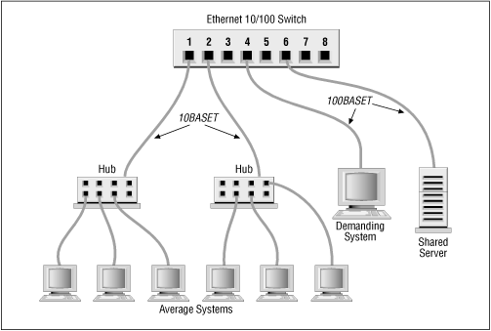
What happens here?
•
Source Address Table
Port Source MAC Add. Port Source MAC Add.
1 1111 6 3333
1 2222 1 3333
1111
3333
Notice the Source Address Table has multiple entries for port #1.
3333
1111
2222
5555

Slide 24
What happens here?
•
Source Address Table
Port Source MAC Add. Port Source MAC Add.
1 1111 6 3333
1 2222 1 5555
1111
3333
The switch filters the frame out port #1.
But the hub is only a layer 1 device, so it floods it out all ports.
Where is the collision domain?
Note: A CAM table may contain multiple entries per port, if a hub or a switch is attached to that port
3333
1111
2222
5555

Slide 25
What happens here?
•
Source Address Table
Port Source MAC Add. Port Source MAC Add.
1 1111 6 3333
1 2222 1 5555
1111
3333
Collision Domain
3333
1111
2222
5555

Slide 26
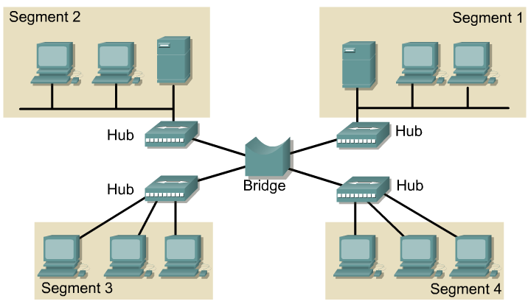
Filter or Flood (Switch)
Switches flood frames that are:
  Unknown unicasts
  Layer 2 broadcasts
  Multicasts (unless running multicast snooping or IGMP)
    Multicast are special layer 2 and layer 3 addresses that are sent to devices that belong to that “group”.

Slide 27
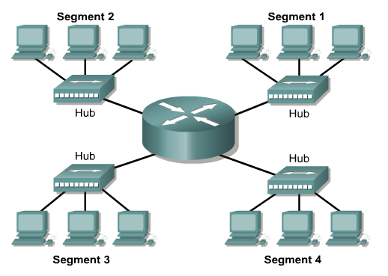

LAN segmentation with routers
•
Routers provide segmentation of networks
operates at the network layer and uses the IP address to determine the best path to the destination node.
Bridges and switches provide segmentation within a single network or subnetwork.
Routers provide connectivity between networks and subnetworks.
Routers also do not forward broadcasts while switches and bridges must forward broadcast frames.

Slide 28
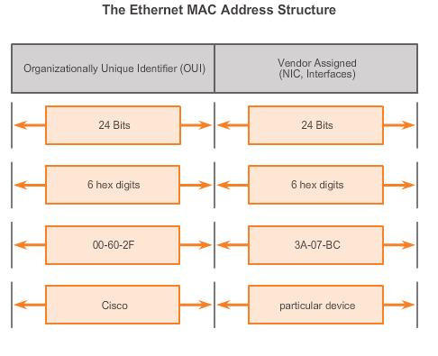
Ethernet Operation
MAC Address: Ethernet Identity
Layer 2 Ethernet MAC address is a 48-bit binary value expressed as 12 hexadecimal digits
Notes:
Section 5.1.1.4

Slide 29
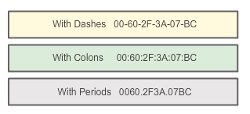
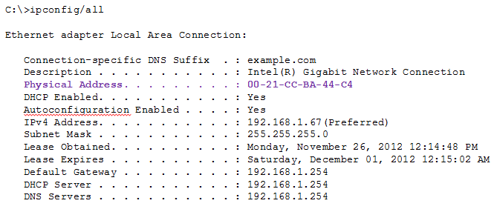
Ethernet MAC
MAC Address Representations
Notes:
Section 5.1.3.2

Slide 30
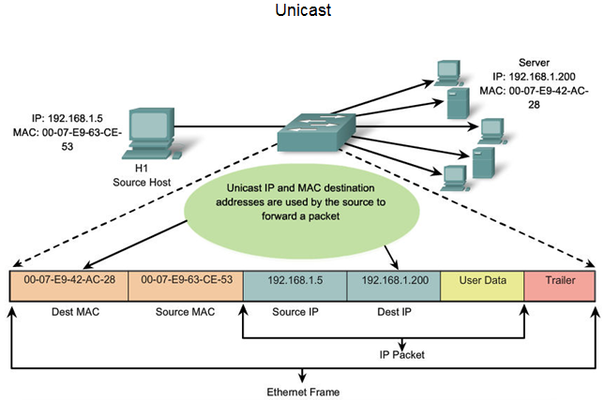
Ethernet MAC
Unicast MAC Address
Notes:
Section 5.1.3.3

Slide 31
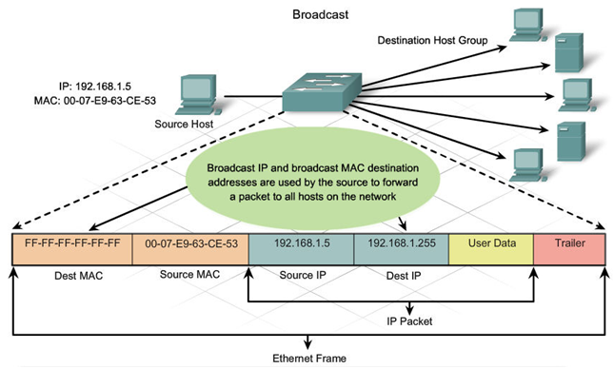
Ethernet MAC
Broadcast MAC Address
Notes:
Section 5.1.3.4

Slide 32
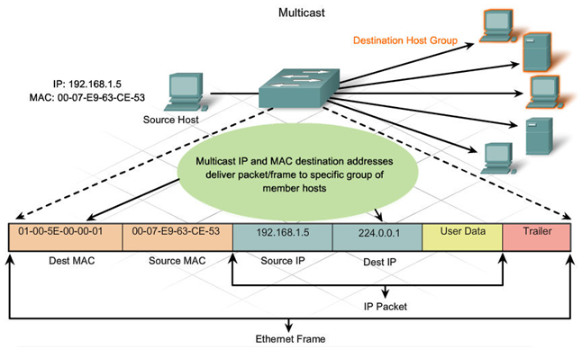
Ethernet MAC
Multicast MAC Address
Multicast MAC address is a special value that begins with 01-00-5E in hexadecimal
Range of IPV4 multicast addresses is 224.0.0.0 to 239.255.255.255
Notes:
Section 5.1.3.5

Slide 33
MAC and IP
MAC and IP
MAC address
This address does not change
Similar to the name of a person
Known as physical address because physically assigned to the host NIC
IP address
Similar to the address of a person
Based on where the host is actually located
Known as a logical address because assigned logically
Assigned to each host by a network administrator
Both the physical MAC and logical IP addresses are required for a computer to communicate just like both the name and address of a person are required to send a letter
Notes:
Section 5.1.4.1

Slide 34
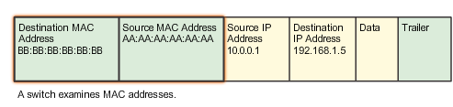
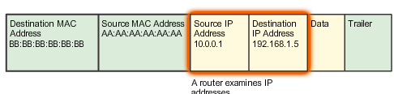
Ethernet MAC
End-to-End Connectivity, MAC, and IP
http://cisco.edu.mn/CCNA_R&S_(Introduction_to_Networking)/course/module5/index.html#5.1.4.1
Notes:
Section 5.1.4.2

Slide 35
ARP – Address Resolution protocol
ARP relies on certain types of Ethernet broadcast messages and Ethernet unicast messages, called ARP requests and ARP replies.
The ARP protocol provides two basic functions:
  Resolving IPv4 addresses to MAC addresses
  Maintaining a table of mappings

Slide 36
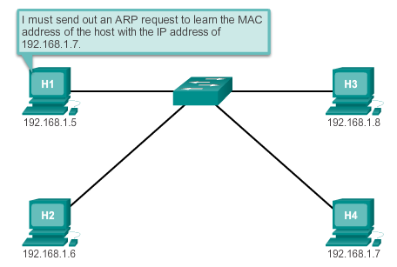
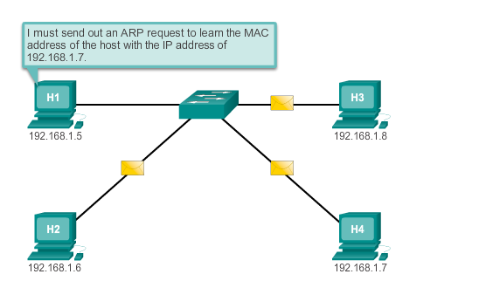
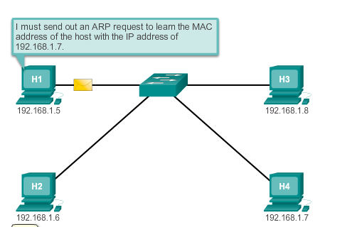
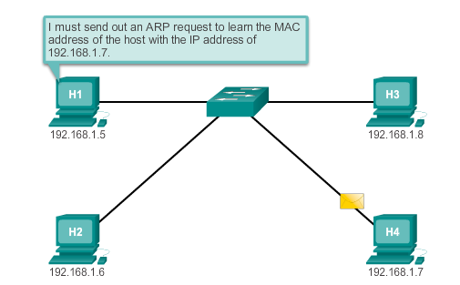

Slide 37
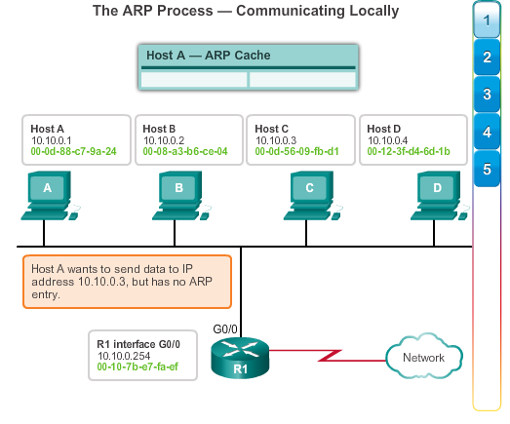

Slide 38
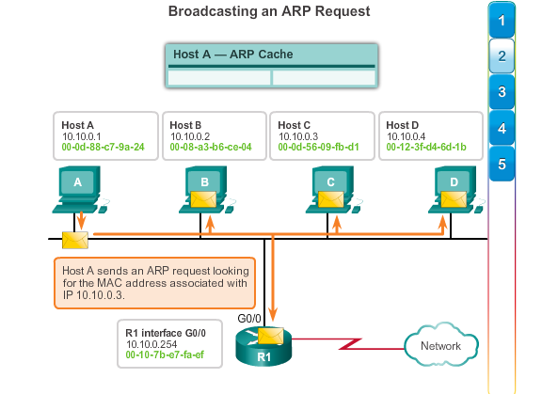

Slide 39
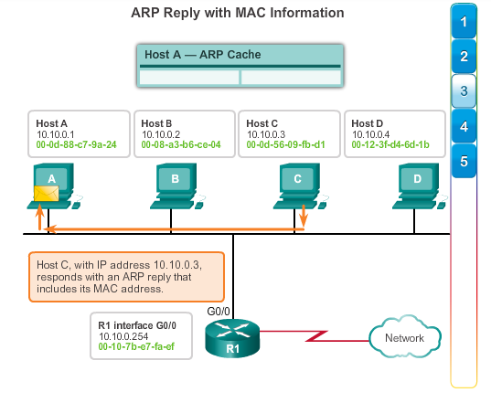

Slide 40
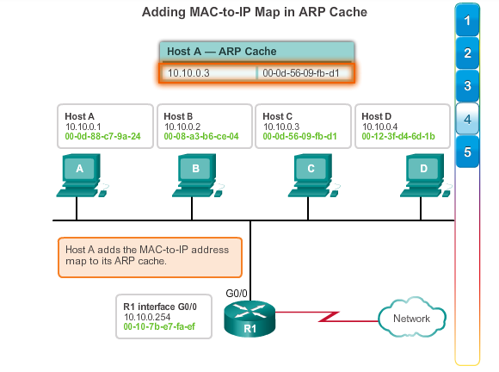

Slide 41
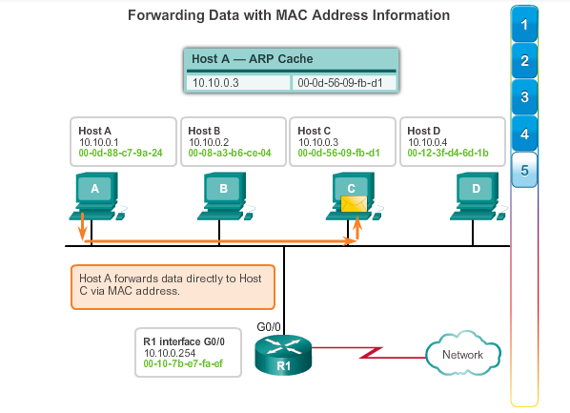

Slide 42
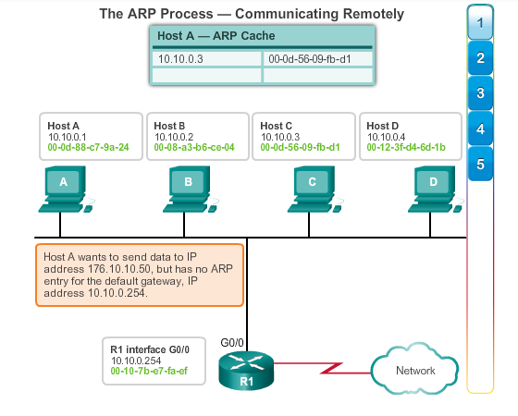

Slide 43
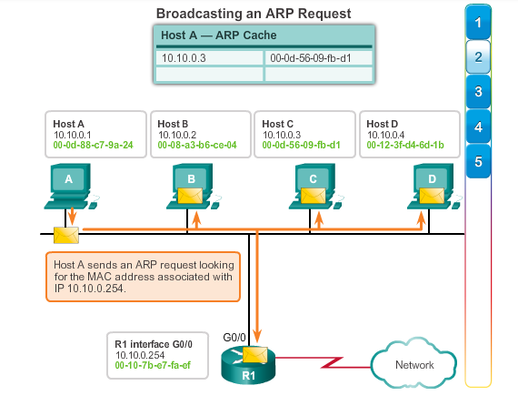

Slide 44
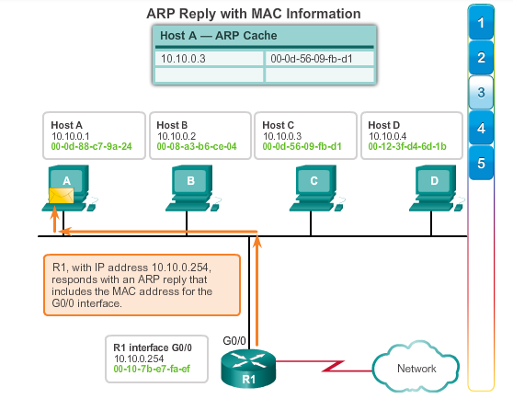

Slide 45
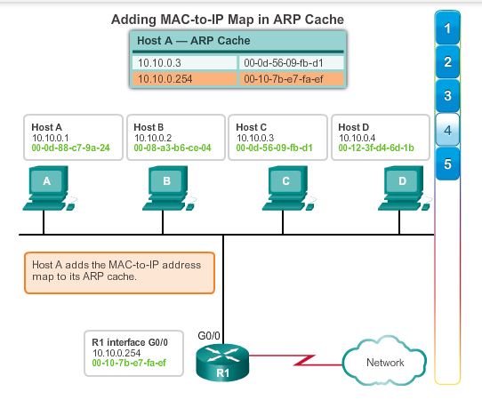

Slide 46
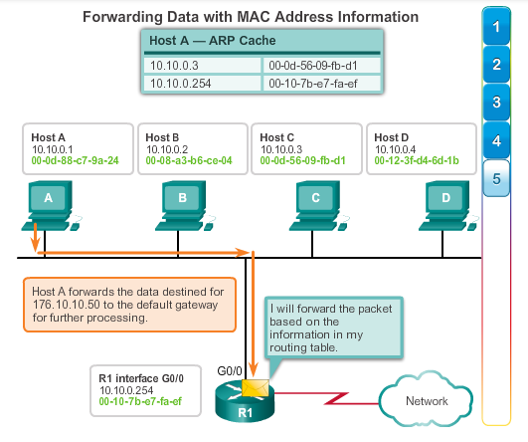

Slide 47
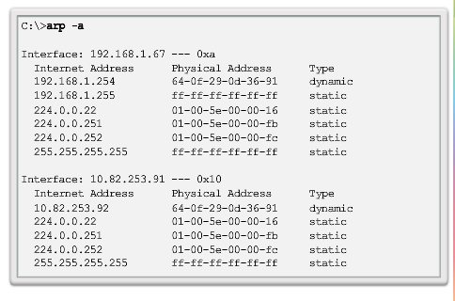
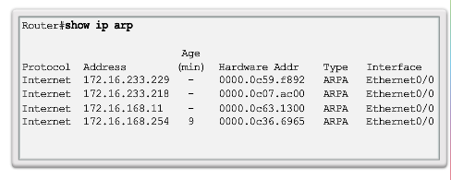
Entries in the ARP table are time stamped.
static map entries can be entered in an ARP table, but this is rarely done. Static ARP table entries do not expire over time and must be manually removed.

Slide 48
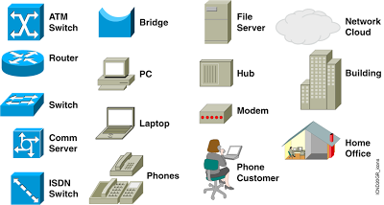
CISCO Symbols

Slide 49
Recourses:
Cisco slides

