Slide 1
Lecture #01
Transmission Media
ct1304- Asma Alosaimi

Slide 2
Topics:
Review
Transmission media types
UTP
STP
Wireless Media

Slide 3
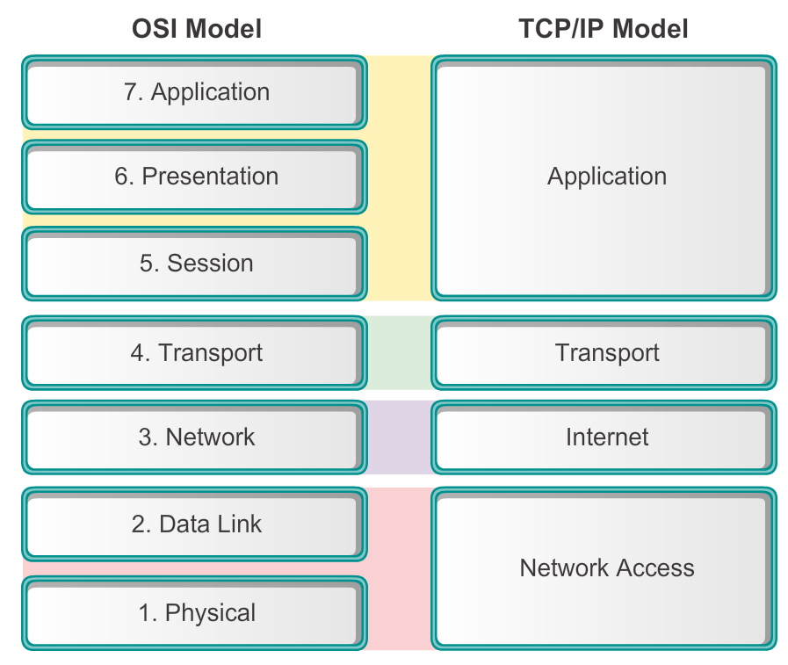

The two models
Data Link Header
IP Header
TCP Header
HTTP Header
Data
Data Link Trailer

Slide 4
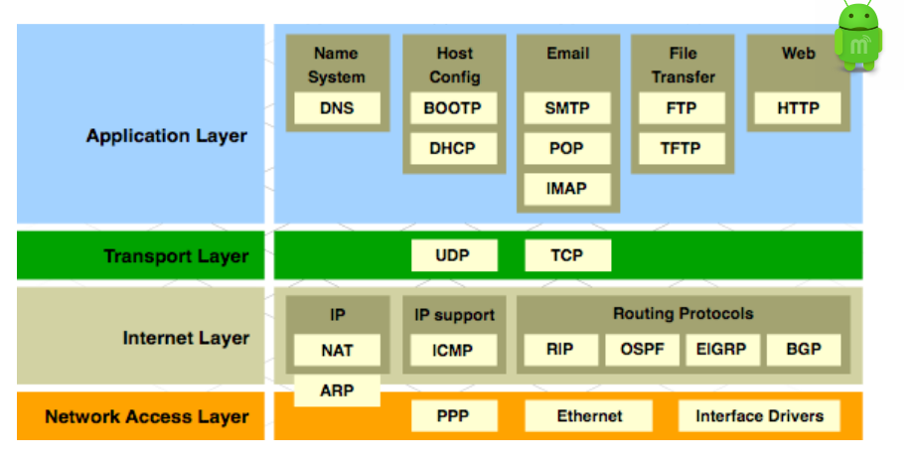
Protocol Suites
TCP/IP Protocol Suite and Communication

Slide 5
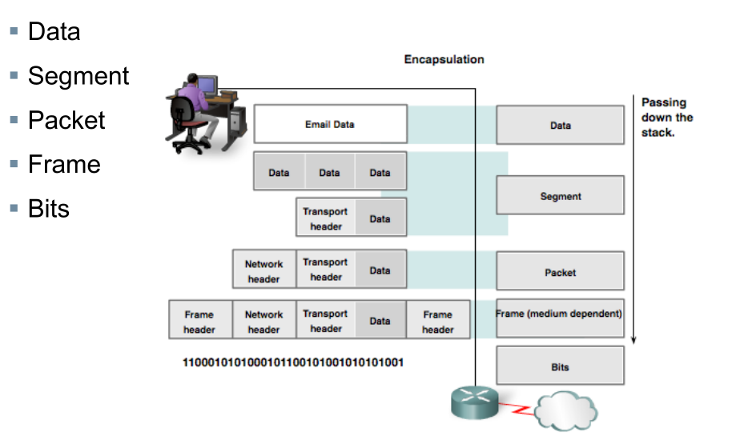
Data Encapsulation
Protocol Data Units (PDUs)

Slide 6
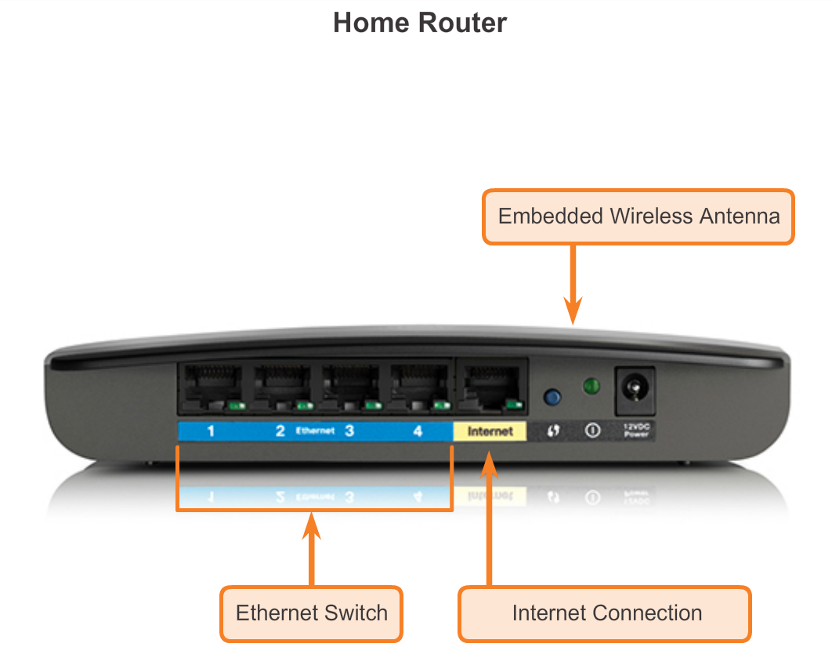
Getting it Connected
Connecting to the Network
A physical connection can be a wired connection using a cable or a wireless connection using radio waves.
Notes:
Section 4.1.1.1

Slide 7
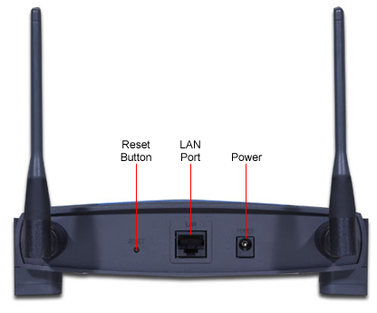
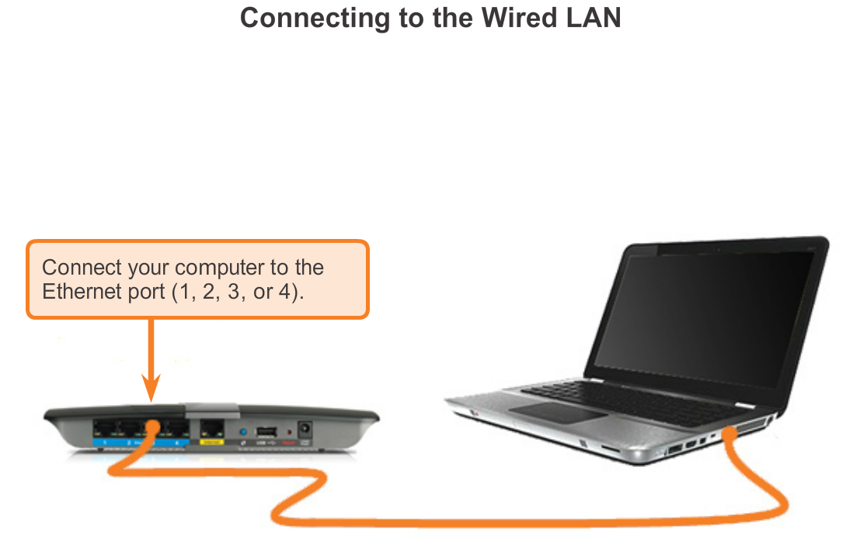
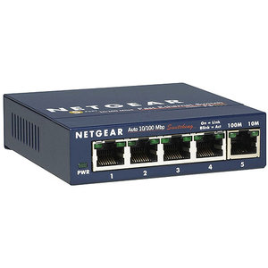
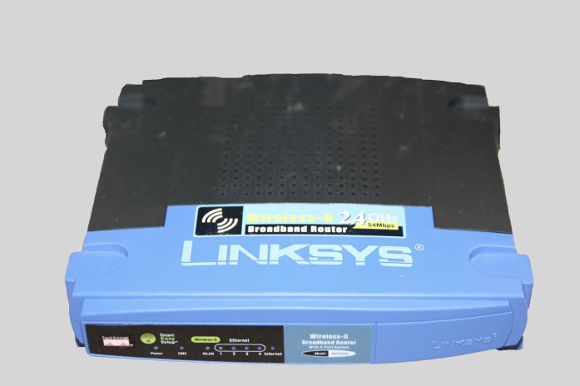
Getting it Connected
Connecting to the Network
Switches and wireless access points are often two separate dedicated devices, connected to a router.
Many homes use integrated service routers (ISRs),
Notes:
Section 4.1.1.1

Slide 8
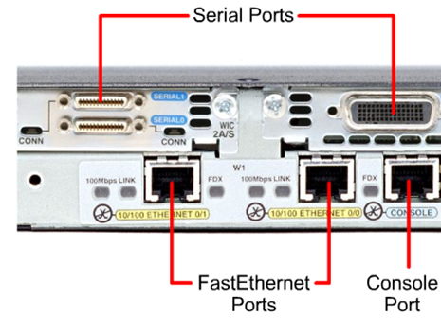
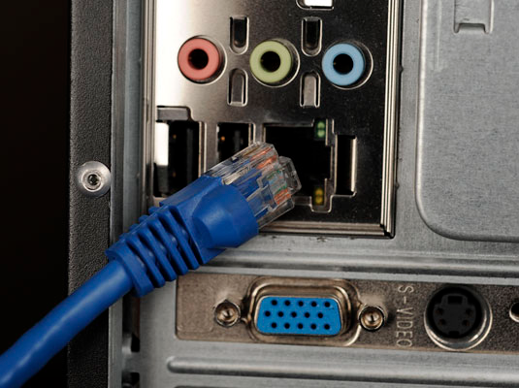
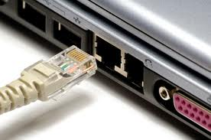
Getting it Connected
Network Interface Cards
Network Interface Cards (NICs) connect a device to the network.
Ethernet NICs are used for a wired connection whereas WLAN (Wireless Local Area Network) NICs are used for wireless.
Notes:
Section 4.1.1.2

Slide 9
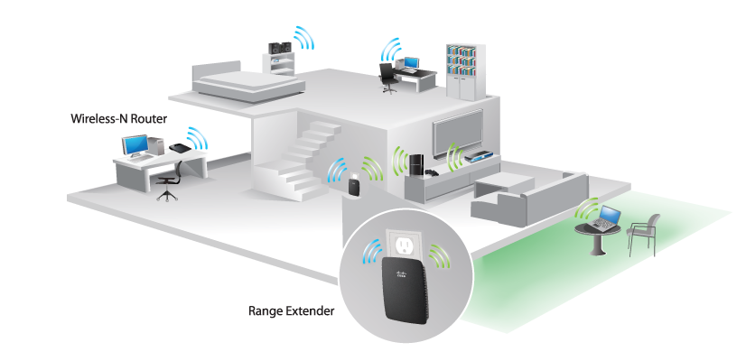
Getting it Connected
Network Interface Cards
Connecting to the Wireless LAN with a Range Extender
Wireless devices must share access to the airwaves connecting to the wireless access point.
  Slower network performance may occur
A wired device does not need to share its access
  Each wired device has a separate communications channel over its own Ethernet cable.
Notes:
Section 4.1.1.2

Slide 10
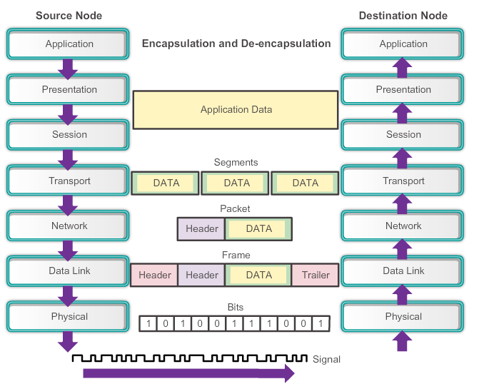
The Physical Layer
Encoding or line encoding - Method of converting a stream of data bits into a predefined "codes”.
Signaling - The physical layer must generate the electrical, optical, or wireless signals that represent the "1" and "0" on the media.
Notes:
Section 4.1.2.1

Slide 11
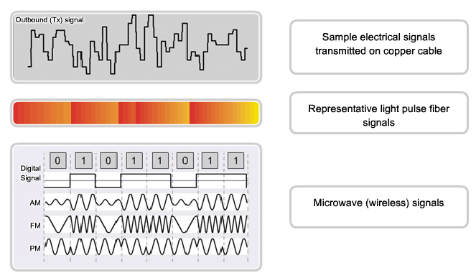
Purpose of the Physical Layer
Physical Layer Media
The physical layer produces the representation and groupings of bits for each type of media as:
Copper cable: The signals are patterns of electrical pulses. ( Focus on STP & UTP)
Fiber-optic cable: The signals are patterns of light. ( details in NET301)
Wireless: The signals are patterns of microwave transmissions. ( brief description only )
Notes:
Section 4.1.2.2

Slide 12
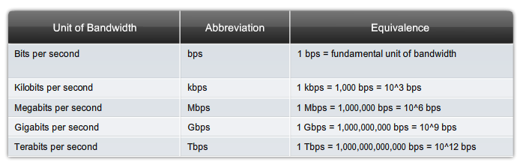
Fundamental Principles of Layer 1
Bandwidth
Bandwidth is the capacity of a medium to carry data.
Typically measured in kilobits per second (kb/s) or megabits per second (Mb/s).
Notes:
Section 4.1.3.2

Slide 13
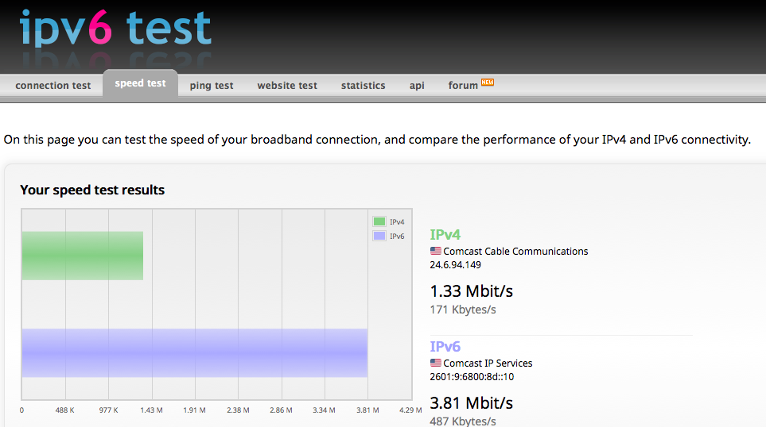
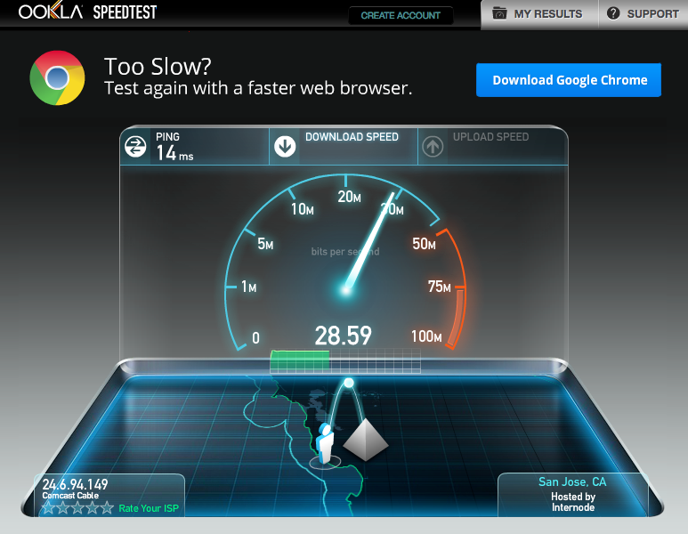
Fundamental Principles of Layer 1
Throughput
Throughput is the measure of the transfer of bits across the media over a given period of time.
Due to a number of factors, throughput usually does not match the specified bandwidth in physical layer implementations.
http://www.speedtest.net/
http://ipv6-test.com/speedtest/
Notes:
Section 4.1.3.3

Slide 14
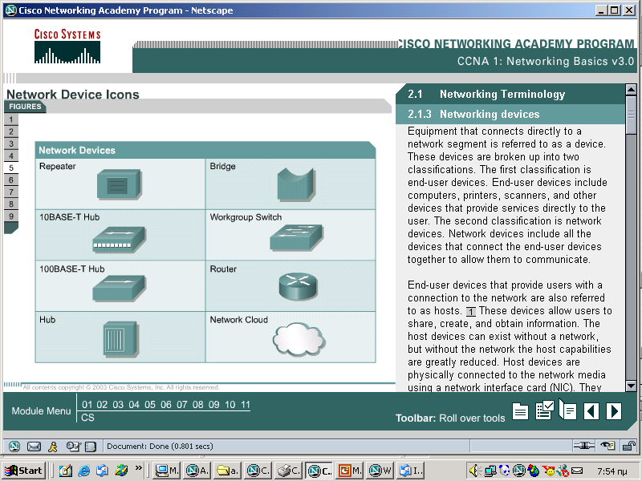
Network Symbols

Slide 15
Physical Media

Slide 16
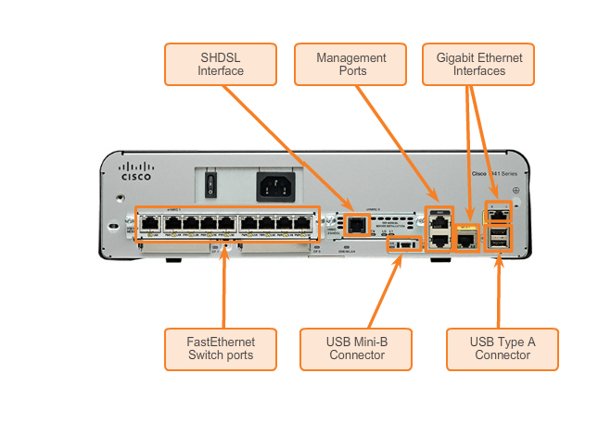
Fundamental Principles of Layer 1
Types of Physical Media
Different types of interfaces and ports available on a 1941 router
Notes:
Section 4.1.3.4

Slide 17
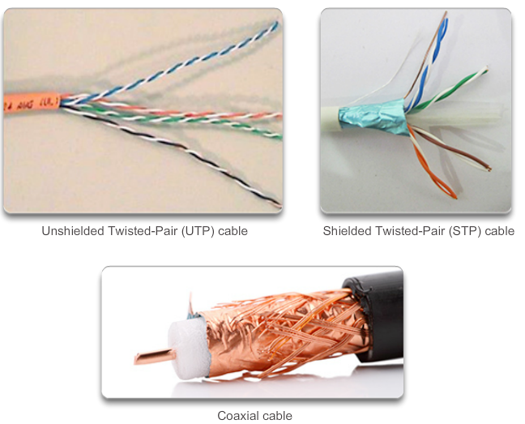
Copper Cabling
Copper Media
Notes:
Section 4.2.1.2

Slide 18
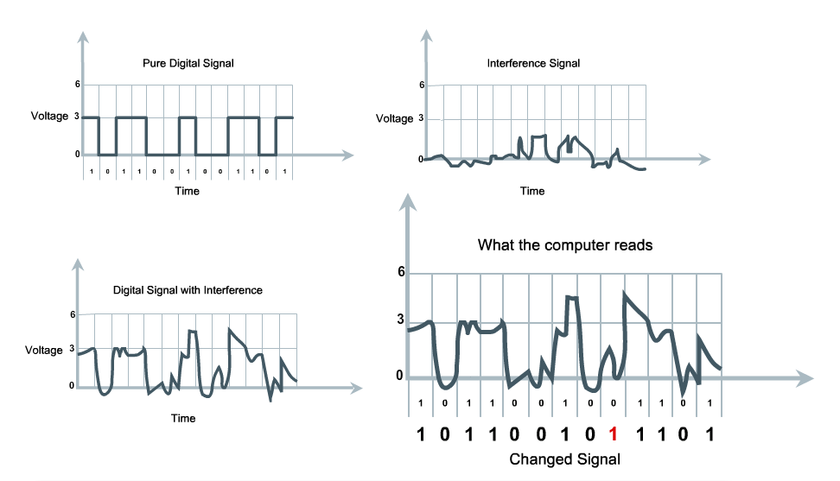
Copper Cabling
Characteristics of Copper Media
1
2
4
3
Signal attenuation - the longer the signal travels, the more it deteriorates - susceptible to interference
Crosstalk - a disturbance caused by the electric or magnetic fields of a signal on one wire to the signal in an adjacent wire.
Notes:
Section 4.2.1.1

Slide 19
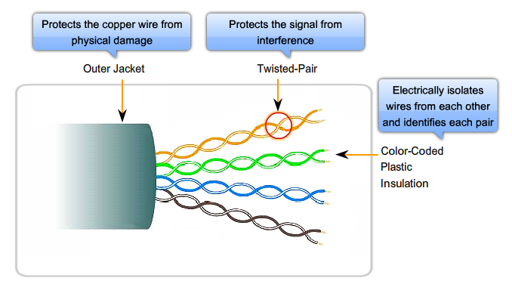
Copper Cabling
Unshielded Twisted-Pair (UTP) Cable
Notes:
Section 4.2.1.3

Slide 20
Copper Cabling
UTP Categories
Category 1 | Voice only (Telephone)
Category 2 | Data to 4 Mbps (Localtalk)
Category 3 | Data to 10Mbps (Ethernet)
Category 4 | Data to 20Mbps (Token ring)
Category 5 Category 5e | Data to 100Mbps (Fast Ethernet) Data to 1000Mbps (Gigabit Ethernet)
Category 6 | Data to 2500Mbps (Gigabit Ethernet)

Slide 21
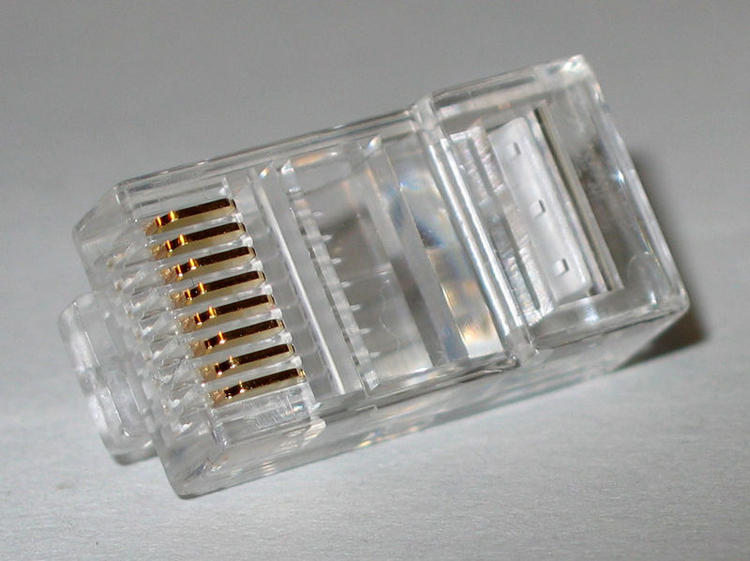
Copper Cabling
UTPRJ45 connector

Slide 22
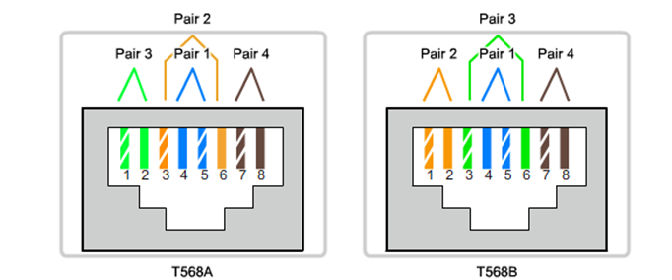
Copper Cabling
UTP
EIA/TIA-568A/B compliant refers to which of the four pairs in the UTP cable are designated as transmit, and which are designated as receive. Use the following as a guide:
  EIA/TIA-568A: Devices transmit over pair 3, and receive over pair 2.
  EIA/TIA-568B: Devices transmit over pair 2, and receive over pair 3.

Slide 23
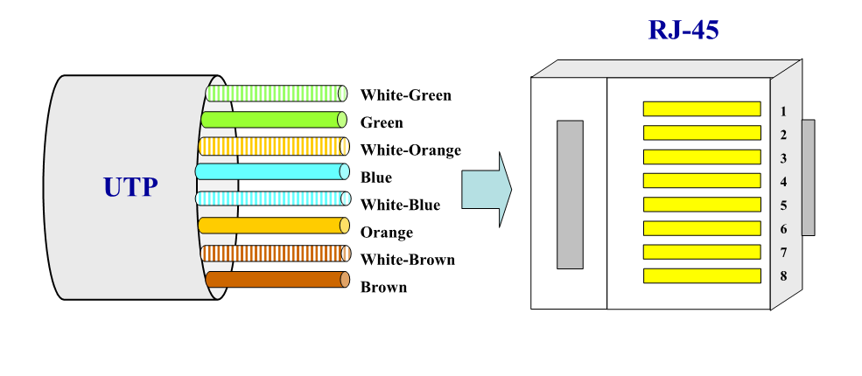
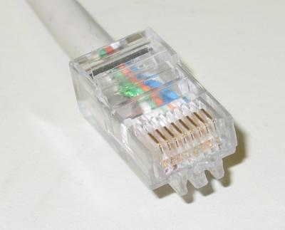
Copper Cabling
Termination — EIA/TIA-568A

Slide 24
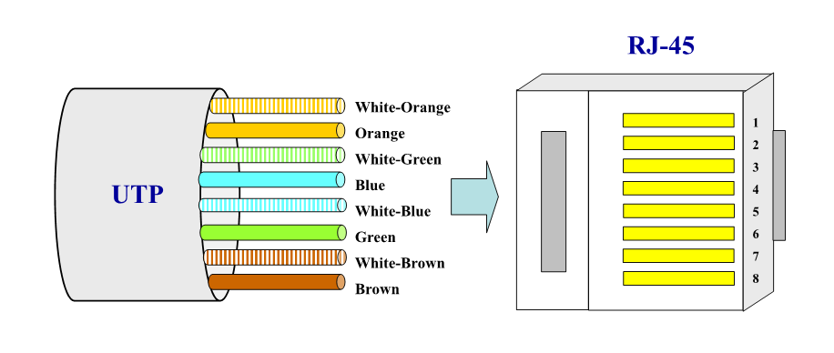
Copper Cabling
Termination — EIA/TIA-568B

Slide 25
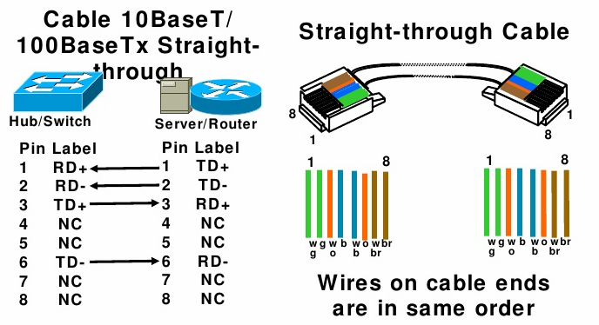
Copper Cabling
UTP Implementation: Straight-Through

Slide 26
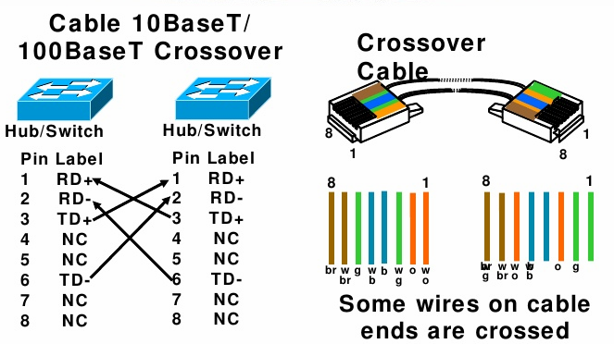
Copper Cabling
UTP Implementation: CrossOver

Slide 27
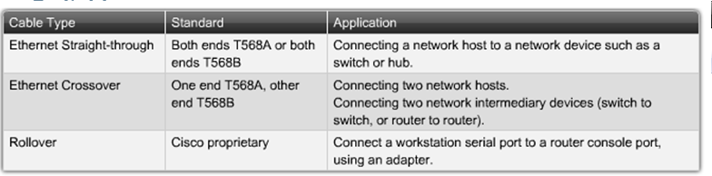
Copper Cabling
Straight-Through Vs. Crossover
Use straight-through cables for the following cabling:
  Switch to Router.
  Switch to Server (PC).
  Hub to Server (PC).
Use crossover cables for the following cabling:
  Switch to Switch.
  Switch to Hub.
  Hub to Hub.
  Router to Router.
  PC to PC

Slide 28
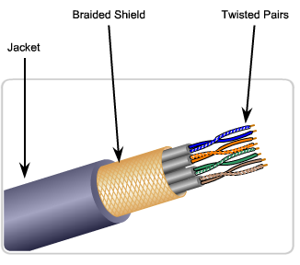
Copper Cabling
Shielded Twisted-Pair (STP) Cable
Braided or Foil Shield
Foil Shields
UTP cable does not use shielding to counter the effects of EMI and RFI. Instead, cable designers have discovered that they can limit the negative effect of crosstalk
STP cable combines the techniques of shielding to counter EMI and RFI and wire twisting to counter crosstalk.
Notes:
Section 4.2.1.4

Slide 29
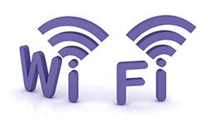


Wireless Media
3) Wireless Media
 | IEEE 802.11 standards Commonly referred to as Wi-Fi. Uses CSMA/CA Variations include: 802.11a: 54 Mbps, 5 GHz 802.11b: 11 Mbps, 2.4 GHz 802.11g: 54 Mbps, 2.4 GHz 802.11n: 600 Mbps, 2.4 and 5 GHz 802.11ac: 1 Gbps, 5 GHz 802.11ad: 7 Gbps, 2.4 GHz, 5 GHz, and 60 GHz
 | IEEE 802.15 standard Supports speeds up to 3 Mbps Provides device pairing over distances from 1 to 100 meters.
 | IEEE 802.16 standard Provides speeds up to 1 Gbps Uses a point-to-multipoint topology to provide wireless broadband access.
Notes:
Section 4.2.4.2

Slide 30
Recourses:
Rehab AlFallaj , lecture notes
Cisco slides

