Slide 1

Pharmacology for Nurses: A Pathophysiologic Approach
Sixth Edition
Chapter 5
Pharmacodynamics
Copyright © 2020, 2017, 2014 Pearson Education, Inc. All Rights Reserved
Notes:
If this PowerPoint presentation contains mathematical equations, you may need to check that your computer has the following installed:
1) MathType Plugin
2) Math Player (free versions available)
3) NVDA Reader (free versions available)

Slide 2
Learning Outcomes
Explain the application of pharmacodynamics to nursing practice.
Frequency distribution curves
Median effective dose (E D50), median lethal dose (L D50) and median toxicity dose (T D50).
Drug’s therapeutic index is related to its margin of safety.
Explain the significance of the graded dose—response relationship to nursing practice.
Compare and contrast the terms potency and efficacy.
Receptors: Distinguish among an agonist, a partial agonist, and an antagonist.

Slide 3
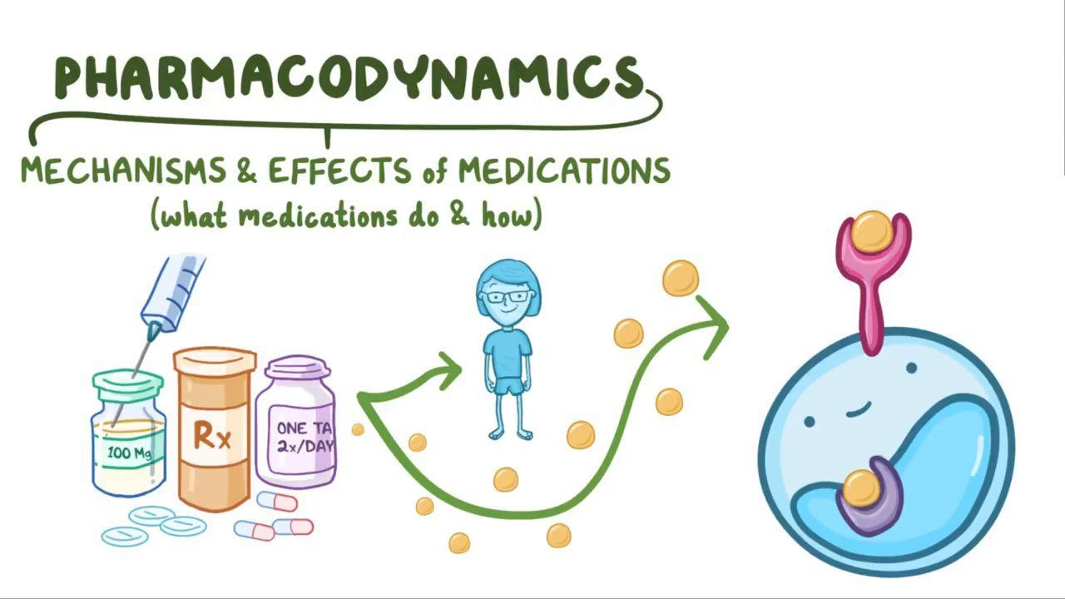
Pharmacodynamics and Interpatient Variability
Pharmacodynamics—how a medicine changes the body
Helps to predict if drug will produce change
Will ensure that drug will provide safe, effective treatment
Combination of drug guides and intuitive experience will guide safe treatment

Slide 4
Frequency Distribution Curve
Graphical representation of number of patients responding to a drug action at different doses
Peak of curve indicates largest number of patients responding to drug

Slide 5
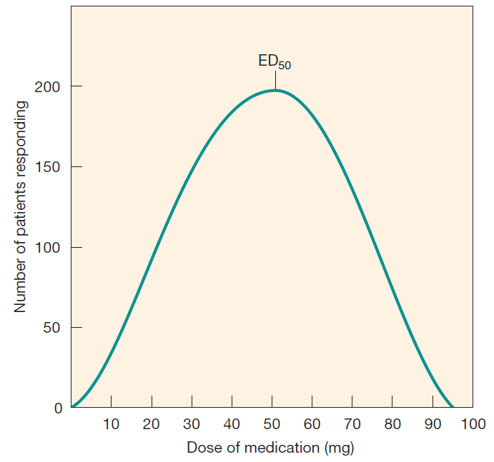
Figure 5.1
Frequency distribution curve: Interpatient variability in drug response

Slide 6
Median Effective Dose (E D₅₀)
Middle of frequency distribution curve
Dose that produces therapeutic response in 50% of a group
Sometimes called “average” or “standard” dose
Many patients require more or less

Slide 7
Nurse’s Skill Critical in Determining If Average Dose is Effective
Patient observation
Taking vital signs
Monitoring lab data

Slide 8
Median Lethal Dose (L D₅₀)
Used to assess safety of a drug
Shown on frequency distribution curves
Determined in preclinical trials
Is lethal dose in 50% of group of animals
Cannot be experimentally determined in humans

Slide 9
Median Toxicity Dose (T D₅₀)
Dose that will produce given toxicity in 50% of group of patients
Value may be extrapolated from
  Animal data
  Adverse effects in patient clinical trials
Needed because median lethal dose cannot be tested in humans

Slide 10
Therapeutic Index
Measure of a drug’s safety margin
The higher the value, the safer the drug

Slide 11
Calculating Therapeutic Index

Slide 12
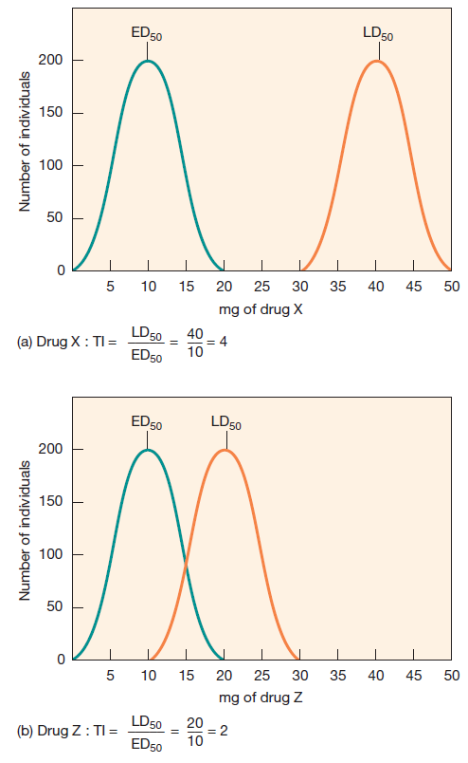
Example
Therapeutic index: (a) Drug X has a therapeutic index of 4;
Drug Z has a therapeutic index of 2. In a human clinical study, L D₅₀ is labeled as T D₅₀

Slide 13
Example of Therapeutic Index
Therapeutic index of 4: need error four times dose to be lethal

Slide 14
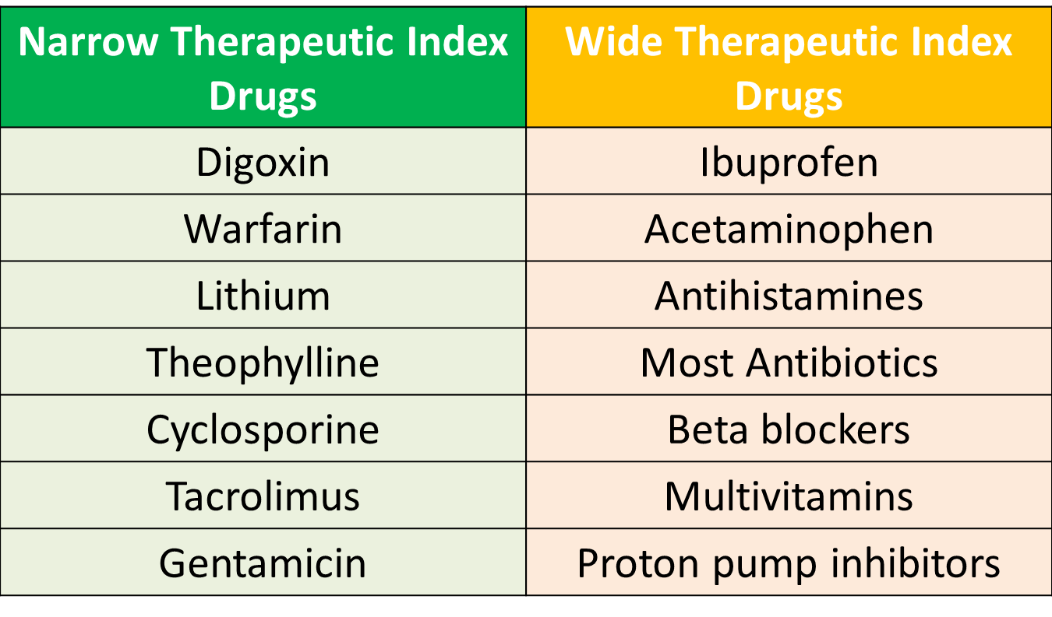

Slide 15
The Graded Dose—Response Relationship and Therapeutic Response
Graphically visualizes differences in responses to medications in a single patient
Obtained by observing and measuring patient's response at different doses of the drug

Slide 16
Three Phases of Graded Dose—Response Curve (1 of 2)
Phase 1: occurs at lowest dose
  Few target cells affected by drug
Phase 2: straight-line portion of curve
  Most desirable range
  Linear relationship between amount of drug administered and degree of patient response

Slide 17
Three Phases of Graded Dose—Response Curve (2 of 2)
Phase 3: plateau reached
  Increasing dose has no therapeutic effect
  Increased dose may produce adverse effects

Slide 18
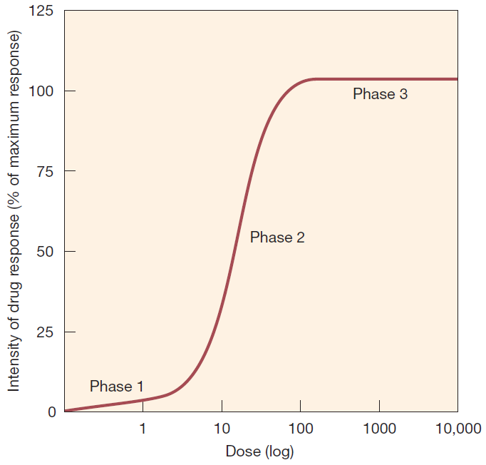
Figure 5.3
Dose—response relationship

Slide 19
Two Ways to Compare Medications
Potency
Efficacy

Slide 20
Potency
Drug with higher potency produces a therapeutic effect at a lower dose, compared with another drug in the same class
The amount of drug that is needed to produce a particular response.

Slide 21
Efficacy
Magnitude of maximal response that can be produced from a particular drug
From a pharmacotherapeutic perspective, efficacy almost always more important than potency

Slide 22
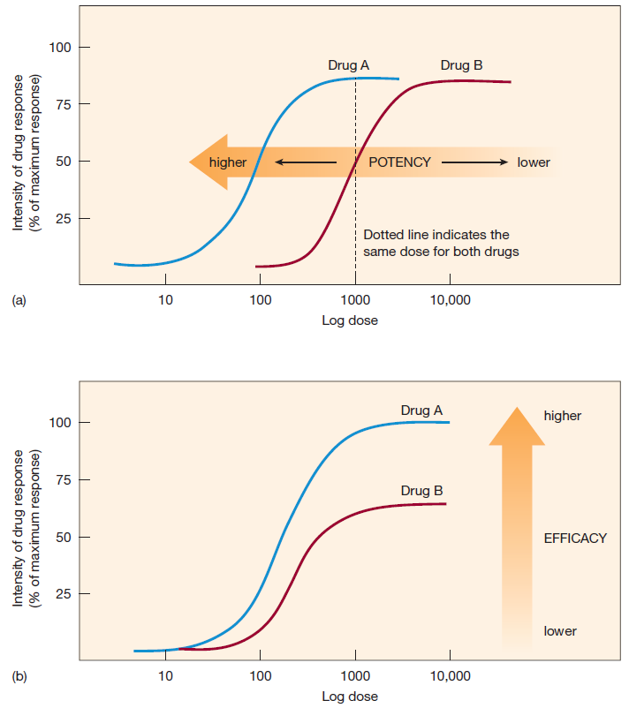
Figure 5.4
Potency and efficacy:
(a) Drug A has a higher potency than drug B;
(b) drug A has a higher efficacy than drug B

Slide 23
Receptor
Molecule to which medication binds in order to initiate its effects
Binds endogenous molecules
  Hormones, neurotransmitters, growth factors
Most drug receptors are protein agonists
Associated with plasma membrane or intracellular molecules
Ligand is usually a molecule which produces a signal by binding to a site on a target protein.

Slide 24
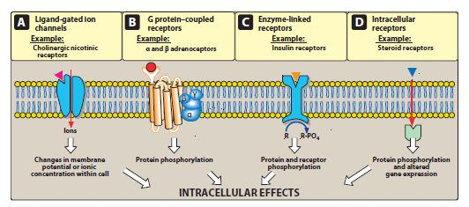
Receptors type

Slide 25
Drug Attaches to Receptor
Comparable to how thumb drive docks to U S B port on a computer
May trigger second messenger events
  e.g., activation of specific G proteins and associated enzymes
Initiates drug action
Can stimulate or inhibit normal activity

Slide 26
Receptor Subtypes Still Being Discovered
Permit “fine-tuning” of pharmacology
Two basic receptor types
  Alpha
  Beta
Drugs affect each subtype differently

Slide 27
Nonspecific Cellular Responses
Caused by drugs that act independently of receptors
Example: changing the permeability of cellular membranes

Slide 28
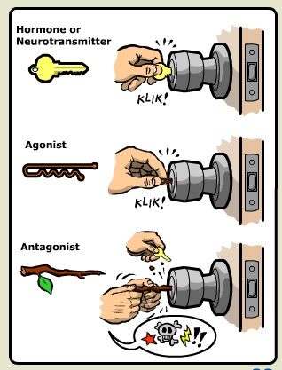
Drugs That Act as Agonists
Bind to receptor
Produce same response
as endogenous chemical
Sometimes produce greater
maximal response

Slide 29
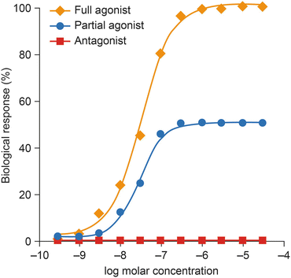
Drugs That Act as Partial Agonists
Bind to receptor
Produce weaker, less effective response than agonists

Slide 30
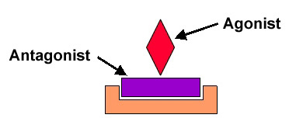
Drugs That Act as Antagonists
Occupy receptor
Prevent endogenous chemical from acting
Often compete with agonists for receptor
Functional antagonists inhibit the effects of an agonist not by competing for a receptor but by changing pharmacokinetic factors

Slide 31

Copyright
This work is protected by United States copyright laws and is provided solely for the use of instructors in teaching their courses and assessing student learning. Dissemination or sale of any part of this work (including on the World Wide Web) will destroy the integrity of the work and is not permitted. The work and materials from it should never be made available to students except by instructors using the accompanying text in their classes. All recipients of this work are expected to abide by these restrictions and to honor the intended pedagogical purposes and the needs of other instructors who rely on these materials

