Slide 1

Pharmacology for Nurses: A Pathophysiologic Approach
Sixth Edition
Chapter 1
Introduction to Pharmacology
Copyright © 2020, 2017, 2014 Pearson Education, Inc. All Rights Reserved
Notes:
If this PowerPoint presentation contains mathematical equations, you may need to check that your computer has the following installed:
1) MathType Plugin
2) Math Player (free versions available)
3) NVDA Reader (free versions available)

Slide 2
Learning Outcomes
What is pharmacology
Pharmacology and therapeutics
Classification of therapeutics agents
Therapeutic and pharmacologic classifications.
Discuss the prototype approach to drug classification.
Distinguish among a drug’s chemical name, generic name, and trade name.
Outline the major differences between prescription and over-the-counter drugs.
Bioavailability

Slide 3
Pharmacology: The Study of Medicines
Pharmacology derived from two Greek words
  Pharmakon: “medicine”
  Logy: “study”
  Most simply defined as the study of medicines
More than 1000 trade-name drugs are available
  Own set of therapeutic application, adverse effects, and mechanisms of action
Many drugs are prescribed for more than one disease
Drugs elicit different responses depending on the individual
If applied properly, drugs can improve the quality of life; if improperly, results may be devastating

Slide 4
Pharmacology and Therapeutics
Nurses are most directly involved with patient care
  Educating
  Managing
  Monitoring
Applicable in all areas of nursing
  Learning pharmacology extends beyond graduation for students
Therapeutics differs from pharmacology
  Therapeutics focuses on disease prevention and treatment of suffering
  Pharmacotherapy (pharmacotherapeutics) is the application of drugs for treating disease and alleviating human suffering

Slide 5
Classification of Therapeutic Agents
Fall into one of three general categories
  Drugs or medications
  Biologics and biosimilar drugs
  Complementary and alternative medicine therapies

Slide 6
Drugs and Medications
Drug
  Chemical agent capable of producing biological responses within the body
  Responses may be desirable (therapeutic) or undesirable (adverse)
  Broadly defined
Medication
  Drug after it is administered
Both may be considered part of the body’s normal activities
  Essential gases we breathe
  Foods we eat

Slide 7
Biologics and biosimilar drugs
Agents naturally produced in animal cells, by microorganisms, or by the body itself
Hormones
Monoclonal antibodies
Natural blood products and components
Interferons
Vaccines

Slide 8
Therapeutic and Pharmacologic Classification of Drugs
Therapeutic classification
  Organization based on therapeutic usefulness
Pharmacologic classification
  Organization based on the way the drug works at a molecular, tissue, or body system level
  Often represents mechanism of action
Both classifications are widely used
Prototype drug used as comparison

Slide 9
Table 1.1 Therapeutic Classification Focus: Cardiovascular Function
Usefulness | Drug Classification
Influence blood clotting | Anticoagulant
Lower blood cholesterol | Antihyperlipidemic
Lower blood pressure | Antihypertensive
Restore normal cardiac rhythm | Antidysrhythmic
Treat angina | Antianginal

Slide 10
Table 1.2 Pharmacologic Classification Focusing on Therapeutic Classification: Pharmacotherapy for Hypertension
Mechanism of Action | Drug Classification
Lowers plasma volume | Diuretic
Blocks heart calcium channels | Calcium channel blocker
Blocks hormonal activity | Angiotensin-converting enzyme inhibitor
Blocks physiological reactions to stress | Adrenergic antagonist
Dilates peripheral blood vessels | Vasodilator

Slide 11
Chemical, Generic, and Trade Names for Drugs
Challenging to master all of the drug names
Three basic drug name types
  Chemical
  Generic
  Trade

Slide 12
Chemical Names (1 of 2)
Nomenclature assigned using established guidelines from the International Union of Pure and Applied Chemistry (I U P A C)
Only one chemical name
Convey clear, concise information about the drug
Difficult to pronounce and remember
  Example: diazepam
    7-chloro-1, 3-dihydro-1-methyl-5-phenyl-2H-1, 4-benzodiazepine-2-1
  In few cases, the chemical name may be used
    Calcium gluconate
    Sodium chloride

Slide 13
Chemical Names (2 of 2)
Drugs may be classified by a portion of the chemical structure
  Antibiotics may be classified as quinolones or cephalosporins

Slide 14
Generic Names
Assigned by U.S. Adopted Name Council
Less complicated and easier to remember
Many organizations use generic names to describe medications
Only one generic name
Use generic name of drug followed by lowercase letters

Slide 15
Trade Names
Usually short and easy to remember
Assigned by the company marketing the drug
Trade name also known as proprietary, product, or brand name
  Proprietary means that a drug developer has exclusive rights to name and market a drug for 17 years after a New Drug Application is submitted
Usually capitalized (Benadryl versus diphenhydramine)
Combination drugs contain more than one generic active ingredient

Slide 16
Prescription Drugs
Written order from someone with legal authority to write a prescription
Numerous benefits
  Specific diagnosis
  Maximize therapy
  Opportunity to teach patient proper use
  Monitor adverse effects

Slide 17
Over-The-Counter Drugs
Also called O T C
Do not require healthcare provider’s order
May have serious adverse effects if not used properly
More easily obtained than prescription drugs
Self-treatment is sometimes ineffectual

Slide 18
Bioavailability
Measurement of bioavailability may be key in comparison of trade name and generic medications
  Bioavailability is physiologic ability of the drug to reach targeted cells and produce its effect
  Anything that affects drug absorption also affects bioavailability

Slide 19
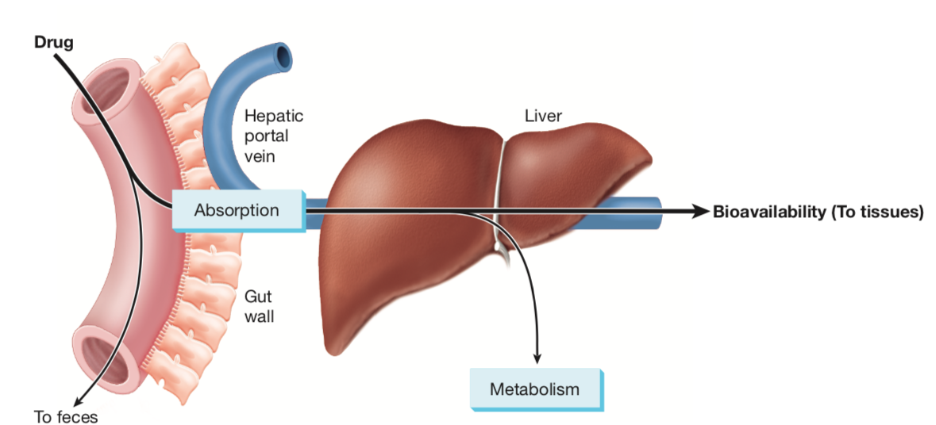
Figure 1.1
A drug’s bioavailability will depend on the dosage form and how much will actually reach the target location

Slide 20

Copyright
This work is protected by United States copyright laws and is provided solely for the use of instructors in teaching their courses and assessing student learning. Dissemination or sale of any part of this work (including on the World Wide Web) will destroy the integrity of the work and is not permitted. The work and materials from it should never be made available to students except by instructors using the accompanying text in their classes. All recipients of this work are expected to abide by these restrictions and to honor the intended pedagogical purposes and the needs of other instructors who rely on these materials

