Slide 1
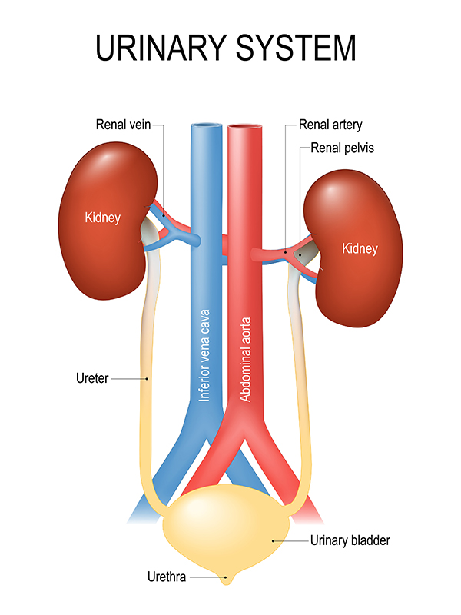
Chapter 17
Anatomy of Urinary System
Lecture 9
Notes:
If this PowerPoint presentation contains mathematical equations, you may need to check that your computer has the following installed:
1) MathType Plugin
2) Math Player (free versions available)
3) NVDA Reader (free versions available)

Slide 2
Learning Outcomes
Identify the structures of the urinary system.
Describe the external and internal anatomy and physiology of the kidneys.
Describe the three processes related to urine formation.
Describe the anatomy of the urinary bladder and the urination reflex.

Slide 3
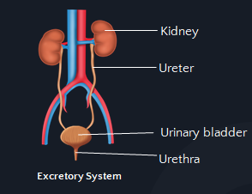
Organ of urinary System

Slide 4
Functions:
Organ | Functions
Kidneys | Regulate blood volume and pH and blood pressure. Produce hormones. Excrete waste products in urine.
Ureters | Transport urine from kidneys to urinary bladder.
Bladder | Stores urine and expels it into the urethra when necessary.
Urethra | Excretes urine to the outside of the body.

Slide 5
System Overview
The urinary system consists of:
Two kidneys; bean-shaped organs located in the superior dorsal abdominal cavity.
A Ureter is a tube that carries urine from each kidney to bladder, located in the ventral pelvic cavity.

Slide 6
System Overview
3. The urinary bladder is basically an expandable sac that holds urine.
4. The urethra is the tube that transports urine from the bladder to the outside of the body.

Slide 7
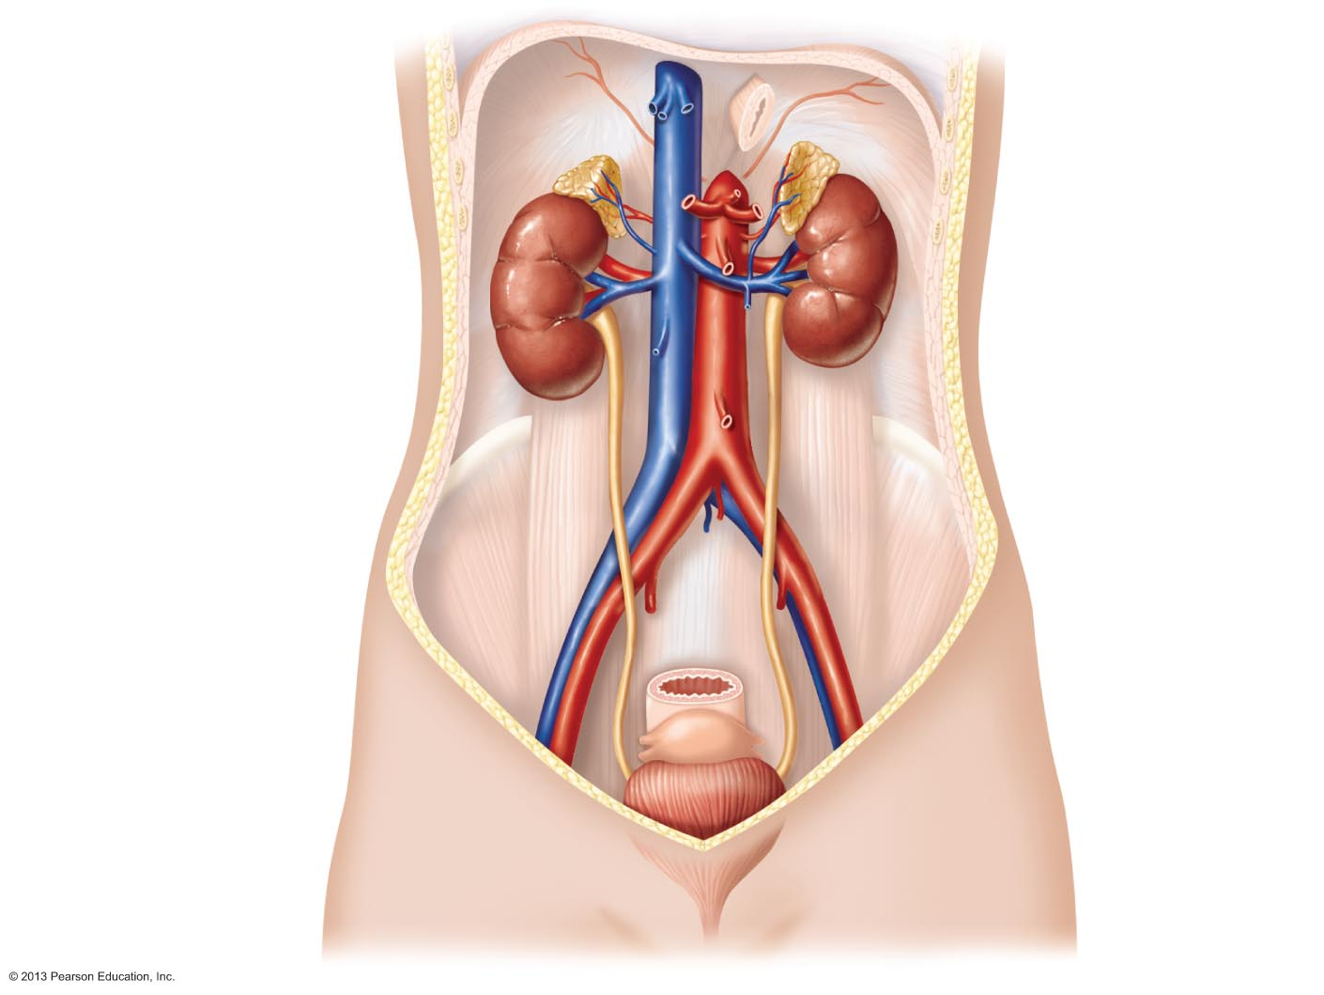
Figure 25.1 The urinary system.
Hepatic veins (cut)
Esophagus (cut)
Inferior vena cava
Adrenal gland
Renal artery
Renal hilum
Aorta
Renal vein
Kidney
Iliac crest
Ureter
Rectum (cut)
Uterus (part of female
reproductive system)
Urinary
bladder
Urethra

Slide 8
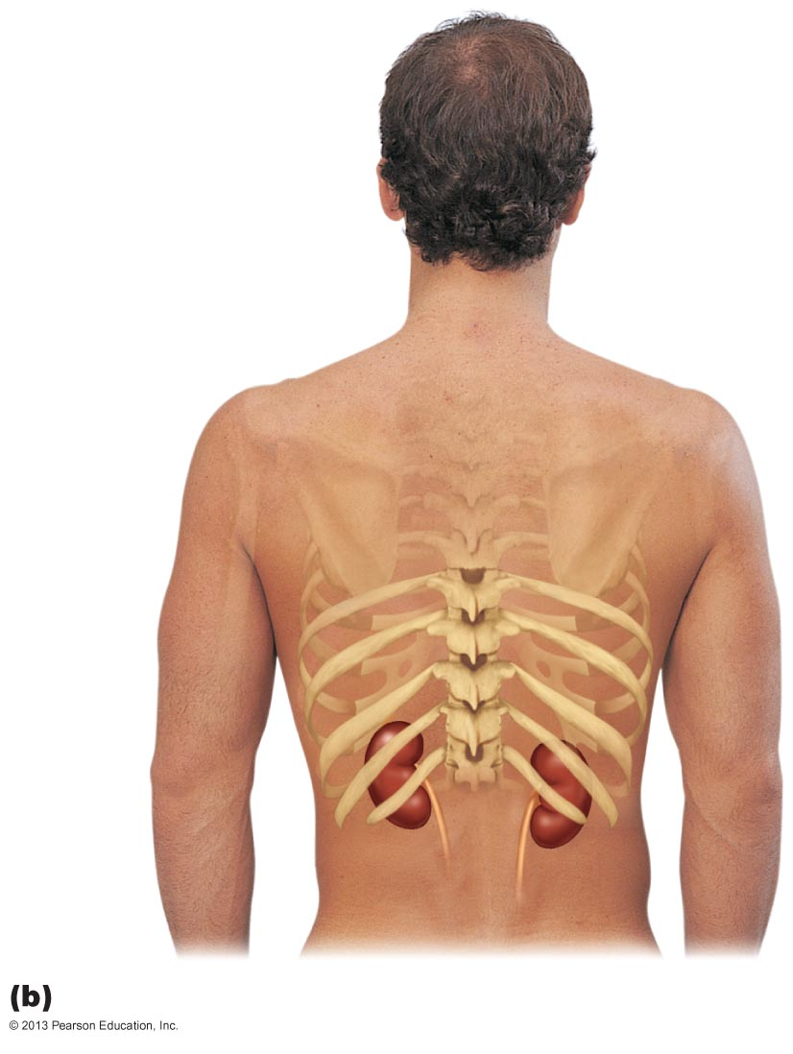
Figure 25.2b Position of the kidneys against the posterior body wall.
12th rib

Slide 9
The Kidneys
Bean-shaped organs.
Located on the posterior abdominal wall on each side of the vertebral column.
Right kidney is lower (pushed down by the liver).
Each kidney has upper and lower poles, anterior and posterior surfaces and medial and lateral borders.
The concave medial border is the hilum. Through it pass: the ureter, renal artery and vein, lymphatics and nerves.
Fig.2: The kidney.

Slide 10
At the hilum:
Renal arteries bring blood to the kidneys to be filtered
Renal veins take the filtered blood away from the kidney.
The ureter is also attached at the hilum to transport urine from the kidney to the bladder.

Slide 11
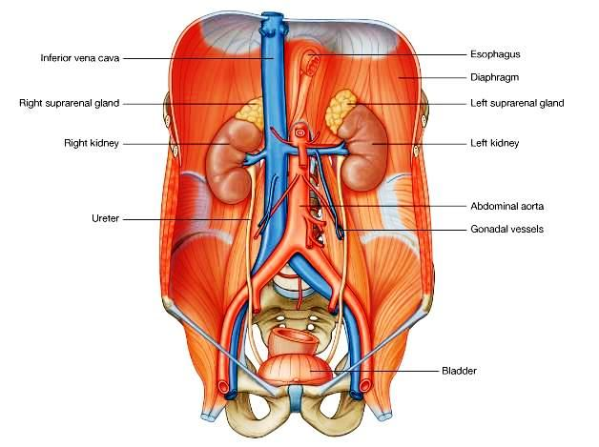
Fig.3: Position of the kidneys.

Slide 12
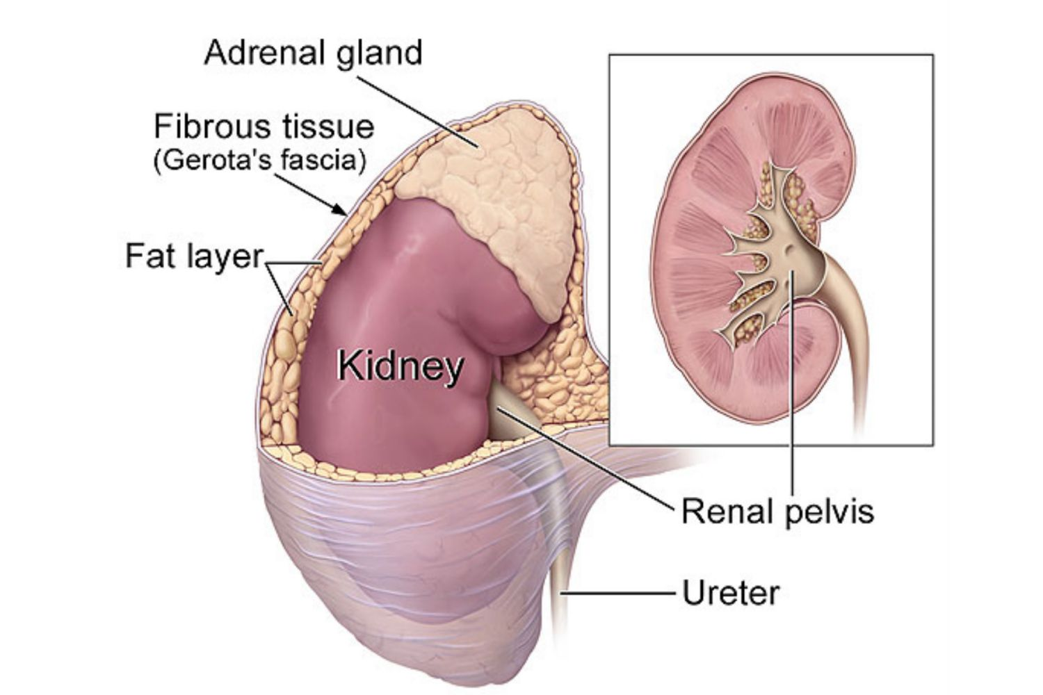
Renal Capsule
The kidney is surrounded by:
Renal capsule: protects the kidneys.
Adipose Capsule: fatty tissue surrounding the renal capsule. It protects the kidneys and keeps them in place.
Renal fascia: connective tissue layer that helps adhere the kidneys to surrounding structures.
Fig.4: Coverings of the kidney.

Slide 13
Kidney has three layers
Renal cortex
Outer layer
Little obvious structure to naked eye
Site where blood filtration occurs

Slide 14
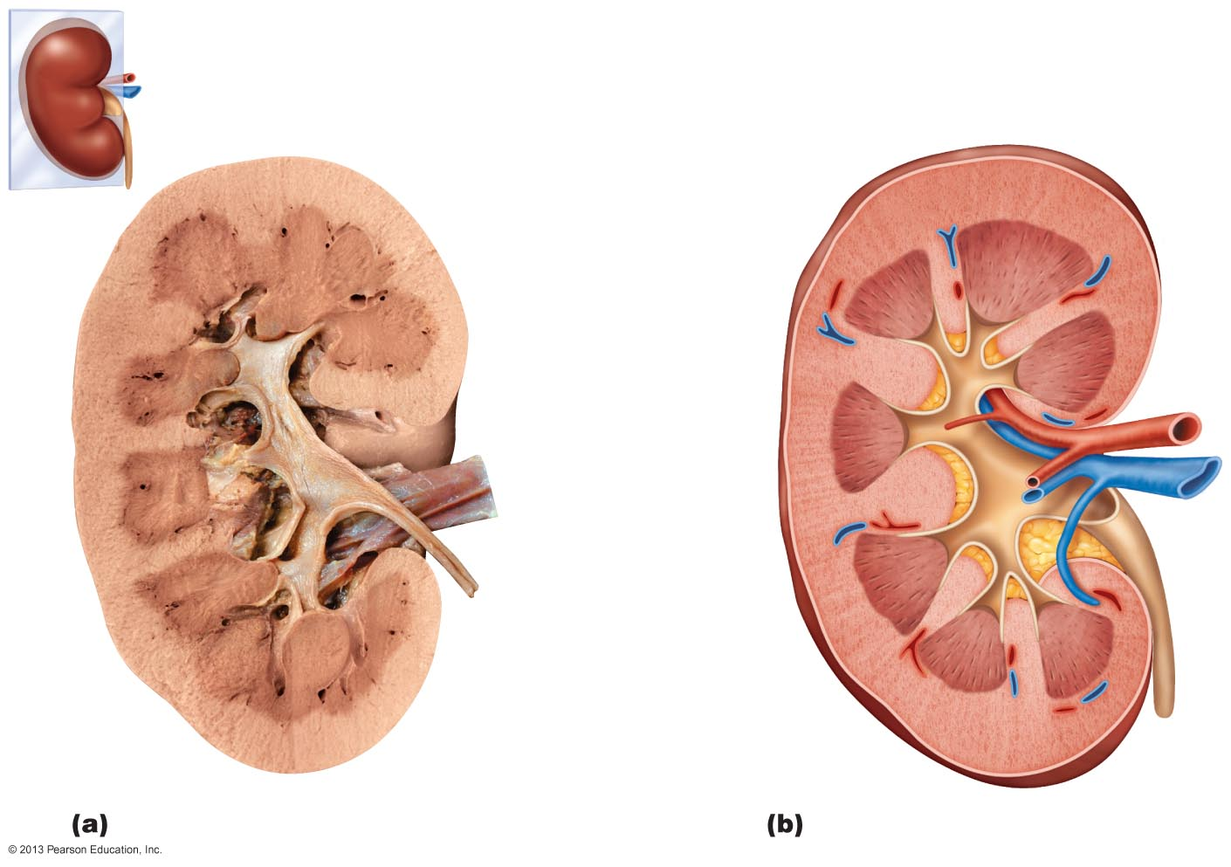
Figure 25.3 Internal anatomy of the kidney.
Renal
hilum
Renal cortex
Renal medulla
Major calyx
Papilla of
pyramid
Renal pelvis
Minor calyx
Ureter
Renal pyramid in
renal medulla
Renal column
Fibrous capsule
Photograph of right kidney, frontal section
Diagrammatic view

Slide 15
Internal Anatomy of the Kidney (2 of 3)
Kidney has three layers
Renal medulla
Middle layer
Contains a number of triangle-shaped, striped areas called renal pyramids
Composed of collecting tubules for the urine

Slide 16
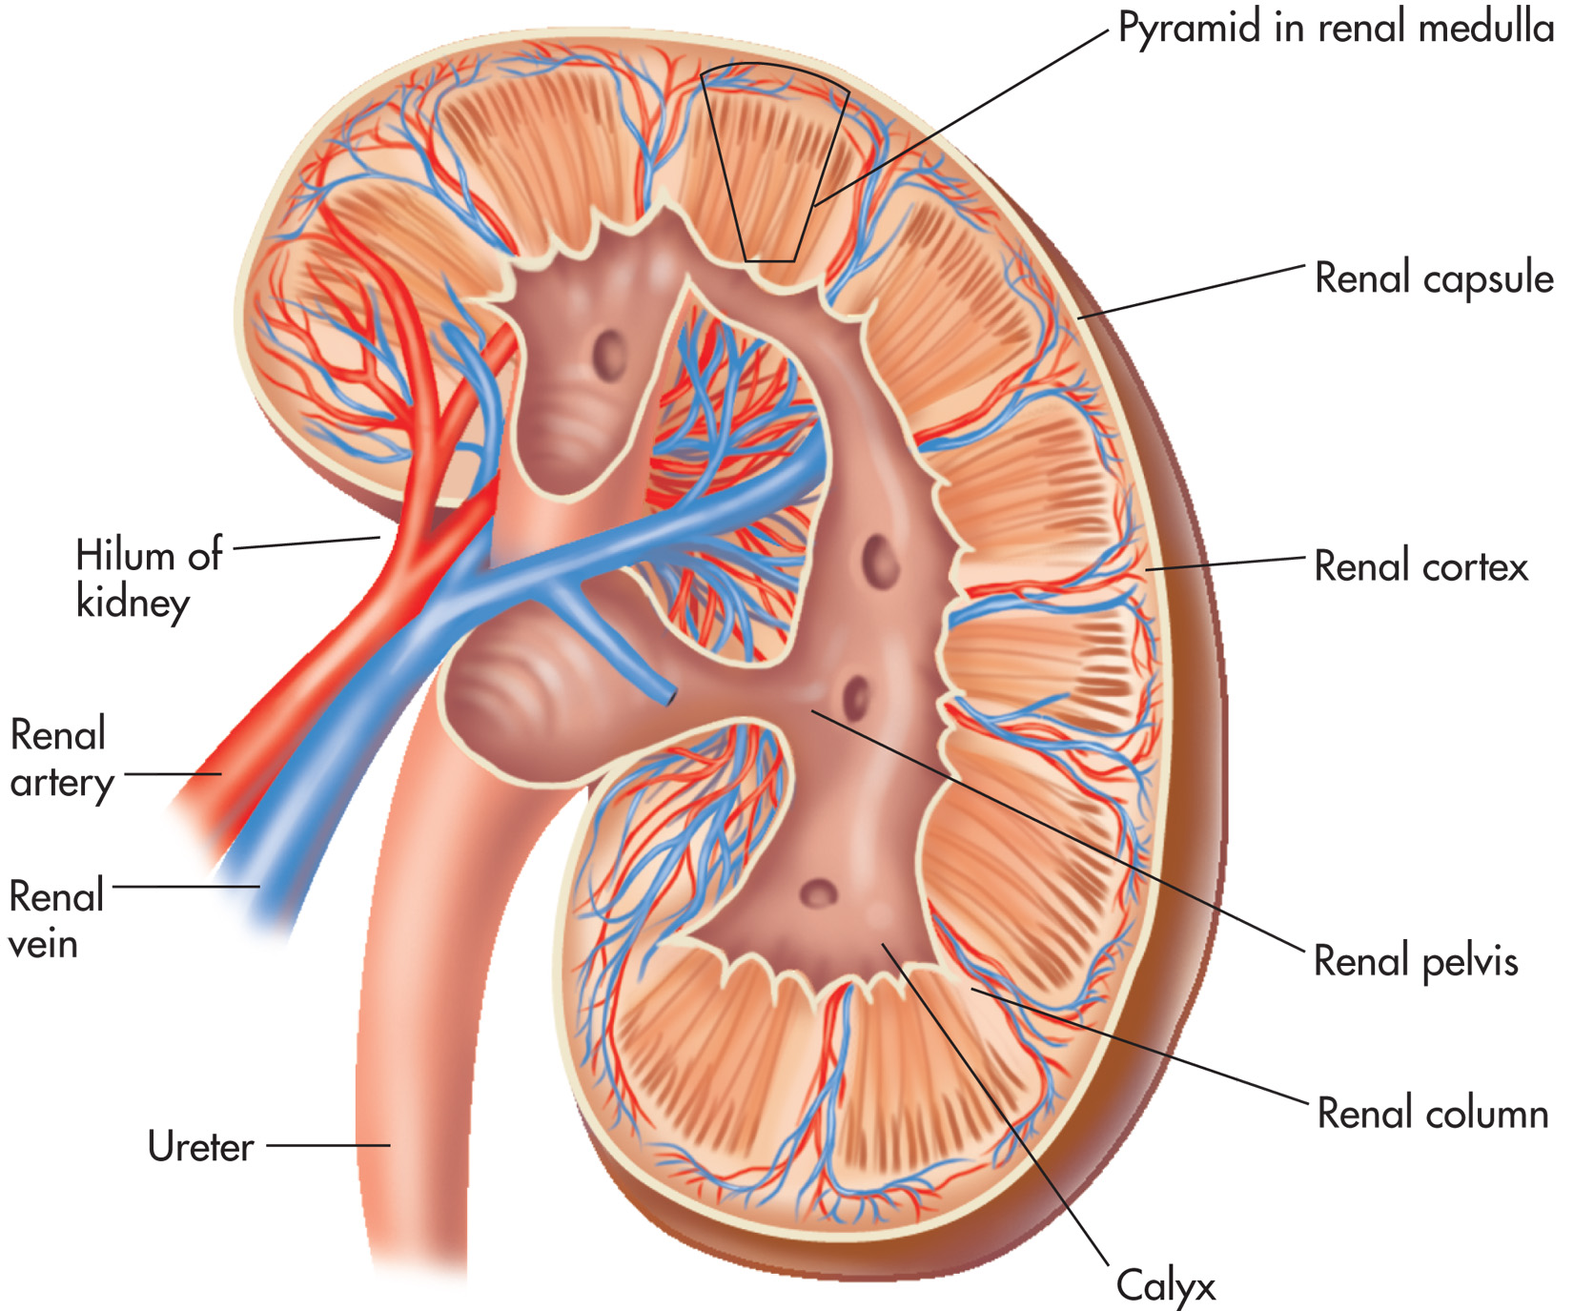
Figure 17–2
Notes:
The internal and external anatomy of the kidney.

Slide 17
Internal Anatomy of the Kidney (3 of 3)
Kidney has three layers
Renal pelvis
Inner layer
A funnel, divided into 2 or 3 large collecting cups called major calyces.
Each major calyx is divided into several minor calyces, forming cup-shaped areas around the tips of the pyramids.

Slide 18
Blood vessels
The blood is filtered by millions of tiny filters in the cortex, and the filtrate flows through tiny tubules in the medulla and collects in the renal pelvis.

Slide 19
Blood supply of the kidney
Blood is supplied to each kidney by the renal artery.
Renal artery forms segmental arteries.
Segmental arteries give rise to lobar arteries.
lobar arteries give interlobar arteries
Interlobar arteries arches near the base of the renal pyramids to form the arcuate arteries.
From the arcuate arteries arise the interlobular arteries.
From the interlobular arteries arise a single afferent arteriole for each nephron.
Afferent arteriole forms a ball of capillaries called glomerulus.
Capillaries then unite to form a single efferent arteriole.

Slide 20
The efferent arteriole will form peritubular capillaries around the renal tubules.
Blood is drained into veins corresponding to the arteries.
The blood is finally collected into a single renal vein that exits the kidney through the hilum.
The right and left renal veins drain into the inferior vena cava.

Slide 21
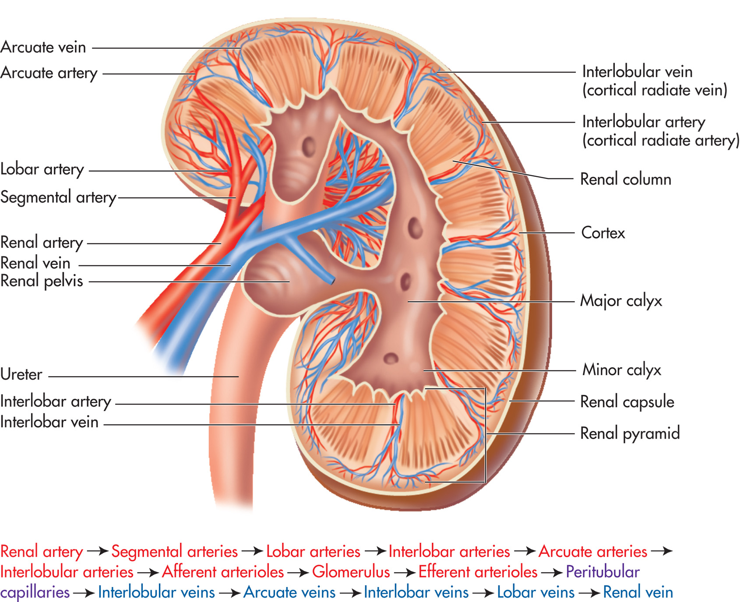
Figure 17–3
Notes:
Renal blood vessels and the pathway of blood through the renal system.

Slide 22
The Ureters
Two long muscular tubes that transport urine from the kidneys to the bladder.
The upper part of the ureter is dilated and forms the renal pelvis.

Slide 23
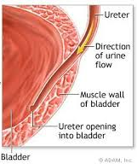
Fig.10: Course of the ureters. The small image shows the passage of the ureter within the bladder wall.

Slide 24
The ureters are constricted at three regions. These are common sites of stones:
Junction of renal pelvis and ureter
As ureter crosses pelvic brim
Within the wall of the bladder
Forces that move urine through the ureters:
Peristalsis
Hydrostatic pressure
Gravity

Slide 25
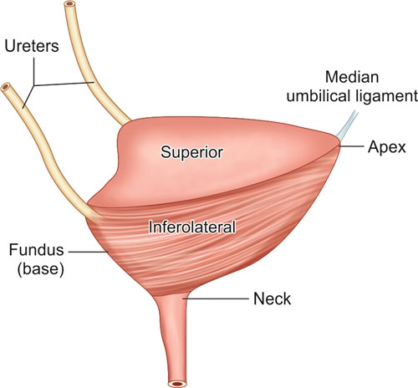
Urinary Bladder
The urinary bladder is a small hollow muscular organ posterior to the pubic symphysis and behind the peritoneum.

Slide 26
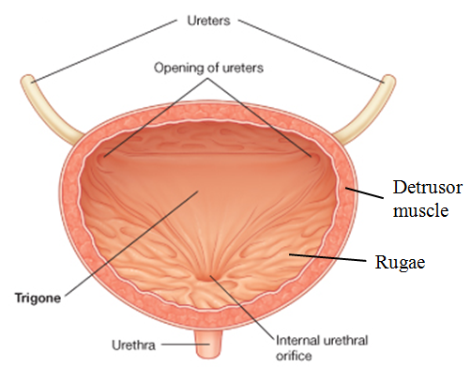
On the inner surface of the bladder, the area between the openings of the two ureters and the urethra is smooth and triangular and known as the Trigone.
Elsewhere in the bladder, the wall shows several rugae because the mucosa of the bladder is thrown into folds.

Slide 27
The wall of the bladder has three layers:
Mucosa – distensible epithelium
Thick Muscle (Detrusor Muscle) – intermingled smooth muscle fibers
Fibrous Adventitia

Slide 28
When empty, the bladder collapses into a pyramid shape.
As urine accumulates, the walls distend and stretch. There is no increase in internal pressure until there is about 300mL of accumulated urine.
A full bladder holds about 500mL of urine.

Slide 29
The Urethra
Short tube that carries urine to the outside of the body. In males the urethra is a passageway for semen also.
It starts from the urinary bladder at the internal urethral orifice (surrounded by a sphincter).
It’s longer in males than in females.
It opens to the outside at the external urethral orifice.

Slide 30
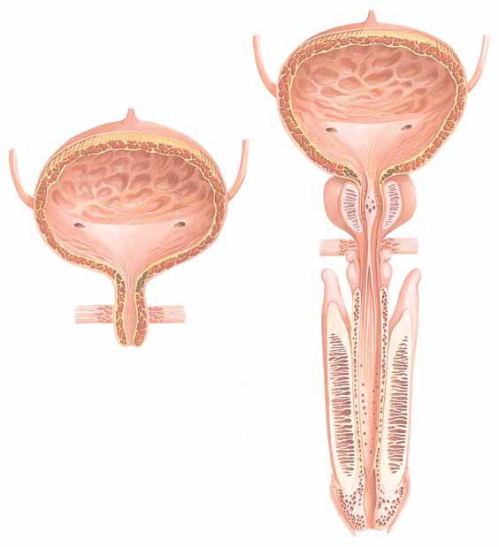
URETHRA STRUCTURE
Ureter
Urinary Bladder
Openings of Ureters
Ureter
Trigone
Prostate Gland
Trigone
Internal Urethral Sphincters
FEMALE
Cavernous (Spongy) Urethra
External Urethral Sphincters
MALE
In women, the urethra is 1 to 1.5 inches (2.5 to 4
cm) long and is anterior to the vagina.
Urethra
Cavernous (Erectile )Tissue of Penis
Urethral Opening
In men, the
urethra is 7 to 8 inches (17 to 20 cm) long. The male urethra carries
semen as well as urine.

Slide 31
The Nephron
The nephron is the structural and functional unit of the kidney.
Each kidney contains approximately 1 million nephrons.
Two distinct parts
Renal corpuscle (filter)
Renal tubule (reabsorption and secretion)

Slide 32
1. Renal Corpuscle
Blood enters the renal corpuscle via the glomerulus, a ball of capillaries.
Surrounding the glomerulus is a double-layered membrane called the Bowman’s capsule.

Slide 33
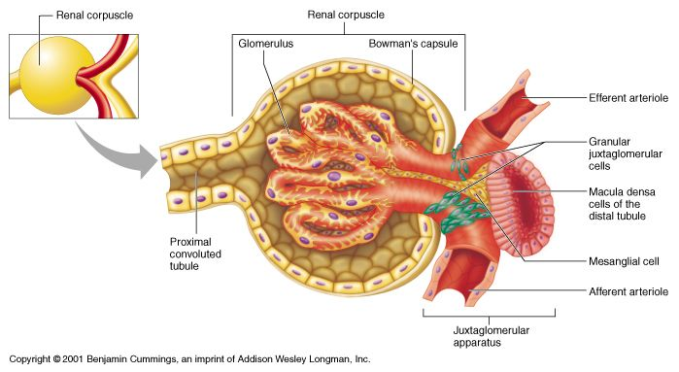
1. Renal Corpuscle (2 of 4)
The inner layer of the glomerular squamous epithelial cells called podocytes. This makes for a very efficient filter.

Slide 34
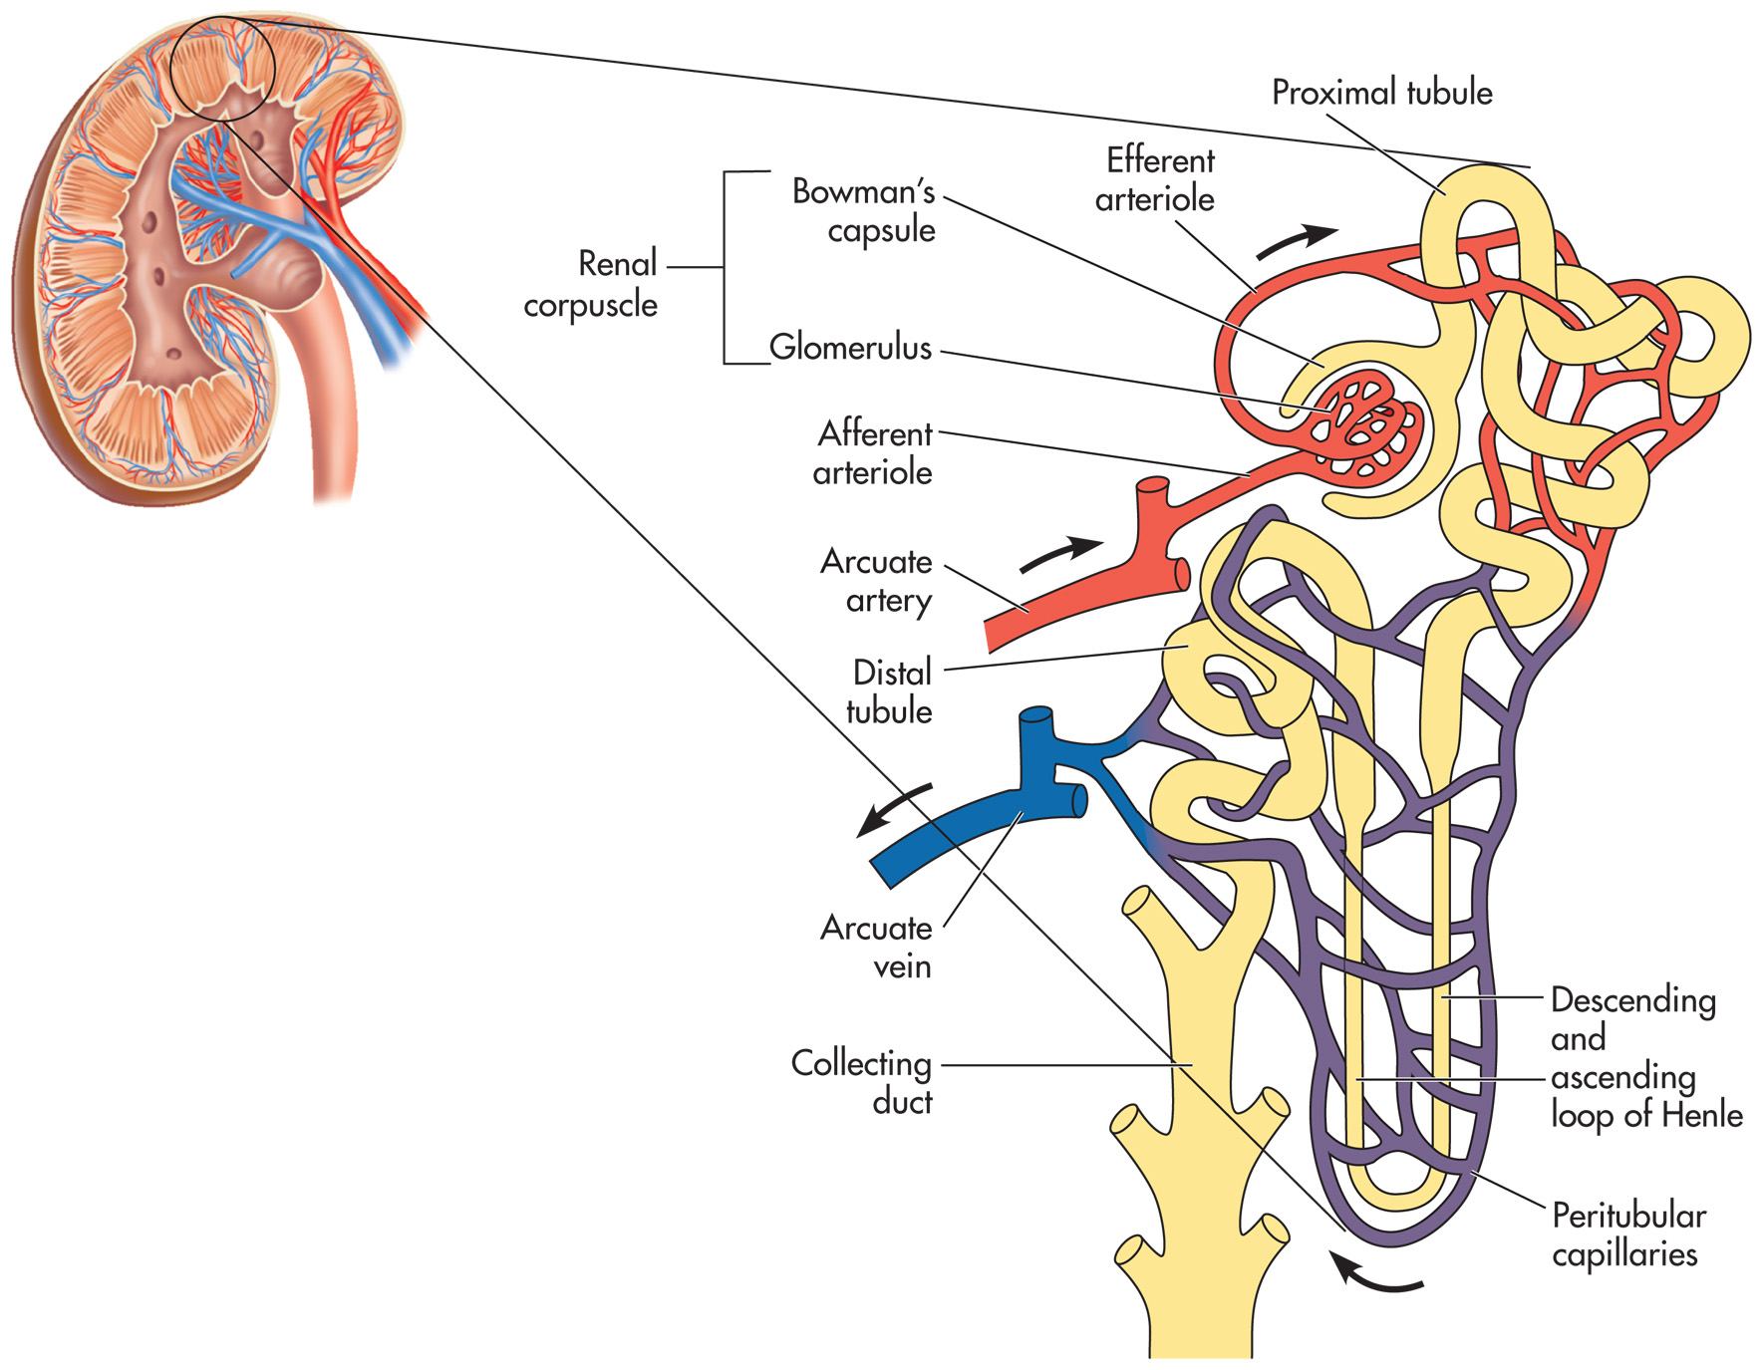
Figure 17–4
Notes:
The nephron.

Slide 35
2. Renal Tubule
The rest of the nephron is a series of tubes known as renal tubules.
Glomerular filtrate travels to the proximal tubule.
From proximal tubule, flows into nephron loop (the Loop of Henle) then distal tubule.

Slide 36
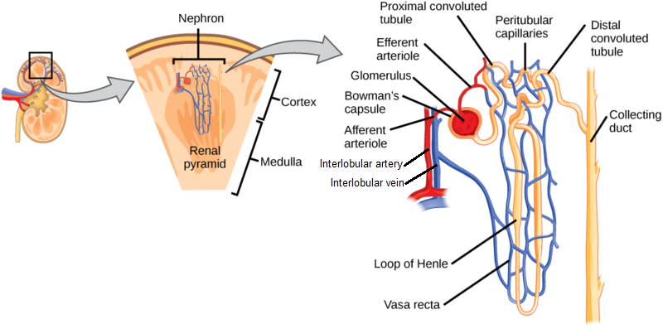

Slide 37
2. Renal Tubule
The collecting ducts lead to minor calyces, then to major calyces, the renal pelvis, and the ureter.
At this point, the glomerular filtrate is urine.

Slide 39
Thank You Any questions?

