Slide 1
Chapter 13
The Cardiovascular System
Lecture 6
Copyright © 2020, 2016, 2011 Pearson Education, Inc. All Rights Reserved
Notes:
If this PowerPoint presentation contains mathematical equations, you may need to check that your computer has the following installed:
1) MathType Plugin
2) Math Player (free versions available)
3) NVDA Reader (free versions available)

Slide 2
Learning Outcomes
1. Identify structures and functions of the cardiovascular system.
2. Explain the cardiac cycle and trace the blood flow through the vessels and chambers of the heart.
3. Explain coronary circulation
4.List the major components of blood and their functions.

Slide 3
Introduction
The cardiovascular system transports nutrients and oxygen to the cells while carbon dioxide and waste products of cells’ metabolism are removed.

Slide 4
System Overview
Heart
Pumps blood
Blood
(Carrier )Connective tissue made up of plasma and cells
Blood vessels
Network of passageways to transport blood to/from cells

Slide 5
System Overview
Circulation is the movement of blood to and from the heart.
Pulmonary circulation: from heart to lungs and back
Systemic circulation: from heart to body tissues and back

Slide 6
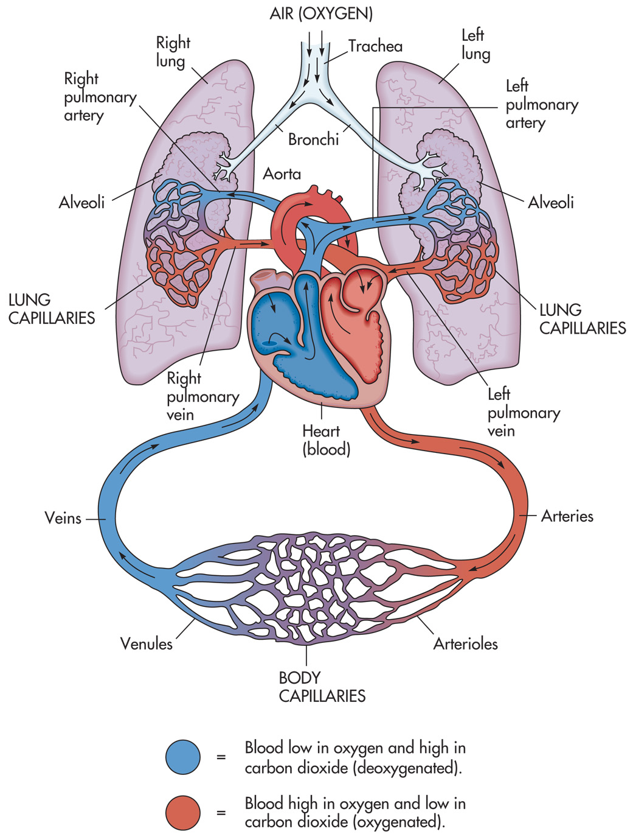
Notes:
Overview of the cardiovascular system.

Slide 7
General Structure and Function of the Heart
The heart is the size of your fist, located slightly left of the center of your chest.
The base of the heart is proximal to your head while the apex of the heart is distal.

Slide 8
General Structure and Function of the Heart
The heart is one single organ; two pumps working together.
Right side - collects blood from the body and sends it to the lungs
Left side - collects blood from the lungs and sends it to the rest of the body.

Slide 9
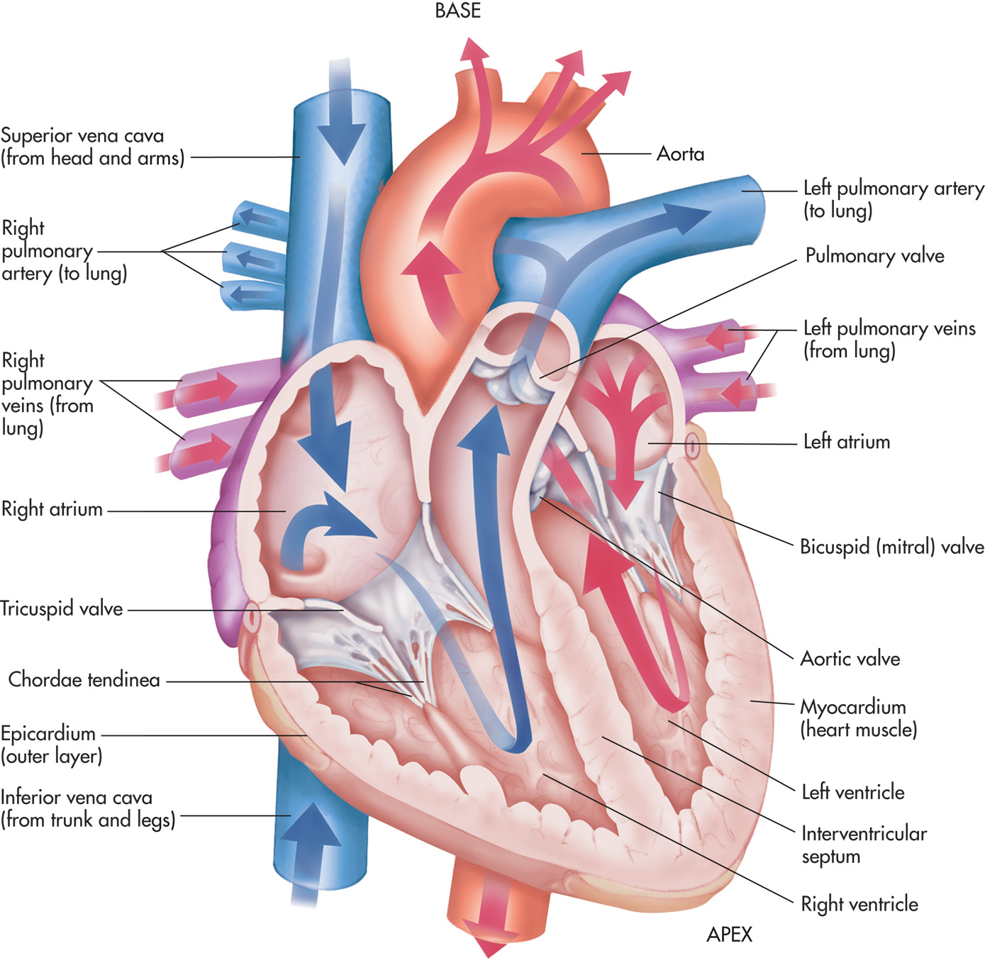

Slide 10
Heart Wall
The heart is surrounded by a tough membrane, the fibrous pericardium.
The parietal layer of the serous pericardium lines the fibrous pericardium.
The visceral layer is fused to the heart surface, and there is a potential cavity between the layers called the pericardial cavity.

Slide 11
Heart Wall
Epicardium: outer layer of heart wall
Same layer as visceral pericardium
Myocardium: middle layer; made of cardiac muscle
Endocardium: epithelium that lines the heart

Slide 13
Cardiac champers
The heart has four chambers.
The small upper chambers are the atria.
The large lower chambers are the ventricles.

Slide 15
Cardiac septums
Interatrial septum: wall that separates the two atria
Interventricular septum: wall between the ventricles

Slide 16
Cardiac walls
Atrial walls: thinner than the ventricular walls.
Higher pressures are generated in the ventricles to move blood.
Walls of the left ventricle: thicker than the walls of the right ventricle because the right ventricle only pumps blood to the lungs while the left ventricle must pump blood throughout the entire body.

Slide 17
Major veins
Two veins bring the blood to the right atrium.
Superior vena cava
Blood from the head, neck, chest, and upper extremities
Inferior vena cava
Blood from the trunk, organs, abdomen, pelvic region, and lower extremities

Slide 19
Major blood vessels
The pulmonary artery carries blood from the right ventricle to the lungs.
Pulmonary veins bring blood back to the left atrium.
The aorta carries blood from the left ventricle to the body.

Slide 20
Cardiac valves
To keep blood flowing in the correct direction through the heart, there are two sets of valves.
1. Atrioventricular (A V) valves
Between each atrium and the ventricle on the same side
On the right side is the tricuspid valve because the valve is formed with three cusps, or folds.
The valve on the left is the bicuspid, or mitral valve.

Slide 22
Cardiac valves
2. Semilunar valves
Between the ventricles and the large arteries that carry blood away from the heart
The pulmonary semilunar valve is on the right.
The aortic semilunar valve is on the left.

Slide 23
Cardiac Cycle Points to Remember
Both atria fill at the same time.
Both ventricles fill at the same time.
Both ventricles eject blood at the same time when the heart contracts.

Slide 24
Coronary Circulation
A portion of the newly oxygen enriched blood leaving the heart is diverted from the aorta by the right and left coronary arteries.
These arteries continuously divide into smaller branches forming a web of interconnections, known as anastomoses, in order to consistently supply the heart muscle with a rich supply of blood.
Regular aerobic exercise increases the density of these blood vessels and the number of anastomoses also increases.

Slide 25
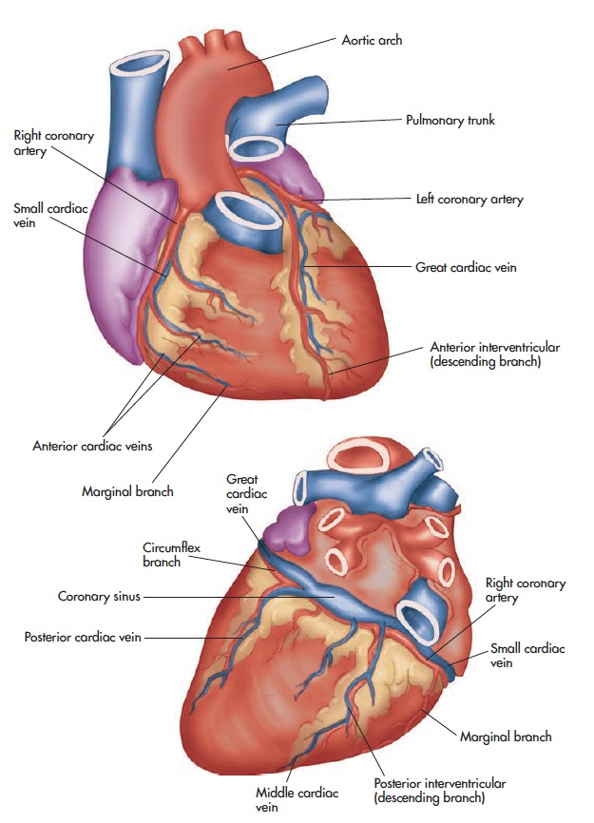
Coronary Circulation
The right coronary artery provides blood for the right ventricle, the posterior portion of the interventricular septum, and inferior parts of the heart.
The left coronary artery provides blood to the left lateral and anterior walls of the left ventricle, and portions of the right ventricle and interventricular septum.

Slide 27
Notes:
Coronary circulation.

Slide 28
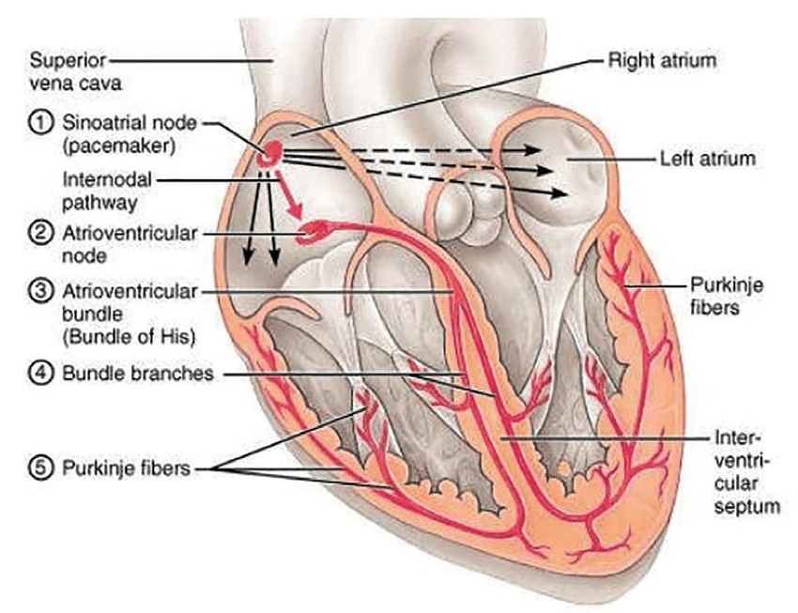
Conduction system of the heart

Slide 29
Blood Vessels
Artery
Arteries carry blood from the heart to capillaries.
Smaller arteries are called arterioles.
Inner lumen is smaller than vein.

Slide 30
Blood Vessels
Veins
Veins carry blood from capillaries back to the heart.
Smaller veins are called venules.
The same three tissue layers are present in veins as in the walls of arteries, but in different thickness.
All the three layers are thin and Tunica media is also thin.
Inner lumen is very large.

Slide 31
CAPILLARIES
Capillaries carry blood from arterioles to venules.
Their walls are only one cell in thickness.
Most tissues, however, have extensive capillary networks.

Slide 32
Blood Vessels–Vascular System
Blood leaves the heart through the aorta which branches into large vessels called arteries.
Arteries divide into smaller and smaller vessels, the smallest of which are called arterioles.
Arterioles feed into capillaries that form capillary beds in your body’s tissues, allowing oxygen and nutrients to enter cells and removing carbon dioxide and waste products.

Slide 33
Walls of Blood Vessels
Walls are composed of three layers, often referred to as coats or tunics.
Tunica interna
Innermost layer
It is composed of a loose layer of tissue made up of squamous epithelial cells.

Slide 34
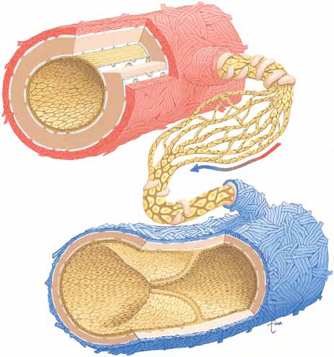
External elastic lamina
Artery (carry oxygenated blood)
Internal elastic lamina
Arteriole
ARTERY
Endothelial cells single layered
Tunica Externa
Capillary (exchange of oxygen and carbon dioxide
Blood Flow
Tunica Media
Endothelium lining
Venule
Tunica Intima
Vein (carry deoxygenated blood)
VEIN

Slide 35
Walls of Blood Vessels
Walls are composed of three layers, often referred to as coats or tunics.
Tunica media
Middle layer
This layer is thicker and is composed mainly of smooth muscle, elastic tissue, and collagen.
By contracting or relaxing those muscles, this layer actually controls the diameter of the vessels to meet certain blood flow needs of the body at a given time.

Slide 36
Walls of Blood Vessels
Tunica externa
Outermost layer
Due to its composition of mostly fibrous tissue, its job is to provide vessel support and protection.

Slide 37
Walls of Blood Vessels
Blood vessel structure varies, depending on their job.
Arteries possess much thicker walls than veins because arteries are closer to the heart and have to deal with higher pressures.
Larger arteries contain complete sheets of elastic tissue, elastic laminae, in their middle walls to help deal with this increased pressure.

Slide 38
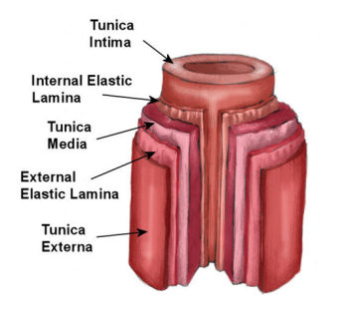

Slide 39
Walls of Blood Vessels
The lumen in veins are larger than in arteries, and also contain valves that prevent backward flow of blood.
The relaxation and contraction of muscles in your body that surround veins help to “milk” the blood toward the heart.

Slide 40
Walls of Blood Vessels
Capillaries
Composed of only the tunica interna
Diameter of only 0.008 millimeters and only one cell layer thick
Oxygen and nutrients can easily move into tissues.
Carbon dioxide and wastes can move into blood.
Dozens of capillaries form a web (capillary bed).

Slide 41
Walls of Blood Vessels
Precapillary sphincters
Composed of smooth muscle, allow blood to flow through or stop blood flow when they contract

Slide 42
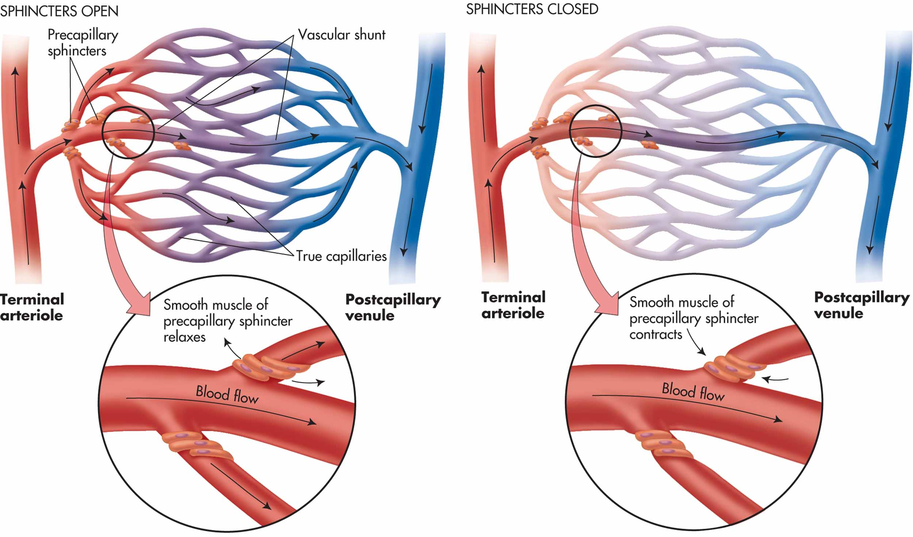
Figure 13–12
Notes:
Capillary beds and sphincters.

Slide 43
The Lymphatic Connection
The lymphatic system runs parallel to the C V system and has three major responsibilities.
Maintain fluid balance by returning interstitial fluid to the venous side of the C V system

Slide 44
The Lymphatic Connection
Assist the C V system in distributing nutrients and hormones, and the removal of waste products from tissues
Help to prevent infection and disease by utilizing lymphocytes

Slide 45
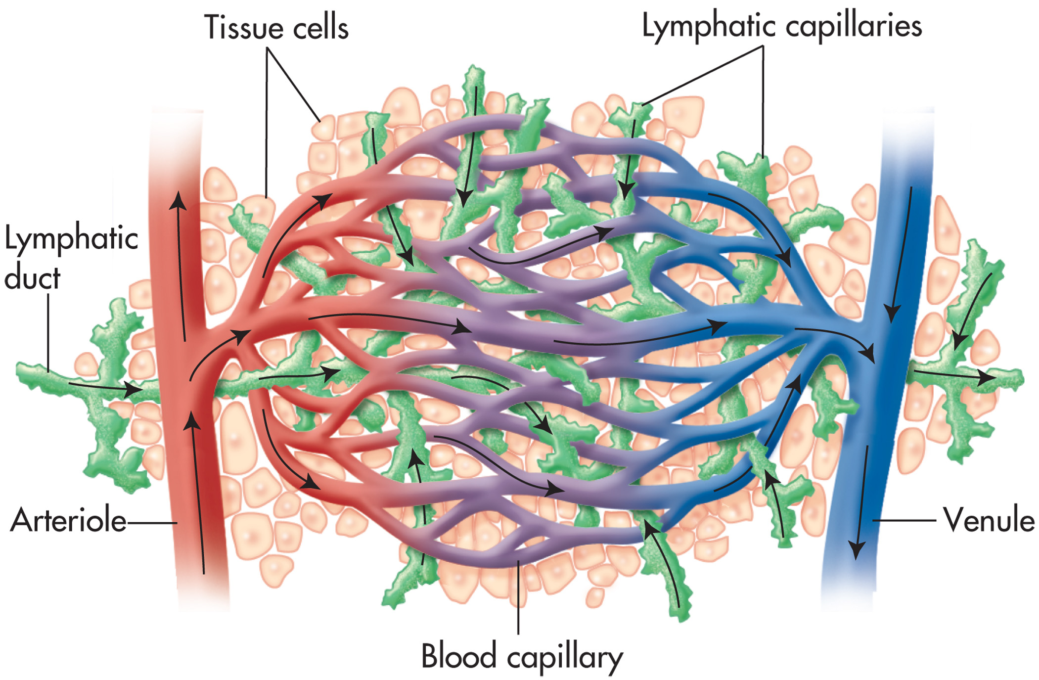
Figure 13–14
Notes:
Relationship of the lymphatic system to the cardiovascular system.

Slide 46
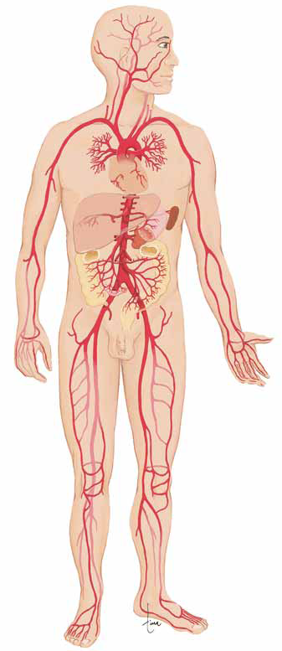
Facial artery
Common Carotid artery
Subclavian artery
Brachiocephalic artery
Brachial artery
Aortic arch
Intercostal arteries
Hepatic artery
Renal artery
Dorsal aorta
Inferior mesenteric arteries
Right common iliac artery
Radial artery
Ulnar artery
Femoral artery
Popliteal artery
Anterior tibial artery
Posterior tibial artery
ARTERIAL SYSTEM

Slide 47
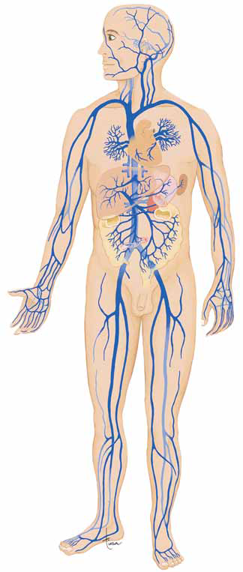
Anterior facial vein
Internal jugular vein
External jugular vein
Subclavian vein
Superior Vena Cava
Brachiocephalic vein
Hemiazygos vein
Pulmonary arteries
Intercostal vein
Brachial vein
Inferior Vena Cava
Hepatic vein
Renal vein
Hepatic Portal vein
Common Iliac vein
Mesenteric veins
External iliac vein
Internal iliac vein
Femoral vein
Popliteal vein
Anterior Tibial vein
VENOUS SYSTEM
Dorsal Arch

Slide 48
Blood
Blood is a fluid form of connective tissue.
The amount of blood in the body depends on size and sex.
Normally you have 4-6 liters of blood; about 7-9% of your total body weight.

Slide 49
Blood Composition
The major components of blood are plasma and formed elements.
Plasma
Plasma is the yellowish, straw-colored liquid that comprises about 55% of the blood’s volume.
Plasma is 90% water.
The other 10% contains nutrients, salts, oxygen, hormones and other regulatory substances.

Slide 50
Blood Composition
Plasma
Plasma proteins include albumin, which aids in keeping the correct amount of water in the blood.
Fibrinogen is a substance needed for blood clotting, and globulins for protection from infection.

Slide 51
Blood Composition
Formed elements
Red Blood Cells (R B Cs) or erythrocytes
White Blood Cells (W B Cs) or leukocytes
Basophils
Eosinophils
Lymphocytes
Monocytes
Neutrophils
Thrombocytes or platelets

Slide 52
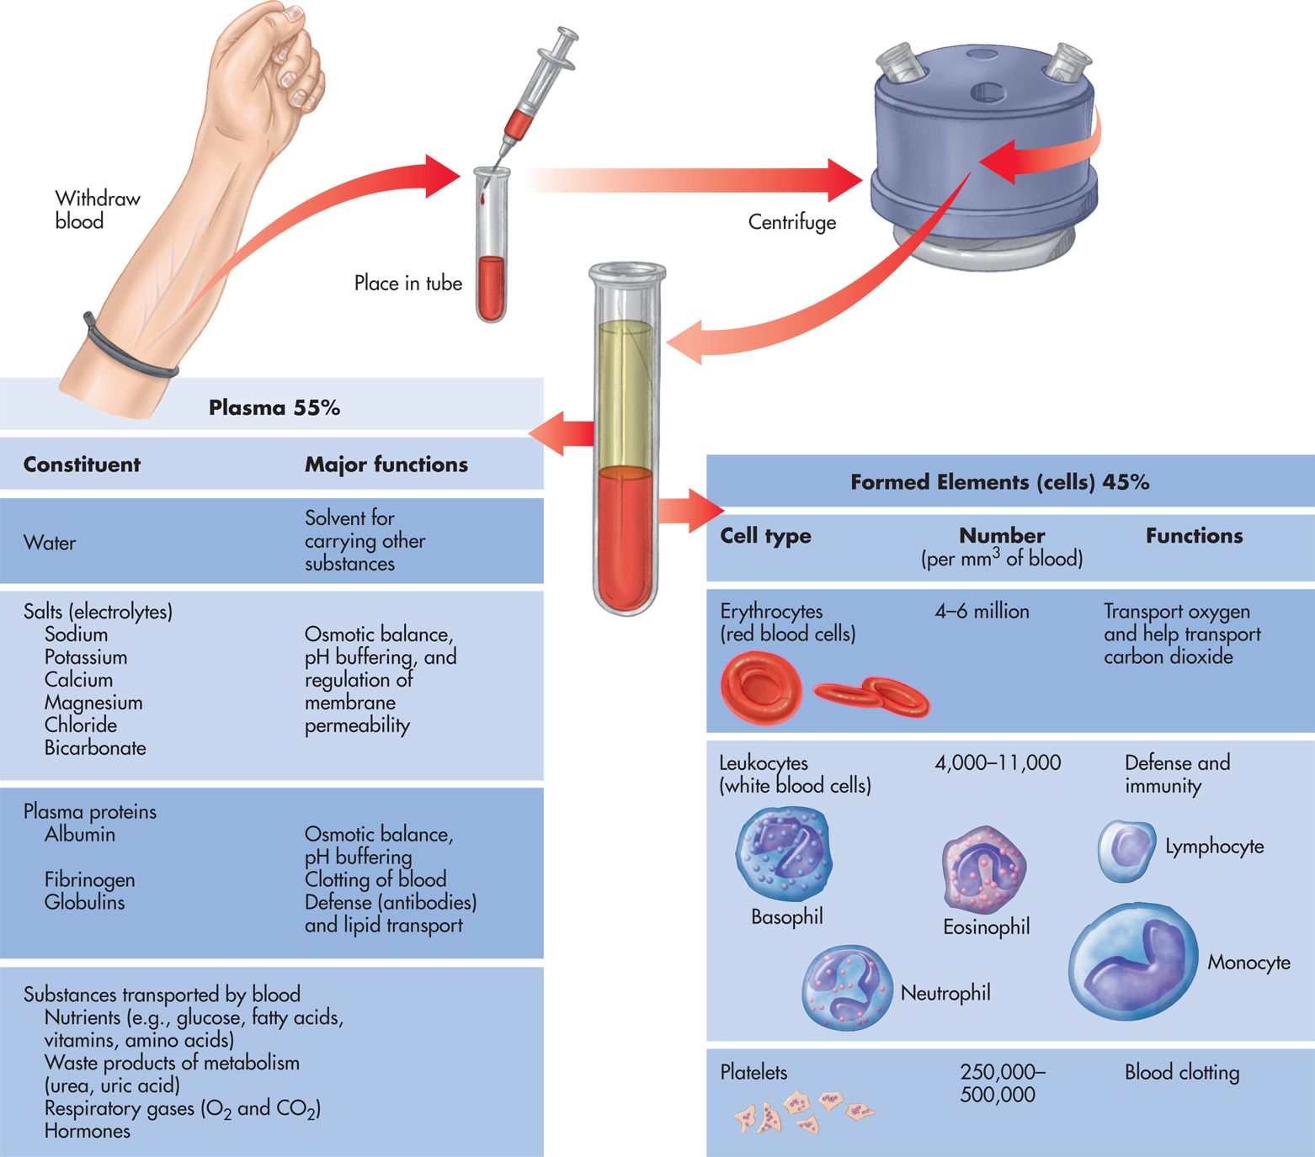
Figure 13–7
Notes:
Composition of blood.

Slide 53
Erythrocytes (RBC)
Red blood cells are created by the red bone marrow through a process called erythropoiesis because they lack a nucleus to reproduce themselves.
R B Cs are similar to a doughnut in shape.
Life span of 120 days
Red blood cells perform two crucial functions.
transport oxygen - With the aid of an iron-containing red pigment called hemoglobin
transport carbon dioxide from the cells to the lungs for removal.

Slide 54
Leukocytes (WBC)
Guardians from invasion and infection
Divided into two main types
Polymorphonuclear granulocytes originate from red bone marrow.
Mononuclear agranulocytes originate from bone marrow, but mature in lymphoid and myeloid tissue.

Slide 55
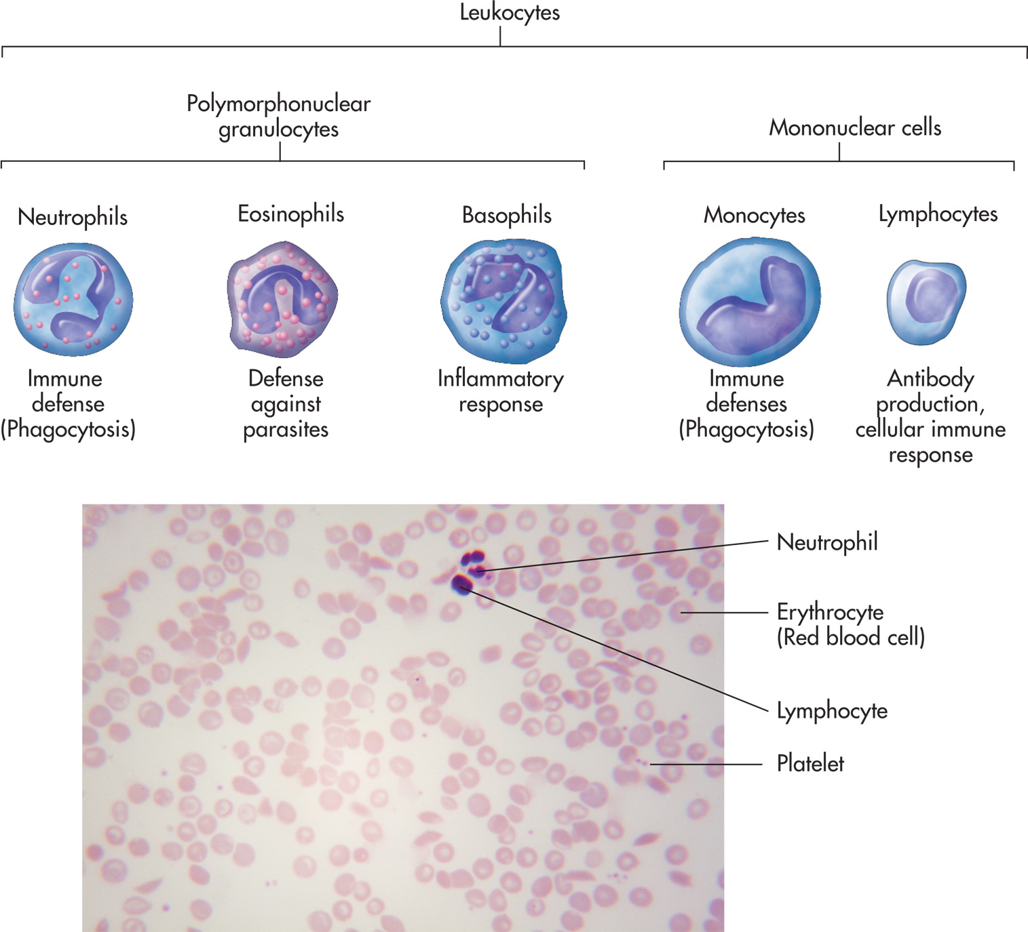
Notes:
Functions of white blood cells. (Source: Ggw/Shutterstock)

Slide 56
Polymorphonuclear Granulocytes
Three types of polymorphonuclear granulocytes exist.
Neutrophils
Most aggressive W B Cs in cases where bacteria attempt to destroy tissue
Use phagocytosis to destroy bacteria
As an infection occurs, the body produces a higher than normal number of neutrophils.

Slide 57
Polymorphonuclear Granulocytes
Eosinophils
Utilized to combat parasitic invasions and allergies
Basophils
Involved with allergic reactions and inflammation

Slide 58
Mononuclear Agranulocytes
Two types of mononuclear agranulocytes exist.
Monocytes
Found in higher than normal amounts when a chronic infection occurs
Destroy invaders through phagocytosis

Slide 59
Mononuclear Agranulocytes
Lymphocytes
Protect us from infection by using a process that produces antibodies that inhibit or directly attack invaders
Some lymphocytes directly attack invaders.

Slide 60
Thrombocytes (platelets)
The smallest formed elements
Responsible for the blood’s ability to clot
Platelets stick together and plug a hole in a blood vessel and can release a substance called serotonin, which causes smooth muscle constriction and decreased blood flow.

Slide 61
Blood Types and Transfusions
A person needing a blood transfusion cannot randomly select a blood donor because of antigens, cell surface markers.
Foreign antigens which were not originally found in the body are “non-self” antigens.
“Self-antigens” exist on the cell membrane of every cell in our body.

Slide 62
Blood Types and Transfusions
Antibodies will react with the antigens that caused them to form, and the antigens stick together in little clumps, called agglutination.
This chain of events called the antigen-antibody reaction is the basis of the immune response.
While there are over 50 different antigen types, the main focus is on A, B, and R h antigens.

Slide 63
Type A
Very common; approximately 41% of U . S. population has this type A
“A” represents a specific type of “self” antigen found on the cell membrane of the R B C.
Since person was born with type A blood, no antibodies were created to fight it, so there are no anti-A antibodies, but there are anti-B antibodies.

Slide 64
Type B
Possess type B antigens
Plasma contains anti-A antibodies.
If a person with type B blood was given type A blood, the anti-A antibodies would attack the donated R B Cs and destroy them because they see the cells as foreign material.
Antibodies cause agglutination, resulting in serious harm and even death

Slide 65
Type A B Blood
Contains both A and B self antigens
Has neither A nor B antibodies in the plasma
Because there are no A or B antibodies, people with type A B blood are called universal recipients because they can accept any type of blood type transfusion.

Slide 66
Type O Blood
Contain no A or B antigens, but its plasma contains both A and B antibodies.
Type O blood can be given to anyone and the person with type O blood is labeled a universal donor.

Slide 67
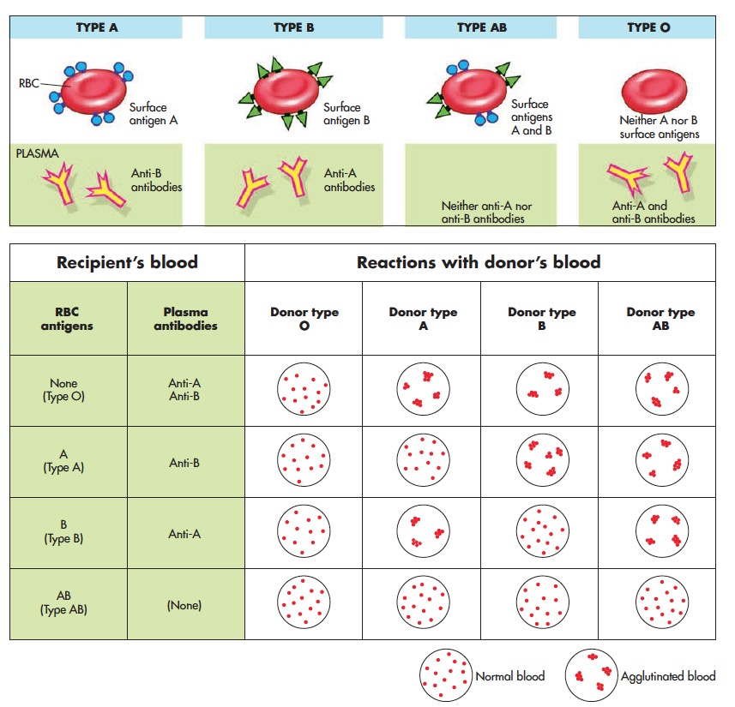
Figure 13–9
Notes:
Blood types and results of donor recipient combinations.

Slide 68
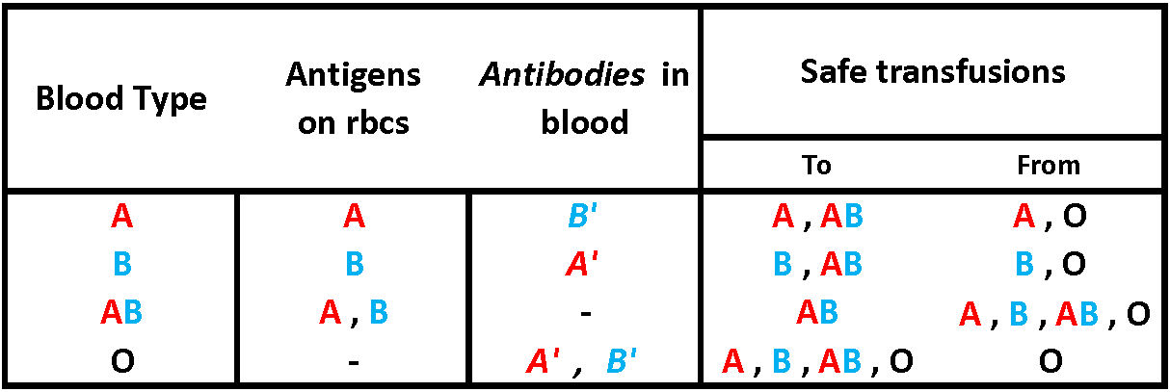

Slide 69
Any Questions?

