Slide 1
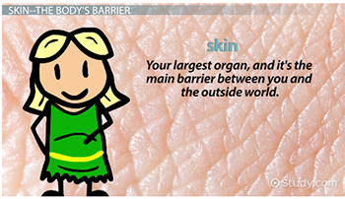
The Integumentary System (skin)
Chapter 8
Lecture 2
Notes:
If this PowerPoint presentation contains mathematical equations, you may need to check that your computer has the following installed:
1) MathType Plugin
2) Math Player (free versions available)
3) NVDA Reader (free versions available)

Slide 2
Learning Outcomes
Discuss the functions of the integumentary system.
List and describe the layers of the skin.
Describe the purposes, structure, and growth of nails and hair.
Describe common disorders of the integumentary system
Types of tissues

Slide 3
System Overview
The integumentary system is comprised of the skin and its accessory components including hair, nails, and associated glands.

Slide 4
Integumentary System Functions
Protection from pathogens
Balances fluid levels
Stores fatty tissue for energy supply
Produces vitamin D (with help from the sun)
Provides sensory input
Helps to regulate body temperature

Slide 5
The Skin
The largest organ
  Weighs approximately 20 pounds
  Covers an area about 21 square feet on an adult
Three layers include:
  Epidermis
  Dermis
  Subcutaneous fascia

Slide 6
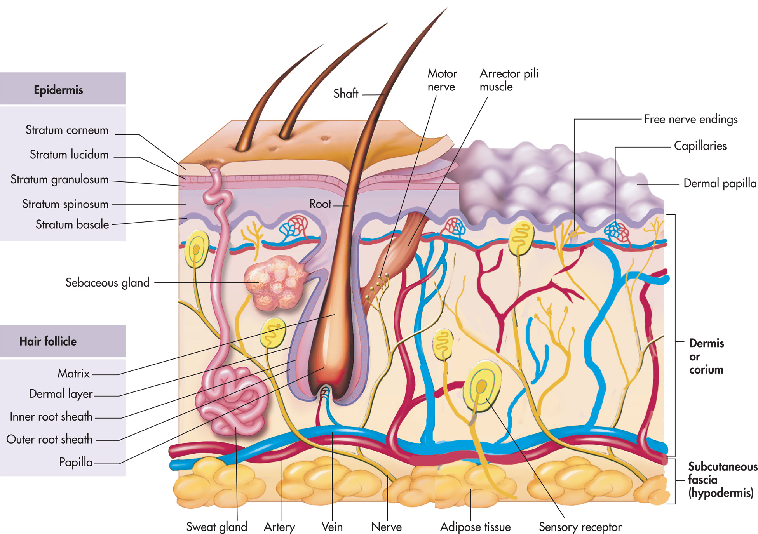
Notes:
The three layers of the skin.

Slide 7
1. Epidermis
Outside layer of skin
  It is made up of five smaller layers of tissue.
Avascular (no blood vessels)
Surface cells constantly shed, replaced with new cells that grow stratum basale every 2–4 weeks
  Stratum germinativum: region of cell birth (basal layer)

Slide 8
Epidermis (2 of 2)
The outermost layer is a layer of dead cells, called the stratum corneum, which are flat, keratinized epithelial cells.
slough off 500 million cells every day, or about 1½ pounds of dead skin a year, allowing for rapid repair in case of injuries.

Slide 9
layers of Epidermis
Stratum Basale: known as stratum germinativum, is the deepest layer,The cells found are constantly producing keratinocytes. This layer also contains melanocytes.
Stratum spinosum: Dendritic cells can be found in this layer.
Stratum granulosum: The lamellar granules contain the glycolipids that get secreted to the surface of the cells and function as a glue, keeping the cells stuck together.
Stratum lucidum: present in thicker skin found in the palms and soles.
Stratum corneum: is the uppermost layer, made up of keratin and horny scales made up of dead keratinocytes. This is the layer which varies most in thickness.

Slide 10
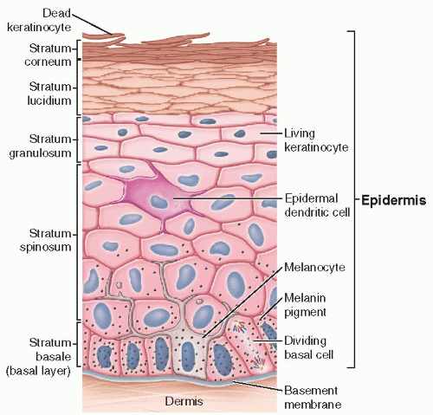

Slide 11
Which of the following structures is NOT found in the dermis layer?
a. Sweat glands
b. Hair follicles
c. Blood vessels
d. Stratum corneum

Slide 12
Cells of the Epidermis
Keratinocytes: produce keratin, and are responsible for the formation of the epidermal water barrier by making and secreting lipids. Keratinocytes also regulate calcium absorption.
Melanocytes are primarily produce melanin, which is responsible for the pigment of the skin.
Langerhans cells: dendritic cells, are the skins first line defenders and play a significant role in antigen presentation.
Merkel cells: These cells serve a sensory function.

Slide 13
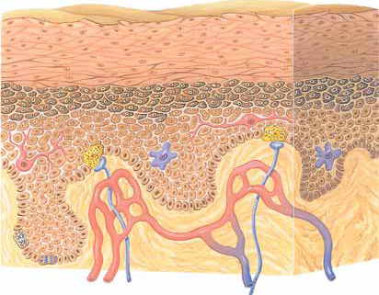
Cells of the Epidermis
Langerhan’s cell (for protection from germs)
Melanocytes (produce melanin for skin color)
Merckel cell receptors for touch
Sratum
Corneum
Upper portion of DERMIS
Mitosis
Cell Division
Stratum
Germinativum
Capillary
Sensory neurons

Slide 14
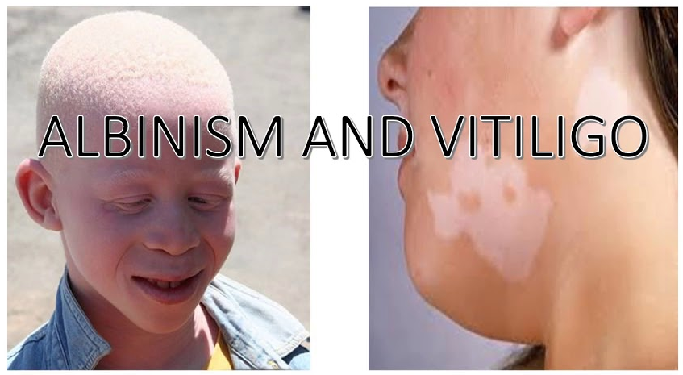
Skin Color
Skin color variation is the result of melanin is distributed, not the number of melanocytes.
People with genetic condition of albinism have little skin pigment.

Slide 15
2. Dermis
Contains
  Capillaries
  Muscles
  Nerve endings
  Lymph vessels
  Hair follicles
  Sudoriferous (sweat) and sebaceous (oil) glands

Slide 16
Notes:
The three layers of the skin.

Slide 17
2. Dermis
  Fingerprints and other unique patterns arise from dermis.
Nerve fibers provide sensation to environment.
Vasodilation of capillaries in this layer causes blushing.

Slide 18
2. Dermis
Collagen and elastic fibers allow for the elasticity of skin, preventing the tearing of skin with movement.
  Allows skin to return to normal shape during periods of rest (turgor)
  Older people lose some of this elasticity, leading to wrinkles.

Slide 19
2. Dermis
Sweat Glands
Two main types of sweat:
  Apocrine: secrete at hair follicles in groin, anal region, armpits; become active at puberty.
  Eccrine: found in greater numbers on palms, feet, forehead, upper lip.

Slide 20
2. Dermis
Sweat Glands
The body has 3 million sweat glands.
Sweat has no odor, but bacteria degrades the substances in the sweat over time into chemicals that give off strong smells commonly known as body odor.

Slide 21
Dermis
Sebaceous Glands
Play an important role by secreting oil (sebum)
  Sebum keeps skin from drying out.
  Acidic nature helps destroy some pathogens on skin’s surface.

Slide 22
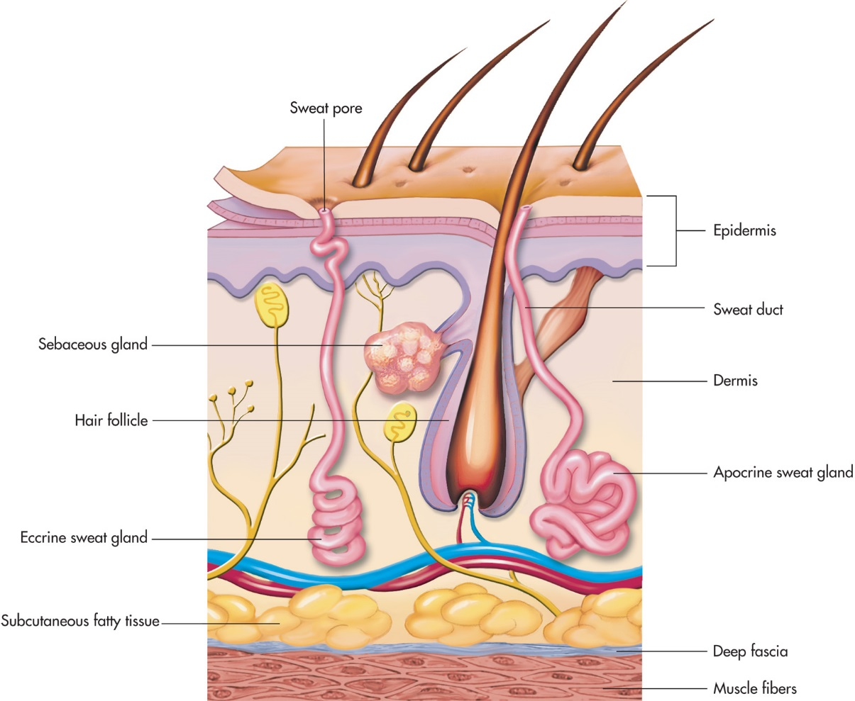
Figure 8–3
Notes:
Sweat and sebaceous glands.

Slide 23
3. Subcutaneous
Innermost layer of the skin; also called hypodermis
Composed of elastic and fibrous connective tissue and fatty tissue
Lipocytes (fat cells) produce the fat to provide padding and act as temperature regulation.
attaches to the body muscles.

Slide 24
Which layer of the skin contains blood vessels, nerves, and hair follicles?
a. Epidermis
b. Dermis
c. Hypodermis
d. muscularis

Slide 25
Which of the following is true about the epidermis?
a. It is the innermost layer of the skin.
b. It contains blood vessels and nerves.
c. It is responsible for producing sebum.
d. It is composed of multiple layers of cells.

Slide 26
Burns to the Skin
Burns can be caused by heat, chemicals, electricity, or radiation.

Slide 27
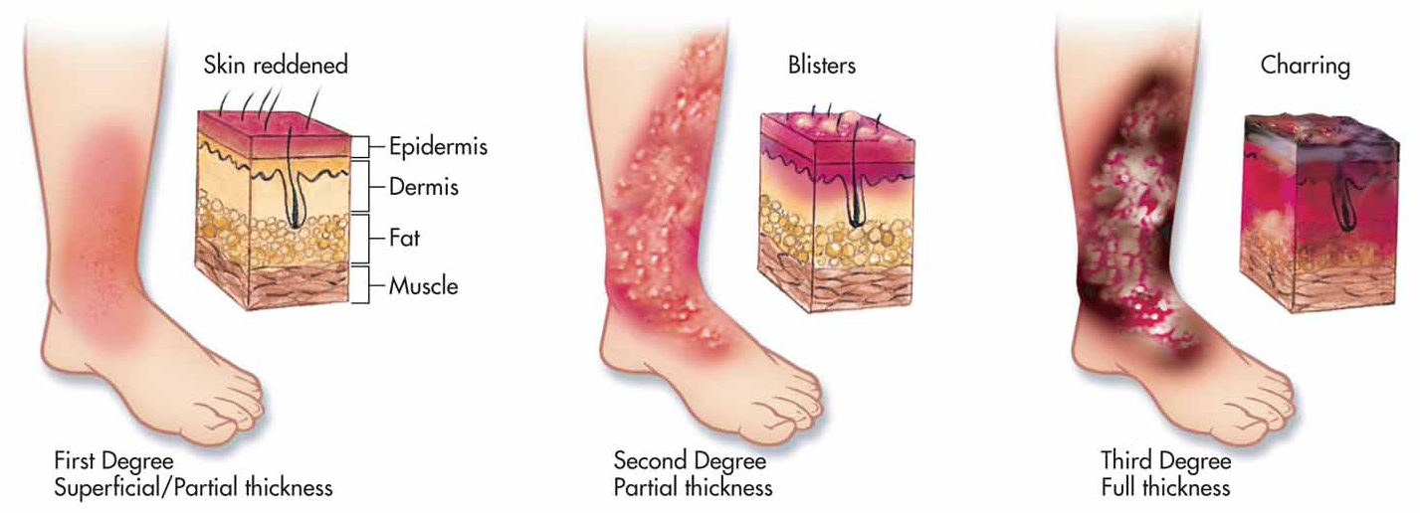
Figure 8–6 (2 of 3)
Notes:
Assessing the degree of the burn.

Slide 28
Nails (1 of 2)
Specialized epithelial cells originating from the nail root the nails.
  Keratinization
The cuticle is a fold of tissue that covers the nail root.

Slide 29
Nails (2 of 2)
Nail body: visible portion
Lunula: white, half moon-shaped area
Nails normally grow 1 millimeter every week.

Slide 30
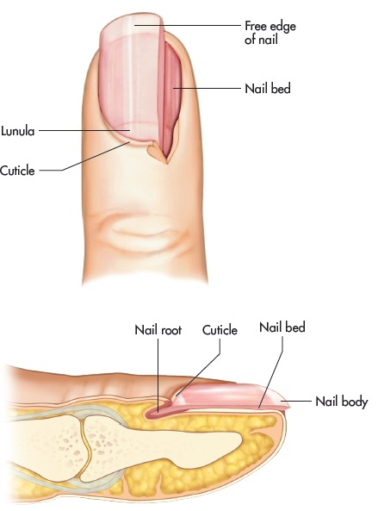
Figure 8–7
Notes:
Structures of the fingernail.

Slide 31
Hair Anatomy (1 of 3)
Visible hair is composed keratin, a fibrous protein.
Shaft: visible hair
Cuticle: protective cells covering shaft
Follicle: formed by epithelial cells with a rich source of blood provided by the dermal blood vessels
Cells divide and grow in the base of the follicle, older cells are pushed away and die, so the shaft of the hair is comprised of dead cells.

Slide 32
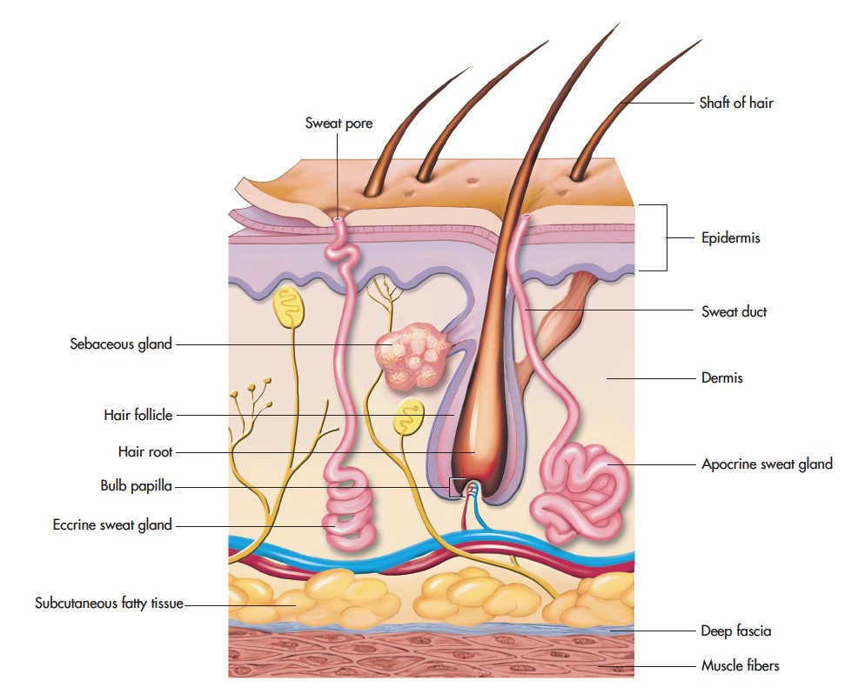
Figure 8–9
Notes:
Diagram of a hair follicle.

Slide 33
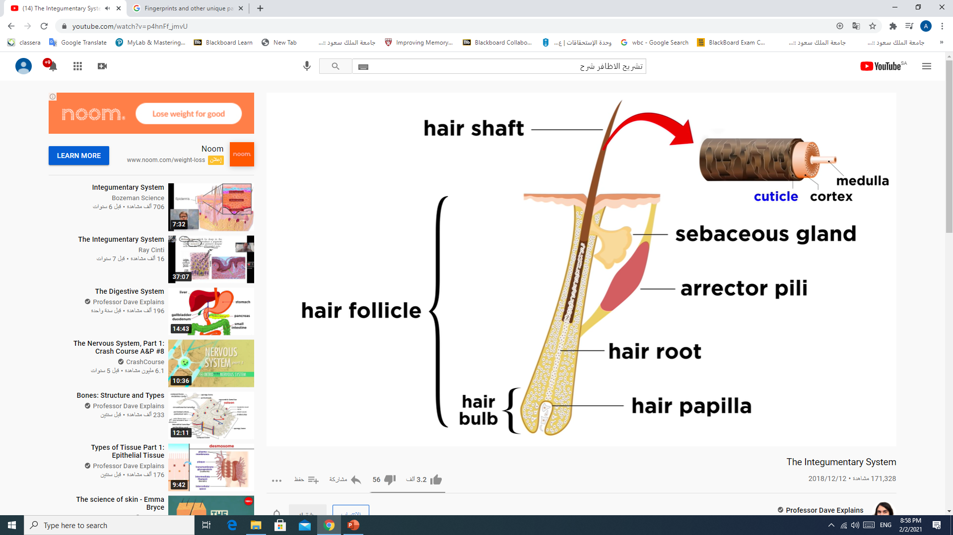

Slide 34
Hair Anatomy
A sebaceous gland at each hair follicle secretes sebum to prevent drying and act as anti-bacterial.
  Sebum production decreases with age, explaining why older people have drier skin and more brittle hair.

Slide 35
Hair Color and Texture
Hair color dependent on amount and type of melanin produced
  Darker hair has more melanin.
  White hair, absence of melanin
  Red hair has melanin that contains iron.

Slide 36
Overview of Tissues

Slide 37
Overview of Tissues
Tissue is formed when there is a collection of similar cells that act together to perform a function.
Imagine the cells as bricks, placed in a specific pattern to create functional walls of a building.

Slide 38
Tissue Types
There are many types of tissue. The four main types of tissues are
  Epithelial
  Connective
  Muscle
  Nervous

Slide 39
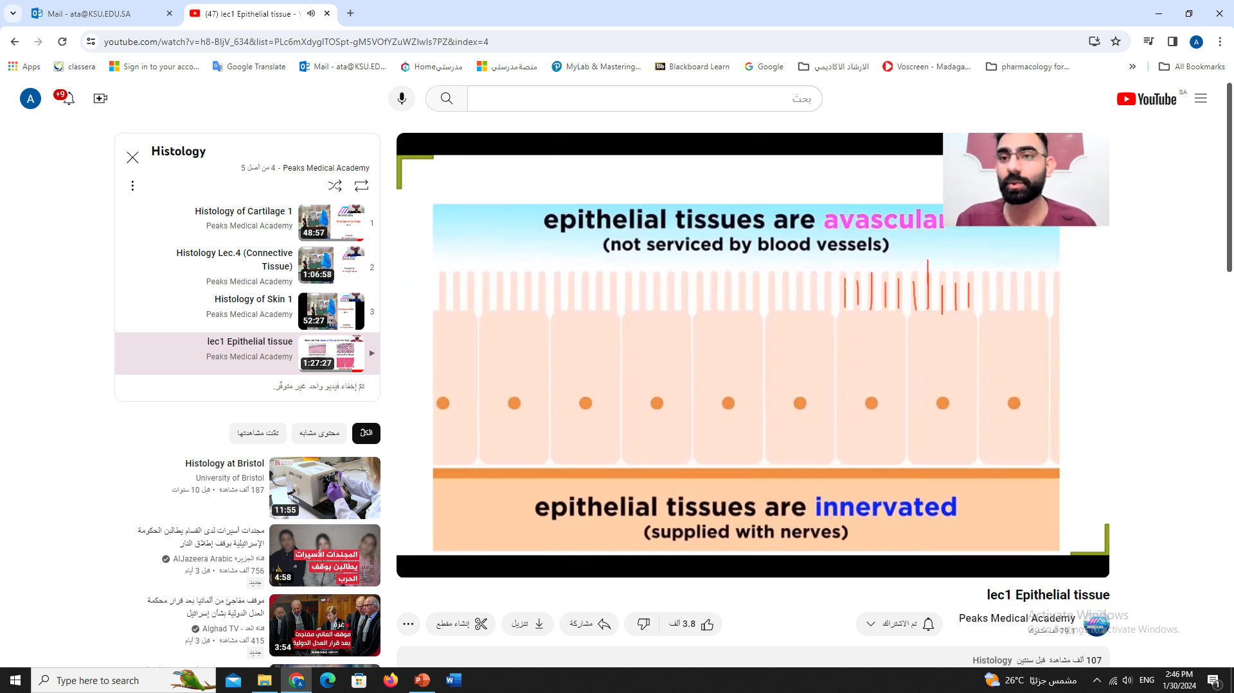
1. Epithelial Tissue (1 of 3)
Like plastic wrap, epithelial tissue covers and lines much of the body and also covers many of the parts found in the body.
The cells are packed tightly together forming a sheet that usually has no blood vessels in it, except for the epithelial tissue of the bowel, that has capillaries.

Slide 40
1. Epithelial Tissue (2 of 3)
Epithelial tissues can be further classified by their shape and arrangement.
  Flat– squamous (kidney, capillary and alveoli)
  Cube shaped – cuboidal( ovary, thyroid gland, pancreas and salivary gland)
  Column-like – columnar (stomach and intestine)
  Stretchy and variably shaped – transitional ( bladder)

Slide 41
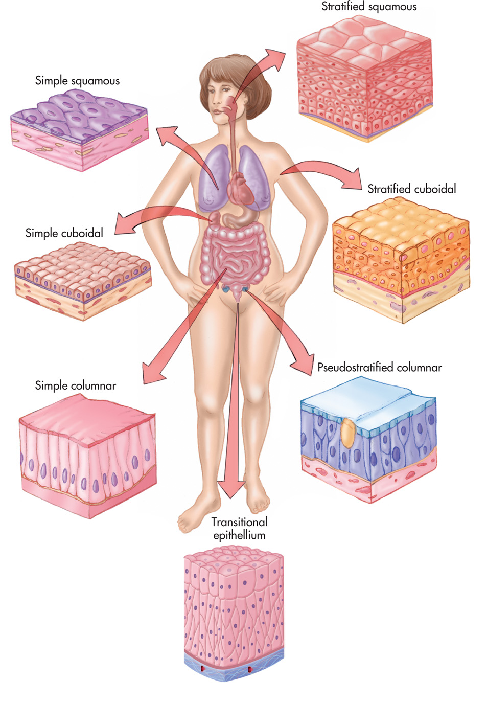
Epithelial Tissue
Notes:
Types and locations of epithelial tissues.

Slide 42
2. Epithelial Tissue (3 of 3)
Simple: cells are arranged in a single layer and are all the same type of cell
Stratified: cells are several layers deep; named by the type of cell on the outer layer
Pseudostratified: a single layer of cells that looks stratified

Slide 43
2. Connective Tissue (1 of 3)
The most common type of the tissue
  Scattered throughout the body
  Found in organs, bones, nerves, muscles, membranes, and skin
Holds things together and provides structure and support

Slide 44
Connective Tissue
Connective tissue proper
  Areolar
    Fine, delicate webs
  Adipose
    Fat
  Dense
    Strong cord-like structures, similar to wire cables

Slide 45
Connective Tissue (3 of 3)
Cartilage
  Cells in holes in gel-like matrix
Bone
  Cells in mineral matrix
Blood and Lymph Fluid
  Cells in liquid matrix

Slide 46
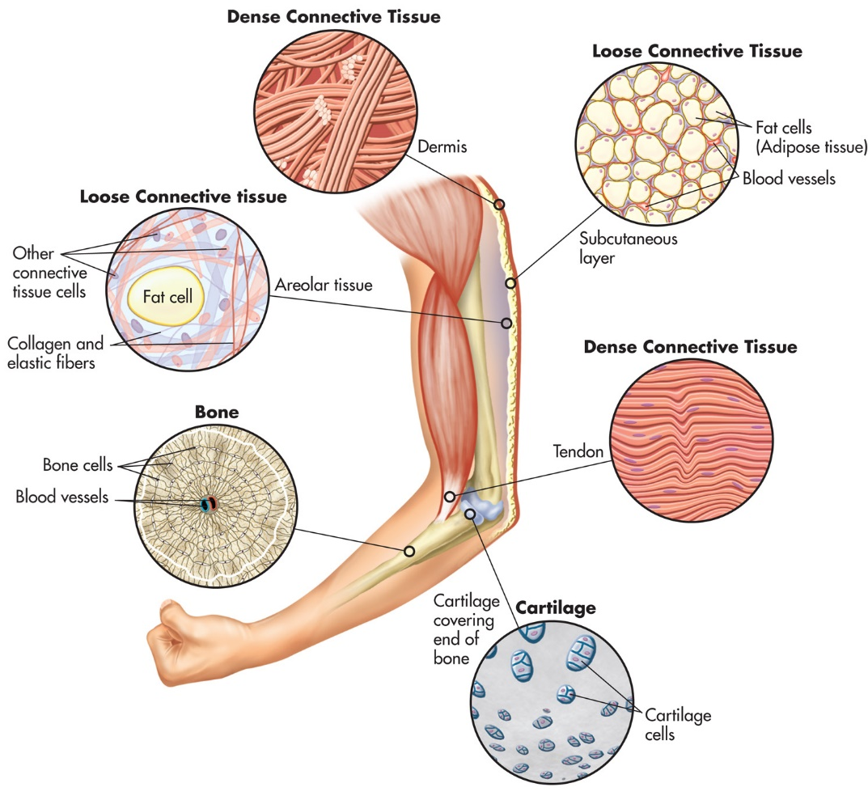
Notes:
Types and locations of connective tissues.

Slide 47
Synovial Membrane
The connective tissue membrane is the synovial membrane.
Found in the space between joints
Produces a slippery substance called synovial fluid that reduces friction when joints move

Slide 48
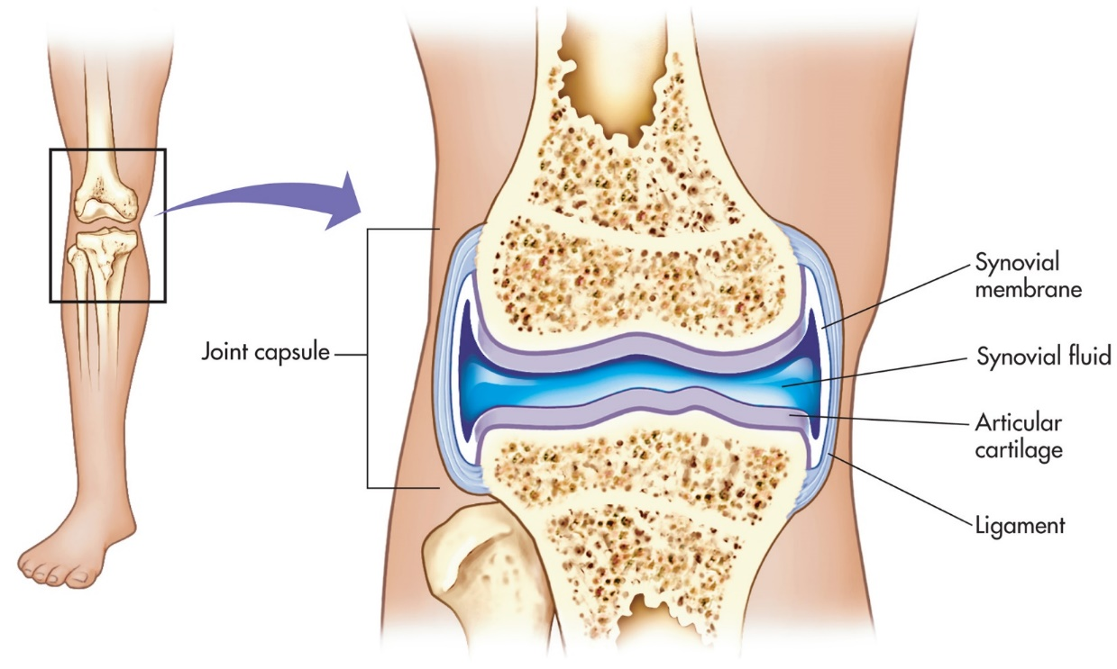
Figure 5–4
Notes:
The synovial joint and membrane.

Slide 49
3. Muscle Tissue
Muscle tissue provides the means for movement, by and in our bodies.
This form of tissue has the ability to shorten itself (contractility).
There are three types of muscle tissue
  Skeletal
  Cardiac
  Smooth

Slide 50
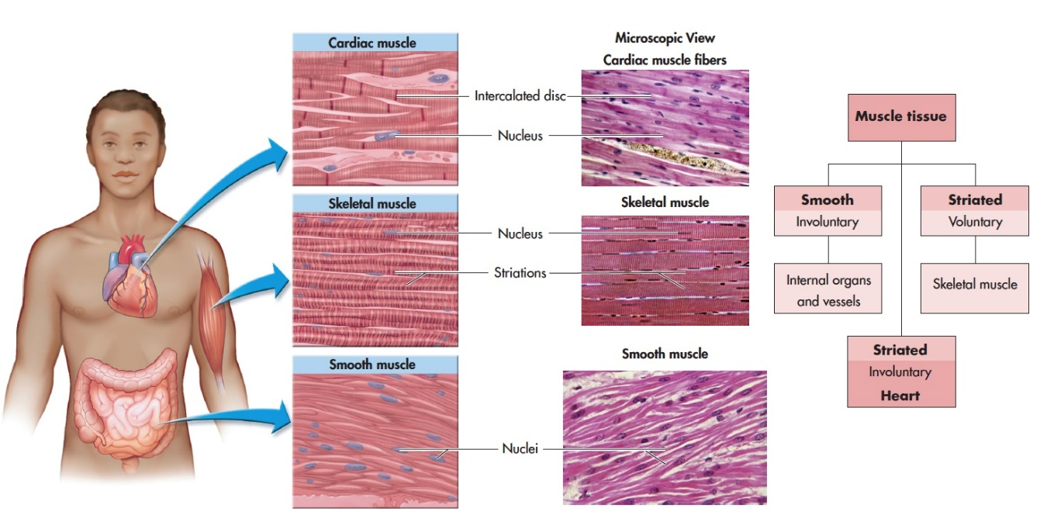
Figure 5–5
Notes:
Labeled diagram and flowchart of the three muscle tissue types. (Source: De Agostini Picture Library/Science Source; Eric Grave/Science Source; Biophoto Associates/Science Source)

Slide 51
4.Nervous Tissue (1 of 3)
Acts as body’s rapid messenger service; messages can cause actions to occur
Two types of nerve cells
  Neurons
  Neuroglia (glia)

Slide 52
Nervous Tissue (2 of 3)
Neurons: conduct information
  Dendrites (branch-like formations on neurons) receive sensory information
  Axons (trunk-shaped structures) transport information away from the cell body
  Glia (or neuroglia)
    Support and connection cells

Slide 53
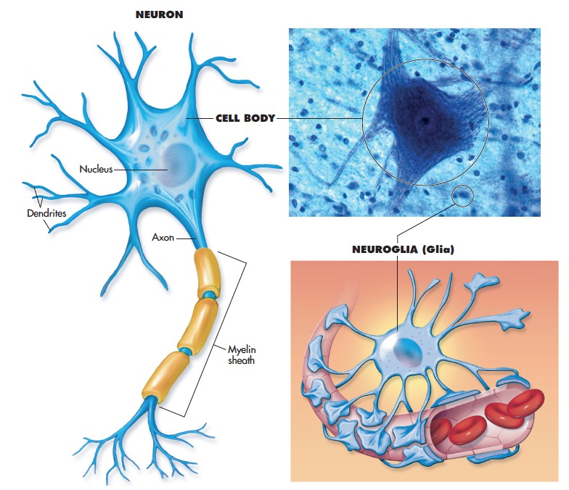
Figure 5–6
Notes:
The two main types of nerve cells. (Source: Christopher Meade/Shutterstock)

Slide 54


