Slide 1
HUMAN ANATOMY
LECTURE – 12
Sense Organs

Slide 2
Functions of Special Senses
Vision. Sight or vision is the capability of the eye(s) to focus and detect images of visible light on photoreceptors in the retina.
Hearing. Hearing or audition is the sense of sound perception.
3. Taste. Taste refers to the capability to detect the taste of substances such as food, certain minerals, and poisons, etc.
4. Smell. Smell or olfaction is the other “chemical” sense.
5. Touch. Touch or somatosensory, also called tactition or mechanoreception, is a perception resulting from activation of neural receptors, generally in the skin.

Slide 3
1.CUTANEOUS SENSES (SKIN)
The dermis of the skin and the subcutaneous tissue contain receptors for the sensations of touch, pressure, heat, cold, and pain.
The receptors for pain, heat, and cold are free nerve endings, which also respond to any intense stimulus.
Intense pressure, may be felt as pain.
The receptors for touch and pressure are encapsulated nerve endings.
The cutaneous senses provide us with information about the external environment and also about the skin itself.

Slide 4
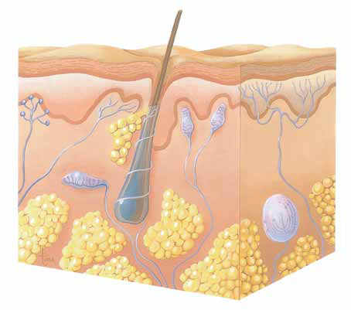
Free Nerve Endings (Pain Receptors)
Free Nerve Endings (Temperature Receptors)
Epidermis
Merkel Discs (Touch Receptors
Dermis
Subcutaneous Tissue
Pacinian Corpuscle (Pressure Receptor)
Ruffini Corpuscles (Pressure Receptors)
Meissner Corpuscle (Touch Receptor)
Cutaneous Receptors in the SKIN for receiving various kinds of senses.

Slide 5
2.SENSE OF TASTE
The receptors for taste are found in taste buds, most of which are in papillae on the tongue.
These chemoreceptors detect chemicals in solution in the mouth.
The chemicals are foods and the solvent is saliva (if the mouth is very dry, taste is very indistinct).
There are five general types of taste receptors: sweet, sour, salty, bitter, and savory.

Slide 6
2.SENSE OF TASTE
Taste buds. The taste buds, or specific receptors for the sense of taste, are widely scattered in the oral cavity.
Papillae. The dorsal tongue surface is covered with small peg-like projections, or papillae.
Circumvallate and fungiform papillae. The taste buds are found on the sides of the large round circumvallate papillae and on the tops of the more numerous fungiform papillae.
Gustatory cells. The specific cells that respond to chemicals dissolved in the saliva are epithelial cells called gustatory cells.
Facial nerve. The facial nerve (VII) serves the anterior part of the tongue.
Glossopharyngeal and vagus nerves. The other two cranial nerves– the glossopharyngeal and vagus- serve the other taste bud-containing areas.

Slide 7
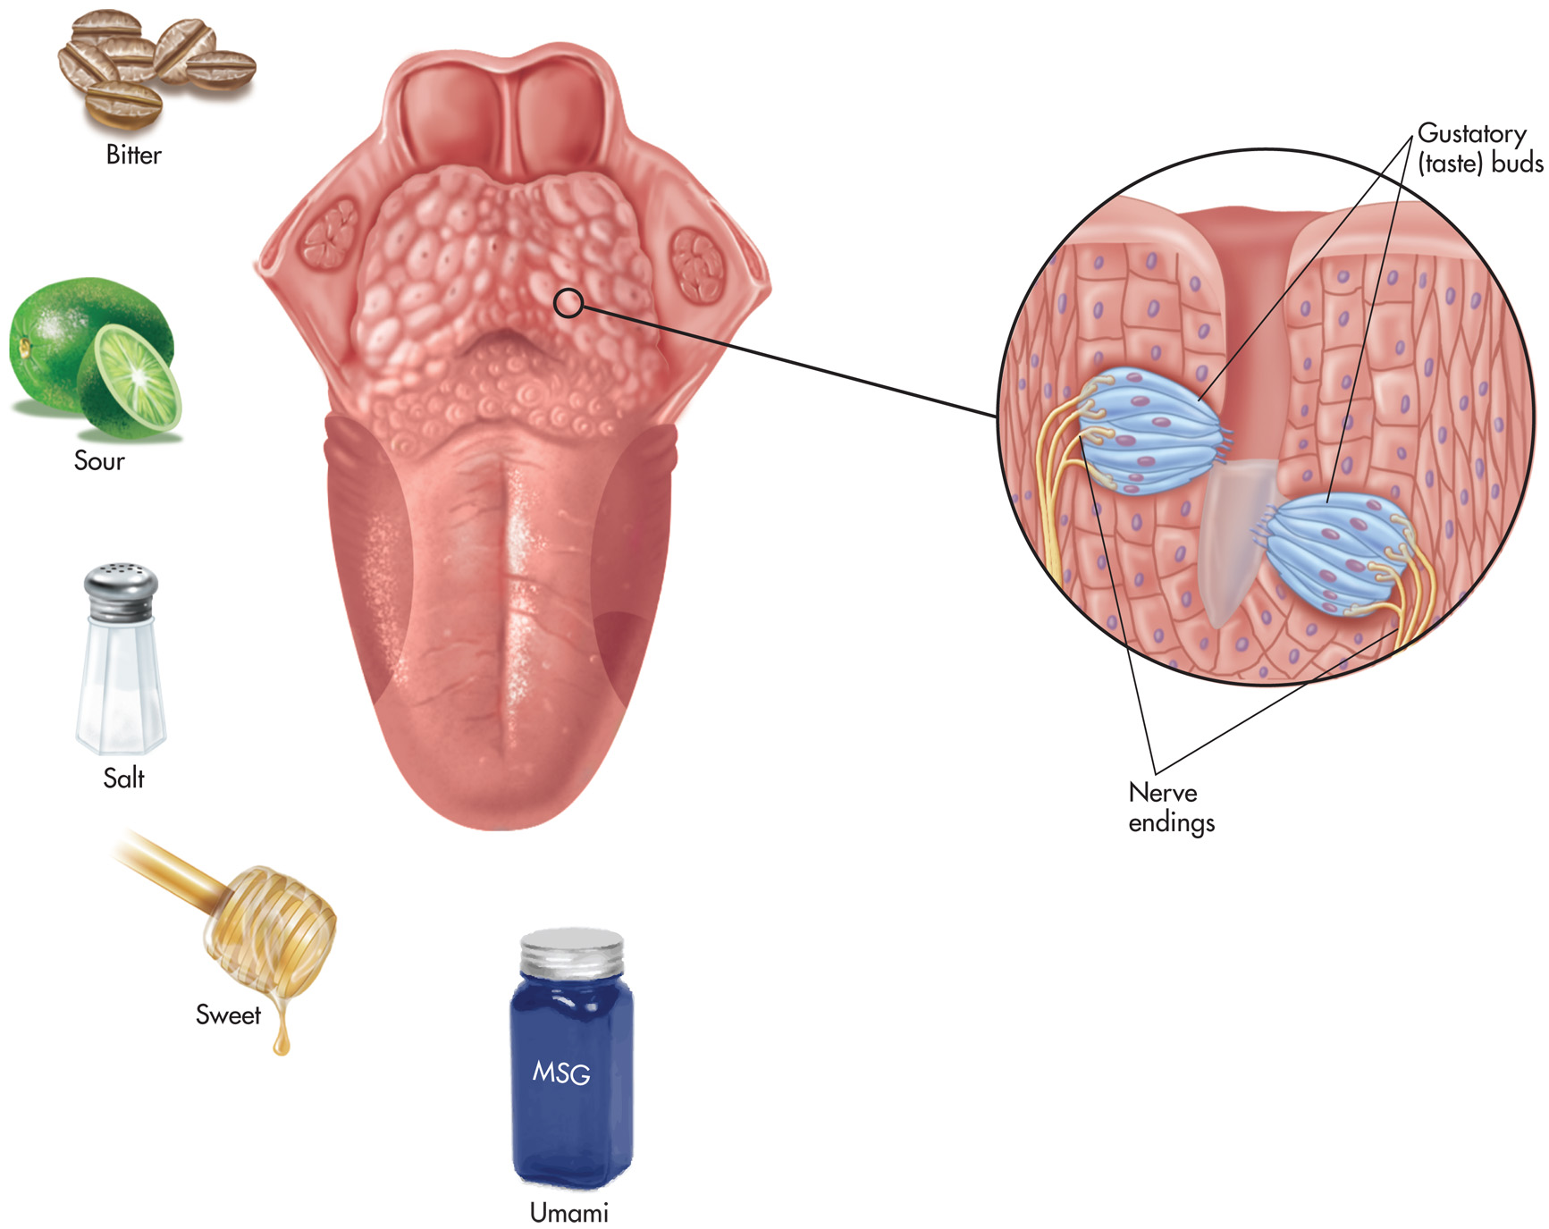

Slide 8
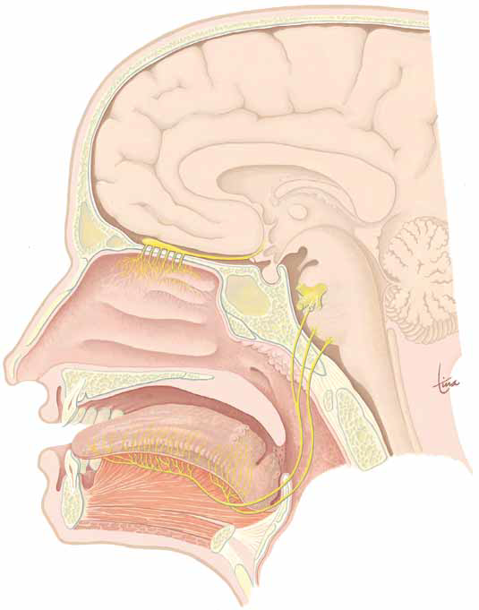
Olfactory buld and tracts
Olfactory Nerves
Olfactory Receptors
Nasal Cavity
Tongue
Taste Buds
(Papillae)
SENSES OF SMELL (OLFACTORY) AND TASTE.
Sweet
SALT
Sour
Bitter

Slide 9
3. SENSE OF SMELL
When stimulated by vapor molecules, olfactory receptors generate impulses carried by the olfactory nerves (1st cranial) to the olfactory bulbs.
The human brain is capable of distinguishing among 10,000 different scents.

Slide 10
Olfactory buld and tracts
Olfactory Nerves
Olfactory Receptors
Nasal Cavity
Tongue
Taste Buds
(Papillae)
SENSES OF SMELL (OLFACTORY) AND TASTE.
Sweet
SALT
Sour
Bitter

Slide 11
4. THE EYE
Eyelids. Anteriorly, the eyes are protected by the eyelids, which meet at the medial and lateral corners of the eye, the medial and lateral commissure (canthus).
Eyelashes. Projecting from the border of each eyelid are the eyelashes.
Conjunctiva. A delicate membrane, the conjunctiva, lines the eyelids and covers part of the outer surface of the eyeball.
Lacrimal glands. The lacrimal glands are located above the lateral end of each eye; they continually release a salt solution (tears) onto the anterior surface of the eyeball through several small ducts.
Lysozyme. Lacrimal secretion also contains antibodies and lysozyme, an enzyme that destroys bacteria; thus, it cleanses and protects the eye surface as it moistens and lubricates it.
Extrinsic eye muscle. Six external, are the lateral rectus, medial rectus, superior rectus, inferior rectus, inferior oblique, and superior oblique.

Slide 12
4. THE EYE
Sclera. thick, glistening, white connective tissue, is seen anteriorly as the “white of the eye”.
Cornea. The central anterior portion of the fibrous layer is crystal clear; this “window” is the cornea through which light enters the eye.
Ciliary body. form two smooth muscle structures, to which the lens is attached by a suspensory ligament.

Slide 13
4. THE EYE
Pupil: The pigmented iris has a rounded opening, the pupil, through which light passes.
Optic disc: The photoreceptor cells are distributed over the entire retina, except where the optic nerve leaves the eyeball; this site is called the optic disc, or blind spot.
Fovea centralis: Lateral to each blind spot is the fovea centralis, a tiny pit that contains only cones.

Slide 14
4. THE EYE
Chambers. The lens divides the eye into two segments or chambers; the anterior (aqueous) segment, anterior to the lens, contains a clear, watery fluid called aqueous humor; the posterior (vitreous) segment posterior to the lens, is filled with a gel-like substance called either vitreous humor, or the vitreous body.

Slide 15
Layers Forming the Wall of the Eyeball
1. Fibrous layer. The outermost layer, called the fibrous layer, consists of the protective sclera and the transparent cornea.
2. Vascular layer. The middle eyeball of the layer, the vascular layer, has three distinguishable regions: the choroid, the ciliary body, and the iris.
3. Neural layer. The transparent inner neural layer of the retina contains millions of receptor cells, the rods and cones, which are called photoreceptors because they respond to light.

Slide 16
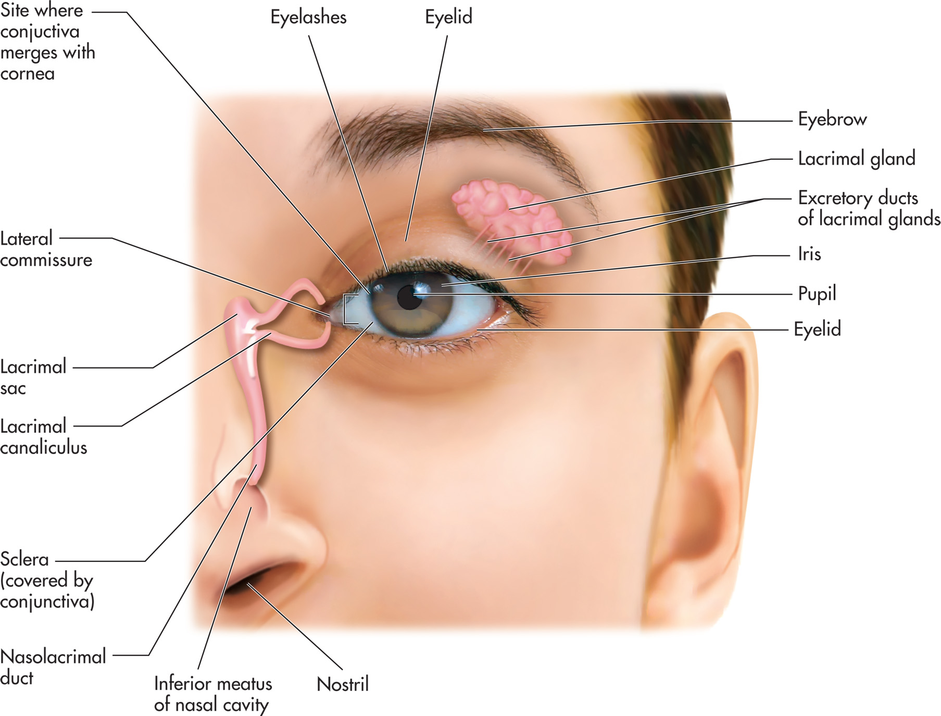
Figure 11–1
Notes:
Lacrimal structures of the eye.

Slide 17
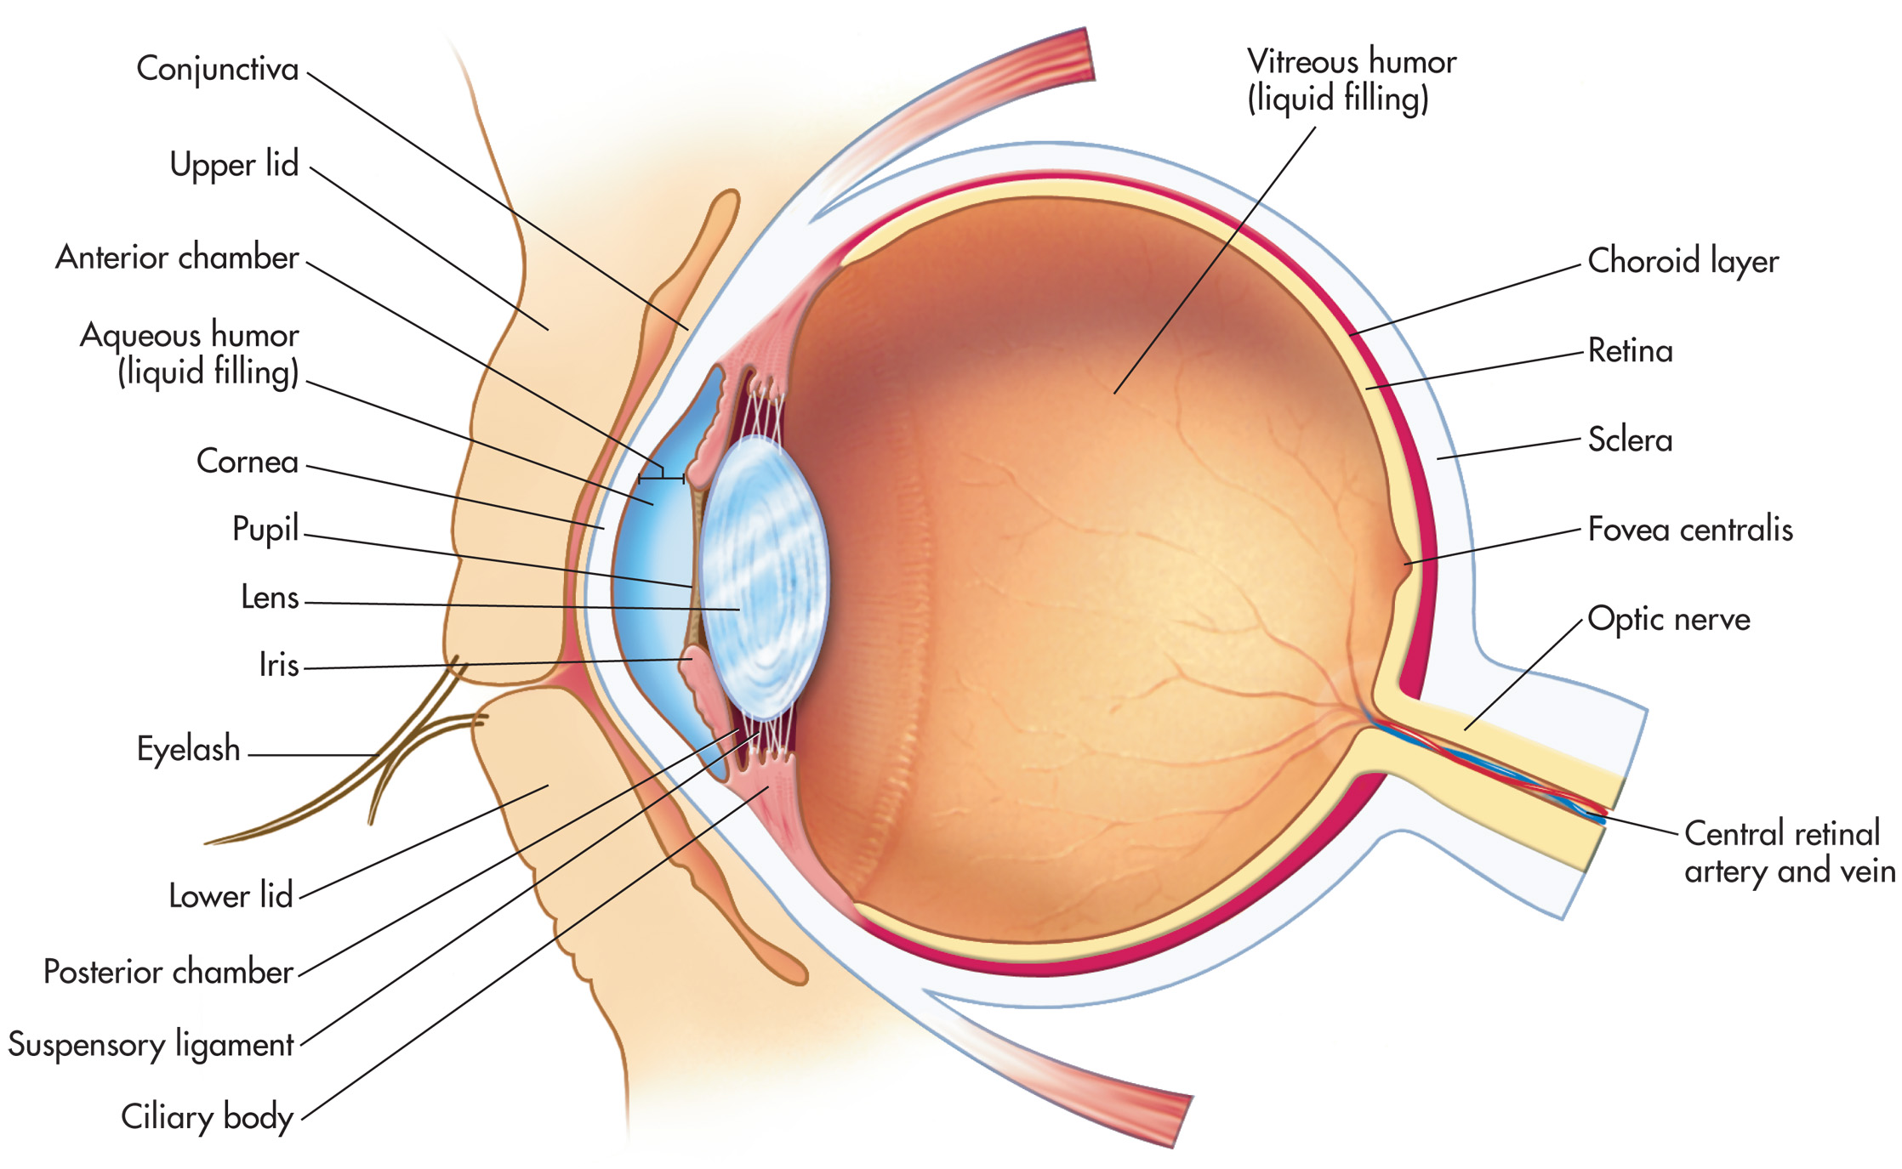
Figure 11–2
Notes:
Internal structures of the eye.

Slide 19
5. THE EAR
The ear consists of three areas: the outer ear, the middle ear, and the inner ear.
The ear contains the receptors for two senses: hearing and equilibrium.
These receptors are all found in the inner ear.
OUTER EAR: consists of the auricle and the ear canal. The auricle, or pinna, is made of cartilage covered with skin.
MIDDLE EAR : is an air-filled cavity in the temporal bone. The eardrum, or tympanic membrane, which is at the end of the ear canal and vibrates when sound waves strike it.
These vibrations are transmitted to the three auditory bones: the malleus, incus, and stapes. The stapes then transmits vibrations to the fluid-filled inner ear at the oval window.
The eustachian tube (auditory tube) extends from the middle ear to the nasopharynx and permits air to enter or leave the middle ear cavity.
INNER EAR : is a cavity called the cochlea, concerned with hearing, and the semicircular canals concerned with equilibrium or balance.
The cochlea is shaped like a snail shell.

Slide 20
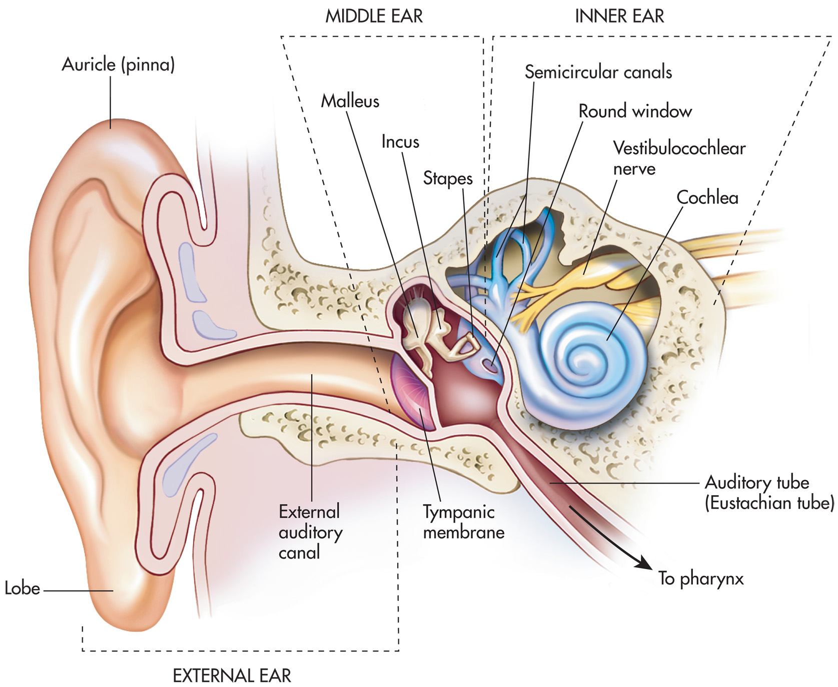
Figure 11–3
Notes:
Structures of the ear.

Slide 21
External (Outer) Ear
Auricle. The auricle, or pinna, is what most people call the “ear”- the shell-shaped structure surrounding the auditory canal opening.
External acoustic meatus. The external acoustic meatus is a short, narrow chamber carved into the temporal bone of the skull; in its skin-lined walls are the ceruminous glands, which secrete waxy, yellow cerumen or earwax, which provides a sticky trap for foreign bodies and repels insects.
Tympanic membrane. Sound waves entering the auditory canal eventually hit the tympanic membrane, or eardrum, and cause it to vibrate; the canal ends at the ear drum, which separates the external from the middle ear

