Slide 1
Lecture 10
Chapter 15
The Endocrine System
Copyright © 2019, 2016, 2013 Pearson Education, Inc. All Rights Reserved

Slide 2
Learning Objectives
1 Define and spell the word parts used to create terms for the endocrine system.
2 Identify the major organs of the endocrine system and describe their structure and function.
3 Break down and define common medical terms used for symptoms, diseases, disorders, procedures, treatments, and devices associated with the endocrine system.

Slide 3
Anatomy and Physiology: Word Parts (1 of 1)
Combining Form | Definition
aden/o | gland
adren/o | adrenal gland
crin/o | to secrete
gonad/o | sex gland
pancreat/o | pancreas
thyr/o | thyroid

Slide 4
Anatomy and Physiology
The endocrine system consists of nine endocrine glands.
Most endocrine glands are controlled by the hypothalamus.
The result of hormone secretion is a change in cell functions, which alters body activities.

Slide 5
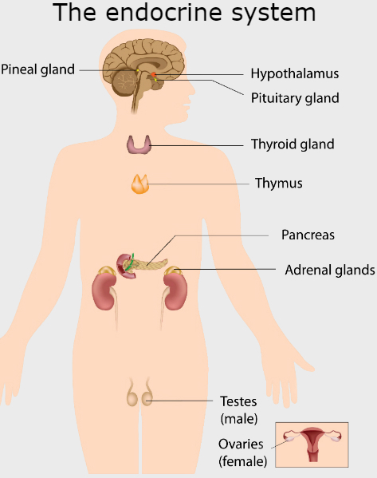
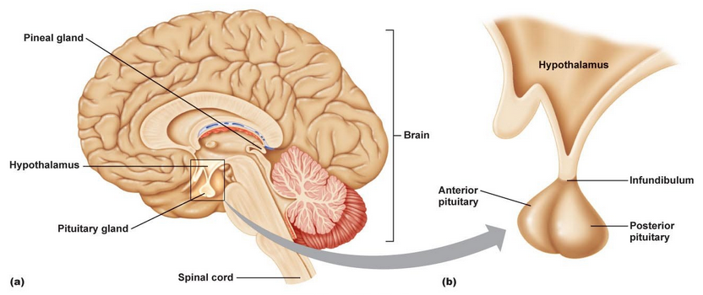
Figure 15.1 The endocrine glands of the endocrine system are distributed throughout the body.

Slide 6
Pathophysiology (1 of 2)
Endocrine disease can result from either hyposecretion or hypersecretion.
Hyposecretion can result from an injury or infection, from an inherited disorder, or from a tumor.
Hypersecretion may arise due to an inherited disease or a tumor.

Slide 7
Pathophysiology (2 of 2)
Endocrinology is the study of the endocrine system.
An endocrinologist is a specialist in the field of endocrinology.

Slide 8
Signs and Symptoms: Word Parts (1 of 3)
Prefix | Definition
ex- | outside, away from
poly- | excessive, many

Slide 9
Signs and Symptoms: Word Parts (2 of 3)
Combining Form | Definition
acr/o | extremity
dips/o | thirst
hirsut/o | hairy
ophthalm/o | eye

Slide 10
Signs and Symptoms of the Endocrine System (1 of 3)
Acidosis - it occurs when carbon dioxide, the primary waste product from cellular metabolism, accumulates in tissues (including blood) to form carbonic acid.
Acromegaly - a sign of bone structure enlargement in an adult without a gain in height
acr/o = extremity
-megaly = abnormally large
Exophthalmos - the abnormal protrusion of the eyes

Slide 11
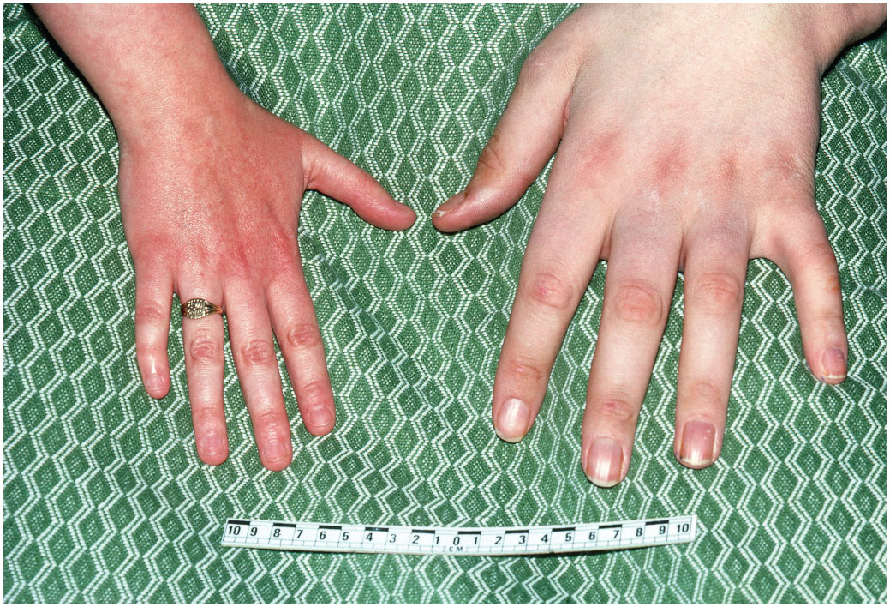
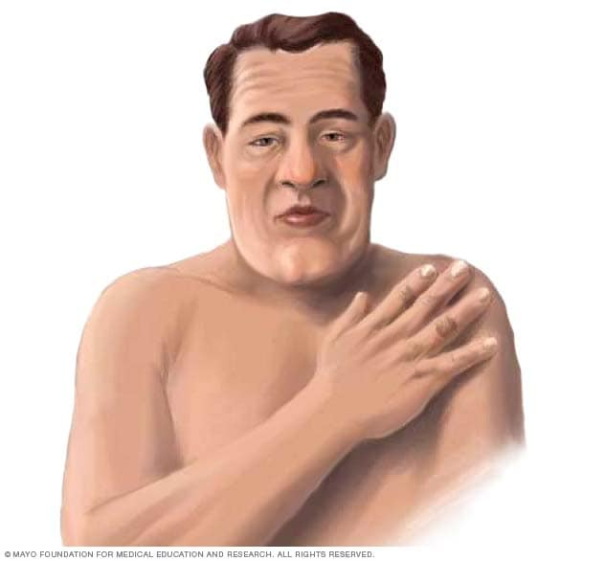
Figure 15.2 Acromegaly. Acromegaly is a metabolic disorder in which excessive amounts of growth hormone are secreted during adulthood, resulting in enlarged bones without increased height. The changes occur gradually and are often apparent mainly in the face and hands. In this photograph, a normal hand (left) is compared with the hand of a person of the same height, but with acromegaly (right).
Notes:
Source: Biophoto Associate/Science Source Images.

Slide 12
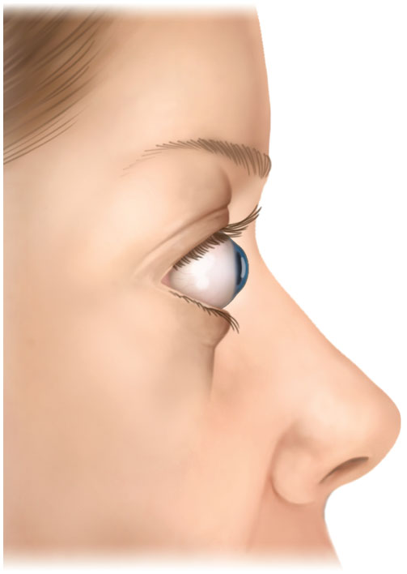
Figure 15.3 Exophthalmos. The protrusion of the eyes is a common symptom of hyperthyroidism.

Slide 13
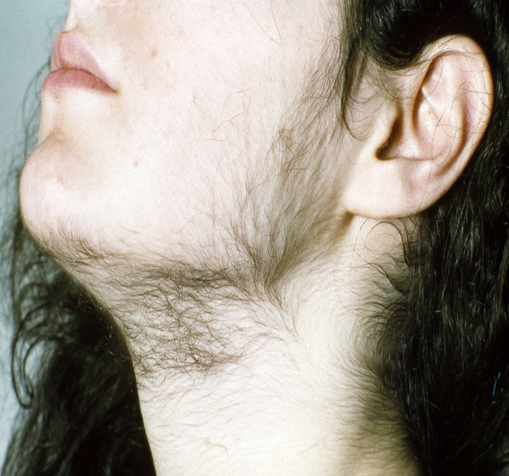
Signs and Symptoms of the Endocrine System (2 of 3)
Goiter - an abnormal enlargement of the thyroid gland caused by a tumor, lack of iodine in the diet, or an infection
Hirsutism - symptom of excessive body hair in a caused by hypersecretion of androgens by the adrenal cortex

Slide 14
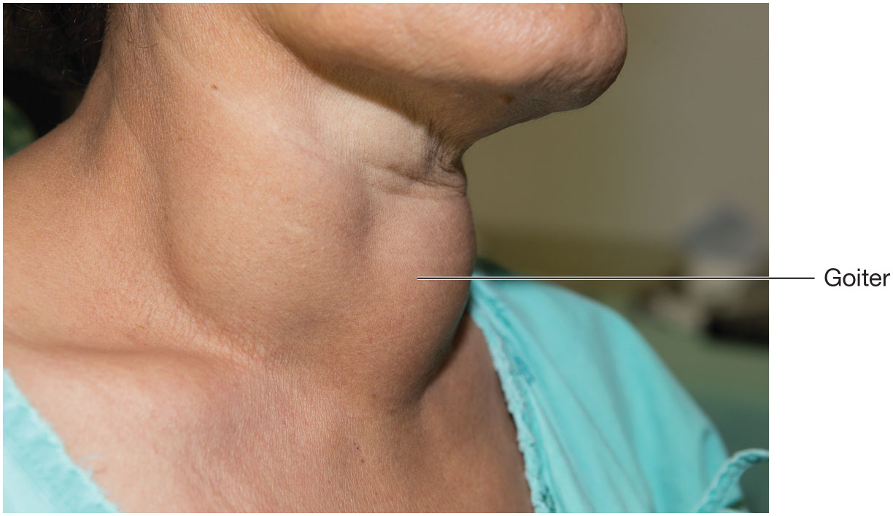
Figure 15.4 Goiter. A goiter appears as a swelling in the anterior neck region, at the location of the thyroid gland.
Notes:
Source: Karan Bunjean/Shutterstock.

Slide 15
Signs and Symptoms of the Endocrine System (3 of 3)
Ketosis - excessive amount of ketone bodies in the blood and urine and is a sign of unmanaged diabetes mellitus
Ketoacidosis - an acidic condition of the body by ketosis
Polydipsia - abnormal state of excessive thirst occurs during certain disorders of the pituitary gland or the pancreas, including diabetes mellitus
poly- = excessive
dips/o = thirst
-ia = condition of
Polyuria - the production of abnormally large volumes of urine

Slide 16
Diseases and Disorders: Word Parts
Prefix | Definition
endo- | within
hyper- | excessive, abnormally high, above
hypo- | deficient, abnormally low, below
para- | alongside, abnormal

Slide 17
Diseases and Disorders of the Endocrine System (1 of 8)
Adenocarcinoma - A malignant tumor that arises from epithelial tissue to form a glandular or glandlike pattern of cells
aden/o = gland
carcin/o = cancer
-oma = tumor
Adenoma - benign tumor of glandular cells

Slide 18
Diseases and Disorders of the Endocrine System (2 of 8)
Adrenalitis - an inflammation of the adrenal gland
Adrenal insufficiency - Adrenal gland failure leads to several disorders, some of which are due to genetic errors
Adrenal hyperplasia - excessive growth of the adrenal gland

Slide 19
Diseases and Disorders of the Endocrine System (3 of 8)
Congenital hypothyroidism (Cretinism) - A child suffering from the thyroid gland’s inability to produce normal levels of growth hormone at birth
Cushing syndrome - syndrome caused by excessive secretion of the hormone cortisol by the adrenal cortex and affecting many organs

Slide 20
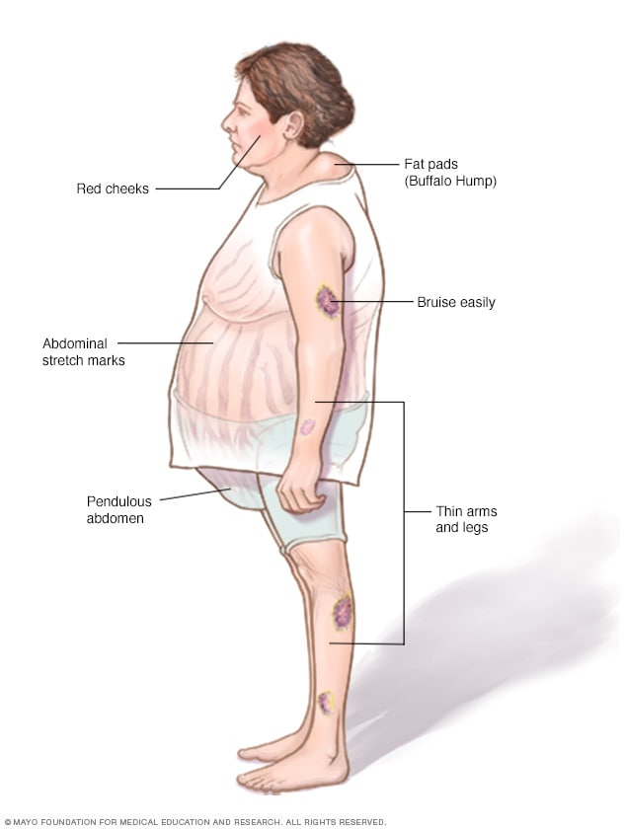
Figure 15.5 Cushing syndrome. This syndrome includes the symptoms of obesity, moon face, hyperglycemia, and muscle weakness.

Slide 21
Diseases and Disorders of the Endocrine System (4 of 8)
Diabetes insipidus (DI) - caused by hyposecretion of ADH by the pituitary gland showing polydipsia and polyuria
Diabetes mellitus (DM) - chronic disorder of carbohydrate metabolism due to resistance of body cells to insulin, or deficiency or complete lack of insulin production by cells of the pancreas

Slide 22
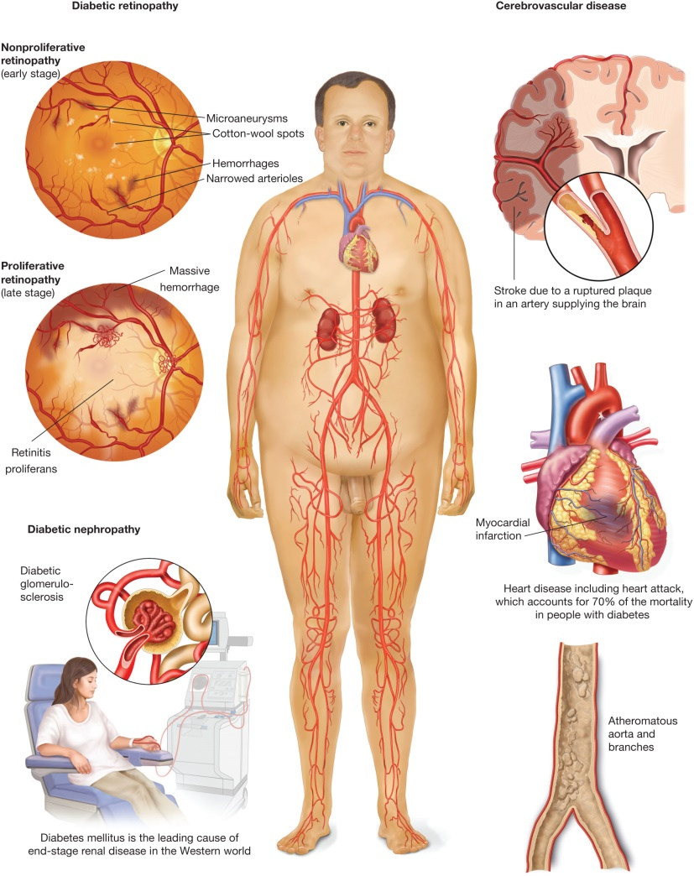
Figure 15.6 Diabetes mellitus. The metabolic disease diabetes mellitus, with symptoms of polydipsia, polyuria, and widely ranging blood sugar levels, produces many chronic complications if not managed carefully. They include an increased risk of blindness (diabetic retinopathy), kidney disease (diabetic nephropathy), and heart attack (cerebrovascular disease).

Slide 23
Diseases and Disorders of the Endocrine System (5 of 8)
Hyperadrenalism (Cushing syndrome) - Excessive activity of one or more adrenal glands
Hypoadrenalism - opposite disorder occurs when the adrenal gland activity becomes abnormally reduced, resulting in the early symptoms of fatigue and darkening of the skin
Addison’s disease

Slide 25
Diseases and Disorders of the Endocrine System (6 of 8)
Hypercalcemia - calcium levels in the blood become abnormally high
hyper- = excessive
calc/o = calcium
-emia = condition of blood
Excess parathyroid hormone (PTH)
Hypocalcemia - condition of abnormally low levels of calcium in the blood
Hyperglycemia - condition of blood excessive sugar
Hypoglycemia - blood sugar levels fall to abnormally low levels

Slide 26
Diseases and Disorders of the Endocrine System (7 of 8)
Hyperparathyroidism - excessive production of PTH by the parathyroid glands
Hypoparathyroidism - PTH levels are reduced
Hyperthyroidism - Excessive activity of the thyroid gland produces abnormally high levels of thyroid hormone
Graves’ disease > believed to be an autoimmune disease of hyperthyroidism
Thyrotoxicosis > triggered by infection or trauma and can become life-threatening
Hypothyroidism - When thyroid gland activity becomes deficient, thyroid hormone blood levels drop below normal
Hashimoto’s disease - autoimmune nature of hypothyroidism
Myxedema - chronic form of hypothyroidism

Slide 27
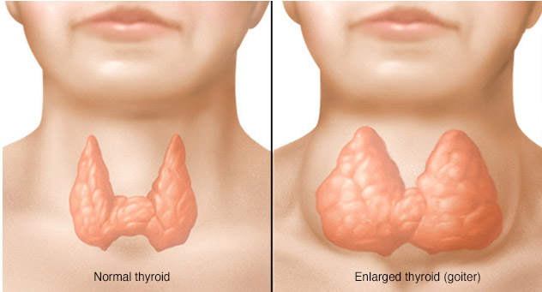

Slide 29
Diseases and Disorders of the Endocrine System (8 of 8)
Hypogonadism - reduces the production of the sex hormones testosterone (produced by the male testes) and estrogen/progesterone (produced by the female ovaries)
Low amounts of FSH and LH from the pituitary gland
Pancreatitis - Inflammation of the pancreas
Pituitary dwarfism - pituitary growth hormone is deficient at birth, resulting in short stature
Pituitary gigantism - abnormally high production of pituitary growth hormone before adulthood
Thyroiditis - Inflammation of the thyroid gland

Slide 30
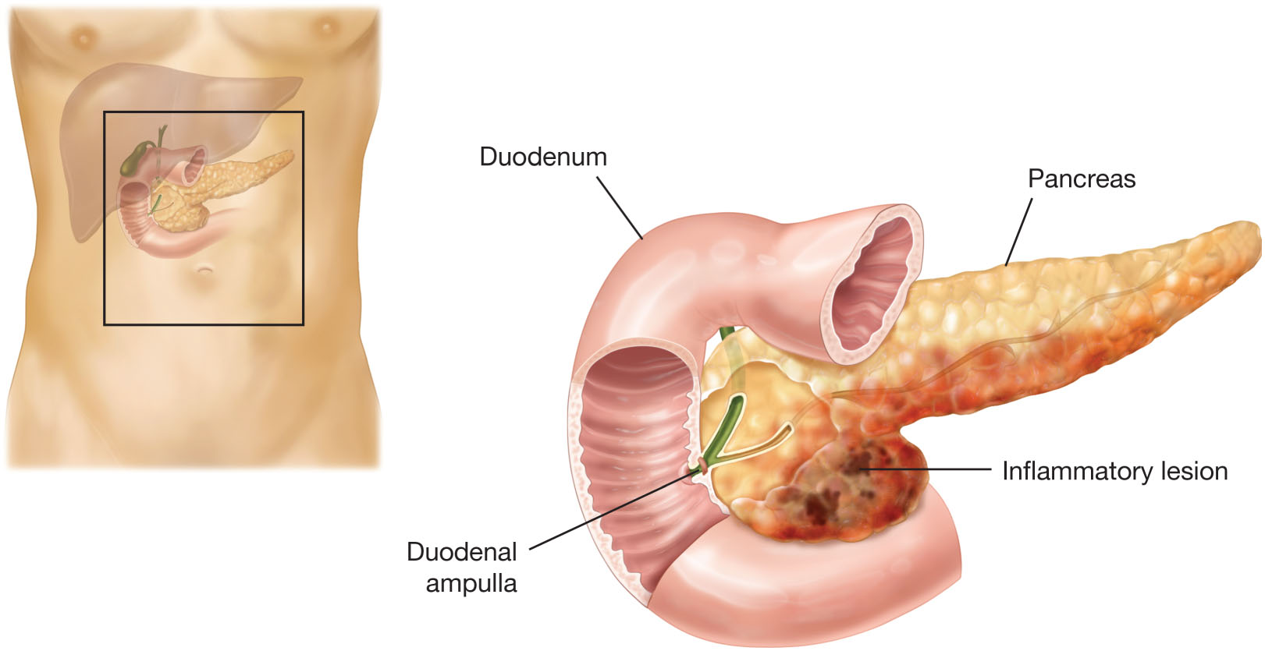
Figure 15.8 Pancreatitis. Inflammation of the pancreas may be the result of a bacterial infection, trauma, or chronic disease such as cancer.

Slide 31
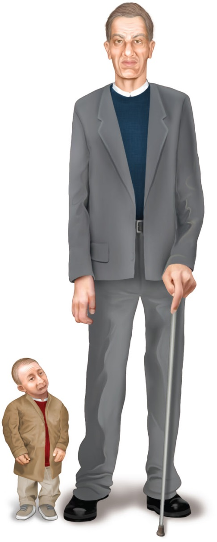
Figure 15.9 Growth hormone disorders. Illustration of a pituitary giant and a pituitary dwarf, both adults of about the same age.

Slide 32
Treatments, Procedures, and Devices of the Endocrine System (1 of 5)
Adrenalectomy - A procedure involving the surgical excision, or removal, of one or both of the adrenal glands

Slide 33
Treatments, Procedures, and Devices of the Endocrine System (2 of 5)
Fasting blood sugar (FBS) - Measuring blood sugar levels after a 12-hour fast
Postprandial blood sugar (PPBS) > blood sugar levels are measured about 2 hours after a meal
Glucose tolerance test (GTT) - A test that may be used to confirm a diagnosis of diabetes mellitus examines a patient’s tolerance of glucose given to patient either orally or intravenously

Slide 34
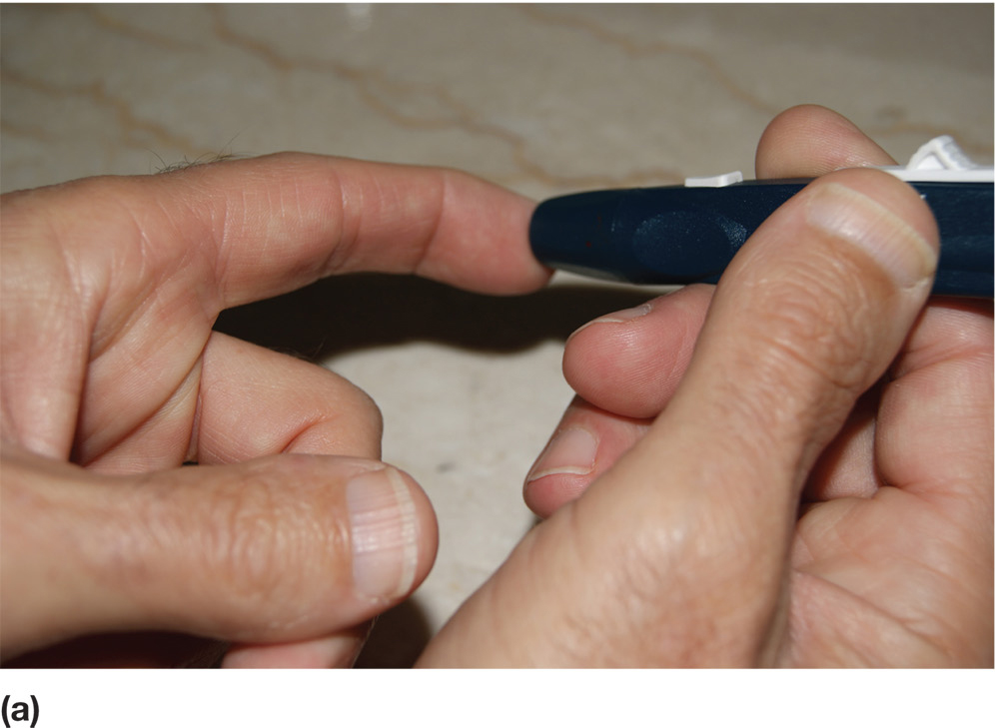
Figure 15.10a Blood glucose measurement. A fasting blood sugar or postprandial test may be self-administered. A lance pierces the skin of a finger.

Slide 35
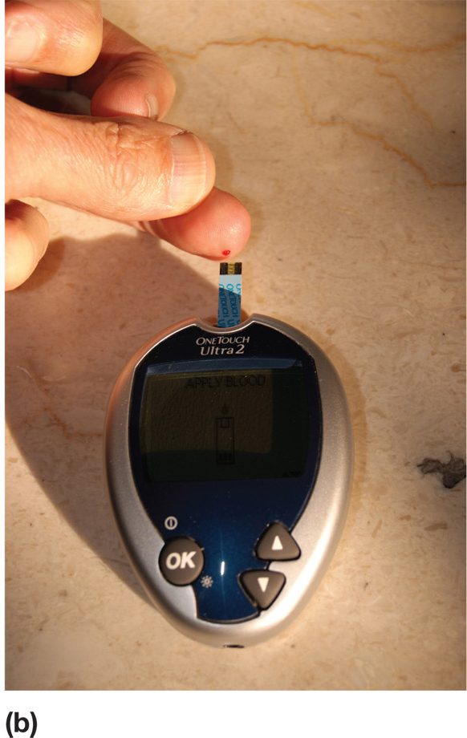
Figure 15.10b Blood glucose measurement. A fasting blood sugar or postprandial test may be self-administered. A small blood sample is gently squeezed onto a reagent strip.

Slide 36
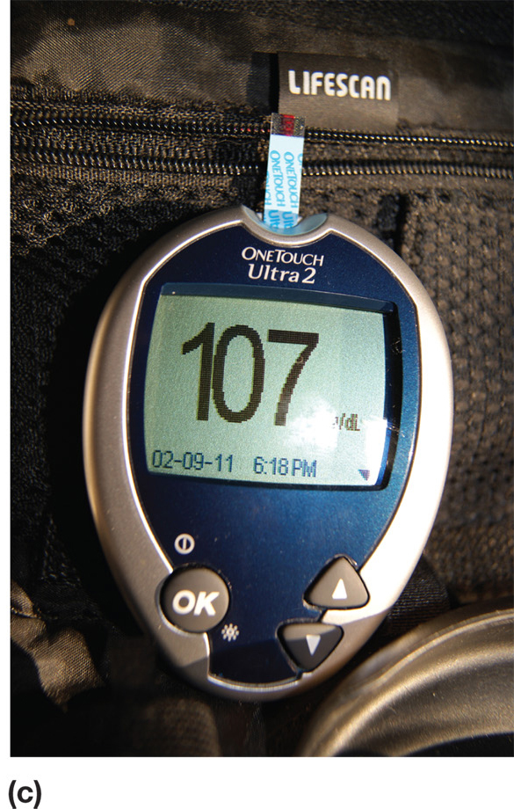
Figure 15.10c Blood glucose measurement. A fasting blood sugar or postprandial test may be self-administered. The glucose meter will display the glucose concentration in the blood sample.

Slide 37
Treatments, Procedures, and Devices of the Endocrine System (3 of 5)
Hormone replacement therapy (HRT) - A common therapy to counteract hyposecretion of endocrine hormones and may also be used following the surgical removal of an endocrine gland to restore homeostasis
Parathyroidectomy - The surgical removal, or excision, of a parathyroid gland may be a treatment
para- = alongside of
thyroid/o = thyroid
-ectomy = excision

Slide 38
Treatments, Procedures, and Devices of the Endocrine System (4 of 5)
Thyroid scan - A procedure measuring thyroid function which an image of the thyroid gland is obtained.

Slide 39
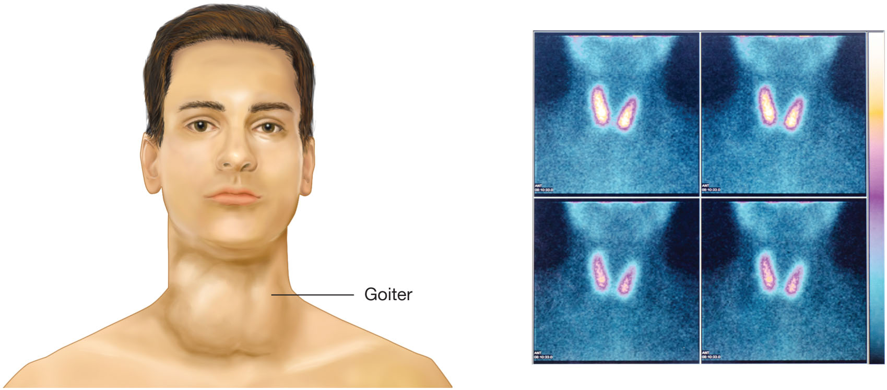
Figure 15.11 Thyroid scan. The right image is a colorized image from an abnormal thyroid scan, such as would occur in a patient with a goiter (illustrated on the left).
Notes:
Source: Stefania Arca/Shutterstock.

Slide 40
Treatments, Procedures, and Devices of the Endocrine System (5 of 5)
Thyroidectomy - surgical removal of the thyroid gland
Thyroid ultrasonography - the thyroid gland is evaluated for disease using ultrasound
Thyroxine test - a diagnostic test measuring thyroxine levels in the blood

Slide 41
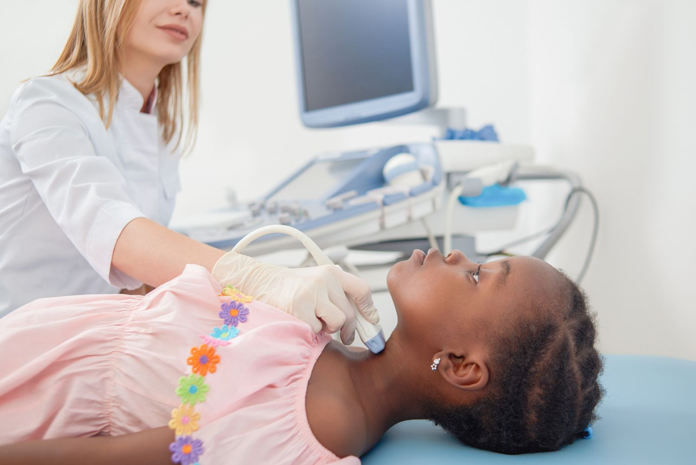
Figure 15.12 Thyroid ultrasonography. This diagnostic procedure sends sound waves generated by a transducer through a probe pressing on the anterior neck. The reflected sound waves are picked up and converted by a computer to a monitor to reveal thyroid gland abnormalities.
Notes:
Source: Alexander Raths/Shutterstock.

