Slide 1
Representing Boolean Functions
Sum-of-products Expansions

Slide 2
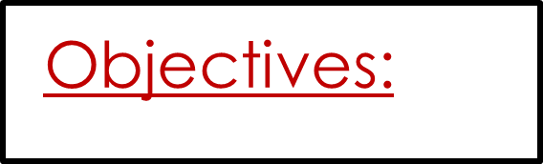
The main purpose for this lesson is to introduce the following:
How can Find Boolean expressions that represent for any function.
Define literal and minterm.
Define Sum-of-products Expansions and give examples.
Define Functional Completeness.

Slide 3
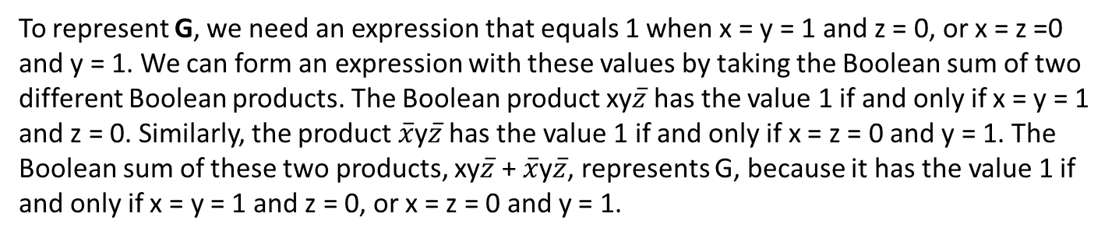
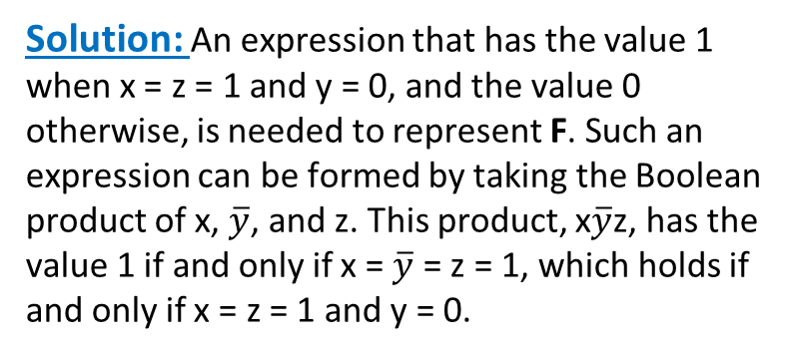
EXAMPLE 1 Find Boolean expressions that represent the functions F(x, y, z) and G(x, y, z), which are given in Table.
G | F | z | y | x
0 | 0 | 1 | 1 | 1
1 | 0 | 0 | 1 | 1
0 | 1 | 1 | 0 | 1
0 | 0 | 0 | 0 | 1
0 | 0 | 1 | 1 | 0
1 | 0 | 0 | 1 | 0
0 | 0 | 1 | 0 | 0
0 | 0 | 0 | 0 | 0
Solution: An expression that has the value 1 when x = z = 1 and y = 0, and the value 0 otherwise, is needed to represent F. Such an expression can be formed by taking the Boolean product of x, $\overline{y}$, and z. This product, x$\overline{y}$z, has the value 1 if and only if x = $\overline{y}$ = z = 1, which holds if
and only if x = z = 1 and y = 0.
To represent G, we need an expression that equals 1 when x = y = 1 and z = 0, or x = z =0 and y = 1. We can form an expression with these values by taking the Boolean sum of two different Boolean products. The Boolean product xy$\overline{z}$ has the value 1 if and only if x = y = 1 and z = 0. Similarly, the product $\overline{x}$y$\overline{z}$ has the value 1 if and only if x = z = 0 and y = 1. The Boolean sum of these two products, xy$\overline{z}$ + $\overline{x}$y$\overline{z}$, represents G, because it has the value 1 if and only if x = y = 1 and z = 0, or x = z = 0 and y = 1.

Slide 4
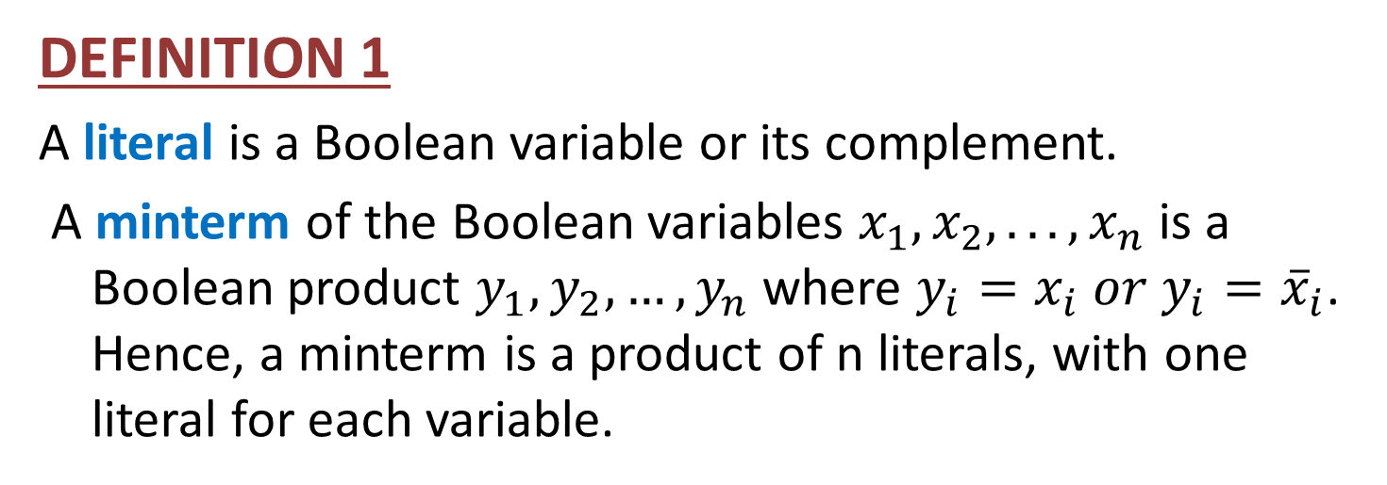
Literal & Minterm
DEFINITION 1
A literal is a Boolean variable or its complement.
A minterm of the Boolean variables $x_{1},x_{2}, . . . , x_{n}$is a Boolean product $y_{1},y_{2},…,y_{n}$ where $y_{i}=x_{i} or y_{i}={\overline{x}}_{i}$. Hence, a minterm is a product of n literals, with one literal for each variable.

Slide 5
EXAMPLE 2
Find a minterm that equals 1 if x₁=x₃=0 and x₂=x₄=x₅=1, and equals 0 otherwise.
Solution:
The minterm has the correct set of values.

Slide 6
Sum-of-products Expansions
By taking Boolean sums of distinct minterms we can build up a Boolean expression with a specified set of values. In particular, a Boolean sum of minterms has the value 1 when exactly one of the minterms in the sum has the value 1. It has the value 0 for all other combinations of values of the variables.
The sum of minterms that represents the function is called the sum-of-products expansion or the disjunctive normal form of the Boolean function.

Slide 7
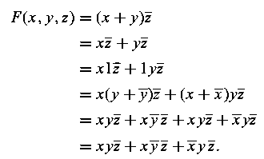
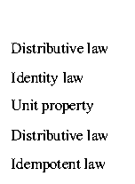
EXAMPLE 3
Solution: We will find the sum-of-products expansion of F(x, y, z) in two ways. First, we will use Boolean identities to expand the product and simplify. We find that

Slide 8
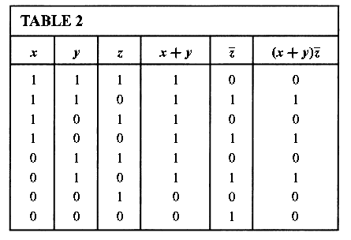

Second, we can construct the sum-of-products expansion by determining the values of F for all possible values of the variables x, y, and z. These values are found in Table 2.
The sum-of products expansion of F is the Boolean sum of three minterms corresponding to the three rows of this table that give the value 1 for the function. This gives

Slide 9
Functional Completeness
Every Boolean function can be expressed as a Boolean sum of minterms.
Each minterm is the Boolean product of Boolean variables or their complements.
This shows that every Boolean function can be represented using the Boolean operators . , +, and -.
Because every Boolean function can be represented using these operators we say that the set { . , +, - } is functionally complete.
We can eliminate all Boolean sums using the identity
Similarly, we could eliminate all Boolean products using the identity

Slide 10
Homework
Page 822
1(b,c)
2(a,d)
3(a,d)
7(c)
12(a,c)

