Slide 1
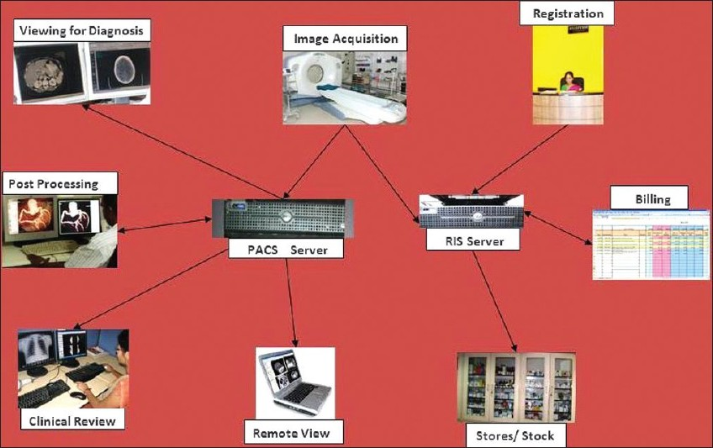
PACS in Radiology
By :
Alanoud Al Saleh

Slide 2
PACS In Radiology
The practice of radiology is a complex system that includes generation of images with multiple modalities, image display, image interpretation and reporting, and image file management.
Organizational systems that enable efficient functioning in small departments often fail as departments grow larger.
The development of systems to meet increasingly complex needs will be challenging, the promise of a PACS is its ability to improve operational efficiency while maintaining on improving high diagnostic ability.

Slide 3
PACS In Radiology
Modern radiology equipment and modalities feed patient images directly to the PACS in digital form.

Slide 4
PACS component
Short term storage
long term storage
Web clients
HIS
RIS
Modality
Workstation

Slide 5
PACS and HIS&RIS
All PACS, whether they span the entire enterprise or a localized within a department, should also interface with existing hospital information systems: Hospital information system (HIS) and Radiology Information System (RIS). There are several data flowing into PACS as inputs for next procedures and back to HIS as results corresponding inputs.

Slide 6
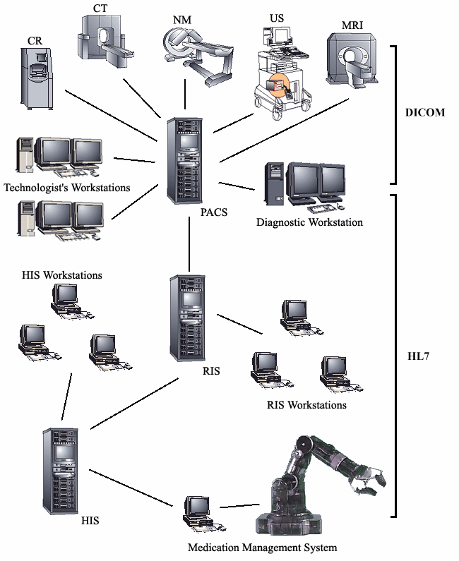
Typical Hospital IT Systems
Interactions among hospital IT systems including modalities, picture
archiving and communications system (PACS), radiology information
system (RIS), hospital information system (HIS), and automation
systems

Slide 7
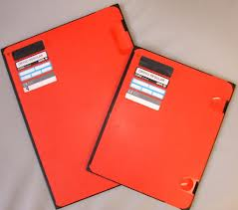
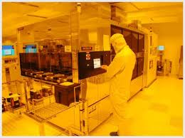
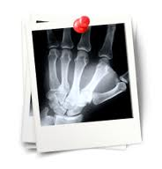
Why PACS ??
1- cost reduction :
No Films
No chemicals
No processors

Slide 8
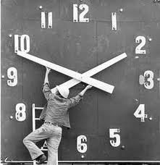
Why PACS ??
2-Time saving :
In old fashion of radiological procedures we used to take along time to accomplish them with PACS no significant time is needed .

Slide 9
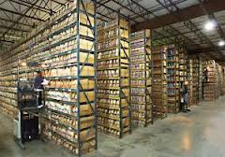
Why PACS ??
3- No need for large space for filling .

Slide 10
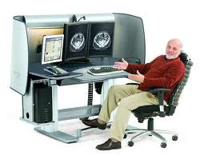
Why PACS ??
4- Productivity :
The productivity of radiological procedures is much higher with PACS than the old way of doing them .

Slide 11
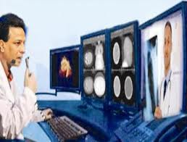
Why PACS ??
5- Fast accessing the films within seconds .
6- Nowadays with PACS researches more easer than the old fashion .

Slide 12
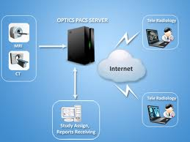
Why PACS ??
Other features :
Tele radiology , conferences , email … etc

Slide 13
PACS work flow :
Patient will come to reception in radiology department .
Exam is ordered/scheduled through “ HIS”
Patient data sent to PACS and imaging modalities via DICOM .

Slide 14
PACS work flow :
Technologist should select the patient from modality work list .
Database creates electronic patient folder and waiting for the images to be pushed from the modality . The status of exam at PACS will be ORDER

Slide 15
PACS work flow :
Radiological exams will be carried out by the technologist on the modality .
Images should be rechecked by technologist at the modality before pushed to PACS .

Slide 16
PACS work flow :
The images will be sent from the modality to “short term storage “ at this stage will be marked ARRIVED .
images should be verified by technologist at workstation after making the required changes to the image before VERIFICATION .

Slide 17
PACS work flow :
Upon verification the exam is archived to the “ long term storage” .after that, it will be marked VERIFIED on the PACS .
Radiologist can start viewing the images and dictating reports . After that the status of exam will be DICTATED . Later on the report will transcribed . Exams will be marked as COMPLETED on PACS workstation .

Slide 18
PACS work flow :
Physicians can view the images and reports through the web site of this PACS any where in hospital wards , clinics …etc

Slide 19
THANK
YOU

