Slide 1
Lecture 6
Phase Shift Keying (PSK)
1st semester 1440 - 2018

Slide 2
Outline
- Modulation.
Modulation of digital data.
Why we need digital modulation?
Types of digital-to-analog conversion.
Amplitude shift keying.
BASK and OOK

Slide 3
Phase Shift Keying
In phase shift keying, the phase of the carrier is varied to represent two or more different signal elements (Both peak amplitude and frequency remain constant).
In binary PSK, we have only two signal elements: one with a phase of 0°, and the other with a phase of 180°.

Slide 4
Bandwidth of Binary PSK
PSK is less susceptible to noise than ASK.
PSK is superior to FSK because we do not need two carrier signals.
The implementation of BPSK :
the signal element with phase 180° can be seen as the complement of the signal element with phase 0°.
Notes:
. No bandwidth is wasted for
separating two carrier signals.
PSK is limited by the ability of the equipment to distinguish small differences in phase.
This factor limits its potential bit rate.

Slide 5
Digital Modulation Summary
Amplitude Shift Keying (ASK) | Frequency Shift Keying (FSK) | Phase Shift Keying (PSK)
Very simple. | Needs larger bandwidth. | More complex.
Low bandwidth requirements | More error resilience than AM. | Robust against interference.
Very susceptible to interference

Slide 6
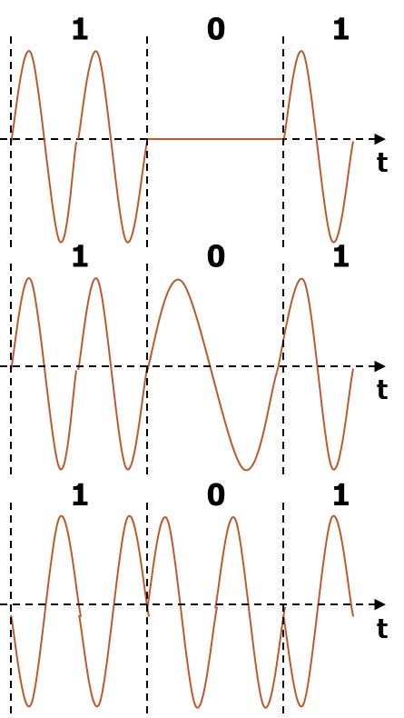
Digital Modulation Summary

Slide 7
Any Question?

