Slide 1
(Analog Data, Digital Signal )
Data Transmission And Digital Communication
Lecture 5– 2019/1440
By: Elham Sunbu

Slide 2
OUTLINE
Sampling.
Pulse Amplitude Modulation .
Analogue to Digital conversion.
Sampling (PCM).
Pulse Code Modulation Advantages.
Pulse Code Demodulation.
PAM
PCM

Slide 3
Pulse Amplitude Modulation(PAM)

Slide 4
Introduction
- An analog signal: amplitude can take any value over a continuous range.
- Digital signals: amplitude can take only discrete and finite values.
- Note:
can we convert an analog signal to a digital signal.

Slide 5
Introduction
- One can convert an analog signal to a digital signal by sampling and quantizing (collectively called analog-to-digital conversion, or ADC).
- The processed signals are then converted back into analog signals using a reconstruction or interpolation operation (called digital-to-analog conversion, or DAC).

Slide 6
Sampling Process
- The sampling process is a basic operation in the digital communication.
- In this process, the continuous-time analog signal is sampled by measuring its amplitude at a discrete instants.
- So, the continuous-time analog signal is converted into a corresponding sequence of samples that are usually spaced uniformly in time.
- It is necessary to choose the sampling rate properly, so the sequence of samples uniquely defines the original analog signal.

Slide 8
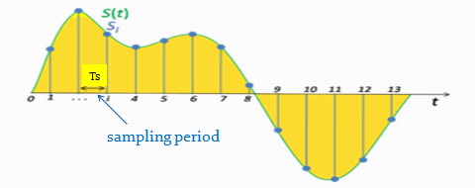
Sampling
- To sample a continuous-time signal x(t) is to represent x(t) at a discrete number of points, t = nTs , where Ts is the sampling period.

Slide 9
Sampling
The sampling theorem states that a band-limited signal x(t) with a bandwidth W ( W is the highest frequency) can be reconstructed from its sample values if the sampling rate (frequency)
fs =1/Ts is greater than or equal to twice the bandwidth W of x(t)
- The minimum sampling rate of fs for an analog band-limited signal is called the Nyquist rate.

Slide 10
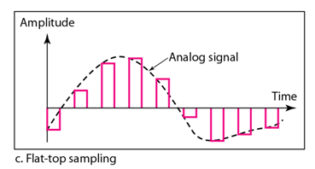
Sampling
- There are 3 sampling methods:
Ideal - an impulse at each sampling instant.
Natural - a pulse of short width with varying amplitude.
Flattop - sample and hold, like natural but with single amplitude value.

Slide 11
Sampling
- As long as the sampling of the analog signal is taken with a sufficiently high frequency (higher than the minimum Nyquist rate of twice the signal largest frequency), it can be shown that there is no loss in information as a result of taking discrete samples.

Slide 12
PAM
Pulse Amplitude Modulation

Slide 13
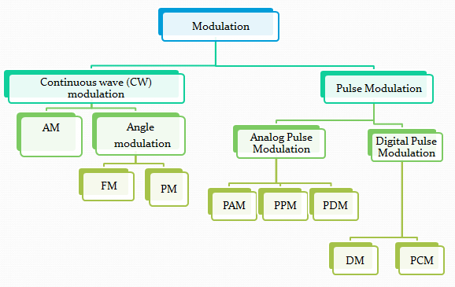

Slide 14
Introduction
- CW modulation: a parameter of a sinusoidal carrier wave is varied continuously in accordance with the message signal.
Amplitude, frequency and phase.
- Pulse Modulation: signal is transmitted at discrete intervals of time.
- Pulse modulation can be analog pulse modulation or digital pulse modulation.

Slide 15
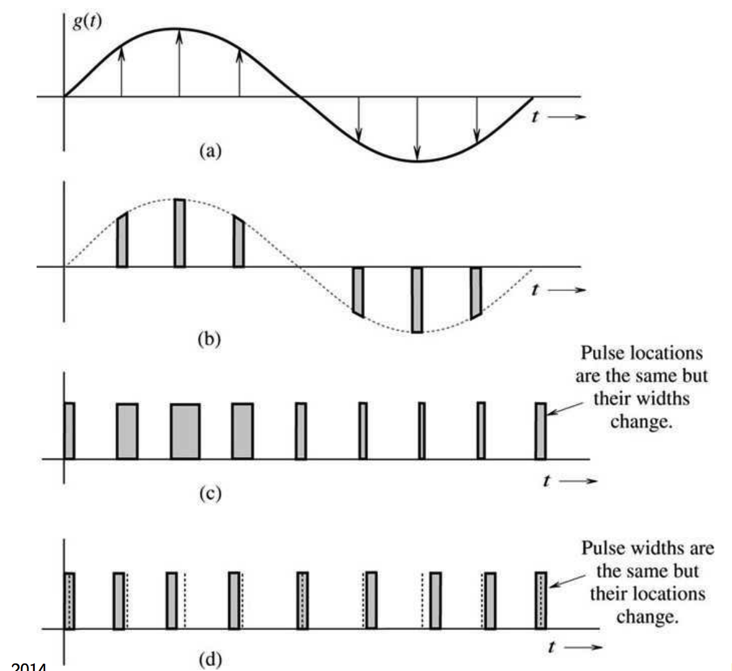

Slide 16
Pulse Amplitude Modulation (PAM)
- In the PAM, the amplitude of periodic pulse train is varied with a amplitude of the corresponding sample value of a continuous message signal.
- In PAM: width and position are fixed but amplitude varies.

Slide 17
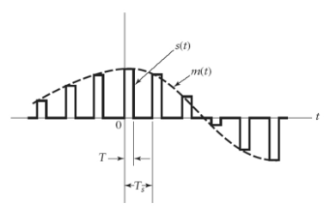
Pulse Amplitude Modulation (PAM)

Slide 18
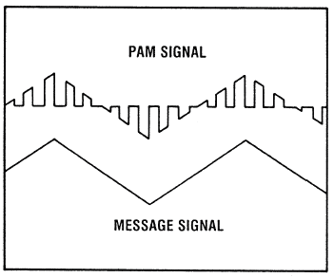
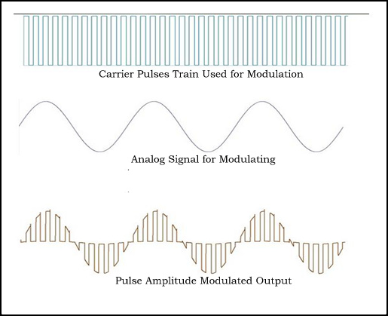
Pulse Amplitude Modulation (PAM)
- Natural PAM
top portion of the pulses are subjected to follow the modulating wave.

Slide 19
Pulse Amplitude Modulation (PAM)
- Pulse width modulation is also called pulse duration modulation (PDM).
- Pulse width modulation: position and amplitude are fixed but width varies.
- PWM is more often used for control than for communication.
LEDs: output luminosity is proportional to average current.

Slide 20
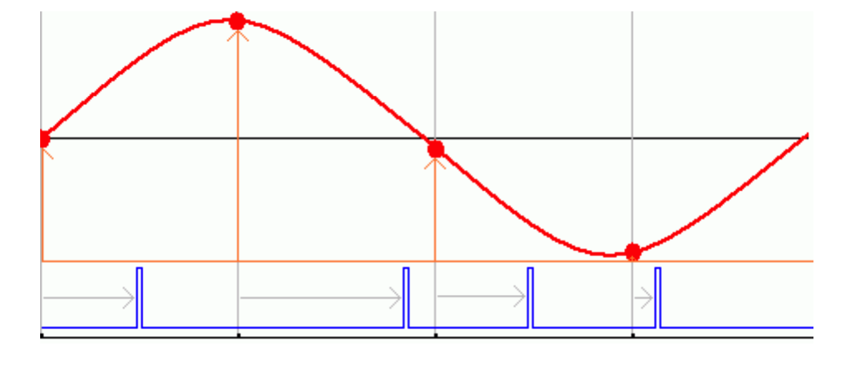
Pulse Amplitude Modulation (PAM)
Pulse position modulation:
width and amplitude are fixed but position varies.
- The value of the signal determines the delay of the pulse from the clock.

Slide 21
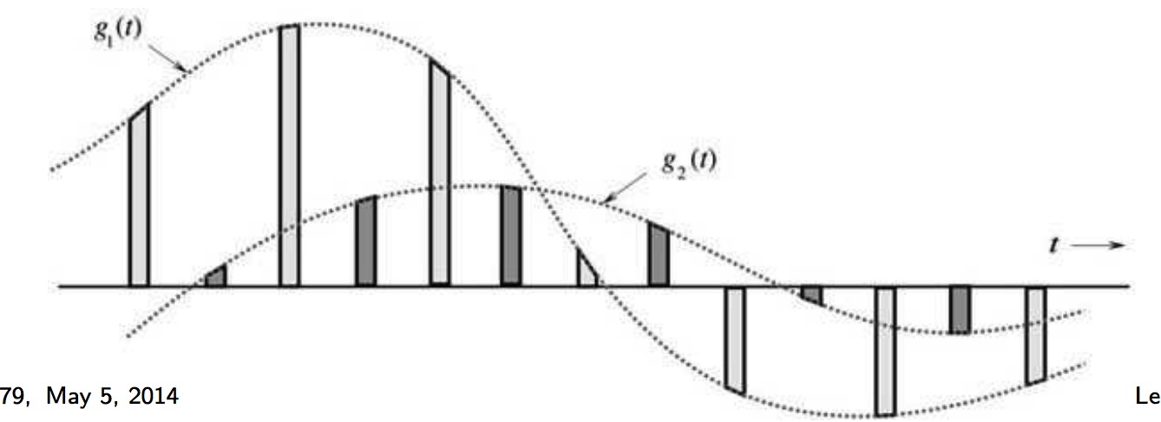
Time Division Multiplexing (TDM)
- In many cases, bandwidth of communication link is much greater than signal bandwidth.
- All three methods can be used with time-division multiplexing (TDM) to carry multiple signals over a single channel.

Slide 22
Analog to Digital Conversion
A digital signal is superior to an analog signal.
Digital is less prone to noise and distortion.
We can’t use analog signals for long distance (lose their strength, which means amplifiers are needed to amplify signal. However the amplifier creates distortion in the signal and adds some noise).
The tendency today is to change an analog signal (such as audio ,voice and music) to digital data.
Pulse Code Modulation (PCM) is a technique to convert analog data to digital signal.

Slide 23
Pulse Code Modulation(PCM)

Slide 24
Analog to Digital Conversion
The idea of digitizing analog signal started with telephone companies, to provide long distance services; They digitized the analog signal at the sender; The signal is converted back to analog at the receiver.
- Pulse Code Modulation (PCM):
1- Sampling (PAM).
2- Quantization.
3- Binary encoding.
4- Line or block coding.

Slide 25
1. Sampling (PAM)
The first step in PCM is sampling.
The analog signal is sampled at equal interval, every T_{s} s (sample interval)
The inverse of sampling interval is sampling rate or sampling frequency.
f_{s}= 1/T_{s}
Sampling rate: number of samples per second.

Slide 26
1. Sampling PAM (Pulse Amplitude Modulation)

Slide 27
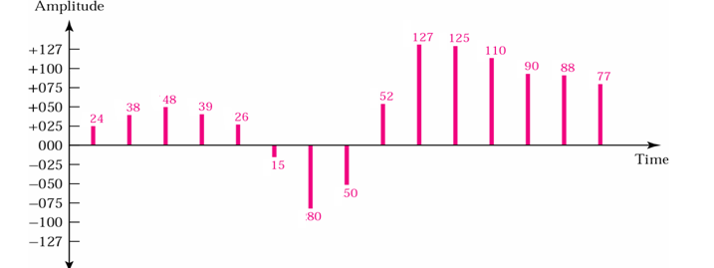
2. Quantized PAM Signal
The result of PAM is a series of pulses with amplitude values between the maximum and minimum amplitudes of the signal with real values.
Quantization: is a method of assigning integer values in a specific range to sampled instances.

Slide 28
3. Binary Encoding
Each quantized samples is translated into equivalent binary codes .

Slide 29
4. Line Encoding
- The binary digits are then transformed to a digital signal using one of the line encoding.

Slide 30
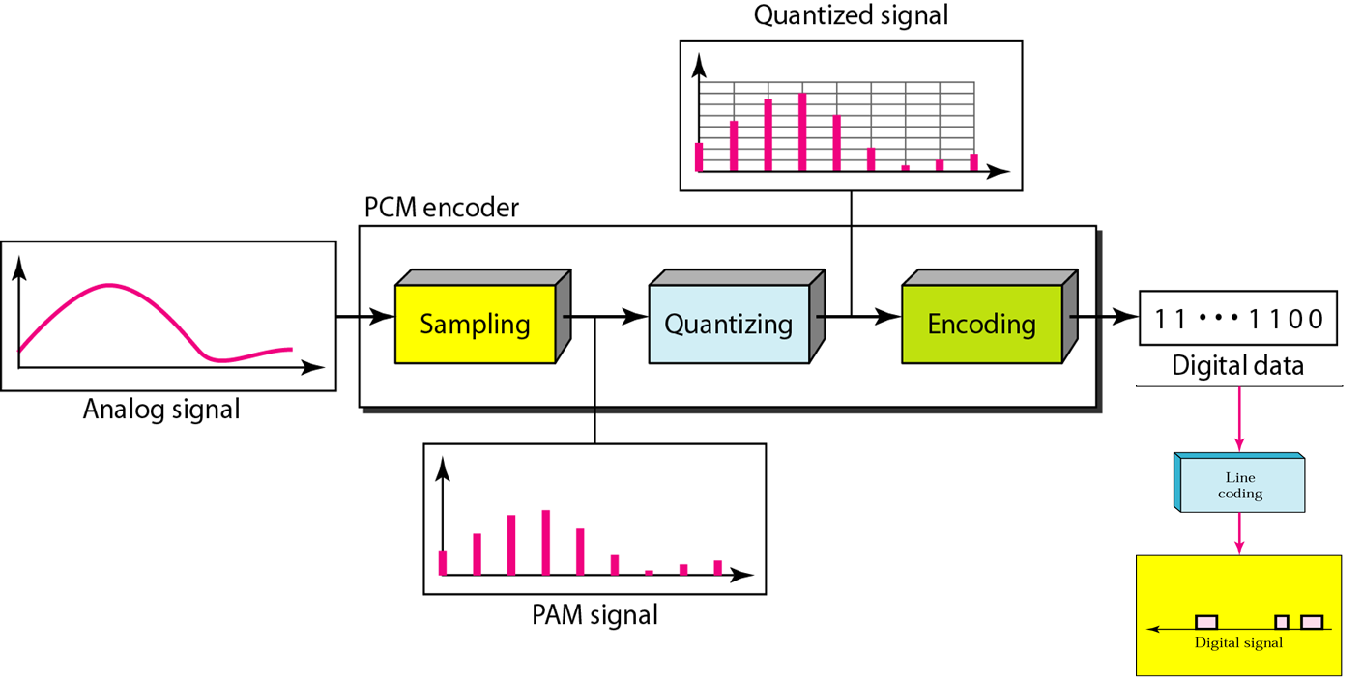
Components of PCM Encoder

Slide 31
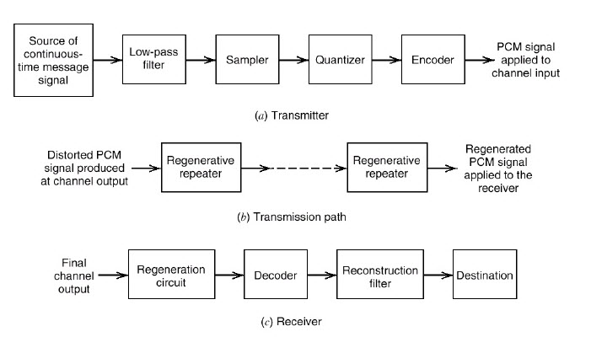
PCM Block
The basic elements of a PCM system

Slide 32
Pulse Code Modulation Advantages
Analog signal can be transmitted over a high speed digital communication system.
Probability of occurring error will reduce by the use of appropriate coding methods.
PCM is used in Telkom system, digital audio recording, digitized video special effects, digital video, voice mail.
PCM is also used in Radio control units as transmitter and also receiver for remote controlled cars, boats, planes.
The PCM signal is more resistant to interference than normal signal.

Slide 33
Pulse Code Demodulation
Pulse Code Demodulation: will be doing the same modulation process in reverse.
Demodulation starts with decoding process
During transmission the PCM signal will effected by the noise interference.

Slide 34
Thank You

