Slide 1
Lecture 4
Amplitude Shift Keying (ASK)
1st semester 1440 - 2018

Slide 2
Outline
- Modulation.
Modulation of digital data.
Why we need digital modulation?
Types of digital-to-analog conversion.
Amplitude shift keying.
BASK and OOK

Slide 3
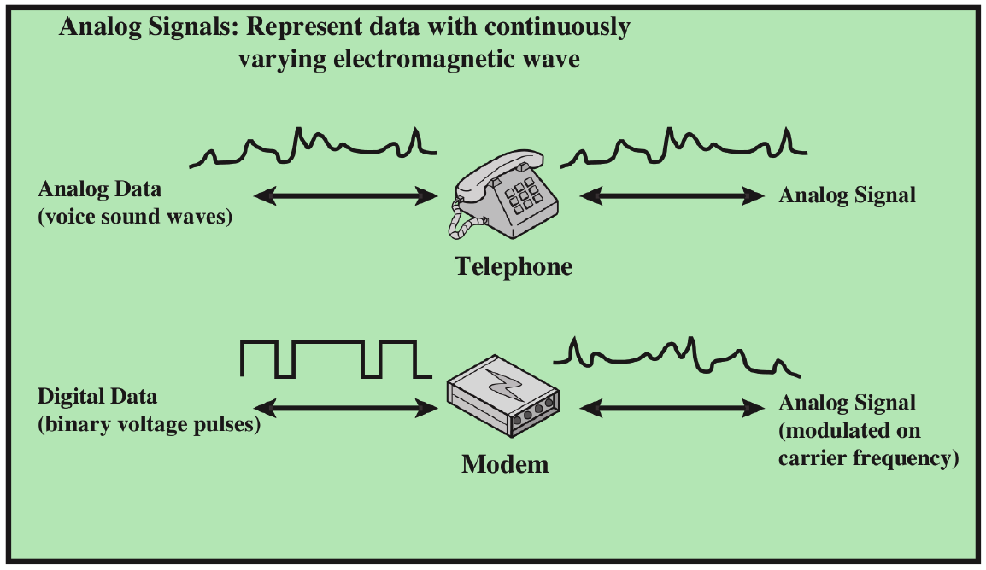
Introduction
Converting digital data or low-pass analog signal to a band-pass analog signal is traditionally called modulation.
Notes:
If the available channel is a bandpass channel~we cannot send the digital signal directly to
the channel; we need to convert the digital signal to an analog signal before transmission.

Slide 4
Modulation
Definition: transforming the information to be transmitted into a format suitable for the used medium.
The signals are transmitted as a sine wave which has three parameters: amplitude, frequency and phase shift.
These parameters can be varied in accordance with data or another modulating signal.
Two types of modulation:
Digital modulation( Shift Keying).
Analog modulation: the center frequency of the baseband signal is shifted up to the radio carrier.

Slide 5
Modulation of Digital Data
Digital-to-analog conversion is the process of changing one of the characteristics of an analog signal (carrier signal) based on the information in digital data.
Digital /Analog converter
Analog /Digital converter

Slide 6
Why we need digital modulation
Digital modulation is required if digital data has to be transmitted over a medium that only allows analog transmission.
Modems in wired networks.
Wireless must use analogue sine waves.

Slide 7
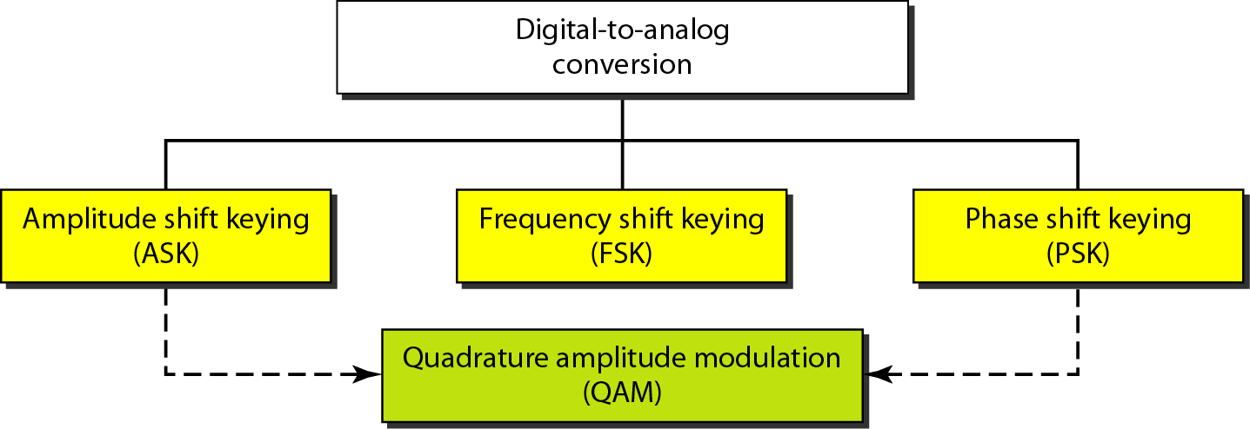
Types of Digital-to-Analog Conversion

Slide 8
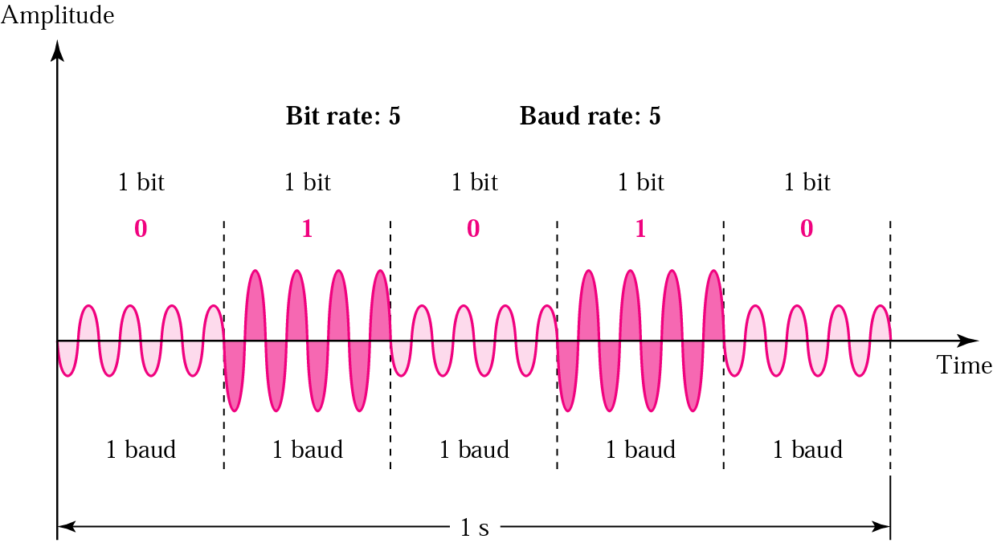
Amplitude Shift Keying (ASK)
In ASK the amplitude of the carrier signal is varied to represent binary 1 or 0.
Carrier signal is a high frequency signal that acts as a basis for the information signal.
Both frequency and phase remain constant while the amplitude changes.
The peak amplitude of the signal during each bit duration is constant, and its value depends on the bit (0 or 1).

Slide 9
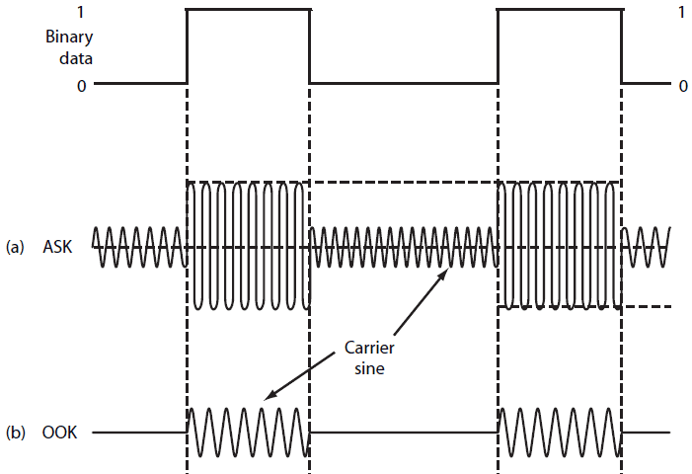
Binary ASK (BASK) or On Off Keying (OOK)
- Although we can have several levels of signal elements, each with a different amplitude, ASK is normally implemented using only two levels. This is referred to as binary amplitude shift keying.
- In ON OFF Keying: bit 0 is represented by the absence of a carrier and bit 1 is represented by the presence of a carrier .

Slide 10
Pros and Cons
- Pros:
ASK transmitter and receiver are simple to design.
ASK needs less bandwidth than FSK.
- Cons:
ASK transmission can be easily corrupted by noise.
- Application:
Early telephone modem (AFSK).
ASK is used to transmit digital data over optical fiber.

Slide 11
Any Question?

