Slide 1
CHS 382
Lecture 1
OVERVIEW OF HEALTH PROMOTION

Slide 2
Outline
Key words, terms, and definitions
Social determinants of health
Evolution of public health
The importance of health education/health promotion
Useful links

Slide 3
Objectives:
By the end of this lecture, you will be able to :
Define health promotion and other related terms
Recognize the importance of the profession

Slide 4
Think about the following questions
What is health promotion?
Why health promotion?
What are the social determinants of health?

Slide 5
Watch and discuss
https://www.youtube.com/watch?v=y9THQTEqMaU

Slide 6
Key words, Terms, and Definitions
Health: “the state of complete mental, physical, and social well being not merely the absence of disease or infirmity” (WHO, 1947,p. 1)
Community Health: “the health status of a defined group of people and the actions and conditions to protect and improve the health of the community” (Green & McKenzie, 2002,p. 99)
Disease Prevention: “the process of reducing risks and alleviating disease to promote, preserve, and restore health and minimize suffering and distress” (Joint Committee, 2001, p. 99)
Notes:
Refer to http://applications.emro.who.int/dsaf/EMRPUB_2012_EN_1362.pdf

Slide 7
Key words, Terms, and Definitions
Public health: “The science and art of preventing disease, prolonging life and promoting health through organized efforts and informed choices of society, organizations, public and private, communities and
individuals”.
Global Health: The health of populations in a global context; it has been defined as "the area of study, research and practice that places a priority on improving health and achieving equity in health for all people worldwide”.

Slide 8
Key words, Terms, and Definitions
Health communication: The study and practice of communicating promotional health information, such as in public health campaigns, health education, and between doctor and patient. The purpose of disseminating health information is to influence personal health choices by
improving health literacy.

Slide 9
Key words, Terms, and Definitions
Health literacy :“The degree to which people are able to access, understand, appraise and communicate information to engage
with the demands of different health contexts in order to
promote and maintain good health across the life-course.”

Slide 10
Key words, Terms, and Definitions
Health Education “Any combination of planned learning experiences based on sound theories that provide individuals, groups and communities the opportunity to acquire information and the skills needed to make quality health
decisions” (Joint Committee, 2001,p. 10)

Slide 11
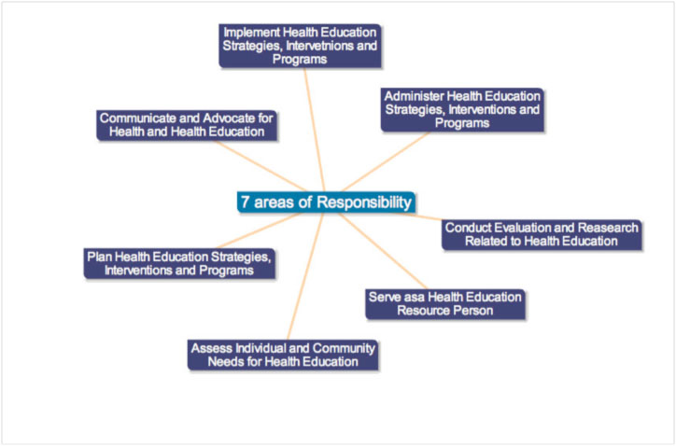
Health Education Competencies

Slide 12
Key words, Terms, and Definitions
Health promotion:
“The combination of educational and environmental supports
for actions and conditions of living conducive to health”
According to the WHO, Health promotion is the process of enabling people to increase control over, and to improve, their health. It moves beyond a focus on individual behavior towards a wide range of social and environmental interventions.

Slide 13
Development of Public Health in the US
Late 19th -mid 20th century:
First public health revolution.
Was aimed at controlling the harm (morbidity and mortality) that came from infectious diseases.
Mid 1950s:
Many of the infectious diseases were under control
Focus shifted from infectious diseases to major chronic diseases such as heart disease, cancer and strokes.

Slide 14
Development of Health Education/Promotion in the US
Mid-1970s:
Recognized that health promotion and disease prevention played the major role in reducing morbidity, saving lives, and reducing health costs.
A shift from the traditional medical model to lifestyle and environmental strategies that emphasized prevention was the focus of the first publication of ‘Healthy People’ in 1979.

Slide 15
Development of Health Education/Promotion in the US
1980s:
A comprehensive national agenda for prevention had been developed with specific goals for the first time. The objectives were divided into three main areas—preventive services, health protection, and health promotion.
Even though not all objectives were reached, the planning process highlighted the value of setting goals and listing specific objectives to help measure progress.

Slide 16
Development of Health Education/Promotion in the US
This led to the practice of developing health objectives each
decade (Healthy People1990, 2000, 2010)
2010:
Healthy People 2010 will guide the U.S. public health and health education practice through 2020. Its vision is “a society in which all people live long, healthy lives” (U.S Department of Health and Human Services, 2010)

Slide 17
Healthy People Program
Healthy People is a program of nationwide health-promotion and disease-prevention goals set by the United States Department of Health and Human Services. The goals were first set in 1979 “in response to an emerging consensus among scientists and health authorities that national health priorities should emphasize disease prevention”.
The Healthy People program was originally issued by the Department of Health, Education and Welfare (DHEW). This first issue contained “a report announcing goals for a ten-year plan to reduce controllable health risks

Slide 18
Useful links
http://applications.emro.who.int/dsaf/EMRPUB_2012_EN_1362.pdf

Slide 19
Quiz 1
http://www.who.int/healthpromotion/about/HPR%20Glossary%201998.pdf?ua=1

