Slide 1
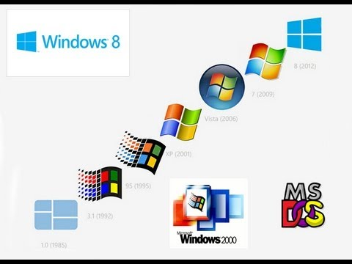
Lecture 4: Windows Operating Systems
By: Elham Sunbu

Slide 2
Overview
Peer-to-Peer:
Windows for workgroups/95
Client/server:
Windows NT

Slide 3
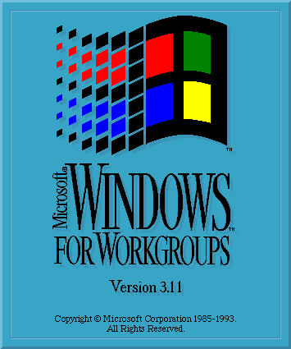
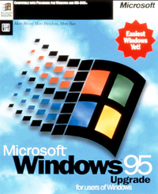
Peer-to-Peer Windows for Workgroups/Windows 95
Windows for Workgroups, introduced in the early 90s
Windows 95, introduced in 1995
They are both considered peer-to-peer networking systems and do not have the capabilities of true internetworking operating systems.
They are, however, inexpensive and more than adequate for small workgroups wanting to share resources, use email, and connect to the Internet.

Slide 4
Windows for Workgroups/Windows 95
Windows for Workgroups and Windows 95 both offer peer-to-peer network protocols.
The protocols used by these operating systems allow users to share files and devices over LANs.
Both offer NetBEUI (Microsoft’s small network protocol).
They also offer TCP/IP, and IPX/SPX protocols to access the network through either a dialup connection/modem, or directly through a NIC.

Slide 5
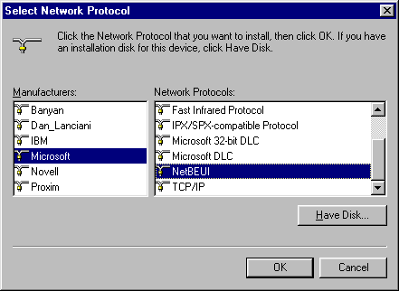
NetBEUI
Pronounced net-booey, NetBEUI is short for NetBios Extended User Interface.
It is an enhanced version of the NetBIOS protocol used by network operating systems such as:
LAN Manager, LAN Server, Windows for Workgroups, Windows 95 and Windows NT.
Netbeui was originally designed by IBM for their Lan Manager server and later extended by Microsoft and Novell.

Slide 6
NetBEUI features
NetBEUI protocols, are :
not routable,
Suitable for small LAN needs.
easy to use and do not require deep networking knowledge.
NetBEUI software identifies computer devices by name
➔it is easier to remember that a computer name is Nora than 141.252.20.2 or 141.252.10.1.

Slide 7
NetBEUI features
NetBEUI protocols, are :
Each device name in a network must be unique.
NetBEUI software installed on each of the networked computers is the only thing necessary to configure devices in order to share resources and create a network.

Slide 8
Windows for Workgroups/Windows 95
If a small company does want to connect to the Internet, the necessary software and protocols are available with these operating systems.
Shared resources on Windows for Workgroups/95 networks are accessed by a password that protects the resource and there is only one level of access; either you have access or you don’t have access.

Slide 9
Windows for Workgroups/Windows 95: Security Issues
Anyone connected to the network who knows the password of the resource has access to that resource.
This can create security issues since there is no way to prevent a user from access once s/he knows the password.

Slide 10
Windows for Workgroups/Windows 95: Security Issues
As the network grows, it is usually more difficult to keep resource passwords secure.
Since there is no central control, managing these peer-to-peer networks becomes an issue when the network becomes too large.

Slide 11
Sharing files and printers using Windows for Workgroups
Only items designated as shares can be seen by other members.
All other files and printers are hidden from all users except the local computer.
When you share a disk directory or printer from a workstation, you give the shared resource a name to which others can refer.
For Details & Steps: (Enabling File Sharing and Printer Sharing) http://www.hawaii.edu/its/micro/pc/win31/fsps3112.html

Slide 12
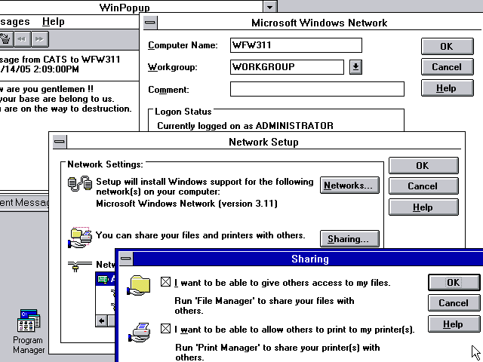
Sharing files and printers using Windows for Workgroups

Slide 13
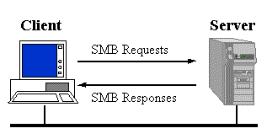
Server Message Block (SMB)
SMB operates as an application-layer network protocol mainly used for providing shared access to:
files,
printers,
serial ports, and
various communications between nodes on a network.
It also provides an authenticated inter-process communication mechanism.

Slide 14
Server Message Block (SMB) Features
SMB can run on top of the Session (and lower) network layers in several ways:
Directly over TCP;
Over the NetBIOS API, which can run on several transport layer protocol :On UDP, TCP ports(NetBIOS over TCP/IP);
Over IPX/SPX protocol (Internetwork Packet Exchange/Sequenced Packet Exchange)
Notes:
IPX/SPX stands for Internetwork Packet Exchange/Sequenced Packet Exchange. IPX and SPX are networking protocols used primarily on networks using the Novell NetWare operating systems.

Slide 15
Windows 95 and 98
Windows 95 and 98 operating systems include software necessary to create a peer-to-peer network and enable sharing of printers and files.
Computers running Windows 95 or 98 will also work well as clients on Windows NT and NetWare LANs.
But you will have to install the client (requester) software.
Note that users of Windows 95 and 98 cannot have the full benefit of Windows NT security features; those features require use of the NTFS file format, which is not compatible with Windows 95 or 98.

Slide 16
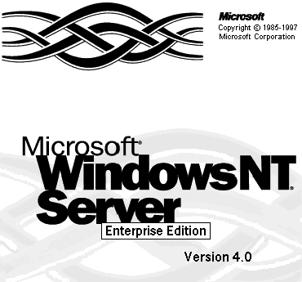
Client/server: Windows NT Server
Windows NT is a server operating system
Windows NT Server was first introduced in the mid-90s and is capable of managing workgroups just like Windows for Workgroups/95.
Windows NT Server has all of the advantages mentioned for the other Windows operating systems, plus, it contains several other features making it more robust.

Slide 17
Windows NT Server
Windows NT is a symmetric multiprocessing operating system which support multiple operating system environments.
It has a windows graphical user interface and runs win32, 16-bit windows, ms-dos, posix, and os/2 program.
It employs advanced operating system principles such as virtual memory, preemptive multitasking, structured exception handling, and operating system objects.
It is secure, powerful, reliable, and flexible.

Slide 18
Symmetric Multiprocessing
Memory
Processor A
Processor B
Operating
System
User
Thread
User
Thread
User
Thread
User
Thread
Operating
System
I/O Devices(Monitor,Mouse,Keyboard)

Slide 19
Windows NT Structure
The structure of Windows NT can be divided into two parts:
The user-mode portion of the system(the Windows NT protected subsystems) and
The kernel-mode portion (the NT executive).
Notes:
The structure of Windows NT can be divided into two parts: the user-mode portion of the system(the Windows NT protected subsystems) and the kernel-mode portion(the NT executive).
Windows NT servers are called protected subsystem because each one resides in a separate process whose memory is protected from other processes by the NT executive’s virtual memory system. They communicate with each other by passing messages.
The NT executive is capable of supporting any number of server processes. The servers give the NT executive its user and programming interfaces and provide execution environments for various type of applications.

Slide 20
Protected Subsystem
Windows NT has two types of protected subsystems:
Environment subsystem
Integral subsystem
Notes:
Windows NT has two types of protected subsystems: environment subsystem and integral subsystem.
An environment subsystem is a user-mode server that provides an API specific to an operating system. When an application calls an API routine, the call is delivered through LPC facility to the environment subsystem. The environment subsystem executes the API routine and returns the result to the application process by sending another LPC. The most important environment subsystem in Windows NT is Win32 subsystem.
The remaining protected subsystems, the integral subsystems, are servers that perform important operating system functions. One of them is security subsystem, which runs in user mode and records the security policies in effect on the local computer. Several components of the Windows NT networking software are also implemented as integral subsystems.

Slide 21
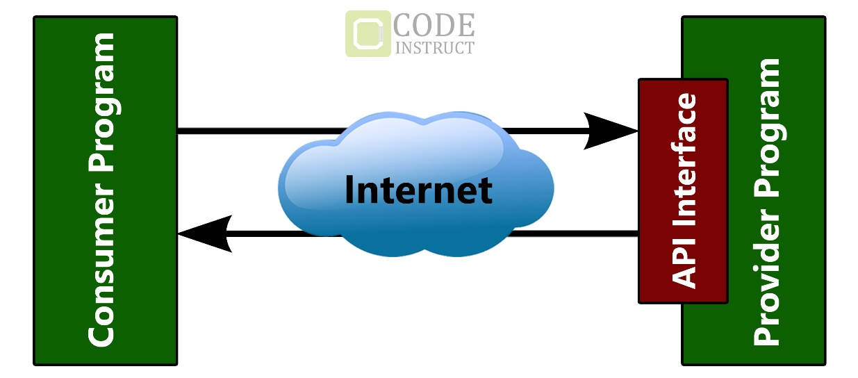
Environment subsystem
An environment subsystem is a user-mode server that provides an API specific to an operating system.
Application Program Interface (API) is a set of routines, protocols, and tools for building software applications. The API specifies how software components should interact.
Notes:
Windows NT has two types of protected subsystems: environment subsystem and integral subsystem.
An environment subsystem is a user-mode server that provides an API specific to an operating system. When an application calls an API routine, the call is delivered through LPC facility to the environment subsystem. The environment subsystem executes the API routine and returns the result to the application process by sending another LPC. The most important environment subsystem in Windows NT is Win32 subsystem.
The remaining protected subsystems, the integral subsystems, are servers that perform important operating system functions. One of them is security subsystem, which runs in user mode and records the security policies in effect on the local computer. Several components of the Windows NT networking software are also implemented as integral subsystems.

Slide 22
Environment subsystem
When an application calls an API routine, the call is Sent to the environment subsystem.
The environment subsystem executes the API routine and returns the result to the application process.
The most important environment subsystem in Windows NT is Win32 subsystem.

Slide 23
Integral Subsystems
The integral subsystems, are servers that perform important operating system functions.
One of them is security subsystem, which runs in user mode and records the security policies in effect on the local computer.
Several components of the Windows NT networking software are also implemented as integral subsystems.
Notes:
Windows NT has two types of protected subsystems: environment subsystem and integral subsystem.
An environment subsystem is a user-mode server that provides an API specific to an operating system. When an application calls an API routine, the call is delivered through LPC facility to the environment subsystem. The environment subsystem executes the API routine and returns the result to the application process by sending another LPC. The most important environment subsystem in Windows NT is Win32 subsystem.
The remaining protected subsystems, the integral subsystems, are servers that perform important operating system functions. One of them is security subsystem, which runs in user mode and records the security policies in effect on the local computer. Several components of the Windows NT networking software are also implemented as integral subsystems.

Slide 24
Executive Components
Object Manager
Security Reference Manager
Process Manager
Virtual Memory Manager
I/O and File System
Kernel
Hardware abstraction layer(HAL)

Slide 25
Windows NT Design Objectives
Extensibility
Backoffice Suite (SQL Server, Exchange,..etc.)
Portability (from one hardware to another)
Written by C, which is not hardware dependent
Compatibility
DOS, Win16, Win32 and POSIX (Portable Operating System Interface based on UNIX) Compatible.
Security
Security logon, Discretionary access control, Audit, Memory protection
Performance
Reliability and Robustness

Slide 26
Windows NT Features
Networking components
NetBEUI, IPX/SPX, TCP/IP, DLC, ApplTalk, PPTP, VLAN
Internet/Intranet components
Internet Information Server (IIS), FTP server, gopher server.
Interoperability components
Clients: DOS, Windows95/98, Windows NT workstation, Macintosh.
Application-Enabling components
Support Inter Process Communication (IPC)
Administrative components
Primary domain controller: responds to security authentication requests (logging in, checking permissions, etc.)
backup domain controller: has a copy of the user accounts database.
Workstation components
NT server can also be used as a workstation.

Slide 27
What’s the differences between Win95/98 and Windows NT?
Windows 95/98 | Windows NT
File systems: FAT slow when file> 200mb Index: Linked list (data structure) | File systems: NTFS bigger partition, more secure Index : B-tree (data structure)
Support only single processor | Support both single and multiprocessors
Weaker security | Stronger security

Slide 28
Security in Windows NT Server
Windows NT Server has more than one level of security beyond access/no access.
It offers the following security levels:
no access.
access that restricts the user to read only capabilities.
access that allows read and write usage.
access that allows you to change access permissions for network users.
Each user who wishes to access services on the network must have a password and a user account set up within the domain.

Slide 29
Security in Windows NT Server: Security Domains
A domain is a security model where the database of user accounts is stored on one or more computers known as domain controllers.
Important for the centralize control of the network.
The network administrator creates, deletes, and manages these accounts and passwords using the User Manager for Domains program that comes with Windows NT Server.

Slide 30
Security in Windows NT Server
For security reasons, companies often have two servers capable of authenticating passwords:
one that acts as the Primary Domain Controller (PDC) and
the other as the Backup Domain Controller (BDC).

Slide 31
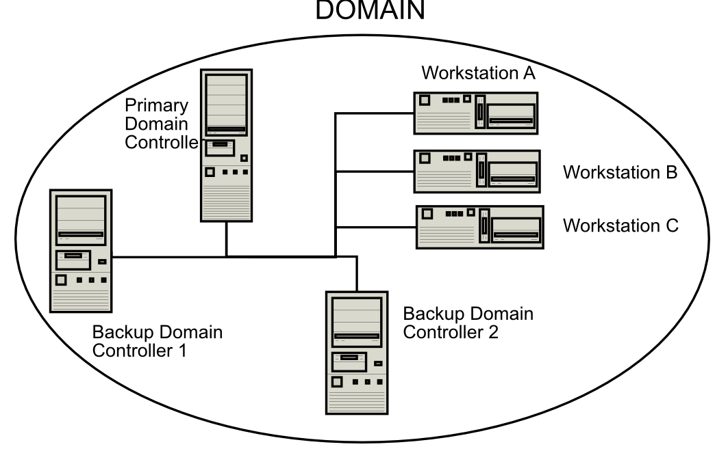
Security in Windows NT Server
Primary Domain Controller (PDC):
The PDC is a computer on the network that maintains a database of users and security policies for the domain.
This database contains the names of users and the resources they may access.
User access may be defined for individual files or for entire directories.
Network services can be implemented on one computer and the PDC functions on another

Slide 32
Security in Windows NT Server
BDC (Backup Domain model) :
A BDC maintains a copy of the PDC database.
Prevents network disruption in the event of failure of the PDC.
If a failure occurs in the PDC, the backup domain controller can be easily switched on.
With Windows NT Server networks can connect to other domains.

Slide 33
Domain Models
NT provides four domain models to manage multiple domains within a single organization.
– Single domain model, domains are isolated.
– Master domain model, one of the domains is designated the master domain.
– Multiple master domain model, there is more than one master domain, and they all trust each other.
– Multiple trust model, there is no master domain. All domains manage their own users, but they also all trust each other.

Slide 34
Windows NT Services
File Services
Security
Printing
Network Services
Interoperability

Slide 35
File Services
There are two approaches to sharing files on a Windows NT network:
The first Based on simple file sharing, as on a peer-to-peer network.
Any workstation or server can publicly share a directory to the network and set the attributes of the data (No Access, Read, Change, or Full Control).
The Second Takes full advantage of Windows NT's security features.
You can assign directory-level and file-level permissions.
Restrict access to specified individuals or groups
Done using the Windows NT file system (NTFS)

Slide 36
Security
Windows NT provides security for any resource on the network.
A Windows NT network domain server maintains all the account records, and manages permissions and user rights.
To access any resource on the network, a user must have the permission to use the resource.

Slide 37
Printing
Client or server can function as a print server In Windows NT network.
Sharing a printer makes it available to anyone on the network.
When installing a printer, you will first be asked whether or not the printer will be classified as:
a local printer (My Computer)
or a network printer.

Slide 38
Network Services
Windows NT provides several services to help facilitate a smooth-running network. The following list summarizes these services:
Messenger Service Monitors the network and receives pop-up messages for you.
Alerter Service Sends notifications that are received by the messenger service.
Browser Service Provides a list of servers available on domains and workgroups.
Workstation Service Runs on a workstation and is responsible for connections to servers. This is also referred to as the redirector.
Server Service Provides network access to the resources on a computer.

Slide 39
Interoperability
The NWLink network protocol is designed to make Windows NT compatible with NetWare.
The following NetWare services are available:
Gateway Services for NetWare (GSNW)
All Windows NT clients within a domain must contact a NetWare server through a single source.
GSNW provides the gateway connection between a Windows NT domain and a NetWare server.
Client Services for NetWare (CSNW) This service enables a Windows NT Workstation to access file and print services on a NetWare server. It is included as part of GSNW.

Slide 40
Interoperability
File and Print Service for NetWare (FPNW) This utility allows NetWare clients to access Windows NT file and print services.
Directory Service Manager for NetWare (DSMN) This add-on utility integrates NetWare and Windows NT user and group account information.
Migration Tool for NetWare This tool is used by administrators who are converting from NetWare to Windows NT.
It sends a NetWare server's account information to a Windows NT domain controller.

Slide 41
Any Question?

