Slide 1
Titration of weak acids

Slide 2
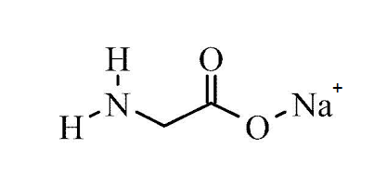
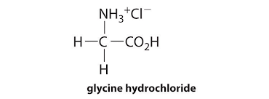
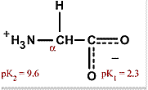
Titration of amino acids
Amino acids are weak polyprotic acids .
Neutral amino acids are (gly, ala, threonine ) are treated as diprotic acids .
acidic amino acids (glu, asp,) are treated as triprotic acids .
Basic amino acids (lys , arg , his ) are treated as triprotic acids .
pHm is the pH at which the maximum total number of charges present.
Glycine can be obtained in three forms :
a) Glycine hydrochloride b) Isoelectric glycine c)Sodium glycinate

Slide 3
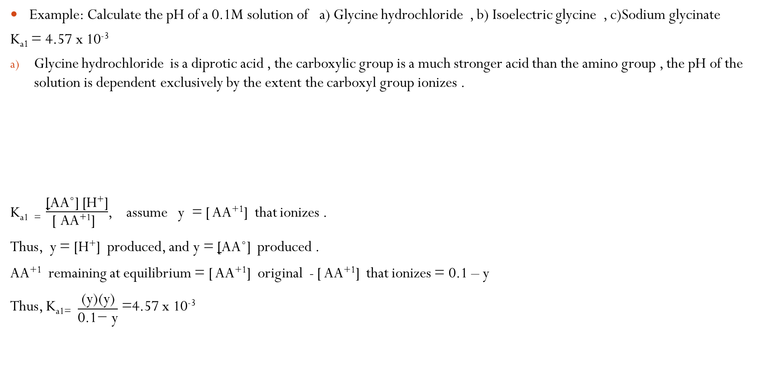
Titration of amino acids
Example: Calculate the pH of a 0.1M solution of a) Glycine hydrochloride , b) Isoelectric glycine , c)Sodium glycinate
K_{a1} = 4.57 x 10⁻³
Glycine hydrochloride is a diprotic acid , the carboxylic group is a much stronger acid than the amino group , the pH of the solution is dependent exclusively by the extent the carboxyl group ionizes .
$\text{K}\text{a}\text{1 }\text{= }\frac{\text{[}\text{AA}\text{˚] [}\text{H}\text{+}\text{]}}{\text{[ }\text{AA}\text{+}\text{1}\text{]} }$, assume y = [ AA⁺¹] that ionizes .
Thus, y = [H⁺] produced, and y = [AA˚] produced .
AA⁺¹ remaining at equilibrium = [ AA⁺¹] original - [ AA⁺¹] that ionizes = 0.1 – y
Thus, $\text{K}\text{a}\text{1}\text{=} \frac{\text{(}\text{y}\text{)(}\text{y}\text{)}}{\text{0.1}\text{− }\text{y}}$ =4.57 x 10⁻³

Slide 4
Titration of amino acids
Since amount of y (value of y) is stronger than that can be ignored ,
Thus 4.57 x 10⁻⁴ - 4.57 x 10⁻³ y = y ²
y ² + 4.57 x 10⁻³ y - 4.57 x 10⁻⁴ = 0.0
Y$=\frac{−b±\sqrt{b^{2}−4ac}}{2a}$ , where a = 1 , b = 4.57 x 10⁻³ , c = 4.57 x 10⁻⁴
Thus y = [H⁺ ] = 1.92 x 10⁻² .
pH = 1.72 .
What is the degree of ionization of glycine hydrochloride in this 0.1M solution ?
b) The pH of AA˚ is the pI ( the pI is defined as that pH where the predominant ionic form is AA˚ , so net charge on the amivo acid is zero .)
So pH = $\frac{\text{pK}\text{a}\text{1 }\text{+ }\text{pKa}\text{2}}{2}= \frac{2.34 +9.6}{2}$= 5.97
c)Sodium glycinate is a diprotic base ,
Both the unionized amino group and the carboxylate ion can accept a proton from water , but since the amino group is a much stronger base than the α-carboxylate group , the pH of the solution depends almost exclusively on the extent to which amino group ionizes .

Slide 5

Titration of amino acids
For the amino group :
K_{b1} =$\frac{K\text{w}}{\text{K}\text{a}\text{2}}=\frac{\text{10}\text{−}\text{14}}{\text{10}\text{−}\text{9.6}}=3.98$x10⁻⁵
For carboxylate group ;
K_{b2} =$\frac{K\text{w}}{\text{K}\text{a}1}=\frac{\text{10}\text{−}\text{14}}{\text{10}\text{−}\text{2.34}}=2.19$x10⁻¹²
K_{b1} = [OH⁻ ] [AA˚ ] = (y) (y)
K_{b1} = $\frac{\text{[}\text{OH}\text{− }\text{]} \text{[}\text{AA}\text{˚ ]}}{\text{[ }\text{AA}\text{−}\text{1}\text{]}}=\frac{\text{(}\text{y}\text{) (}\text{y}\text{)}}{\text{0.1 }\text{– ( }\text{y}\text{ )}}$
Because the concentration of sodium glycinate is much larger than K_{b1} thus y can be neglected from the dominator .

Slide 6

Titration of amino acids
3.98 x10⁻⁵ =$\frac{\text{y}\text{2}}{\text{0.1}}$ , so y² = 3.98 x 10⁻⁶
y = $\sqrt{\text{3.98 }\text{x} \text{10}\text{−}\text{6}}$
y = 1.99 x 10⁻³ M , [OH⁻] = 1.99 x 10⁻³ M
[H⁺] = $\frac{K\text{w}}{\text{[}\text{OH}\text{−}\text{]}}= \frac{\text{1 }\text{x} \text{10}\text{−}\text{14}}{ \text{1.99 }\text{x} \text{10}\text{−}\text{3 }}=$ 5 x 10⁻¹² M
pH = -log[H⁺ ] = 11.3 .

Slide 7
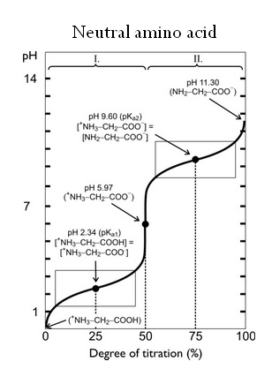
Titration Curve of Neutral Amino Acids
Amino acids are titrated in exactly the same manner as diprotic and triprotic weak acids .
Neutral amino acid

Slide 8
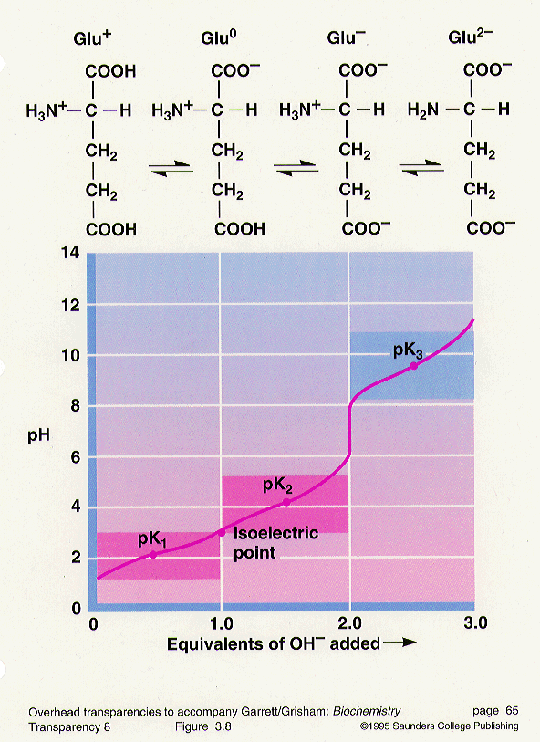
Titration Curve of Acidic amino Acid (Glutamate )

Slide 9
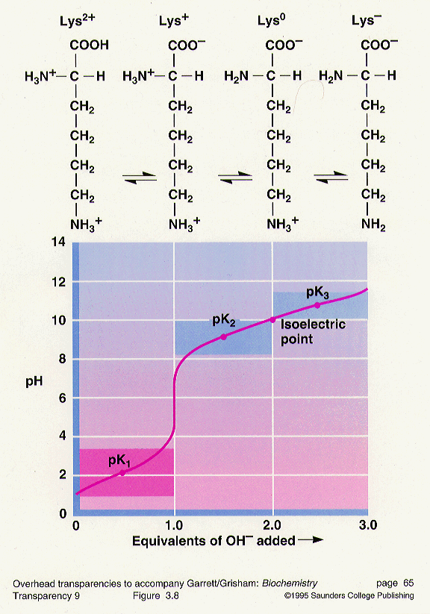
Titration Curves of Lysine

Slide 10
Titration Curves of Amino Acids
Information that can be obtained from a titration curve :
1- The number of ionizable groups in that amino acid , which can be detected from the number of titration stages in the curve , (or the number of pK_{a} ‘s or number of flat zones in the curve) .
2-Whether the triprotic amino acid is basic or acidic , that can be detected from the pKa₂ .
If it’s value is closer to the value of pKa₁ (that of the α- carboxyl group ), then it is an acidic amino acid .
If the value of it’s pKa₂ is closer to the value of pKa₃ (that of the α- aminogroup ), then it is basic amino acid .
3- The pK_{a} values of the amino acid can be obtained from the curve which is equal to the pH value at the mid-point .
4- The isoelectric point , pI for each amino acid can be obtained from the curve by detecting the point where the amino acid is all in the zwitterion form (net charge = 0.0) the pH at that point is the pI .
Or it can be obtained mathematically from ;
pI = pKa₁ + pKa₂ ( in the case of a neutral amino acid ) .
2
In the case of triprotic amino acids , the pI is calculated from :
pI = pKa₁ + pKa₂ ( in the case of acidic amino acids ) .
2

Slide 11
Titration Curves of Amino Acids
pI = pKa₂ + pKa₃ in the case of basic amino acids.
2
5- You can also determine from the curve the pH values at which the amino acid can act as a buffer . (the pH ranges ±1 from the pH value of each midpoint).

Slide 12

How to Obtain a Titration Curves of Amino Acids
No of moles of weak acid or a.a
Calculate the first moles of OH by A= $\frac{no of mole of acid or a.a}{PKa1}$
Calculate the second moles of OH added B= No of moles of weak acid or a.a + A
Calculate the third moles of OH added C= No of moles of weak acid or a.a + B

Slide 13
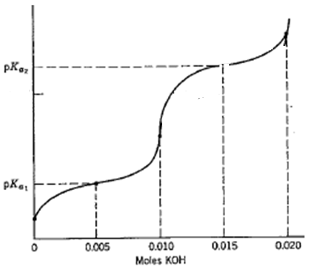
How to Obtain a Titration Curves of Amino Acids
Sketch the pH curve for the titration of 100ml of 0.1M Glycine with KOH? Pka1=1.71, Pka2=9.6?
No of moles of a.a = M*V
= 0.1 * 0.1
=0.01 mole
The first moles of OH by A= 0.01 / 1.71 = 0.005
The second moles of OH added B= 0.01 + 0.005 = 0.015
PI = (Pka1 + pka2)/ 2
=5.66

Slide 14
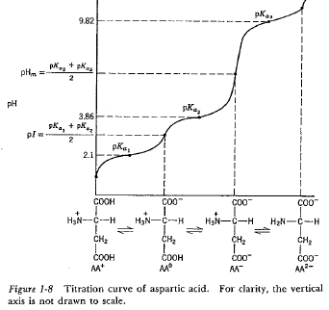
Plot the titration curve of Aspartic acid it has a volume of 100ml and0.1M
When titrated with 0.1M KOH? Pka1=2.09, Pka2=3.86, Pka3=9.82?

Slide 15
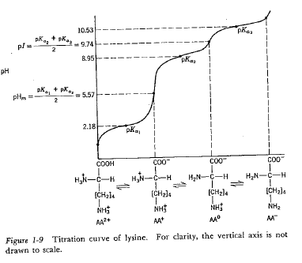
Plot the titration curve of Lysine which has a volume of 200ml and 0.3M
When titrated with 0.1M NaOH? ? Pka1=2.18, Pka2=8.95, Pka3=10.35?

