Slide 1
Volumetric and Gravimetric analysis
Analytical Chemistry
250 Chem.

Slide 2
King Saud university
Chemistry department
250 Chem.
Volumetric and Gravimetric Analysis ………5(3+1+1)
Instructor : Dr. Amal M. AL-Mohaimeed
Office No. : 188Building 5‏
‏ ‏Phone. : Email : muhemeed@ksu.edu.sa
Class time: 10.00-11. Place:5/58‎
Text book:‎. التحليل الحجمي والوزني للدكتور :ابراهيم الزامل
Analytical Chemistry by G.D. Christian , Jone Wiley and Sons , New York , last edition .
Week | Topice
1,2,3 | Solutions and concentrations
4,5,6,7,8,9 | Chemical Equilibrium: Dissociation constant in acid-base reaction, Solubility product in perception reaction, Formation constant in complexes, equilibrium constant in redox reaction)
10,11,12,13 | Volumetric analysis (titrations) (Neutralization, Perception, Complexiometric, redox)
14,15 | Gravimetric analysis
16 | Review and problems

Slide 3
Schedule of Assessment Tasks for Students During the Semester
Assessment | Assessment task | Date | Proportion of final assessment
1 | Midterm exam I | 8\2\1438 | 10
2 | Midterm exam II | 14\3\1438 | 10
3 | Practical exam I | 26/1/1438 | 15
4 | Practical exam II | - | 15
5 | Quizzes | homeworks | 10
6 | Final exam |  | 40

Slide 4
Introduction to Analytical Chemistry

Slide 5
What is Analytical Chemistry????
Analytical chemistry is the study of the separation, ‎identification, and quantification of the chemical ‎components of natural and artificial materials
Branches of analytical chemistry
Qualitative
gives an indication of the identity of the chemical species in the sample
Quantitative
determines the amount of certain components in the substance
Qualitative: recognized by color, boiling point, solubility, taste

Slide 6
Classification of Quantitative Methods of Analysis
Classical methods
Gravimetric Method: mass is measured.
Volumetric Method: volume is measured
Instrumental Method
use an instrumental technique to assay the amount of sample
Electro analytical
Measurement of electrical property
Spectrophotometric
Interaction of light and matter

Slide 7
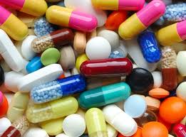
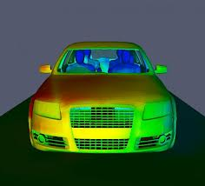
Several different areas of analytical chemistry:
Clinical analysis
Pharmaceutical
Environmental analysis
Forensic analysis
Industrial quality control
Bioanalytical chemistry

Slide 8
Analytical Methodology
1. Understanding and defining the problem
2. Select a method
A-sample type
B-size of sample
C-samples preparation needed
D-sensitivity and selectivity
E-accuracy and precision needed
F-tools/instrument available
g-Cost and speed
3- obtain representative sample
A-sample type / homogeneity/size
4- preparing the sample for analysis
5-Perform the measurement
6-Calculate the result and report

