Slide 1
Novell NetWare 5
A Network Operating System
Edited By Maysoon AlDuwais
Jingfeng Gao

Slide 2
What includes in this presentation
What is Novell NetWare?
Novell Protocols
The Services
NetWare Server Communications
Manage Network Access for Users
Novell Distributed Print Services (NDPS)
Novell Storage Services (NSS)

Slide 3
What is Novell NetWare?
NetWare was developed by Novell to connect, manage, and maintain network and its services.
A NetWare network uses the NetWare software to enable devices to communicate and allow resources to be shared.
NetWare is a suite of software components run only on the NetWare server. Some components run only on workstations.
Most administrative tasks are performed from workstations.

Slide 4
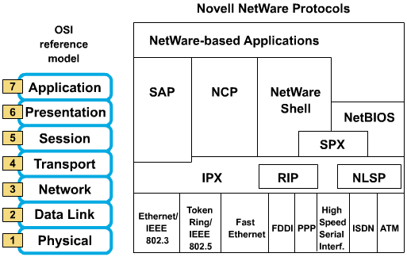
The Novell NetWare Protocol Suite

Slide 5
Novell Protocols
Novell Netware is a proprietary suite of protocols and includes the following:
IPX, a connectionless Layer 3 protocol, that does not require an acknowledgment for each packet & defines the network and node addresses
NetWare 5 allows a choice of running networks with IPX, with both IP and IPX, or with pure IP

Slide 6
Novell Protocols
Novell Routing Information Protocol (RIP), which is different from IP RIP, to facilitate the exchange of routing information
Service Advertising Protocol (SAP) to advertise network services
NetWare Core Protocol (NCP) to provide client-to-server connections and applications
Sequenced Packet Exchange (SPX) service for Layer 4 connection-oriented services

Slide 7
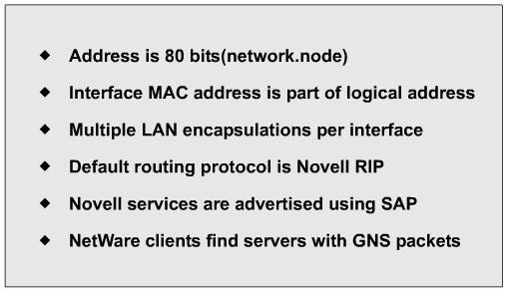
IPX Features

Slide 8
The Services
Novell Directory Services (NDS): After network communications Novell Directory Services is the most fundamental network service NetWare provides.
• NDS maintains a database of information on network resources and processes client requests for network resources. It locates the resource on the network, verifies the client, and connects the client with the resource.

Slide 9
The Services (Cont.)
Security: The network services in NetWare have their own types of NetWare security. Each service provides methods for you to control access to network resources.
The primary component of network security is your account, which identifies who you are and what you are allowed to do on this network.

Slide 10
Manage Network Access for Users
NetWare Administrator: NetWare Administrator is Windows-based utility that lets you easily create and modify objects in the NDS tree.
ConsoleOne: is a Java-based utility that enables you to create user objects through a browser.
UIMPORT: is DOS based and enables you to import users from a database application to NDS.

Slide 11
Manage Network Access for Users (Cont.)
Z.E.N.works (Zero Effort Networks): it includes Novell Application Launcher (NAL) and Workstation Manager to facilitate centralize software distribution and desktop management.
a) Distribute and maintain application on workstation
b) Launch applications On hosts automatically for users
c) Import W.S. object information into NDS eDirectory
d) Centralize the location and administration of user profile
e) View & update client configuration w/o visiting the w.s.

Slide 12
Novell Distributed Print Services (NDPS)
NetWare allows all workstations to print to the same printers. These network printers can be attached to NetWare servers, workstations, or the network cable.
NDPS streamlines and simplifies network print services administration by providing automatic printer discovery and configuration of printing resources.

Slide 13
Novell Storage Services (NSS)
NSS supports systems with large files and volumes, NSS allows up to 8 TB file size, and holds up to 8 trillion files in an NSS volume.
With NSS, hard disk space can be fully utilized.
NSS and the traditional NetWare file system run side-by-side.

Slide 14
What NetWare 5 Delivers To Network Server In General
The most advanced directory-based management system on the network:
Z.E.N.works
Novell Directory Service (NDS),
ConsoleOne
Novell Distributed Print Services (NDPS)
Strategic platform delivering scalable network services using:
open standards-Pure IP
Dynamic Host Configuration Protocol /Domain Name Services (DHCP)/(DNS)

Slide 15
What NetWare 5 Delivers To Network Server In General (Cont.)
Scalable application support— Java server Software Development Kit (SDK), Multi-Processing Kernel (MPK), Oracle 8
High level reliability, scalability, performance, and security:
Novell Storage Services (NSS), NDS

Slide 16
NetWare 6 Internet Service Components
Novell’s Internet/intranet services:
Help simplify the implementation of business networks by providing a common set of services for accessing data and resources with a variety of workstation and server operating systems
The Internet service component can be divided into Web Services, which are TCP/IP-based applications that give users access to network data and services though Web sites and FTP servers, and Net Services, which extend the capabilities of standard Web services

Slide 17
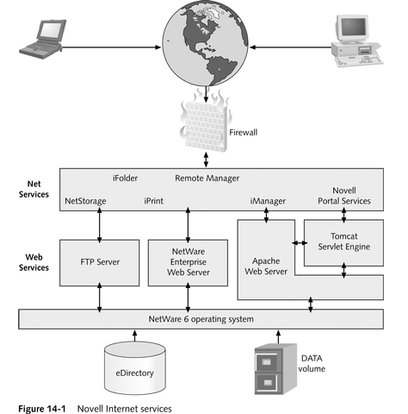

Slide 18
NetWare 6 Internet Service Components
Net Services requests:
A network can be configured so that requests for Net Services originating at user workstations are sent via the Internet to a firewall running on a server or router; once through the firewall, the request is routed to the appropriate services based on its IP address and port number
Port numbers are used to transfer information in a data packet to the correct application
To gain access to NetWare files and resources, Net Services run as applications on Web Services components, such as Apache Web Server

Slide 19
NetWare 6 Internet Service Components
Apache Web Server:
Is open-source Web server software and a common platform for implementing Web-based services
It is installed by default during the NetWare 6 install
It’s primary purpose is to provide support for Novell Portal Services and Net Services, such as iFolder
Requires no special configuration
NetWare 6 ships with the Tomcat Servlet Engine, which is used to run Java-based Web applications

Slide 20
NetWare 6 Internet Service Components
Novell Portal Services (NPS) is a portal strategy for delivering the right information to the people authorized to use it
A portal provides one view into a company’s information and displays this data as Web pages
With NPS, network administrators can protect and control access to network resources, delivering personalized data to people based on their company roles, locations, and group associations
NPS consists of a number of Java servlets that run on Apache Web Server

Slide 21
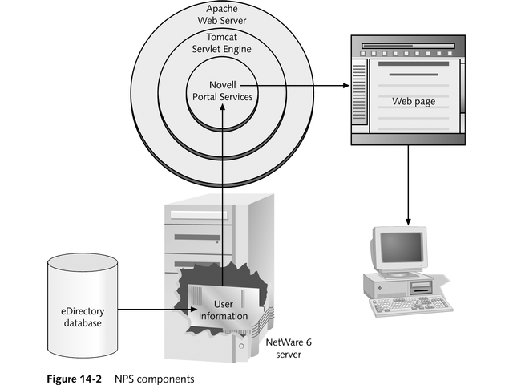

Slide 22
NetWare 6 Internet Service Components
NetWare Web Search Server:
Makes network or Internet data searchable in minutes, and it bridges all types of networks
NetWare Enterprise Web Server:
Is an HTTP-based service for sending Web pages to browsers on the Internet, or to an intranet
FTP server:
Allows for file transferring between Internet hosts
NetWare Web Manager:
The portal service for managing Web Services

