Slide 1
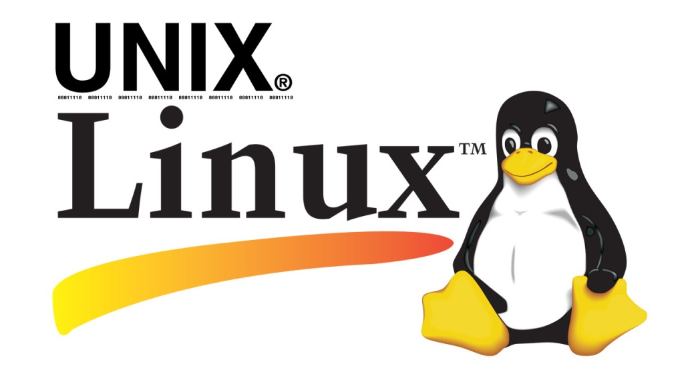
Lecture 5: UNIX & LINUX Operating Systems
By: Elham Sunbu

Slide 2
OUTLINE:
What is UNIX ?
Unix Internals
Unix Filesystem
UNIX & LINUX Review
Linux File Permissions

Slide 3
What is UNIX ?
The UNIX brand has traditionally been applied to the family of multitasking, multiuser computer operating systems.
Universities, research institutes, government bodies and computer companies all began using the powerful UNIX system to develop many of the technologies which today are part of the IT environment.
The success of the UNIX operating system has led to many different versions.
Soon all the large vendors, and many smaller ones, were marketing their own, versions of the UNIX system optimized for their own computer architectures and boasting many different strengths and features.

Slide 4
Unix Internals
Tow parts:
kernel space:
The kernel performs its tasks, such as executing processes and handling interrupts, in kernel space.
user space:
whereas other process operate in user space

Slide 5
Unix Internals
Unlike DOS (and some other operating systems), UNIX system programs do not have access to the physical hardware of the computer. All they see are the kernel services, provided by the system call interface.
Monolithic kernels

Slide 6
Unix Filesystem
In Unix and operating systems inspired by it, the file system is considered a central component of the operating system.
The filesystem provides information storage and retrieval, and one of several forms of interprocess communication.

Slide 7
Unix Filesystem
UNIX comes with various file systems such as jfs, gpfs (AIX), jfs, gpfs (HP-UX), jfs, gpfs (Solaris).

Slide 8
Linux: a UNIX flavor
Linux is a product that mimics the form and function of a UNIX system.
Linux is written from scratch by Linus Torvalds with assistance from a loosely-knit team of hackers across the Net. It aims towards POSIX compliance.

Slide 9
Linux is Just a Kernel
Linux is just a kernel.
Linux has a number of different versions to suit nearly any type of user.
These versions are called distributions (or, in the short form, “distros.”)
All Linux distributions include: GUI system + GNU utilities (such as cp, mv, ls,date, bash etc) + installation & management tools + GNU c/c++ Compilers + Editors (vi) + and various applications (such as OpenOffice, Firefox).
The most popular Linux distributions are:
Ubuntu Linux
Linux Mint
Debian

Slide 10
UNIX & LINUX Review
License and cost
Security Firewall Software
Backup and Recovery Software
File Systems
System Administration Tools

Slide 11
License and cost
- Linux is Free. You can download it from the Internet or redistribute it under GNU licenses.
- Most UNIX like operating systems are not free (but this is changing fast, for example OpenSolaris UNIX).
- However, some Linux distributions such as Redhat / Novell provides additional Linux support, consultancy, bug fixing, and training for additional fees.

Slide 12
User-Friendly
- Linux is considered as most user friendly UNIX like operating systems.
- It makes it easy to install sound card, flash players, and other desktop goodies.
- However, Apple OS X is most popular UNIX operating system for desktop usage.

Slide 13
Security Firewall Software
Linux comes with open source netfilter/iptables based firewall tool to protect your server and desktop from the crackers and hackers.
UNIX operating systems comes with its own firewall product.

Slide 14
Backup and Recovery Software
UNIX and Linux comes with different set of tools for backing up data to tape and other backup media.
However, both of them share some common tools such as tar, dump/restore, and cpio etc.

Slide 15
File Systems
Linux by default supports and use ext3 or ext4 file systems.
UNIX comes with various file systems such as jfs, gpfs (AIX), jfs, gpfs (HP-UX), jfs, gpfs (Solaris).

Slide 16
System Administration Tools
UNIX comes with its own tools such as SAM on HP-UX.
Suse Linux comes with Yast.
Redhat Linux comes with its own gui tools called redhat-config-*.
However, editing text, config file, and typing commands are most popular options for sys admin work under UNIX and Linux.

Slide 17
UNIX Operating System Names
A few popular names:
HP-UX
IBM AIX
Sun Solairs
Mac OS X
IRIX

Slide 18
Linux Distribution (Operating System) Names
A few popular names:
Redhat Enterprise Linux
Fedora Linux
Debian Linux
Suse Enterprise Linux
Ubuntu Linux

Slide 19
Common Things between Linux & UNIX
Both share many common applications such as:
GUI, file, and windows managers (KDE, Gnome).
Shells (ksh, csh, bash).
A Unix shell is a command-line interpreter or shell that provides a traditional Unix-like command line user interface
Various office applications such as OpenOffice.org.
Development tools (perl, php, python, GNU c/c++ compilers).
Posix interface.

Slide 20
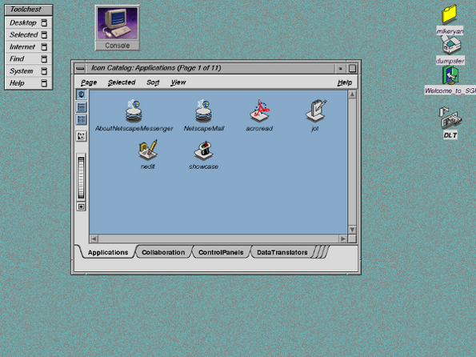
A Sample UNIX Desktop Screenshot

Slide 21
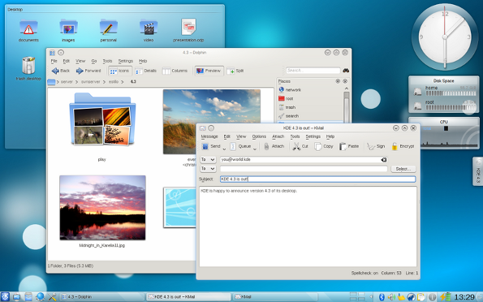
A Sample Linux Desktop Screenshot

Slide 22
Linux Command
What Is "The Shell"?
the shell is a program that takes commands from the keyboard and gives them to the operating system to perform. In the old days, it was the only user interface available on a Unix-like system such as Linux. Nowadays, we have graphical user interfaces (GUIs) in addition to command line interfaces (CLIs) such as the shell.

Slide 23
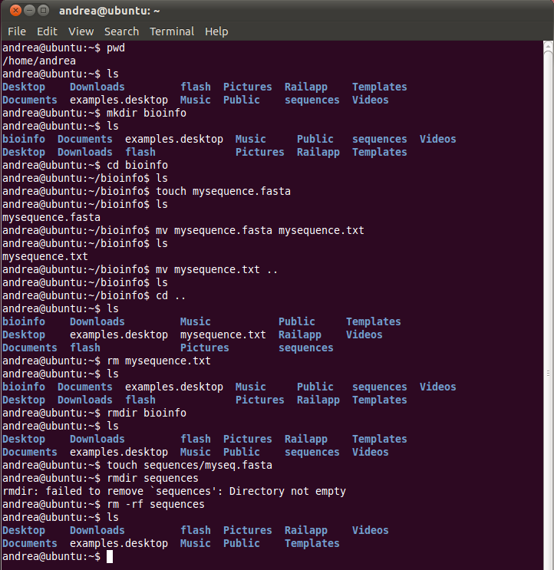
Basic Linux Shell Commands

Slide 24
Linux Command
What's A "Terminal”?
This is a program that opens a window and lets you interact with the shell.

Slide 25
Linux Command
Some Commands:
pwd: to find the name of the working directory.
ls: to list the files in the working directory
cd: to change your working directory

Slide 26
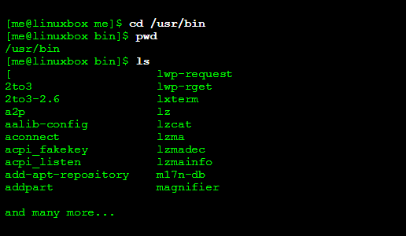
Example

Slide 27
Vim Command
vim, which stands for "Vi Improved", is a texteditor. It can be used for editing any kind of text and is especially suited for editing computer programs.

Slide 28
Vim Command
Example:
vi /path/to/file

Slide 29
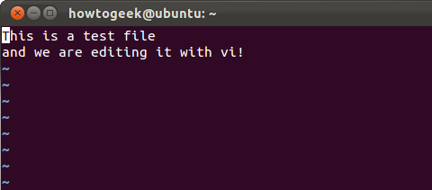
Vim Command
This is what you’ll see when you open a file in vi. It looks like you can just start typing, but you can’t.

Slide 30
Vim Command
Insert Mode:
just press the i key once after you’ve positioned the cursor in command mode. Start typing and Vi will insert the characters you type into the file rather than trying to interpret them as commands.

Slide 31
Vim Command
Saving and Quitting
Type :wq and press enter to write the file to disk and quit vi.
Type :w and press enter to write the file to disk without quitting.
Type :q to quit vi without saving the file.
Vi won’t let you quit if you’ve modified the file since you last saved, but you can type :q! and press enter to ignore this warning.

Slide 32
Linux File Permissions
Although there are already a lot of good security features built into Linux-based systems, one very important potential vulnerability can exist when local access is granted.

Slide 33
Linux File Permissions
Each file and directory has three user based permission groups:
owner - The Owner permissions apply only the owner of the file or directory, they will not impact the actions of other users.
group - The Group permissions apply only to the group that has been assigned to the file or directory, they will not affect the actions of other users.
all users - The All Users permissions apply to all other users on the system, this is the permission group that you want to watch the most.

Slide 34
Linux File Permissions
Each file or directory has three basic permission types:
read - The Read permission refers to a user's capability to read the contents of the file.
write - The Write permissions refer to a user's capability to write or modify a file or directory.
execute - The Execute permission affects a user's capability to execute a file or view the contents of a directory.

Slide 36
Any Question?

