Slide 1
IMMUNOPARASITOLOGY (Zoo 565)
Mechanisms of immune evasion
by parasites

Slide 2
Preface
Parasite immune evasion is the process by which parasites counteract the immune system of the host. Parasites use diverse mechanisms to avoid and antagonize the immune response of their hosts.

Slide 3
Introduction
Parasite Immune Evasion –Evasion strategies.
Parasites need time in host - development, reproduce & ensure vector transmission.
Chronic infections normal.
Parasites evolved variety immune evasion strategies.

Slide 4
Objectives
Familiar with both vertebrate & invertebrate immune responses to a variety of parasites.
Familiar with range of strategies used by parasites to evade hosts’ immune mechanisms.
Able to give specific examples of parasites & their immune evasion strategies.

Slide 5
Contents
Methods of immune evasion
by parasites

Slide 6
Contents
Protozoan immune evasion strategies.
1. Anatomical seclusion in vertebrate host.
Parasites may live intracellular - avoid host immune response.
E.g. Plasmodium inside RBC’s - when infected not recognised by T_{C} & NK cells. Other stages Plasmodium inside liver cells.
Leishmania parasites & Trypanosoma cruzi inside macrophages.

Slide 7
Protozoan immune evasion strategies
Trypanosoma cruzi
Leishmania spp.

Slide 8
Protozoan immune evasion strategies
2. Anatomical seclusion in invertebrate host.
Plasmodium ookinetes in serosal membrane - beyond reach haemocytes.
3. Antigenic variation.
In Plasmodium, different stages of life cycle express different antigens.
Antigenic variation also in extracellular protozoan, Giardia lamblia.

Slide 9
Protozoan immune evasion strategies
3. Antigenic variation cont’d.
African trypanosomes -1 surface glycoprotein that covers parasite = VSG.
Immunodominant for ab responses.
Tryps have “gene cassettes” of VSG’s allowing regular switching to different VSG.
Host mounts immune response to current VSG but parasite already switching VSG to another type.

Slide 10
Protozoan immune evasion strategies.
3. Antigenic variation cont’d.
Parasite expressing new VSG escapes ab detection, replicates & continue infection.
Allows parasite survival - months / years.
Up to 2000 genes involved.

Slide 11
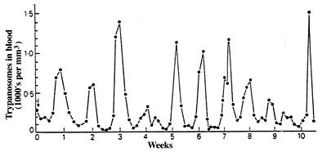
Protozoan immune evasion strategies.
3. Antigenic variation cont’d.
Parasitaemia fluctuates.
After each peak, trypanosome population antigenically different from that earlier / later peaks.
After Ross, P. (1910), Proc. Royal Soc. London, B82, 411

Slide 12
Protozoan immune evasion strategies.
4. Shedding / replacement surface e.g. Entamoeba histolytica.
5. Immunosupression – manipulation host immune response
e.g. Plasmodium.
6. Anti-immune mechanisms - Leishmania - anti-oxidases to counter macrophage oxidative burst.

Slide 13
Mid Activity

Slide 14
Helminth immune evasion strategies vertebrate host.
1-Large size
Difficult to eliminate.
Primary response – inflammation.
Often worms not eliminated.

Slide 15
Helminth immune evasion strategies vertebrate host.
2. Coating with host proteins.
Tegument cestodes & trematodes adsorb host components, e.g. RBC ags.
Immunological appearance of host tissue.
E.g. Schistosomes - host blood proteins, (blood group ags & MHC class I & II).
Worms seen as “self”.

Slide 16
Helminth immune evasion strategies vertebrate host.
3. Molecular mimicry. Parasite mimics host structure / function. E.g. schistosomes have E-selectin - adhesion / invasion.
4. Anatomical seclusion - 1 nematode larva does this -Trichinella spiralis inside mammalian muscle cells.
5. Shedding / replacement surface e.g. trematodes, hookworms.

Slide 17
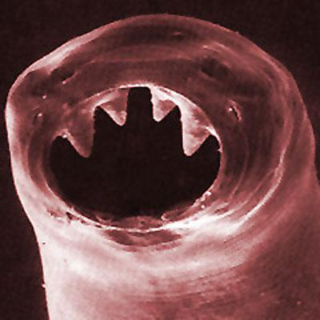
Helminth immune evasion strategies vertebrate host.
6. Immunosupression – manipulation of the immune response. High nematode burdens - apparently asymptomatic.Parasite may secrete anti-inflammatory agents suppress recruitment & activation effector leukocytes or block chemokine-receptor interactions .E.g. hookworm protein binds ß integrin CR3 & inhibits neutrophil extravasation.

Slide 18
Helminth immune evasion strategies vertebrate host.
7. Anti-immune mechanisms e.g.
liver fluke larvae secretes enzyme that
cleaves ab.
8. Migration e.g.
Hookworms - move about gut avoiding
local inflammatory reactions.

Slide 19
Helminth immune evasion strategies vertebrate host.
9. Production of parasite enzymes
Filarial parasites secrete anti-oxidant enzymes (glutathione peroxidase & superoxide dismutase)
resistance to ADCC & oxidative stress?

Slide 20
Helminth immune evasion strategies invert host.
1. Anatomical seclusion – Acanthocephala acanthors maintain host tissue layer around them. Acanthor only melanized if larva dies.
2. Molecular mimicry – Schistosoma sporocysts produce surface molecules similar to haemolymph molecules of snail host. Parasite seen as “self”.

Slide 21
Helminth immune evasion strategies invertebrate host.
3. Immunosupression – developing microfilariae Brugia pahangi & Dirofilaria immitis suppress mosquito immune response.

Slide 22
Final Activity
Give reason
Schistosoma can evade the immune system
Schistosoma cause: -
-antigen disguise.
- antigen mimicry.
-antigen shedding.
-Cause inactivation of complement by protease activity.
- Produce blocking antibodies. Host’s RBCs

Slide 23
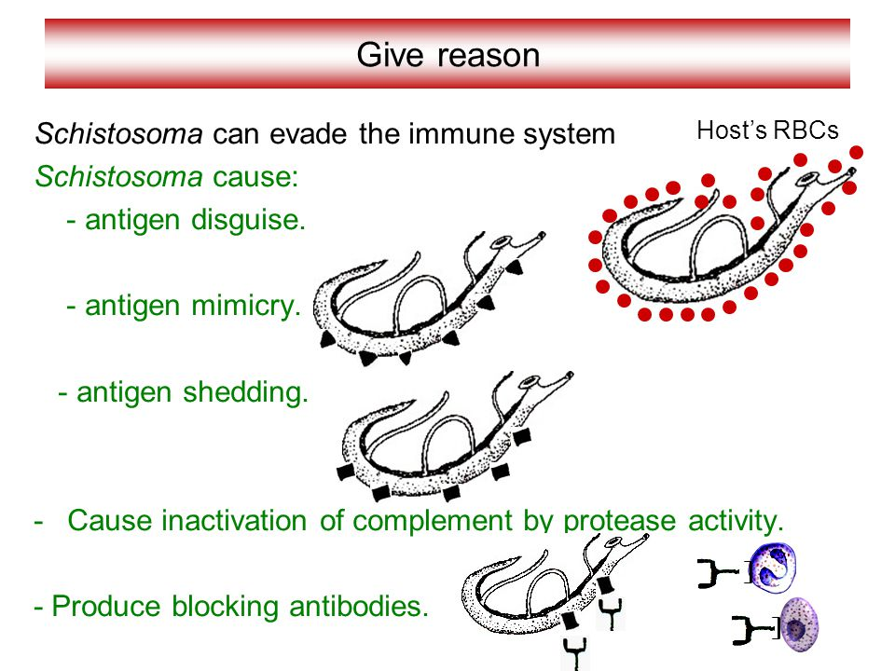
Final activity (Cont.)

Slide 24
Summary I
Protozoa evade vertebrate immunity by :
Anatomical seclusion.
Antigenic variation.
Surface shedding / replacement.
Immunosupression
Anti-immune mechanisms.
Protozoa evade invertebrate immunity by:
Anatomical seclusion.

Slide 25
Summary II
Size
Using host protein.
Molecular mimicry.
Anatomical seclusion.
Surface shedding / replacement.
Immunosupression.
Helminth evade vertebrate
immunity by :
Anti-immune mechanisms.
Migration.
Production enzymes

Slide 26
Summary III
Helminth evade invertebrate
immunity by :
Anatomical seclusion.
Molecular mimicry.
Immunosupression.

