Slide 1
Creating Health Communication Campaign
CHS382

Slide 2
Objectives
By the end of this lecture, you be able to:
Identify the steps of developing health communication campaign
Write smart objectives

Slide 3
How health campaigns are created?

Slide 4
Preliminary research and goal setting
Engagement of stakeholders
Audience research
Strategic and tactic planning
Implementation
Monitoring and reporting

Slide 5
1. Preliminary Research and Goal Setting What is the campaign's purpose – what is your overall goal?
Identify the problem, target audience, attitude or behavior you are trying to change, and intended outcomes.
Campaigns start with a clear understanding of the problem they're tackling. Why is the problem so important? What are the benefits of
solving it? What behaviors are behind it?

Slide 6
Different methods and sources of information to consider include:
Interviews with experts
Demographic data
Focus groups
Public opinion surveys
Behavior surveys
Academic studies
Literature reviews
Direct observation

Slide 7
Campaign Context
What internal strengths and what weaknesses of your campaign?
What are the external opportunities and threats?
What does past experience tell you about this problem and how to solve it?

Slide 8
2.Engagement of Key Stakeholders
Talk with potential partners and funders about the campaign; involve them in the planning process to get buy-in and support.
Here are some benefits that a partner may bring to your campaign:
Funding
Expertise and staff
Access to other funders/partners
Reputation/Credibility
Distribution networks
Entrée into close-knit communities
Visibility
Political/Policy Influence

Slide 9
Tips for attracting funders and partners Establish common areas of focus and interest. Paint a complete picture by presenting a detailed plan for the campaign. Emphasize the desired outcomes and how they will be measured and reported. Offer options for participation and contribution, ranging from cash contributions to in-kind services to access their audience/customers/constituency.

Slide 10
3. Audience Research
Learn everything you can about your audience: how they view the problem, what barriers they face and their trusted sources of information.
Start with these basic questions to identify your target
audience:
Which group or groups of people are most affected by the problem you're trying to solve?
How big are these groups – hundreds, thousands, millions?
Are there some groups that are more ready to make the changes you want than others?
Given your organization's role and resources, are there some segments of your audience that will be easier to reach than others?

Slide 11
Know Your Audience What's important to them? What influences their relevant choices and behavior? What might make them skeptical about your message? What are the best times and places to reach them?

Slide 12
4. Strategic and Tactical Planning: Plan your strategies and tactics and then create and test the campaign messages. Think about how to evaluate and measure success. Set Objectives: What do you want your audience to do? The objectives should be very specific behaviors: things you want your audience to do, do at a particular time, or do differently. Focus on actions that are as simple and easy to complete as possible.

Slide 13
Your objectives should be SMART

Slide 14
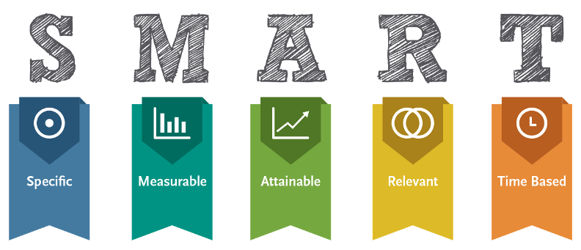

Slide 15
Now you're ready for the final stage of planning: the marketing plan. A strong marketing plan connects clear objectives and research findings to specific strategies for changing behavior. Basically, it describes how your campaign will get your audience to do what you want them to do. It should have at least three sections: strategy, tactics and budget.

Slide 16
First, put yourself in your audience's shoes. Use what you've learned from your research to plot out the potential benefits and barriers to the action you want them to take, and to the actions they take instead. Now consider what your campaign could do to enhance the benefits and reduce the barriers. Which ones are the most important to your audience or different segments of your audience? Which ones are the most closely linked to your desired action? Your answers will help describe your campaign's overall strategy.

Slide 17
Tactics: What your campaign will do
Types of Tactics Here are some types of tactics to consider. Marketing and Media
Media coverage
Advertising
Policy change

Slide 18
The next step is to brainstorm about how to make it easier and more attractive for your audience to do what you want them to do. Once you've described a wide range of options, start narrowing your focus. Which are most likely to positively influence your audience and fit your organization's resources and role? These are the tactics (sometimes called "interventions") that will form the bulk of your marketing plan.

Slide 19
Message: What your audience sees and hears
Your campaign's message is its public face – it's what your tactics deliver. Message development involves translating your objective into words and images that appeal to and motivate your target audience. Effective campaigns have one overarching message but different ways of getting it across, from the choice of words and tone to the tactics used to deliver it. When developing and evaluating messages, ask yourself:
How will this message motivate your audience to act?
What kind of tone is most likely to appeal to your audience?
How will your target audience know that your message is for them?
What is the most important piece of information you want to convey?

Slide 20
Strong messages are the result of both research and creativity. A catchy slogan or logo might be memorable, but you're trying to influence more than people's memories. Most importantly, your message must fit your strategy and tactics. Your marketing plan should include adequate time and resources for message development, including pre-testing with representatives of your target audience.

Slide 21
Budget: What you've got and what you'd like to have
Your marketing plan should include a proposed budget for your campaign. This budget will inform your choice of tactics and your timeline. Since most of us have limited access to resources, be careful to plan within your means. On the other hand, if there are tactics you'd like to use but can't afford, you might choose to look for outside funding or new partners to help bridge the gap.

Slide 22
Consider developing a detailed timeline as part of your marketing plan. The level of detail will depend on how much of the necessary research, funding and personnel you have in place to implement your campaign.
Implementation: Implement your campaign
plan. Implementation requires planning.
What will we do?
Who will be responsible?
When will it be done?
How much will it cost?

Slide 23
Monitoring and Reporting: Monitor your progress, make changes as needed and keep all stakeholders informed of campaign events and milestones. Document and report what you learn in the field.
Be data-driven To track your progress, start collecting the information you need from the very start. Make sure that every component of your campaign is associated with one or more pieces of data. Focus on hard numbers connected to specific actions, such as participation at events, calls to your toll-free number, visits to key pages of your website, user survey results, and some measure of the ultimate campaign objective. .

Slide 24
:Track what is happening
Is there evidence of progress toward the campaign's primary objective?
Are some target audiences or portions of target audiences responding more than others?
o What can we do to expand our reach or better focus our resources on those most likely to respond?
Which campaign activities have been most or least successful?
o What are the relative costs (including staff time) and benefits of each activity? o Which should be continued and strengthened, and which should be dropped or substantially changed?

Slide 25
Could our successful activities work for other relevant audiences or situations?
Is there any new or different information that needs to be incorporated into the program messages or design?
Are partner organizations doing what they committed to do? What effect is their performance or work style having on the campaign?

Slide 26
No campaign ever goes exactly as planned. The most important and immediate use for the information you gather is to fix things that aren't working as intended. Assume from the start that you'll be gathering and using data throughout the campaign. Set a schedule, based on key points in the implementation process, for analyzing the data and considering changes. Depending on what you learn, these changes may involve the message, timing, audience, or other aspects of your campaign. Document any changes you make, and adjust your monitoring and evaluation measures so that they keep track of what you're actually doing instead of what you originally intended to do.

Slide 27
Share your experience Save your planning documents and research to share with others in the field who can learn from your experience. Don't just hype the good news. Honestly discussing what did not work well will improve your credibility

