Slide 1
272 Bot- Plant Physiology
Dr. Abdulrahman Al-hashimi

Slide 2
Lecture 3
Water Balance of Plants
1- Water in the soil
2- Water absorption by roots
3- Water transport through the xylem
4- Water loss by transpiration

Slide 3
Learning Objectives
Explaining the effects of different soil conditions on water movement from the soil into the plants.
Understanding the physiological mechanisms involved in the uptake and transport of water in the plants.
Understanding the concept of transpiration and mechanism of water loss in the plants.

Slide 4
1- Water in the soil
Water content in the soil and rate of water movement depends on the type and texture of the soil:
Sandy soil:
Low surface area per gram and large spaces between particles.
Clay soil:
Large surface area per gram and small spaces between particles.

Slide 5
1- Water in the soil
Different Types of Soil Water:
Gravitational water:
Water filled in big spaces/interstices of soil particles.
It is free water moving through soil by force of gravity.
Very little gravitational water is available to plants as it drains rapidly down the water table by gravitation.
It can cause upland plants to wilt and die because gravitational water occupies air space, which is necessary to supply oxygen to plant roots.

Slide 6
1- Water in the soil
Different Types of Soil Water:
Bound water:
This type of water is bound so tightly to the soil.
It forms very thin film around soil particles.
It is generally not available to the plant.
Since this water is found on the soil particles and not in the pores, certain types of soils with few pores (clays for example) will contain a higher percentage of this water.

Slide 7
1- Water in Plant Life
Different Types of Soil Water:
Capillary water:
Water filled in small spaces/interstices of particles.
Easily get to surface of water by the force of capillarity.
It is held in micropores of the soil by surface tension properties (cohesion and adhesion).
It is the main water that is available to plants as it is trapped in the soil solution right next to plants roots.

Slide 8
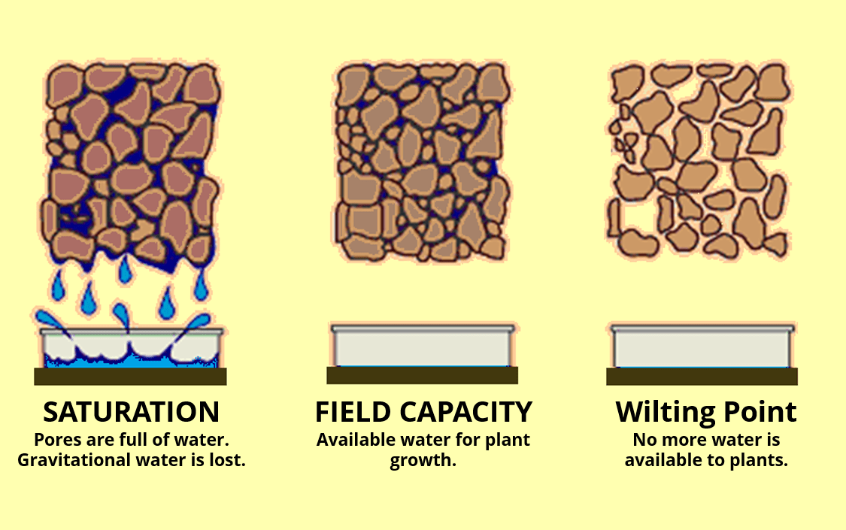
1- Water in the soil
Field capacity:
The water content of a soil after it has been saturated with water and excess water has been allowed to drain away due to the force of gravity. It is large (40%) for clay soils.

Slide 9
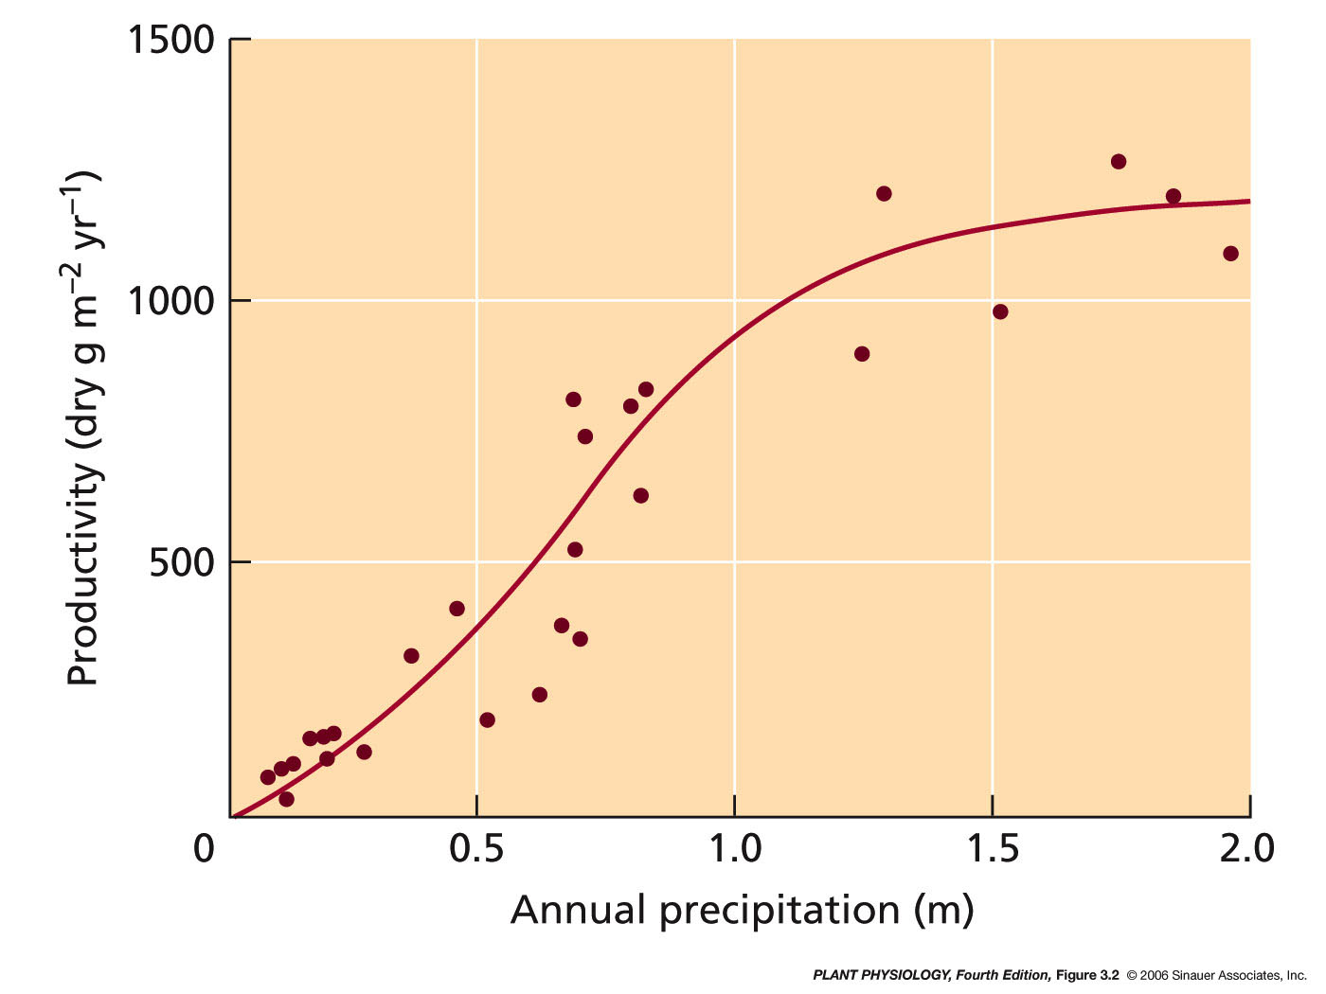
1- Water in the soil
Productivity of various ecosystems as a function of annual precipitation

Slide 10
1- Water in the soil
Main driving forces for water flow from the soil through the plant to atmosphere include differences in:
1- Water vapor concentration (Δc_{wv})
2- Hydrostatic pressure (ΔΨ_{p})
3- Water potential (ΔΨ_{w})
All of these act to allow the movement of water into plant.

Slide 11
1- Water in the soil
Because of adhesive forces, water tends to cling to the surfaces of soil particles, so a large surface area between soil water and soil air develops.
As soil dries out, water moves first from the center of the largest spaces between particles.
Water then moves to smaller spaces between soil particles.

Slide 12
Water moves through the soil by bulk flow
Diffusion of water vapor accounts for some water movement.
As water moves into root, less in soil near the root results in a pressure gradient with respect to neighboring regions of soil.
So there is a reduction in ψ_{p} near the root and a higher ψ_{p} in the neighboring regions of soil.
Water filled pore spaces in soil are interconnected.
Water moves through soils predominantly by the bulk flow driven by the pressure gradient.

Slide 13
Water moves through the soil by bulk flow
The rate of water flow depends on:
Size of the pressure gradient
Soil hydraulic conductivity (SHC)
(Measure of the ease in which water moves through soil)
SHC varies with water content and type of soil
Sandy soil high SHC
Large spaces between particles
Clay soil low SHC
Very small spaces between particles

Slide 14
1- Water in Plant Life
As water moves from soil into root, the spaces fill with air,
This reduces the flow of water.
Permanent wilting point:
At this point the water potential (ψ_{w}) in the soil is so low that plants cannot regain turgor pressure,
There is not enough of a pressure gradient for water
to flow to the roots from the soil
- This varies with plant species
Lyman
CI 13227
Lyman
Overley

Slide 15
2- Water absorption by roots
Meristematic zone
Cells divide both in direction of root base to form cells that will become the functional root and in the direction of the root apex to form the root cap
Elongation zone
Cells elongate rapidly, undergo final round of divisions to form the endodermis.
Some cells thicken to form casparian strip
Maturation zone
Fully formed root with xylem and phloem – root hairs first appear here
Plant root

Slide 16
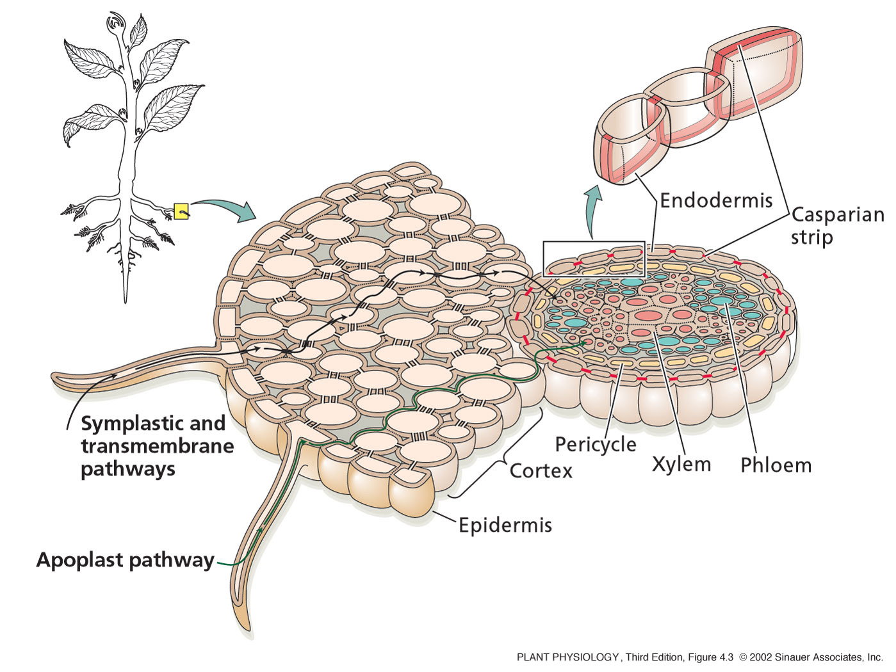
Root hairs increase surface area of root to maximize water absorption.
From the epidermis to the endodermis there are three pathways in which water can flow:
1- Apoplast pathway:
Water moves exclusively through cell walls without crossing any membranes.
The apoplast is a continuous system of cell walls and intercellular air spaces in plant tissue

Slide 17
2- Transmembrane pathway:
Water sequentially enters a cell on one side, exits the cell on the other side, enters the next cell, and so on.
3- Symplast pathway:
Water travels from one cell to the next via plasmodesmata.
The symplast consist of the entire network of cell cytoplasm interconnected by plasmodesmata.

Slide 18
Pathways for water uptake by the root
- At the endodermis:
Water movement through the apoplast pathway is stopped by the Casparian Strip,
Band of radial cell walls containing suberin, a wax-like water-resistant material.
The casparian strip breaks continuity of the apoplast and forces water and solutes to cross the endodermis through the plasma membrane.
So, all water movement across the endodermis occurs through the symplast.
CI13227
Lakin

Slide 19
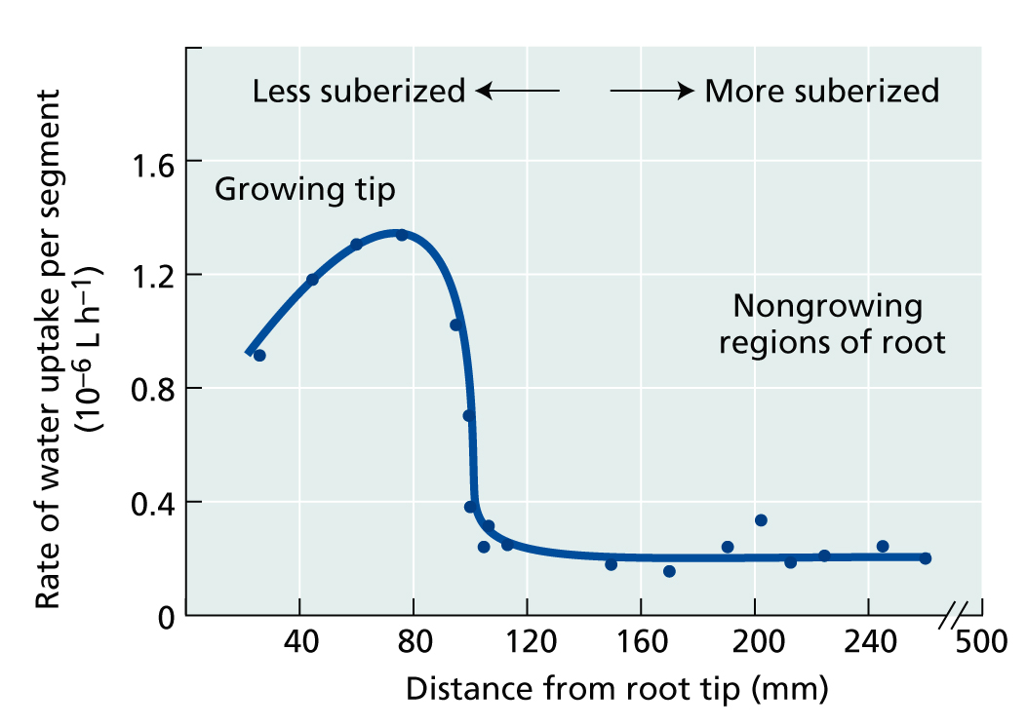
Rate of water uptake at various positions

Slide 20
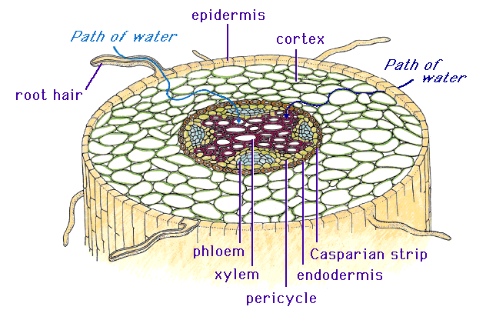
3- Water transport through the xylem
After water moves through the Casparian Strip via the symplast pathway,
Water traveling from one cell to the next via plasmodesmata.
It enters the xylem system.
Compared with water movement across root tissue the xylem is a simple pathway of low resistance.
Water movement through the xylem needs less pressure than movement through living cells.

Slide 21
3- Water transport through the xylem
Compared with water movement across root tissue the xylem is a simple pathway of low resistance.
The xylem consists of two types of tracheary elements;
Tracheids
Vessile elements – only found in angiosperms, and some ferns.
The maturation of both these elements involves death of the cell.
They have no organelles or membranes.
Water can move with very little resistance.

Slide 22
3- Water transport through the xylem
Tracheids: Elongated spindle - shaped cells , arranged in overlapping vertical files.
Water flows between them via pits (areas with no secondary walls and thin porous primary walls).
Vessel elements: Shorter and wider.
The open end walls provide an efficient low-resistance pathway for water movement.
Perforation plate forms at each end, allow stacking end on to form a larger conduit called a vessel.

Slide 23
3- Water transport through the xylem
Air bubbles can form in the xylem,
Air can be pulled through microscopic pores in xylem cell wall.
Cold weather allows air bubbles to form due to reduced solubility of gases in ice.
Once a gas bubble has formed it will expand as gases can not resist tensile forces called Cavitation.

Slide 24
3- Water transport through the xylem
Such breaks in the water column are not unusual.
Gas bubbles can not easily pass through the small pores of the pit membranes.
Xylem are interconnected, so one gas bubble does not completely stop water flow.
Water can detour blocked point by moving through neighboring, connected vessels.

Slide 25
3- Water transport through the xylem
Gas bubbles can also be eliminated from the xylem.
At night, xylem water pressure increases and gases may simply dissolve back into the solution in the xylem.
Many plants have secondary growth in which new xylem forms each year.
New xylem becomes functional before old xylem stops functioning.

Slide 26
4- Water loss by transpiration
The tensions needed to pull water through the xylem are the result of evaporation of water from leaves.
Water is brought to leaves via xylem of the leaf vascular bundle, which branches into veins in the leaf.
From the xylem, water is drawn in to the cells of the leaf and along the cell wall.

Slide 27
4- Water loss by transpiration
Transpiration pull, which causes water to move up the xylem begins in the cell walls of leaf cells.
The cell wall acts as a capillary wick soaked with water.
Water adheres to cellulose and other hydrophilic wall components.
Mesophyll cells within leaf are in direct contact with atmosphere via all the air spaces in the leaf.

Slide 28
4- Water loss by transpiration
Tensions or negative pressure exists in the leaves cause surface tension on the water.
As more water is lost to the atmosphere, the remaining water is drawn into the cell wall.
As more water is removed from the wall the pressure of the water becomes more negative.
This induces a motive force to pull water up the xylem.

Slide 29
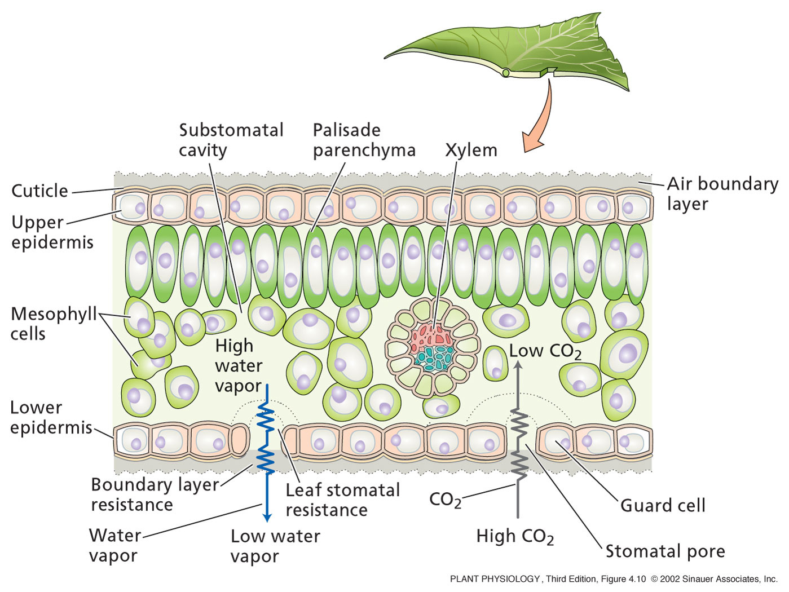
4- Water loss by transpiration
After water has evaporated from the cell surface of the intercellular air space diffusion takes over.
So: The path of water is ;
Xylem
Cell wall of mesophyll cells
Evaporated into air spaces of leaf
Diffusion occurs – water vapor from leaves via stomatal pore
Goes down a concentration gradient.

Slide 30
4- Water loss by transpiration
Diffusion of water out of the leaf is very fast.
Transpiration from the leaf depends on two factors:
Difference in water vapor concentration between leaf air spaces and the atmosphere,
Due to high surface area to volume ratio
Allows for rapid vapor equilibrium inside the leaf
The diffusional resistance of the pathway from the leaf to atmosphere.

Slide 31
4- Water loss by transpiration
Diffusional resistance of the pathway from leaf to atmosphere;
Two components:
Leaf stomatal resistance:
Resistance associated with diffusion through stomatal pores.
2. Boundary layer resistance:
Resistance due to a layer of unstirred air next to the leaf surface

Slide 32
4- Water loss by transpiration
Dependence of transpiration flux on the stomatal aperture
in still air and in moving air
The boundary layer is larger and more rate limiting in still air than in moving air
As a result, the stomatal aperture has less control over transpiration in still air

Slide 33
Stomata Control
When water is abundant:
Temporal regulation of stomata is:
OPEN during the day
CLOSED at night
At night there is no photosynthesis,
so no demand for CO₂ inside the leaf,
so, stomata closed to prevent water loss.
Sunny day - demand for CO₂ in leaf is high so, stomata wide open.
As there is plenty of water, plant trades water loss for photosynthesis products.

Slide 34
Stomata Control
When water is limited:
Stomata will open less or even remain closed even on a sunny morning.
(Plant can avoid dehydration)

Slide 35
Stomata Guard Cells
There are two main types of guard cells;
One is typical of monocots and grasses,
Dumbbell shape with bulbous ends
Pore is a long slit
The other is typical of dicots
Kidney shaped - have an elliptical contour with pore in the center.

Slide 36
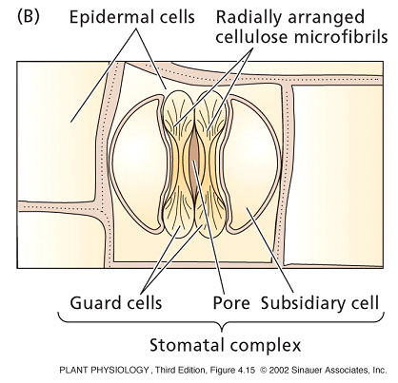
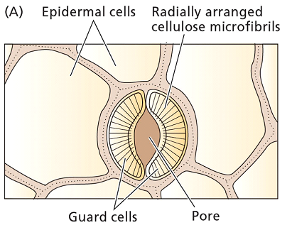
Stomata Guard Cells
Stomata guard cells play an essential role in opening and closing stomata
In monocots:
Guard cells works like beams with inflatable ends.
Bulbous ends swell, beams separate and slit widens.
In dicots:
Cellulose microfibrils fan out radially from the pore.
Cell girth is reinforced like a steel-belted radial tire.
Guard cell curve outward during stomatal opening.

Slide 37
Relationship between water loss and CO₂ gain
Effectiveness of controlling water loss and allowing CO₂ uptake for photosynthesis is called the transpiration ratio,
There is a large ratio of water efflux and CO₂ influx
Concentration ratio driving water loss is 50 larger than that driving CO₂ influx.
CO₂ diffuses 1.6 times slower than water,
Due to CO₂ being a larger molecule than water
CO₂ uptake must cross the plasma membrane, cytoplasm, and chloroplast membrane. All these add resistance

Slide 38
Overview - Soil to Plant to Atmosphere
Movement of water from soil to plant to atmosphere involves different mechanisms of transport:
Soil and Xylem:
Water moves by bulk flow.
In the vapor phase:
Water moves by diffusion – until it reaches out side air, then convection occurs.
When water is transmitted across membranes,
Driven by water potential differences across the membrane.
Such osmotic flow due to cells absorb water and roots take it from soil to xylem.

Slide 39
Overview - Soil to Plant to Atmosphere
In each of these three cases, water moves towards regions of low water potential or free energy.
Water potential decreases from the soil to the leaves.
However, water pressure can vary between neighboring cells,
The Xylem – negative pressure
Leaf cells – positive pressure
Within leaf cells water potential is also reduced by a high concentration of dissolved solutes.

Slide 40
Thank you

