Slide 1
CHS382 Fundamentals of Health Education
Lecture 2

Slide 2
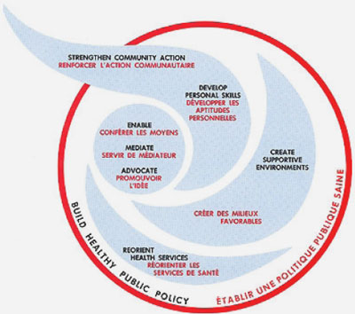
Ottawa Charter as a Health Promotion Framework
By the end of this lecture, you will be able to:
Describe the Ottawa Charter
Outline the 5 action areas in the Ottawa Charter
Explain each action area in the Ottawa Charter, and how it is likely impact health
Link the 5 action areas of the Ottawa Charter to the 2030 Vision

Slide 3
What is Ottawa Charter for health promotion?
https://www.mheducation.co.uk/openup/chapters/9780335263202.pdf
The Ottawa Charter for Health Promotion is the name of an international agreement signed at the First International Conference on Health Promotion, organized by the World Health Organization (WHO) and held in Ottawa, Canada, in November 1986.

Slide 4
The Ottawa Charter identifies three basic strategies for health promotion:
Advocacy for health to create the essential conditions for health
Enabling all people to achieve their full health potentials
Mediating between the different interests in society in the pursuit of health.

Slide 5
1) Advocacy
Good health is a major resource for social, economic and personal development and an important dimension of quality of life.
Political, economic, social, cultural, environmental, behavioural and biological factors can all favour health or be harmful to it. Health promotion action aims at making these conditions favourable through advocacy for health.

Slide 6
1) Advocacy
Pre-requisites for health which include peace, adequate economic resources, food and shelter, and a stable eco-system and sustainable resource use.
Recognition of these pre-requisites highlights the inextricable links between social and economic conditions, the physical environment, individual lifestyles and health.
These links provide the key to a holistic understanding of health which is central to the definition of health promotion.

Slide 7
2) Enabling
Health promotion focuses on achieving equity in health.
Health promotion action aims at reducing differences in current health status and ensuring equal opportunities and resources to enable all people to achieve their fullest health potential.
This includes a secure foundation in a supportive environment, access to information, life skills and opportunities for making healthy choices.
People cannot achieve their fullest health potential unless they are able to take control of those things which determine their health.

Slide 8
3) Mediating
The prerequisites and prospects for health cannot be ensured by the health sector alone.
Health promotion demands coordinated action by all concerned: by governments, by health and other social and economic sectors, by nongovernmental and voluntary organization, by local authorities, by industry and by the media.

Slide 9
3) Mediating
People in all walks of life are involved as individuals, families and communities. Professional and social groups and health personnel have a major responsibility to mediate between differing interests in society for the pursuit of health.
Health promotion strategies and programs should be adapted to the local needs and possibilities of individual countries and regions to take into account differing social, cultural and economic systems.

Slide 10
These strategies are supported by five priority action areas as outlined in the Ottawa Charter for health promotion:
Build healthy public policy
Create supportive environments for health
Strengthen community action for health
Develop personal skills
Re-orient health services

Slide 11
1) Build Healthy Public Policy
Healthy public policy is a pre-requisite for successful health promotion.
A Healthy Public Policy is characterized by a concern for health and equity and accountability for health impact.
Policy-makers should be made aware of the health consequences of their decisions.
Health should be made a priority item on the agenda of policy-makers in all sectors.

Slide 12
1) Build Healthy Public Policy
All relevant government sectors like agriculture, trade, education, industry and finance need to give important consideration to health as an essential factor during their policy formulation
Joint action by all sectors will contribute to achieving safer and healthier goods and services, healthier public services, and cleaner and healthier environment.
According to the Adelaide Conference (1988), “The main aim of HPP is to create a supportive environment to enable the people to lead healthy lives. Healthy choices are thereby made possible and easier for citizens”.

Slide 13
2) Create Supportive Environments for Health
A supportive environment is essential for health
Supportive environments cover the physical, social, economic, and political environment.
Supportive environments encompass where people live, work and play.
Everyone has a role in creating supportive environments for health.
The protection of the natural and built environments and the conservation of natural resources must be addressed in any health promotion strategy.

Slide 14
3) Strengthen Community Action for Health
Community action is any activity undertaken by a community in order to effect change
According to the Ottawa Charter, “health promotion works through concrete and effective community action in setting priorities, making decisions, planning strategies and implementing them to achieve better health”.

Slide 15
3) Strengthen Community Action for Health
A Definition (Rifkin et al. 1988) : Community participation is a social process whereby groups with shared needs living in a defined geographic area actively pursue identification of their needs, take decisions and establish mechanisms to meet these needs
Community participation covers a spectrum of activities

Slide 16
3) Strengthen Community Action for Health
At the low end, it may be token participation in the form of consultation or endorsing plans drawn up by the health authorities. At the high end, it may be in the form of ‘people power’ where they have full say in identifying needs, setting priorities, planning strategies and activities and implementing the program
Full community participation occurs when communities participate in equal partnership with health professionals as stakeholders in setting the health agenda.

Slide 17
3) Strengthen Community Action for Health
According to the Jakarta Declaration (1997), “health promotion improves both the ability of individuals to take action, and the capacity of groups, organizations or communities to influence the determinants of health”.
Empowerment is an important strategy, based on the notion that health is significantly affected by the extent to which one has control or power over one’s life.

Slide 18
4)Develop Personal Skills
Health promotion supports personal and social development through providing information, education for health, and enhancing life skills.
Skills which can promote an individual’s health include those pertaining to identifying, selecting and applying healthy options in daily life.
Health education is life-long, so that people can develop the relevant skills to meet the health challenges of all stages of life, and to be able to cope with chronic illness and disabilities.

Slide 19
4)Develop Personal Skills
Health education should be conducted in all settings.
Empowerment helps people to identify their own needs and concerns, and gain the power, skills and confidence to act upon them

Slide 20
5) Re-orient health services
The role of the health sector must move increasingly in a health promotion direction, beyond its responsibility for providing clinical and curative services.
Reorienting health services requires stronger attention to health research as well as changes in professional education and training.
This must lead to a change of attitude and organization of health services which refocuses on the total needs of the individual as a whole person.

Slide 21
5) Re-orient health services
May necessitate reengineering and organizational change, especially in the areas of professional education and training, management, recruitment and deployment of health personnel, and planning, development and delivery of services.

Slide 22
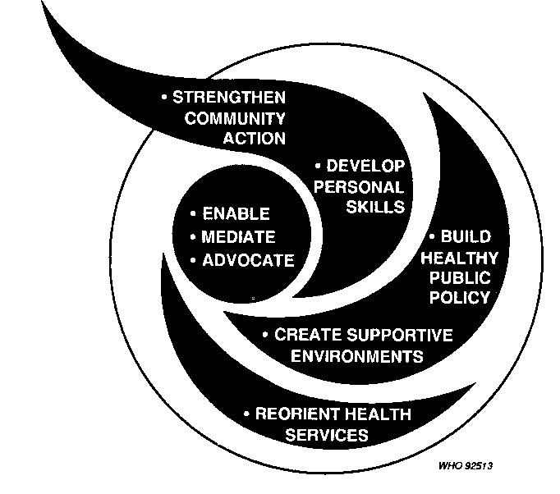
Health Promotion Logo

Slide 23
Putting health promotion into practice-Regrouping the Five Dimensions of the Ottawa Charter
The HESIAD Framework For Health Promotion

Slide 24
The HESIAD Framework For Health Promotion
Promoting health
Health education
Service improvements
Advocacy
Communication directed to at individuals, families and communities to influence:
Awareness/knowledge
Decision making
Belief/attitudes
Empowerment
Individual and community Action/behavior change
Community participation
Improvements in quality and quantity of services:
Accessibility
Case management
Counseling
Patient education
Social marketing
Agenda setting and advocacy for healthy public policy:
Polices for health
Income generation
Removal of obstacles:
Discrimination
Inequalities
Gender barriers

Slide 25
Examples of application of HESIAD

Slide 26
Example 1
 | 3 components of a comprehensive health promotion strategies
Health topic | Health education | Services improvement | Advocacy
Nutrition promotion of fruit and vegetable consumption | Using schools and mass media to promote awareness of the health benefits of eating fruit and vegetables | Ensuring that schools and workplace canteens provide fruit and vegetables | Subside for farms to grow fruit and vegetables; actions to reduce sales prices of fruit and vegetables ( subsides for shops, transport costs, guidelines on meals, provided in schools, institutions, etc.

Slide 27
Example 2
 | 3 components of a comprehensive health promotion strategies
Health topic | Health education | Services improvement | Advocacy
Physical exercise | Promotion of benefits of exercise , understanding of the kinds of exercise that will improve health and skills in specific exercise methods | Improved leisure/exercise facilities, exercise promotion within primary care-e.g. provision of personalized tailored advice on exercise, GP exercise referral schemes to local gyms or exercise programs targeted to specific groups. | Develop local policies for exercise facilities, subsides for exercise programs, partnerships to increase exercise opportunities etc.

Slide 28
Assignment 1:
For one of the following, or a health topic of your own choice, apply HESAID approach and suggest contributions of health education, services improvement and advocacy: preventing falls in elderly people; promotion of breast cancer screening.
For this assignment:
Work as a group
Write your answers in a table similar to the one in this lecture
List your references if any (APA Style)
Hand your assignment next week at 8:30 am

Slide 29
Homework:
In a group of 2 students, try to link the action areas of the Ottawa Charter to the 2030 Vision, and discuss your answers with your classmates
http://vision2030.gov.sa/ar/node/10

Slide 30
Useful links:
http://www.who.int/healthpromotion/conferences/previous/ottawa/en/
http://www.crrps.org/download/OttawaCharter.pdf
https://www.mheducation.co.uk/openup/chapters/9780335263202.pdf

