Slide 1
Lexicography
Lexicon has two different meanings:
All the vocabulary of a language
The dictionary
The English suffix -graphy means either "writing" or a "field of study“
Lexicography is used in two different senses:
* Practical lexicography is the art or craft of writing dictionaries.
* Theoretical lexicography is the theory or scholarly discipline of analyzing and describing dictionaries.

Slide 2
The term lexicology is variously used. Some use it as a synonym for theoretical lexicography, others use it for a branch of linguistics pertaining to the treasure of words in a particular language i.e. the study of forms, meanings and behaviors of words.

Slide 3
Dictionary
A dictionary is a list of words with their definitions, a list of characters with their glyphs or a list of words with corresponding words in other languages. Many dictionaries also provide pronunciation information, word derivations, histories, or etymologies, illustrations, usage guidance, and examples in sentences.

Slide 4
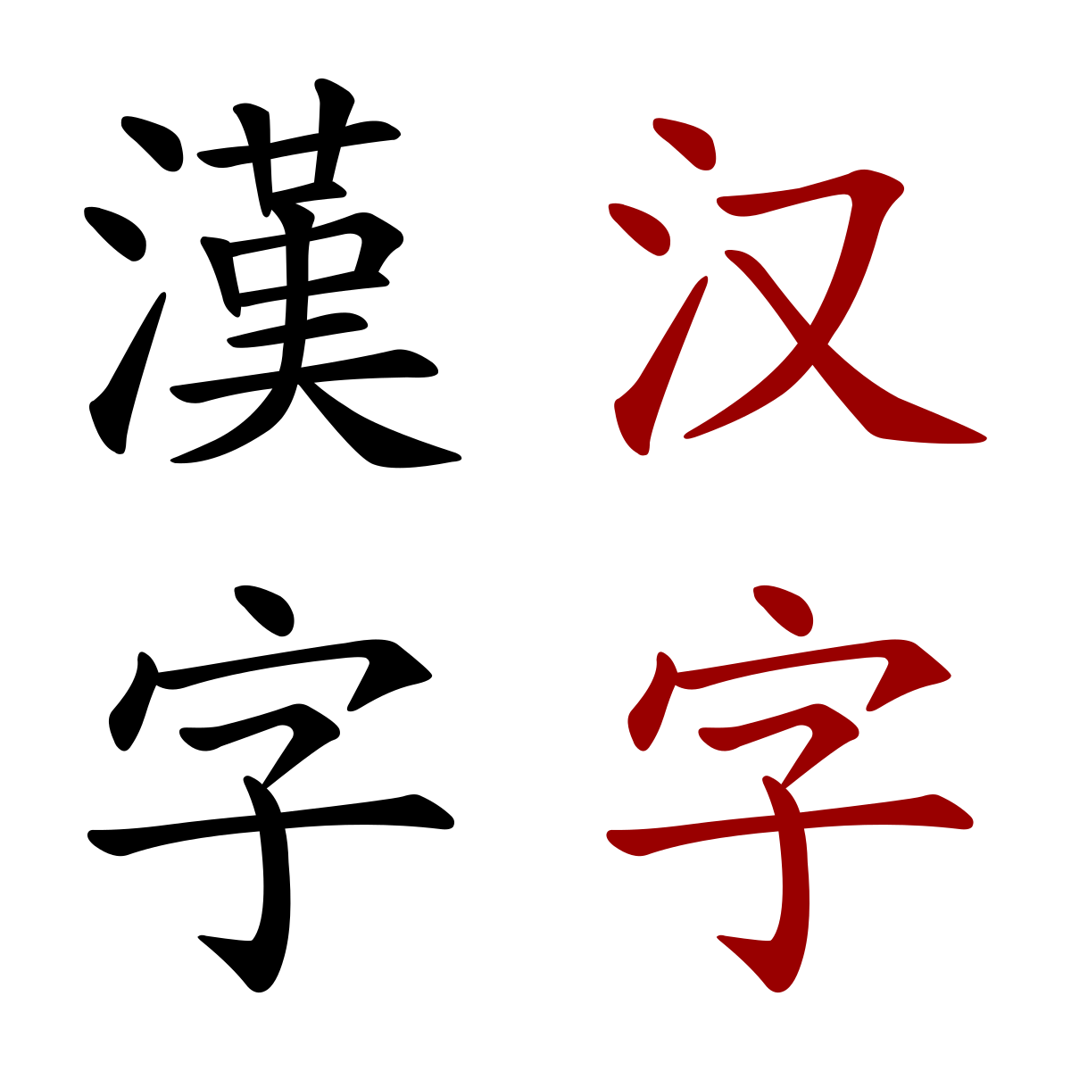

Slide 5
character ك
ك
ـك
ـكـ
كـ
Different glyphs

Slide 6
Fundamental questions for lexicographers
1. Users – who will use the dictionary?
2. Uses – what will the dictionary be used for?
Answers to these questions will inform design and publication decisions for dictionary maker, e.g. monolingual vs. bilingual, encyclopedic vs. compact, symmetrical vs. asymmetrical bilingual, general purpose vs. specialist etc.

Slide 7
Structure of dictionary
1. macrostructure – overall structural organization of volume, typically:
* front matter, introduction, user guidelines; before the (A)
* body – entries and definitions (plus often other stuff), typically organized alphabetically; (from A-z)
* end matter – appendices and additional information, e.g. personal names, place names, loan items etc. After the z

Slide 8
Structure of dictionary
2. microstructure – internal structure of dictionary entry blocks, typically:
* headword
* spelling
* pronunciation
* part of speech category or word class
* semantic specification – senses and reference
* cross-references to related items, related by sense
* collocations, co-occurrence strings
* usage with examples
* etymological or historical notes

Slide 9
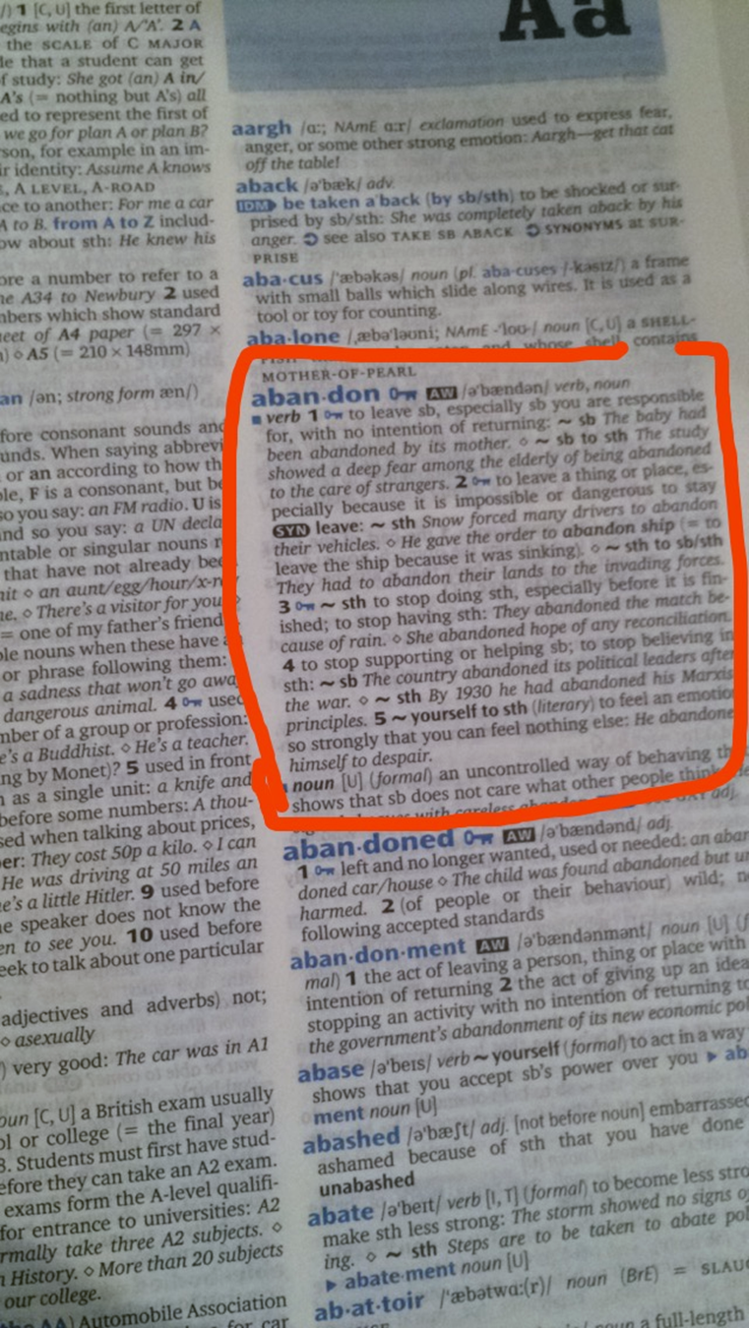

Slide 10
Nature of Headwords
What is a word: are the following words? want, wanting, wanted, war chest, war crime, courthouse, wannabe, half-baked
Distinguish:
1. Orthographic word – (of or relating to spelling) written word surrounded by spaces; but what about compounds, hyphenated forms etc. Distinguish
2. Phonological word – sequence of sounds that forms phonological unit (determined by rules of syllable structure, stress, etc)

Slide 11
3. Lexeme – item of vocabulary that may occur as dictionary headword. Lexemes can be more than one orthographic word i.e. a word or several words that have a meaning that is not expressed by any of its separate parts
* Lexeme is an abstract concept – it is the set of word forms that comprise a paradigm of related words forms, eg. sing – sings – singing - sang – sung (cf. talk – talks – talking – talked – talked) – regular and irregular paradigms;
a lexeme can have many different forms.
* Word-form is inflectional variant of lexeme i.e. word forms have the same lexeme e.g. runs, ran, running are forms of the same lexeme (run). However, the derivative (runner ) has a different lexeme.
* A headword is typically a citation form of a lexeme i.e. represents a lexeme.

Slide 12
Entry order
Dictionaries of alphabetic languages list words in alphabetical order. With non-alphabetic languages, it may be different. The order in a dictionary with ideographic entries i.e. graphic symbols that represent an idea rather than a group of letters; such as Chinese character is often troublesome and controversial because each character has different readings.

