Slide 1
272 Bot- Plant Physiology
Dr. Abdulrahman Al-hashimi

Slide 2
Lecture 2
Water and Plant Cells
1- Water in Plant Life
2- Properties of Water
3- Water Transport Processes
4- Water Potential

Slide 3
Learning Objectives
Describing the properties of water and its importance to the plant life.
Exploring water transport processes in the plants (diffusion and osmosis).
Learning the concepts of water potential and its individual components.
Explaining the importance of water potential

Slide 4
1- Water in Plant Life
Water plays an important role in the life of the plant.
For every gram of organic matter made by the plant, approximately 500 g of water is absorbed by the roots, and transported through the plant body.
Plant continuously absorb and lose water.
Lost through plant leaves called transpiration
Water deficit affects plant growth and cellular processes.
Plant must delicately balance its uptake and loss of water

Slide 5
1- Water in Plant Life
Water makes up most of the mass of plant cells.
80-95% of a growing plant cell is water.
Water content varies between types of plant cells;
Vegetables such as carrots has 85 to 95% water.
Lettuce may contain 85 to 95% water.
Wood contains 35 to 75% water.
Seeds, the driest of plant tissues, have 5 to 15% water.

Slide 6
1- Water in Plant Life
Water makes up most of the mass of plant cells.
Most (97%) of the water absorbed by roots is carried through the plant and evaporates from leaf surfaces (transpiration).
Only a small amount of water absorbed by roots actually remains in the plant to supply growth (~2%) or to be used in photosynthesis and other metabolic processes (~1%).

Slide 7
1- Water in Plant Life
The importance of Water in Plant Life:
Makes up the medium for the movement of molecules within and between cells.
Needed for the proper conformation of all macromolecules.
Constitutes the environment for nearly all biochemical reactions in the cell.
Reagent in many chemical reactions, (e.g. hydrolysis).
Necessary for tissue mechanics.
Evaporative cooling.

Slide 8
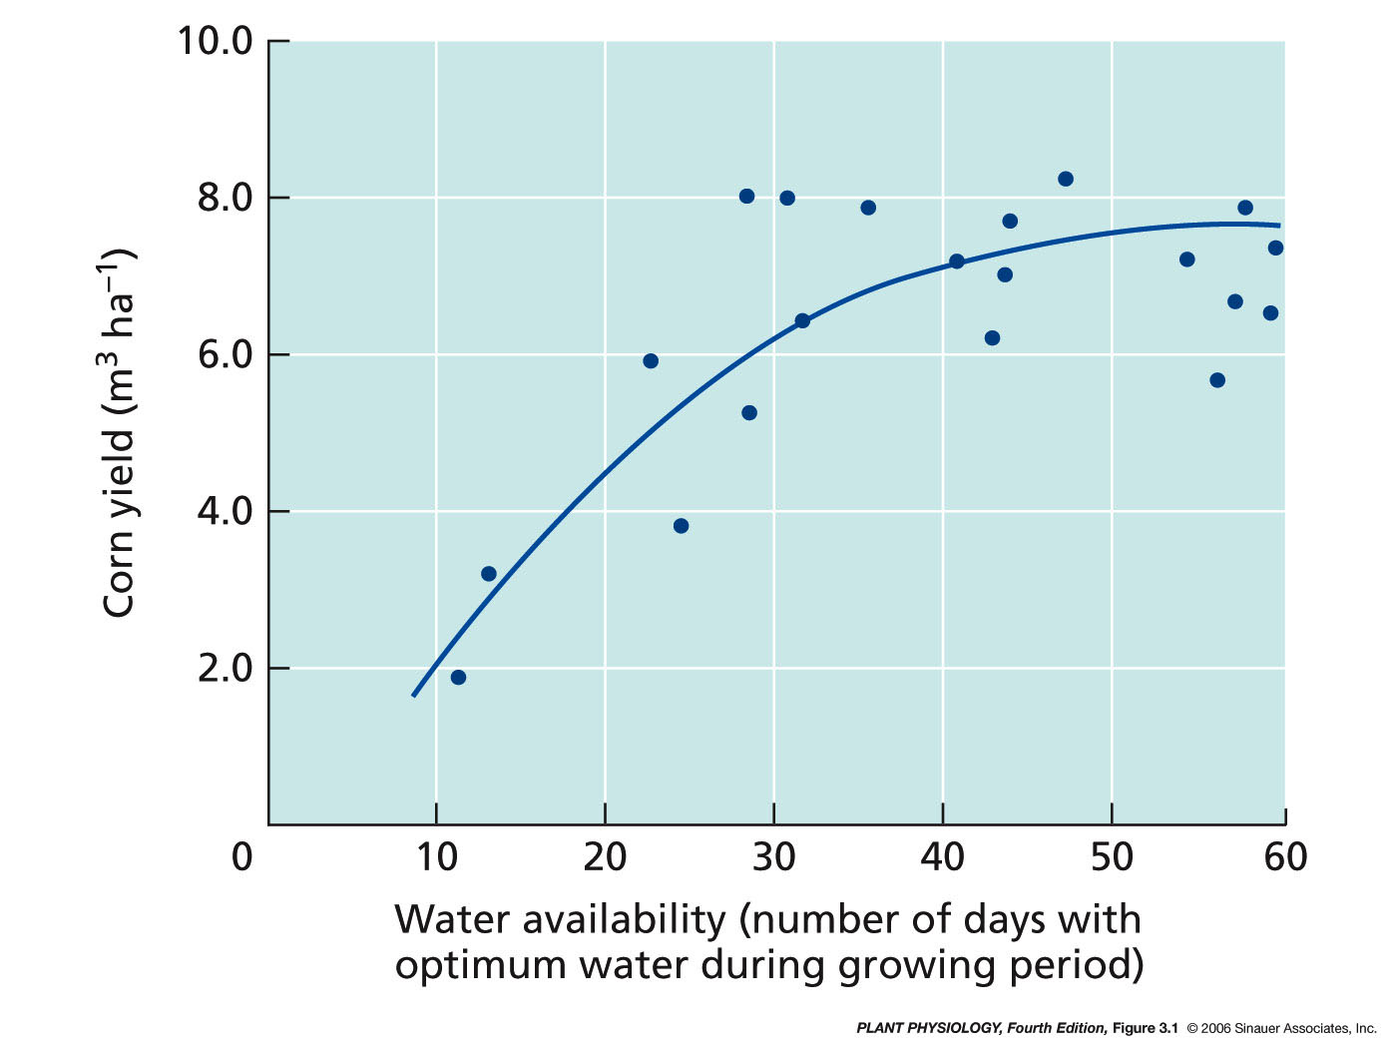
1- Water in Plant Life
Importance of water on crop yield
Corn yield as a function of water availability

Slide 9
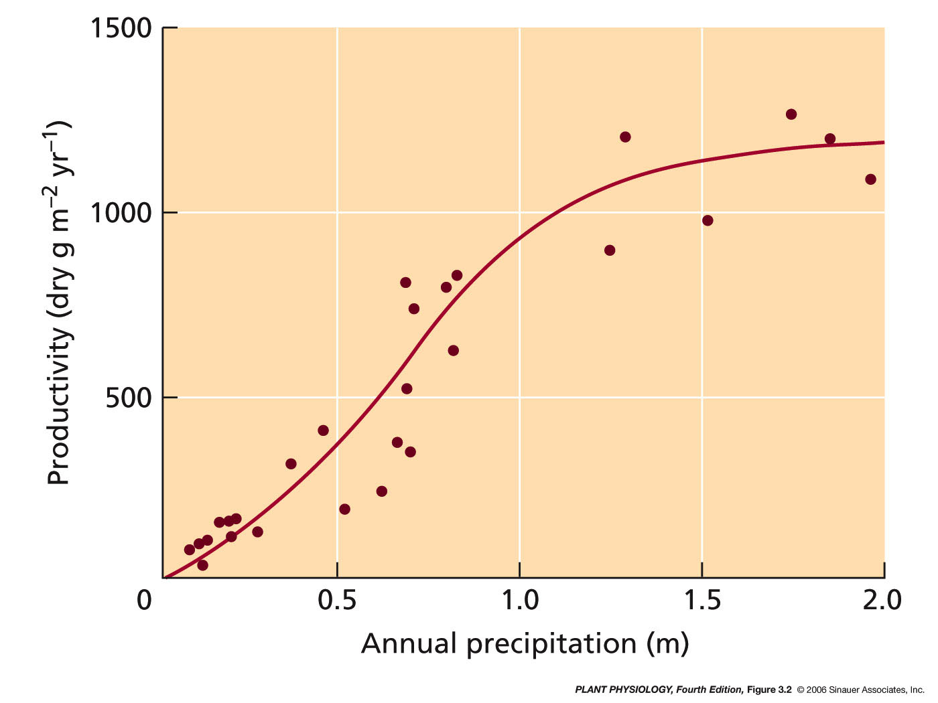
1- Water in Plant Life
Productivity of various ecosystems as a function of annual precipitation

Slide 10
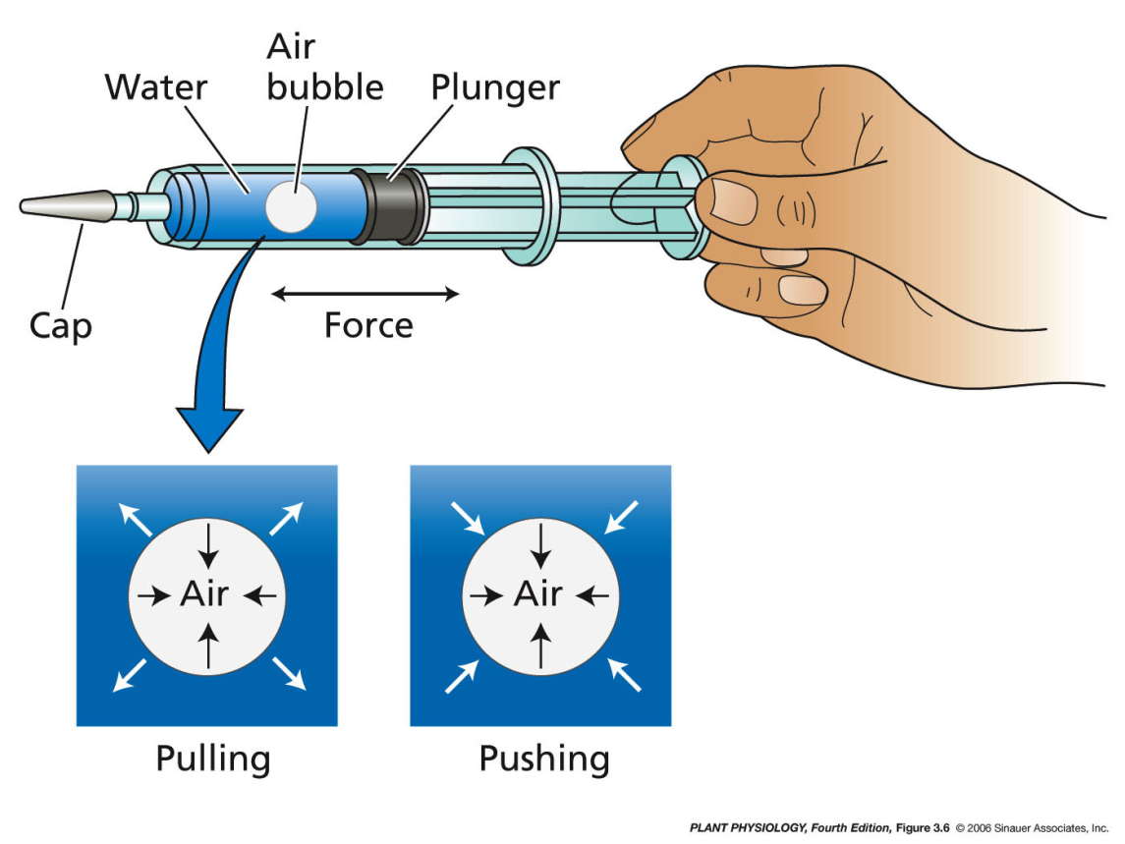
1- Water in Plant Life
What Drives the Movement of Water ?
Gravity
Pressure
Osmosis
Combinations
Pushing compresses the fluid
(positive hydrostatic pressure).
Pulling causes the fluid to develop a tension (negative hydrostatic pressure).

Slide 11
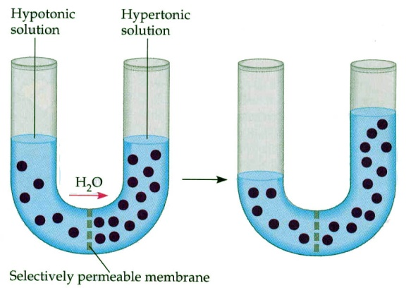
Plants Characteristics
What Drives the Movement of Water ?
Gravity
Pressure
Osmosis
Combinations
Water movement by Osmosis
(through a selective permeable membrane from a region of high water concentration to a region of low water concentration

Slide 12
1- Water in Plant Life
Cell walls allow plant cells to build up large internal hydrostatic pressure, called turgor pressure, which are a result of their normal water balance.
The turgidity is caused by the osmotic flow of water through a selectively permeable membrane.
The turgor pressure is essential for many physiological processes, including cell enlargement, gas exchange in the leaves, transport in the phloem, and various transport processes across membranes.

Slide 13
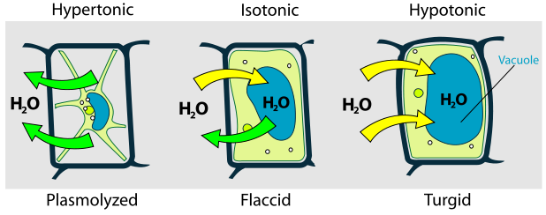
The turgor pressure is the force within the cell that pushes the plasma membrane against the cell wall.

Slide 14
1- Water in Plant Life
How does turgor pressure affect plants?
The central vacuole fills with water getting bigger and bigger.
This pushes the organelles and cytoplasm into the cell wall.
The cell wall then becomes very rigid as a result of the turgor pressure.
This rigidity allows a plant to stand up.
Without turgor pressure plants would always look wilted and would never stand up straight.
Lyman
CI 13227
Lyman
Overley

Slide 15
2- Properties of Water
Water has special properties that enable it to act as a solvent and to be readily transported through the body of the plant.
These properties derive primarily from the polar structure of the water molecule.
The water molecule consists of an oxygen atom covalently bonded to two hydrogen atoms.
The polarity of water makes it an excellent solvent, dissolves greater amounts of a wider variety of substances

Slide 16
2- Properties of Water

Slide 17
Hydrogen bonding:
Cohesion,
(mutual attraction between water molecules)
Adhesion,
(attraction of water to a solid phase such as the cell wall)
High specific heat,
(heat energy required to raise temperature of a substance)
High latent heat
of vaporization,
(energy required to change
one gram of a liquid to gas)
Hydrogen bonds between water molecules results in local aggregations.
Very short lived, break up rapidly to form more random configurations

Slide 18
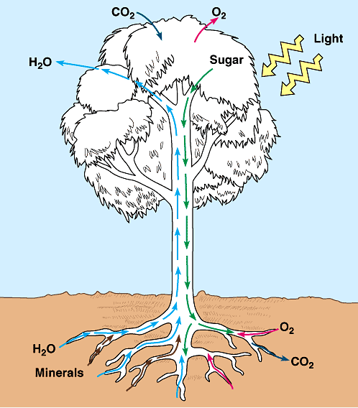
3- Water Transport Processes
Water moves from the soil through the plant to the atmosphere through a widely variable medium (cell wall, cytoplasm, Plasma membrane, air spaces).
The mechanisms of water transport also vary with the type of medium.
CI13227
Lakin

Slide 19
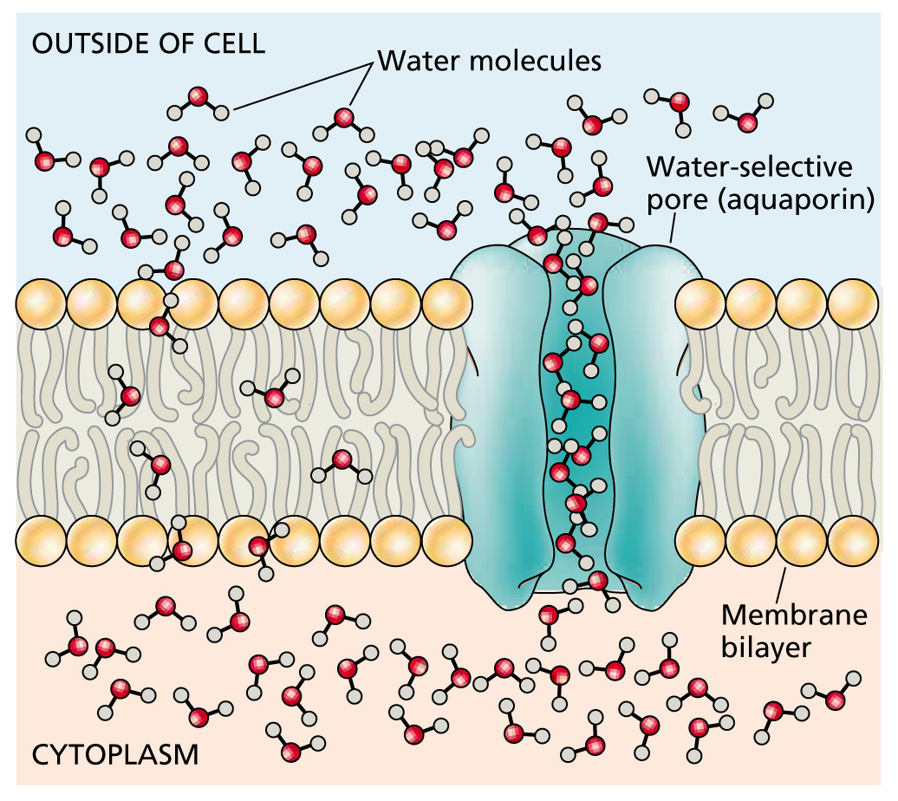
3- Water Transport Processes
Diffusion انتشار
The movement of molecules from an area
of high concentration to an area of low concentration
Diffusion is rapid over short distances but extremely slow over long distances. It is fastest in gases, slower in liquids, and slowest in solids.

Slide 20
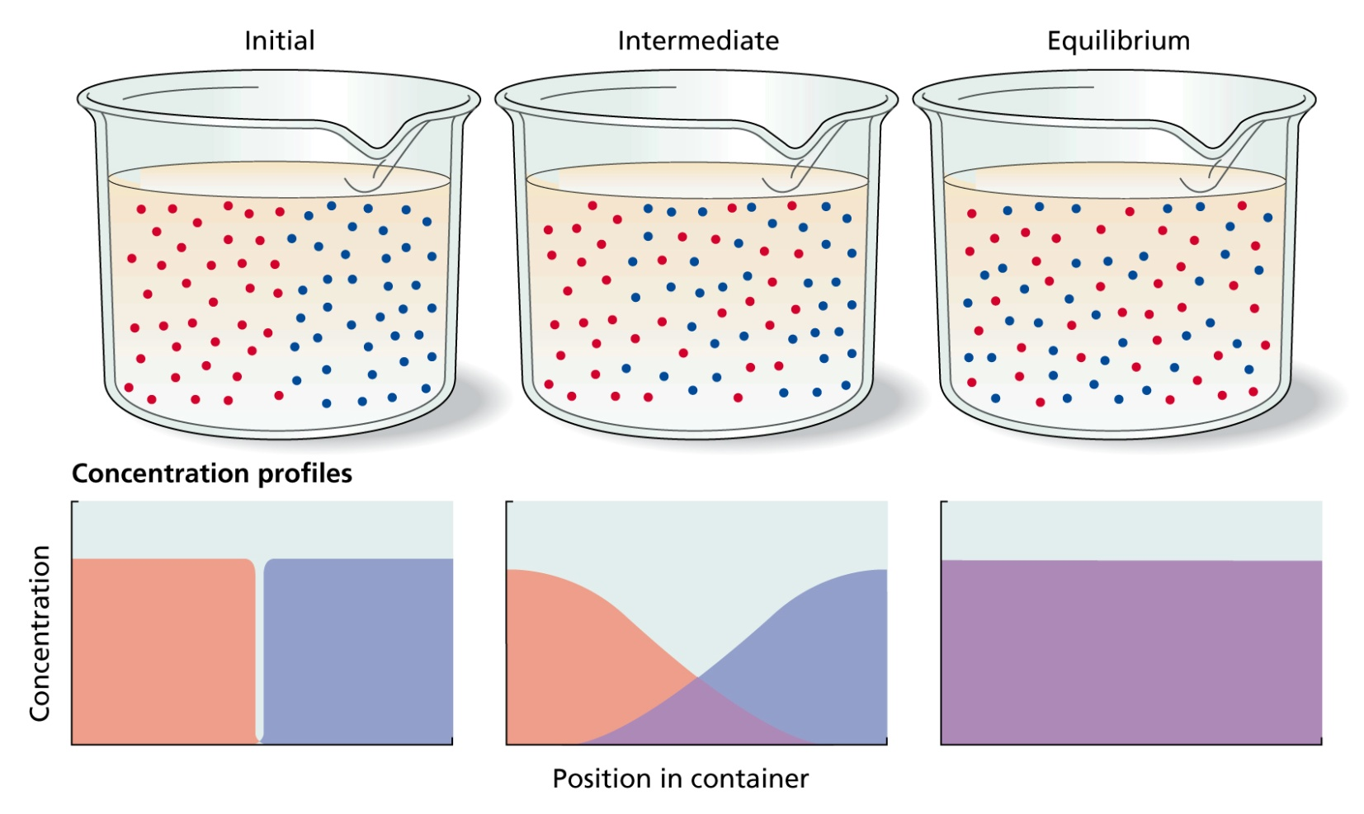
3- Water Transport Processes
The movement of molecules by random thermal agitation
Thermal motion of molecules leads to diffusion
Gradual mixing of molecules and eventual dissipation of concentration differences

Slide 21
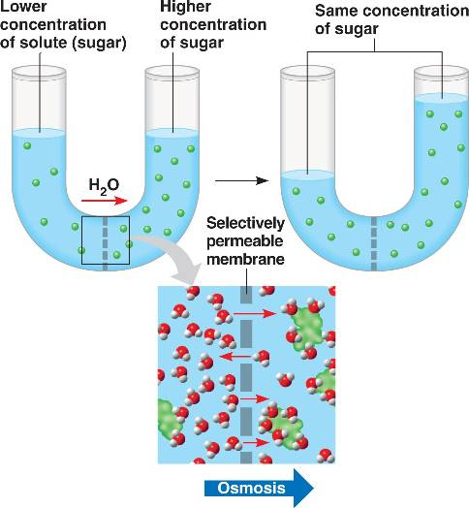
3- Water Transport Processes
Osmosis & Tonicity
The Osmosis:
The movement of water molecules through a selective permeable membrane from a region of high water concentration to a region of low water concentration aiming to equalize the concentrations on
the two sides.

Slide 22
The Tonicity: a measure of the effective osmotic pressure gradient
between two solutions separated by a semi-permeable membrane.
(The relative concentration of solutes, determine direction of diffusion).
The amount of a solute in a solution, moles of total dissolved
solutes per liter of water (mol L^{–1}),
The minus sign indicates that dissolved solutes reduce water
potential of a solution relative to reference state of pure water.
A solute is any dissolved substance in a solution (eg. sugars and salts).
The term Tonicity is commonly used when describing response
of cells immersed in an external solution.

Slide 23
3- Water Transport Processes

Slide 24
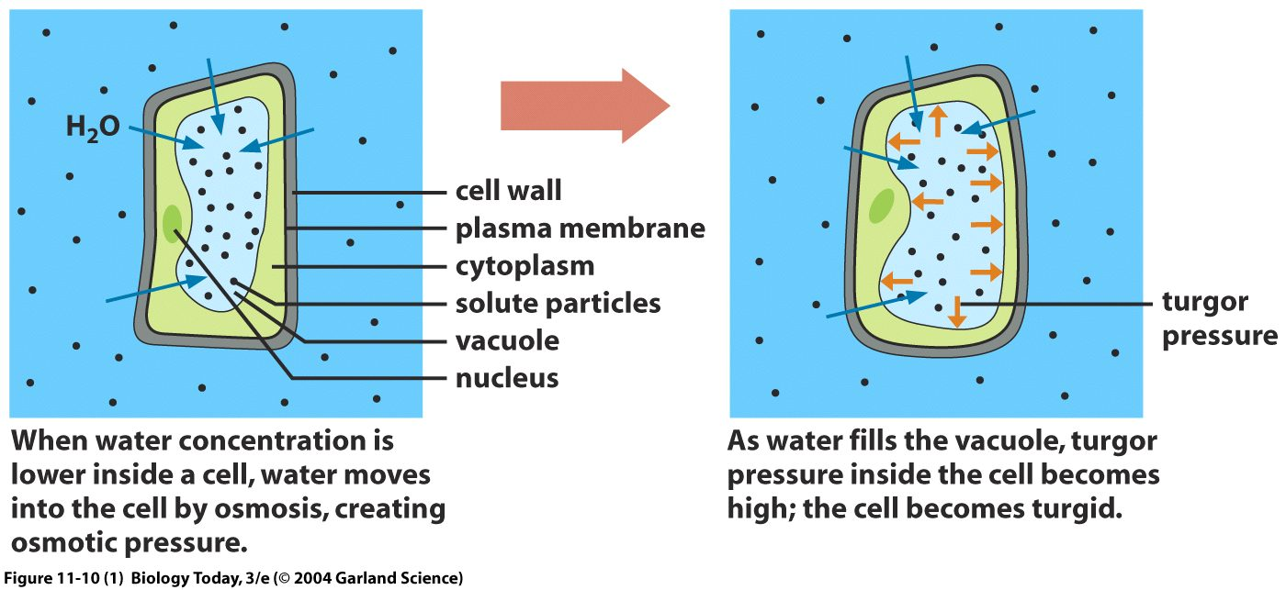
Plant cell in hypotonic solution
Flaccid cell in 0.1 M sucrose solution.
Water moves from sucrose solution to the cell, swells up, becomes turgid.
A Hypotonic solution, has less solute than the cell (higher water).
Pressure increases on the cell wall as the cell expands to equilibrium.

Slide 25
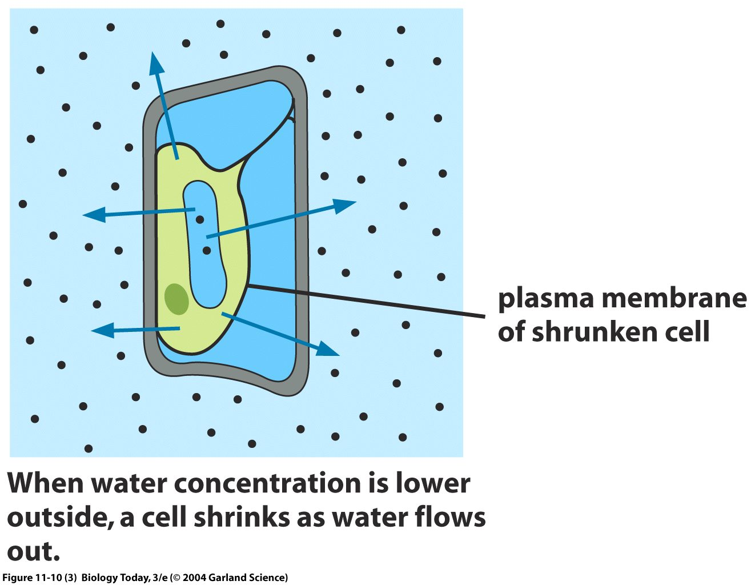
Plant cell in hypertonic solution
Turgid cell in 0.3 M sucrose solution
Water movers from the cell to sucrose solution.
A Hypertonic solution has more solute than the cell (lower water).
Turgor pressure reduced and protoplast pulls away from the cell wall.

Slide 26
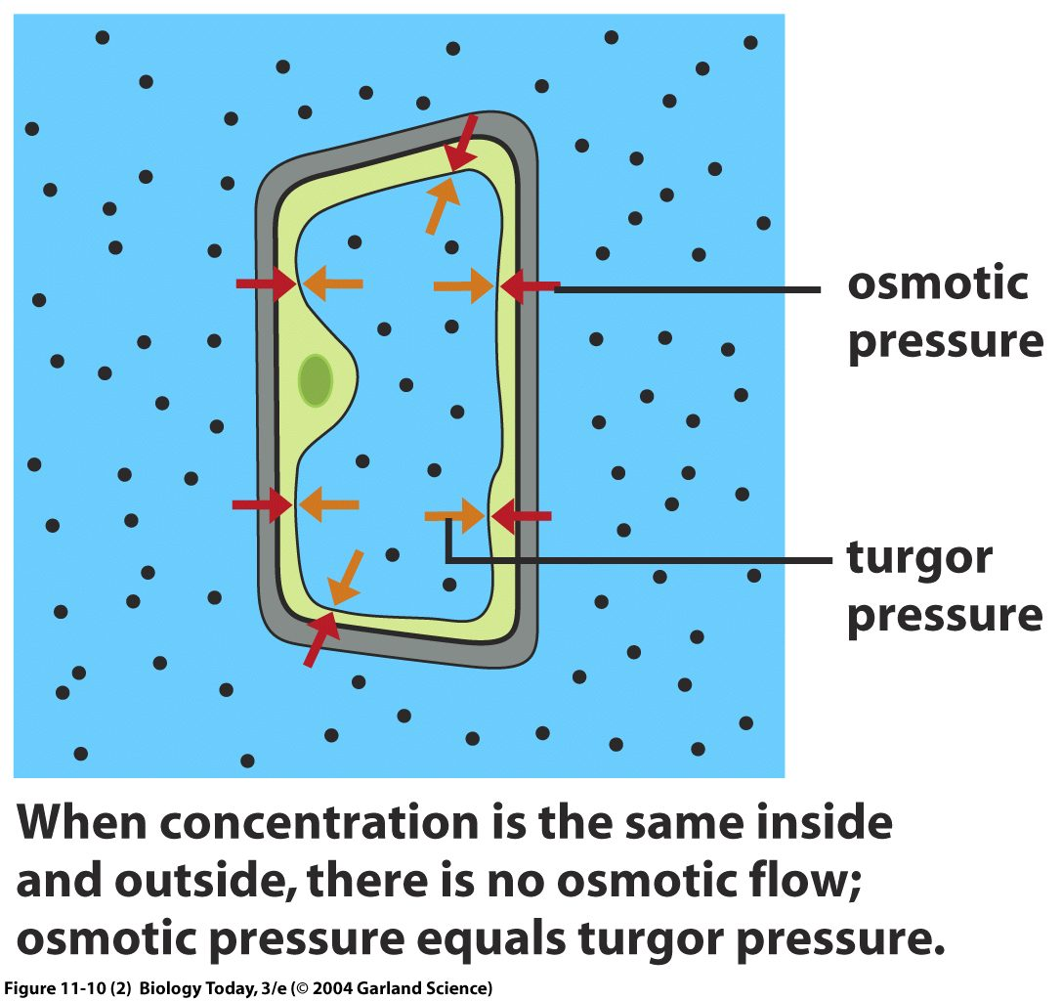
Plant cell in isotonic solution
Water is the same inside the cell and outside.
An isotonic solution has the same solute than the cell (no osmotic flow).
Turgor pressure and osmotic pressure are the same.
This is of NO real benefit to a plant cell and it enters a state known as Flaccid. Chemical reactions will still occur, BUT the plant cell can’t help support the structure of the entire plant.

Slide 27
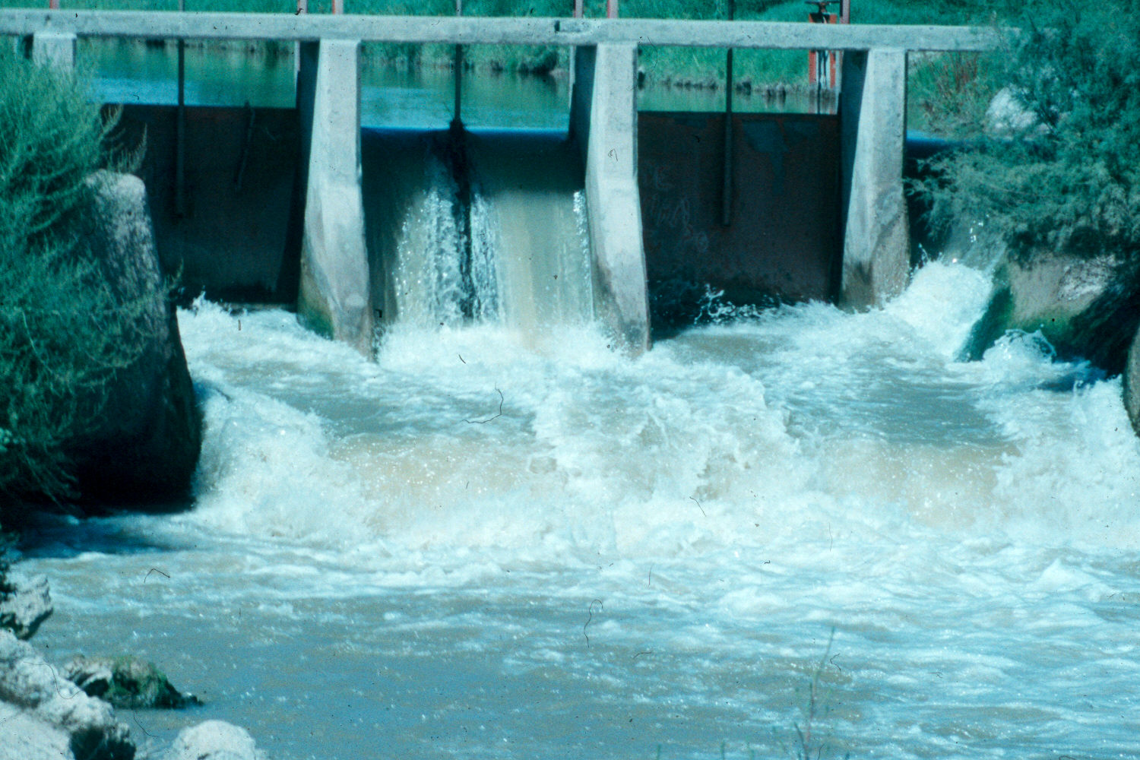
4- Water Potential
In thermodynamics, the free energy is defined as the potential for performing work.
The water at the top of the fall has a higher potential for performing work than the water at the base of the fall.
The water is moving from an area of higher free energy to an area of lower free energy.
The free energy from water is the power source for waterwheels and hydroelectric facilities.

Slide 28
4- Water Potential
The water potential is a measure of the potential or the free energy in the water. (the ability of water to do work).
The Greek symbol for Water Potential, Ψ_{W})
(Several forces affects the ability or potential of water to do work)
The water potential (Ψ_{w}( is the sum of three components:
Solute or Osmotic potential (Ψ_{S}), effect of dissolved solutes on water and cell, depends on concentration of dissolved substance.
Pressure potential (Ψ_{P}), (Known as turgor pressure), depends on the hydrostatic pressure on the water.
Gravitational potential (Ψ_{G}), causes water to move downwards unless opposed by an equal and opposite force
Notes:
http://6e.plantphys.net/topic03.06.html

Slide 29
4- Water Potential
At the cell level, the gravitational potential (Ψ_{G} ) is ignored because it is negligible compared to osmotic and pressure potential
Ψ_{w} =
Ψ_{S} +
Ψ_{P} +
Ψ_{G}
Ψ_{w} =
Ψ_{S}
+ Ψ_{P}
Ψ (Units) is the free energy of a water sample per unit mass, expressed as units of pressure,
1 MegaPascal (MPa) = 10 bars, ~ 10 atmospheres, 7500 mmHg.
Standard (Ψ₀) = pure water at ambient pressure = 0 MPa.

Slide 30
4- Water Potential
Examples illustrating the concept of water potential and its components

Slide 31
Examples illustrating the concept of water potential and its components

Slide 32
Examples illustrating the concept of water potential and its components

Slide 33
Ψ_{w} = Ψ_{S} + Ψ_{p}
Solute (or) Osmotic Potential (Ψ_{S})
Represents the effect of dissolved solutes on the water potential,
Solutes reduce the free energy of water by diluting the water.
Ψ_{S} = -RT c_{s}
R : pressure constant (8.32 J mol⁻¹ K⁻¹)
T : absolute temperature (K)
c_{s}: molar concentration (mol L⁻¹)

Slide 34
Ψ_{w} = Ψ_{S} + Ψ_{p}
Pressure Potential (Ψ_{P})
Hydrostatic pressure represents the physical pressure on a solution, or by the solution,
Positive pressure raises the pressure potential,
Negative pressure (tension) reduces the pressure potential,
The positive hydrostatic pressure within plant cells is referred to as Turgor Pressure.

Slide 35
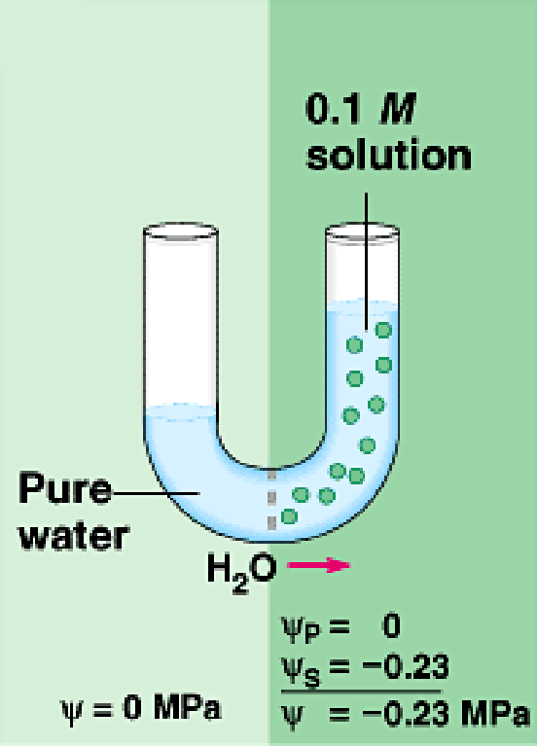
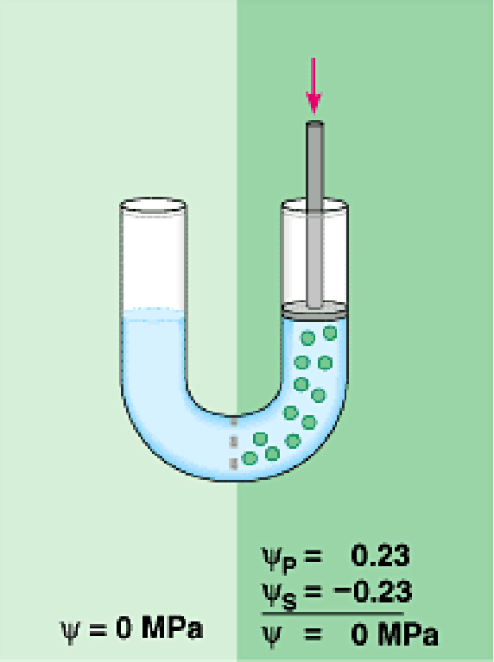
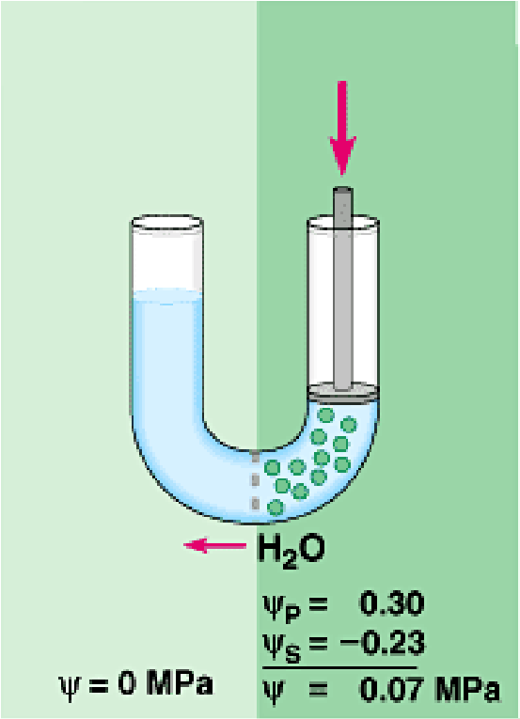
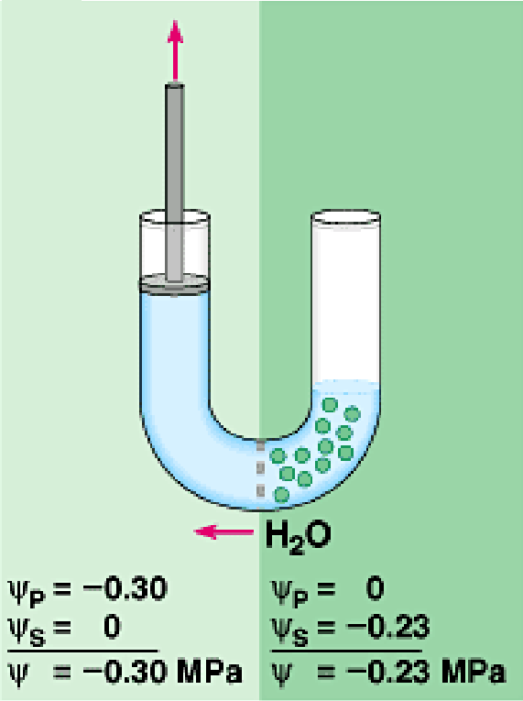
Ψ_{w} = Ψ_{S} + Ψ_{p} Changes in water potential by changes in pressure or solute potential
Positive pressure Tension

Slide 36
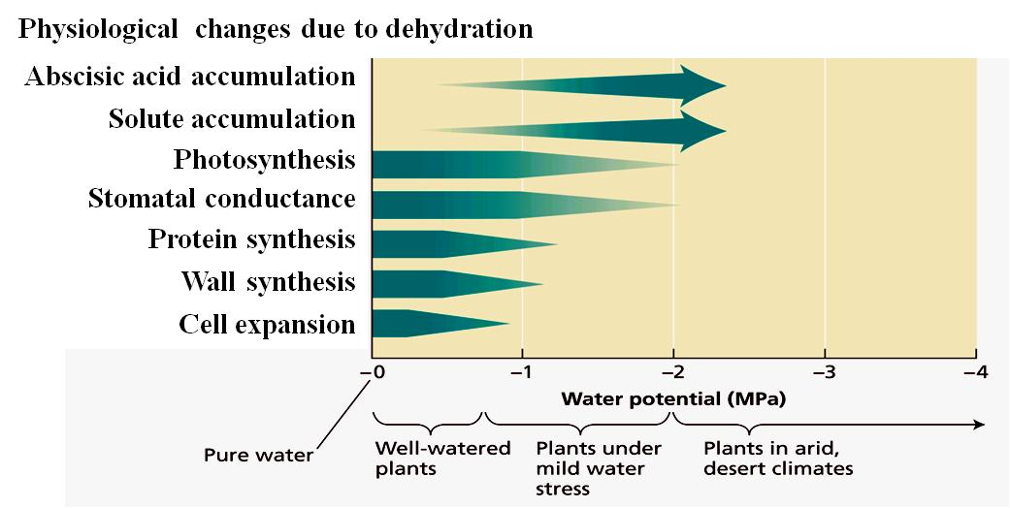
The Water Potential helps us to evaluate the water status of a plant.
Components of water potential vary with growth conditions
and the location within the plant.
Sensitivity of various physiological processes to water potential

Slide 37
Water potential affects plants in many ways;
Atmospheric water potential is one of the factors that influences the rate of transpiration or water loss in the plants.
Soil water potential influences the water available for uptake by plant roots.
Atmospheric
Water Potential
Water available for
uptake by plant roots

Slide 38
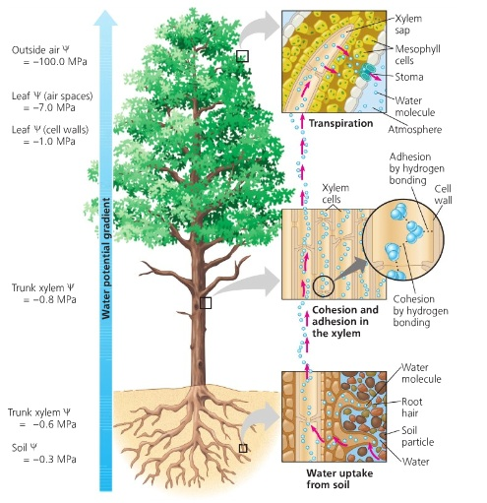
The importance of water potential:
Describes how tightly water is bound in the soil.
Describes the availability of water for physiological processes in the plant.
Defines the flow of water in all plant systems.

Slide 39
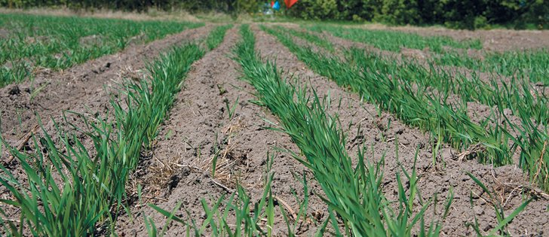
Scientists use water potential measurements to;
determine drought tolerance in the plants,
the irrigation needs of different crops,
how the water status of a plant affects its yield and quality

Slide 40
Thank you

