Slide 1
A Heap Implementation
Chapter 26

Slide 2
Heaps (ch23)
Complete binary tree: nodes contain Comparable objects
Organization
Each node contains object no smaller (or no larger) than objects in descendants
Maxheap, object in node greater than or equal to descendant objects
Minheap, object in node less than or equal to descendant objects

Slide 3
Reprise: The ADT Heap
Interface considered in Chapter 23
Listing 23-6

Slide 4
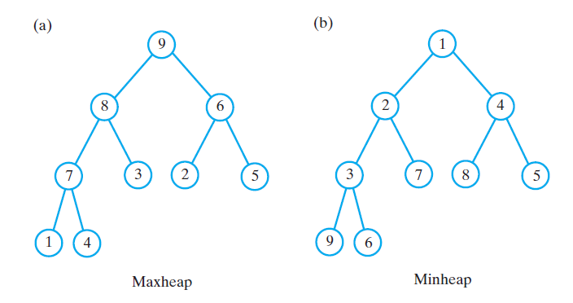
Example

Slide 5
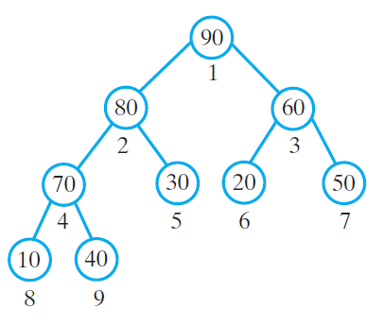
Array to Represent a Heap
Begin by using array to represent complete binary tree.
Complete tree is full to its next-to-last level
Leaves on last level are filled from left to right
Locate either children or parent of any node by performing simple computation on node’s number

Slide 6
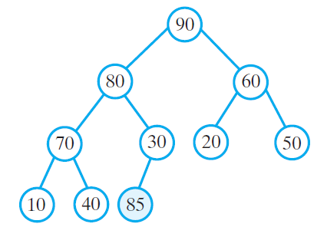
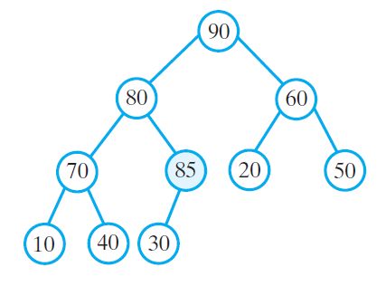
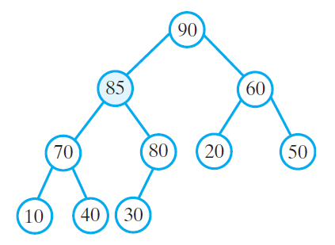
The steps in adding 85 to a maxheap

Slide 7
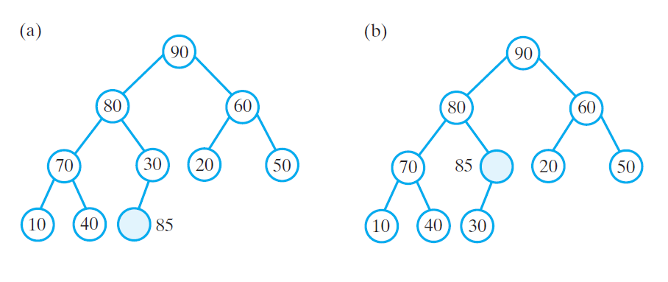
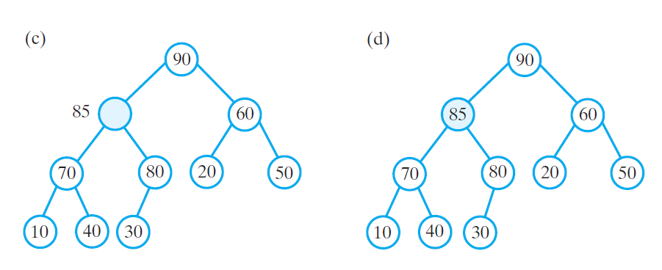
A revision of the steps to avoid swaps

Slide 8
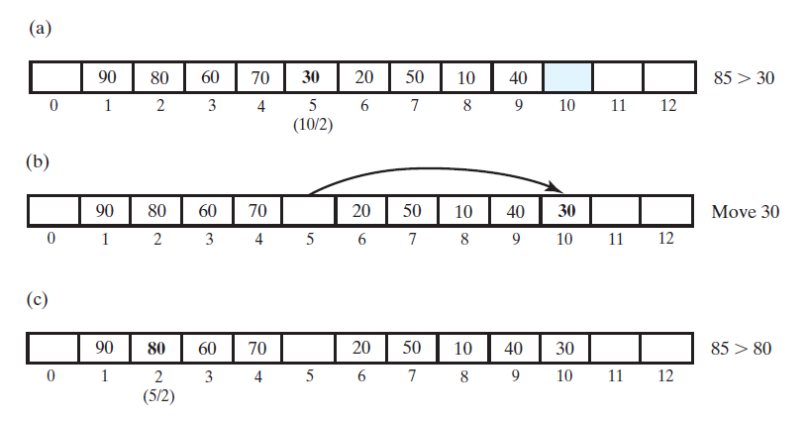
An array representation of the steps

Slide 9
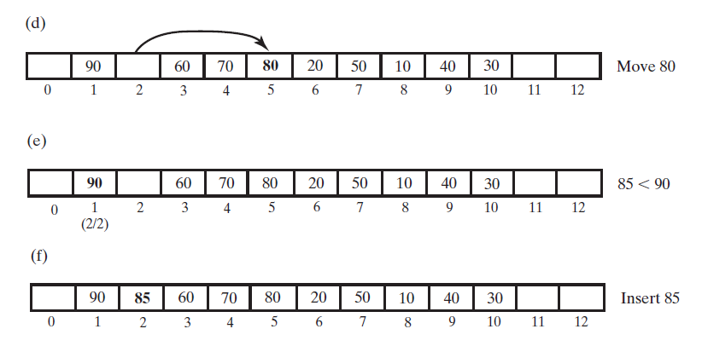
An array representation of the steps

Slide 10
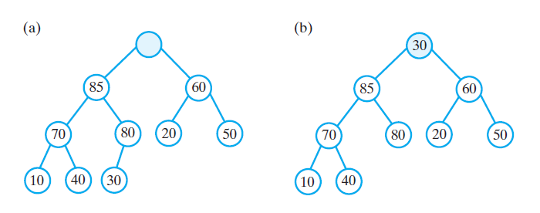
RemoveMax

Slide 11
Adding 20, 40, 30, 10, 90, and 70

Slide 12
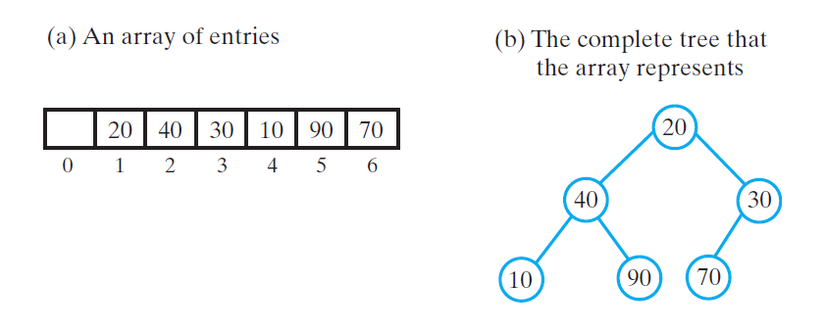
The steps in creating a heap of the entries 20, 40, 30, 10, 90, and 70 by using reheap

Slide 13
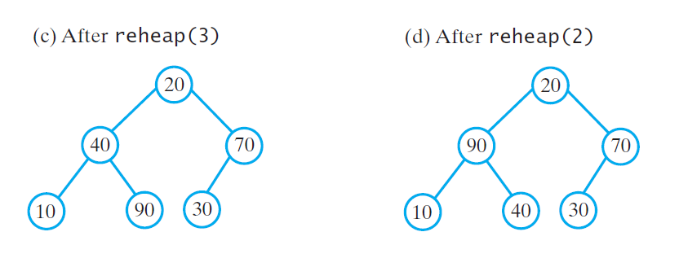
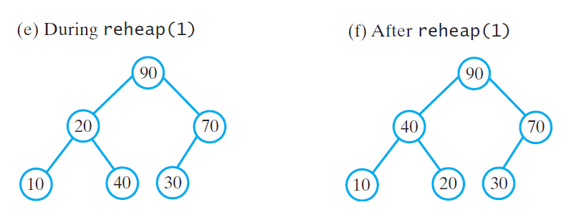
The steps in creating a heap of the entries 20, 40, 30, 10, 90, and 70 by using reheap

Slide 14
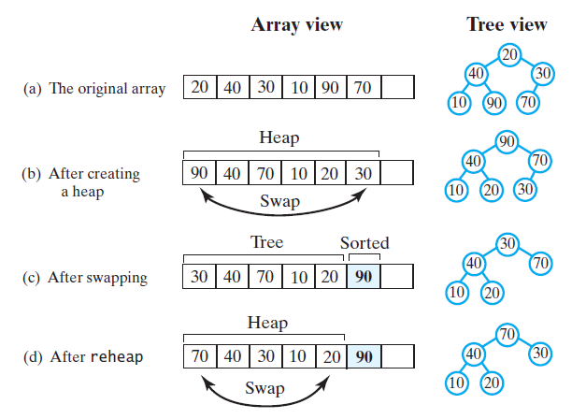
Figure 26-9 A trace of heap sort

Slide 15
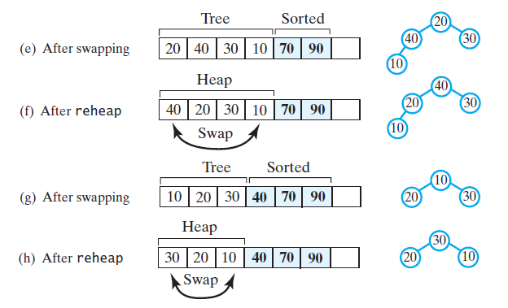
Figure 26-9 A trace of heap sort

Slide 16
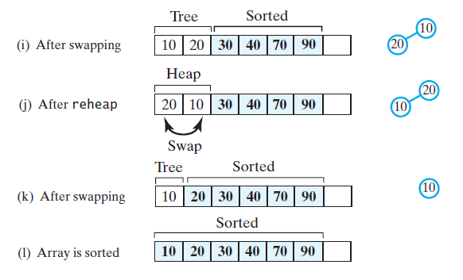
Figure 26-9 A trace of heap sort

Slide 17
Efficiency

