Slide 1
Stacks

Slide 2
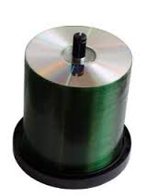
Stack: Last In First Out (LIFO).–Used in procedure calls, to compute arithmetic expressions etc.•

Slide 3
Specifications of a Stack
Organizes entries according to order added
All additions added to one end of stack
Added to “top”
Called a “push”
Access to stack restricted
Access only top entry
Remove called a “pop”

Slide 4
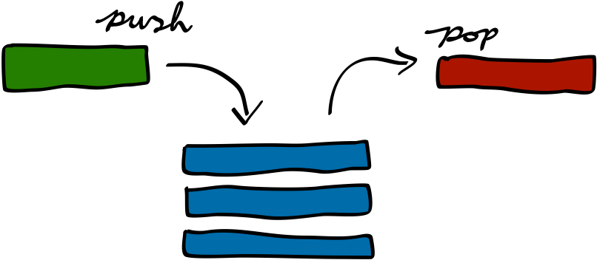
Applications of Stacks
Direct applications
◦Page-visited history in a Web browser
◦Undo sequence in a text editor
◦Chain of method calls in the Java Virtual Machine
Indirect applications
Auxiliary data structure for algorithms
Component of other data structures

Slide 5
Stack operations
Consider peek
Consider push
Another push
Consider pop
Farah
Manal
Samia
Samia
Asma

Slide 6
Stack operations
The TOP
Samia
Consider peek
Consider push
Another push
Consider pop
Which end of the stack is involved?
Farah
Manal
Samia
Asma

Slide 7
Linked Implementation
The TOP
Samia
Which is better?
Why?
Farah
FirstNode
Manal
Manal
Samia
Samia
Manal
Samia
Asma
Asma
Asma
FirstNode

Slide 8
The Stack ADT (§4.2)
The Stack ADT stores arbitrary objects
Insertions and deletions follow the last-in first-out scheme
Main stack operations:
push(object): inserts an element
object pop(): removes and returns the last inserted element
Auxiliary stack operations:
object top(): returns the last inserted element without removing it
integer size(): returns the number of elements stored
boolean isEmpty(): indicates whether no elements are stored

Slide 9
ADT Stack

Slide 10
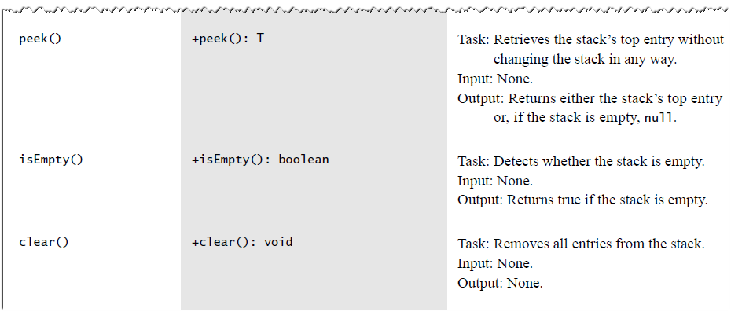
ADT Stack

Slide 11
Stack Interface in Java
public interface Stack {
public int size();
public boolean isEmpty();
public Object top() throws EmptyStackException;
public void push(Object o);
public Object pop() throws EmptyStackException; }
Java interface corresponding to our Stack ADT
Requires the definition of class EmptyStackException
Different from the built-in Java class java.util.Stack

Slide 12
import java.io.*;
import java.util.*;
public class stack {
public static void main(String[] args) {
Stack<Integer> myStack = new Stack<Integer>();
myStack.push(1);
myStack.push(2);
myStack.push(3);
myStack.push(3);
myStack.push(4);
myStack.push(5);
System.out.println( "This is the stack : " +myStack);
myStack.pop();
System.out.println("This is the stack after pop : " +myStack);
System.out.println("This is first number in the stack : " +myStack.peek());
System.out.println("This is the stack now : " +myStack);
}
}

Slide 13
Output:
This is the stack : [1, 2, 3, 3, 4, 5]
This is the stack after pop : [1, 2, 3, 3, 4]
This is first number in the stack : 4
This is the stack now : [1, 2, 3, 3, 4]

Slide 14
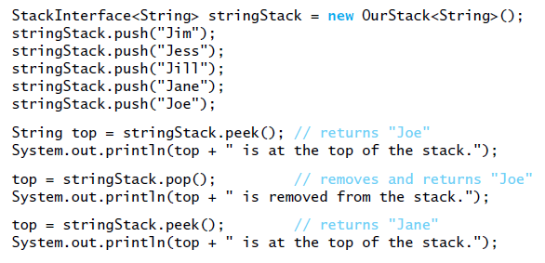
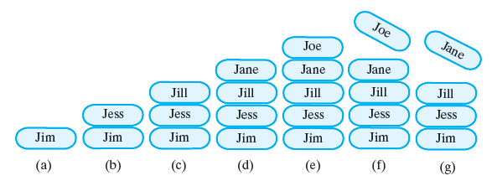
Stack Usage Example

Slide 15
Algebraic Expressions
Algebraic expressions are composed of
Operands (variables, constants)
Operators (+, -, /, *, ^)
Operators can be unary or binary
Precedence must be maintained
According to order of operators
According to parentheses
When parentheses are used, they must be balanced
Different notations
Infix a + b
Prefix + a b
Postfix a b +

Slide 16
Infix to Postfix Conversion – Example (1)
Figure 5-7
Converting a + b * c to postfix form
 | Next Char | Postfix | Operator Stack (bottom to top)
 | a | a | (empty)
 | + | a | +
 | b | a b | +
 | * | a b | + *
 | c | a b c | + *
 | (end of infix) | a b c * | +
 |  | a b c * + | (empty)

Slide 17
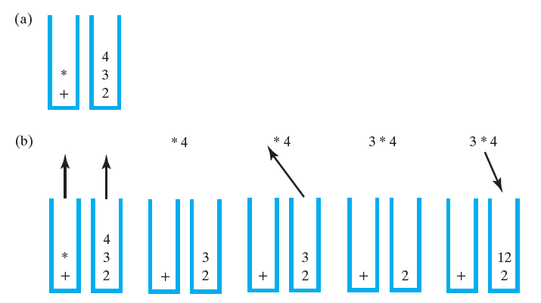
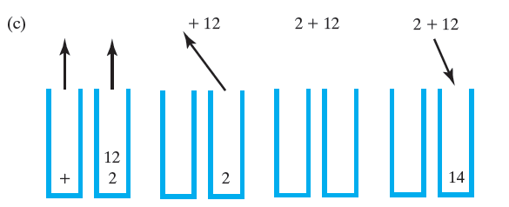
Evaluating Infix Expressions
evaluation of a + b * c when a is 2, b is 3, and c is 4
after reaching the end of the expression
while performing the multiplication;
while performing the addition

Slide 18
Infix to Postfix Conversion – Example (2)
Converting the following to postfix form
7 + 2 ^ ( 1 + 3 ) / ( 6 + 5 * 3 – 5 )
The only thing that can pop an open parenthesis is a matching closing parenthesis
 | Next Char | Postfix | Operator Stack (bottom to top)
 | 7 | 7 | (empty)
 | + | 7 | +
 | 2 | 72 | +
 | ^ | 72 | +^
 | ( | 72 | +^(
 | 1 | 721 | +^(
 | + | 721 | +^(+
 | 3 | 7213 | +^(+

Slide 19
Infix to Postfix Conversion – Example (2)
Converting the following to postfix form
7 + 2 ^ ( 1 + 3 ) / ( 6 + 5 * 3 – 5 )
 | Next Char | Postfix | Operator Stack (bottom to top)
 | 3 | 7213 | +^(+
 | ) | 7213+ | +^
 | / | 7213+^ | +/
 | ( | 7213+^ | +/(
 | 6 | 7213+^6 | +/(
 | + | 7213+^6 | +/(+
 | 5 | 7213+^65 | +/(+
 | * | 7213+^65 | +/(+*

Slide 20
Infix to Postfix Conversion – Example (2)
Converting the following to postfix form
7 + 2 ^ ( 1 + 3 ) / ( 6 + 5 * 3 – 5 )
We are only done when we reach the end of the infix expression AND the stack is empty.
Are we done?
 | Next Char | Postfix | Operator Stack (bottom to top)
 | * | 7213+^65 | +/(+*
 | 3 | 7213+^653 | +/(+*
 | - | 7213+^653* | +/(+
 |  | 7213+^653*+ | +/(-
 | 5 | 7213+^653*+5 | +/(-
 | ) | 7213+^653*+5- | +/
 | (end of infix) | 7213+^653*+5-/ | +
 |  | 7213+^653*+5-/+ | (empty)

Slide 21
Infix to Postfix Conversion – Example (2)
Converting the following to postfix form
7 + 2 ^ ( 1 + 3 ) / ( 6 + 5 * 3 – 5 )
7 + 2 ^ 4 / (6 + 5 * 3 – 5) =
7 + 16 / (6 + 15 – 5) =
7 + 16 / (21 – 5) =
7 + 16 / 16 =
7 + 1 = 8
 | Next Char | Postfix | Operator Stack (bottom to top)
 | * | 7213+^65 | +/(+*
 | 3 | 7213+^653 | +/(+*
 | - | 7213+^653* | +/(+
 |  | 7213+^653*+ | +/(-
 | 5 | 7213+^653*+5 | +/(-
 | ) | 7213+^653*+5- | +/
 | (end of infix) | 7213+^653*+5-/ | +
 |  | 7213+^653*+5-/+ | (empty)

Slide 22
Postfix Evaluation - Algorithm
Any operator operates on its two previous operands
Example - manual
7 2 1 3 + ^ 6 5 3 * + 5 - / +
7 2 4 ^ 6 5 3 * + 5 - / +
7 16 6 15 + 5 - / +
7 16 21 5 - / +
7 16 16 / +
7 1 +
8
Algorithm basics
Scan postfix expression left to right
When operand found, push it onto operand stack
When operator found:
Pop stack for 2nd operand
Pop stack for 1st operand
Evaluate
Push result onto operand stack

Slide 23
Evaluating Postfix Expression – Example (1)
7 2 1 3 + ^ 6 5 3 * + 5 - / +
1 + 3
2 ^ 4
7
2
7
1
2
7
3
1
2
7
427
167
6
167
56167
5 * 3
6 + 15
21 - 5
16 / 16
7 + 1
356167
156167
21167
5
21
167
16167
17
8

Slide 24
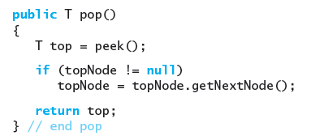
Linked Implementation
null;
return
{ top = topNode.data; topNode = topNode.next; }
null;

Slide 25
Linked Implementation
null;
{ T top = topNode.data;
topNode = topNode.next;
return top; }
return null;
}
{ top = topNode.data; topNode = topNode.next; }

Slide 26
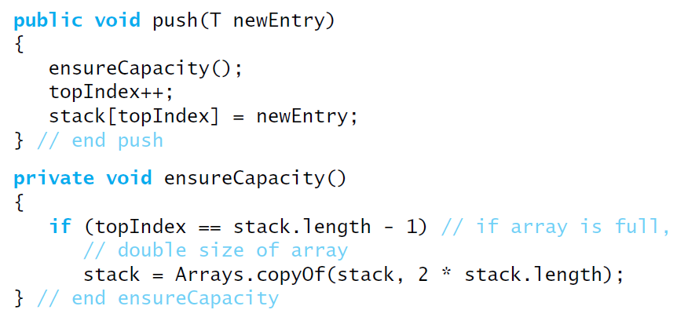
Adding to the Top

Slide 27
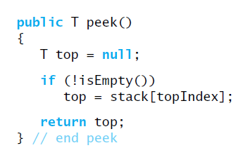
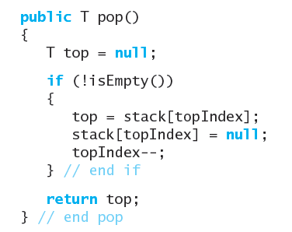
Peek and Pop

Slide 28
Performance and Limitations
Performance
Let n be the number of elements in the stack
The space used is O(n)
Each operation runs in time O(1)
Limitations
The maximum size of the stack must be defined a priori and cannot be changed
Trying to push a new element into a full stack causes an implementation-specific exception

Slide 29
Stack
Array-based Stack
http://www.cs.usfca.edu/~galles/visualization/StackArray.html
Link stack
http://www.cs.usfca.edu/~galles/visualization/StackLL.html

