Slide 1
IP Addressing and Network Software

Slide 2
IP Addressing
For this level of communication, we need a global addressing scheme; we called this logical address or IP address.
The IP address is 32 bits in length.
IP addresses are unique. They are unique in the sense that each address defines one, and only one, connection to the Internet.
Two devices on the Internet can never have the same address at the same time.

Slide 3
Binary Notation
In binary notation, the IP address is displayed as 32 bits.
Each octet is often referred to as a byte.
Example: 01110101 10010101 00011101 00000010

Slide 4
Dotted-Decimal Notation
To make the IP address more compact and easier to read.
The IP address is written in decimal form with a decimal point (dot) separating the bytes.
Example: 117.149.29.2
Note that because each byte (octet) is 8 bits, each number in dotted-decimal notation is a value ranging from 0 to 255.

Slide 5
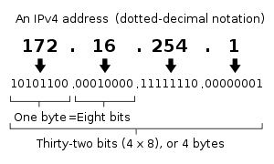
IP Addressing

Slide 6
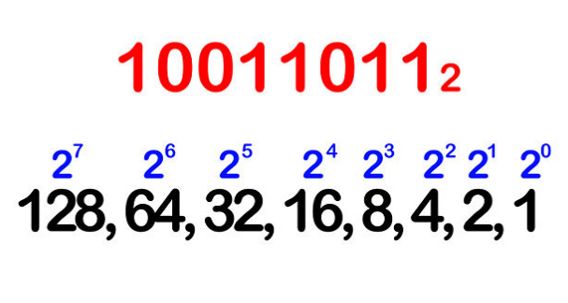
How to Convert from Binary to Decimal
Step1
Write down the binary number and list the powers of 2 from right to left.

Slide 7
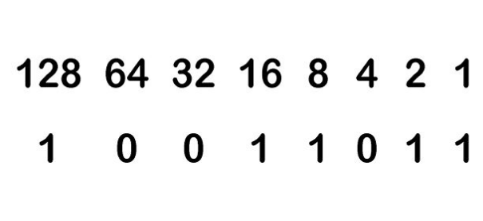
How to Convert from Binary to Decimal
Step 2
Write the digits of the binary number below their corresponding powers of two.

Slide 8
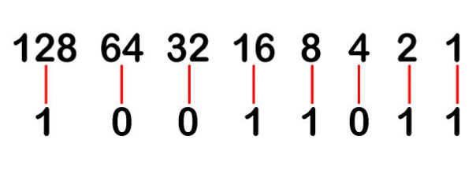
How to Convert from Binary to Decimal
Step 3
Connect the digits in the binary number with their corresponding powers of two.

Slide 9
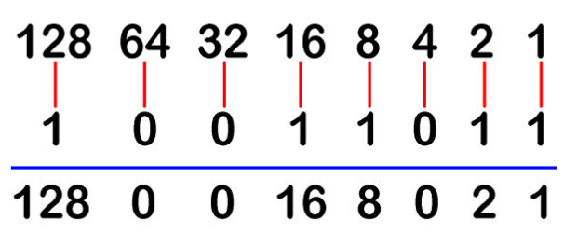
How to Convert from Binary to Decimal
Step 4
Write down the final value of each power of two.

Slide 10
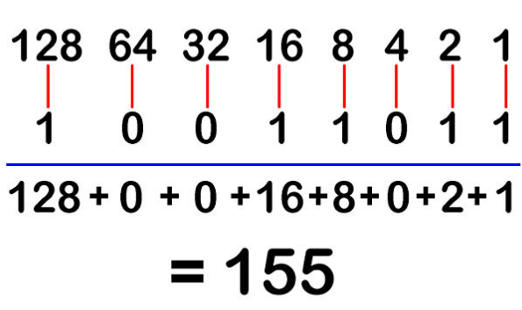
How to Convert from Binary to Decimal
Step 5
Add the final values.

Slide 11
How to Convert from Binary to Decimal
Step 6
Write the answer along with its base subscript.

Slide 12
Example

Slide 13
Classes
There are five classes of IP addresses, Class A through Class E.
We can find the class of an address when given the address in binary notation or dotted-decimal notation.
If the address is given in binary notation, the first few bits can immediately tell us the class of the address.
If the address is given in decimal-dotted notation, the first byte defines the class.

Slide 14
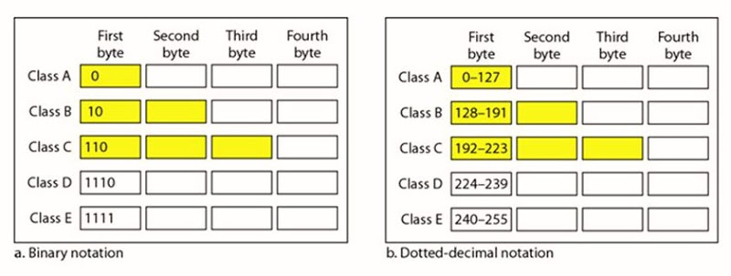
Classes

Slide 15
Classes
Each class is divided into a fixed number of blocks (that indicate the number of the networks) with each block having a fixed size (the number of the host).
An IP address in class A, B, or C is divided into netid and hostid.
These parts are of varying lengths, depending on the class of the address

Slide 17
Classes
Addresses in classes A, B, and C are for the unicast communication, from one source to one destination.
Addresses in class D are for multicast communication, from one source to a group of destinations.
Multicast address can be used only as destination address, but never as a source address.

Slide 18
Class A
The first octet indicates the number of the network, and the remaining three octets indicate the number of the host.
126 network addresses
16 million hosts per network

Slide 19
Class A
Network range from 1- 126

Slide 20
Class B
The first two octets indicate the network number, and last two octets indicate the host.
It is intended for organizations that have more networks, but not as many hosts per network.
16,384 network addresses
65,534 hosts per network

Slide 21
Class B
Network range from 128 - 191
IP 127 is reserved for loop back and for internal testing on a local machine.
[You can test this: you should always be able to ping 127.0.0.1, which points to yourself]

Slide 22
Class C
The first three octets are for the network number, and last octet is for the host.
It is intended for organizations that have many networks, but few hosts per network.
Over 2 million network numbers
254 hosts per network

Slide 23
Class C
Network range from 192 - 223

Slide 24
Other Classes
Class D and Class E addresses are for special uses.
Class D:
Class D network range 224-239
Class D addresses are reserved for multicasting.
Class E:
Class E network range 240-254
Class E addresses are reserved for future use
Special IP addresses are known as private addresses.

Slide 25
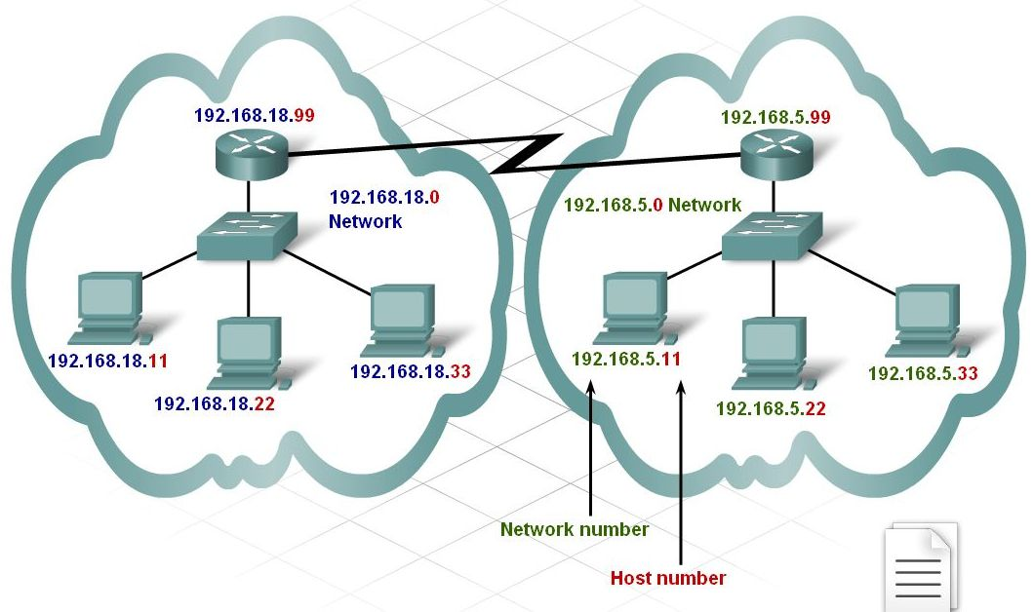

Slide 26
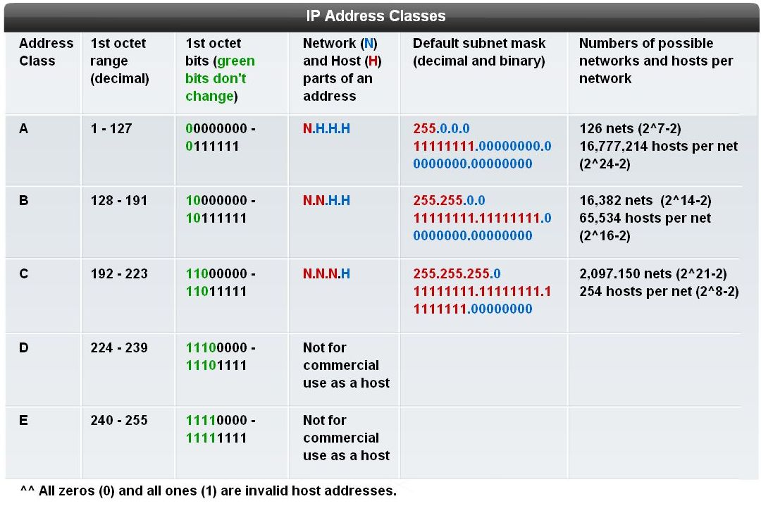

Slide 27
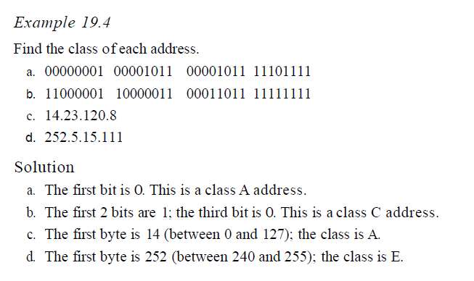
Example

Slide 28
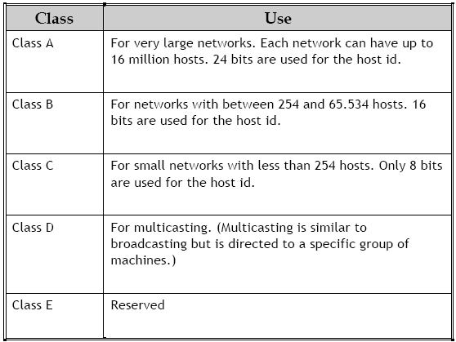

Slide 29
Subnetting

Slide 30
Subnetting
When an organization is given a block of class A, B, or C address, the first address in the block defines the network address.
This address is used by routers outside the organization to route the packets destined for the network.
The outside world, when it comes to routing, recognize the network, not individual hosts on the network.

Slide 31
Subnetting
As known, the IP address is divided to netid and hostid.
To reach a host on the internet, we must first reach the network by using the netid. Then we must reach the host itself by using the hostid.
i.e. the IP addresses are designed with two levels of hierarchy.

Slide 32
Examples

Slide 33
Example

Slide 34
Subnetting
Sometimes, an organization needs to assemble the hosts into groups; the network needs to be divided into several subnetworks (subnets).

Slide 35
Subnetting
Subnetting a network can be done for a variety of reasons:
A company uses two or more types of LAN technology (for example, Ethernet, Token Ring) on their network or different physical media (such as Ethernet, FDDI, WAN, etc.)
Two network segments are restricted by distance limitations (for example, remote offices linked via point-to-point circuit).
Segments need to be localized for network management reasons (accounting segment, sales segment, etc.).
Hosts which dominate most of the LAN bandwidth need to be isolated.
Security.
The most common reason is to control network traffic.

Slide 36
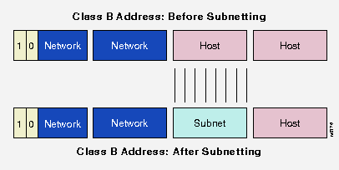
Subnetting
In subnetting, a network is divided into several smaller groups with each subnetwork ( or subnet) having its own subnetwork address.
When we divide a network into several subnets, we have three level of hierarchy, network, subnet and host.
Subnetting is done by borrowing bits from the host part and add them the network part

Slide 37
How it works?
The IP address is split into a network and host portion.
The network portion always remains fixed for a particular network, while the remaining bits which make up the host portion can be altered to give the range of addresses to assign to hosts.
To determine where the network portion ends and the host portion begins, a subnet mask is used.

Slide 38
Mask
When a router receives a packet with a destination address, it needs to route the packet.
The routing is based on the network address and subnetwork address.
The router outside the organization routes the packet based on the network address.
The router inside the organization routes the packet based on the subnetwork address.
But!! How can router find the network and subnetwork address

Slide 39
Mask
The router outside the organization has a routing table with one column based on the network addresses.
The router inside the organization has a routing table based on the subnetwork addresses.
A 32-bit number called mask is the key.
The router outside the organization use a default mask.
The router inside the organization use a subnet mask.

Slide 40
Default Mask
A default mask is 32-bit binary number that gives the network address when ANDed with an address in the block.
If the bit in the mask is 1 → the corresponding bit in the address is retained ( no change).
If the bit in the mask is 0 → 0 bit in the output is the result.

Slide 41
Subnet Mask
The number of 1s in a subnet mask is more than the number of 1s in the corresponding default mask.
In subnet mask, we change some of the leftmost 0s in the default mask to make subnet mask.
The number of subnets is determine by the number of extra1s.
If the number of extra 1 is n, the number of subnets is 2^{n}.
If the number of subnets is N, the number of extra 1s is log₂N

Slide 42
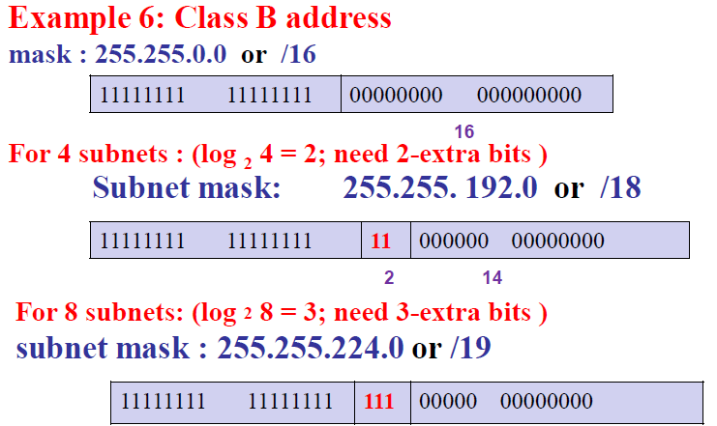

Slide 43
Example
Assume the IP address is 140.179.240.200, it has a Class B default mask, perfume a logical AND:
10001100.10110011.11110000.11001000 140.179.240.200 IP Address
11111111.11111111.00000000.00000000 255.255.000.000 Subnet Mask
--------------------------------------------------------
10001100.10110011.00000000.00000000 140.179.000.000 Network Address

Slide 45
Example
What is the subnetwork address if the destination address is 19.30.84.5 and the mask is 255.255.192.0?

Slide 46
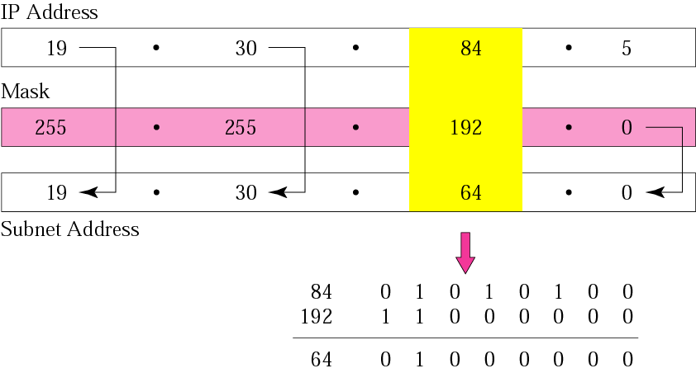
Solution

