Slide 1
Chapter#3 Structured Program Development in C++
King Saud University
College of Applied studies and Community Service
Csc 1101
By: Asma Alosaimi
Edited By: Ghadah R. Hadba & Noor Al-Hareqi
1st semester 1433-1434

Slide 2
Types of Control structure
The control structure :
Sequence structure
Selection structure
Repetition structure.
In this lecture we will continue the talking about the Selection structure .

Slide 3
Selection structure
We learned that the C++ provides three types of selection structures in the form of statements:
The if selection statement : performs an action if a condition is true or skips the action if the condition is false.
The if…else selection statement : performs an action if a condition is true and performs a different action if the condition is false. But!! What if there are more than two actions under different conditions ?
The switch selection statement: performs one of many different actions depending on the value of an expression.

Slide 4
Multiple Selection: Nested if
Multiple if statements can be used if there is more than two alternatives.
This mean we can place the if statement or the if-else statement inside a body of other if or/and else.
There are numerous situations to achieve that and it depends on the problem under consideration.
Here we will take a look on some situations .

Slide 5
Multiple Selection: Nested if
Example for if-else statement inside the else body of other if-else statement
Example for if-else statement inside the if body of other if-else statement
if (expression1)
statement1
else
if(expression2)
statement2
else
statement3
if (expression1)
if(expression2)
statement1
else
statement2
else
statement3
else is associated with the most recent if that does not have an else

Slide 6
Multiple Selection: Nested if (Example-1)
if( tempreture >= 50 )
if (tempreture >= 80)
cout<<“Good swimming day”;
else
cout<<“Good golfing day”;
else
cout<<“Good tennis day”;
Note: else is associated with the most recent if that does not have an else

Slide 7
Multiple Selection: Nested if (Example-2)
if( tempreture >= 50 )
if (tempreture >= 80)
cout<<“Good swimming day”;
else
cout<<“Good golfing day”;
Example of if-else inside an if statement
Remember: else is associated with the most recent if that does not have an else

Slide 8
Multiple Selection: Nested if (Example-3)
if( num == 0)
cout<<“ the entered number is zero \n”
else
if( num < 0)
cout<<“the entered number is negative\n”;
else
cout<<“the entered number is positive\n”;

Slide 9
Multiple Selection: Nested if
Example for if statement inside the else body of other if-else statement
Example for if statement inside the if body of other if-else statement
if (expression1)
statement1
else
if(expression2)
statement2
if (expression1)
{
if(expression2)
statement1
}
else
statement2

Slide 10
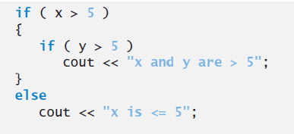
Multiple Selection: Nested if (Example-4)
//The following code does not work as intended.
//This is the correct way of writing the above code
To force the nested if..else statement to execute as it was originally intended we must use the braces {} as following:

Slide 11
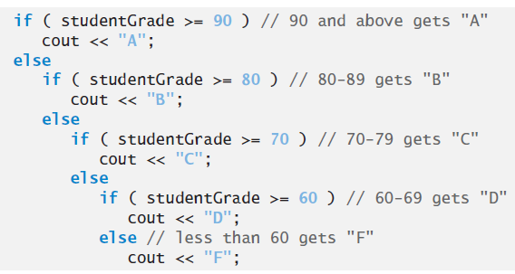
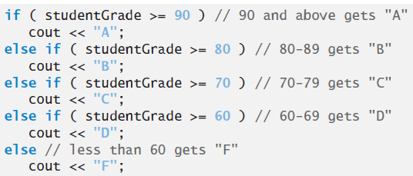
Multiple Selection: Nested if (Example-5)
In this example we want to print a score letter depending on the input studentGrade
if ( grade >= 90 ) cout "A\n" ; else if ( grade >= 80 ) cout<< "B\n" ; else if ( grade >= 70) cout<<"C\n" ; else if ( grade >= 60) cout<<"D\n" ; else cout<<"F\n" ;
if ( grade >= 90 ) cout "A\n" ; else if ( grade >= 80 ) cout<< "B\n" ; else if ( grade >= 70 ) cout<<"C\n" ; else if ( grade >= 60 ) cout<<"D\n" ; else cout<<"F\n" ;
Many C++ programmers prefer to write the preceding if statement as

Slide 12
Comparing if Statements
if (score>=90) printf("A");
if (score>=80 && score<90) printf("B");
if (score>=70 && score<80) printf("C");
if (score>=60 && score<70) printf("D");
if (score<60) printf("F");
5 simple if statements
if (score>=90) printf("A");
else if (score>=80) printf("B");
else if (score>=70) printf("C");
else if (score>=60) printf("D");
else printf("F");
1 multiple
alternative if statement

Slide 13
selection structure: Switch
The switch statement is called a multiple-selection statement because it selects among many different actions.
The switch statement consists of a series of case labels and an optional default case.

Slide 14
selection structure: Switch
Syntax:
switch (expression)
{
case value1: statements1
break;
case value2: statements2
break;
...
case valuen: statementsn
break;
default: statements
}
Expression:
is also known as selector.
Expression can be an identifier.
Value can only be integral.

Slide 15
Type of values in Switch Cases
In Switch statement each action is associated with a value of constant integral expression (i.e. any combination of character constants and integer constant that evaluates to a constant integer value)
Thus, switch selector must be either :
An variable of integer or char data type, OR
An expression that evaluates to a constant integer value.

Slide 16
Switch With break Statements
true
switch (N) {
case 1: x = 10;
break;
case 2: x = 20;
break;
case 3: x = 30;
break;
}
N == 1 ?
x = 10;
false
break;
true
N == 2 ?
x = 20;
false
break;
true
N == 3 ?
x = 30;
false
break;

Slide 17
Switch With no break Statements
switch (N) {
case 1: x = 10;
case 2: x = 20;
case 3: x = 30;
}
true
N == 1 ?
x = 10;
false
true
Without break statements, each time a match occurs in the switch, the statements for that case and subsequent cases execute until a break statement or the end of the
switch is encountered.
N == 2 ?
x = 20;
false
true
N == 3 ?
x = 30;
false

Slide 18
Switch With break Statements
Example
switch (grade)
{
case 'A': cout<<"The grade is A.";
break;
case 'B': cout<<"The grade is B.";
break;
case 'C': cout<<"The grade is C.";
break;
case 'D': cout<<"The grade is D.";
break;
case 'F': cout<<"The grade is F.";
break;
default: cout<<"The grade is invalid.";
}

Slide 19
Previous Example - With Nested If
if (grade == 'A') printf("The grade is A."); else if (grade == 'B') printf("The grade is B."); else if (grade == 'C') printf("The grade is C."); else if (grade == 'D') printf("The grade is D."); else if (grade == 'F') printf("The grade is F."); else printf("The grade is invalid.");

Slide 20
Switch With more than one case labels
Example
switch (grade)
{
case 'A': case ‘a':
cout<<"The grade is A.";
break;
case 'B': case ‘b':
cout<<"The grade is B.";
break;
case 'C': case ‘c':
cout<<"The grade is C.";
break;
case 'D': case ‘d':
cout<<"The grade is D.";
break;
case 'F': case ‘f':
cout<<"The grade is F.";
break;
default: cout<<"The grade is invalid.";
}

Slide 21
Switch With break Statements
Example 2
switch (number1+number2)
{
case 0: cout<<"The sum is 0";
break;
case 1: cout<<"The sum is 1";
break;
case 2: cout<<"The sum is 2";
break;
case 3: cout<<"The sum is 3";
break;
case 4: cout<<"The sum is 4";
break;
default: cout<<“ illegal expression";
}

Slide 22
Switch With break Statements
Example 3
switch (number%2)
{
case 0: cout<<number<<“is an even number”;
break;
case 1: cout<< number<<“is an odd number”;
break;
default: cout<<number<<"is invalid.";
}

Slide 23
Common Errors in the switch

Slide 24
Comparison of if Statements and The Switch Statement
if statements are more general than the switch statement.
Case labels that contain type float values or strings are not permeated in switch statements.
The switch statement is more readable in many contexts. Thus, it should be used whenever practical.

Slide 25
Exercise
Write a program that reads the price and the production date ( month and year of an item ) then the program prints the price after applying the discount rate which equals to :
50% if it is produced before 2011.
30% if it is produced in 2011 but before the 4th month.
10% if it is produced after 4 ,2011 and before 8,2011

