Slide 1
Chapter#3 Part1 Structured Program Development in C++
King Saud University
College of Applied studies and Community Service
Csc 1101
By: Asma Alosaimi
Edited By: Ghadah R. Hadba , Alaa Altheneyan, & Noor Alhareqi
2nd semester 1432-1433

Slide 2
Control structure
Normally, statements in a program are executed one after the other in the order in which they are written. This is called sequential execution.
Various C++ statements will enable you to specify the next statement to be executed which might be other than the next one in sequence. This is called transfer of control.

Slide 3
Types of Control structure
C++ has only three kinds of control structures, which from this point forward we refer to as control statements:
Sequence statements.
Selection statements ( if, if – else, and switch).
Repetition statements ( for, while, and do - while).
Each program combines these control statements as appropriate for the algorithm the program implements.

Slide 4
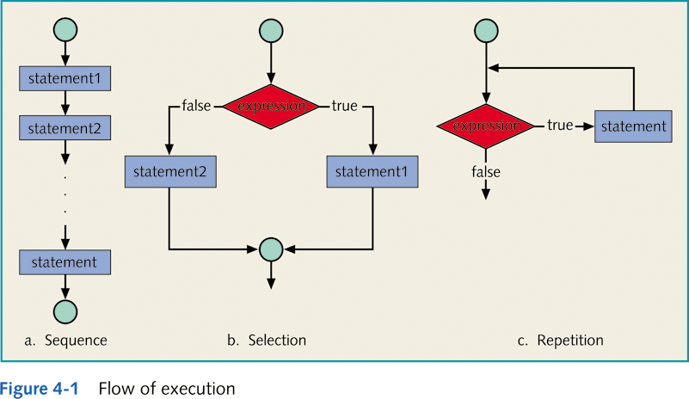
Types of Control Structures

Slide 5
Types of Control structure
The control structure of this lecture is :
Sequence structure
Selection structure
Repetition structure.

Slide 6
Selection structure
C++ provides three types of selection structures in the form of statements:
The if selection statement
either performs (selects) an action if a condition is true or skips the action if the condition is false.
The if…else selection statement
performs an action if a condition is true and performs a different action if the condition is false.
The switch selection statement
performs one of many different actions depending on the value of an expression.

Slide 7
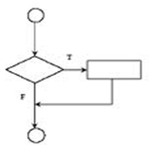
Selection structure: if
The if statement is called a single-selection statement because it selects or ignores a single action (or, as you’ll see later, a single group of actions)..
Syntax:
if (expression)
statement
Expression referred to as decision maker and it can be formed by using equality operators and relational operator.
Statement referred to as action statement.

Slide 8
Selection structure: if -Example
Write a program that reads a student’s grade and prints “passed” if the grade is greater than or equal 60.
Flowchart:
Code:
...
if ( grade >= 60 )
cout<<"Passed”;
...
Note that, these statements
Represents the selection part
Of the code (i.e. not the whole
Code)

Slide 9
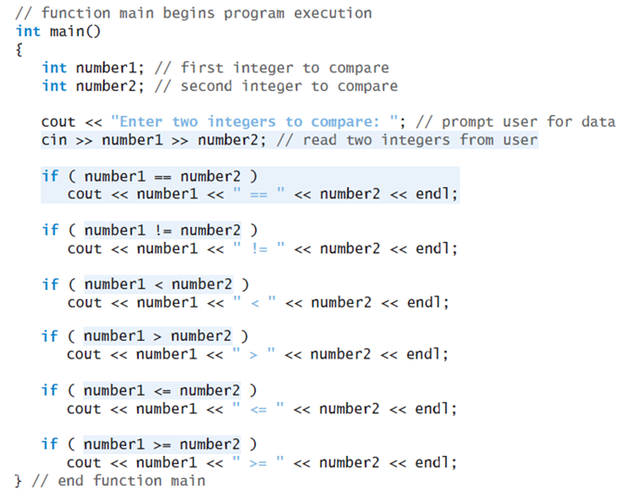

Slide 10
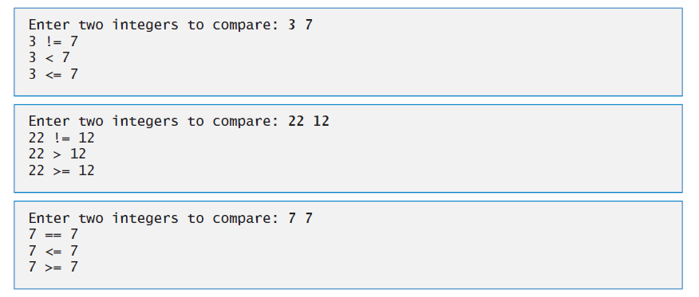
Example

Slide 11
Selection structure
Note, you should not put a semicolon after the right parenthesis of the if condition.
if( condition) ; → X

Slide 12
selection structure: if … else
The if…else statement is called a double-selection statement because it selects between two different actions (or groups of actions).
Syntax:
if (expression)
statement1
else
statement2

Slide 13
selection structure: if … else -Example
For example,
pseudocode statement
If student’s grade is greater than or equal to 60 Print “Passed” else Print “Failed”
Code:
…
if ( grade >= 60 ) cout<<"Passed"; else cout<<"Failed";
…
Flowchart

Slide 14
selection structure: if…else –Example2
Write a program that reads a number from the user and determines if it's a positive or negative number.
Code:
…
if ( number >= 0 ) cout<<" Positive\n "; else cout<<" Negative\n ";
…
Flowchart
“Positive”
Num>=0
“Negative”

Slide 15
conditional Operator (? :)
C++ provides the conditional operator (?:) which is closely related to the if…else statement.
The conditional operator is C++’s only ternary operator i.e. it takes three operands.
Syntax:
expression1 ? expression2 : expression3
The first operand is a condition.
The second operand is the value for the entire conditional expression if the condition is true
The third operand is the value for the entire conditional expression if the condition is false.

Slide 16
Conditional (? :) Operator- example1
Example:
int x = 5 , y =3 , min ;
if (x <= y)
min = x ;
else
min = y ;
The above statement can be written using the conditional operator as following:
min = ( x <= y ? x : y);

Slide 17
Conditional (? :) Operator- example2
…
if ( grade >= 60 ) cout<<"Passed"; else cout<<"Failed";
…
The above statement can be written using the conditional operator as following:
Cout << ( grade >= 60 ? “Passed” : “Failed”);
The precedence of the conditional operator is low, so the parentheses in the preceding expression are required

Slide 18
Compound (Block of) Statements
Syntax:
{
statement1
statement2
.
.
.
statementn
}

Slide 19
Compound (Block of) Statements: Example
if ( grade >= 60 ) cout<<"Passed\n"; else
{ cout<<"Failed\n" ;
cout<<“you have to take this course again\n";
}
Java Programming: From Problem Analysis to Program Design, D.S. Malik

Slide 20
Exercise
Write a program that calculates the discount, if any, on a sale. Sales of $100 and over are eligible for a 10% discount. The program should ask the user what the amount of their purchase is and calculates and displays the discount, if there is any, or else it will display a message stating that there is no discount.

Slide 21
Review of Syntax
Simple if Statement
if (condition)
statement;
Simple if-else Statement
if (condition)
statement;
else
statement;

Slide 22
Review of Syntax
Compound if Statement
if (condition)
{
Statements
}
Compound if-else Statement
if (condition)
{
Statements
}
else
{
Statements
}

