Slide 1

CT1305
Computer Network Management
RMON
Dr. Mostafa H. Dahshan
Department of Computer Engineering
College of Computer and Information Sciences
King Saud University
mdahshan@ksu.edu.sa

Slide 2
Acknowledgements
• Notes are based on slides of:
• Network Management: Principles and Practice, 2E, Mani Subramanian.
2

Slide 3
Overview
• Remote network monitoring, RMON
• RMON1: Monitoring Ethernet LAN and token-ring LAN
• RMON2: Monitoring upper protocol layers
• Generates and sends statistics close to subnetworks to central NMS
• RMON MIBs for RMON group objects
3

Slide 4
RMON
• SNMP poll operation can degrade data rate on large-scale WANs
• RMON was designed by IETF to solve this problem
• Represents an extension of network manager to distant networks
• RMON agents (probes)
• intelligent devices that monitor data flowing into remote network
• organize data traffic occurring on distant network
• reduce info required to be transmitted to mgmt. station for analysis
• Uses SMNP as transport mechanism between manager and agent
4

Slide 5
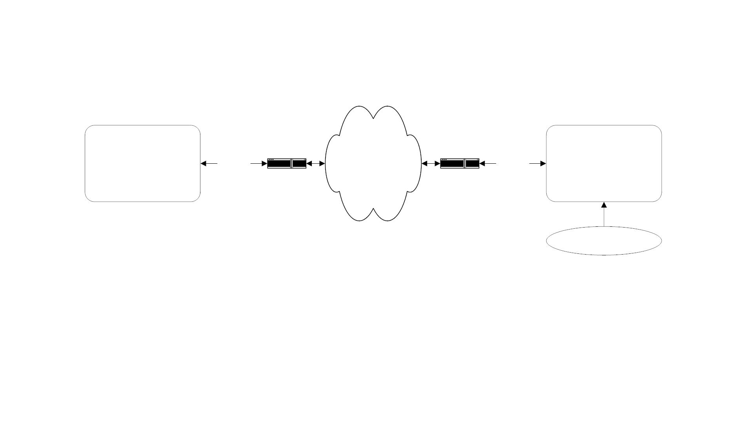
RMON Components
Data
Analyzer
SNMP
Traffic
BACKBONE
NETWORK
SNMP
Traffic
RMON
Probe
Router
Router
LAN
• RMON Probe
• Data gatherer - a physical device
• Data analyzer
• Processor that analyzes data
5

Slide 6
RMON Components
• RMON probe includes an MIB defines attributes of monitored objects
• RMON MIB is specified in RFC 2819
• Actual value and use of information depends on manager application
• RMON delivers information in nine groups of monitoring elements
• Some applications support full areas and tasks (groups)
• Some applications support only a subset of them
6

Slide 7
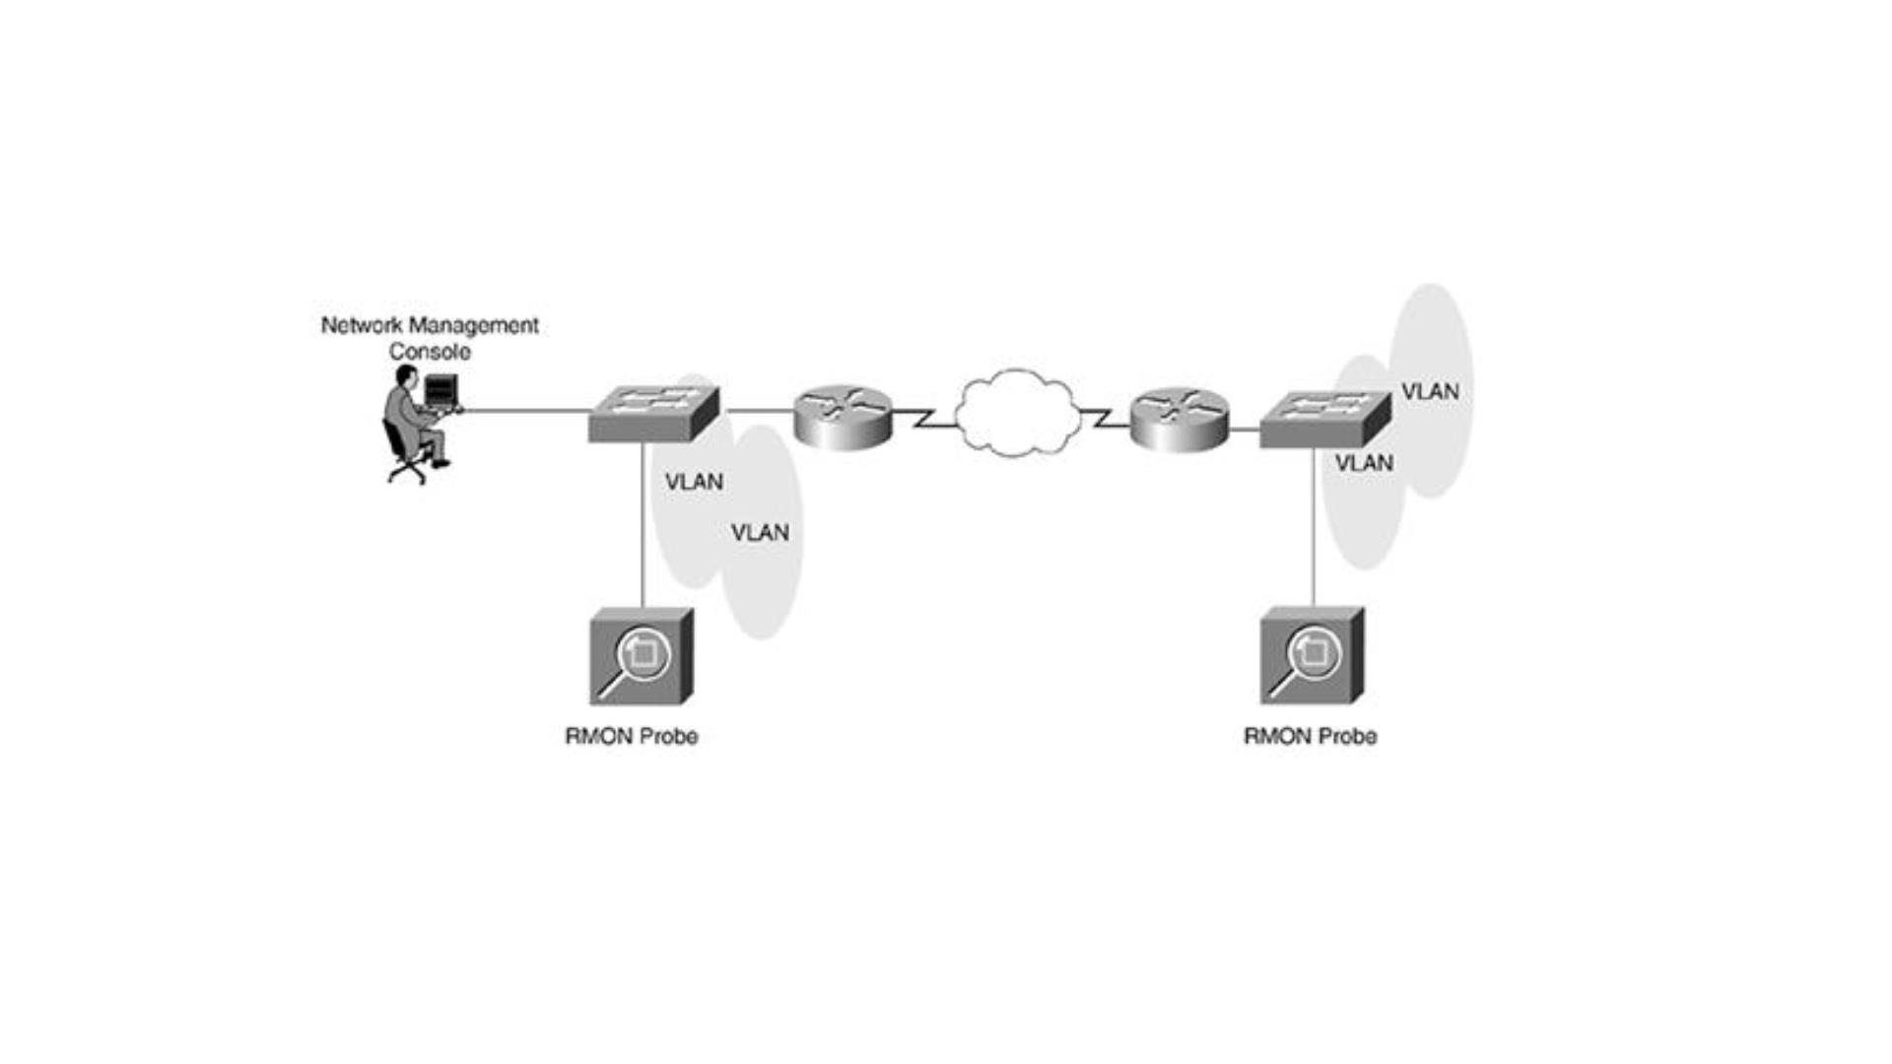
Network with RMONs
7

Slide 8
RMON Benefits
• Monitors and analyzes locally and relays data
• Less load on the network
• Needs no direct visibility by NMS
• More reliable information
• Permits monitoring on a more frequent basis
• faster fault diagnosis
• Increases productivity for administrators
8

Slide 9
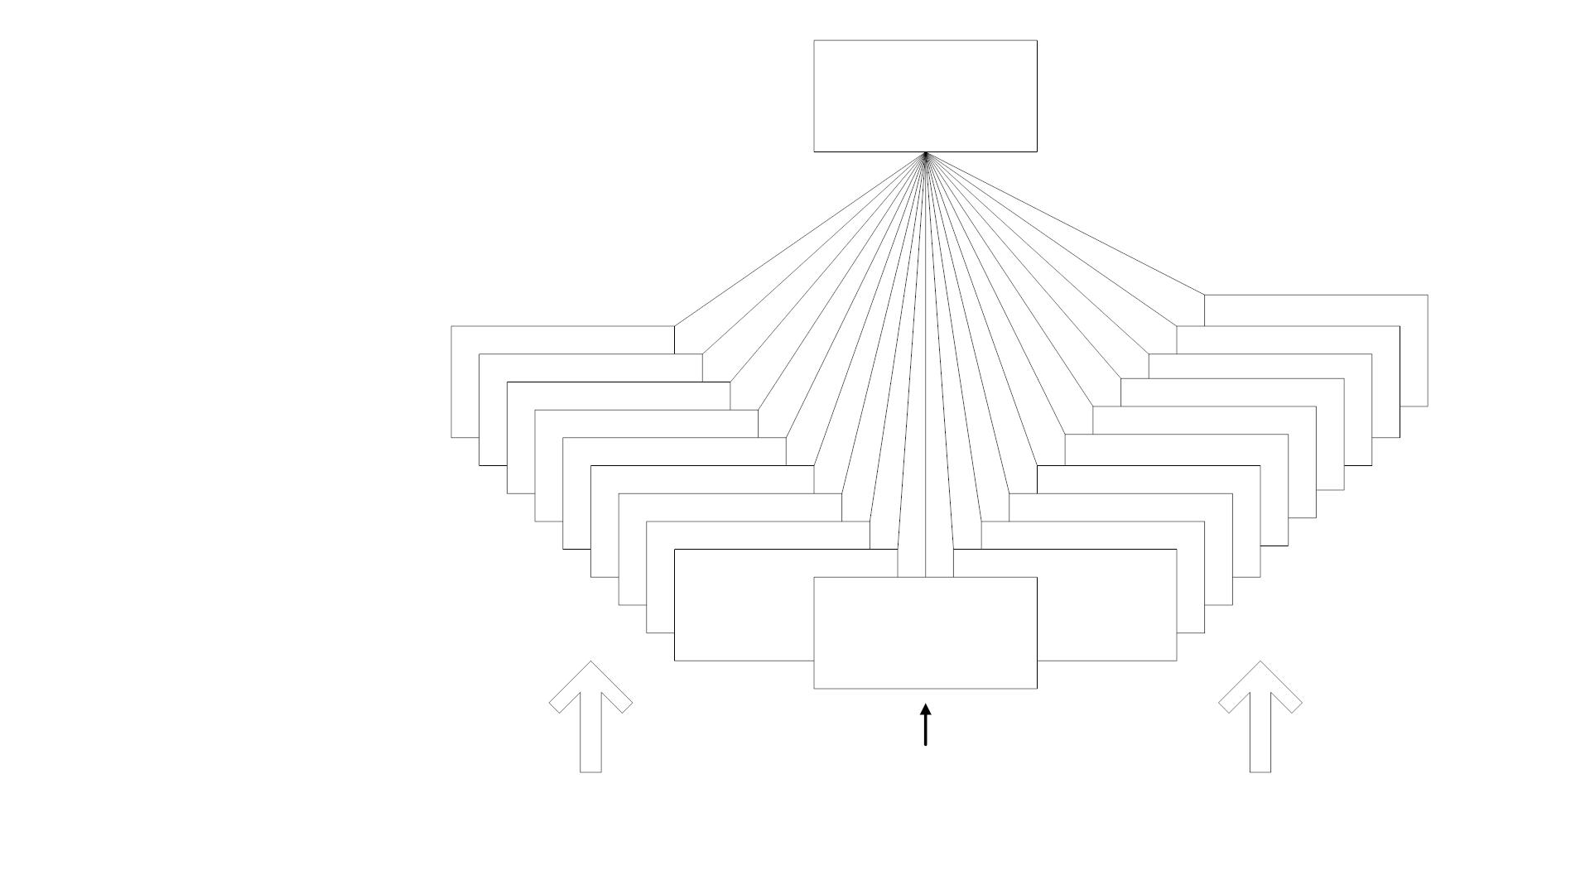
RMON MIB
rmon (mib-2 16)
rmonConformance (20)
probeConfig (19)
statistics (1)
history (2)
usrHistory (18)
alMatrix (17)
alarm (3)
host (4)
hostTopN (5)
alHost (16)
nlMatrix (15)
nlHost (14)
addressMap (13)
matrix (6)
filter (7)
capture (8)
event (9)
protocolDist (12)
protocolDir (11)
tokenRing (10)
RMON1 Extension
RMON1: Ethernet RMON groups (rmon 1 - rmon 9)
RMON1: Extension: Token ring extension (rmon 10)
RMON2: Higher layers (3-7) groups (rmon 11 - rmon 20)
Figure 8.2 RMON Group
9

Slide 10

RMON1 MIB Groups and Tables
Group
OID
Function
Statistics
History
Alarm
rmon 1
rmon 2
rmon 3
Link level statistics
Periodic statistical data collection and storage for later retrieval
Generates events when the data sample gathered crosses pre-
established thresholds
Host
HostTopN
rmon 4
rmon 5
Gathers statistical data on hosts
Computes the top N hosts on the respective categories of statistics
gathered
Matrix
Filter
rmon 6
rmon 7
Statistics on traffic between pair of hosts
Filter function that enables capture of desired parameters
Packet Capture rmon 8
Packet capture capability to gather packets after they flow through a
channel
Event
rmon 9
Controls the generation of events and notifications
Token Ring
rmon 10
See Table 8.3
10

Slide 11
RMON1 MIB Groups and Tables
• Ten groups divided into three categories
• Statistics groups (rmon 1, 2, 4, 5, 6, and 10)
• Event reporting groups (rmon 3 and 9)
• Filter and packet capture groups(rmon 7 and 8)
• Groups with “2” in the name are enhancements with RMON2
11

Slide 12

Row Creation and Deletion
Table 8.1 EntryStatus Textual Convention
Description
State
Enumeration
valid
1
2
3
4
Row exists and is active. It is fully configured and operational
Create a new row by creating this object
Row is not fully active
createRequest
underCreation
invalid
Delete the row by disassociating the mapping of this entry
• EntryStatus data type introduced in RMON
• EntryStatus used to create and delete conceptual row
12

Slide 13
RMON2
• Adds support for layers above Media Access Control (MAC)
• Ability to measure network and application statistics
• Additional 10 MIB groups
13

Slide 14

RMON2 Groups
Group
protocolDir
OID
rmon 11
Function
Inventory of protocols
protocolDist
addressMap
nlHost
nlMatrix
alHost
rmon 12
rmon 13
rmon 14
rmon 15
rmon 16
rmon 17
rmon 18
rmon 19
rmon 20
Relative statistics on octets and packets
MAC address to network address on the interfaces
Traffic data from and to each host
Traffic data from each pair of hosts
Traffic data by protocol from and to each host
Traffic data by protocol between pairs of hosts
User-specified historical data on alarms and statistics
Configuration of probe parameters
alMatrix
usrHistory
probeConfig
rmonConformance
RMON2 MIB Compliances and Compliance Groups
14

Slide 15
Case Study
• A study at Georgia Tech on Internet traffic
• Objectives
• Traffic growth and trend
• Traffic patterns
• Network comprising Ethernet and FDDI LANs
• Tools used
• HP Netmetrix protocol analyzer
• Special high-speed TCP dump tool for FDDI LAN
• RMON groups utilized
• Host top-n
• Matrix group
• Filter group
• Packet capture group (for application level protocols)
15

Slide 16
Case Study Results
Growth Rate
• Internet traffic grew at a significant rate from February to June
• A monthly rate of 9% to 18%
• February to March 12%
• March to April 9%
• April to May 18%
• Note: There is sudden drop in June due to end of spring quarter and
summer quarter starting
16

Slide 17
Case Study Results
Traffic Pattern
• Monthly / Weekly: Only noticeable variation is lower traffic over weekends
• Daily: 2/3 of the top 5% peaks occur in the afternoons
• Users: Top six domain of users (96%) are
• Domain 1
• Domain 2
20%
30%
25%
5%
• Subdomain 1
• Subdomain 2
• Domain 3
34%
• Domain 4
• Domain 5
• Domain 6
7%
3%
2%
17

Slide 18
Case Study Results
What we have learned
• The three top groups of users contributing to 84% of the Internet
traffic are students (surprise!), Newsgroup services, and Domain 1
• Growth rate of Internet during the study period in spring quarter is
50%
18

Slide 19
References
• James Kurose and Keith Ross, Computer Networking, a top-down
approach, Pearson, 6E, 2013, Chapter 9.
• SNMP Technical Reference, Microsoft TechNet.
• Simple Network Management Protocol, Cisco Unified Communications
Manager Managed Services Guide, Chapter 4.
• William Stallings, Data and Computer Communications, Pearson, 8E, 2010,
Chapter 22.
• SNMP - IT Strategic Template Document Solutions.
• Remote Monitoring (RMON), Internetworking Technologies Handbook 2E,
Cisco Press, 2001.
• Benoit Claise and Ralf Wolteris, Network Management: Accounting and
Performance Strategies, 1E, Cisco Press, 2007, Chapter 5.
19

