Slide 1
KINGDOOM OF SAUDI ARABIA
King Saud University
College of Sciences - Department Botany & Microbiology
Plant Physiology
BIO 323
Dr. Abdulrahman Al-hashimi

Slide 2
Lecture 7
Translocation in the Phloem
1- Pathways of translocation
2- Materials translocated
3- Patterns of translocation
4- Rates of movement
5- Phloem loading and unloading

Slide 3
Introduction
The vascular bundle is a strand of specialized vascular tissue of vascular plants consisting mostly of xylem and phloem.
The phloem is the tissue that transports the products of photosynthesis (carbohydrates) from mature leaves to areas of growth and storage, including the roots.
This transport process is called translocation.
Monocots and dicots differ in the arrangement of their vascular bundles in the stem and roots.

Slide 4
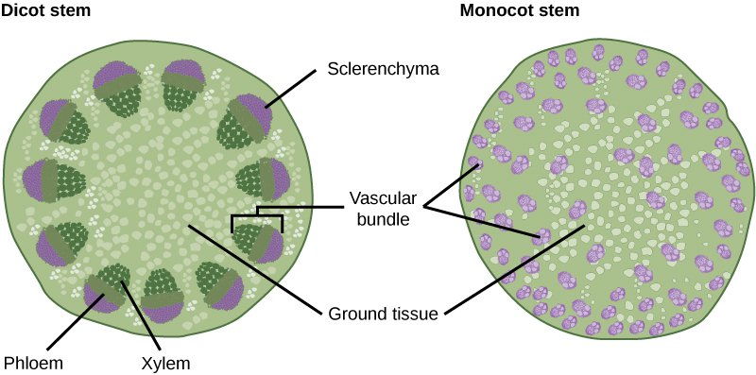
Introduction
Monocots : scattered vascular bundles.
Dicots : the vascular bundles are arranged in a ring.

Slide 5
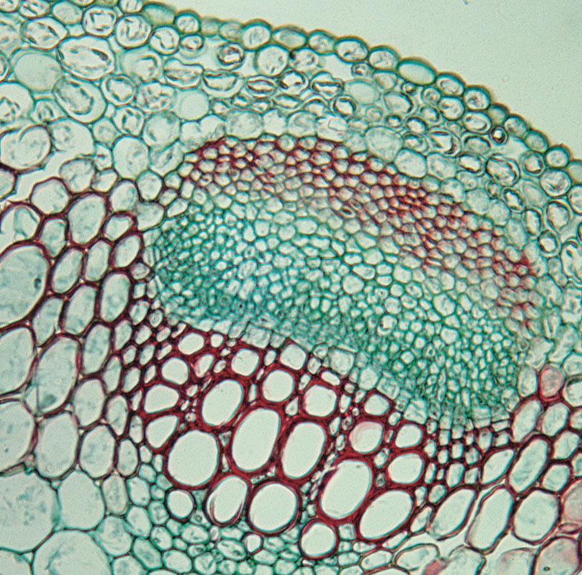
Phloem Structure
The phloem is generally found on the outer side of both primary and secondary vascular tissues. In plants with secondary growth the phloem constitutes the inner bark.
Phloem
Xylem

Slide 6
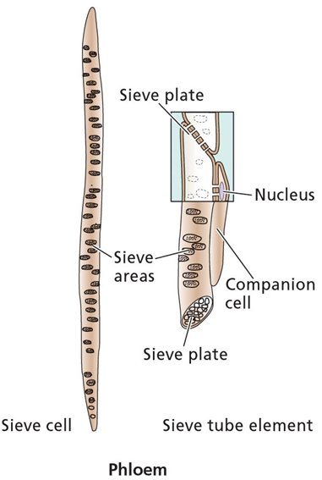
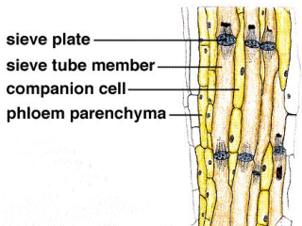
Phloem Structure
The phloem tissue contains :
1- Sieve elements
2- Companion cells
3- parenchyma cells

Slide 7
Pathways of translocation
Sieve elements :
- Cells called “sieve tube elements”
join to form a continuous tube.
- Sieve tubes connect leaves,
shoots and roots.
- Sieve tube elements contain ;
many plasmodesmata ,
little cytoplasm,
no nuclei, vacuole, Golgi,
Ribosomes, or microtubules.
External view Longitudinal section

Slide 8
Pathways of translocation
Sieve elements :
- Components are translocated
from one element to another
via perforations (sieve plates).
- Pores in sieve plate between
sieve tube elements are
open channels for transport.
- each sieve tube element is
associated with one or more
companion cells.
External view Longitudinal section

Slide 9
Pathways of translocation
Companion cells :
- Transport photosynthesis
products from producing
cells in mature leaves to sieve
plates of the small vein of
the leaf through plasmodesmata.
- Synthesize various proteins
used in the phloem.
- Contain many mitochondria
to provide the cellular energy
required for active transport.
External view Longitudinal section

Slide 10
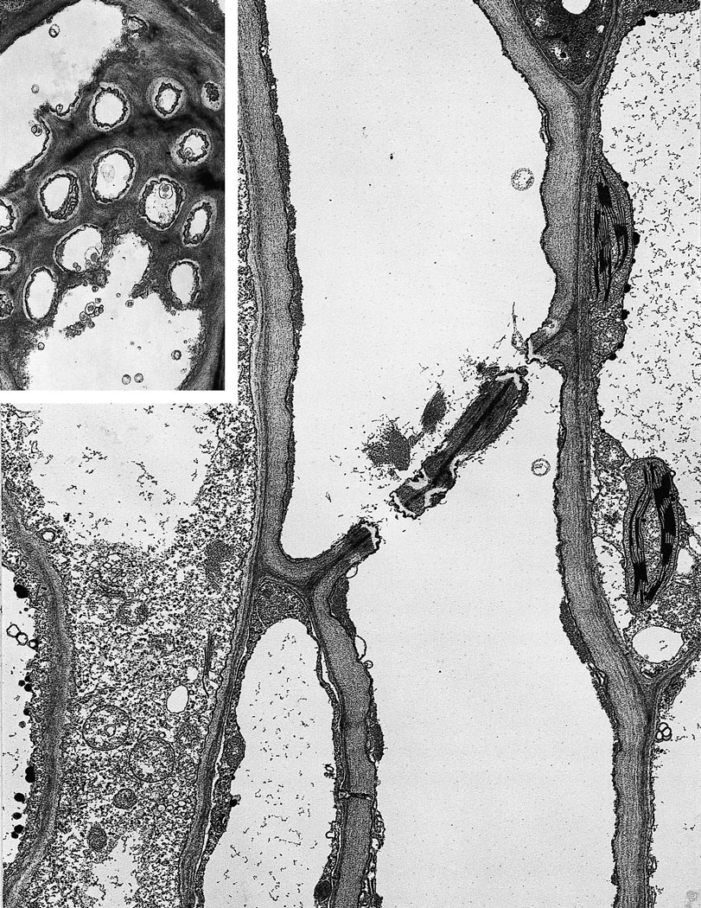
Pathways of translocation
Sieve elements and open sieve plate pores
(A) face view (B) longitudinal section
Sieve tube
element
Cell wall between
sieve elements
Parenchyma
cell
Sieve tube
element
Sieve plate pores
Companion cell

Slide 11
Pathways of translocation
Sieve elements and open sieve plate pores
Nucleus
Companion cell
Sieve tube element
Sieve plate
Sieve plate pore
Longitudinal section

Slide 12
Materials translocated
What is transported in phloem ?
Water is the most abundant substance transported in the phloem.
Dissolved in the water are the translocated solutes, mainly carbohydrates.
Sucrose is the sugar most commonly transported in sieve elements.
Other materials that are translocated in the phloem are;
Proteins, Amino acids, Hormones and some inorganic ions.

Slide 13
Materials translocated
What is transported in phloem ?
Proteins found in the phloem include filamentous proteins (which are involved in the sealing of wounded sieve elements), protein kinases (protein phosphorylation), thioredoxin (disulfide reduction), ubiquitin (protein turnover), chaperones (protein folding), and protease Inhibitors (protection of phloem proteins from degradation and defense against phloem-feeding insects).

Slide 14
Materials translocated
What is transported in phloem ?
Amino acids and amides include glutamate, aspartate, glutamine and asparagine.
Plant hormones include auxin, gibberellins, cytokinins, and abscisic acid.
Inorganic solutes that move in the phloem include potassium, magnesium, phosphate, chloride.
In contrast, nitrate, calcium, sulfur, and iron are relatively immobile in the phloem.

Slide 15
Materials translocated
What is transported in phloem ?

Slide 16
Sugars that are not generally translocated in the phloem
Materials translocated
Carbohydrates translocated in phloem are all nonreducing sugars, such as sucrose.
This is because they are less reactive.
Reducing sugars, such as Glucose, Mannose and Fructose, contain an exposed aldehyde or ketone group, are not generally translocated in the phloem.
because they are too chemically reactive.

Slide 17
Materials translocated

Slide 18
Materials translocated

Slide 19
Materials translocated
The most common transported sugar is sucrose.
Made up from glucose and Fructose ,
It is a reducing sugar ,
The ketone or aldehyde group is combined with a similar group on another sugar ,
Or the ketone or aldehyde group is reduced to an alcohol.
Many of the other mobile carbohydrates contain sucrose bound to varying numbers of galactose molecules.
Translocated sugar alcohols include mannitol and sorbitol.

Slide 20
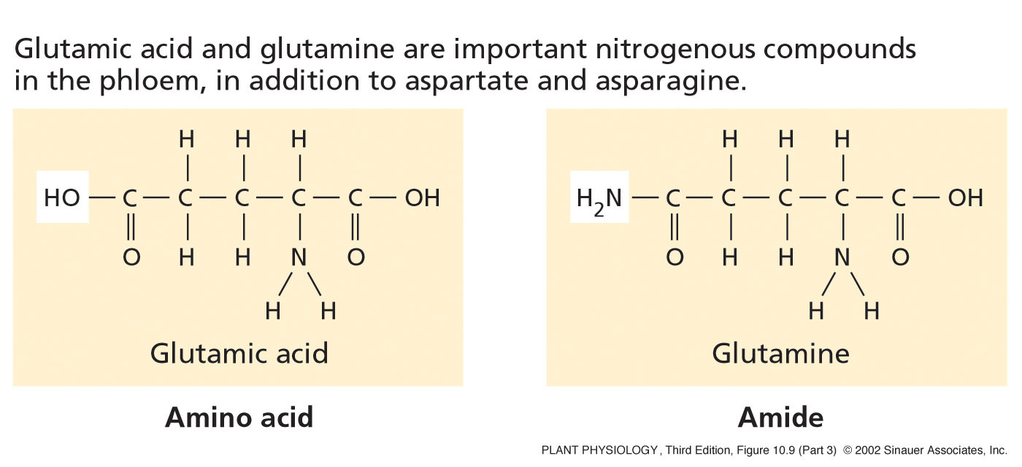
Materials translocated
Nitrogen is found in the phloem mainly in :
Amino acids (Glutamic acid).
Amides (Glutamine).

Slide 21
Patterns of translocation: Source to Sink
Sap in the phloem is translocated from areas of supply, called Sources, to areas of metabolism or storage, called Sinks.
Sources include any exporting organs, typically mature leaves, that are capable of producing photosynthate (products of photosynthesis ) in excess of their own needs.
Another type of source is a storage organ during the exporting phase of its development. For example, the storage root of the biennial wild beet (Beta maritima).

Slide 22
Patterns of translocation: Source to Sink
Sinks include any nonphotosynthetic organs of the plant and organs that do not produce enough photosynthetic products to support their own growth or storage needs.
Roots, tubers, developing fruits, and immature leaves, which must import carbohydrate for normal development, are all examples of sink tissues.
All the studies support that, the source-to-sink is the pattern of translocation in the phloem.

Slide 23
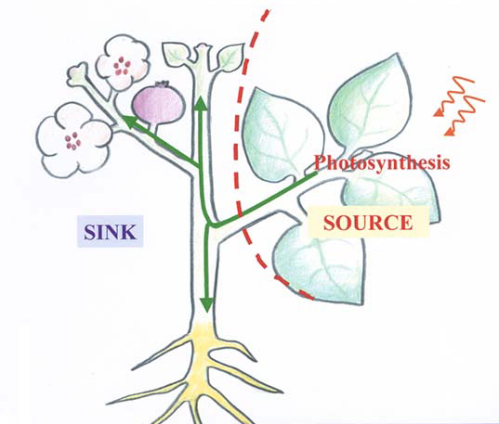
Patterns of translocation: Source to Sink
Phloem translocates sugars from a “source” to a “sink”
Source:
Any exporting region that produces sugars above its own needs.
(usually mature leaves)
Sink:
Any area that does not produce enough sugars to meet its own needs.
(roots, immature leaves)

Slide 24
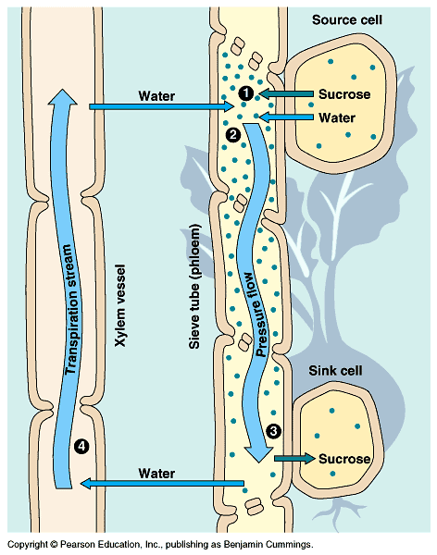
Mechanism of translocation
In source tissue :
Phloem loading: Active transport (using ATP energy) of sugars from photosynthetic cells into companion cells and sieve elements.
Phloem loading leads to more sugars (the phloem cells become hypertonic),
In response, the water flows from the xylem into sieve elements by osmosis.
Thus, phloem turgor pressure increases.

Slide 25
Mechanism of translocation
In sink tissue :
Phloem unloading: active transport of sugars from sieve elements to sink cells, leads to lower sugar concentration in the phloem (phloem cells become hypotonic).
Water leaves the phloem and enters the sink sieve elements and the xylem (by osmosis).
Thus, phloem turgor pressure decreases.

Slide 26
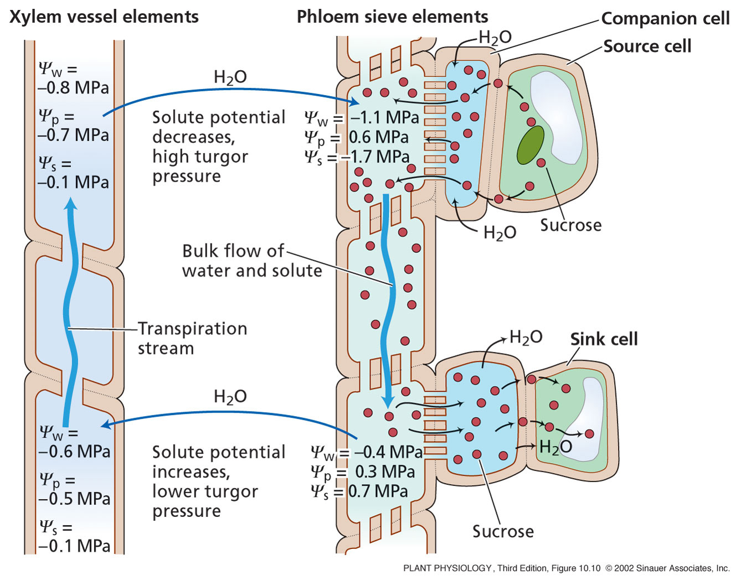
The Pressure-Flow Model
Phloem translocation is driven by a gradient of pressure generated by the differences in solute concentration between source and sink.

Slide 27
Rates of movement
Rate of translocation:
The rate of movement of materials in the sieve elements can
be expressed in two ways :
The velocity, the linear distance traveled per unit time.
The mass transfer rate, the quantity of material passing through a given cross section of phloem or sieve elements per unit time.
Both velocities and mass transfer rates can be measured with radioactive tracers.

Slide 28
Phloem loading
From Chloroplasts to sieve elements
The movement of sucrose from the mesophyll chloroplasts to the sieve elements of mature leaves include several steps ;
Mesophyll cells

Slide 29
Phloem loading
From Chloroplasts to sieve elements
At mesophyll cells :
Triose phosphate, formed from photosynthesis during the day is moved from chloroplast to cytosol.
At night, Triose phosphate is converted to sucrose.

Slide 30
Phloem loading
From Chloroplasts to sieve elements
Sucrose then moves from the mesophyll cell to near the sieve elements in the smallest veins of the leaf.
known as short-distance transport pathway – usually covers a distance of only two or three cells.

Slide 31
Phloem loading
From Chloroplasts to sieve elements
Sieve element loading :
Sugars are translocated into the sieve elements and companion cells. Sugars become more concentrated in sieve elements and companion cells than in mesophyll cells.

Slide 32
Phloem loading
From Chloroplasts to sieve elements
Once inside sieve elements, sucrose and other solutes are translocated away from the source (export),
the translocation through the vascular system to the sink is known as long-distance transport.

Slide 33
Phloem loading
From Chloroplasts to sieve elements
Photosynthates (photosynthesis products) can move from mesophyll cells to sieve elements by either apoplast or symplast pathway.
Active transport , requires energy,
the energy dissipated by protons (H⁺) moving back into the cell is coupled to the uptake of sucrose

Slide 34
Phloem loading
Symplast pathway
Requires the presence of open plasmodesmata between different cells in the pathway, depends on plant species that transport sugars other than sucrose.

Slide 35
Phloem loading
Symplast pathway
Sucrose, synthesized in mesophyll, diffuses into intermediary cells, here Raffinose is synthesized. Due to larger size, Raffinose can NOT diffuse back into the mesophyll. While, Raffinose and sucrose are able to diffuse into sieve element.

Slide 36
Phloem unloading
Translocation of sugars from sink sieve elements to sink cells include three steps :
Sieve element unloading: transported sugars leave the sieve elements of sink tissue.
Short distance transport: after sieve element unloading, sugars transported to the cells in the sink by the short distance pathway.
Storage and metabolism: sugars are stored or metabolized in sink cells.

Slide 37
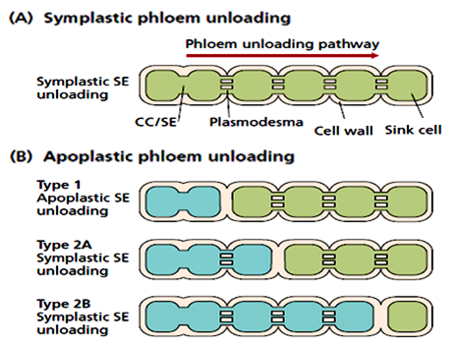
Phloem unloading
Phloem unloading can occur by symplast or apoplast pathway.
(A) Symplastic phloem unloading.
(B) Three types of apoplastic unloading.
Type 1: one step apoplastic pathway, transport from sieve element–companion cell complex to successive sink cells.
Type 2: The apoplastic step occurs later in the pathway.
CC/SE means the sieve element–companion cell complex. The presence of plasmodesmata is assumed to provide functional symplastic continuity. An absence of plasmodesmata between cells indicates an apoplastic transport step.

Slide 38
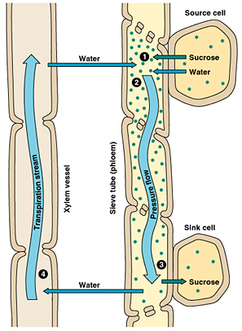
General diagram of translocation
Loading sucrose from source into the phloem
Pressure-flow
Phloem and xylem are coupled in an osmotic system that transports sucrose and circulates water.
unloading sucrose from the phloem into the sink

Slide 39
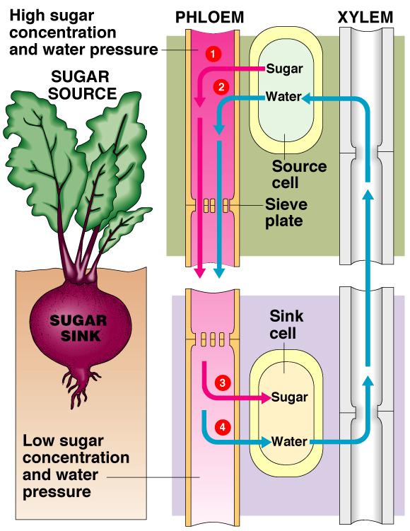
Pressure flow schematic
Build-up of pressure at the source and release of pressure at the sink causes source-to-sink flow.
At the source phloem loading causes high solute concentrations.
So water flows into the cells increasing hydrostatic pressure.
At the sink, solute concentrations is lower outside the cell due to sucrose unloading.
Osmotic loss of water releases hydrostatic pressure, Xylem vessels recycle water from the sink to the source.

Slide 40
Protective mechanisms in phloem
Sieve elements are under high internal turgor pressure.
When they are damaged, the release of pressure causes the contents of sieve elements to surge towards the damage site.
Damaged is caused by ;
Insects feeding on sugars.
Wind damage.
Temperature (hot and cold).
Pollution causing a change in light wavelength.

Slide 41
Protective mechanisms in phloem
Many plant species react to sieve elements damage by synthesizing components as protective mechanism including ;
P proteins :
- can be in many forms (tubular, fibrillar, chrystaline),
depends on plant species and age of cell.
- These proteins seal off damaged sieve elements
by plugging up the sieve plate pores.
- P-protein was called slime.
- This type is Short term solution.

Slide 42
Protective mechanisms in phloem
Many plant species react to sieve elements damage by synthesizing components as protective mechanism including ;
Callose (β-1,3-glucan) : a type of plant polysaccharide.
- Callose is synthesized in functioning sieve elements
in response to damage by an enzyme in the plasma
membrane and is deposited between the plasma
membrane and the cell wall.
- It seals off damaged sieve elements.
- This type is Long term solution.

Slide 43
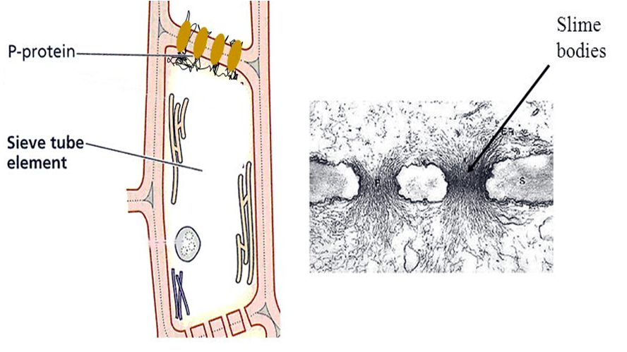
Protective mechanisms in phloem
P-protein bodies (slime bodies)

Slide 44
Any
QUESTIONS ?

