Slide 1
Chapter 2 part #4 Operator
King Saud University
College of Applied studies and Community Service
Csc 1101
By: Asma Alosaimi
Edited By: Ghadah R. Hadba
2nd semester 1432 -1433

Slide 2
Operators
Operators are special symbols used for:
arithmetic calculations
assignment statements
logical comparisons
Examples of operators:
3 + 5 // uses + operator
14 + 5 – 4 * (5 – 3) // uses +, -, * operators
Expressions: can be combinations of variables and operators that result in a value

Slide 3
C++ Operators
In C++, there are 5 different groups of operators:
Arithmetic Operators
Assignment Operator
Increment / Decrement Operators
Relational Operators
Logical Operators

Slide 4
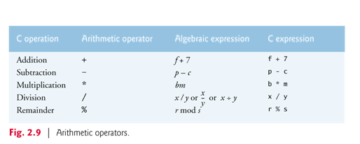
C++ Operators: Arithmetic Operators

Slide 5
C++ Operators: Arithmetic Operators
The arithmetic operators in Fig. 2.9 are all binary operators, i.e. operators that take two operands
Each operand can be either a literal , a variable identifier , or an expression.
It is better for the two operands to be of the same data type, otherwise:
The compiler will perform implicit casting (with literal values) and/or,
Explicit casting need to be specified (with variables)
Note the use of various special symbols not used in algebra.( e.g. * and %)

Slide 6
Writing Mathematical Formulas in C
Always specify multiplication explicitly by using the operator *
where needed.
Example: b² - 4 a c =
b * b - 4 * a * c
Use parentheses when required to control the order of operator
evaluation.
Example: a + b =
c + d
( a + b ) / ( c + d )
Two arithmetic operators can be written in succession if the second
is a unary operator
Example: a x - ( b + c )=
a * - ( b + c )

Slide 7
Writing Mathematical Formulas in C++ (Examples)
a + b - c
= a + b - c
1
1 + a²
= 1 / ( 1 + a * a)
a x (5b + c)
= a * ( 5 * b + c )

Slide 8
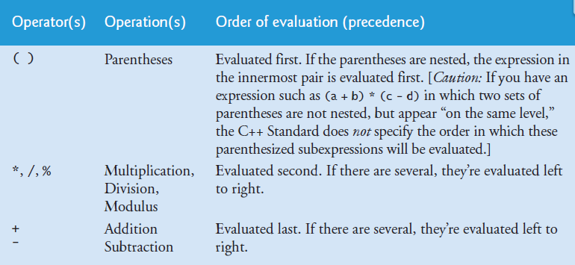
C++ Operators: Arithmetic Operators

Slide 9
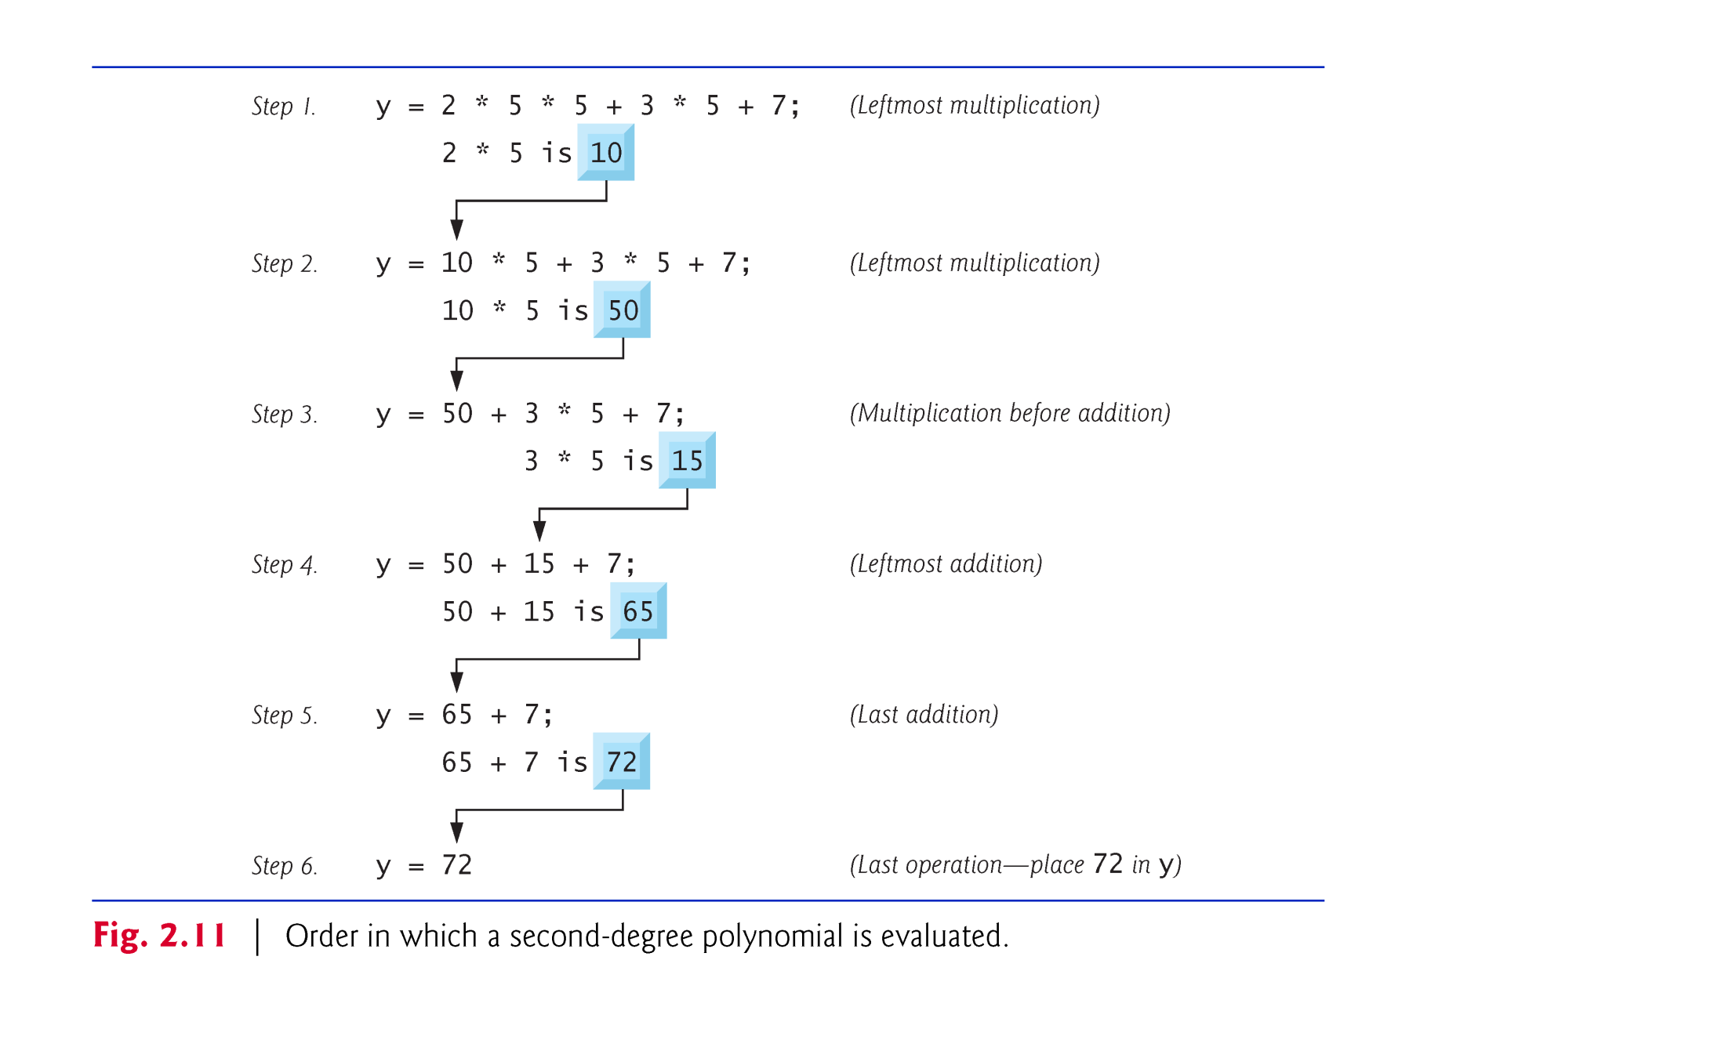
Operators Precedence - Example

Slide 10
Parentheses
The value of the expression
x + y * z * z
is always the same as the value of
x + ((y * z) * z)

Slide 11
Rules for Expression Evaluation (Examples)
z - ( a + b / 2 ) + w * - y
( b * b ) - ( 4 * 4 ) * ( a * c )
A * - ( b + c )

Slide 12
Division Example
Example of division issues:
10 / 3 gives 3
10.0 / 3 gives 3.33333
As we can see,
if we divide two integers we get an integer result.
if one or both operands is a floating-point value we get a floating-point result.
If the operands are from different data type, especially dividing floating-point number by an integer or vice a versa the result will be a floating-point number

Slide 13
Modulus Example
Generates the remainder when you divide two integer values.
5%3 gives 2 5%4 gives 1
5%5 gives 0 5%10 gives 5
Modulus operator is most commonly used with integer operands. If we attempt to use the modulus operator on floating-point values we will garbage! (compileerror)

Slide 14
C++ Operators: Arithmetic Operators
Implicit casting:
is an automatic type conversion by the compiler.
If operands of mixed types are used, the compiler will convert one operand to agree with the other. To do this, it uses a hierarchy of data types:
Long double (highest)
Double
Float
Unsigned long int
Long int
Unsigned int
Int (lowest)
boolean, character, wide character, enumeration, and short integer data types are promoted to int

Slide 15
C++ Operators: Arithmetic Operators
Implicit casting:
Example(1): 5+23.67 The compiler will converts 5 to floating point number because it’s higher than int in the data type hierarchy
Example(2):
short a=2000; int b;
b=a; the value of a has been promoted from short to int
Example(3):
bool f=true; int a;
a=f;
cout<< a<<endl;

Slide 16
C++ Operators: Assignment Operator
We assign a value to a variable using the basic assignment operator (=).
Assignment operator:
Stores a value in a memory.
Basically used in C++ to initialize a variable with a value OR to update it’s content with a new value
It’s syntax is as following
leftSide = rightSide ;
It is always a variable identifier.
It is either a literal , a variable identifier , or an expression.

Slide 17
Mixed Data Types in an Assignment Statement
The variable to the left of the equals sign determines the data types
of an expression.
If both operands of an expression are integer→ then the data type of such an expression will be integer.
If both operands of an expression are double→ then the data type of such an expression will be double.
An expression that has operands of both type integer and double is a mixed-type expression. The data type of such a mixed-type expression → will be double.

Slide 18
Mixed Data Types in an Assignment Statement
Example: if x is int and y is double then
x = 7 * 0.5;
3
y = 7 * 0.5;
3.50
x = 100/5;
20
y = 100/5;
20.00

Slide 19
C++ Operators:
Explicit casting:
Performed by placing (data type) prior the intended variable|value|expression
Example(1):
short a=2000; int b; b = (int) a;
Example(2):
int value1 = 10, value2 = 4;
float result = (float) (value1 / value2);
OR
result= (float) value1/(float) value2; are they the same?

Slide 20
C++ Operators:
Type Cast Explicit casting:
converting an expression to a different type by writing the desired type
in parentheses in front of the expression or the variable.
Example:
Rounding a number
double x;
int rounded_x
/* code to give x a value omitted*/
rounded_x = (int) (x + 0.5);
35.51 is rounded to 36 | 35.12 is rounded to 35
35.51 +0.50 36.01 | 35.12 +0.50 35.62

Slide 21
Compound Assignment Operators
When we want to modify the value of a variable by performing an operation on the value currently stored in that variable we can use compound assignment operators
C++ allows combining arithmetic and assignment operators into a single operator as following:
Addition/assignment +=
Subtraction/assignment −=
Multiplication/assignment ∗=
Division/assignment /=
Remainder/assignment %=

Slide 22
Compound Assignment Operators
The syntax is
leftSide Op= rightSide ;
This is equivalent to:
leftSide = leftSide Op rightSide ;
Example
X+=1 ⇔ x=x+1;
x%=5; ⇔ x = x % 5;
x*=y+w*z; ⇔ x = x*(y+w*z);
It is either a literal , a variable identifier , or an expression.
Allways it is a variable identifier.
It is an arithmetic operator.

Slide 23
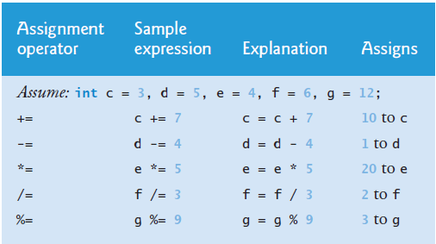
Compound Assignment Operators

Slide 24
C++ Operators: Increment/Decrement Operators
++ and − − are a unary operators that can be applied to variables and increments/decrements the value they hold
x++/++x; is equivalent to x = x+1;
x--/--x; is equivalent to x = x-1;

Slide 25
C++ Operators: Increment/Decrement Operators
Placing the increment/ decrement operator before the
variable name differ from placing it after as following:

Slide 26
C++ Operators: Increment/Decrement Operators
Placing the increment/ decrement operator before the
variable name differ from placing it after as following (Example):

Slide 27
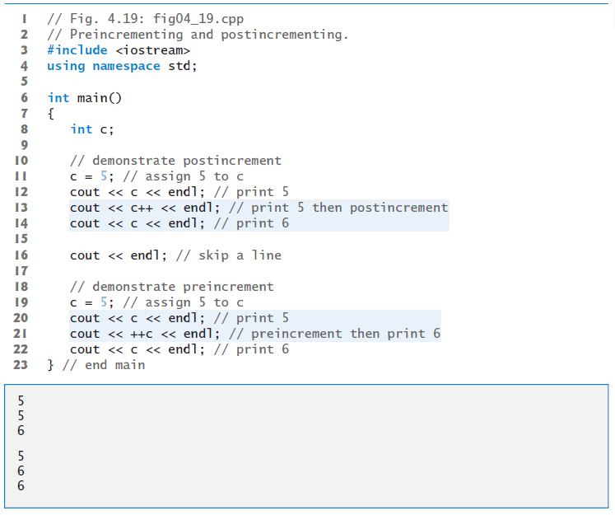

Slide 28
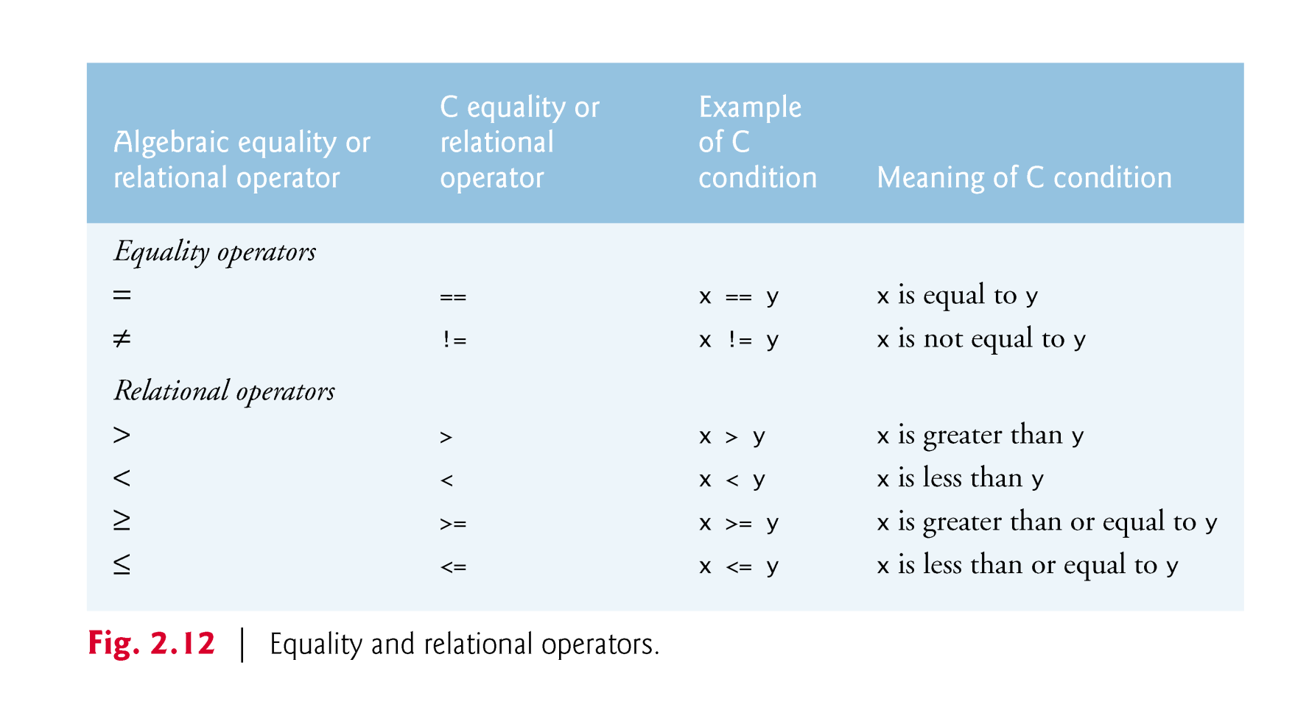
C++ Operators: Equality and Relational Operators

Slide 29
C++ Operators: Equality and Relational Operators
In order to evaluate a comparison between two expressions we can use the relational and equality operators
The relational and equality operators operators in Fig. 2.12 are all binary operators, i.e. operators that take two operands
Each operand can be either a literal , a variable identifier , or an expression.
The result of a equality and relational operations is a Boolean value that can only be true or false, according to its Boolean result.

Slide 30
Example
Of course, instead of using only numeric constants, we can use any valid expression, including variables. Suppose that a=2,b=3 and c=6

Slide 31
Common Programming Errors
A syntax error will occur if the operators ==, !=, >= and <= appears with space(s) between its pair of symbols
A syntax error will occur when reversing the order of the pair of symbols!=, >= and <= (i.e. by writing them as =!, =>, =< respectively)
Confusing the equality operator == with the assignment operator

Slide 32
C++ Operators: Logical Operators
Symbol | Operator
! | NOT
&& | AND
|| | OR
! | T | F
 | F | T
&& | T | F
T | T | F
F | F | F
|| | T | F
T | T | T
F | T | F

Slide 33
C++ Operators: Logical Operators
The Operator ! is an operator to perform the Boolean operation NOT
it has only one operand located at its
Basically, it returns the opposite Boolean value of evaluating its operand
Example:
!(5 == 5) // evaluates to false because the expression at its right (5 == 5) is true.
!(6 <= 4) // evaluates to true because (6 <= 4) would be false.

Slide 34
C++ Operators: Logical Operators
The logical operators && and || are:
binary operators
used when evaluating two expressions to obtain a single relational result.
The operator && corresponds with Boolean logical operation AND.
The operator || corresponds with Boolean logical operation OR.
Example:

Slide 35
Convert Text to C++ code
English language: x less than or equal to 0
C++ language: (x<=0)
English language: grade not equal to 'A'
C++ language: (grade != 'A‘)
English language: an exam score of 90 and above or quiz score of 95 and above
C++ language: (exam>=90) || (quiz>=95)
English language: a single man whose 55 years old or older
C++ language ((status=='s‘)&&(gender=='m‘) )&&(age>=55))

Slide 36
Operator Precedence
Consider the following expression:
x=y*5+y*2/4;
Which operator the compiler will perform first?!
IN C++, order of operations (sometimes called operator precedence) is a rule used to clarify unambiguously which procedures should be performed first in a given
Note that parentheses () can be used to enforce a desired order for performing operations
x=y*5+y; x=y*(5+y);
1
2
2
1

Slide 37
Figure A.1 show the decreasing order of precedence from top to bottom
Associatively | Type | Operator | Precedence
Left-to-right | Parentheses | () | 1
Right-to-left | Prefix increment and decrement | ++, -- | 2
 | Unary minus | -
 | Logical NOT | !
Right-to-left | Type case | (type) | 3
Left-to-right | Multiplication, division, and module | * , / , % | 4
Left-to-right | Addition and subtraction | +,- | 5
Left-to-right |  | <<, >> | 6
Left-to-right | Relational operators | <, <=,>,>= | 7
Left-to-right | Equality operators | ==, != | 8
Left-to-right | Logical AND | && | 9
Left-to-right | Logical OR | || | 10
Right-to-left |  | +=,-=,*=/=,%= | 11
Left-to-right | Postfix increment and decrement | ++, -- | 12

