Slide 1

NET311
Computer Network Management
SNMPv2
Dr. Mostafa H. Dahshan
Department of Computer Engineering
College of Computer and Information Sciences
King Saud University
mdahshan@ksu.edu.sa

Slide 2
Acknowledgements
• Notes are based on slides of:
• Network Management: Principles and Practice, 2E, Mani Subramanian.
2

Slide 3
Overview
• SNMPv2 major changes
• Get-bulk request and information-request
• SNMP MIB modifications
• Incompatibility with SNMPv1
• Proxy server
• Bilingual manager
3

Slide 4
SNMPv2 Major Changes
• Bulk data transfer
• Manager-to-manager message
• Enhancements to SMI: SMIv2
• Module definitions: MODULE-IDENTITY macro
• Object definitions: OBJECT-TYPE macro
• Tra p definitions: NOTIFICATION-TYPE macro
• Textual conventions
• Conformance statements
• Row creation and deletion in table
• MIB enhancements
• Transport mappings
4

Slide 5
SNMPv2 Major Changes
• Security features, originally to be in SNMPv2 moved to SNMPv3
• Like SNMPv1, SNMPv2 is community-based administrative framework
5

Slide 6
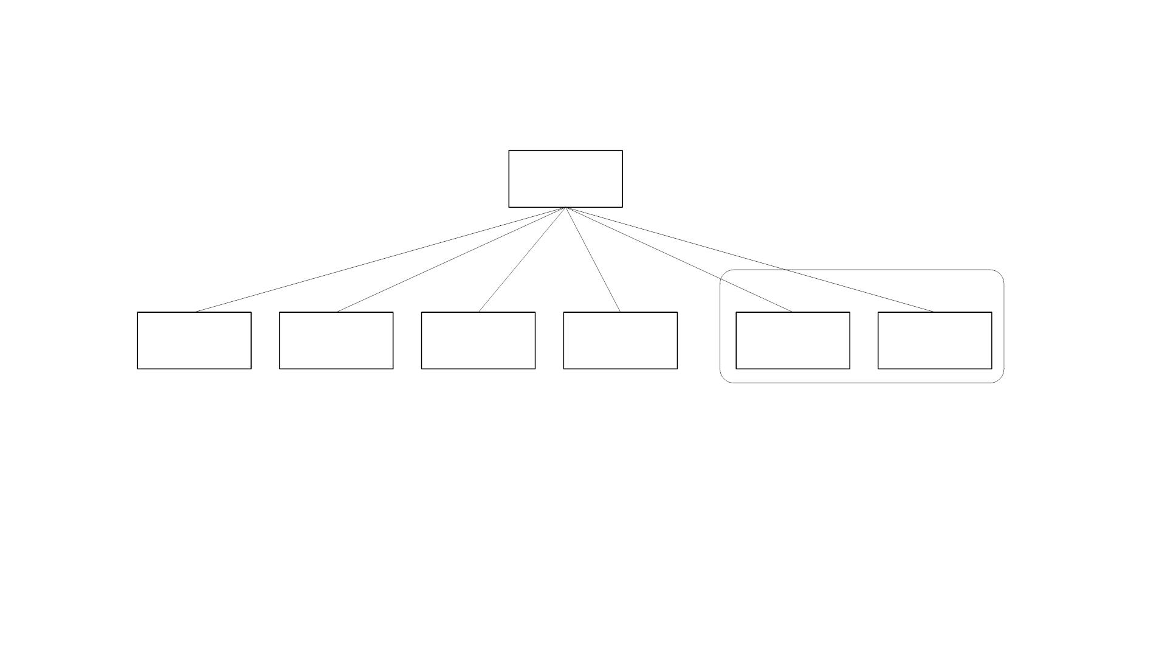
SNMPv2 Internet Group
internet
{1 3 6 1}
SNMPv2
snmpv2
directory
(1)
mgmt
(2)
experimental
(3)
private
(4)
security
(5)
(6)
Figure 6.1 SNMPv2 Internet Group
• Objects added to System group
• Extensive modification of the SNMP group
• Additional SNMPv2 group added
• Security group is a placeholder
6

Slide 7
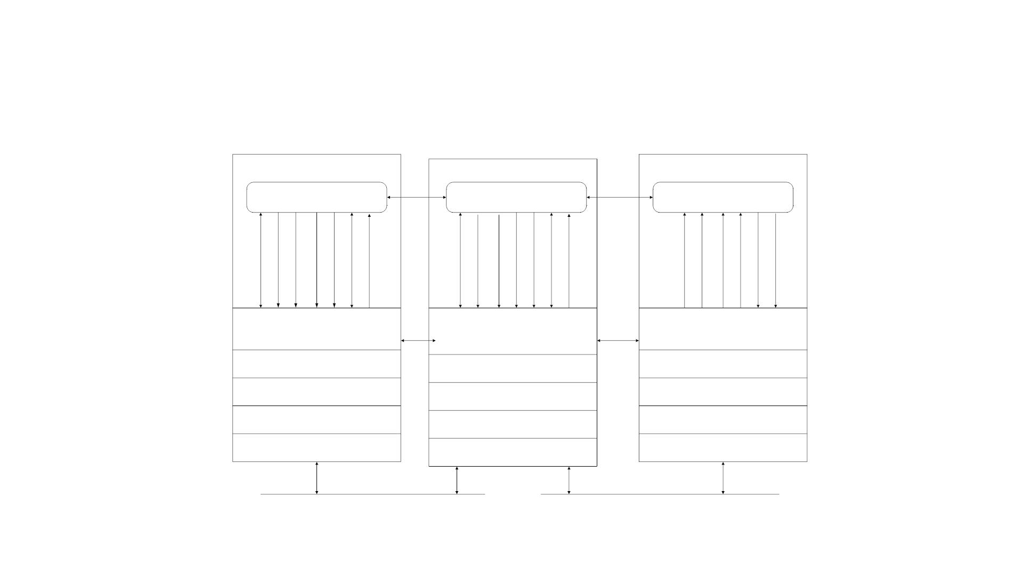
SNMPv2 NM Architecture
SNMP Manager
SNMP Manager
SNMP Agent
Application
PDU
Application
PDU
SNMP Manager
Application
SNMP Manager
Application
SNMP Agent
Application
SNMP
SNMP
PDU
SNMP
SNMP
PDU
SNMP
UDP
IP
UDP
IP
UDP
IP
DLC
PHY
DLC
PHY
DLC
PHY
Physical Medium
Physical Medium
Figure 6.2 SNMPv2 Network Management Architecture
7

Slide 8
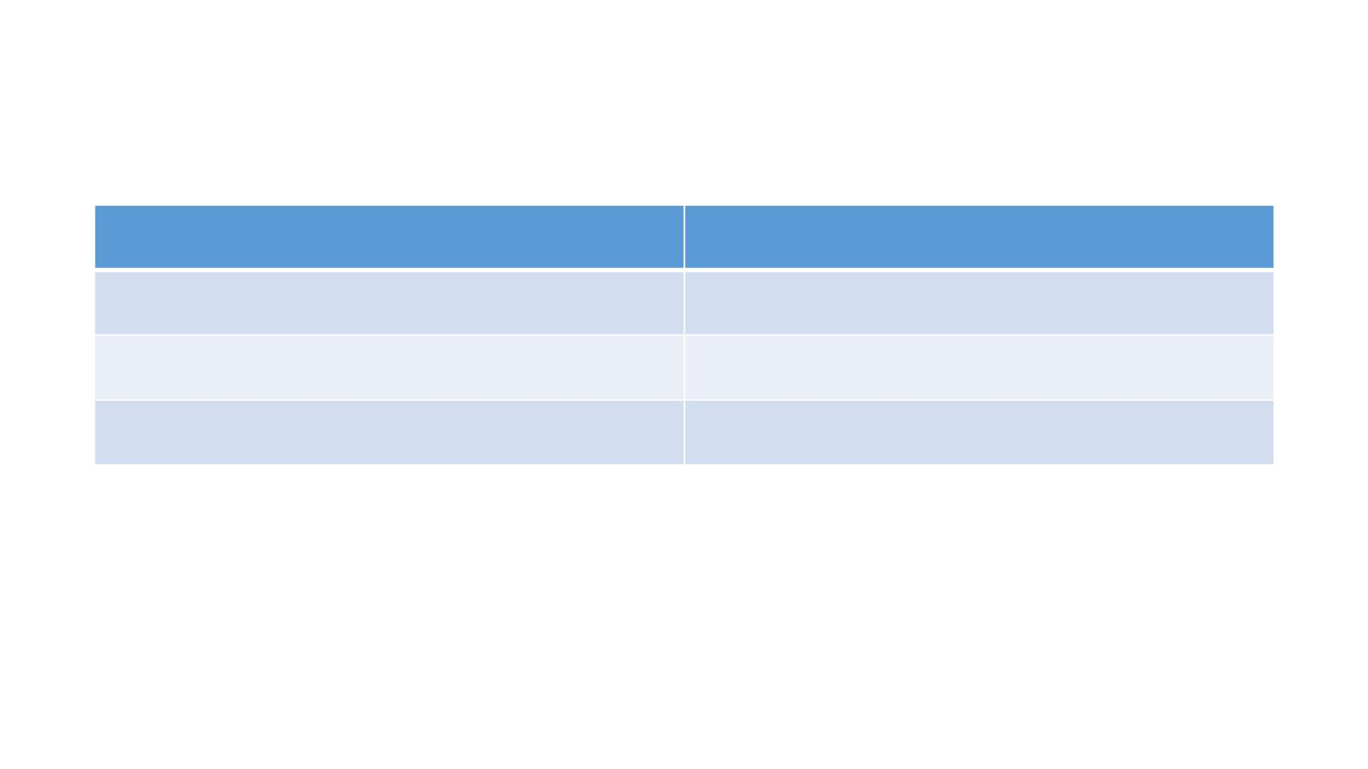
SNMPv2 New Messages
Message
Comments
inform-request
get-bulk-request
Report
Manager-to-manager message
Transfer of large data
Not used
8

Slide 9
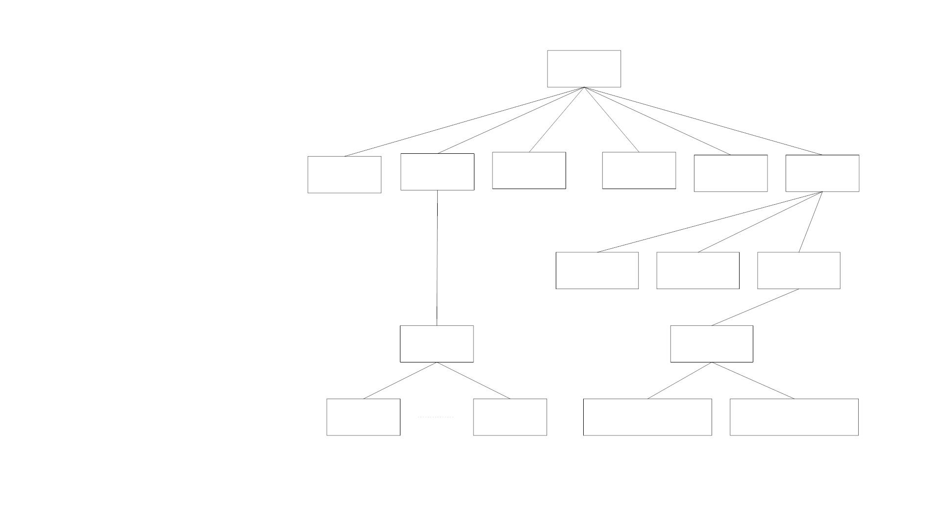
SNMPv2 MIB
Internet
{1 3 6 1}
directory
(1)
mgmt
(2
experimental
(3)
private
(4)
security
(5)
snmpv2
(6)
snmpdomains
(1)
snmpProxys
snmpModules
(3)
(2)
mib-2
(1)
snmpMIB
(1)
system
(1)
snmp
(11)
snmpMIBObjects
(1)
snmpMIBConformance
(2)
Figure 6.31 SNMPv2 Internet Group
9

Slide 10
SNMPv2 MIB
• Security is a placeholder
• System group
• table sysORTable added that lists resources that the agent controls
• Most of the objects in the SNMPv1 obsoleted
• Object Groups and Notification Groups defined for conformance
specifications
10

Slide 11
Agent Capabilities
• AGENT-CAPABILITIES macro
• SUPPORTS modules and includes groups
• VARIATION identifies additional features
11

Slide 12
Agent Capabilities
routerIsi123 AGENT-CAPABILITIES
PRODUCT-RELEASE "InfoTech Router isiRouter123 release 1.0"
STATUS
DESCRIPTION
SUPPORTS
current
"InfoTech High Speed Router"
snmpMIB
INCLUDES
{systemGroup, snmpGroup, snmpSetGroup,
snmpBasicNotificationsGroup }
coldStart
VARIATION
DESCRIPTION
"A coldStart trap is generated on all
reboots."
IF-MIB
SUPPORTS
SUPPORTS
SUPPORTS
SUPPORTS
SUPPORTS
INCLUDES
INCLUDES
INCLUDES
INCLUDES
INCLUDES
{ifGeneralGroup, ifPacketGroup}
IP MIB
{ipGroup, icmpGroup}
TCP-MIB
{tcpGroup}
UDP-MIB
{udpGroup}
EGP-MIB
{egpGroup}
::= { isiRouter 1 }
Figure 6.30 Example of AGENT-CAPABILITIES Macro
12

Slide 13
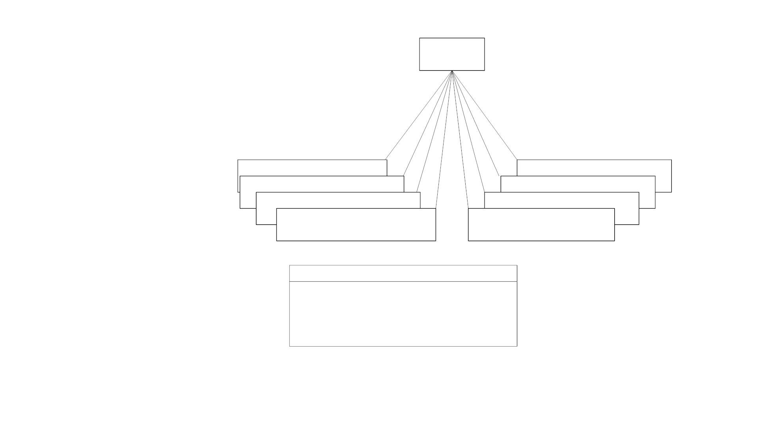
SNMPv2 SNMP MIB
snmp
(mib-2 11)
snmpInPkts(1)
snmpProxyDrops (32)
snmpSilentDrops (31)
snmpInBadVersions (3)
snmpInBadCommunityNames (4)
snmpEnableAuthenTraps (30)
snmpInASNParseErrors (6)
snmpInBadCommunityUses (5)
Compare this to SNMPv1 MIB!
SNMP Group Objects
1,3,6,30,31,32 snmpGroup
4,5
7,23
snmpCommunity Group
not used
2,8-23, 24-29 snmpObsoleteGroup
Figure 6.33 SNMPv2 SNMP Group
13

Slide 14
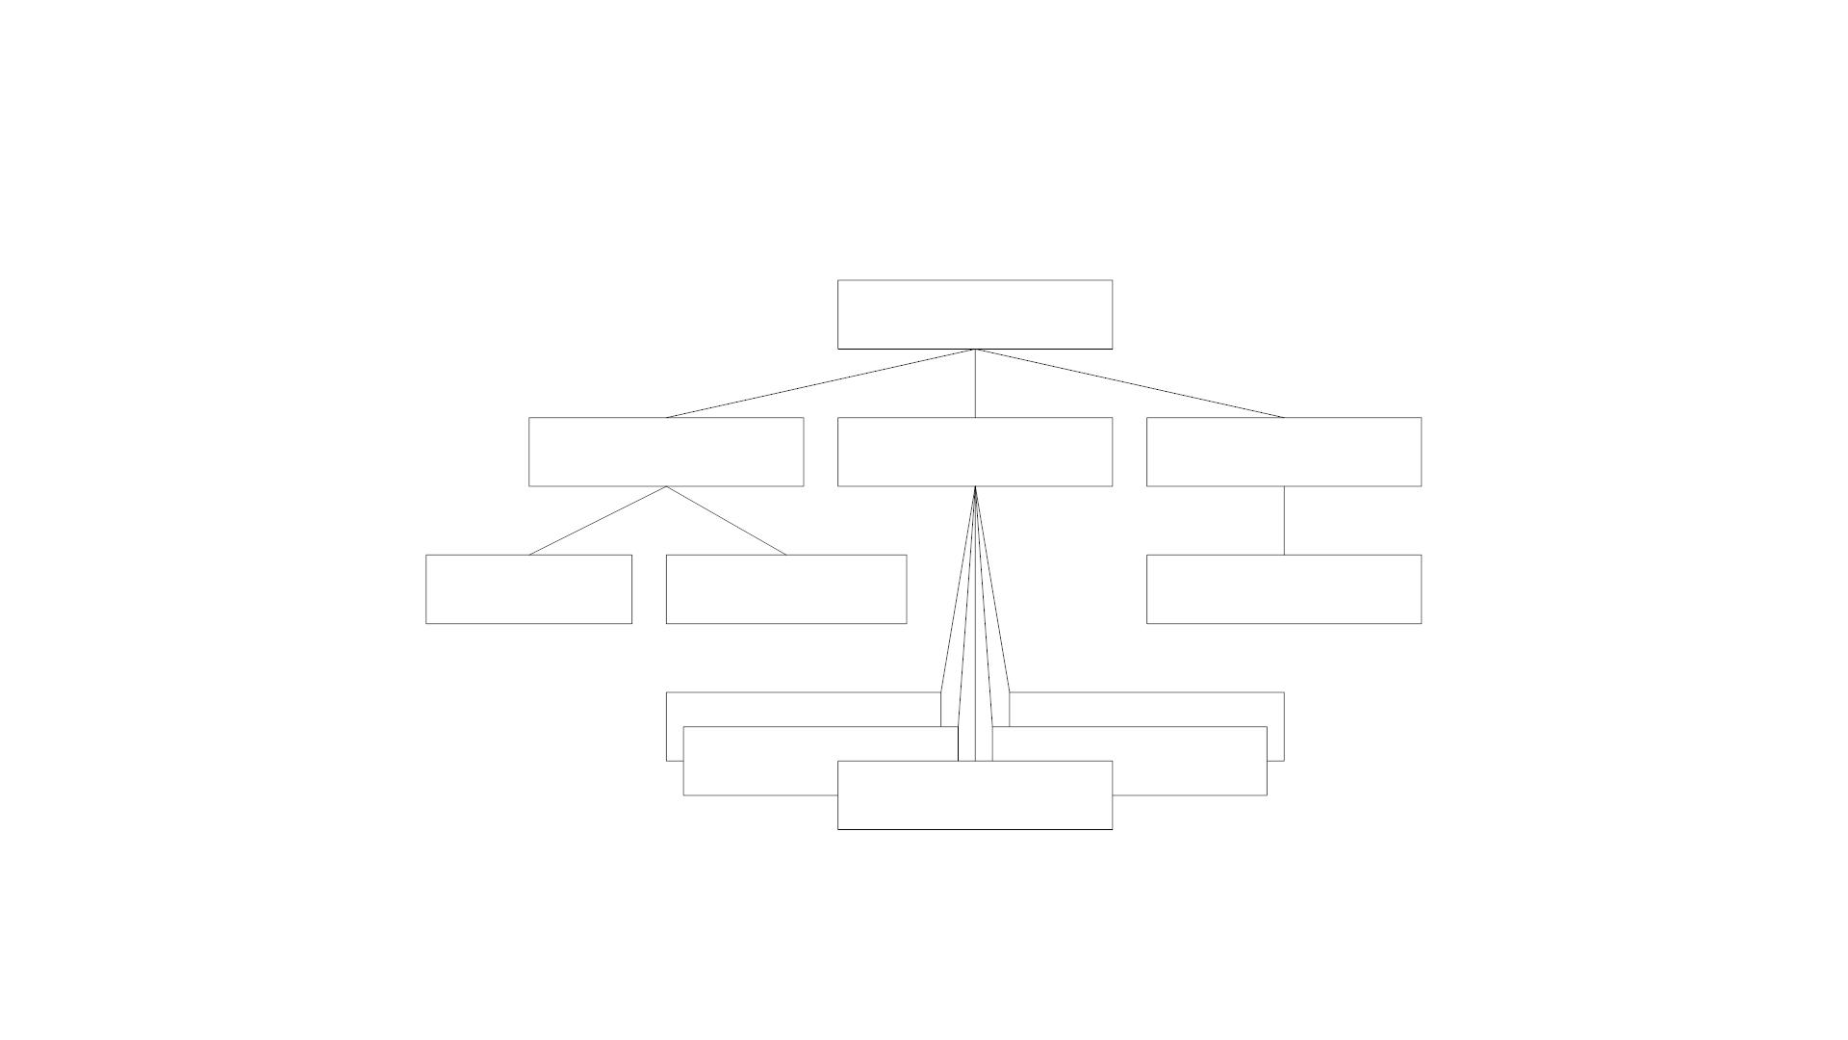
snmpMIBObjects MIB
snmpMIBObjects
(snmpMIB 1)
snmpTrap
(4)
snmpTraps
(5)
snmpSet
(6)
snmpTrapOID
(1)
snmpTrapEnterprise
(3)
snmpSetSerialNo
(1 )
coldStart (1)
authenticationFailure (5)
linkUp (4)
warmStart (2)
linkDown (3)
Figure 6.34 MIB Modules under snmpMIBObjects
14

Slide 15

SNMPv2 PDU
PDU
Type
RequestID
Error
Status
Error
Index
VarBind 1
name
VarBind 1
value
...
VarBind n
name
VarBind n
value
Figure 6.37 SNMPv2 PDU (All but Bulk)
Standardized format for all messages
15

Slide 16
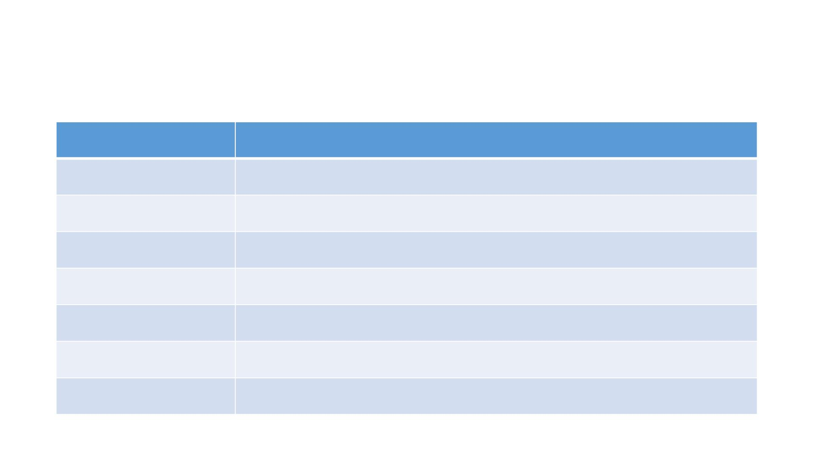
SNMPv2 PDU Values
Table 6.11
Value
Type
0
1
2
3
4
5
6
Get-Request-PDU
GetNextRequest-PDU
Response-PDU
Set-Request- PDU
obsolete
GetBulkRequest-- PDU
InformRequest- PDU
16

Slide 17
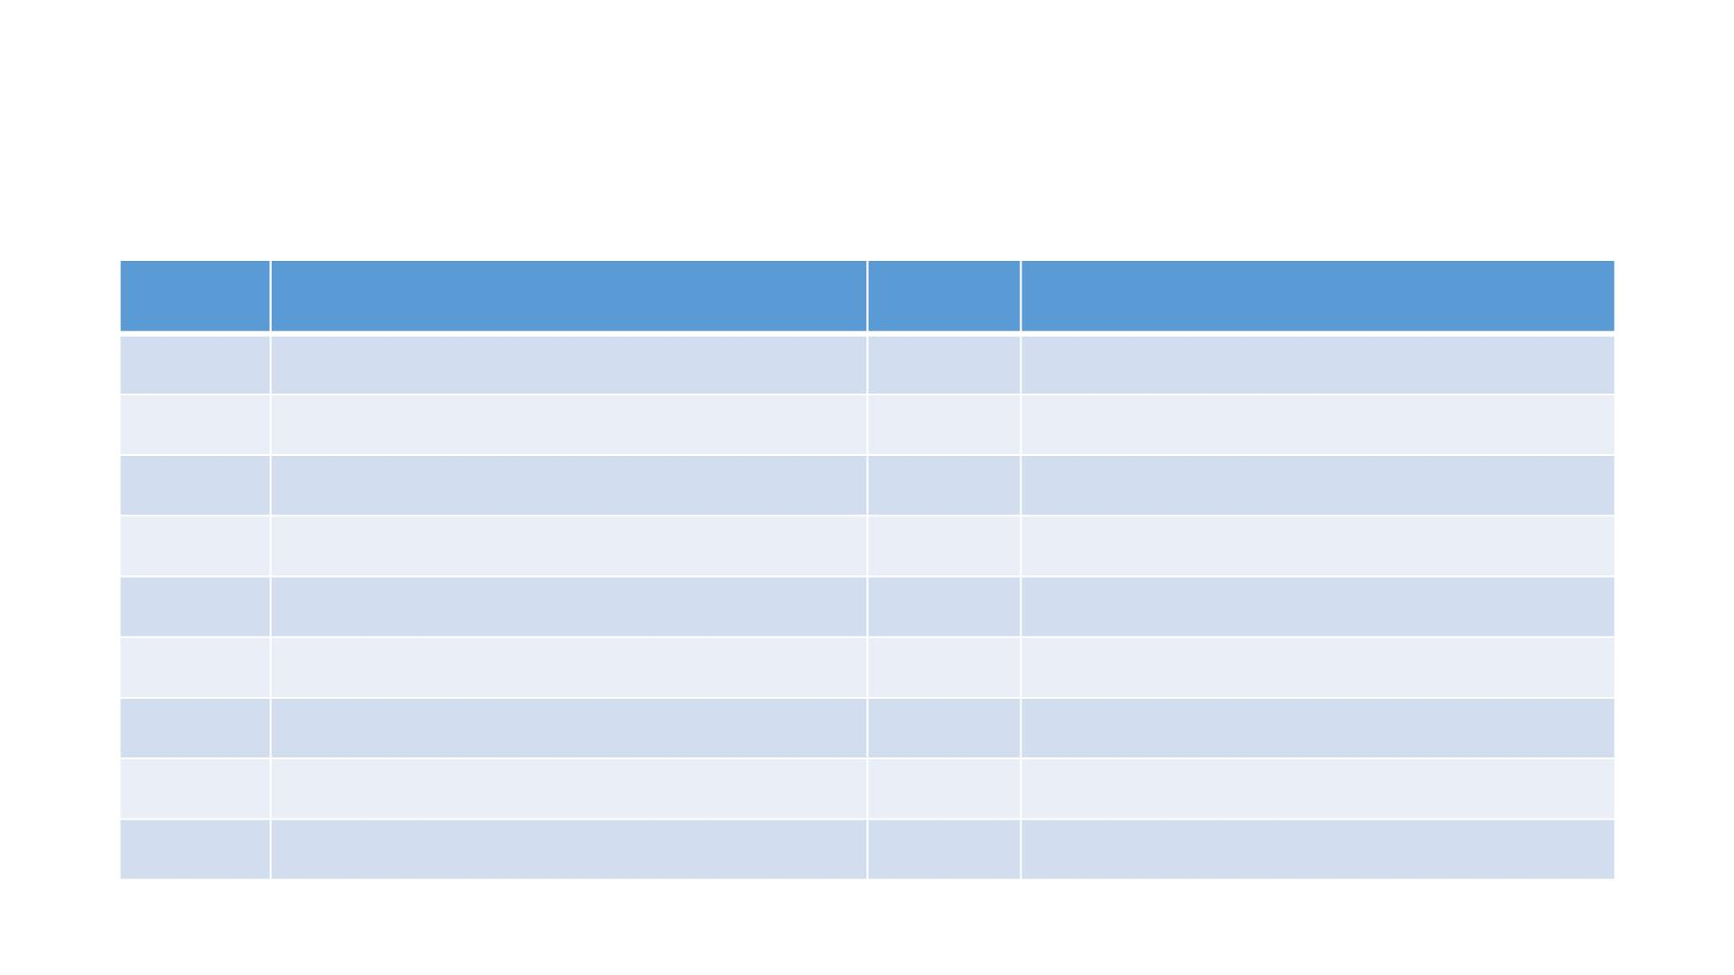
SNMPv2 Error Status Values
Table 6.11
Value Type
Value Type
0
1
2
3
4
5
6
7
8
noError
tooBig
10 wrongValue
11 noCreation
noSuchName
badValue
readOnly
genErr
noAccess
wrongType
wrongLength
12 inconsistentValue
13 resourceUnavailable
14 commitFailed
15 undoFailed
16 authorizationError
17 notWritable
18 inconsistentName
17

Slide 18

SNMPv2 GetBulkRequest PDU
PDU
Type
RequestID
Non-
Max
VarBind 1 VarBind 1
name value
...
VarBind n VarBind n
name value
Repeaters Repetitions
Figure 6.38 SNMPv2 GetBulkRequest PDU
Notes
• Error status field replaced by Non-repeaters
• Error index field replaced by Max repetitions
• No one-to-one relationship between request and response
18

Slide 19

Get-Bulk-Request: Generic MIB
A
B
T
A
B
T
Z
E
E
1.1
2.1
2.2
3.1
3.2
T.E.1.1
T.E.1.2
T.E.1.3
T.E.1.4
T.E.2.1
T.E.2.2
T.E.2.3
T.E.2.4
T.E.3.1
T.E.3.2
T.E.3.3
T.E.3.4
1.2
1.3
1.4
2.3
2.4
3.3
3.4
Z
Figure 6.39 MIB for Operation Sequences in Figures 6.40 and 6.41
19

Slide 20
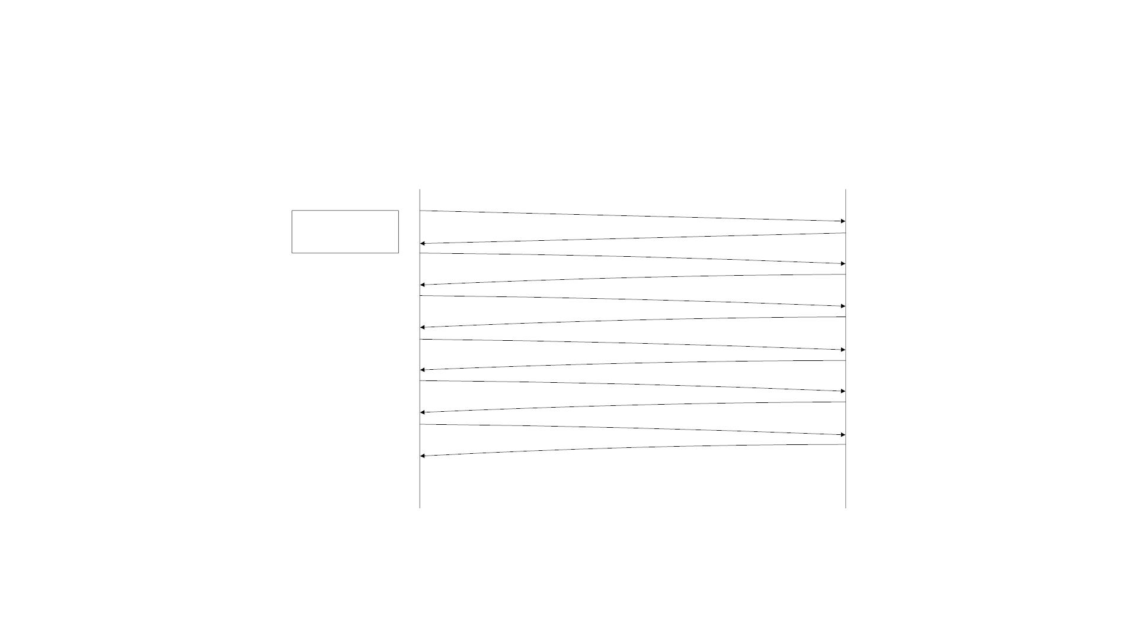
Get-Next-Request Operation
GetRequest ( A,B )
Manager
Process
GetResponse (A,B)
GetNextRequest (T.E.1.T.E.2,T.E.3)
GetResponse (T.E.1.1,T.E.2.1,T.E.3.1)
GetNextRequest (T.E.1.1,T.E.2.1,T.E.3.1)
GetResponse (T.E.1.2,T.E.2.2,T.E.3.2)
GetNextRequest (T.E.1.2,T.E.2.2,T.E.3.2)
GetResponse (T.E.1.3,T.E.2.3,T.E.3.3)
GetNextRequest (T.E.1.3,T.E.2.3,T.E.3.3)
GetResponse (T.E.1.4,T.E.2.4,T.E.3.4)
GetNextRequest (T.E.1.4,T.E.2.4,T.E.3.4)
GetResponse (T.E.2.1,T.E.3.1,Z)
Figure 6.40 Get-Next-Request Operation for MIB in Figure 6.39
20

Slide 21
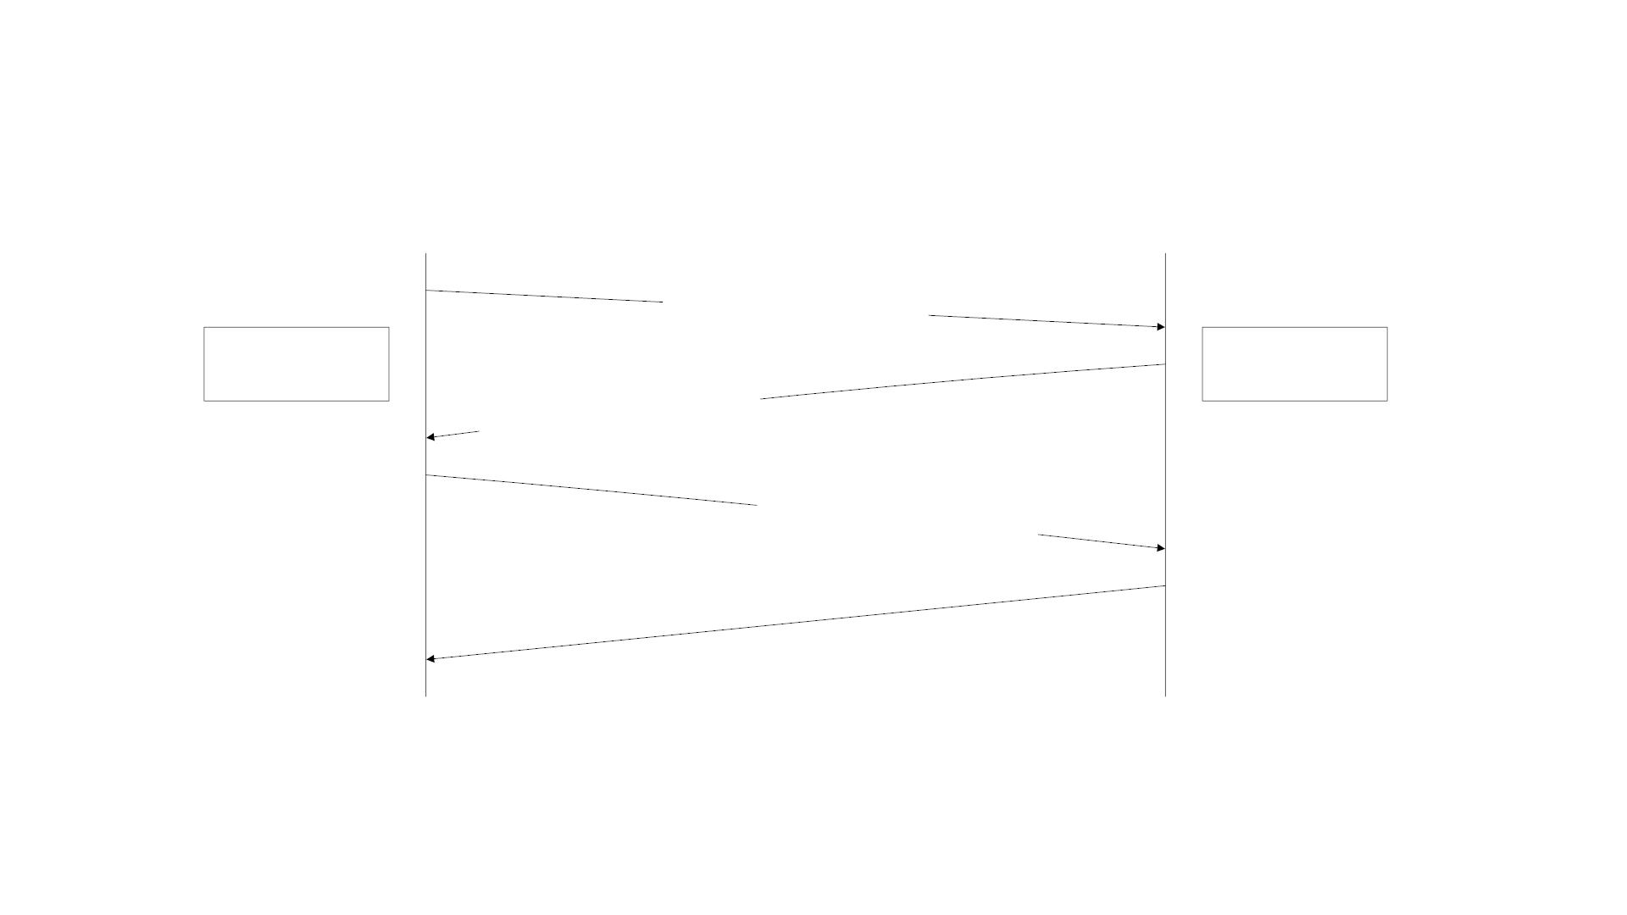
Get-Bulk-Request Operation
GetBulkRequest ( 2,3,
A,B,T.E.1, T.E.2, T.E.3 )
Manager
Agent
Process
Response ( A, B,
Process
T.E.1.1, T.E.2.1, T.E.3.1
T.E.1.2, T.E.2.2, T.E.3.2
T.E.1.3, T.E.2.3, T.E.3.3 )
GetBulkRequest ( 0,3,
T.E.1.3, T.E.2.3, T.E.3.3 )
Response ( T.E.1.4, T.E.2.4, T.E.3.4, Z , "endOfMibView")
Figure 6.41 Get-Bulk-Request Operation for MIB in Figure 6.39
21

Slide 22
Get-Bulk-Request Operation
• GetBulkRequest(2, 3, ..)
• 2: two non-repetitive objects (A and B)
• 3: three repetitive instances of columnar objects (TE.1, TE.2 and TE.3)
• GetBulkRequest(0, 3, ..)
• 3: three more rows of the table
• Response
• only one row left
• sends next lexicographic entry Z, error: endOfMibView
22

Slide 23
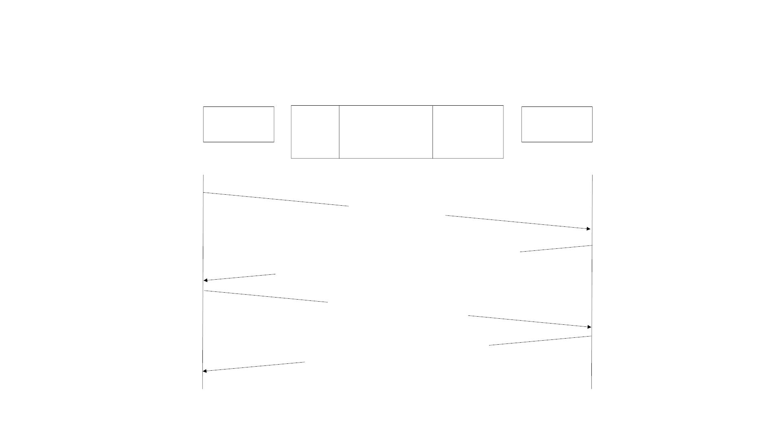
Get-Bulk-Request Example
Manager
Process
atIfIndex
atPhysAddress
0000000C3920AC
0000000C3920AF
0000000C3920B4
atNetAddress
172.46.46.1
172.46.49.1
192.168.3.1
Agent
Process
13
16
23
GetBulkRequest ( 1,3,
sysUpTime,
atPhysAddress )
Response( (sysUpTime.0 = "315131795"),
(atPhysAddress.13.172.46.46.1 = "0000000C3920AC")
(atPhysAddress.16.172.46.49.1 = "0000000C3920AF")
(atPhysAddress.23.192.168.3.1 = "0000000C3920B4") )
GetBulkRequest ( 1,3,
sysUpTime,
atPhysAddress.23.192.168.3.1 )
Response( (sysUpTime.0 = "315131800"),
(ipForwarding.0 = "1") )
Figure 6.42 Get-Bulk-Request Example
23

Slide 24

SNMPv2 Tra p
PDU
Type
RequestID
Error
Status
Error
Index
VarBind 1
sysUpTime
VarBind 1
value
VarBind 2
snmpTrapOID
VarBind 2 ..
value
.
Figure 6.43 SNMPv2 Trap PDU
Notes
• Addition of NOTIFICATION-TYPE macro
• OBJECTS clause, if present, defines
order of variable bindings
• Positions 1 and 2 in VarBindList are
sysUpTime and snmpTrapOID
24

Slide 25

SNMPv2 Tra p
linkUp NOTIFICATION-TYPE
OBJECTS
{ ifIndex }
STATUS
current
DESCRIPTION
"A linkUp trap signifies that the SNSMPv2 entity,
acting in an agent role, recognizes that one of the
communication links represented in its configuration
has come up."
Figure 6.44 Example of OBJECTS Clause in NOTIFICATION-TYPE
• Addition of NOTIFICATION-TYPE macro
• OBJECTS clause, if present, defines order of variable bindings
• Positions 1 and 2 in VarBindList are sysUpTime and snmpTrapOID
25

Slide 26
Inform-Request
• Inform-Request behaves as trap in that the message goes from one
manager to another unsolicited
• The receiving manager sends response to the sending manager
• Uses the same Trap PDU format
26

Slide 27
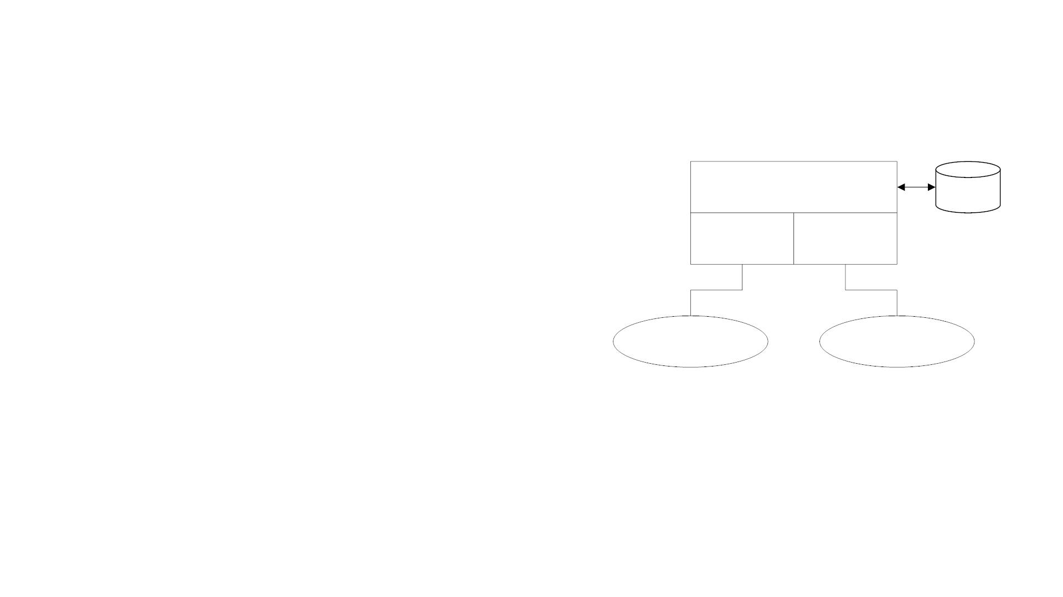
Bilingual Manager
• Compatibility with SNMPv1
• Bilingual Manager
Bi-lingual Manager
Agent
Profile
SNMPv1
SNMPv2
• Proxy Server
Interpreter Interpreter
• Bilingual Manager is expensive in
resource and operation
SNMPv1
Agents
SNMPv2
Agents
Figure 6.45 SNMP Bi-lingual Manager
27

Slide 28
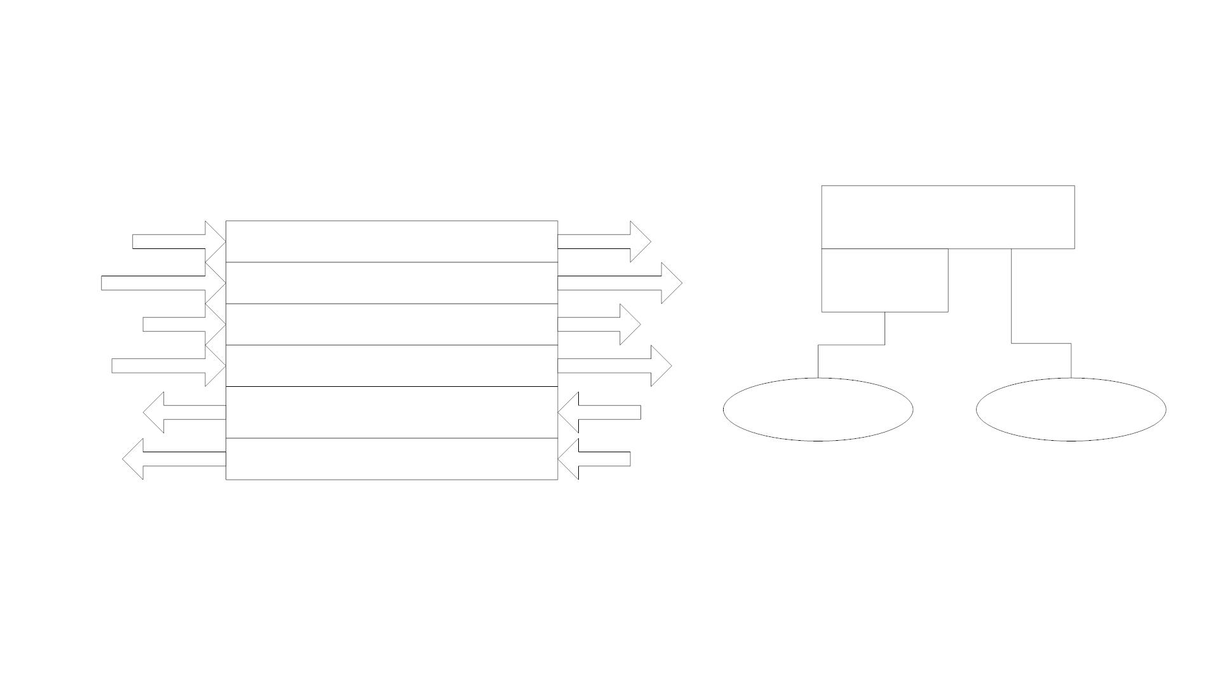
SNMP Proxy Server
SNMPv2 Manager
SNMP v2-v1 Proxy Server
SNMPv2 Manager
GetRequest
Pass-Through
Pass-Through
Pass-Through
GetRequest
Proxy
Server
GetNextRequest
SetRequest
GetNextRequest
SetRequest
GetBulkRequest
Set: 1. non-repeaters = 0
2. max-repetitions = 0
GetNextRequest
Pass-Through
SNMPv1
Agents
SNMPv2
Agents
Response
Exception: For 'tooBig' error, contents of variable-bindings field GetResponse
removed.
SNMPv2-Trap
Prepend VarBind: 1. sysUpTime.0
Trap
2. snmpTrapOID.0
Figure 6.47 SNMP v2-v1 Proxy Server
Figure 6.46 SNMPv2 Proxy Server Configuration
28

