Slide 1
Chapter # 2 Part 2 Programs And data
King Saud University
College of Applied studies and Community Service
CSC1101
By: Asma Alosaimi
Updated By:
Ghadah Alhadbaa ,Fatimah Alakeel, Nouf Almunyif
1st semster 1436

Slide 2
C++ Program Structure
#include <iostream> // Preprocessor Commands
using namespace std;
int main( ) // main function
{
// Declaration section – Declare needed variables
…...
// Input section – Enter required data
…..
// Processing section – Processing Statements
…...
// Output section – Display expected results
…....
return 0;
}// end main
The part of a program that tells the compiler the names of memory cells in a program

Slide 3
Programs and Data
input data
output data
Keyboard
Processing
Screen
Most programs require a temporary storage for the data to be processed inside the computer.
Thus, a computer's memory is used by allocating different locations on it to hold these data
Each allocated location has three characteristics
State
Identifier
Data Type

Slide 4
1.State
The state of a memory location is the current value (data) stored on it.
The state of a memory location:
May be changed.
In this case, this memory location is called variable.
Cannot be changed.
In this case, this memory location is called constant.

Slide 5
2.Identifiers
Identifiers are names for the entities (such as variables, constants, and functions) we create in our programs
In C++, These names, or identifiers, are required to conform to some rules.

Slide 6
2.Identifiers: Rules
It cannot begin with a digit (0 – 9).
After the firs letter it may contains:
A letters a to z, A to Z, OR
A digits 0 to 9, OR
the underscore symbol, _ OR
A combination of all or some of the above
No spaces or punctuation, except the underscore symbol, are allowed.
Reserved words/keywords such as main cannot be used.

Slide 7
2.Identifiers: Are Case-Sensitive
Identifiers in C++ are case-sensitive. Thus, the identifiers myNumber and mynumber, are seen as two different identifiers by the compiler.

Slide 8
2.Identifiers: Examples
According to the previous identifiers rules, state which if the following identifiers are right and which are wrong.
letter2
21etter
Begins with a digit
letter_2
int
Reserved word
joe's
Character ’ not allowed
variable
cent_per_inch

Slide 9
Keywords
Keywords (also called reserved words)
Are used by the C++ language
Must be used as they are defined in the programming language

Slide 10
3.Data Type
In Programming languages, a data type is a classification identifying one of various types of data
A data type determines:
the possible values for that type;
the operations that can be done on values of that type;
the meaning of the data;
the way values of that type can be stored; and
the size of allocated location(s)

Slide 11
int
The int data type represents integers.
Integers are whole numbers.
Examples:
-5235
13253
-35
32767

Slide 12
float
The float data type represents real numbers .
A real number has an integral part and a fractional part separated by a decimal point.
Examples:
3.643
0.325
123.532
3.4

Slide 13
char
The char data type represents one individual character .
Examples:
'D'
'd‘
'5‘
'*'

Slide 14
3.Data Type
The exact range of values for the fundamental types are implementation dependent; you should check your compiler documentation for the actual ranges supported by your computer
Table 3.2a, 3.b lists C++ fundamental data type along with their common bit lengths and ranges for 16-bit environment and 32-bit environment consecutively

Slide 15
Type | keyword | size (byte) | range
character | char | 1 | -128 to 127
Signed character | Signed char | 1 | -128 to 127
Unsigned character | unsigned char | 1 | 0 to 255
Integer | int | 2 | -32768 to +32767
Short Integer | short int | 2 | -32767 to +32767
Long integer | long int | 4 | -2,147,483,648 to +2,147,483,647
Unsigned integer | unsigned int | 2 | 0 to 65535
Unsigned short integer | unsigned short int | 2 | 0 to 65535
Unsigned Long integer | unsigned long int | 4 | 0 to 4,294,967,295
float | float | 4 | 3.4E–38 to 3.4E+38
double | double | 8 | 1.7E–308 to 1.7E+308
Long double | Long double | 10 | 3.4E-4932 to 1.1E+4932
Boolean | bool | N/A | True or false
Table 3.2 a: For 16-bit environment

Slide 16
Type | keyword | size (byte) | range
character | char | 1 | -128 to 127
Signed character | Signed char | 1 | -128 to 127
Unsigned character | unsigned char | 1 | 0 to 255
Integer | int | 4 | -2,147,483,648 to +2,147,483,647
Short Integer | short int | 2 | -32767 to +32767
Long integer | long int | 4 | -2,147,483,648 to +2,147,483,647
Unsigned integer | unsigned int | 4 | 0 to 4,294,967,295
Unsigned short integer | unsigned short int | 2 | 0 to 65535
Unsigned Long integer | unsigned long int | 4 | 0 to 4,294,967,295
float | float | 4 | 3.4E–38 to 3.4E+38
double | double | 8 | 1.7E–308 to 1.7E+308
Long double | Long double | 10 | 3.4E-4932 to 1.1E+4932
Boolean | bool | N/A | True or false
Table 3.2 b: for 32-bit environment

Slide 17
Variable/Constant Declaration
When the declaration is made, memory space is allocated to store the values of the declared variable or constant.
The declaration of a variable means allocating a space memory which state (value) may change.
The declaration of a constant means allocating a space memory which state (value) cannot change.

Slide 18
Declaring Variables: Syntax
Declaration syntax:
DataType Variable_1[= literal | expression] [, Variable_2, . . .] ;
For declaring a variable you must at least specify
Variable data type
Variable name
During declaration statement, optionally ,you may :
Give the variable an initial value, and/or
Declare several variable in one declaration statement , separated by comma (if thy have thy same data type)

Slide 19
Declaring Variables: Examples
Examples:
int number_of_bars;
double one_weight, total_weight;
int num=25;
int age, num_students;
char letter = ‘x’

Slide 20
Declaring Variables: Declaration Location
Two locations for variable declarations
1- Immediately prior to use
int main()
{
……….
int sum;
sum = score1 + score 2;
………..
return 0;}
2- At the beginning
int main()
{
int sum;
…..
sum = score1 +score2;
return 0;
}

Slide 21
Declaring Variables: Initial Value
A variable may be declared:
With initial value.
Without initial value.
Variable declaration with initial value;
dataType variableIdentifier = literal | expression;
double avg = 0.0; int i = 1;
int x =5, y = 7, z = (x+y)*3;
Variable declaration without initial value;
dataType variableIdentifier;
double avg; int i;

Slide 22
Assignment Operator
We assign a value to a variable using the basic assignment operator (=).
Assignment operator:
Stores a value in a memory.
Basically used in C++ to initialize a variable with a value OR to update it’s content with a new value
It’s syntax is as following
Assigning value to variable during declaration time
e.g. int num=5;
Assigning value to variable after it been declared
e.g. num=6;
leftSide = rightSide ;
It is always a variable identifier.
It is either a literal , a variable identifier , or an expression.

Slide 23
Assignment Operator
The assignment operator (=) assigns the value on the right side of the operator to the variable appearing on the left side of the operator.
The right side may be either:
Literal: e.g. i = 1;
Variable identifier: e.g. start = i;
Expression: e.g. sum = first + second;

Slide 24
1.Assigning Literals
In this case, the literal is stored in the memory space allocated for the variable on the left side.
A. Variables are allocated in memory.
firstNumber
1
A
secondNumber
???
int firstNumber=1, secondNumber;
firstNumber = 234;
secondNumber = 87;
B
B. Literals are assigned to variables.
firstNumber
234
Code
secondNumber
87
State of Memory

Slide 25
2.Assigning Variables
In this case, the value of the variable on the right side is stored in the memory space allocated for the variable on the left side.
A. Variables are allocated in memory.
A
firstNumber
1
int firstNumber=1, i;
i
???
firstNumber = 234;
i = firstNumber;
B
B. values are assigned to variables.
firstNumber
234
Code
i
234
State of Memory

Slide 26
3.Assigning Expressions
In this case, the result of evaluating the expression (on the right side) is stored in the memory space allocated for the variable (on the left side).
A. Variables are allocated in memory.
first
???
second
???
A
int first, second, sum;
sum
???
first = 234;
second = 87;
Sum = first + second
B
B. Values are assigned to variables.
first
234
second
87
Code
sum
321
State of Memory

Slide 27
Example of Initializing and Updating Data Using Assignment Operator
A. The variable is allocated in memory and initializes with the value 100
int number=100;
number = 237;
number
A
100
B
B. The value 237 overwrites the previous value 100
number = 35;
C
number
237
C. The value 35 overwrites the previous value 237.
number
35
Code
State of Memory

Slide 28
Declaring Constants: Syntax (1)
const DataType constant_Identifier= literal | expression;
const is the keyword to declare a named constant
Along with const, data type, and constant name, You must specify a value to be stored in it
Unlike variables, const value can’t be changed later.
It is common to name constants with all capital letters (i.e. no error occur when using small letters)

Slide 29
Declaring Constants: Syntax (1)
Examples
const double PI = 3.14159; const int day_in_week = 7; const short int FARADAY_CONSTANT = 23060;
const int MAX = 1024;
const int MIN = 128;
const int AVG = (MAX + MIN) / 2;
The reserved word const is used to declare constants.
These are constants, also called named constant.
These are called literals.
This is called expression.

Slide 30
Declaring Constants: Syntax (2)
The preprocessor #define is another more flexible method to define constants in a program
Syntax :
#define NAME value
#define WIDTH 80
#define LENGTH ( WIDTH + 10 )
what is the difference between #define and const ?
The preprcessor directive #define is used to declare constants.

Slide 31
#define Vs. const ?
#define | Const
Used to store a constant value that cannot be changed during execution. | Used to store a constant value that cannot be changed during execution.
A preprocessor directive | A C++ statement
Does not allocate a memory area for the value. | Allocates a memory area for the value. This area cannot be changed during execution.
The compiler replaces every occurrence of the defined constant with its value. | The compiler treats every constant as any variable but it does not change its value.

Slide 32
Character Data type
The char type is used to store the integer value of a member of the represent table character set. (see Figure B.1)
An example of a character value is the letter A. To declare a character variable called letter and store A in it:
char letter;
letter = 'A';
Note the assignment of the character A to the variable letter is done by enclosing the value in single quotes ‘ ’.

Slide 33
Character Data type
In Figure B.1
the digits at the left of the table are the left digits of the decimal equivalent (0-127) of the character code, and
The digits on the top of the table are the right digits of the decimal equivalent
Example : ‘F’ is 70, ‘&’ is 38

Slide 34
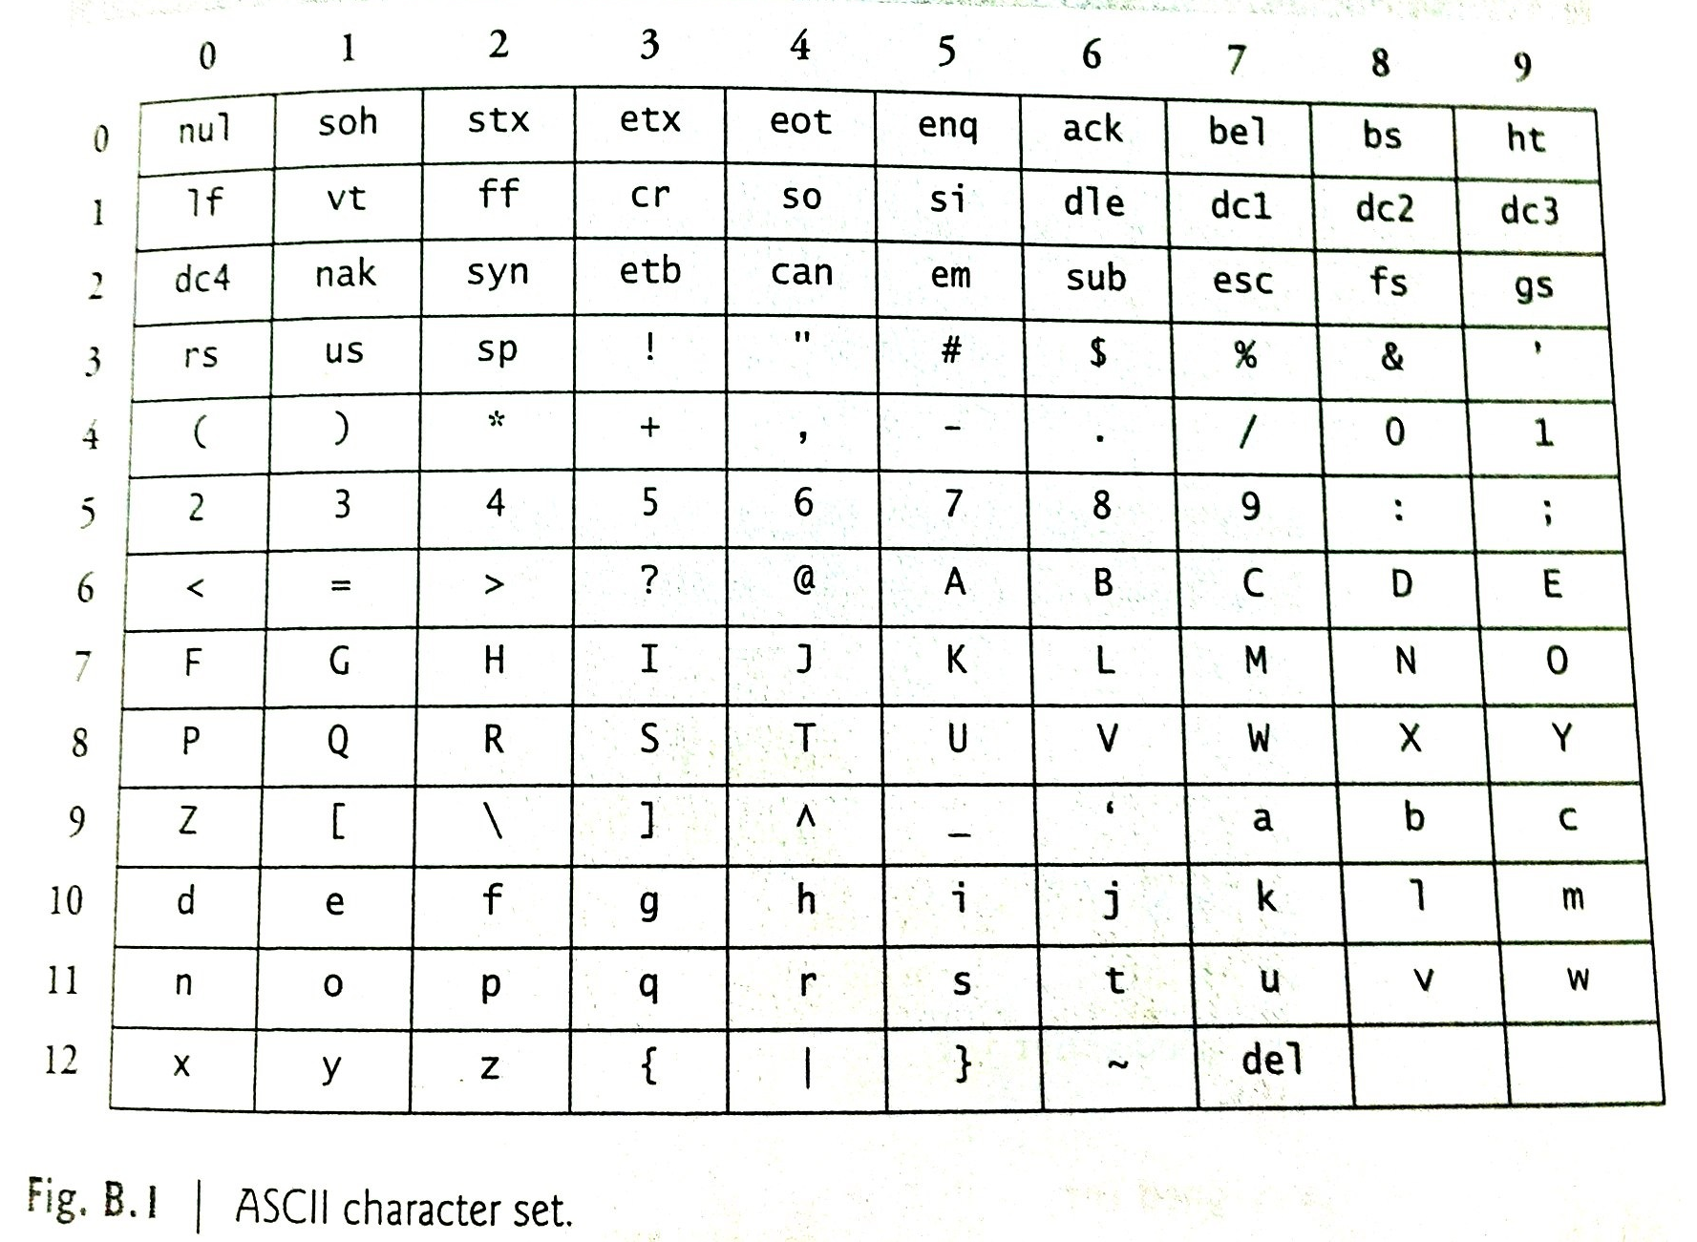

Slide 35
Data Types For Numbers With Decimal Point
To declare values such as 3.4 or 45.999882 , use either float or double.
Which one to choose? Depending on the size of your number.
Syntax:
float c = 4.5;
double z = 3.7777;

